Slide 1
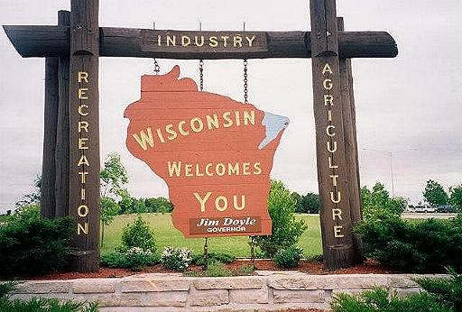
C A R B O N

Slide 2
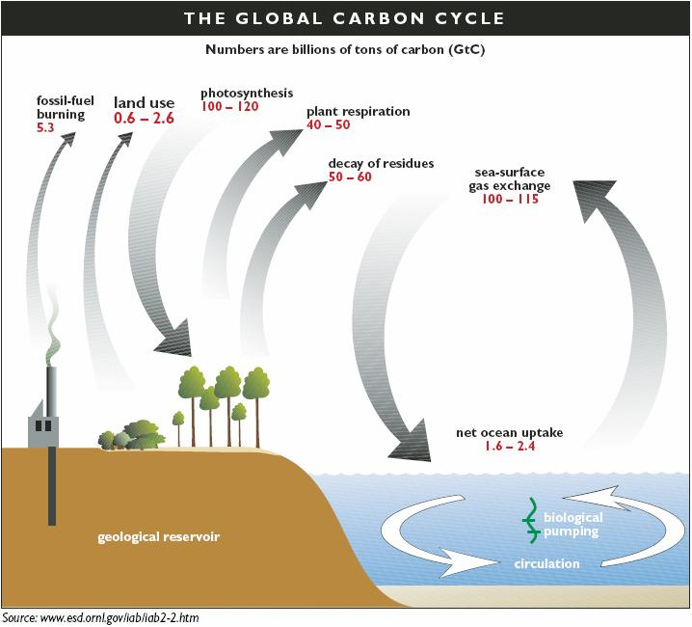

Slide 4
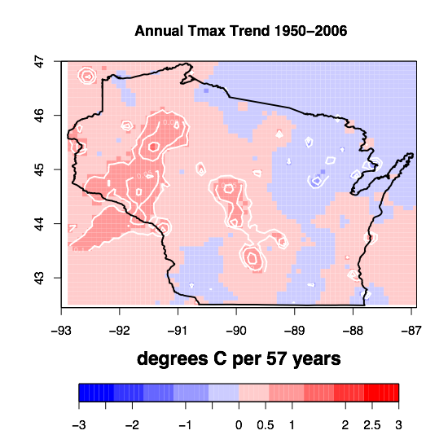
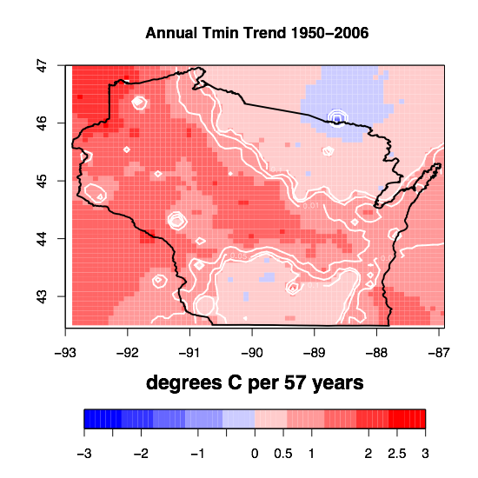

Slide 5
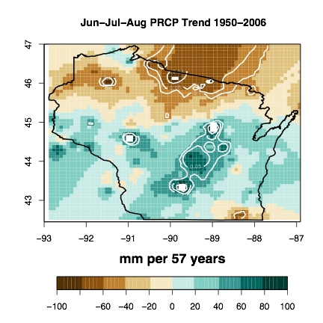

Slide 6
?

Slide 7
Let’s Play: Source or Sink?
Your group is assigned one of four major carbon source/sink types:
forests, agriculture, fossil fuels/industry, water
Discuss and draw where the region exists in WI
For the places you drew, write a + symbol in areas you think is a carbon source, - for sink
After the symbol, draw an up arrow if you think the source or sink will be bigger in the future and a down arrow for smaller

Slide 8
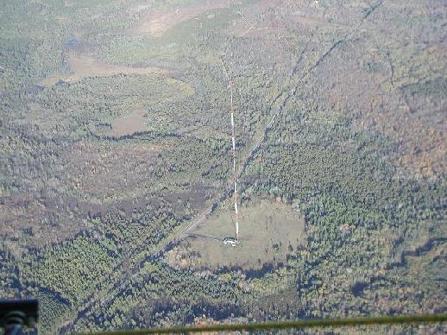
Forests

Slide 9
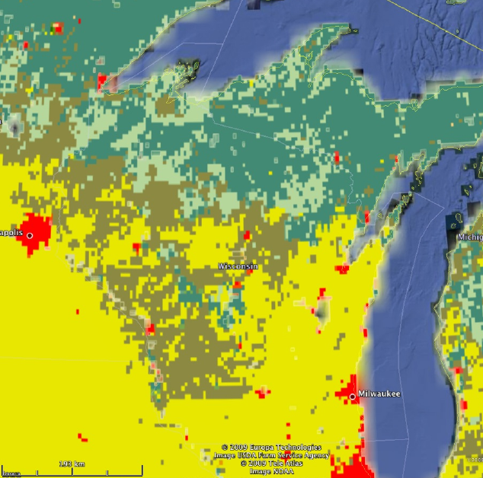

Slide 11
Breathing of a Forest

Slide 12
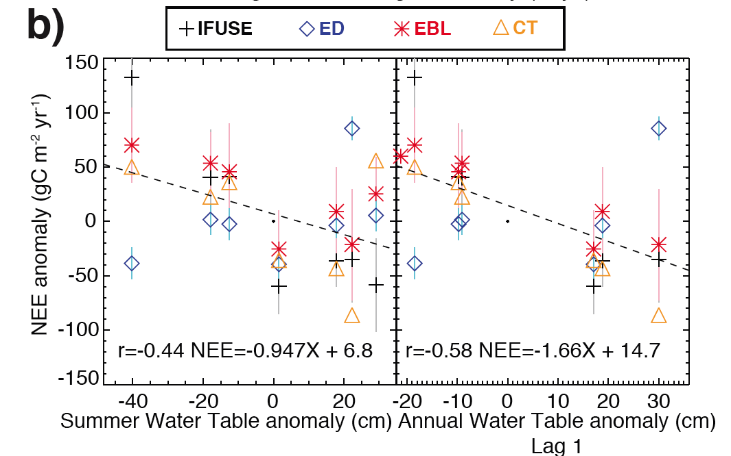
Sensitivity of a Forest

Slide 13
Water

Slide 14
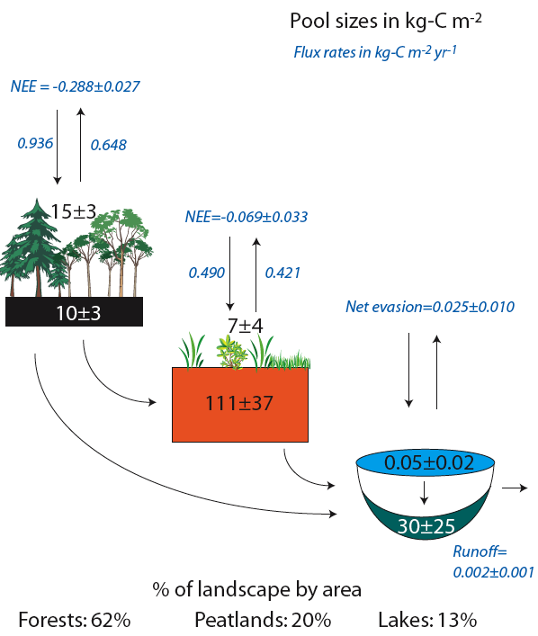

Slide 15
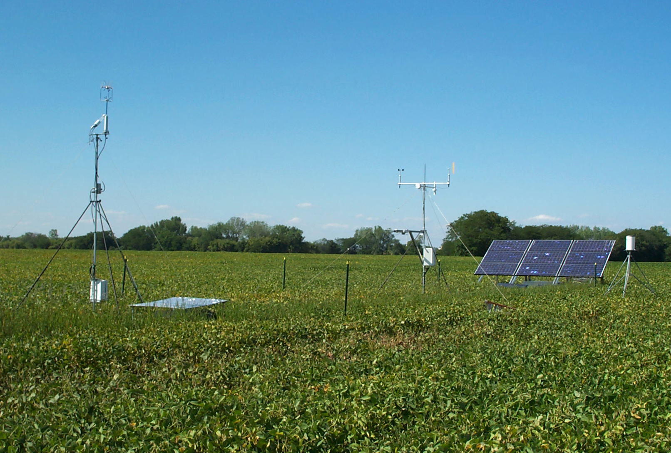
Agriculture

Slide 16
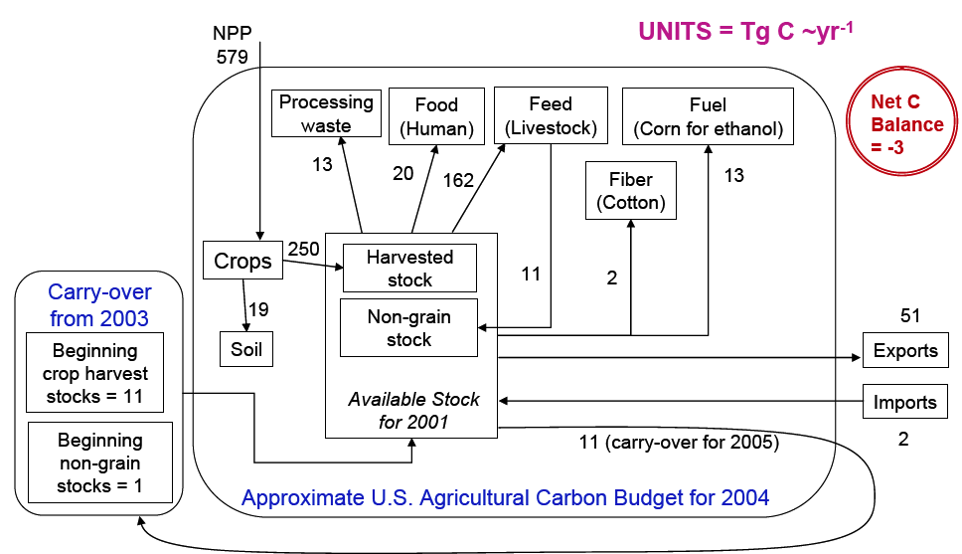

Slide 17
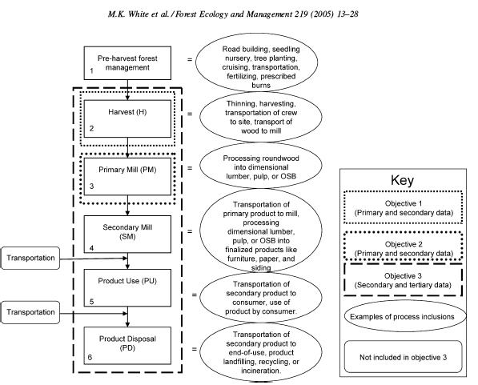

Slide 18
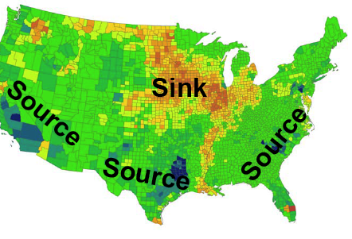

Slide 19
Industry

Slide 20
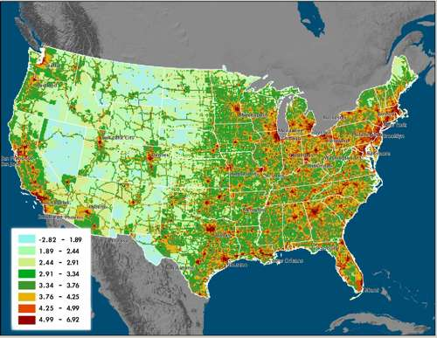

Slide 21
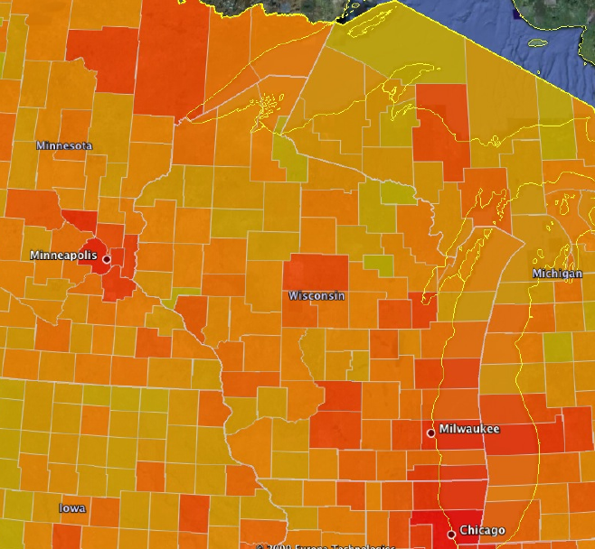

Slide 23
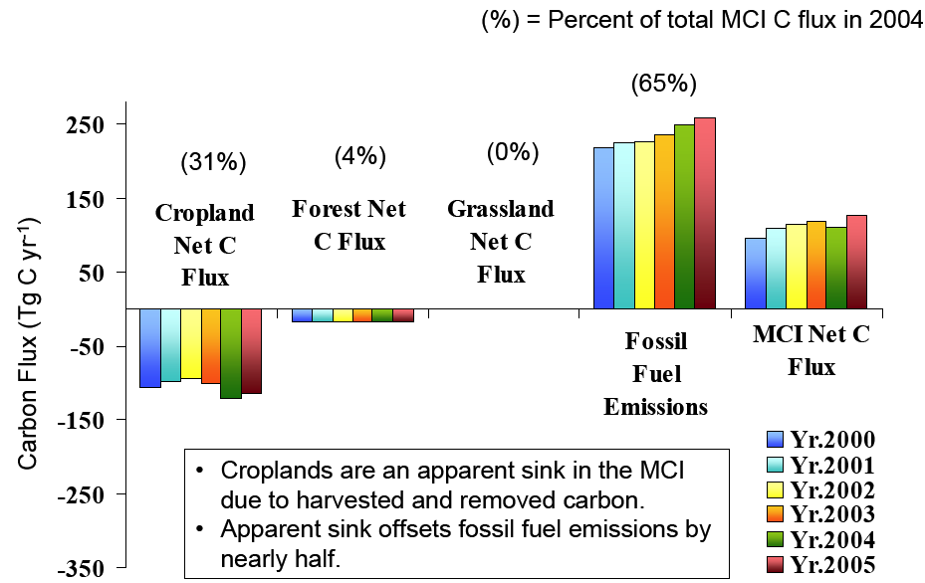
Putting it Together

Slide 24
Resources
Wisconsin Initiative on Climate Change Impacts
http://www.wicci.wisc.edu/
CarbonTracker (CO₂ maps)
http://www.esrl.noaa.gov/gmd/ccgg/carbontracker/
Interactive CO₂ data (CO2 time series)
http://www.esrl.noaa.gov/gmd/ccgg/iadv/
Project Vulcan (Fossil Fuel)
http://www.purdue.edu/eas/carbon/vulcan
MODIS GPP (Photosynthesis)
http://www.ntsg.umt.edu/
Google Earth Pro for Educators
http://www.google.com/educators/p_earth.html

Slide 25
Lesson Planning
What learning standards and objectives can be met by studying Wisconsin’s carbon cycle and climate change?
What kinds of tools and resources would be accessible to your classroom and usable by your students?
How might a lesson plan be devised based on what you learned here?

Slide 26
Thanks!
Prof. Ankur R Desai
Dept of Atmospheric and Oceanic Sciences
desai@aos.wisc.edu
http://flux.aos.wisc.edu
608-265-9201

