Slide 1
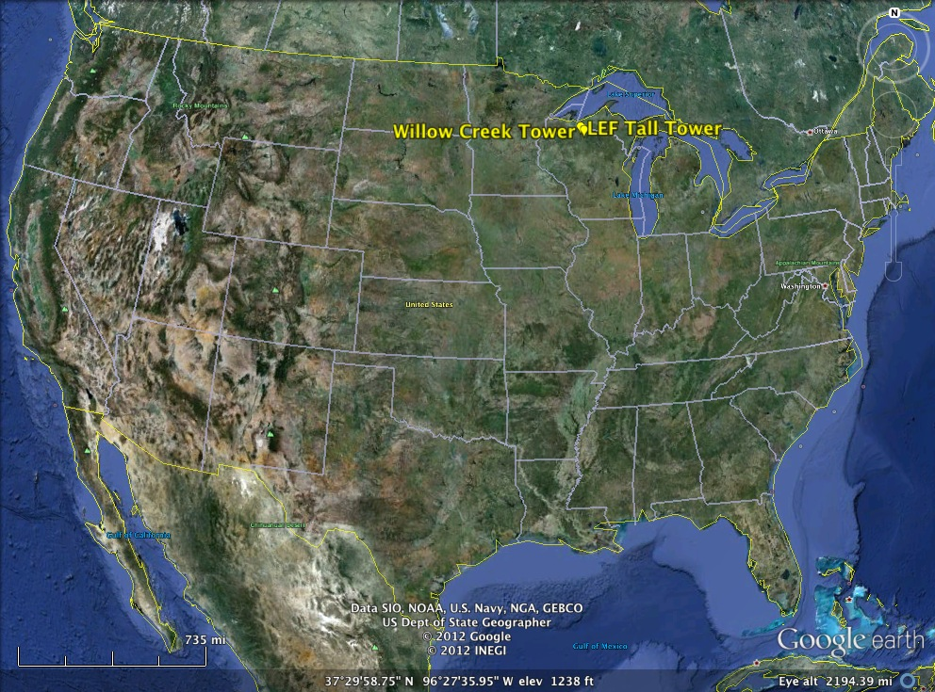
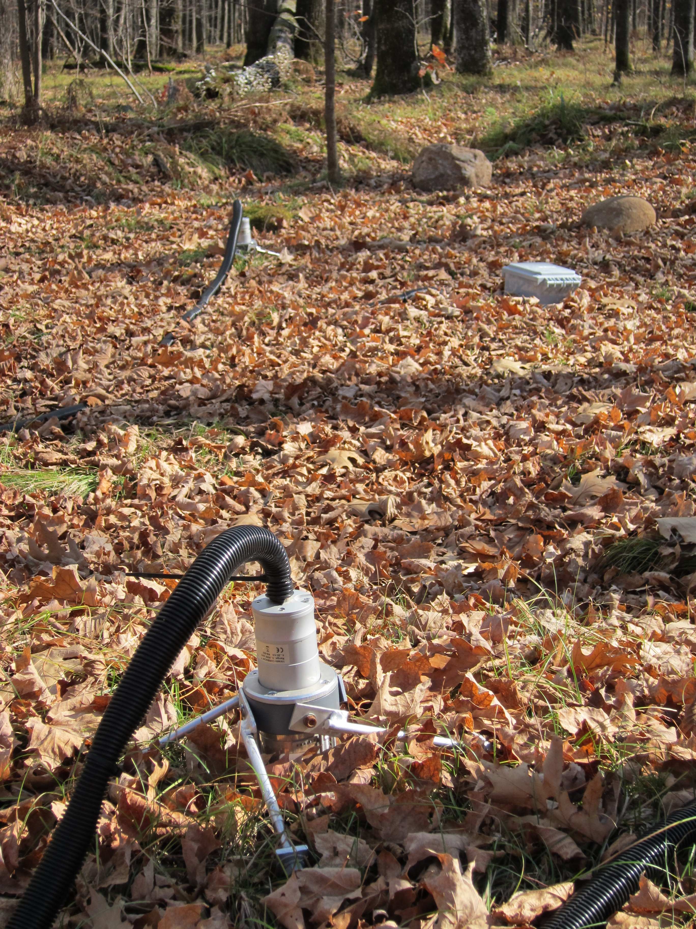
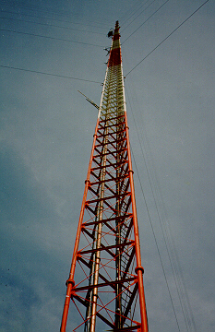
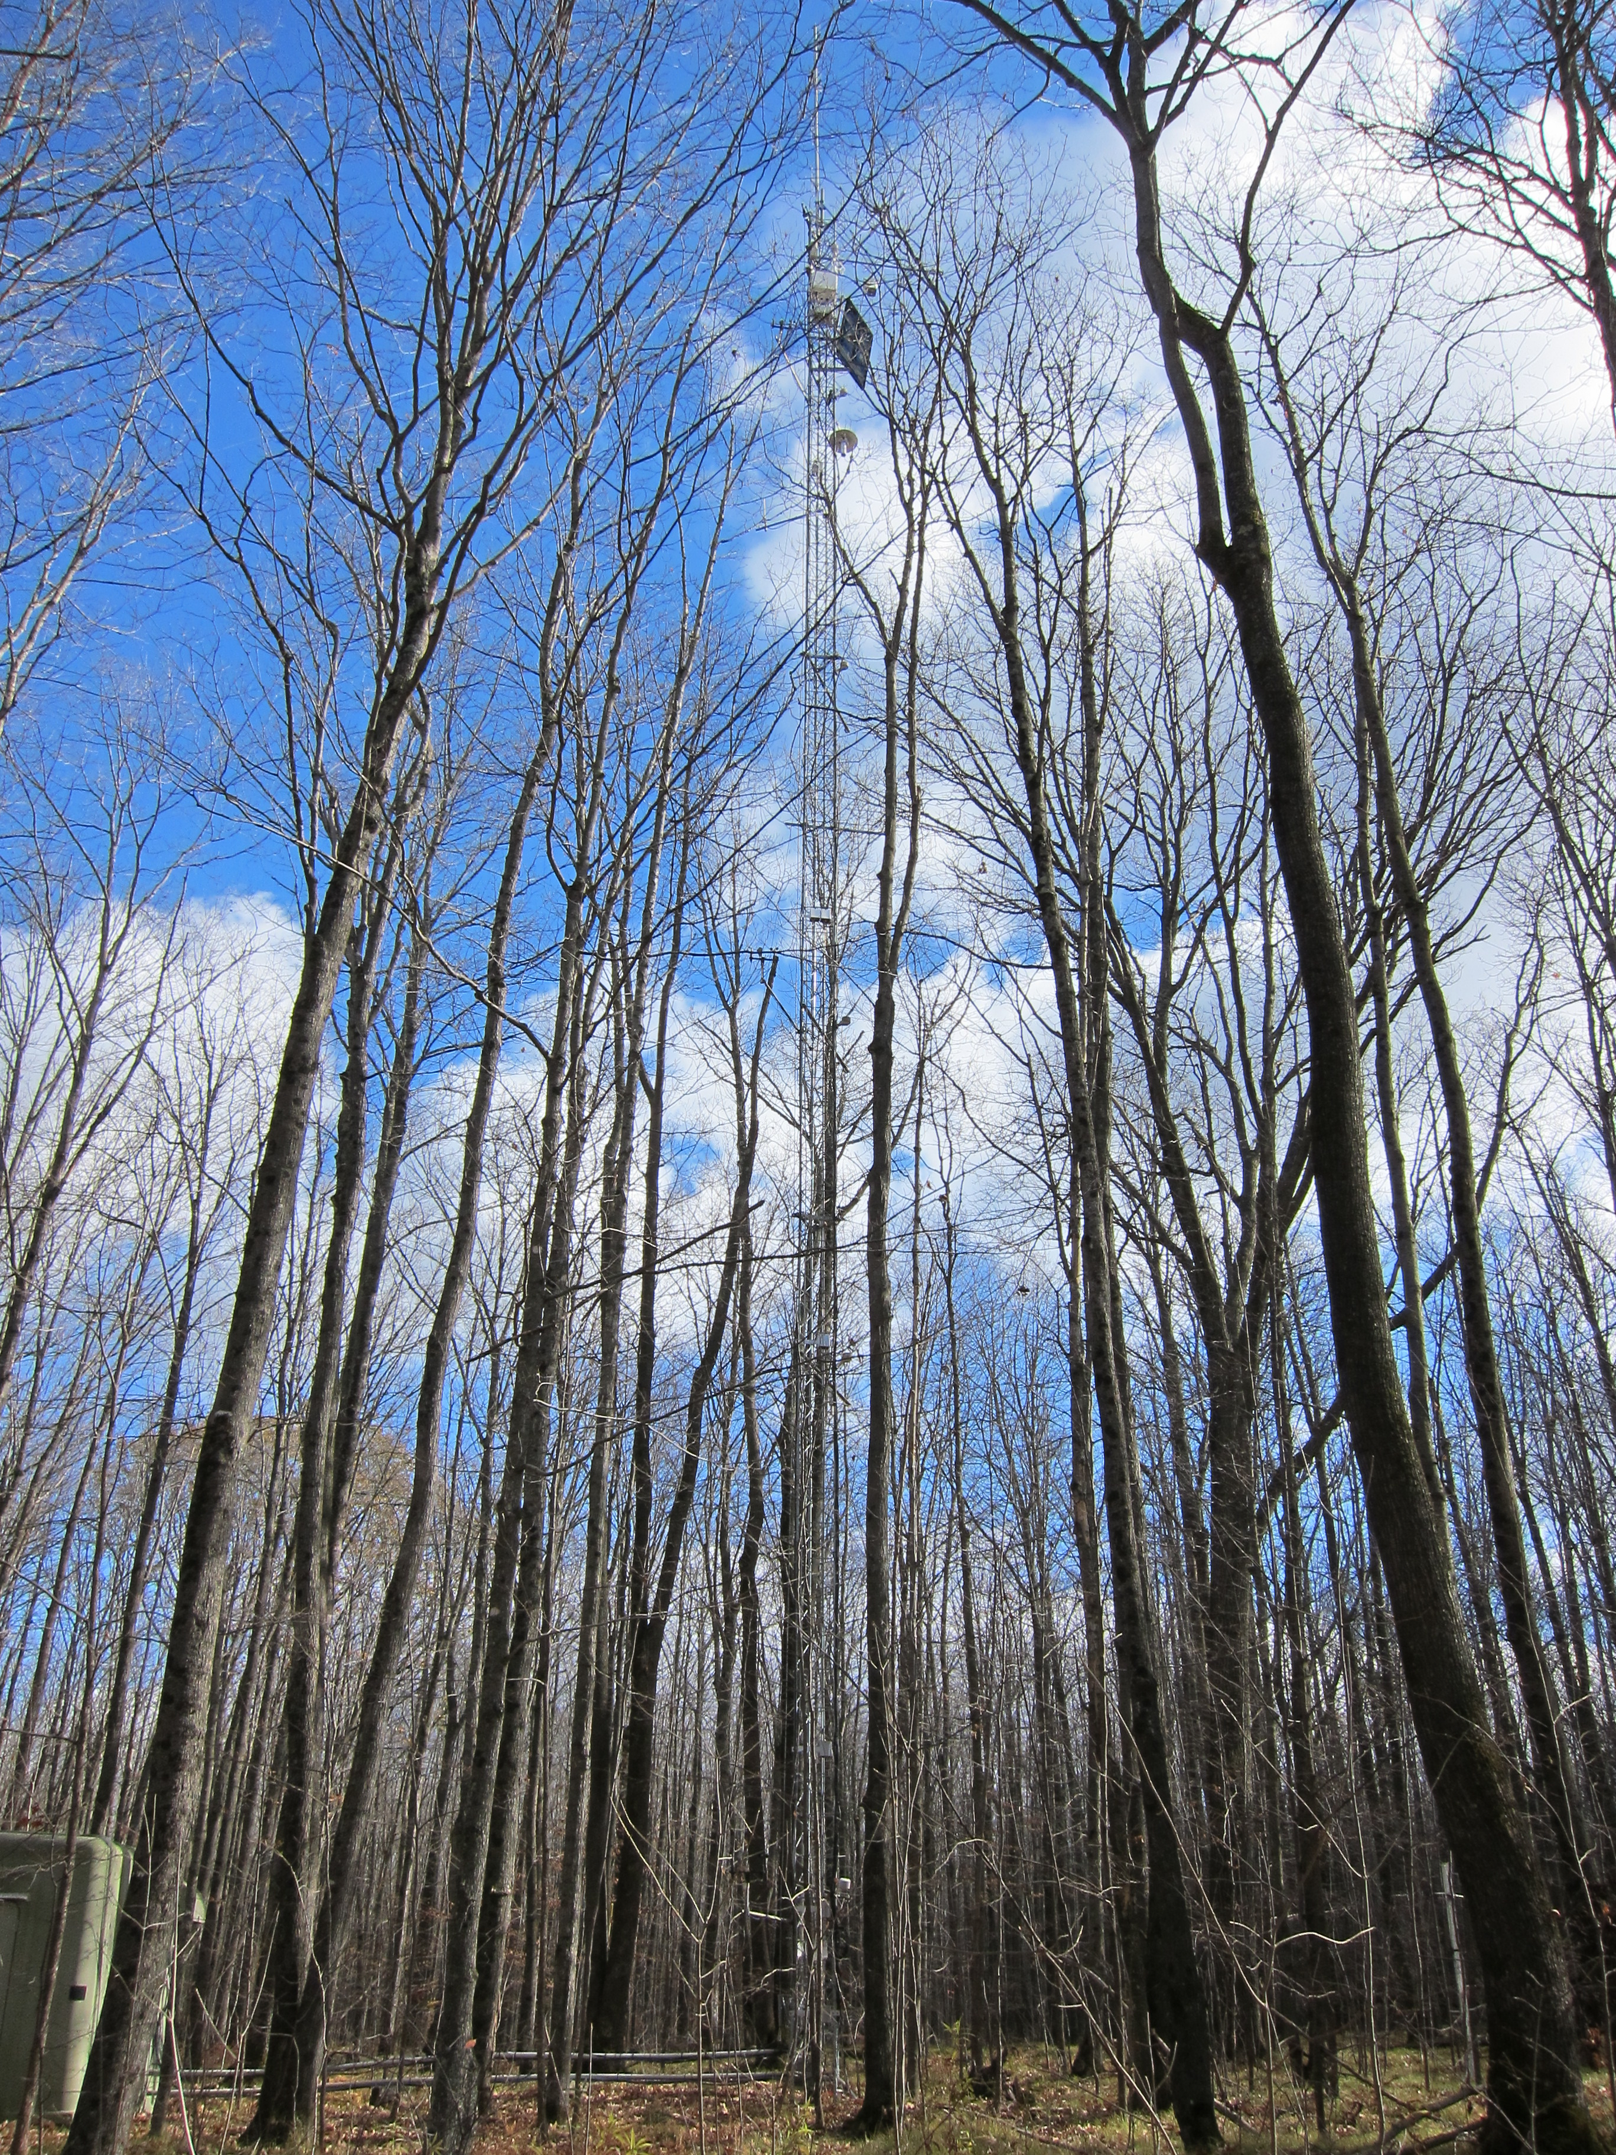
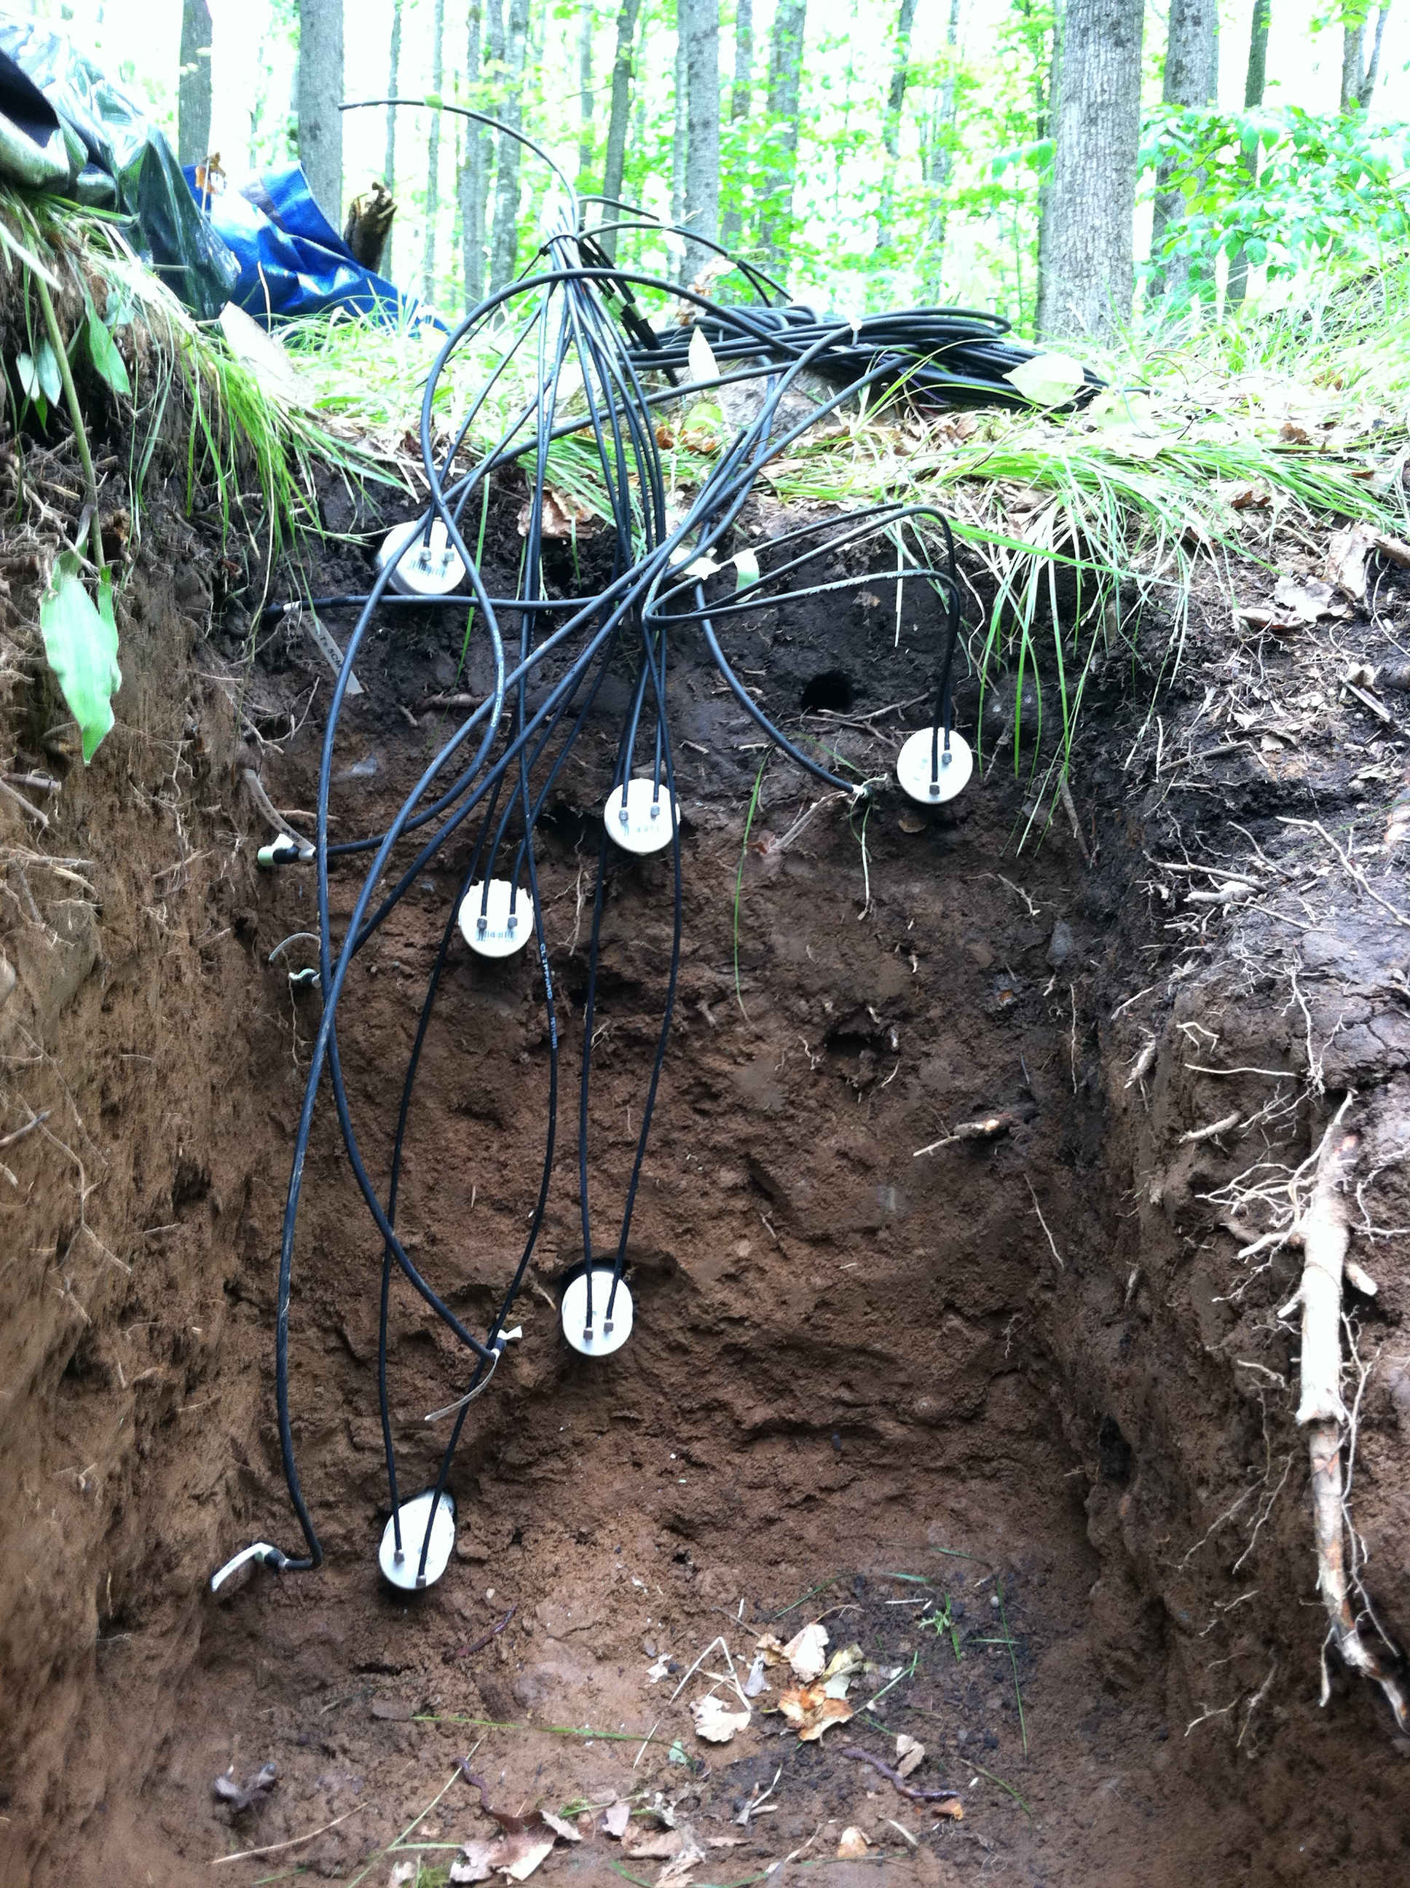




Using ¹⁴C as a high-frequency tracer of forest CO₂ emissions sources: preliminary results from a Northern Wisconsin case study
Claire Phillips¹, Karis McFarlane¹,
Ankur Desai², Brian LaFranchi¹, David Risk³
Soil emissions
Depth of CO₂ production may influence temporal patterns
Tall-tower dynamics
Influence of fossil CO₂ apparent, but biology may matter too.
1 Lawrence Livermore Natlional Laboratory
Livermore, CA
cams.llnl.gov
2 Atmospheric and Oceanic Sciences
University of Wisconsin,
Madiison, WI
flux.aos.wisc.edu
3 Dept of Earth Sciences
St. Francis Xavier University
Antigonish, Nova Scotia, Canada
www,fluxlab.ca
Soil ¹⁴CO₂ is modern (post-bomb)throughout the soil profile, unlike bulk soil.
Soil ¹⁴CO₂ decreased following leaf fall, more resembling Ra.
This is counter to expectation of greater autotrophic contributions when trees are active…
1ppm increase=
0.25 ‰ depletion in summer
0.73 ‰ depletion in winter
Introduction
Radiocarbon is a potential tracer for detecting contributions of soil CO₂ to whole forest emissions.
We are monitoring the ¹⁴C abundance in soil and whole ecosystem CO₂ emissions from a deciduous hardwood forest in Northern Wisconsin for three years.
Questions:
1) How does soil-respired ¹⁴C-CO₂ vary seasonally? With environment?
2) Can signals from soil-respired ¹⁴C-CO₂ be detected in canopy emissions?
3) How do whole-forest emissions impact ¹⁴CO₂ at the nearby WLEF 450 m radio tower? (LEF, Park Falls, WI)
Foliage on
Foliage dropped
Theoretical fossil fuel depletion = 2.7‰ per 1ppm addition
CO₂ corresponded with decreasing ¹⁴C abundance and elevated levels of other anthropogenic gases.
However, ¹⁴C depletion was much lower than expected for pure fossil fuel additions, alone.
¹⁴C depletion was especially low during the growing season (May-Sept), suggesting other factors may be important!
…but vertical flux partitioning suggests a reason: less CO₂ originating from dry, shallow soil in late summer.
Approach
Monitor respired CO₂ and ¹⁴CO₂ at nested spatial scales.
Canopy emissions
Impacts of soil on canopy ¹⁴CO₂ not (yet) detected.
Preliminary Conclusions
Soil ¹⁴CO₂ may vary moderately at seasonal timescales, and dynamics may relate to soil moisture.
No clear evidence of seasonal variation in whole-ecosystem respired ¹⁴CO₂; however, additional data and method improvements are forthcoming.
Fossil fuel emissions have dominant impacts on atmospheric ¹⁴CO₂ at high altitudes. However, other influences may be important, particularly during the summer.
While difficult to compare methods, soil and whole-ecosystem respiration were similar in magnitude.
Nevertheless, there were no obvious Impacts of soil on canopy ¹⁴CO₂
Forced Diffusion probes (4) measure soil surface flux
Flask air samples of ¹⁴CO₂ collected by NOAA-ESRL¹ at LEF tower (450 m) since early 2010…
During nocturnal CO₂ buildup ¹⁴C generally decreased
= less soil bomb-C
Nocturnal Keeling plots exhibited large scatter, determination of Reco end-member not possible.
Flas samples at Willow Creek Eddy Covariance Tower (30 m) since early 2011
1. J.B. Miller, S.J. Lehman, A.E. Andrews, J.D. Kofler (2011), University of Colorado, Institute of Alpine and Arctic Research (INSTAAR), Radiocarbon Composition of Atmospheric Carbon Dioxide (14CO2) from the NOAA ESRL Carbon Cycle Air Sampling Network, 2009-2011, Version: 2011-11-10,
Subsurface sampling (4 pits, including a trenched pit, x 7 levels) allow us to partition soil CO₂ production by depth.
This summer: will measure canopy ¹⁴CO₂ profiles to characterize possible soil influences.
This work performed under the auspices of the U.S. Department of Energy by Lawrence Livermore National Laboratory under Contract DE-AC52-07NA27344, the Wisconsin Focus on Energy and NSF# DEB-0845166. LLNL-POST-491850

