Slide 1
You have NEE
Now what?
Ankur Desai, U Wisconsin-Madison

Slide 2
How do you know you have a good measurement at all?
QA/QC flags (in situ, post-processing)
How confident are you in that good measurement?
Uncertainty estimation
What do we do when we don’t have a good measurement?
Gap-filling
How do we infer ecologically useful properties from this measurement?
Flux partitioning (GPP/RE)

Slide 3
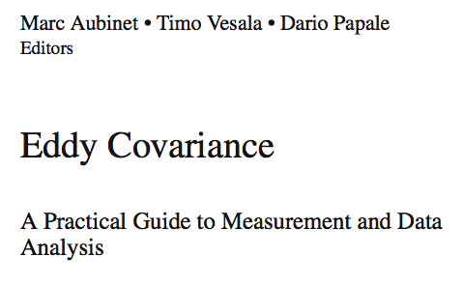

Slide 4
QA/QC

Slide 5
QA/QC
Does your measurement violate EC or theoretical assumptions?
Stationary, homogeneity, vertical turbulent flux dominance, energy balance closure, storage flux accounting, well-defined continuous turbulence
Is your measurement noisy?
Sensor high-frequency performance, large lag times, sensor separation issues, data logger resolution
Is your measurement biased?
Sensor drift, calibration offset, heterogeneous footprint

Slide 6
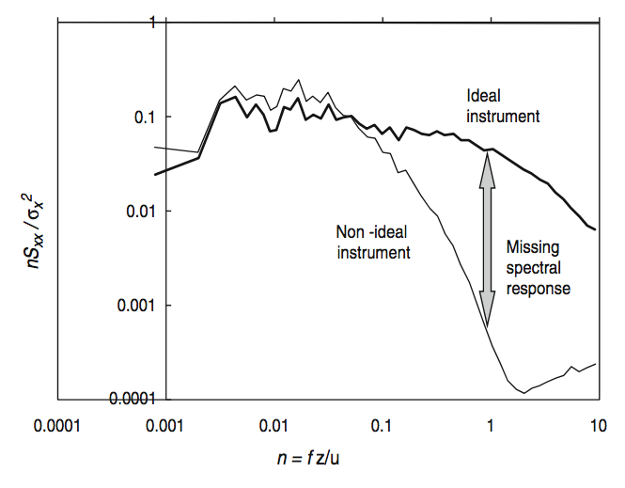

Slide 7
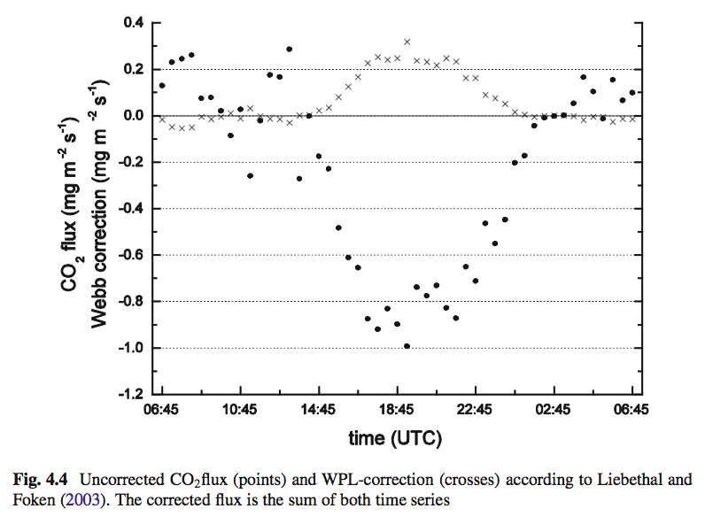

Slide 8
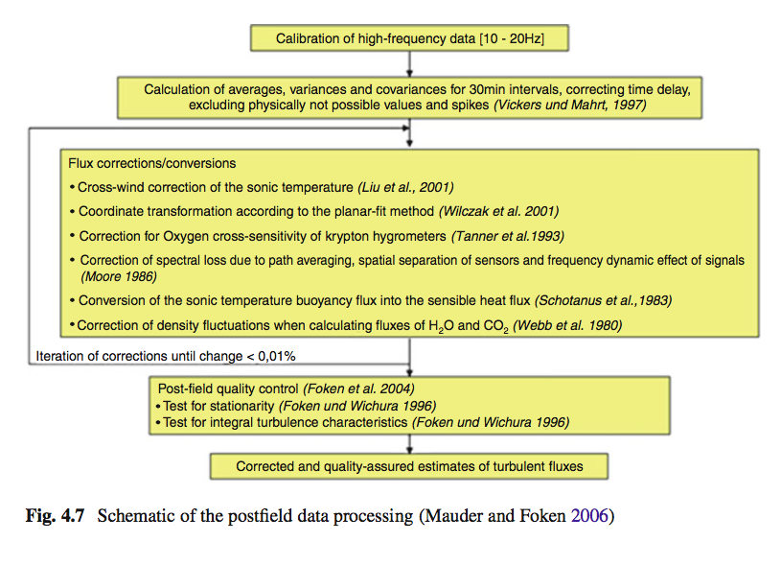

Slide 9
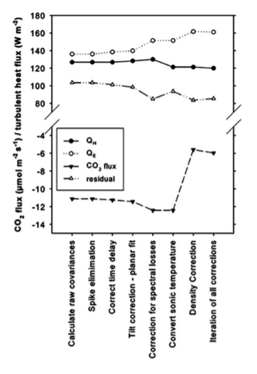

Slide 10
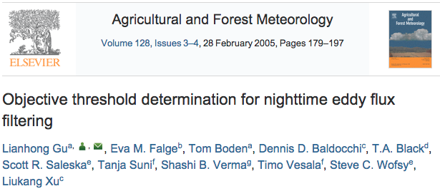
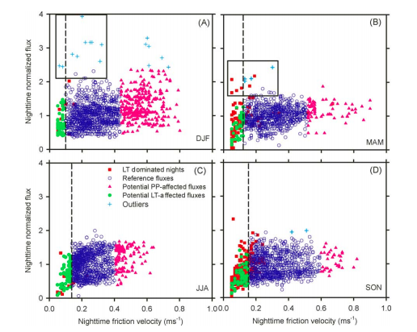
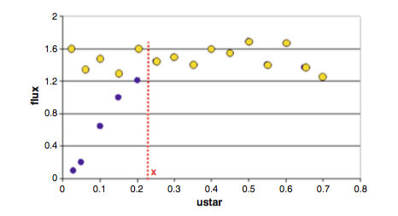
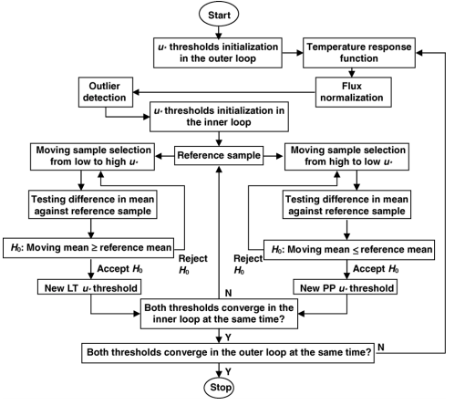

Slide 11
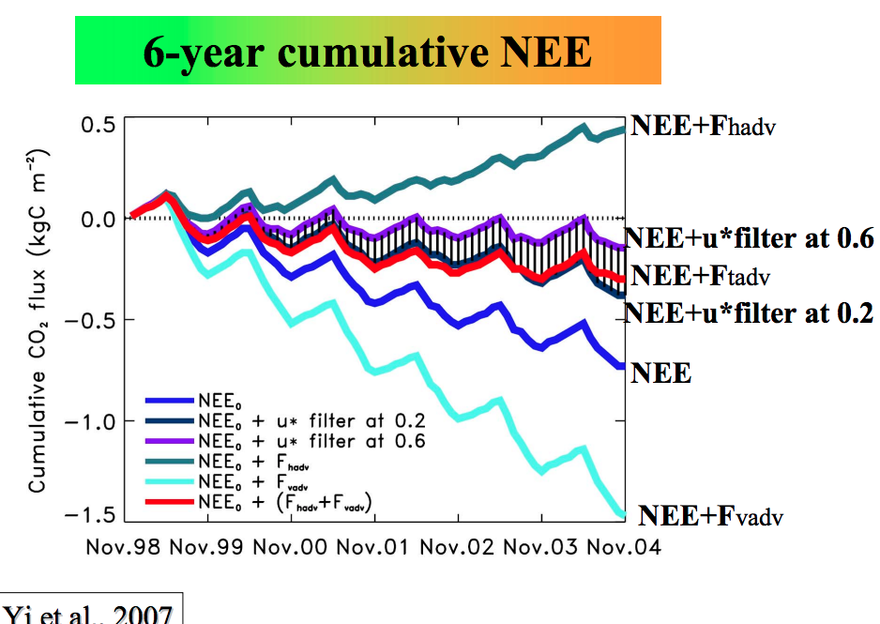

Slide 12
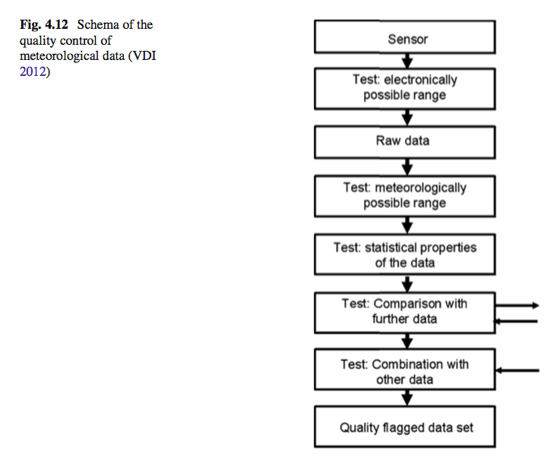

Slide 13
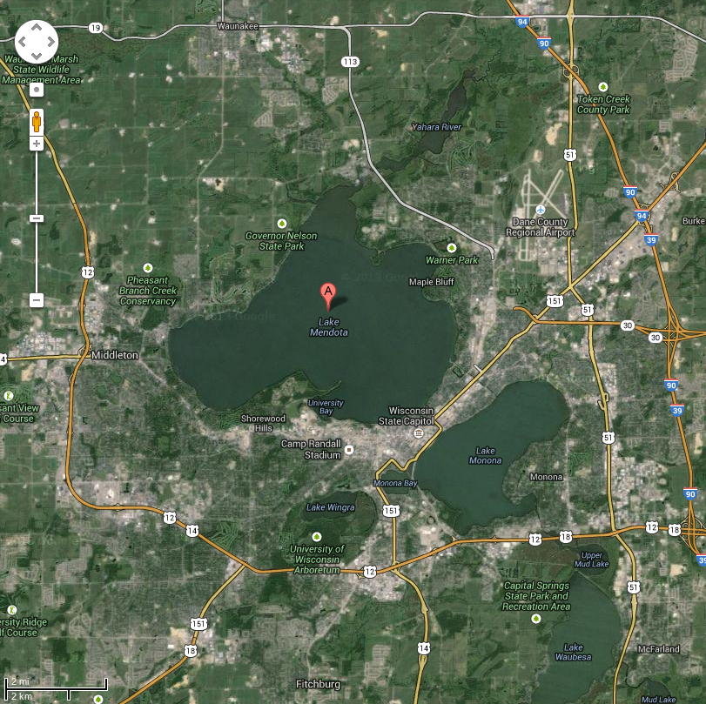
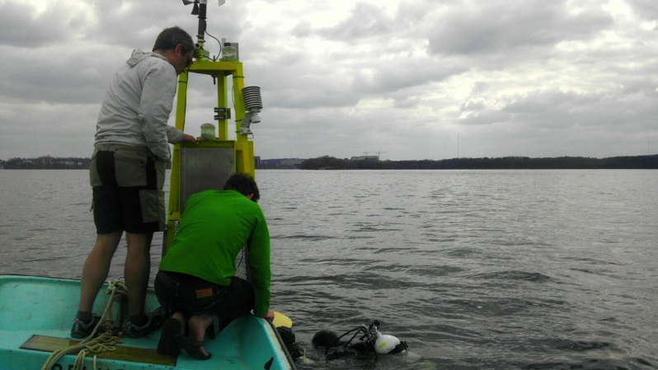
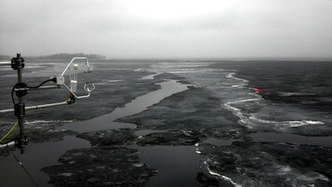
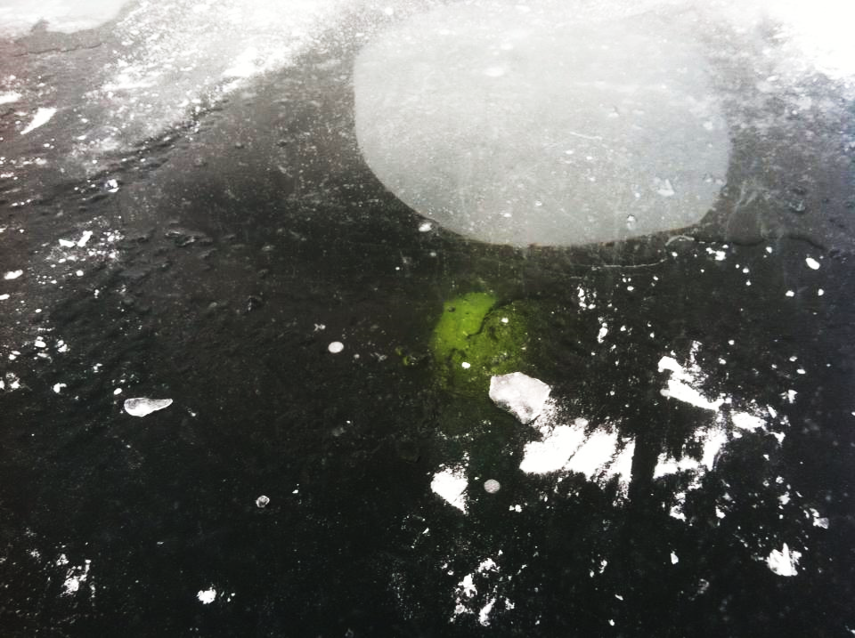

Slide 14
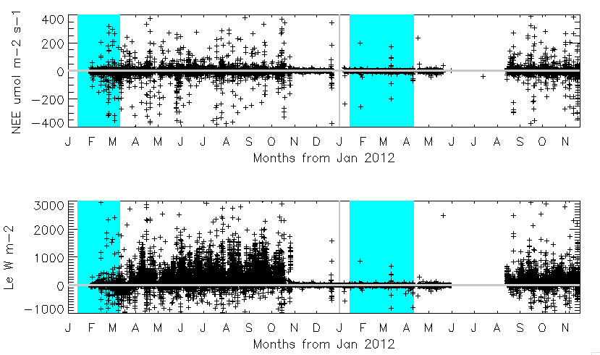
Some data…

Slide 15
QA/QC strategy for long-term EC measurements (Mauder et al., AFM, 2013)
Tests on high-frequency data
Instrument diagnostic flags (e.g. CSAT3 0-63, LI7500 240-251)
Instrumental/plausibility limits (site-specific)
Spike-detection with MAD-test, z = 7
Tests on statistics, flux calculation + corrections
Maximum number of missing values: <=10%: flags = 0, >10%: flags = 2
Stationarity test covariances (FW96,MF04, <30%: flag = 0, <75%: flag = 1)
Test on well-developed turbulence (ITC test: FW96,MF04, <30%: flag = 0, <100%: flag = 1)
[w] after planar fit > 0.10 m s⁻¹: former flags +1, >0.15 ms⁻¹: flags = 2
Interdependence of flags due to corrections/conversions: if flagλE==2 then former flagH +1 else if flagH==2 then former flagλE +1 else if flagλE==2 or flagH==2 then former flagNEE +1
Quantification of errors/uncertainty estimates
Stochastic error: use Finkelstein&Sims (2001) on high-pass filtered time series.
Instrumental noise error after Lenschow et al. (2000)
Systematic error: flux underestimation and lack of energy balance closure, only applicable for daytime: EBR = sum (λE+H)/Sum(R_{n}-G-J) for one day
Footprint: Kormann&Meixner(2001); calculate percentage of flux contribution from several targets of interest

Slide 16
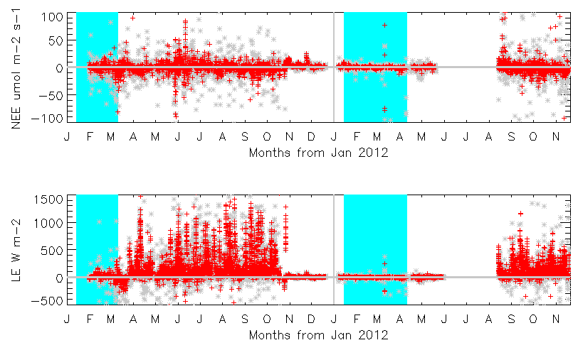
Flagging data

Slide 17
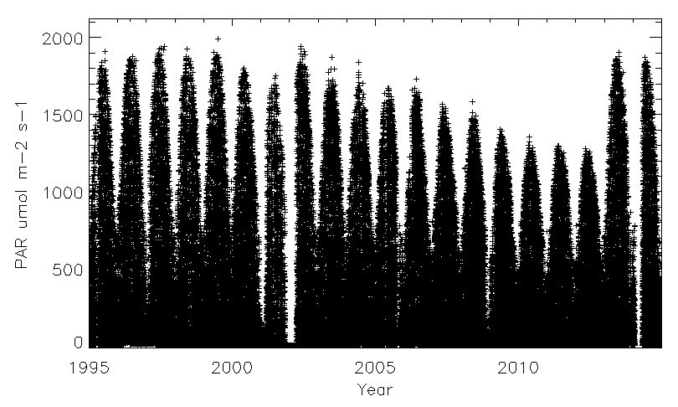
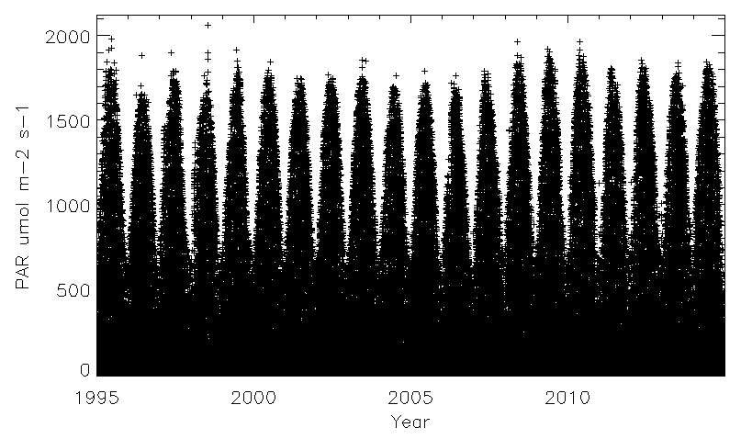
Watch out for simple things

Slide 18
MORALS
Calibrate, calibrate, calibrate, report/correct drifts
Flag your data using one of standard methods (Foken/Mauder)
Don’t remove flagged data, just report flags, let user decide what to do

Slide 19
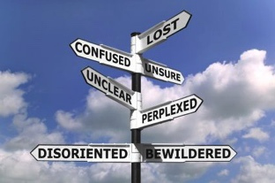
Uncertainty

Slide 20
Types
Systematic
Filtering (low-turbulence)
Bias
Correctable by flagging and filtering data – but adds gaps
Does not get better by averaging
Is notorious at night
Random
Cannot be corrected
But it can be estimated
And it reduces with averaging
Scales with absolute magnitude of flux, so worst in mid-day

Slide 21
Sources of Uncertainty
Instrumental noise
Turbulent sampling (how long is long enough?)
Time or space average is only an approximation of ensemble average that requires stationarity and homogeneity
Non-homogenous surface flux

Slide 22
Estimating Random Error
Lenschow
Based on turbulence sample theory (only accounts for sampling error) – get around 10-20% on a single 30-minute flux
Hollinger/Schmidt-Hanson
Run multiple flux towers
Richardson
Paired flux samples or model-observation error
Billesbach/Finkelstein-Sims/Salesky
Semi-random shuffling of raw data
Much covariance or variance noise can be removed by lagging by one data point

Slide 23
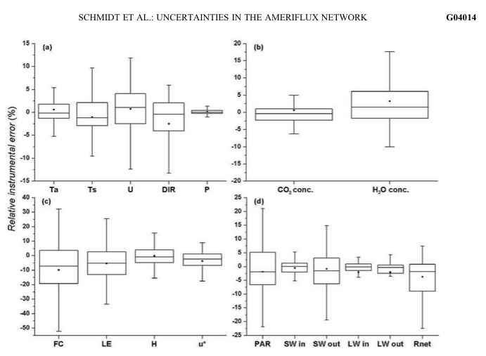

Slide 24
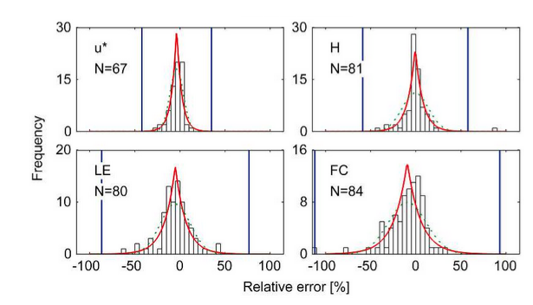

Slide 25
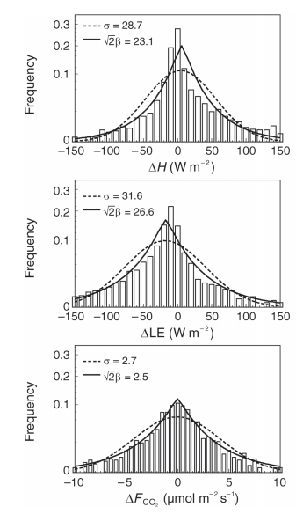
Hollinger &
Richardson
Tree Phys
2005

Slide 26
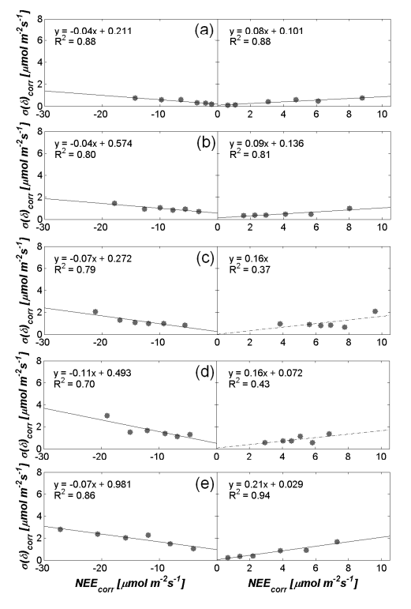
Post et al., Biogeosci., 2015

Slide 27
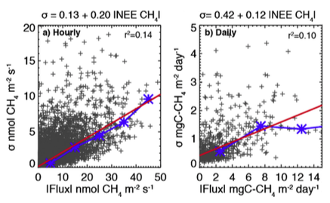
Desai et al., 2015, AFM

Slide 28
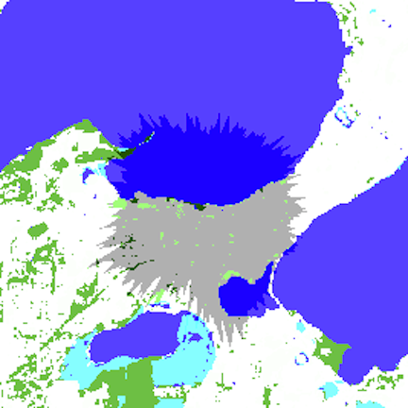
Back to the lake…

Slide 29
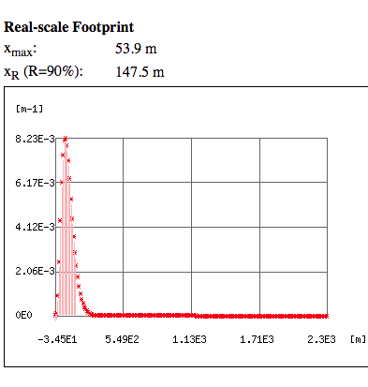
Online flux footprint
http://footprint.kljun.net/varinput.php

Slide 30
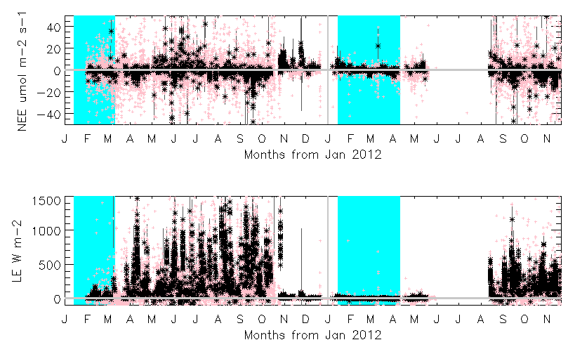
Signal from noise?

Slide 31
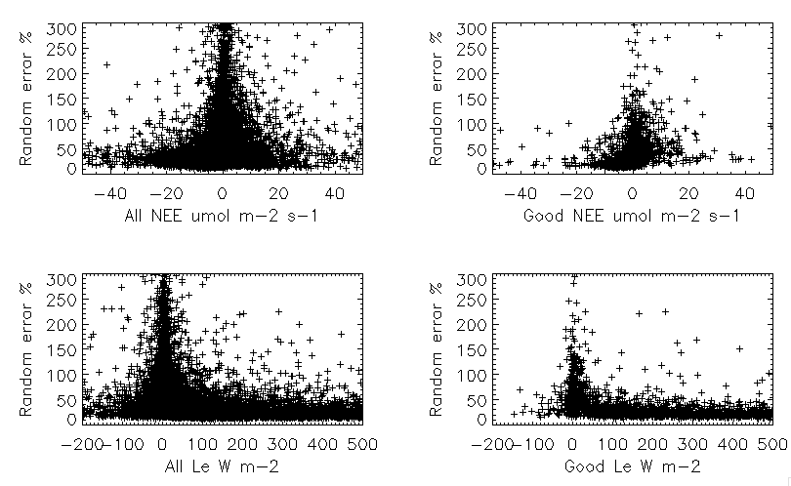
Noise characteristics are improved

Slide 32
MORALS
Uncertainty in NEE is inherent, heteroskedastic, and non-Gaussian, on the order of 10-20% of the flux magnitude. It decreases with averaging time, but doesn’t go away, especially as noise is auto-correlated
Reporting uncertainty is essential for data assimilation and statistical comparison
Random uncertainty is only one component. Systematic uncertainty from low turbulence or footprint bias requires additional flagging

Slide 33
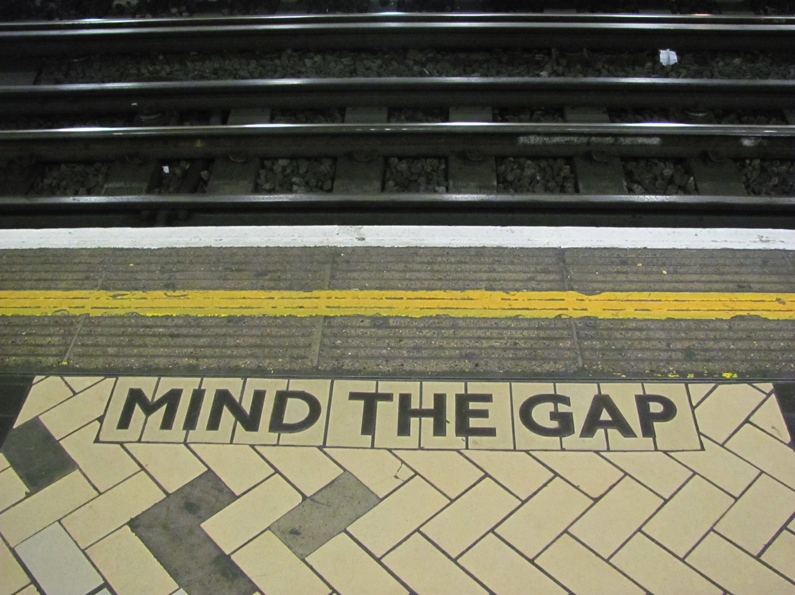

Slide 34
All sites have gaps!
Instrument/power failure, spikes, oddities, maintenance – 10-20%
Precipitation (esp. for open-path) - ??%
Flagged – 20-30%
Systematic error - Low-turbulence at night – 10-25%
Net: 30-60% missing data is quite common!

Slide 35
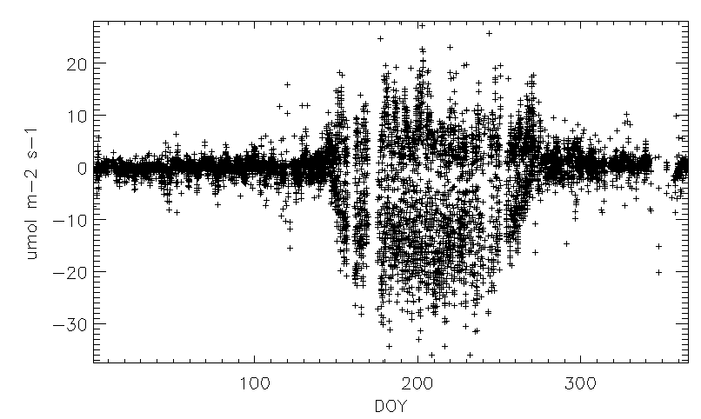
Fill this!

Slide 36
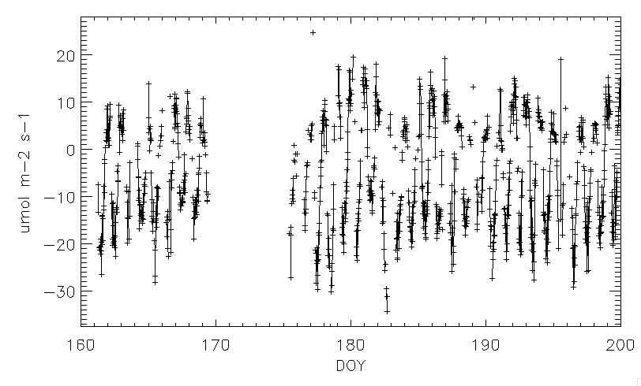
But it’s not bad as it looks…

Slide 37
Gap-Filling
All methods rely on finding analogs in observation record and identifying relationships among those with drivers
MDV
Mean Diurnal Variation (interpolation)
LUT/MDS
Look-Up Table, Marginal Distribution Sampling (pattern matching)
NLR
Non-linear regression to drivers (nighttime/daytime separate)
ANN
Artificial neural networks (very non-linear regression or machine learning)
Process Models
Data assimilation and parameter estimation

Slide 38
Gap-Filling Considerations
Environmental driver data
Which ones? Air Temp, Soil Temp, PAR, etc…
Do they need to be filled too?
Moving windows? How big?
Filling before and after major changes in flux conditions (e.g., disturbance, management, phenology)
Sensitivity to nighttime turbulence filtering
Accepted standards

Slide 39
Back to my site…

Slide 40
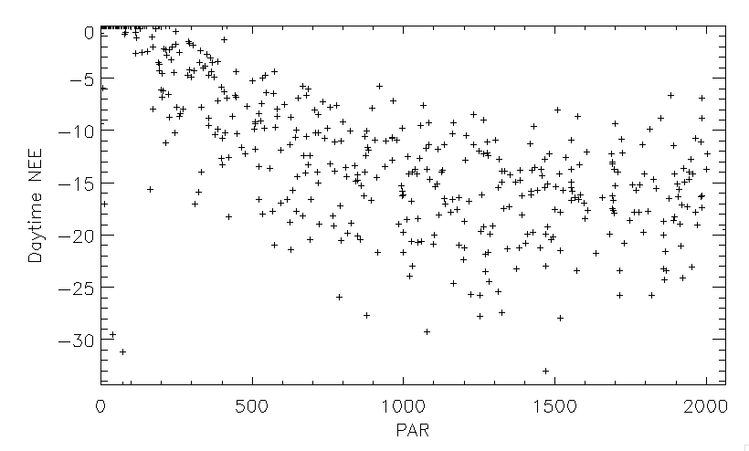
Daytime is easy, maybe

Slide 41
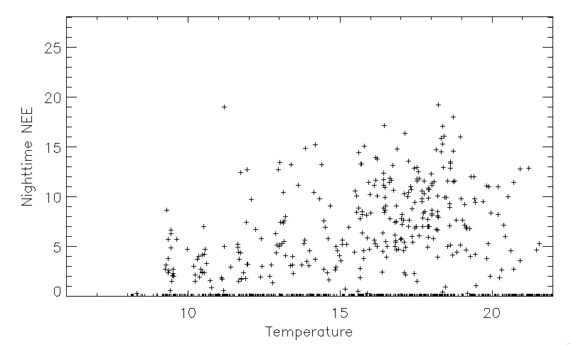
Nighttime looks ok

Slide 42
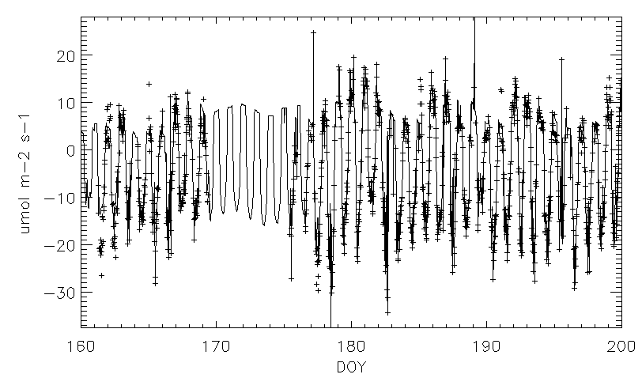
Magic!

Slide 43
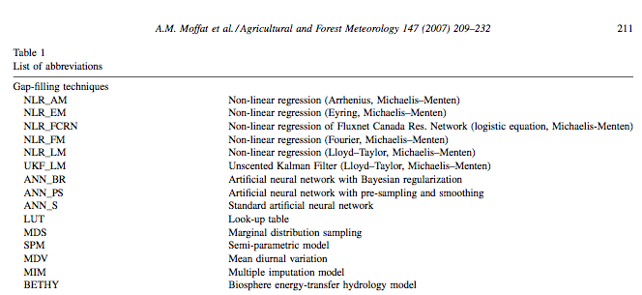

Slide 44
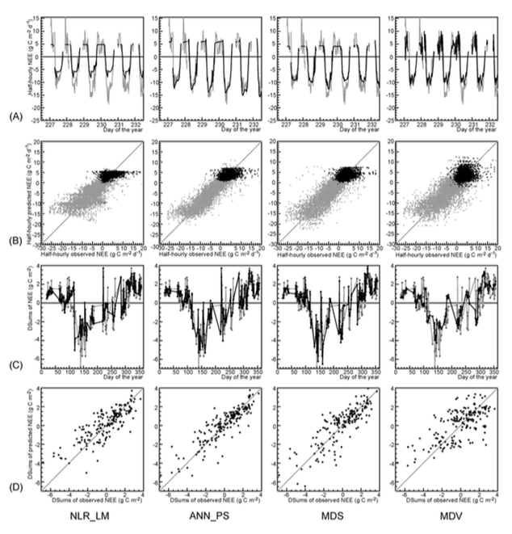

Slide 45
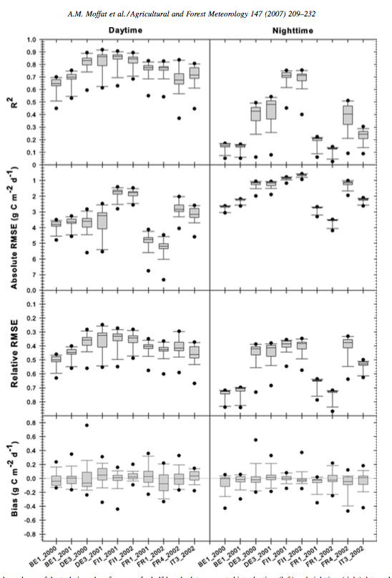

Slide 46
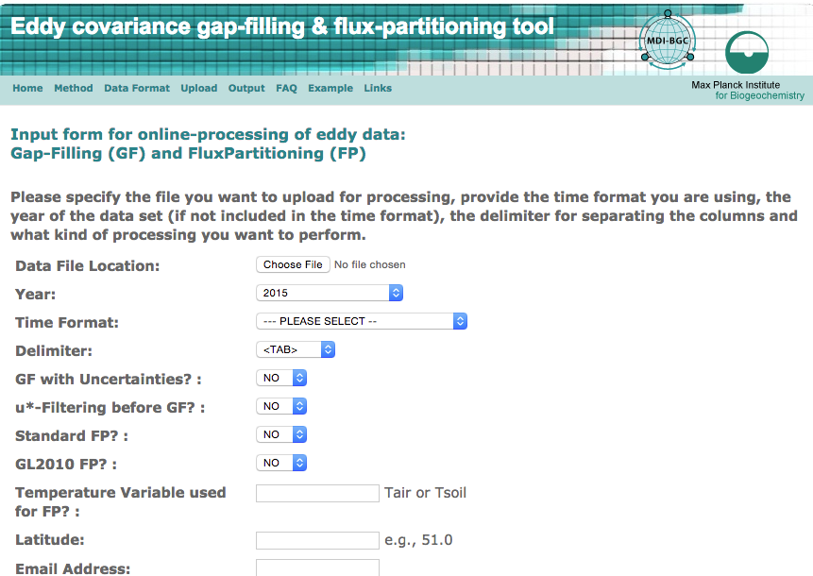
Online and R-Based Tool
REddyProc
http://www.bgc-jena.mpg.de/~MDIwork/eddyproc/

Slide 47
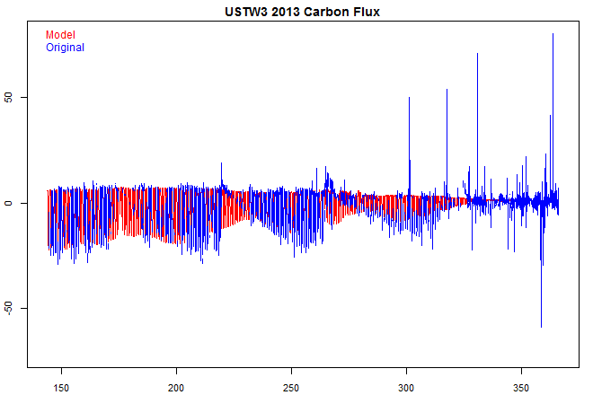
Uh oh?

Slide 48
MORALS
Gap-filling is not magic. It works best on interpolating small, random gaps and poorly on big ones, across big shifts, or into the future
All gap-filling methods rely on analogy of earlier conditions with NEE and/or environmental drivers. Have a sufficiently long data set and know what drives NEE at your site!
Driver data may also need to be gap-filled first, adding another source of uncertainty
Filter data before gap-filling!
There is no single accepted method, but Fluxnet uses MDS and ANN. Uncertainty by methods is in the single digit percent range for annual sums, larger at shorter time scales.

Slide 49
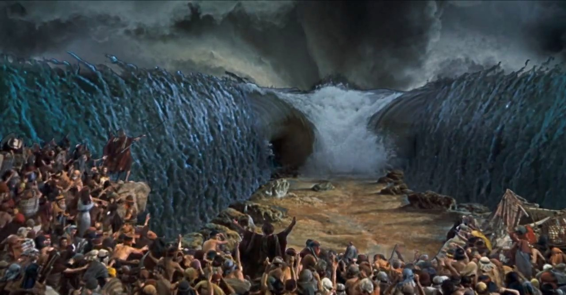
Flux Partitioning

Slide 50
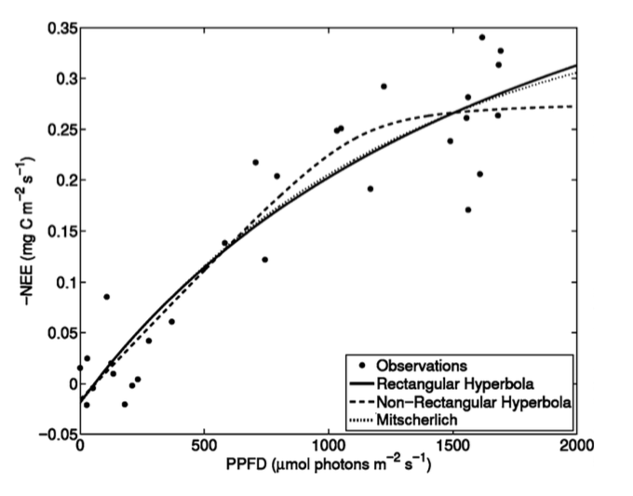

Slide 51
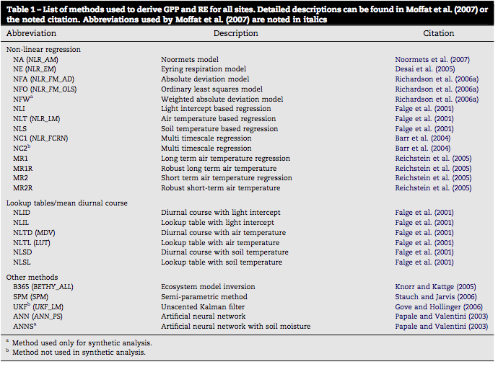

Slide 52
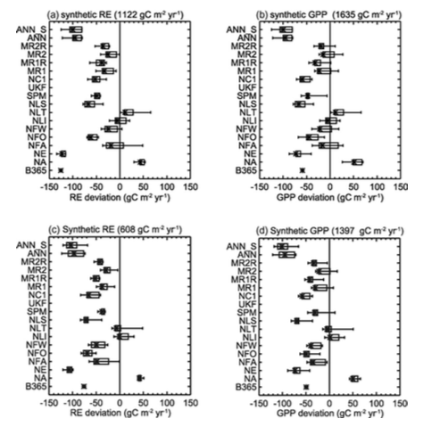
Desai et al, AFM, 2008

Slide 53
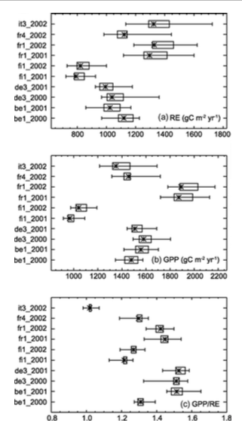

Slide 54
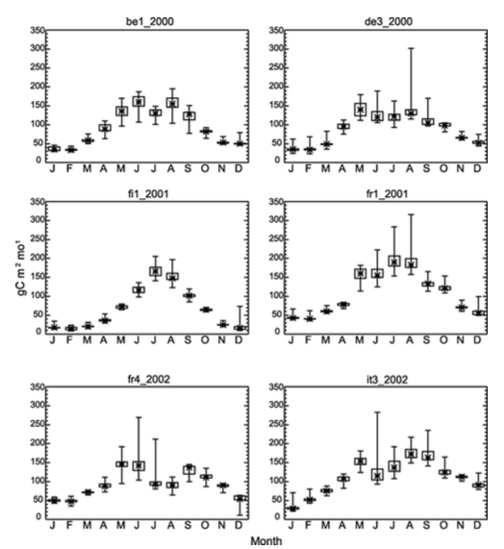
Reco

Slide 55
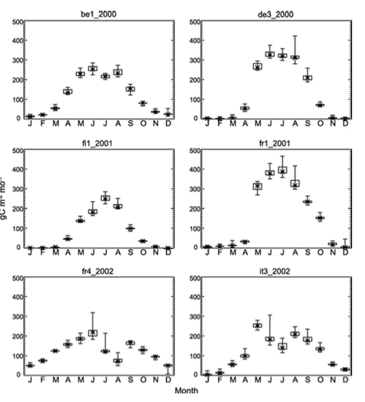
GPP
GPP

Slide 56
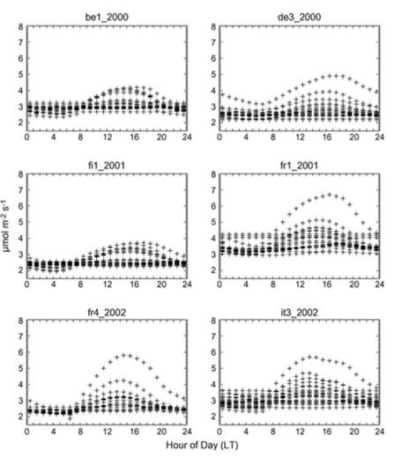
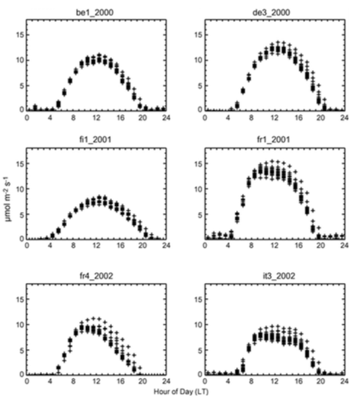

Slide 57
Advanced techniques
Under-constrained problem. So: Use another variable!
Soil Respiration
NPP
Carbon or oxygen isotopes
COS
High-frequency partitioning (Scanlon) based on water vapor

Slide 58
MORALS
There is no single accepted GPP/RE method
Fluxnet has settled on an MDS-based method with NLR
When comparing across time or sites, use the same flux partitioning algorithm
Uncertainty is an order of magnitude greater (20-30%) than for typical gap-filling (2-3%)

Slide 59
Putting it all together
You are NOT done when you just collect data and run it through EddyPro!
Your data is useless for science if it
Lacks flagging for poor quality data
Does not account for systematic biases such as low-turbulence, sensor drifts, footprint differences
Does not provide some estimate of uncertainty (even if crudely)
Gap-fills with incorrect drivers or over very long gaps
Calls flux tower GPP and Reco as “observations” and doesn’t address the underlying model and its uncertainty in this inference

Slide 60
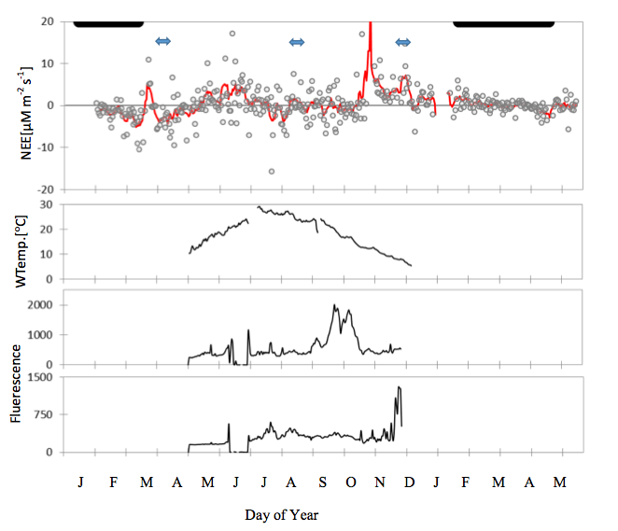

Slide 61
Desai et al., 2005, AFM

Slide 62
Desai et al., 2015, AFM

Slide 63
Putting it all together
You are NOT done when you just collect data and run it through EddyPro!
Your data is useless for science if it
Lacks flagging for poor quality data
Does not account for systematic biases such as low-turbulence, sensor drifts, footprint differences
Does not provide some estimate of uncertainty (even if crudely)
Gap-fills with incorrect drivers or over very long gaps
Calls flux tower GPP and Reco as “observations” and doesn’t address the underlying model and its uncertainty in this inference
Doing good science requires careful consideration of flux data quality and assumptions. Less is often more! Always ask site PIs (or their students!) about flags, special considerations, and filling/partition methods before conducting syntheses

Slide 64
THANK YOU!
Ankur Desai
University of Wisconsin-Madison
desai@aos.wisc.edu
http://flux.aos.wisc.edu
+1-608-520-0305

