Slide 1
Remote sensing of land management, disturbance, and ecosystem properties
CHEAS II Workshop
Wednesday Afternoon Discussion Section

Slide 2
General goals
What are key challenges in using remote sensing to better understand carbon cycle consequences of forest management and ecosystem heterogeneity in ChEAS?
What needs / gaps / issues are we encountering?
What can this group do to help address challenges?

Slide 3
Remote Sensing:
Opportunities & Challenges
Pros
Cons
May be consistent across space and time
Monitors broad spatial extents
May monitor frequently
Provides retrospective view
Detects signal outside of visible spectrum
May not be consistent across space and time
May be too spatially coarse
May measure infrequently
Restricted to recent decades
Technically and financially challenging

Slide 4
Tradeoffs
A zero-sum game
Spectral
For any given remotely-sensed system, there is a finite quantity of electromagnetic energy to be partitioned among spatial, temporal, and spectral (measurement sensitivity) domains.
What role will remote sensing play?
Temporal
Spatial

Slide 5
Potential roles in carbon cycle studies
Remote sensing observations / maps
Dynamic variables: disturbance, growth, land cover/use change, etc.
State variables: LAI, biomass, land cover / use, etc.
Management
Assess and map to aid planning
Evaluate policy / management outcomes
Modeling
Constrain model / Adjust dynamic parameters
State variable or parameter initialization
Basic research
Test hypotheses of geographic distribution
Test hypotheses of drivers or interaction

Slide 6
Separating real from false change
All spectral changes
Artifacts
False
positives
Sensor degradation, atmospheric contamination, geometric misregistration, sun angle variation
Non-target
change
Seasonality of vegetation (phenology), clouds, agricultural practices
Target change
Sustained change in land cover or condition
False
negatives
THRESHOLD
OF CHANGE
Mapped as no-change
Mapped as change

Slide 7
Key technical challenges
False positives
  Clouds and shadows
  Phenological variability
False negatives
  Spectral variability
  Quick spectral recovery
  Multiple successive disturbances

Slide 8
NASA Carbon cycle science project
“Influence of Disturbance and Seasonality on Regional Carbon Flux Upscaling”
Key remote sensing contributions
  Timing / magnitude of disturbance
  Distinction between anthropogenic and natural disturbance types

Slide 9
A process-based view of change
Change occurs all the time
Critical events occur when direction changes
State Change
Cyclical Change
Condition change
Growth,
Succession
Growth
Succession
Growth,
Succession
Drought-stress, Insects
Clearing
Clearing
Forest
Succession
Urban
“succession”
Time

Slide 10
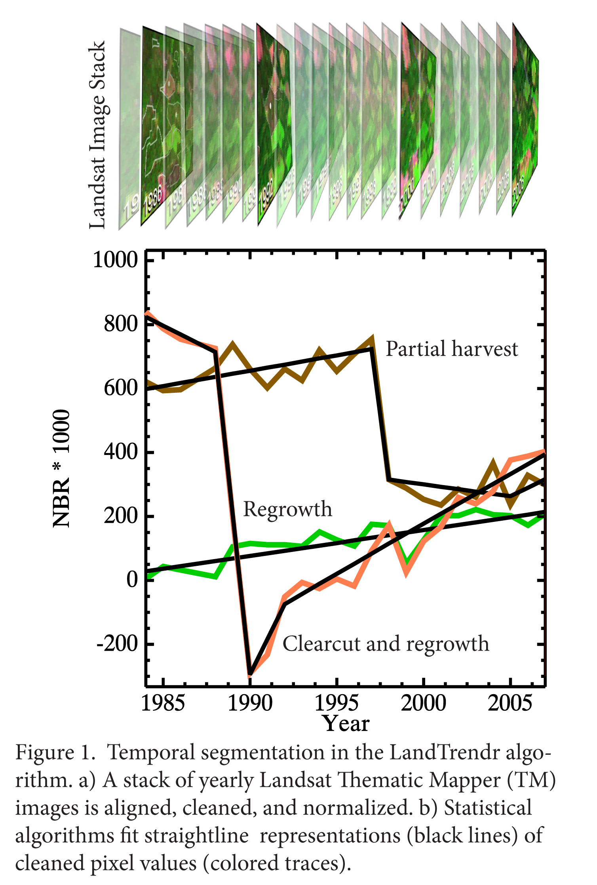
Process-based analysis of the Landsat archive
LandTrendr* strategy
  Look for TRENDS and EVENTS in the same algorithm
Segmentation
  Simplify temporal trajectory into periods of consistent process: SEGMENTS
  Separated by VERTICES
* “Landsat based detection of trends in disturbance and recovery”; See Kennedy et al. 2010 RSE 2897-2910
Landtrendr.forestry.oregonstate.edu

Slide 11
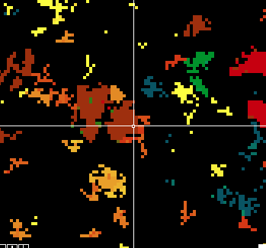
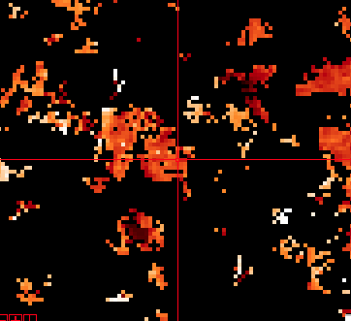
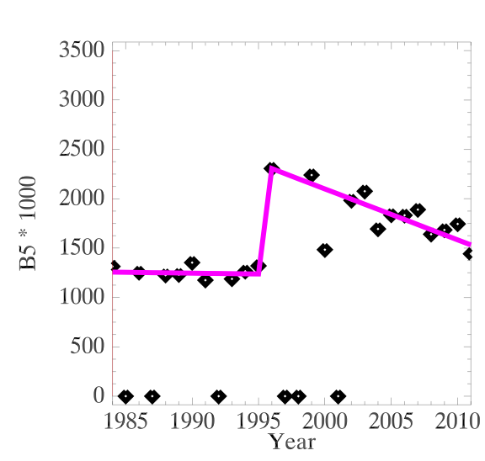
Timing, magnitude of disturbance: ChEAS
Year
Magnitude

Slide 12
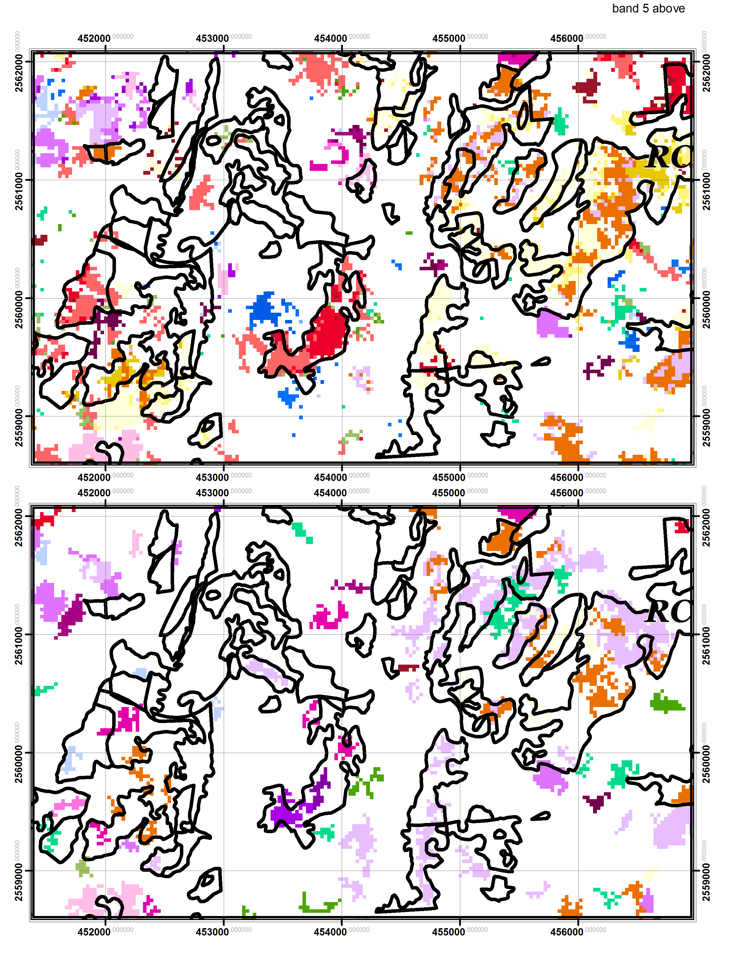
Uncertainty in detection
Band 5
Disturbance signal varies by spectral index
Eventually, a voting/scoring approach may be useful
NBR

Slide 13
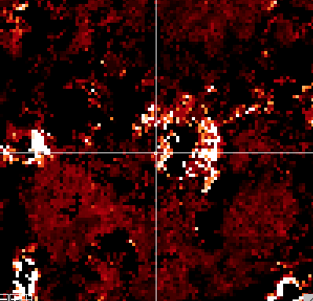
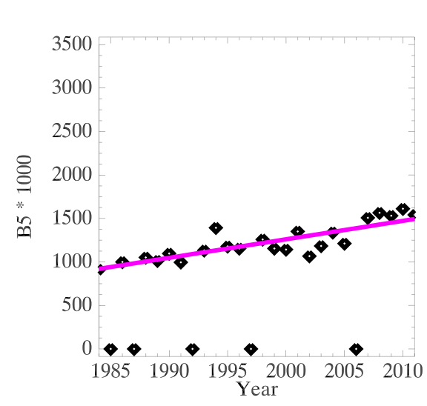
Longer-term processes: Disease
Band 5
Magnitude of long-term increase

Slide 14
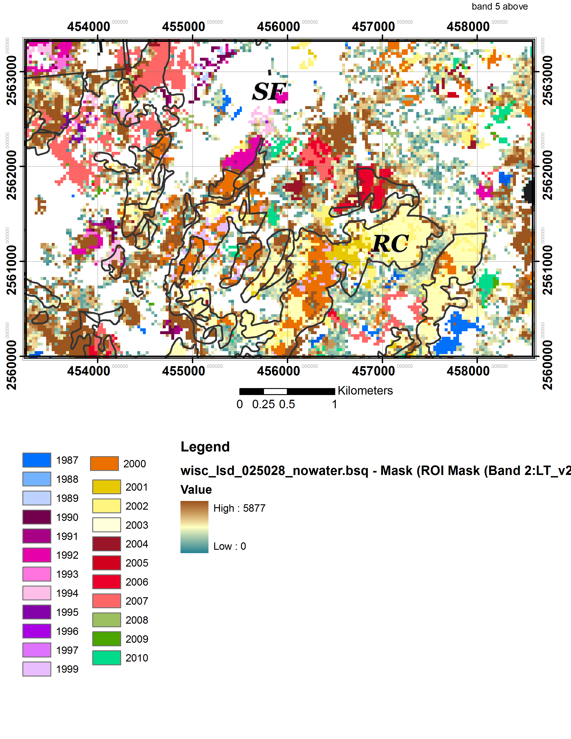
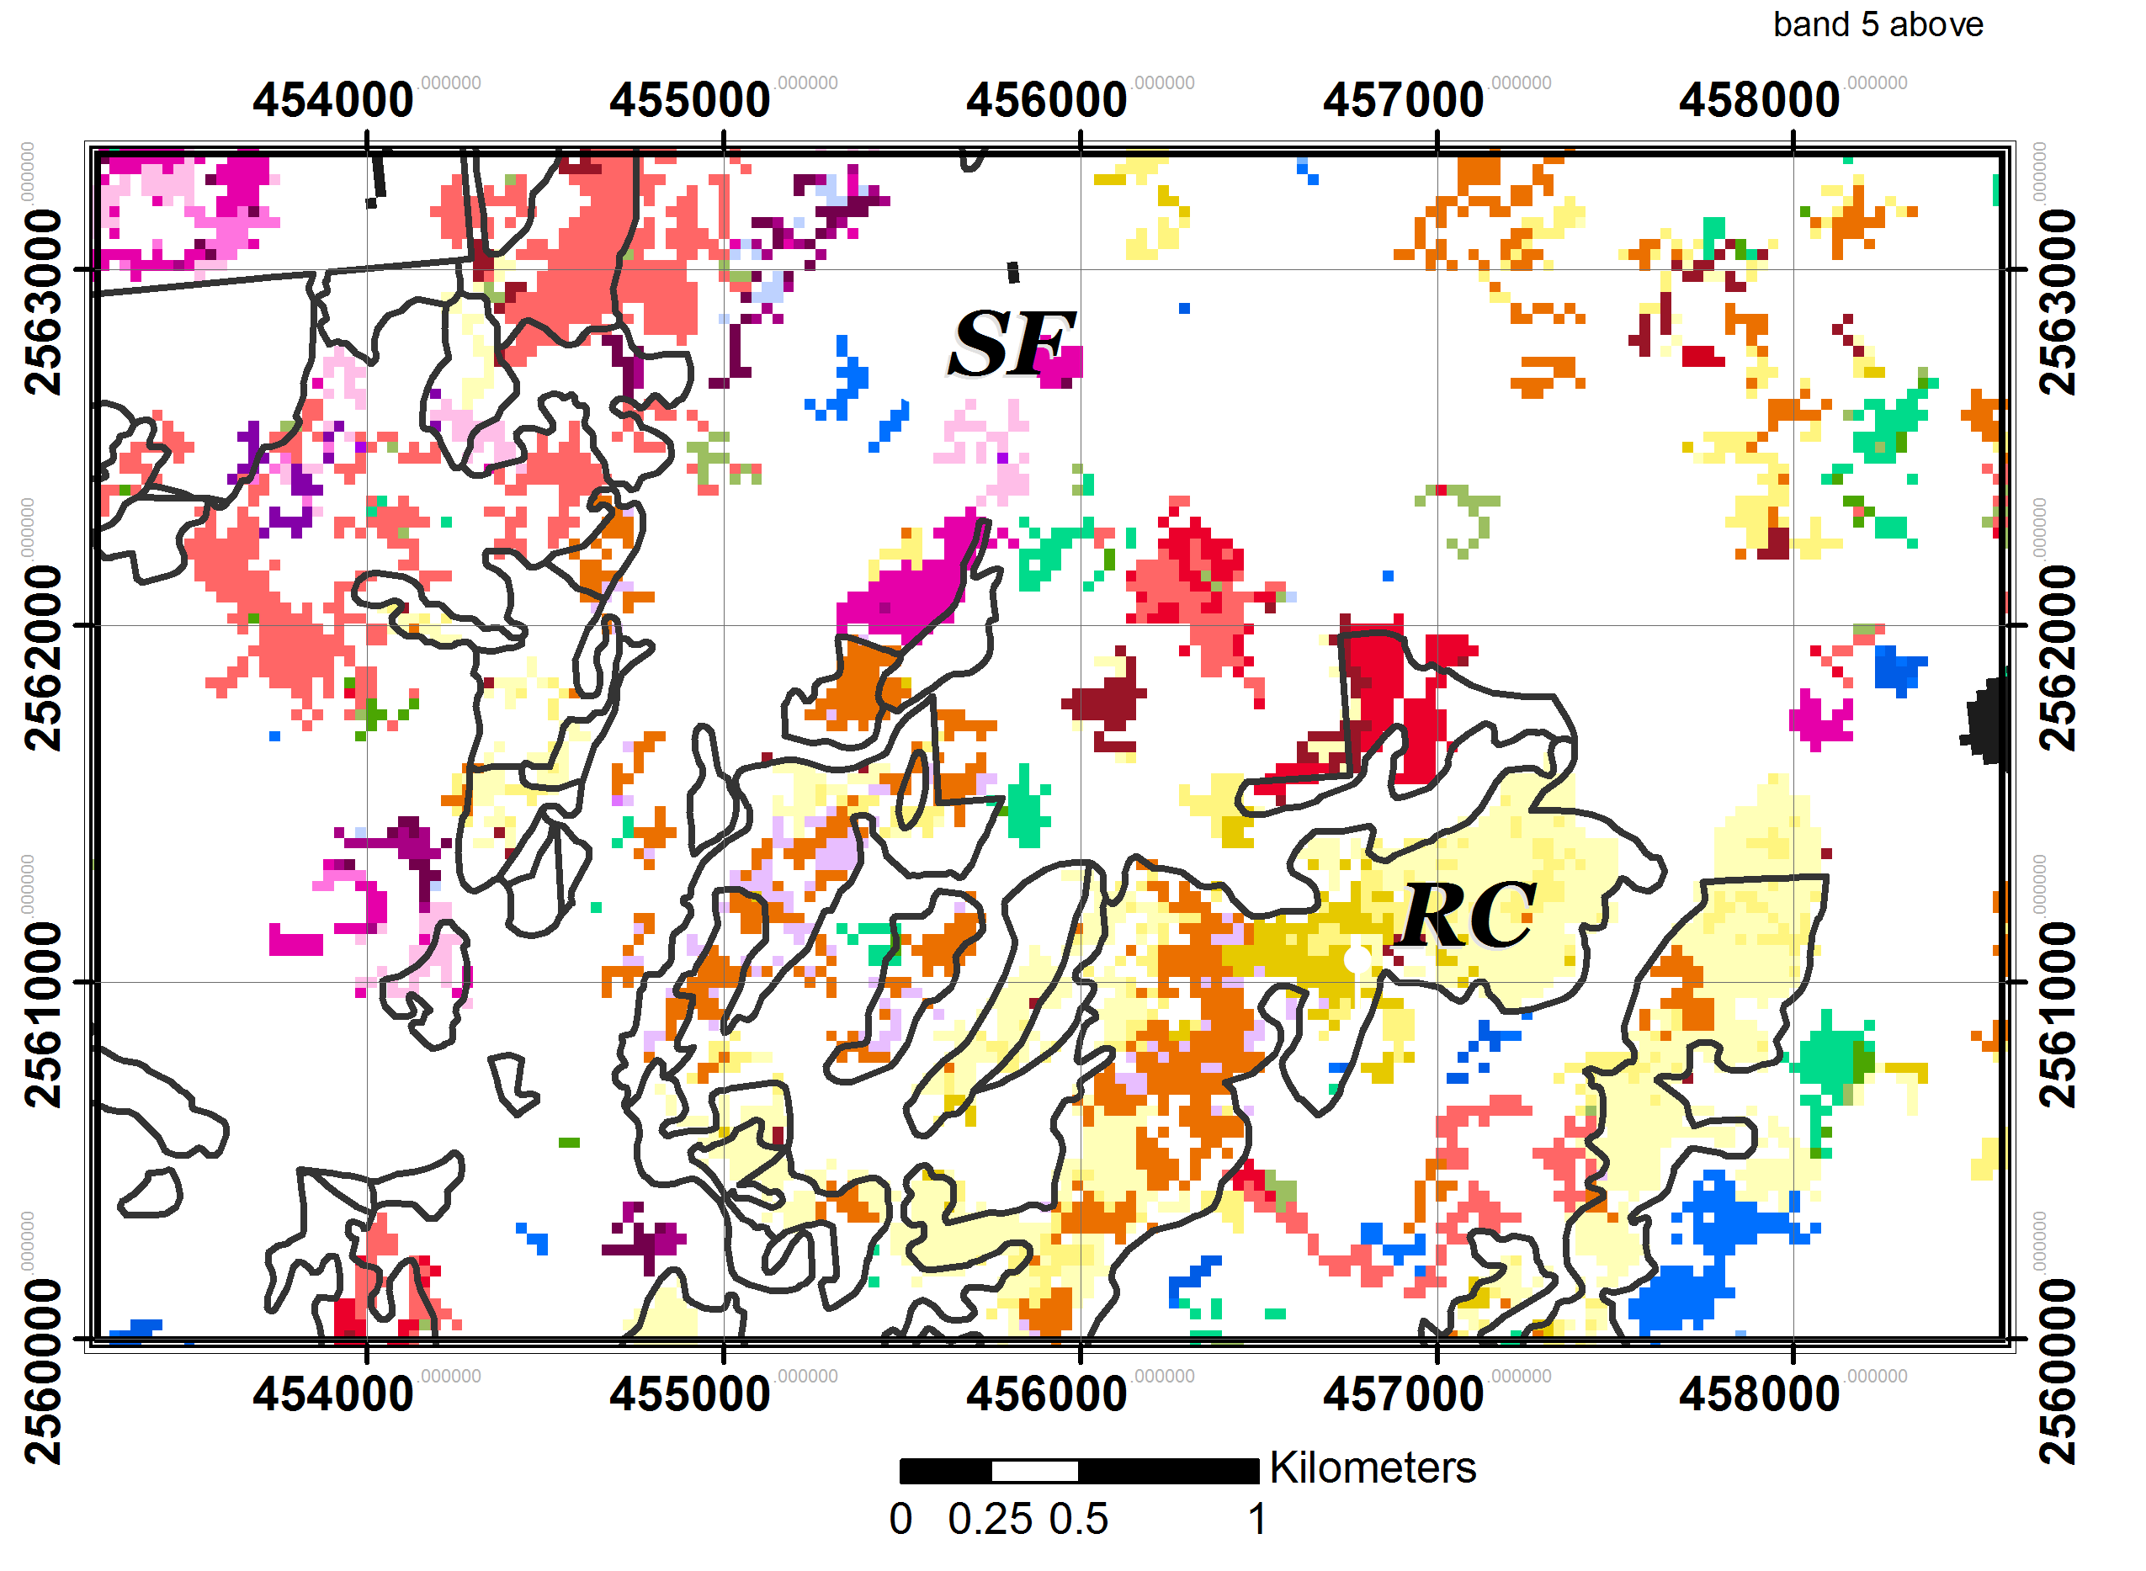
A richer view of change
Band 5
Combination of slow and abrupt change (disturbance)
Longer-duration processes critical for describing landscape dynamics
Low
High
Magnitude of long-term increase
Year

Slide 15
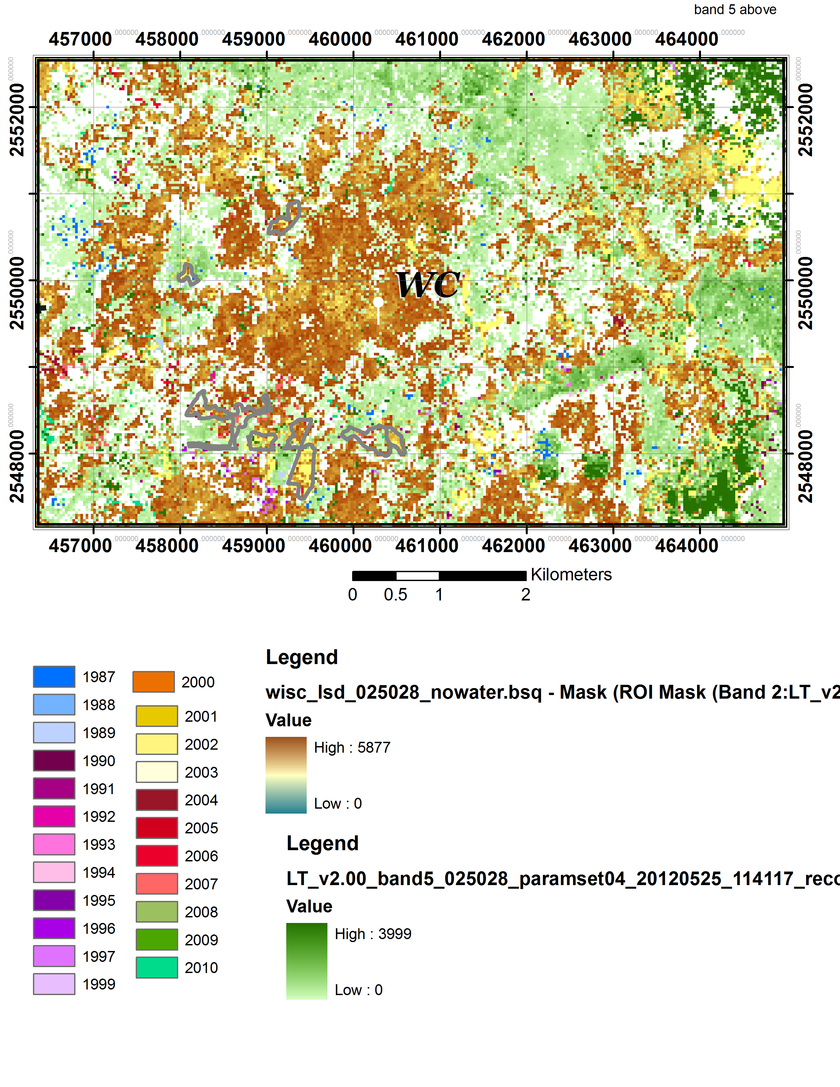
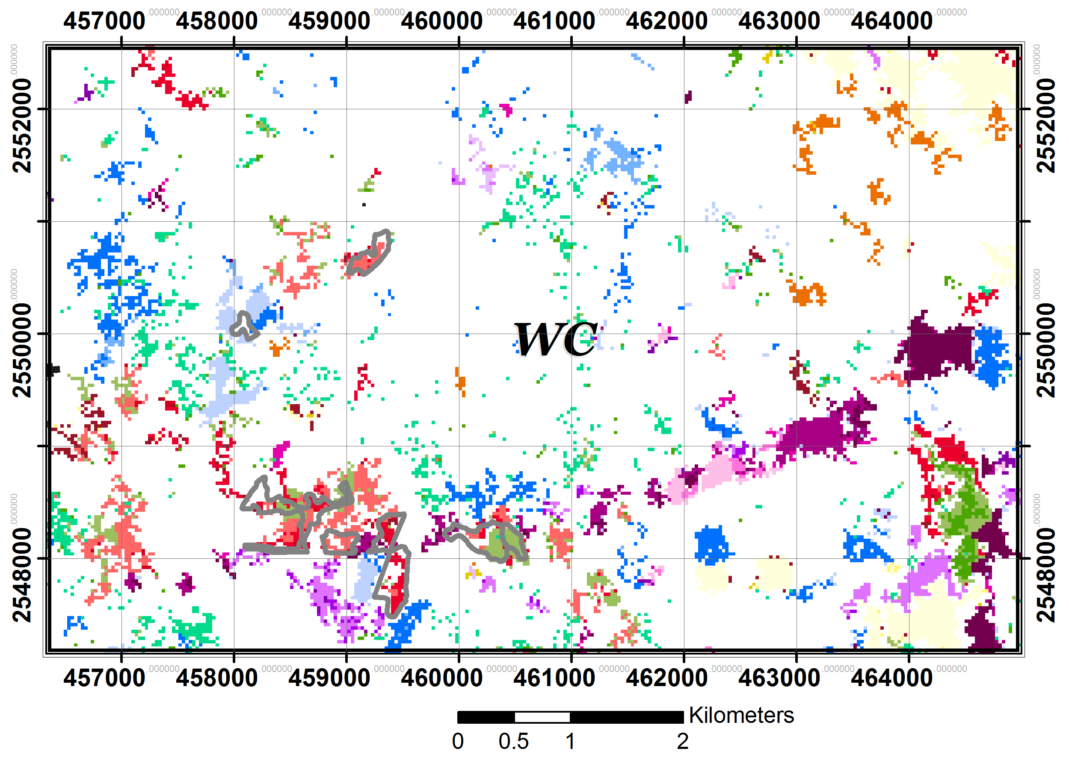
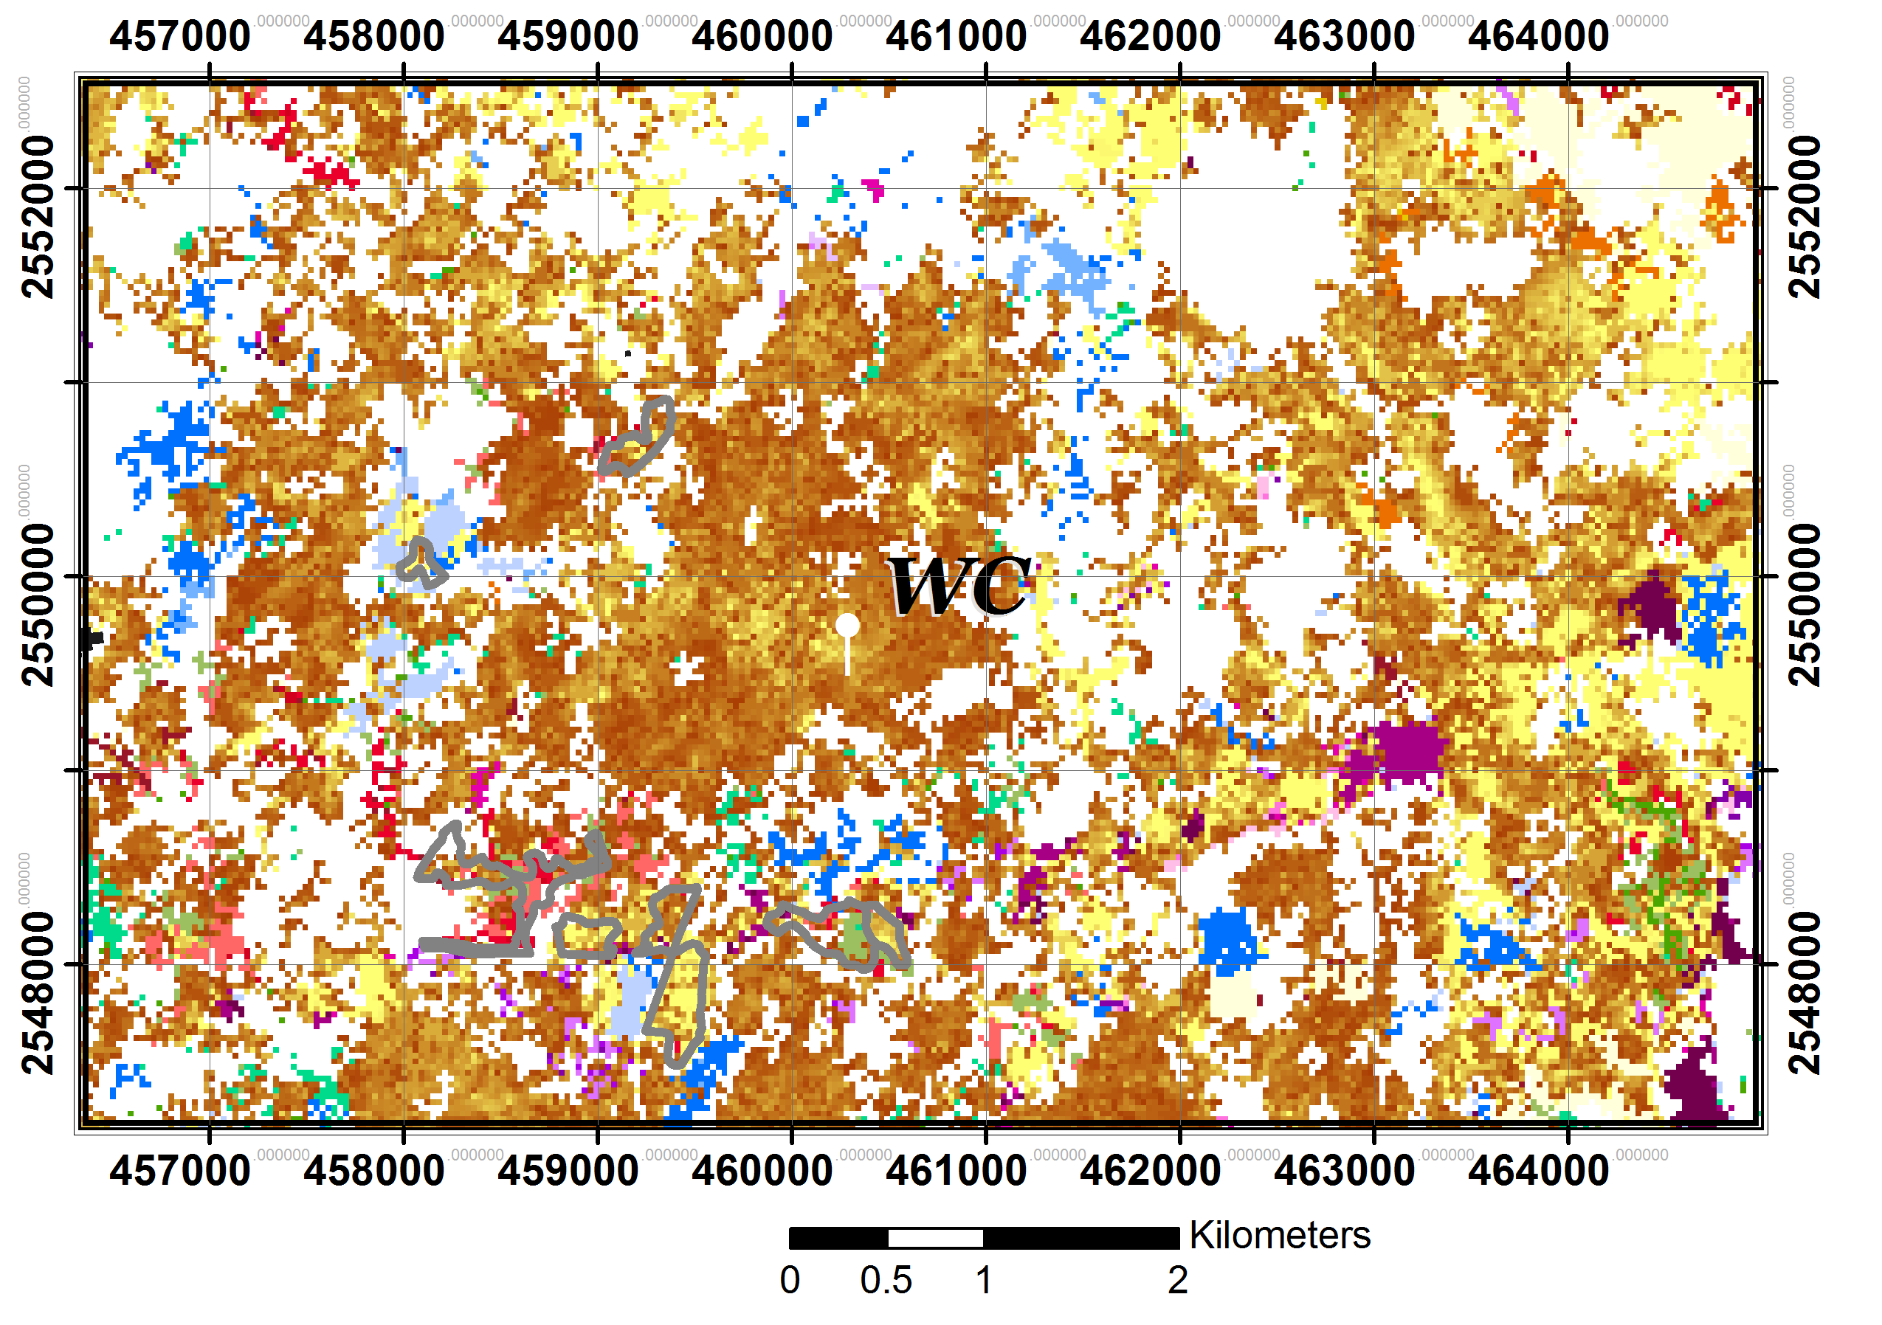
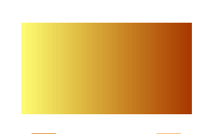
Bringing in “recovery”
Low
High
Low
High
Magnitude of long-duration
increase
Magnitude of instantaneous
decrease
Year

Slide 16
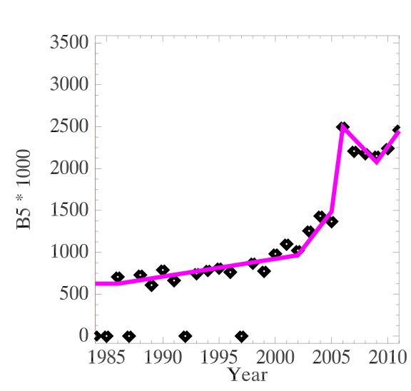
Sequence of change is informative
Disease then salvage
Sequence of change likely has consequences for
  Yearly carbon accounting
  Constraining models

Slide 17
Spectral and temporal context
What happens before and after a change can help describe it
How a change alters multispectral space can also improve description

Slide 18
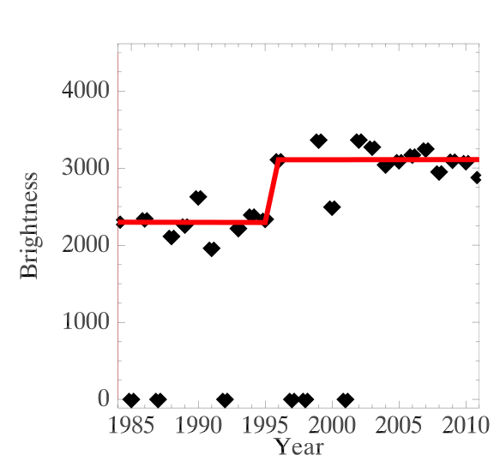
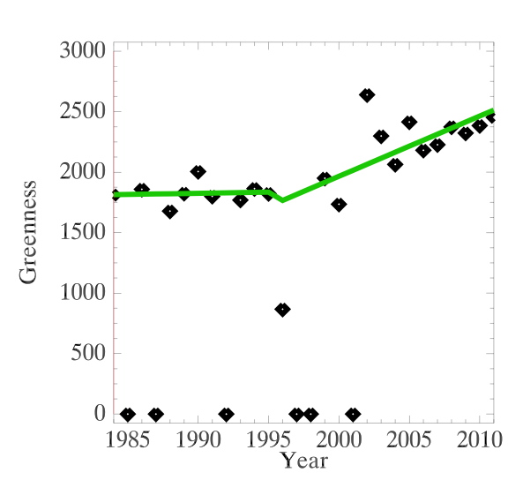
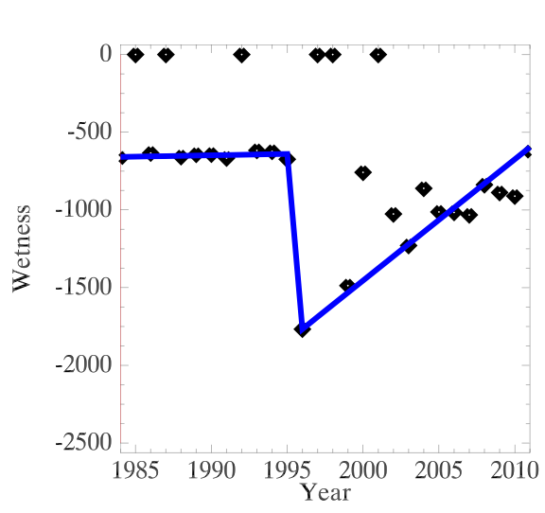
Expanding spectral scope
Force other spectral indices to alter course at same time as master index

Slide 19
Describing change more fully
Year
Spectral condition before disturbance
Spectral change during disturbance
Direction of spectral change after disturbance

Slide 20
Attribution: Natural vs. anthropogenic
Map: Pixels of change
Pixel
Filter to minimum mapping unit, make polygons
Patch
Label accuracy
DEMs, LT data*
Map: Polygons of change
Improved set
Random forest: Assign Label
Iterative modeling cycle
Human: Assign Label
Human: Check Label
Training set
Labeled polygons

Slide 21
What is truth?
Sources of truth:
  Ancillary databases (e.g. FS Activities Database)
  Airphotos
  Satellite imagery itself
Challenge: Validation or corroboration when maps/information is claimed yearly over large areas, across many change types
  No other single reference dataset exists

Slide 22
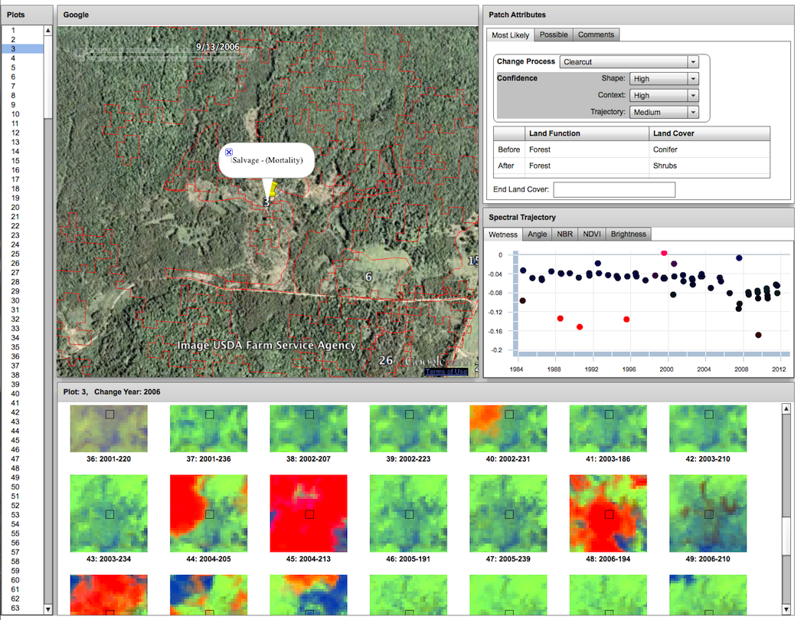
Database offers richness
Database provides full description of change, including intent and cover
Satellite imagery can corroborate timing and location

Slide 23
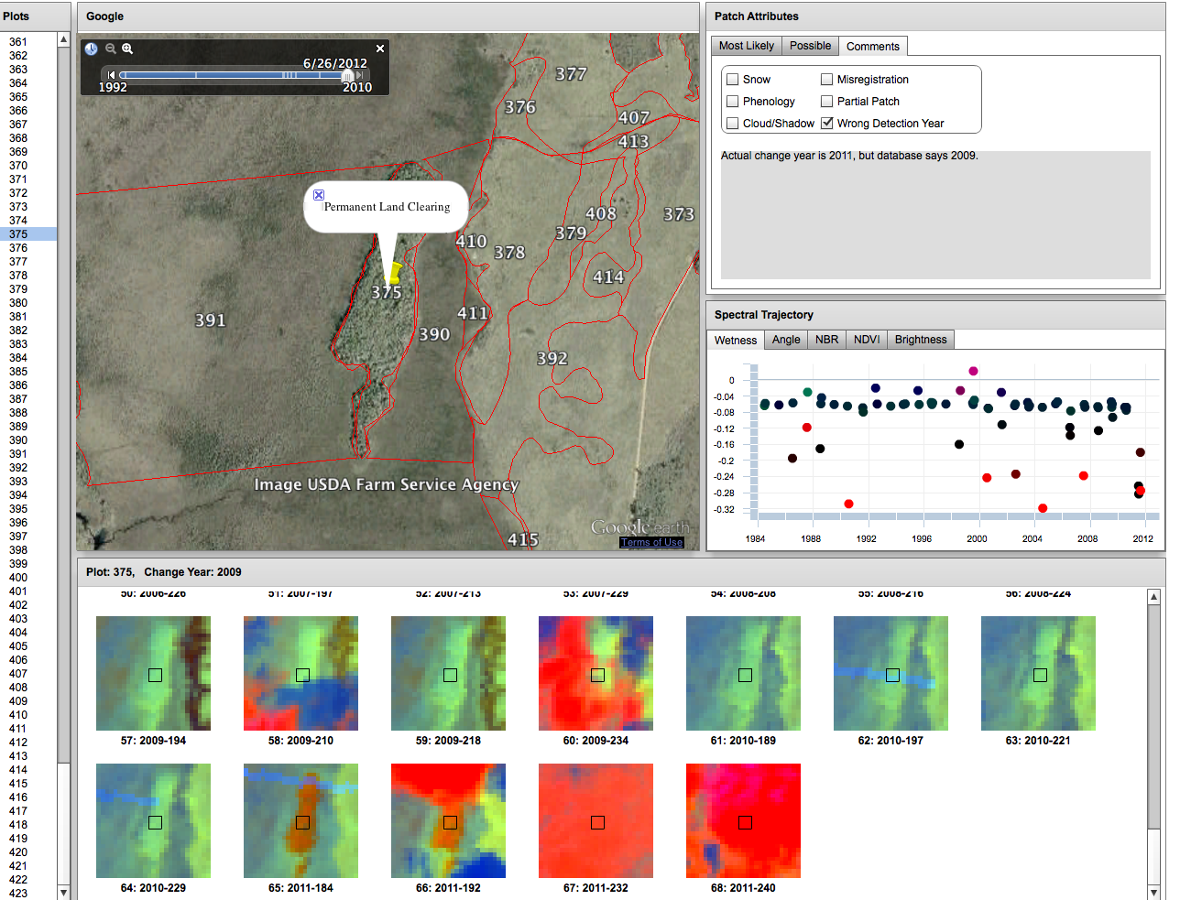
Databases often need corroboration
Database places disturbance in 2009
Actual clearing took place in 2011

Slide 24
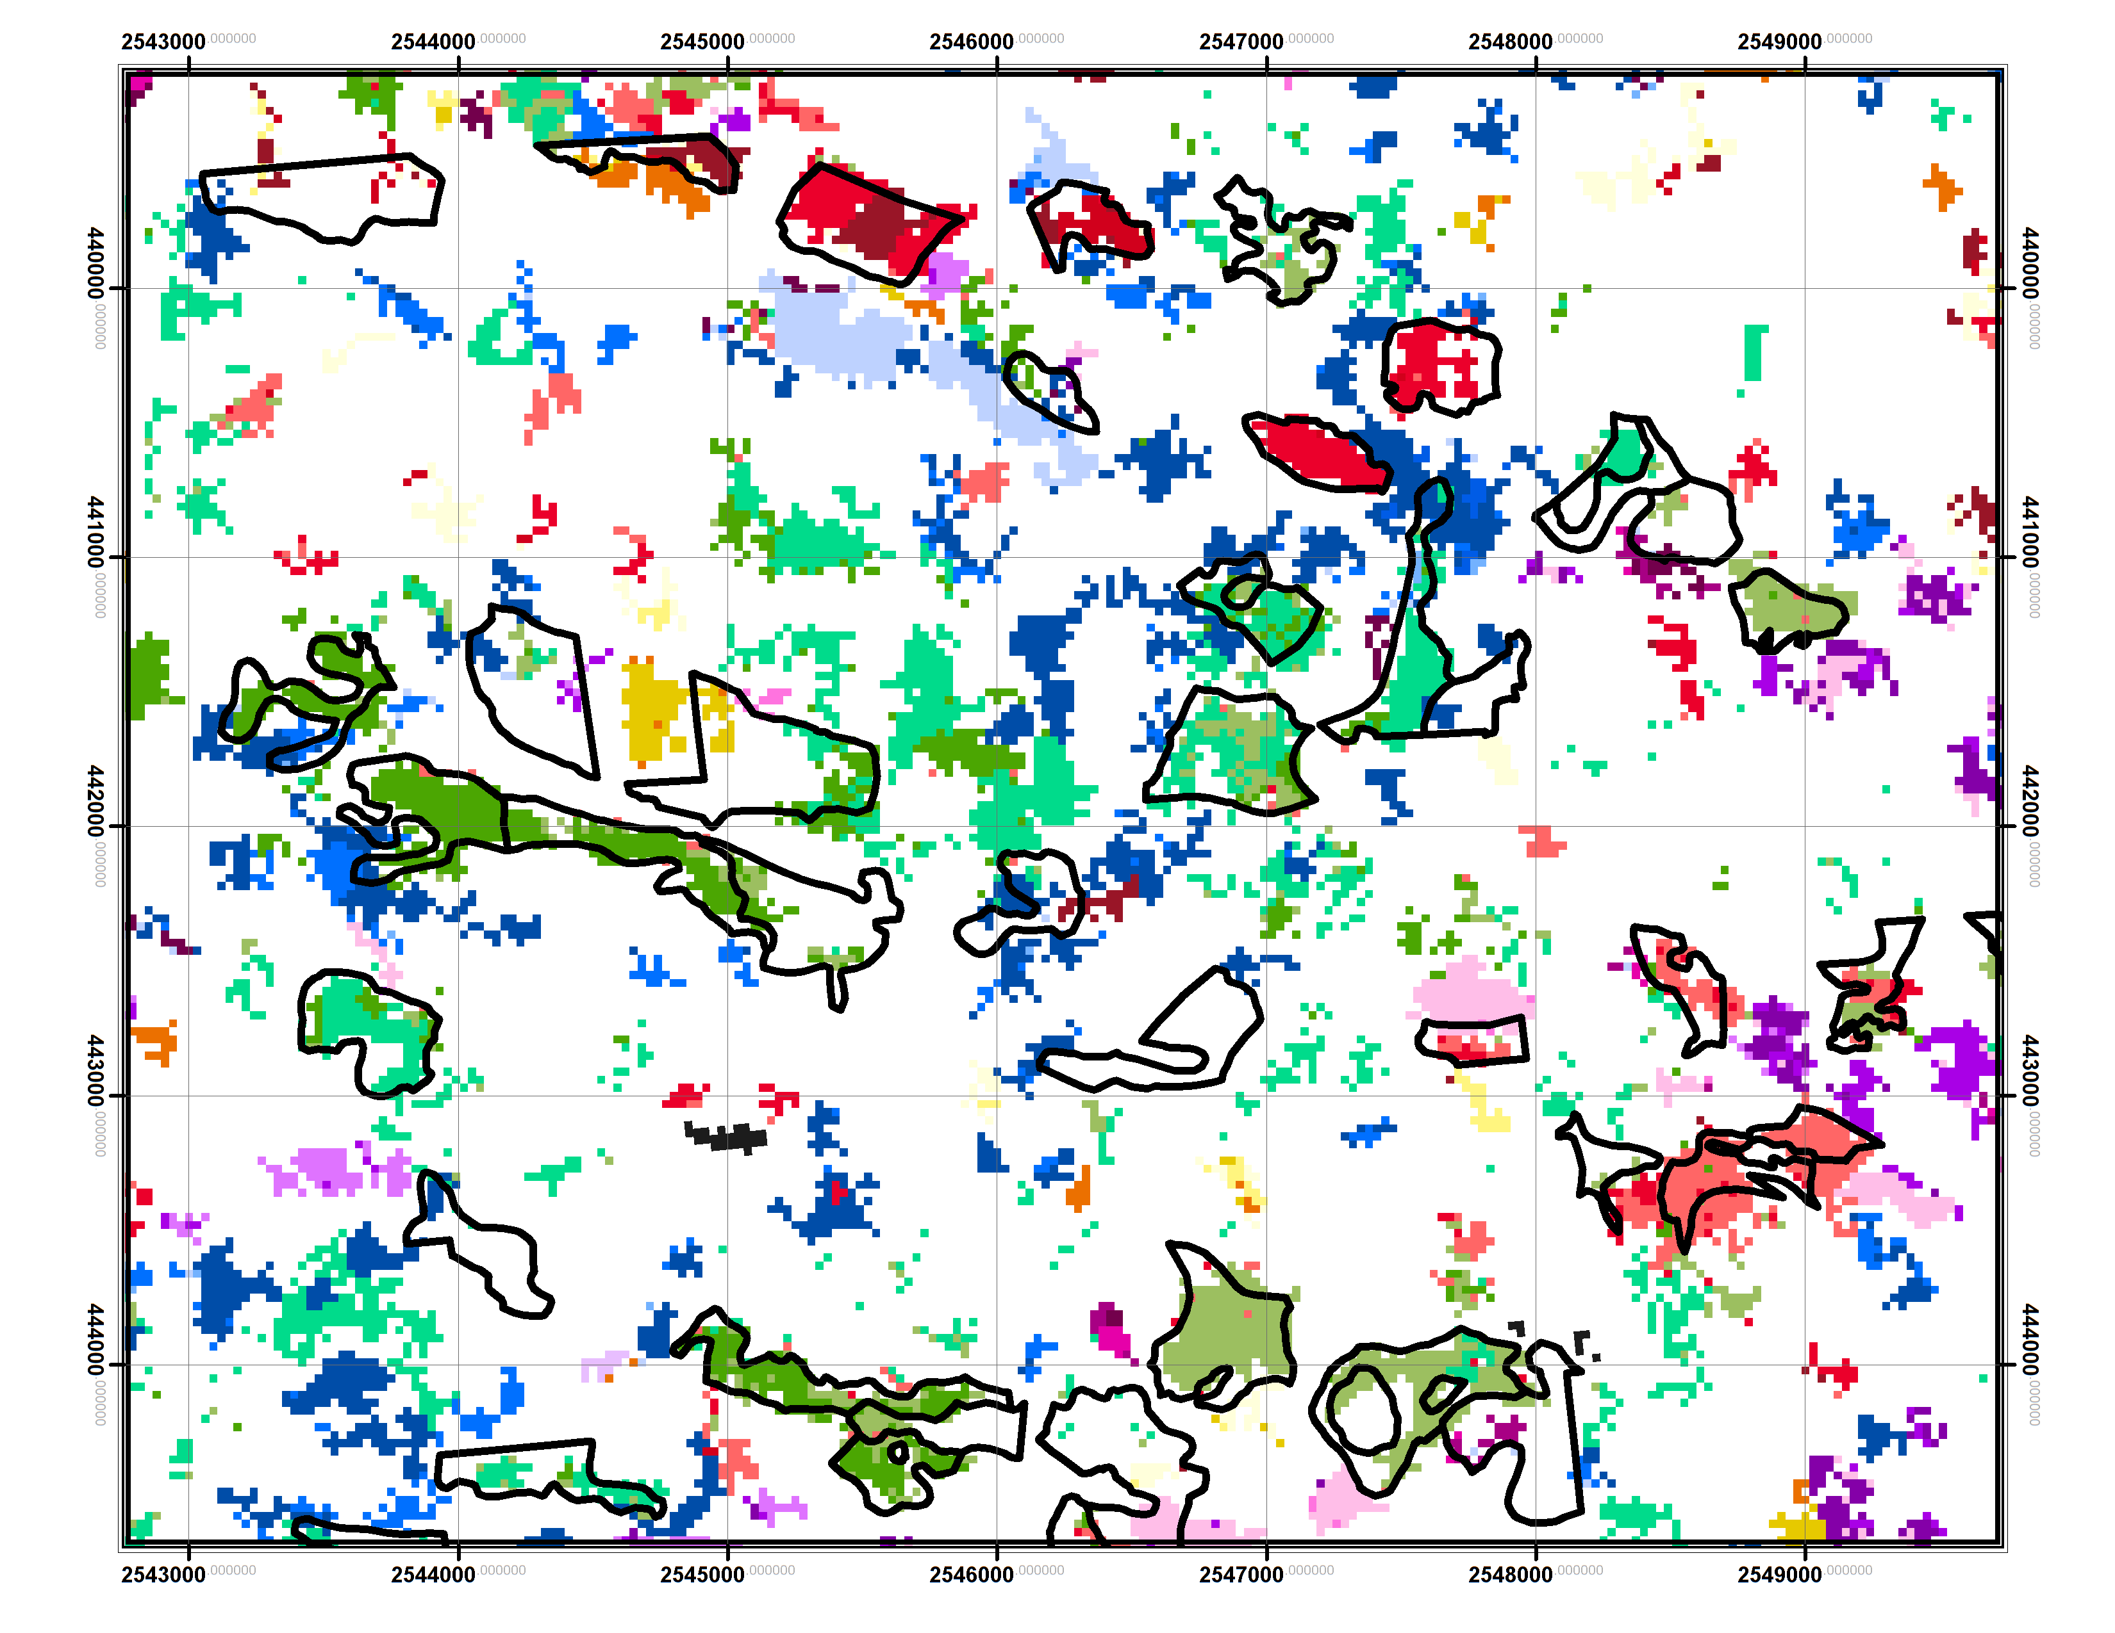
Database uses: Improve automatic detection algorithms
Reference databases tell us where to look!

Slide 25
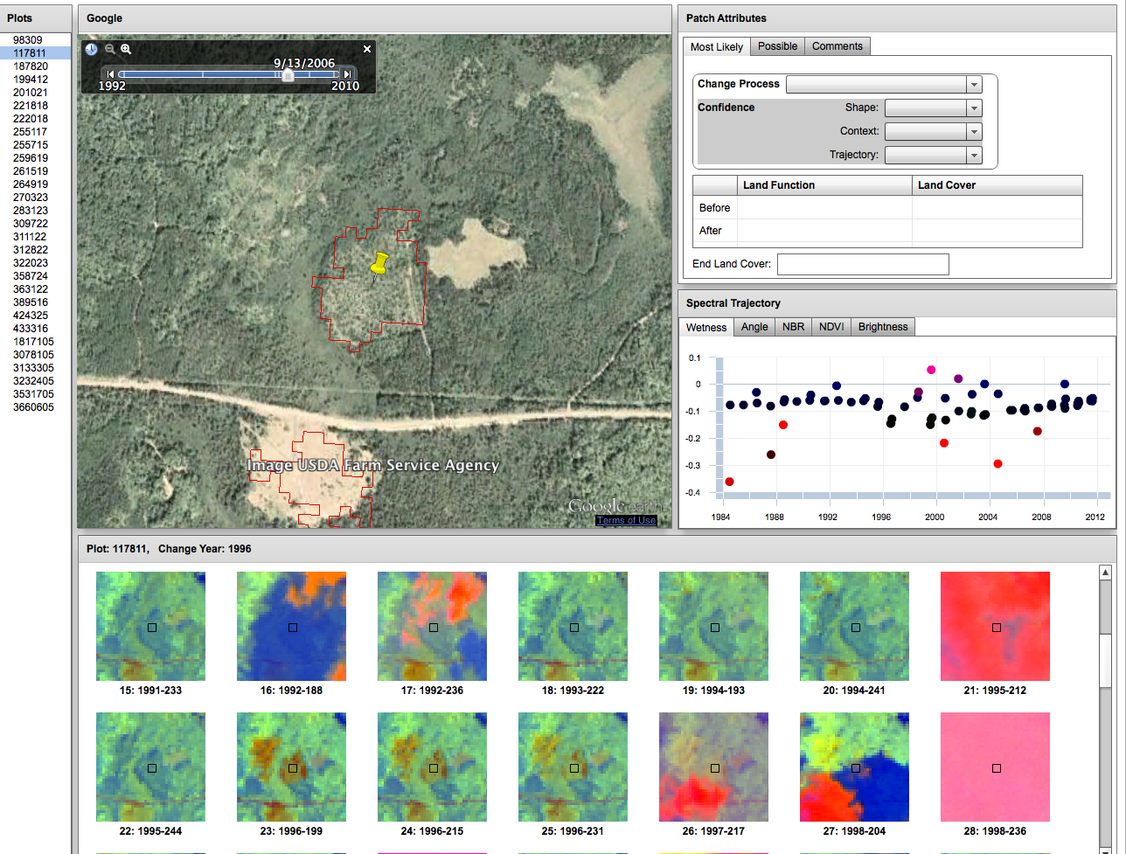
WLEF Area
High intensity cut in 1996
2006 photo

Slide 26
Feeding the machine
Map: Polygons of change
DEMs, LT data*
Improved set
Human: Assign Label
Random forest: Assign Label
Human: Check Label
Training set
Labeled polygons

Slide 27
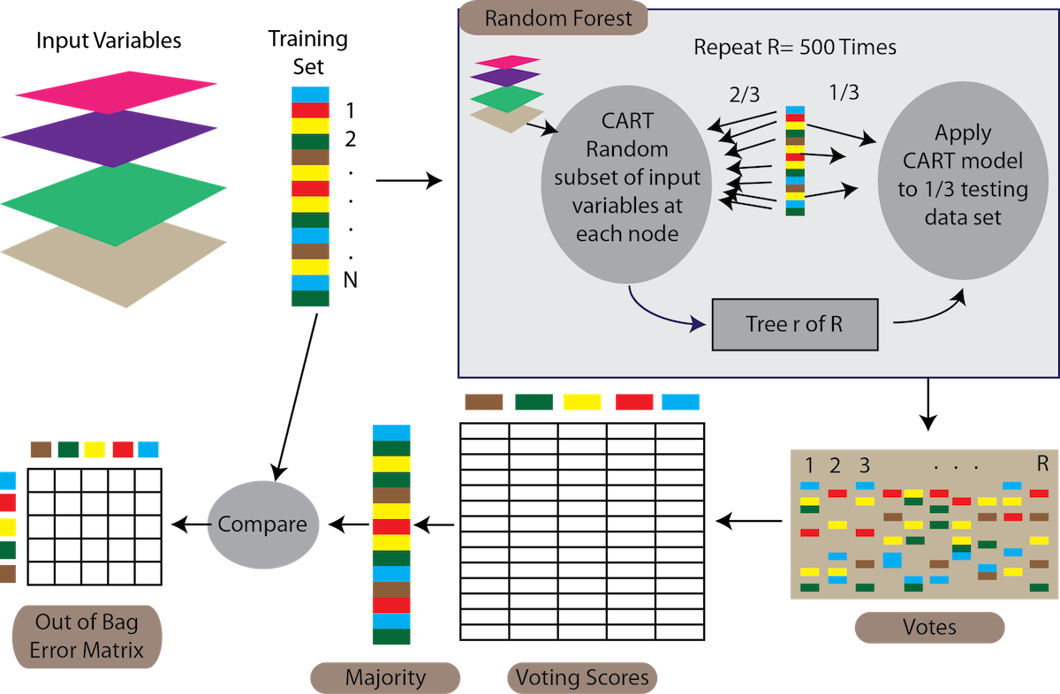
Our framework for attribution
Goal of attribution: Maximize change information and leverage human interpretation for large-area attribution modeling
Map: Pixels of change
Pixel
Filter to minimum mapping unit, make polygons
Patch
Label accuracy
DEMs, LT data*
Map: Polygons of change
Improved set
Random forest: Assign Label
Iterative modeling cycle
Human: Assign Label
Human: Check Label
RandomForest: Non-parametric,
voting-score based,
internal estimate of error
Training set
Labeled polygons

Slide 28
Attribution voting

Slide 29
Cycling back: General goals
What are key challenges in using remote sensing to better understand carbon cycle consequences of forest management and ecosystem heterogeneity in ChEAS?
What needs / gaps / issues are we encountering?
What can this group do to help address challenges?

Slide 30
Challenges / gaps
Technical : Clouds, data processing
Representational : Condensing time-series data into digestible form; characterizing uncertainty in detection and attribution
Integration(al?): How to bring long and slow processes into models? How to represent in accounting?

Slide 31
What can this group do?
Notes….

Slide 32
What can this group do?
Notes….

Slide 33
What can this group do?
Notes….

Slide 34
What can this group do?
Notes….

Slide 35
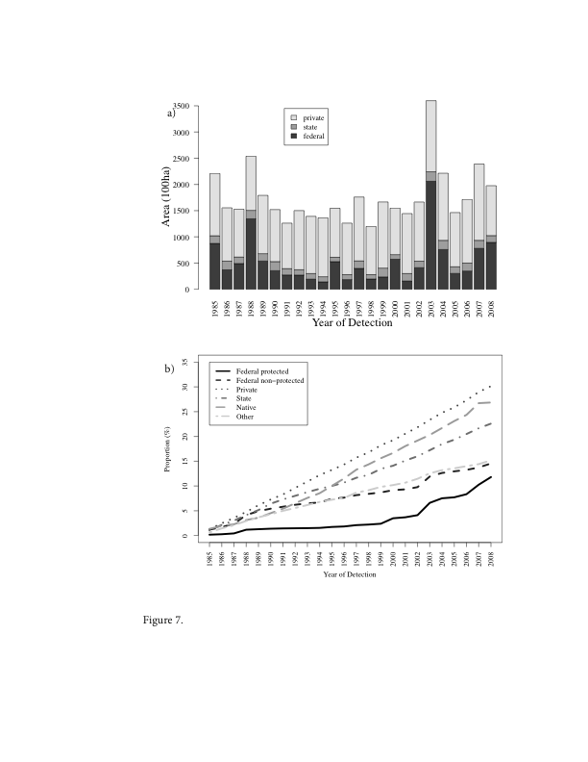
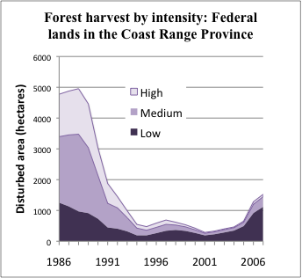
Analysis: Disturbance over time
Examples from Northwest Forest Plan (NWFP) area
Magnitude?
When?
Who?
How much?
Kennedy, Robert E et al. (In press). Spatial and temporal patterns of forest disturbance and regrowth within the area of the Northwest Forest Plan. Remote Sensing of Environment

Slide 36
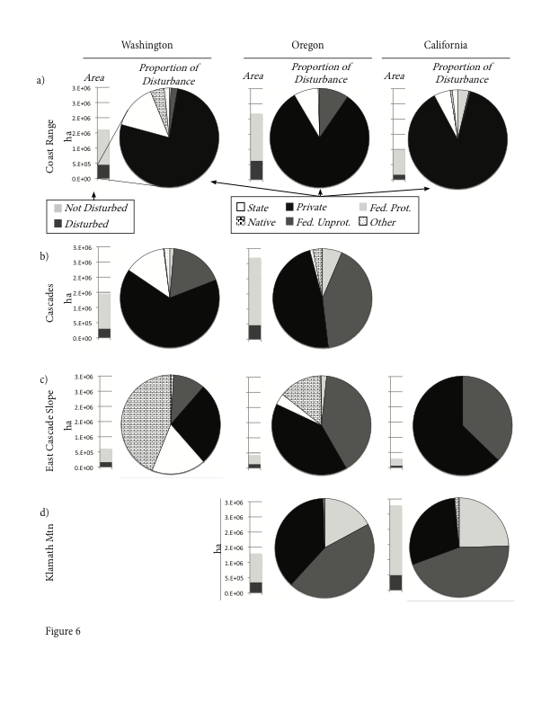
Forest disturbance: How much and who
Where?
Where?
How much?
Who?
Oregon: Greater proportion on federal lands
Washington: Greater proportion on state lands

Slide 37
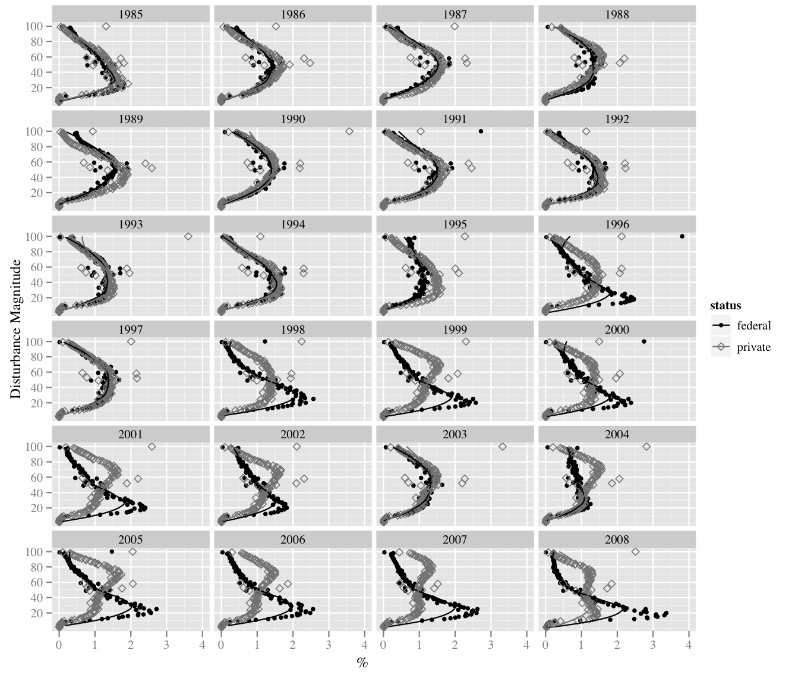
Example change information: Magnitude
Distribution of pixelwise disturbance magnitudes by ownership
Disturbance magnitude dropped on federal forests under Northwest Forest Plan (1994)
NWFP

Slide 38
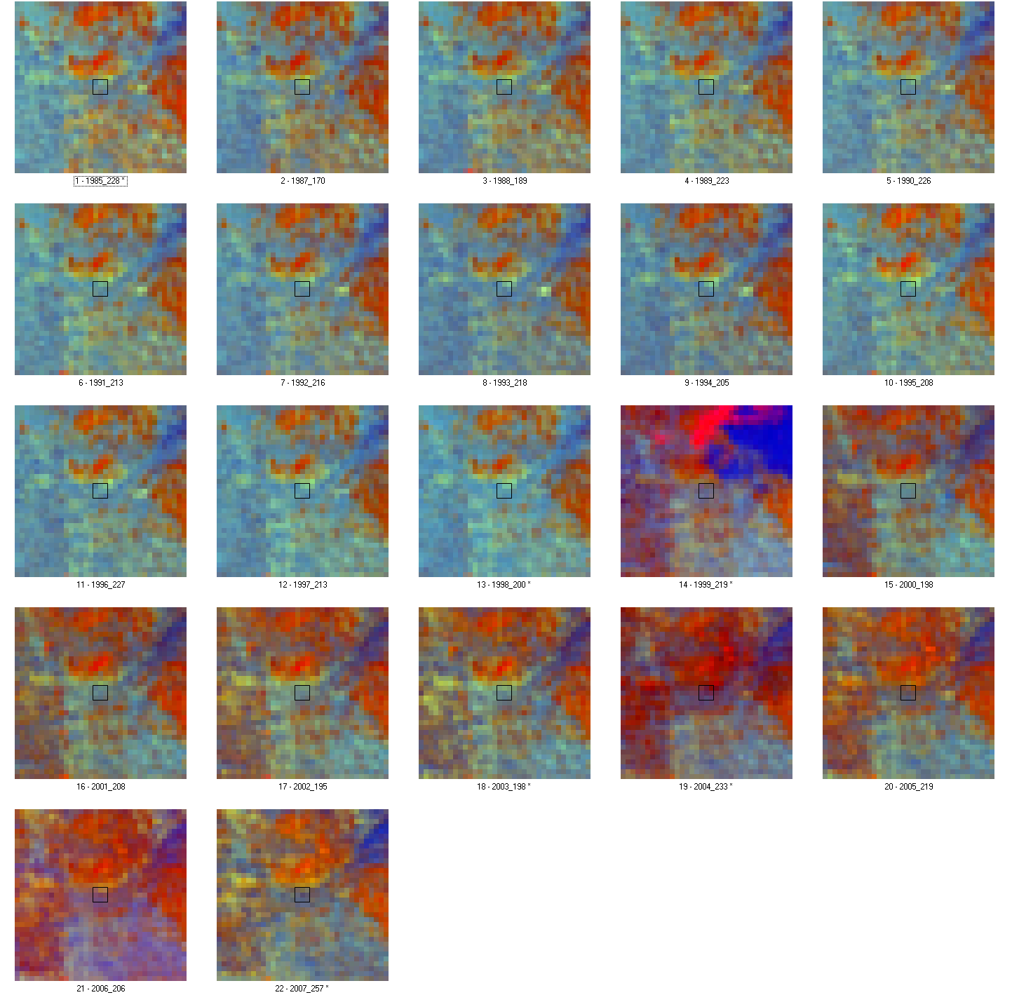
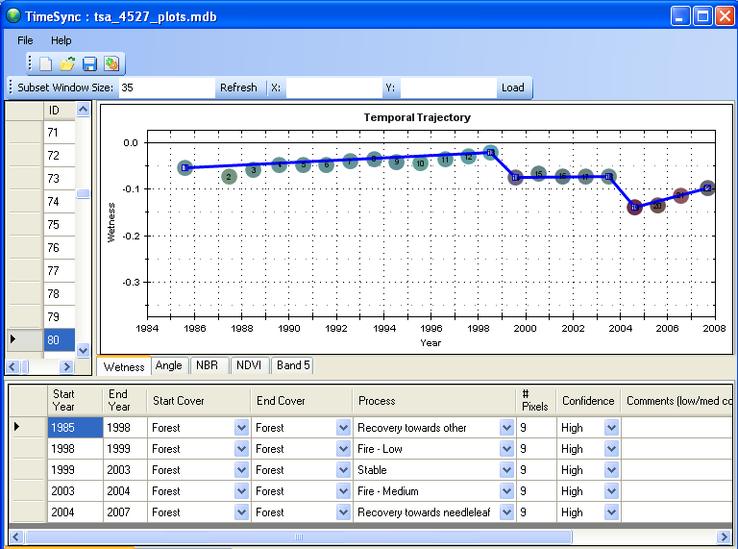
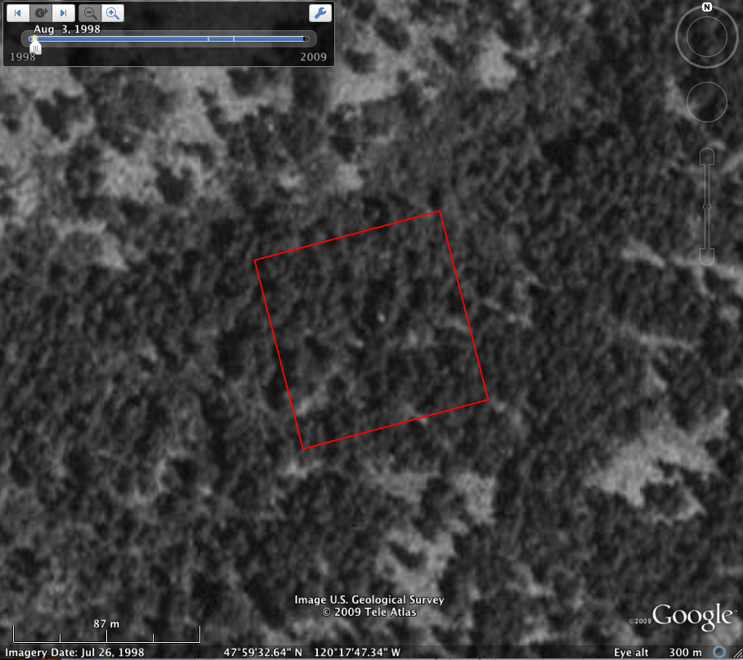
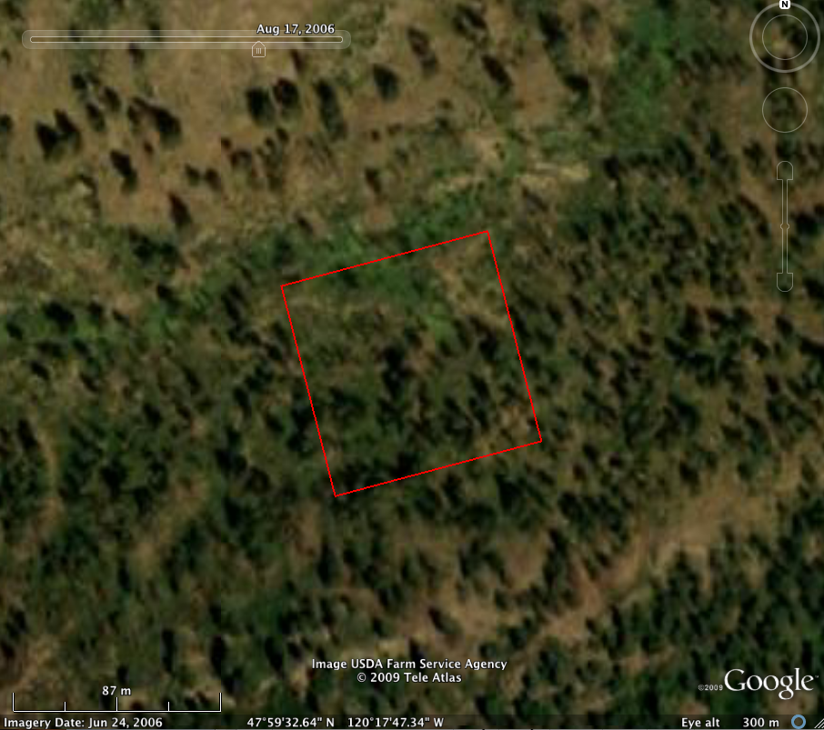
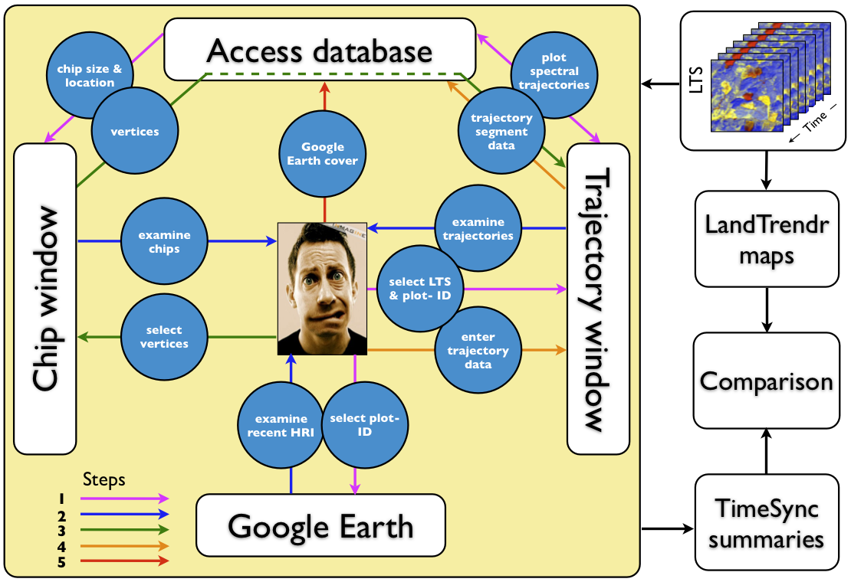

Manual delineation of segments
Image chips for all years
TimeSync example
GoogleEarth High res
Notes:
38

Slide 39
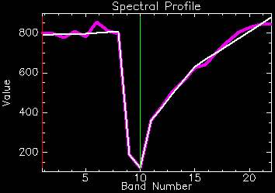
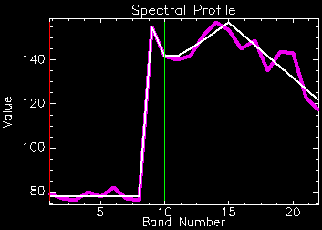
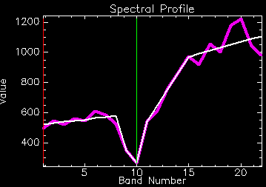
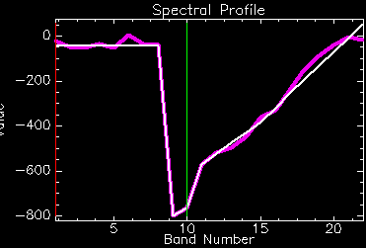
LandTrendr: Temporal fitting
Use segmentation of one band to identify “vertices” in time series
Smooth between vertices in other bands
Result: “Pseudo-images” with year-to-year noise removed, but actual change retained
NBR
Brightness
Greenness
Wetness
39
Notes:
39

Slide 40
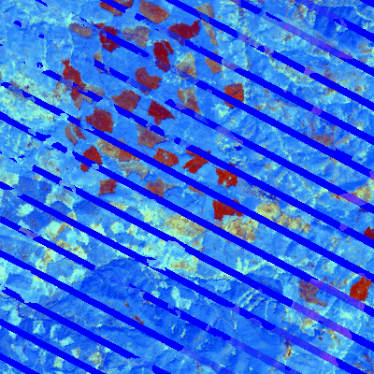
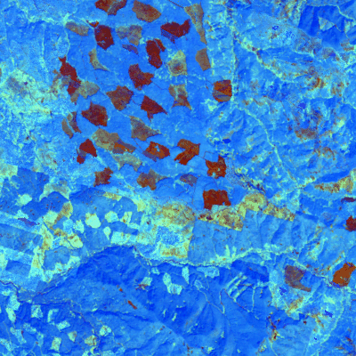
Temporally-fit imagery
“Standard mosaic” of images within one year
After temporal fitting

Slide 41
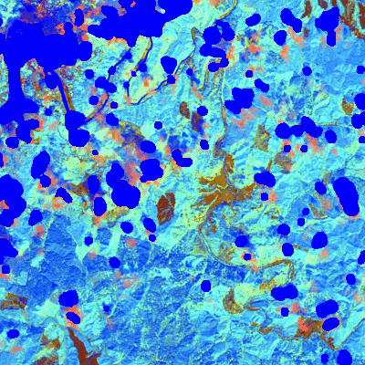
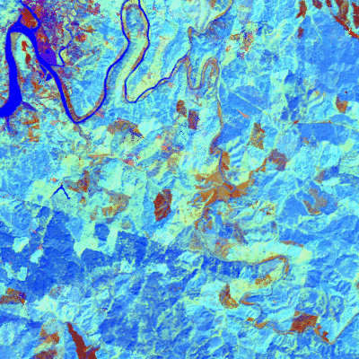
Temporal fitting
Insufficient cloud screening
After temporal fitting
Cloud screening (especially cirrus clouds) is critical!

Slide 42
Changes in how we capture change
Past
Now
Future
Data
Sparse
Rich
Algorithms
Two-date
Manual
Multi-date, multi-sensor, automated
The New Deal!
Spatial /temporal
Small area
Infrequent
Large area
Frequent
Validation
Single source
Multi-source, hierarchical
Utility, flexibility, & complexity continually increase

Slide 43
Process-based analysis of the Landsat archive
LandTrendr* strategy
  Look for TRENDS and EVENTS in the same algorithm
Segmentation
  Simplify temporal trajectory into periods of consistent process: SEGMENTS
  Separated by VERTICES
* “Landsat based detection of trends in disturbance and recovery”; See Kennedy et al. 2010 RSE 2897-2910
Landtrendr.forestry.oregonstate.edu

Slide 44
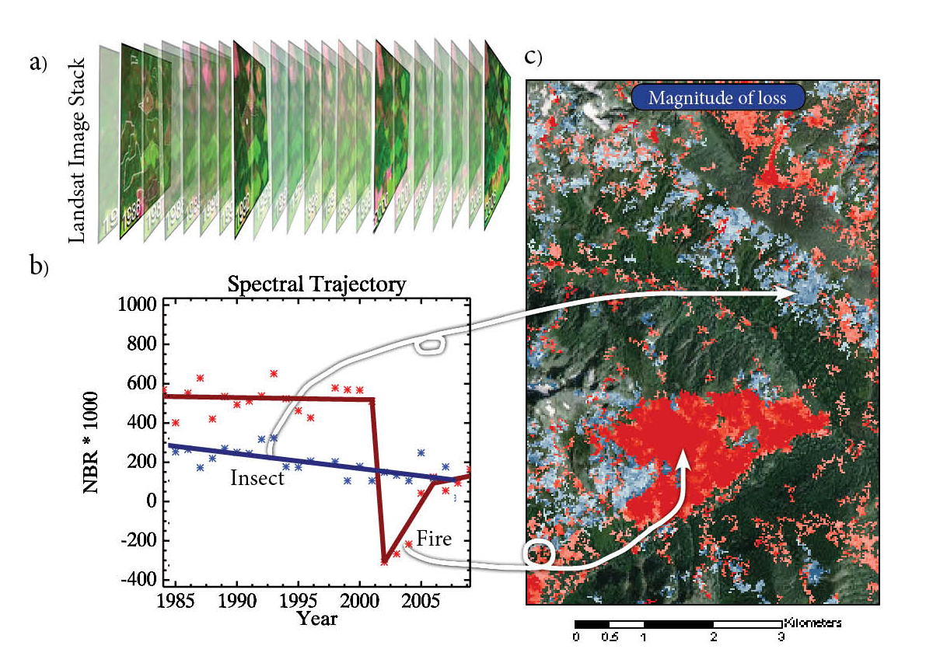
Segments to maps
“Life history” of two pixels. The Y-axis is a measurement related to vegetation
Follow the “life history” of individual pixels

