Slide 1
Dealing with Observations
What do we have and know where it is?
What do we have, know where it is, but don’t know how to deal with it?
What do we know we have (or think we do), but don’t know how to get to it?
What do we think we have and don’t ever want to see it again?
What don’t we have, and would really like to get it?

Slide 2
Have fluxy
Core flux towers
Willow Creek, WLEF/Park Falls, Lost Creek, Sylvania
Roving/short term towers
Jiquan Chen: NE wisconsin – age chronosequence in red pine and hardwood + pine barren
UP jack pine (Mich Tech)
Roving sites (NASA upscaling) 2002-2004: wetlands: Wilson Flowage, South Fork; clear cuts: Riley Creek, Thunder Creek
USFS Aspen tower
Neighbors: UMBS, Rosemount (UMN), Argonne, Mich Tech peatland
Flux = carbon, water (ET), momentum (u*), heat

Slide 3
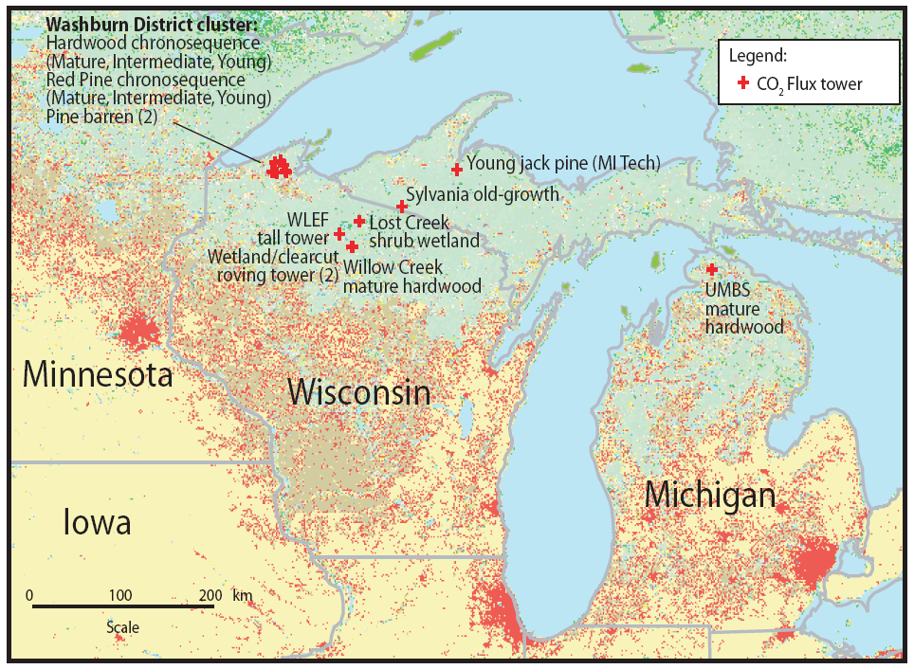

Slide 4
Flux has met(micro)
Air temperature/humidity profile, wind velocity profile, soil temperature/moisture profile
Roving sites – only one level, no soil info
Water table depth sensors (pizeometers)
Energy balance – 4-component net radiation at Willow Creek, just net at others, PAR at all, fPAR from profiles
Calibrated LAI from lidar + litter
NASA Albedo, sun photometer
Micromet stations around WLEF: Red pine, aspen, alder, mixed upland -> soil data T/Q + sub PAR + snow depth. restart
Gap filling is an issue

Slide 5
Flux QA/QC
“Final” fluxes are never final. Data screening for low turbulence, wind direction (footprint), time series analysis.
WLEF is unique – 3 levels with 6 analyzers (1 at 30 m, 3 at 122 m, 2 at 396 m). Preferred NEE is a combination of these
Gap-filling is non-trivial, flux towers don’t measure GPP/RE!

Slide 6
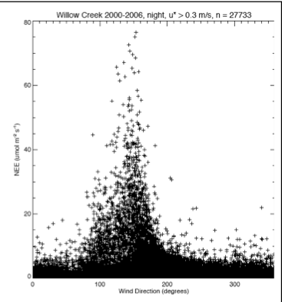

Slide 7
Site characterization
Core towers have species, DBH, height, cores usually in 30 m radius. Also some soil texture/carbon/nitrogen.
BADM/CADM files
Some cores analyzed for ring width, or also isotopes
Less info for roving sites
FIA
FIA style plots + cores at WLEF (Bosltad) + BIGFOOT project LAI samples (Gower)
Phenology plots around WLEF (Schwartz)
Leaf level chemistry/soil chemistry, optical

Slide 8
Core site component fluxes
Survey respiration for soil, CWD, bole, leaf, root at Willow Creek, Sylvania, some at Lost Creek – Bolstad/Martin/Tang/Phillips
Recent autochamber obs – Phillips
Sapflux at Willow Creek and Sylvania for several years + other nearby sites (Ewers/Mackay/Carey)
Leaf photosynthesis at Willow Creek/Sylvania

Slide 9
Have remote sensy
Land cover – NLCD/Wiscland (Landsat), Quickbird/IKONOS around WLEF (10x10 km)
Airborne – AVIRIS hyperspectral + ASTER?
Canopy lidar collections of canopy height, stem, biomass – GLHT – Bruce website forest.gsfc.nasa.gov
Disturbance maps – Robert LandTRENDR
USFS GIS layers
Soil layers (SSURGO, others?)

Slide 10
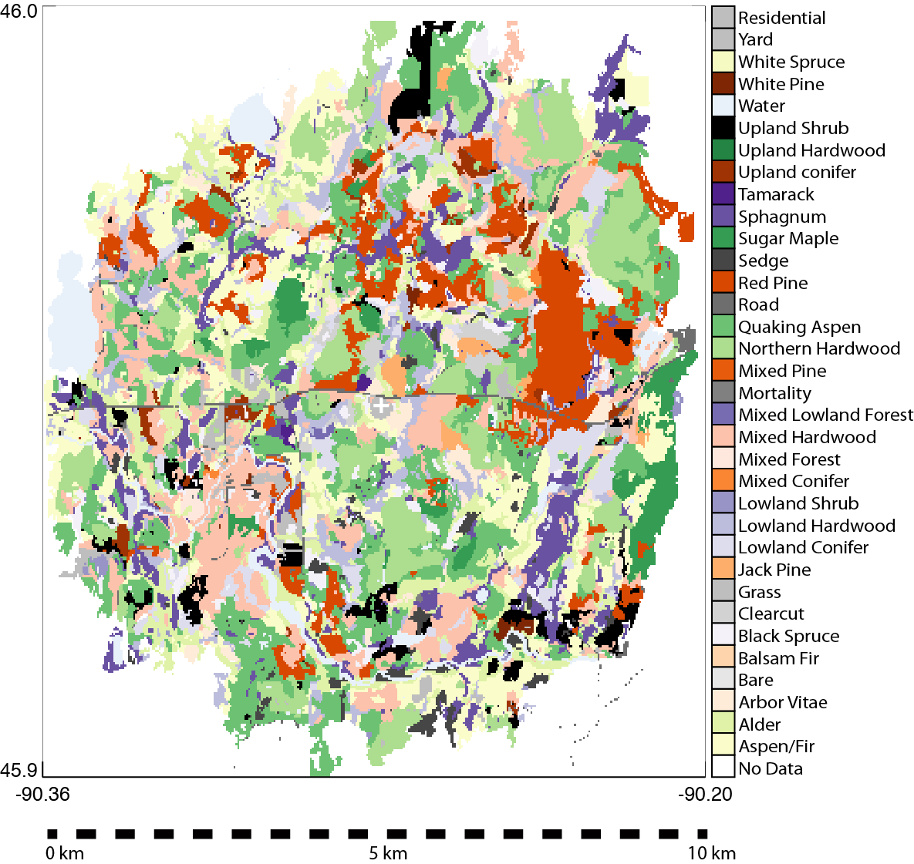

Slide 11
Atmosphere too
Tall tower NOAA flask + GHG profiles CO2,CH4,CO
TCCON column CO2
Airborne GHGs, O2 (NOAA + COBRA)
Radon!
Micromet stations around WLEF (now defunct)
Ring of towers! (CO2)
Ceilometer, soundings, radar profiler, other atmospheric sensors
Radiocarbon

Slide 12
Models I have known
ED (ED1 and ED2) (Desai/Dietze)
Biome-BGC (Faith-Ann Heinsch + Tow Gower)
LANDIS-II (Mladenoff/Sulman)
Sipnet (Moore/Desai)
LUE based model (Davis/Smithwick/…)
NACP models (at the core tower sites)
Climate model projection – downscaled projections are usually timeslices (decades)

Slide 13
What else?
FACE
NTL-LTER (aquatic + met data)
NACP datasets (gap-filled met, flux uncertainty)
COSMOS soil moisture
Cut-outs of global products

Slide 14
Challenges
What do YOU know?
What is troublesome to work with?
When is it too much? What about inconsistencies?
What is a defensible way to maintain/harmonize this database?
Who should do it? Pay for it? What incentives to submit/share?
Do you like Netcdf? EML? OpenDAP?
DOIs? Databases?

Slide 15
Thoughts
Document Xiao et al obs + spatial data
Reanalysis of flux measurement – calculation + QC. Ken
Proposal just for data management, calculation – CBI + uncertainty visualization
ChEAS in Minnesota

Slide 16
Final discussion
What are the overarching science questions?
How should we answer them?
Volunteers to lead activities

Slide 17
Papers/Proposals
Regime shift detection – time series
Long-term drought surrounded by wetter conditions – macrosystems?
Predictability limits, anomaly detection
Forest tent caterpillar – landscape C impact

