Slide 1
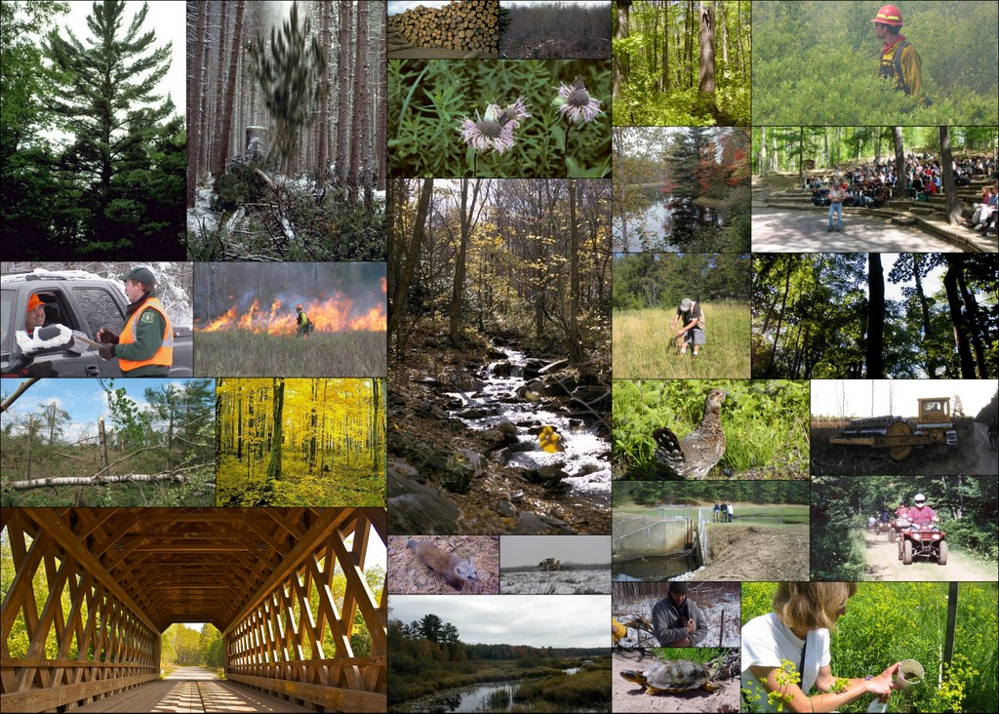
*
A Snapshot of the Chequamegon-Nicolet
Understanding drivers and patterns of forest management in the region

Slide 2
Vegetation Management (aka Timber Harvest)

Slide 3
Timber harvest Volume

Slide 5
volume sold and funding level (2005-2010)

Slide 6
annual budget (2006-2010)

Slide 7
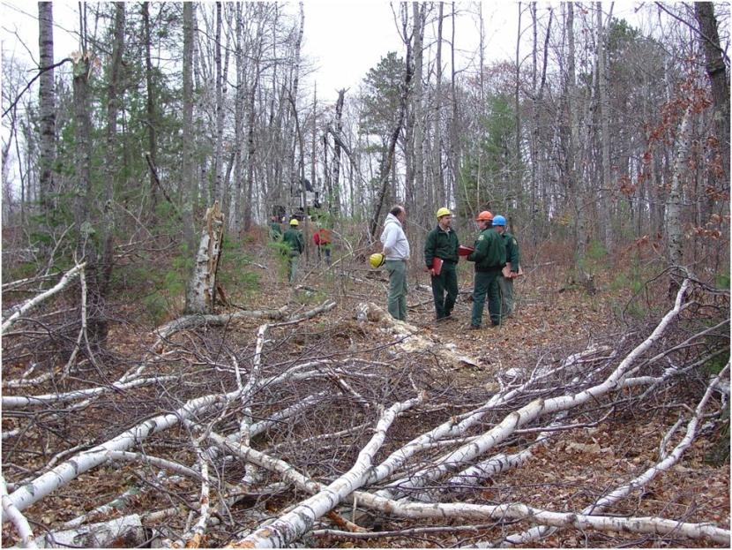
Ground disturbing activities
1.3 to 1.5 percent/year
85 percent undisturbed over the decade.
8,990 acres harvest/year (0.60% of CNNF).

Slide 8
Average size of Clearcuts

Slide 9
Clearcuts
Notes:
In fiscal year 2009, 40 blocks were harvested by clearcutting (not salvage) totaling 769 acres. Blocks are defined as openings (single or multiple adjacent stands) that are being regenerated to forest. The average size of the blocks was 19 acres; they ranged in size from 1 to 40 acres.
In addition, 2,934 acres were clearcut to salvage timber on 79 blocks, averaging 37 acres per block and ranging in size from 3 to 129 acres. These activities were tied to four disturbance events:

Slide 10
Trends in Forest Composition and Age

Slide 11
Acres of regenerating aspen Forest 1950-2010

Slide 12
Northern Hardwoods
Most common type
Un-even aged silviculture
Post-cutover origin
Willow Creek tower most productive

Slide 13
Northern Hardwood Interior

Slide 14
Age class structure of upland vegetation in management area 2B

Slide 15
Red Pine
CCC Era
Even-aged Silviculture
Very little being planted
Usually on sandy soils

Slide 16
Timing of Harvest
Winter logging required in some areas (more and more difficult)

Slide 17
Increasing:
Woody Biomass Harvesting

Slide 18
Landscape Structure

Slide 19
expansion of patches of mature northern hardwood interior forest

Slide 20
Other Disturbance forces

Slide 21
Oak Wilt
Lakewood/Laona oak wilt treatment (2005-2010)
Year | Number of sites treated | Number of individual trees
2005 | 31 | 2,757
2006 | 35 | 3,679
2007 | 19 | 1,559
2008 | 14 | 900
2009 | 27 | 2,815
2010 | 16 | 2,714
Total | 142 | 14,424

Slide 22
Spruce Decline
Spruce decline salvage (2005-2010)
Year | Acres Salvaged
2004 | 52
2005 | 101
2006 | 461
2007 | 1,932
2008 | 1,126
2009 | 459
2010 | 73
Total | 4,155

Slide 23
Prescribed Fire
Acres within fire-adapted landtype associations treated with prescribed fires
Year | Acres
2005 | 325
2006 | 0
2007 | 508
2008 | 3,450
2009 | 117
2010 | 716

Slide 24
WildFire
Average | Number Fires | Average size of fire (acres) | Range of fire size (acres)
RANGE | 38-72 | Less than 10 acres | 0.1 - 1200

Slide 25
Beaver

Slide 26
Data Sources
Linda Parker
Forest Ecologist/
Research Coordinator
lrparker@fs.fed.us
715 762 5169
Marcus Sadak
CNNF GIS coordinator
mlsadak@fs.fed.us
715-362- 1356

Slide 27
Geospatial databases
Vegetation Activities:
FACTS
Timber harvests
Planting
Site Preparation
ETC
Vegetation Composition
FSVEG
Stands
Type
Age
Density
Soils
LTA
Also…DEMs

Slide 28
National Hierarchy of Ecological Units
Landtype Associations

Slide 31
FSGeodata Clearinghouse http://fsgeodata.fs.fed.us/
For Example:
Provinces, Sections, and Subsections of the Conterminous United States
Forest Biomass across the Lower 48 States and Alaska

Slide 32
Loads of layers
http://www.ncrs.fs.fed.us/gla/

Slide 33
National Hierarchy of Ecological Units

Slide 35
Research Natural Areas nrs.fs.fed.us/rna

Slide 36
Discuss

