Slide 1
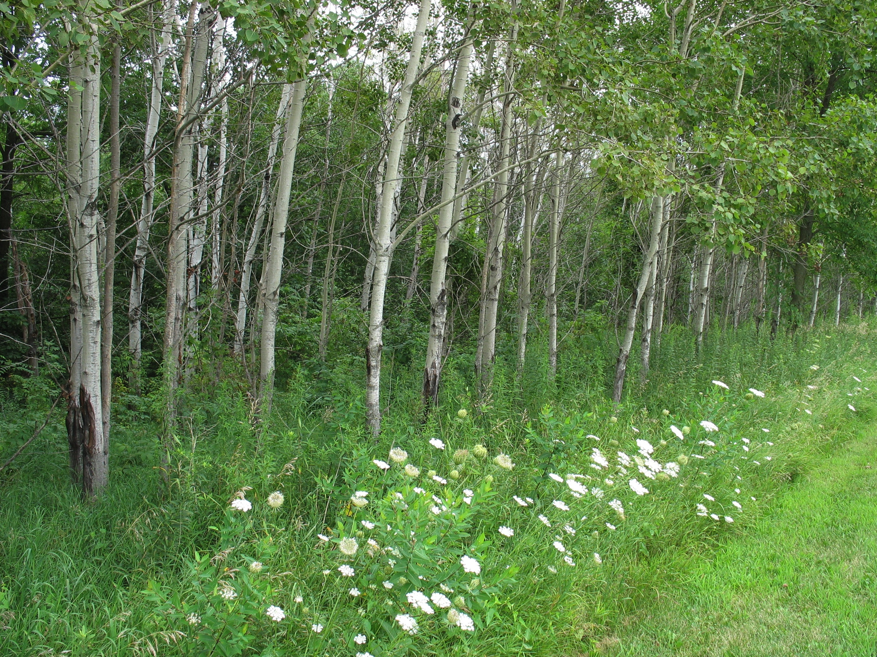
From towers to landscapes: a ChEASii story about disturbance in carbon flux upscaling
Erica A.H. Smithwick
Kusum Naithani
Doug Baldwin

Slide 2

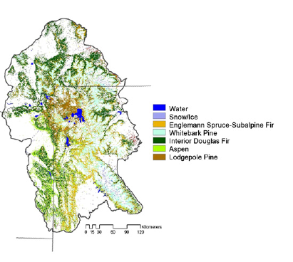
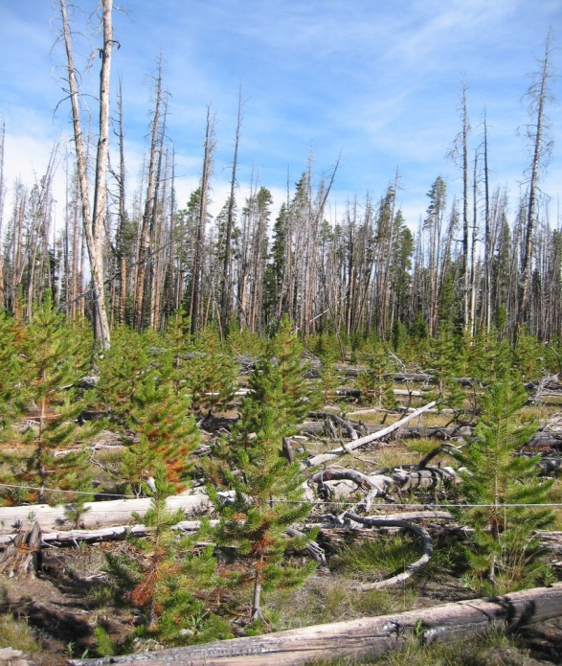
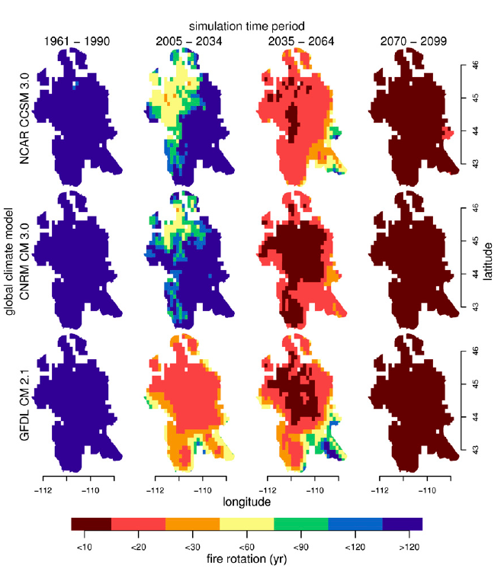
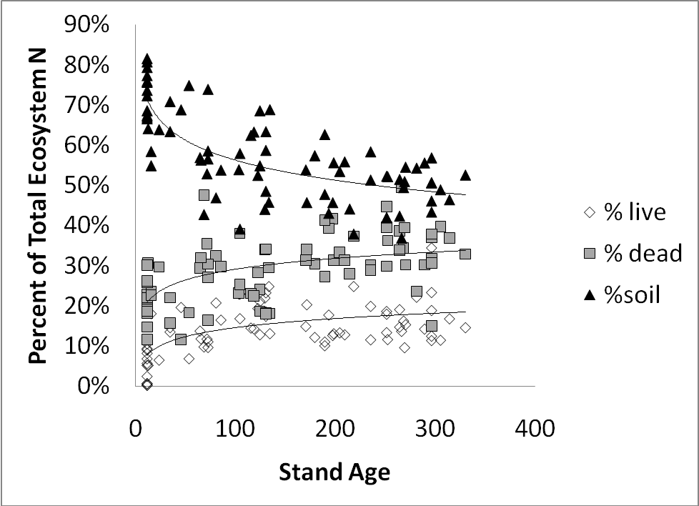
Erica Smithwick

Slide 3
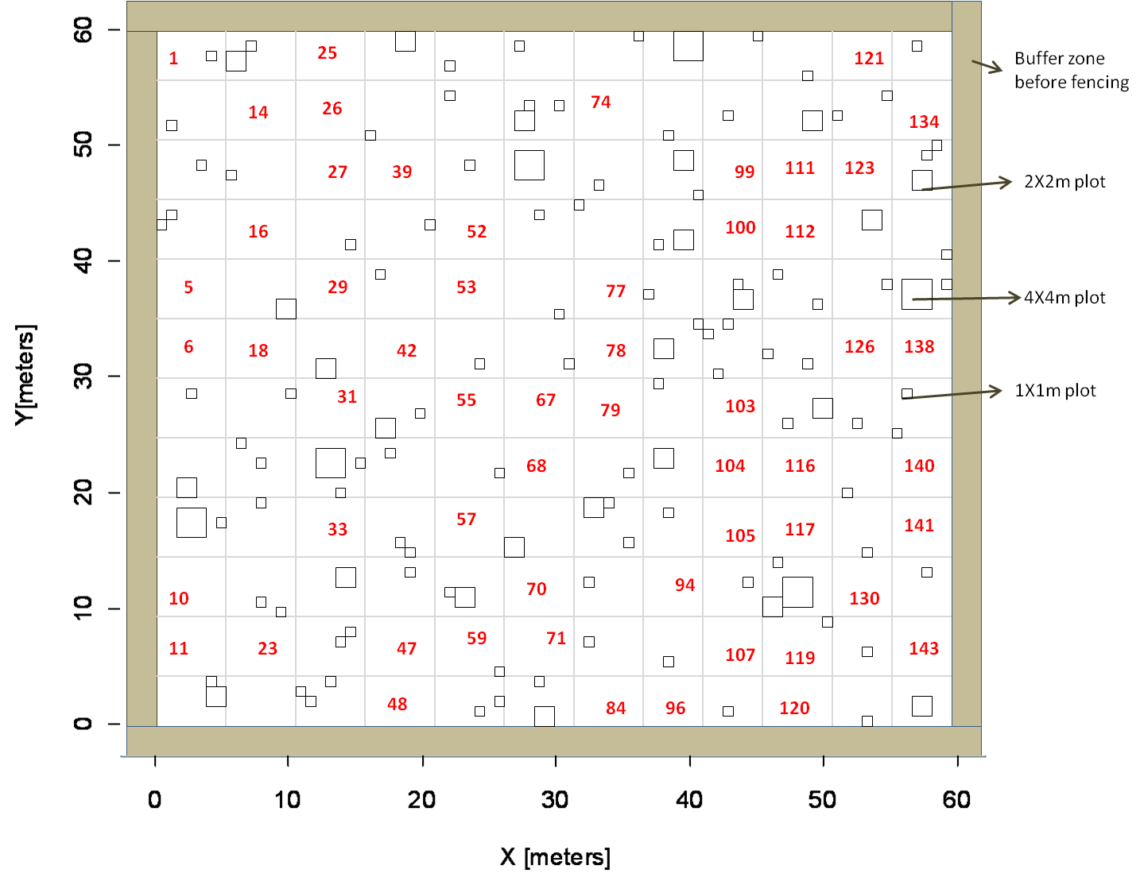
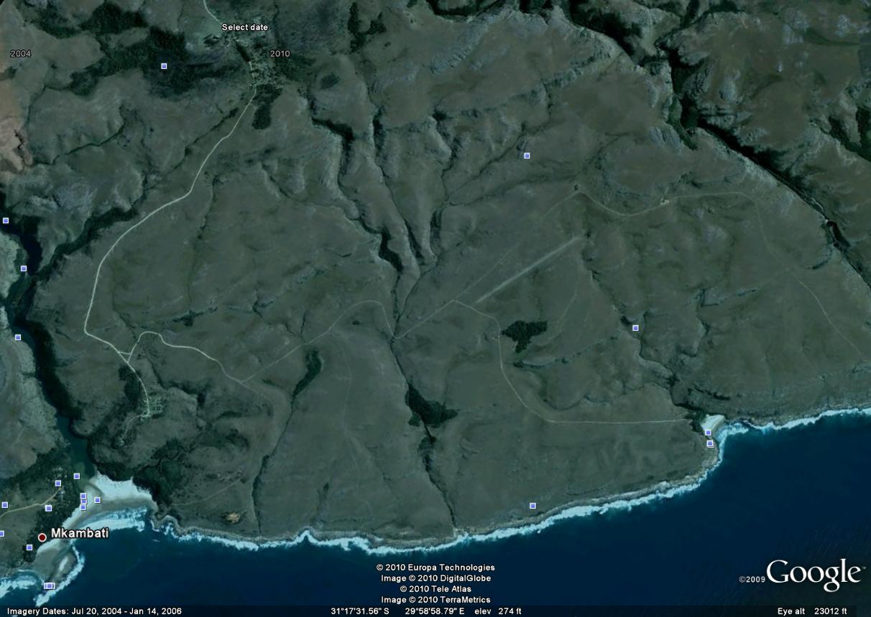
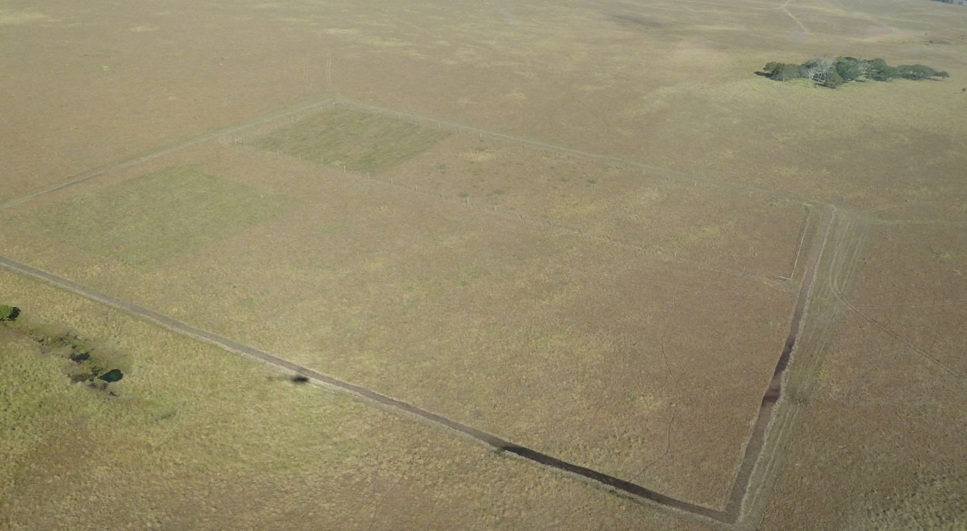
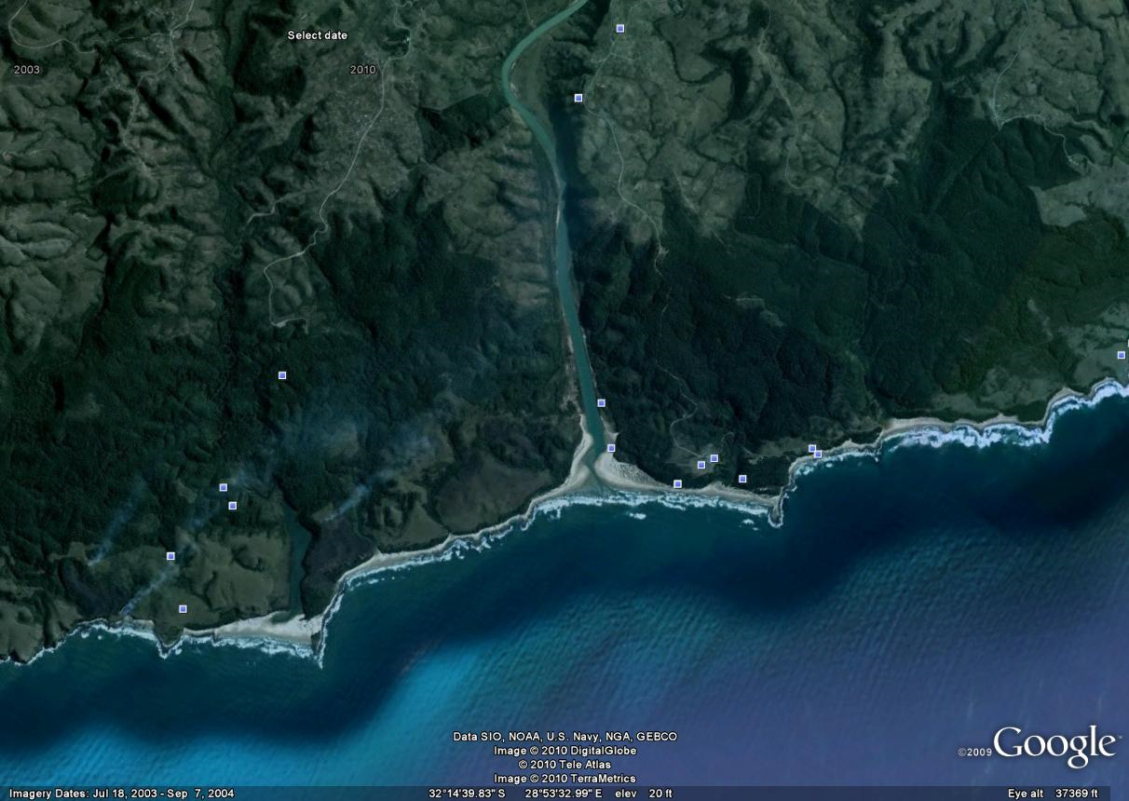
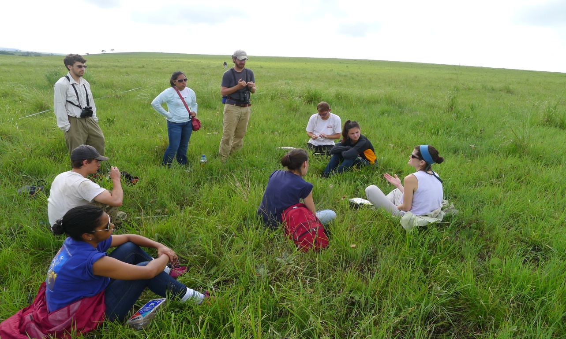
Quantify the scale of variation in nutrient limitation. Scale is included as a driver of variation a priori rather than post hoc.

Slide 4
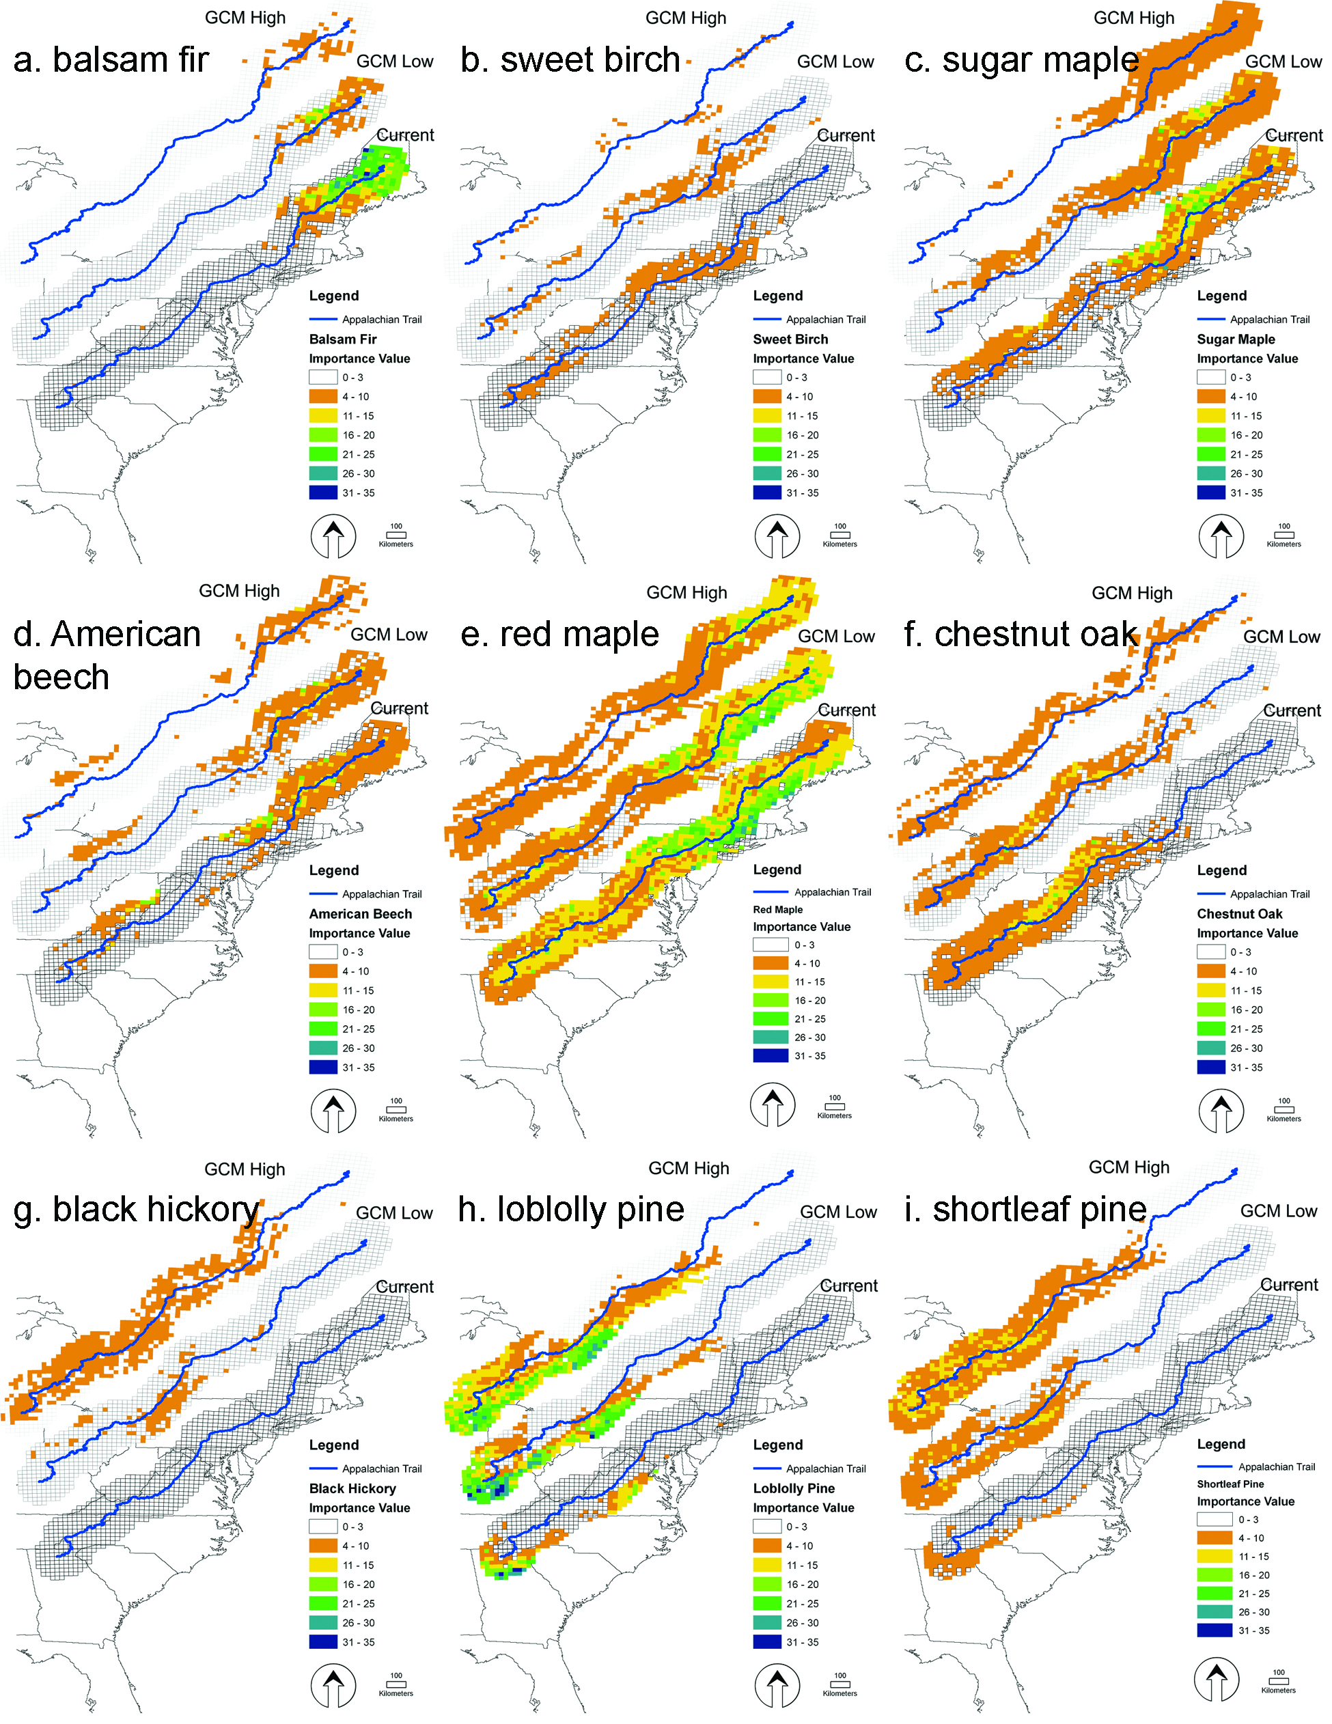
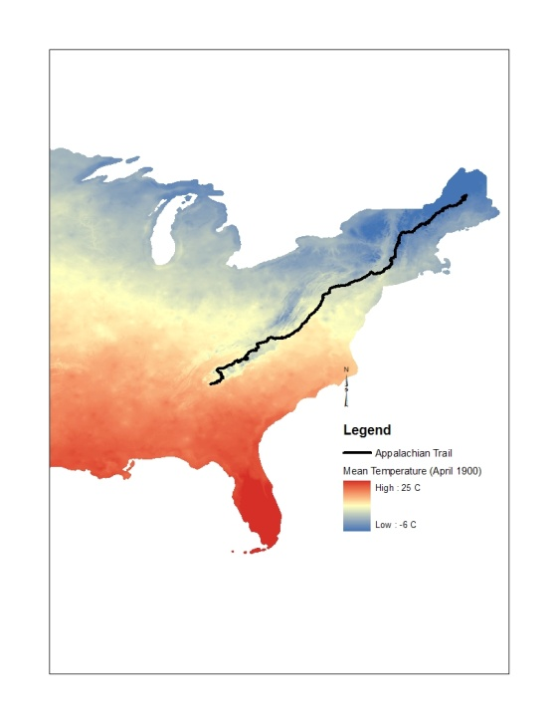
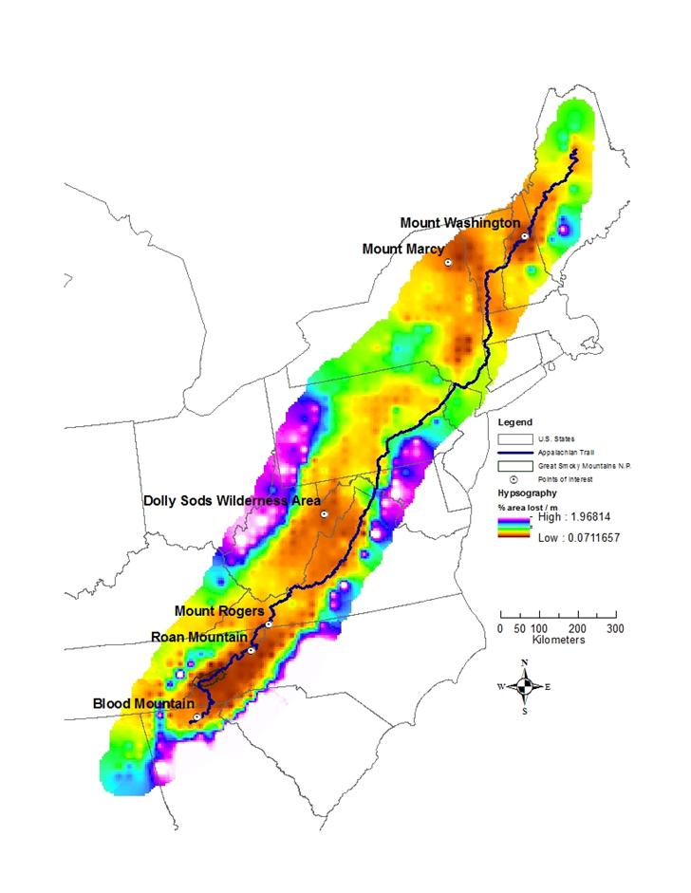
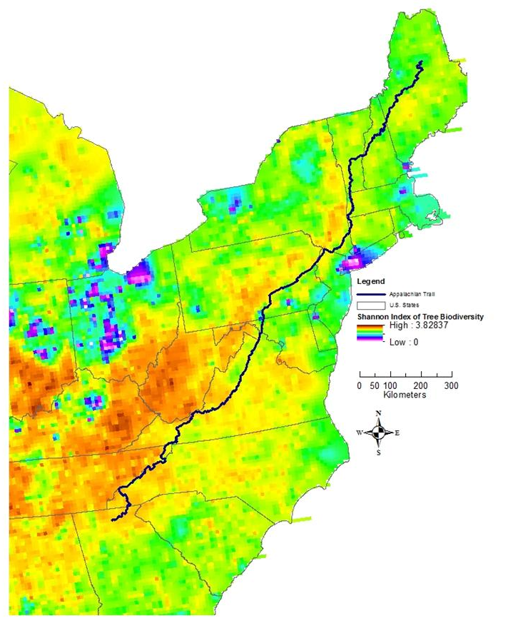
Northeastern climate-fire-vegetation feedbacks
+
climate
oak-hickory
+
+
fire

Slide 5
ChEASii Questions
Does incorporation of variation in physiological model parameters improve seasonal and interannual CO₂ flux hindcasts from eddy flux towers?
Does incorporation of stand-replacement and partial disturbance processes from remotely sensed observations improve yearly to decadal CO₂ flux hindcasts from eddy flux towers?
To what degree does model-data integration aid regional and landscape decision-making for forest C storage management?

Slide 6
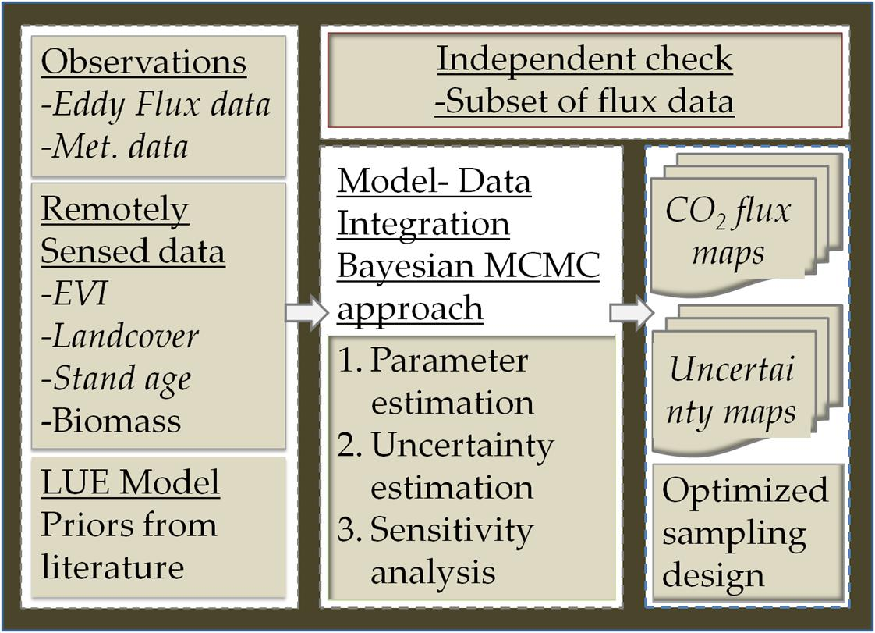
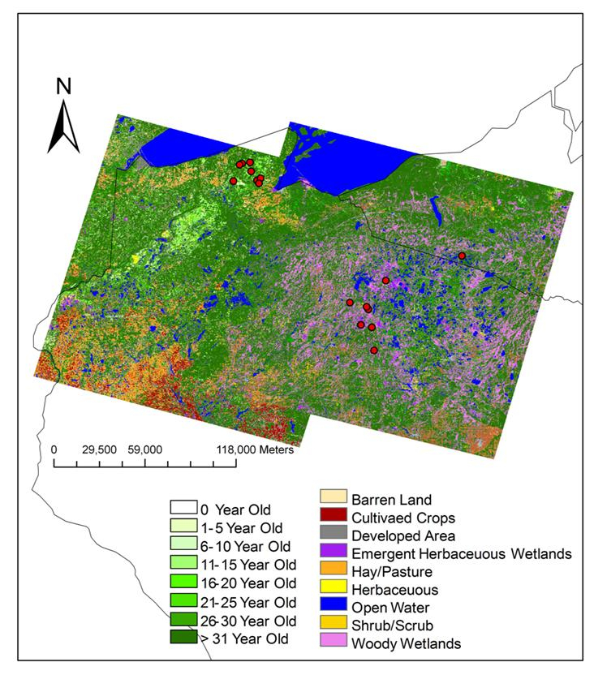
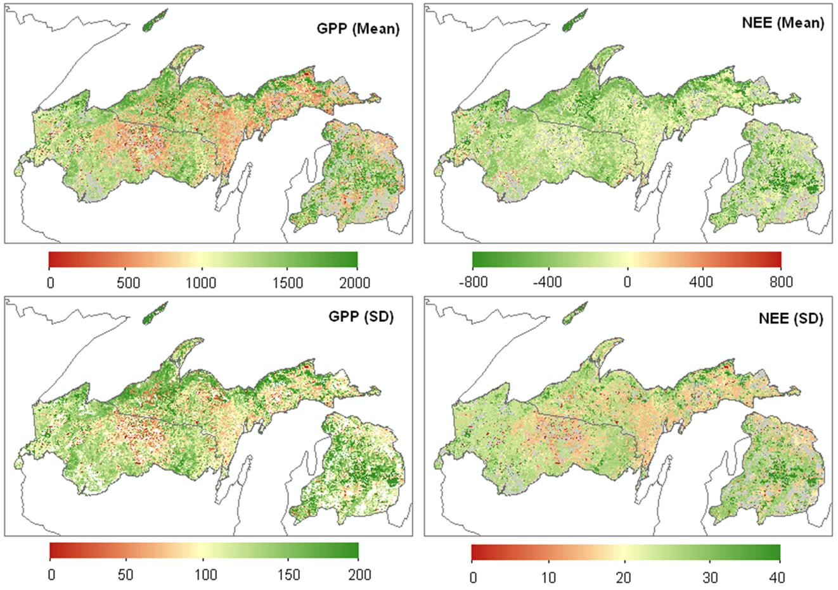
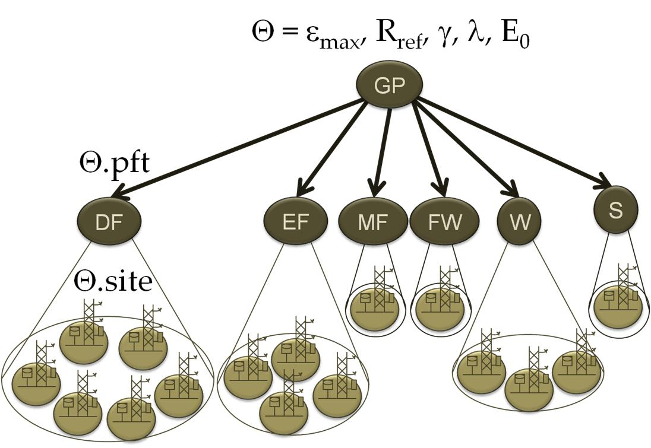
Carbon flux upscaling

Slide 7
Map uncertainty
What uncertainty do we want to express?
  What are the desired standards for quantifying uncertainty?
    What variables useful for science? For management?
    Is there a level of uncertainty that is useful for management?
    What spatial and temporal scales are most useful to science/management?
What uncertainty can/can’t we quantify?
How would this uncertainty be incorporated into map form?
    For what purposes would you use maps (reference, wayfinding, data visualization, decision-making, etc.)?
    Do you use these maps in a static form (pdf, paper, or the like) or through interactive interfaces (web service, arcgis, etc.)?

Slide 8
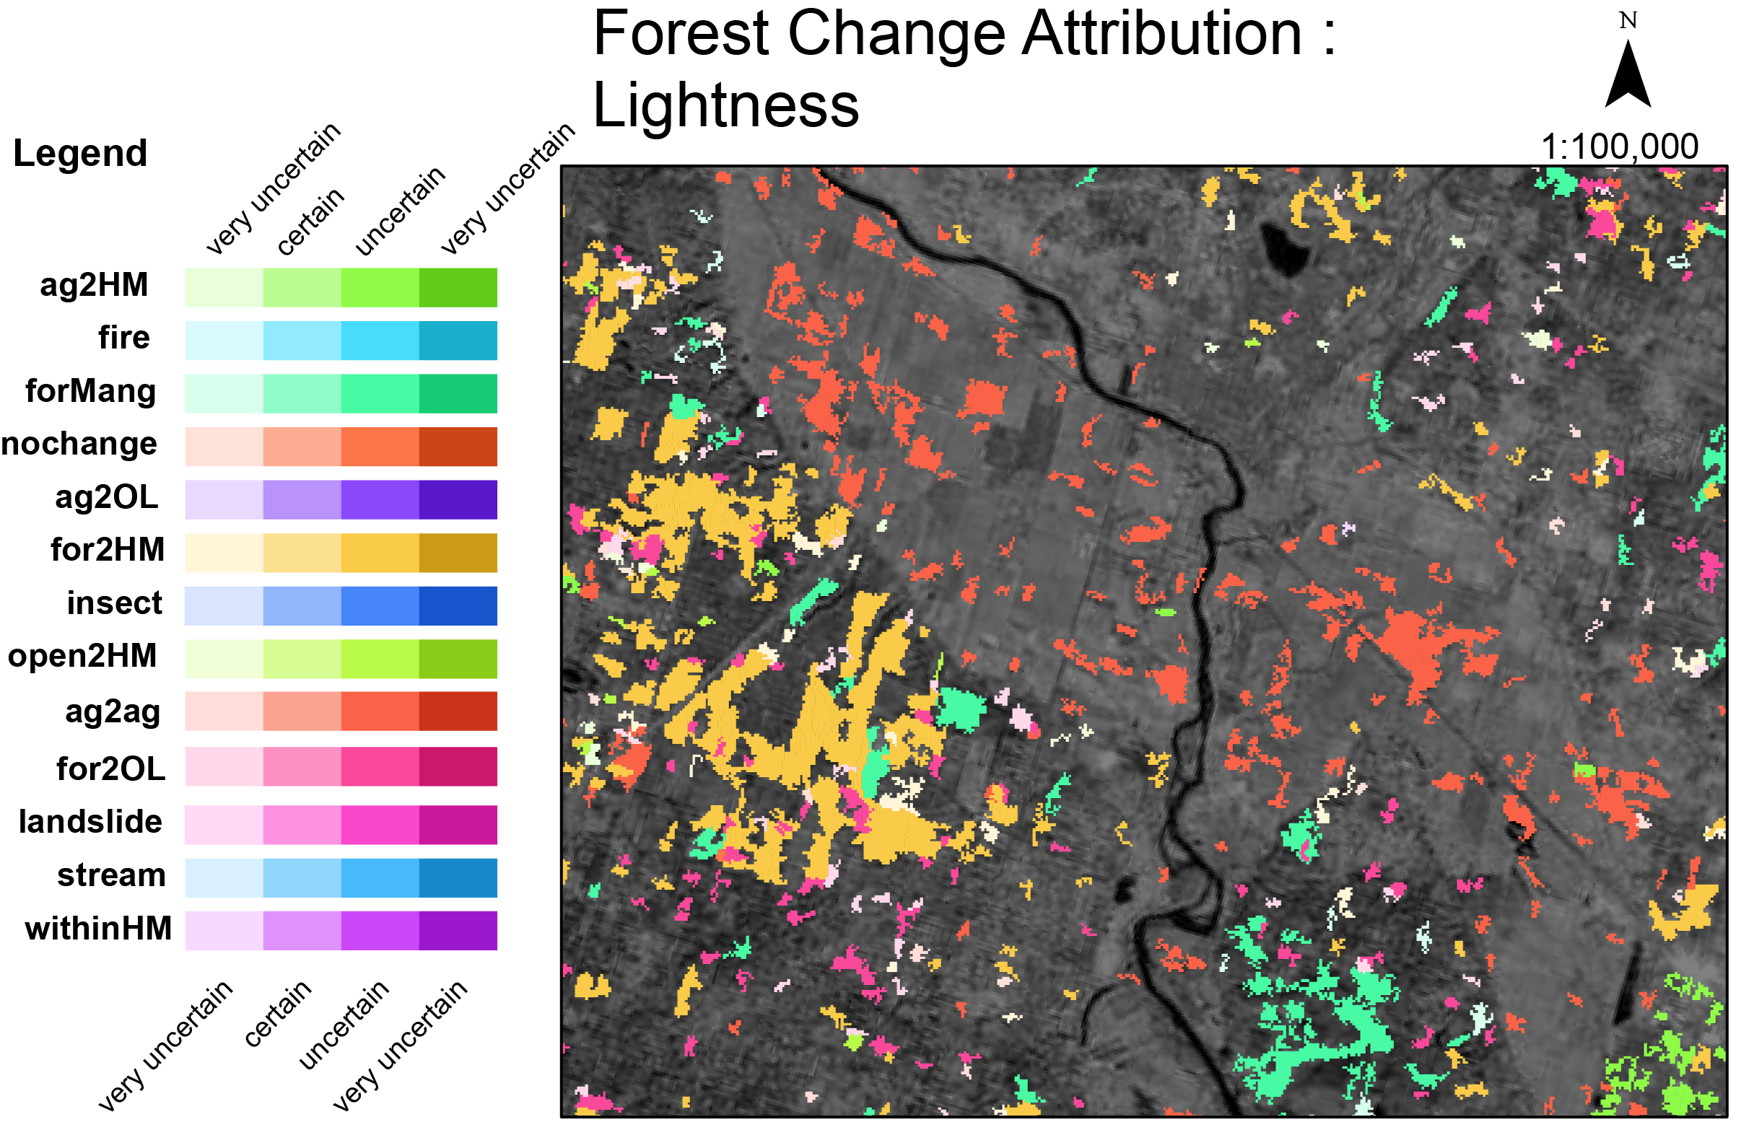
Map uncertainty - lightness

Slide 9
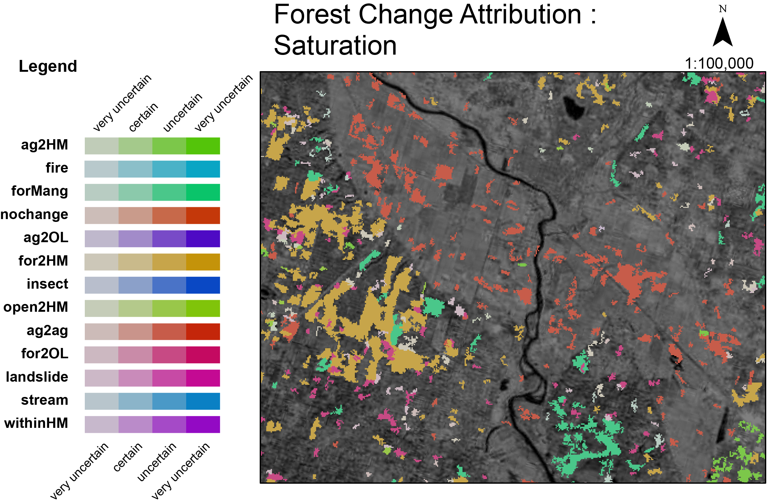
Map uncertainty - saturation

Slide 10
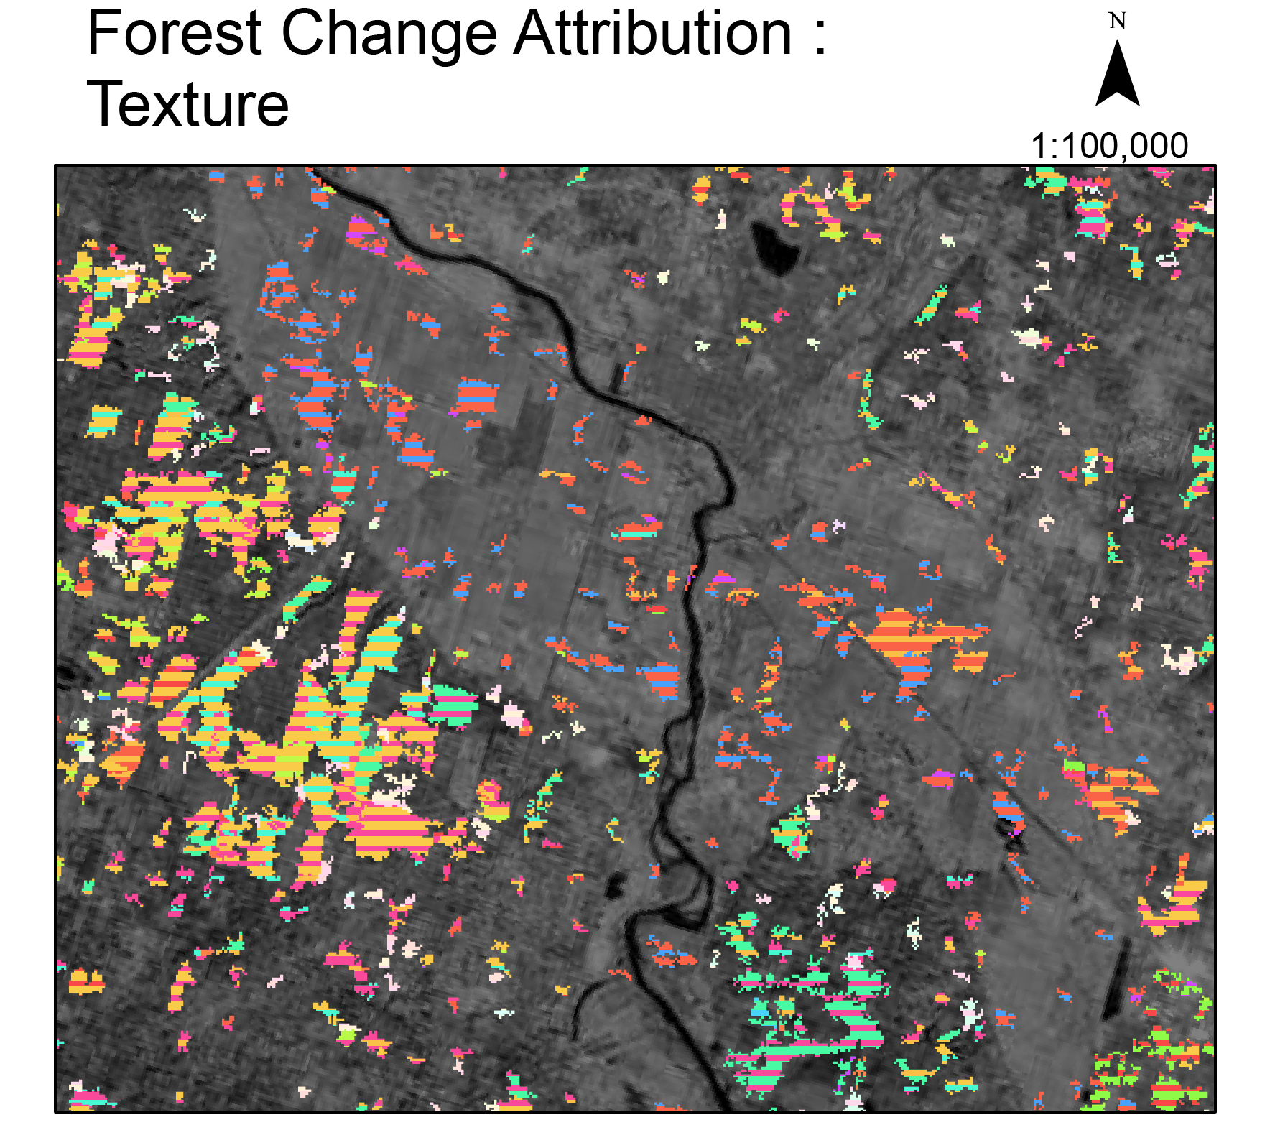
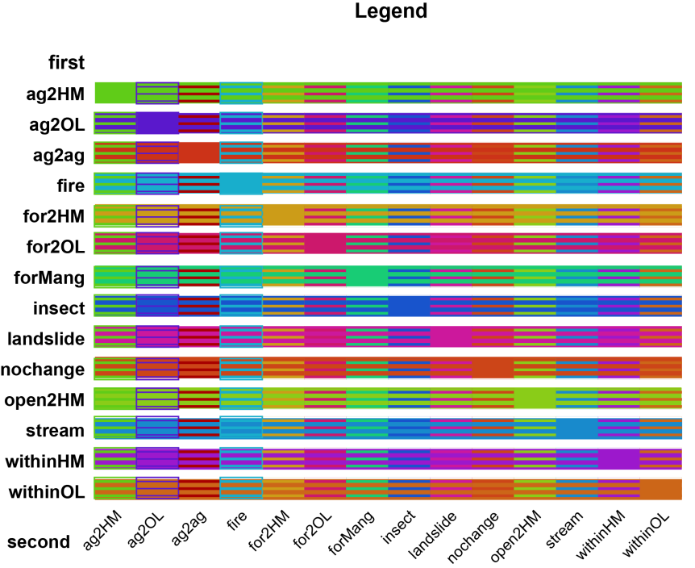
Map uncertainty - texture

Slide 11
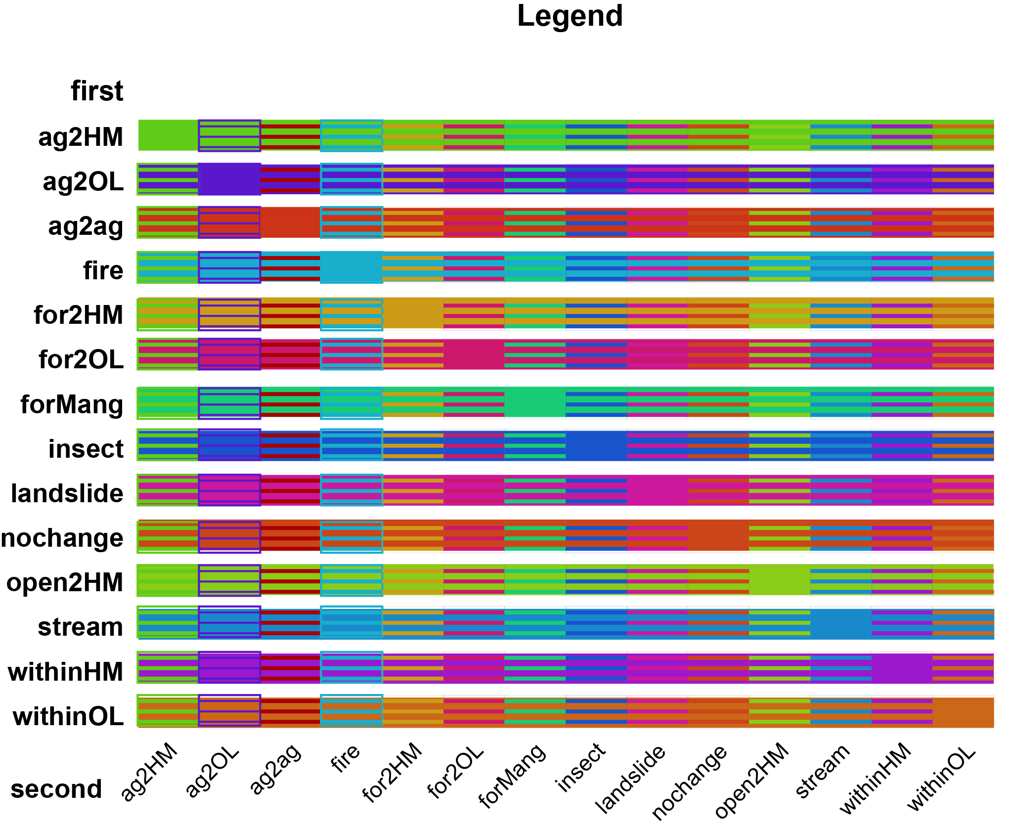

Slide 12
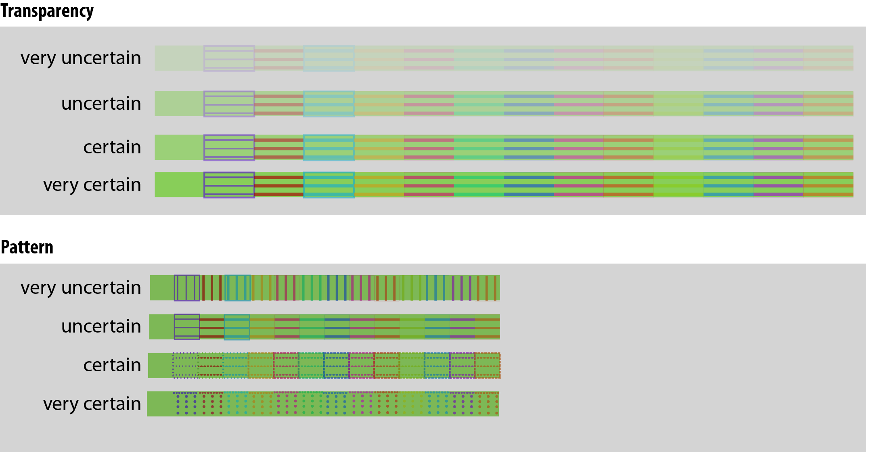

Slide 13
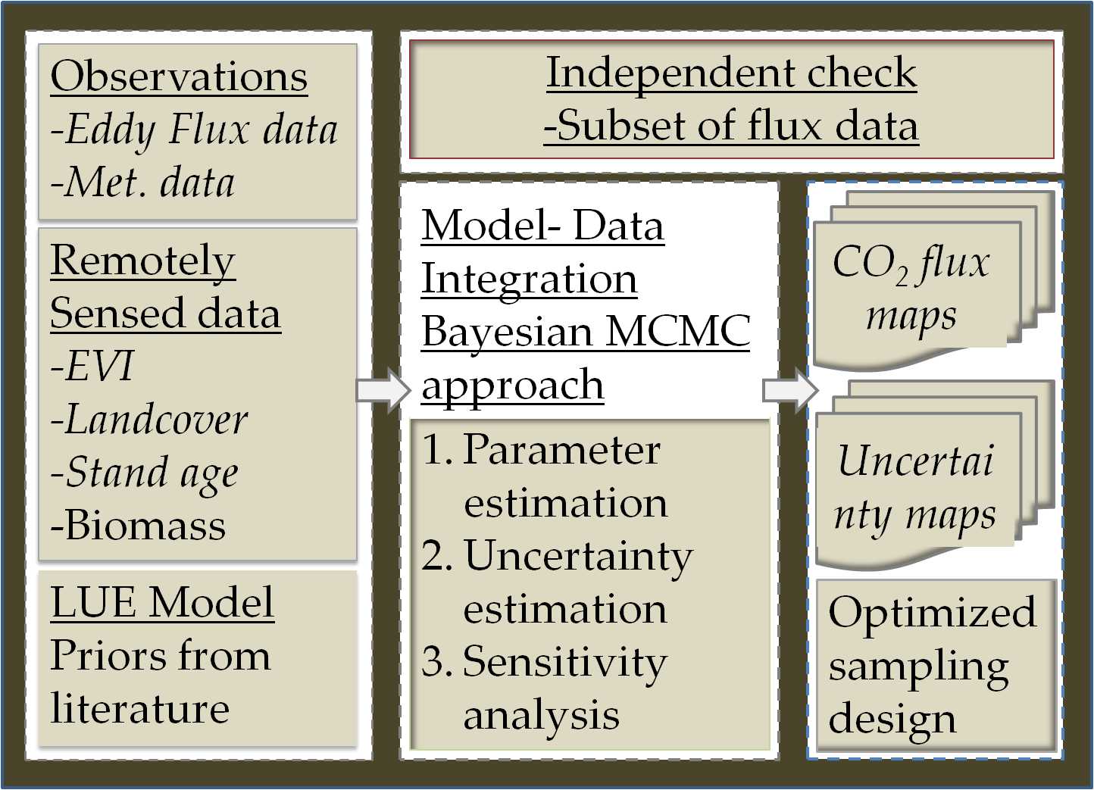
Modeling Framework

Slide 14
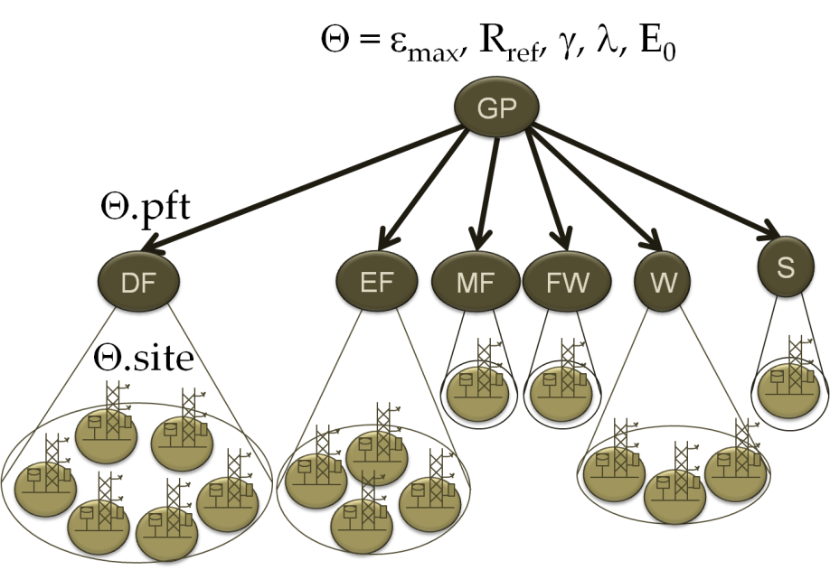
Model details
Solar radiation
InSAR + LandSAT + FIA
Air temperature
Eddy flux data
MODIS FAPAR
MODIS NDWI
DF: Deciduous Forest
EF: Evergreen Forest
MF: Mixed Forest
FW: Forested Wetland
W: Wetland
S: Shrubs
Θ.site: Parameters for individual flux tower
Θ.pft: Parameters for individual PFTs
Θ: Parameter bounds

Slide 15

Carbon Flux Dynamics and the Landscape
Doug Baldwin

Slide 16
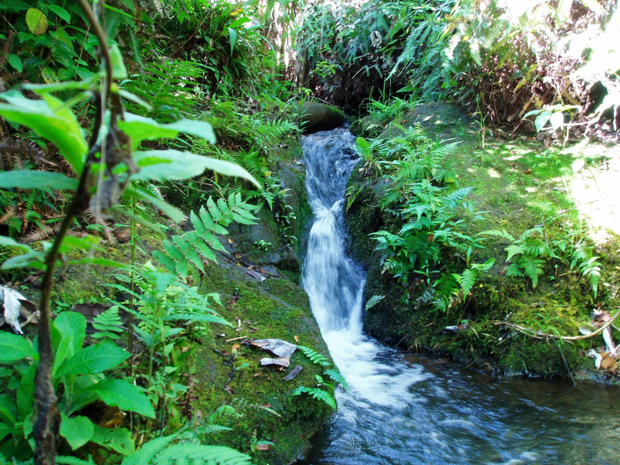
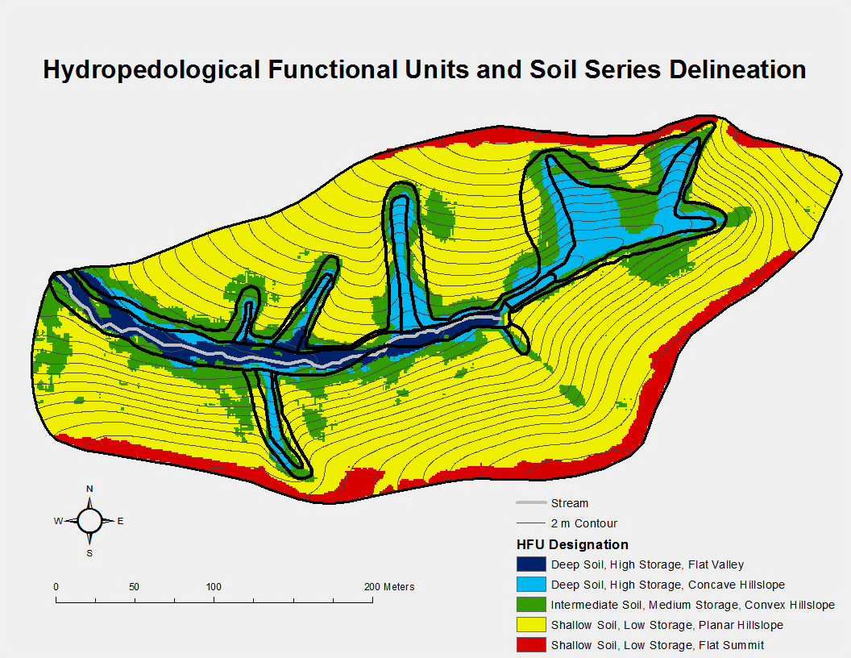
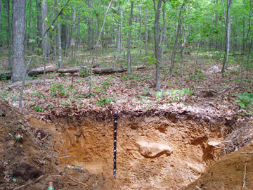
Research Background
MS in Soil Science
Upscaled soil water retention parameters to catchment-scale

Slide 17
Current Research Questions
Do patterns of precipitation influence C eddy flux measurements across the ChEAS region?
  Residuals from current LUE model correlated with soil moisture?
  Are there consistent seasonal periods or climatic conditions (from 2000 – 2006) where precipitation has a significant affect on C flux measurements?
  Are there certain towers where precipitation has more of an affect on C flux measurements than others?

Slide 18
Motive: Other People’s Research
Randerson et al (2002)
  Fleaching and Ferosion may significantly contribute to tower measurements, especially after disturbance in forests
Yang et al (2007)
  Errors from GPP calculation in non-forest areas have strong seasonality and may be influenced by soil moisture patterns
Maracchi et al (2005)
  Increased precipitation in projected climate patterns may offset increased evapotranpsiration in northern European forests
  Will the same effect occur in ChEAS forests under projected climate conditions?

Slide 19
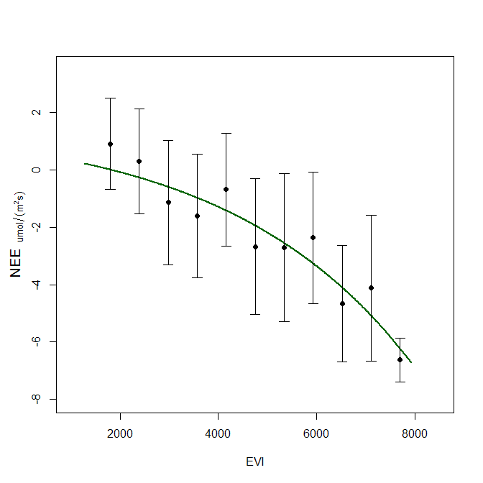

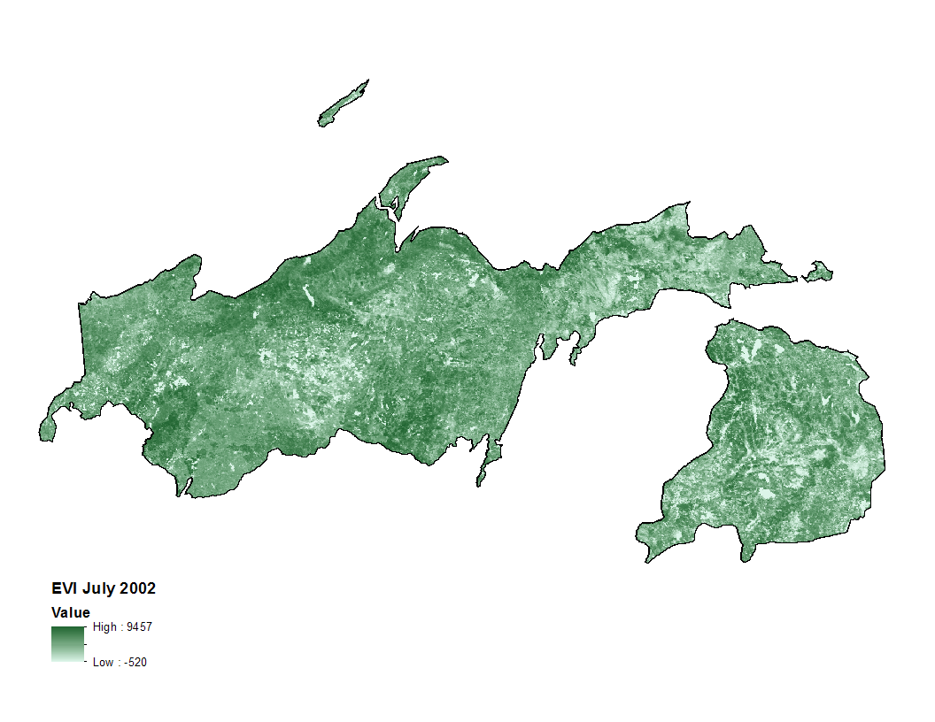
Motive: Personal Research
Correlation study last semester

Slide 20
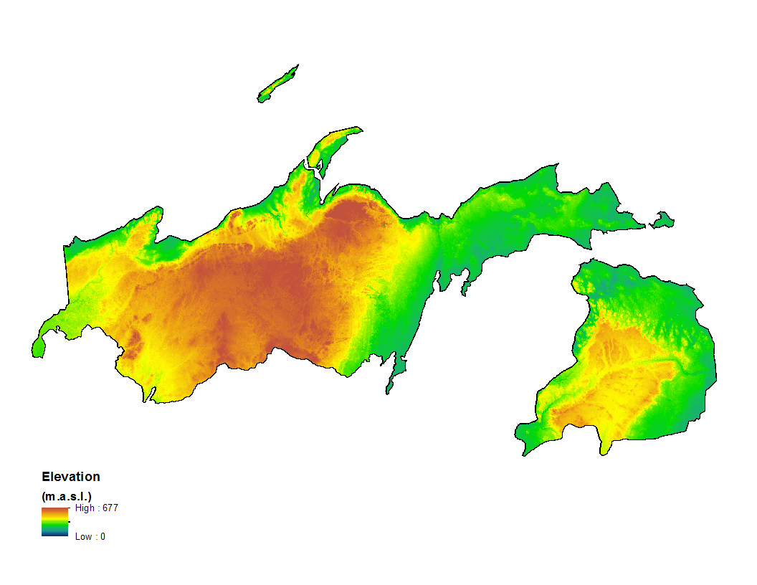
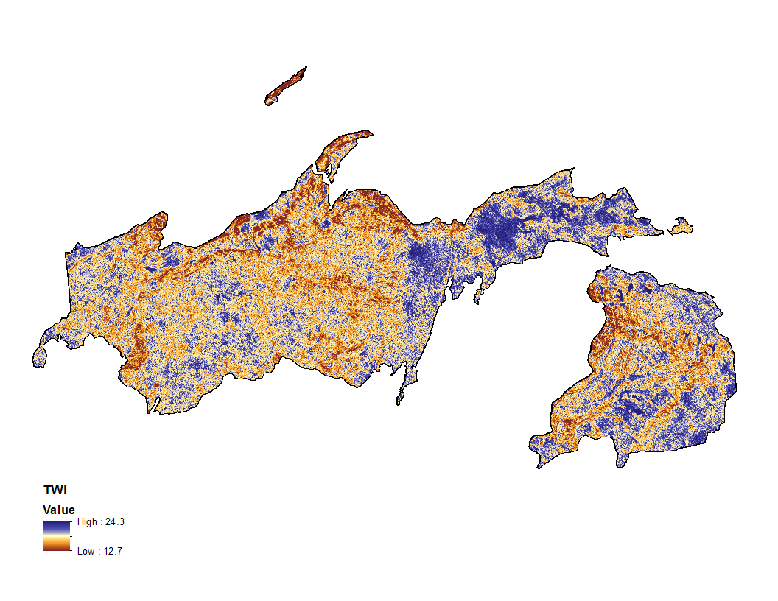
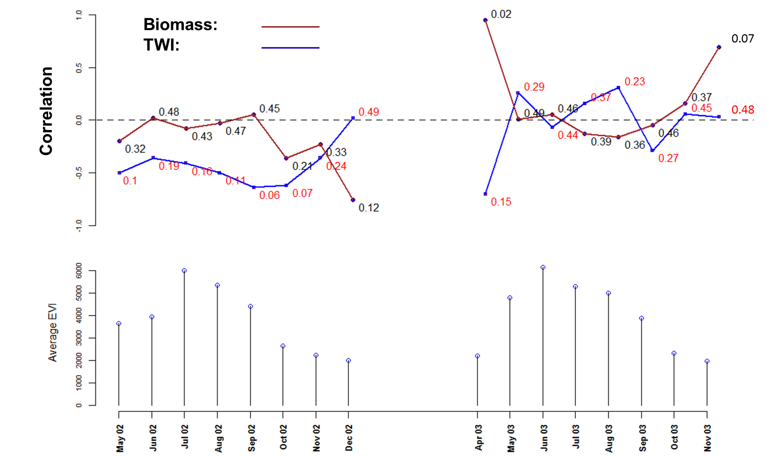

Slide 21
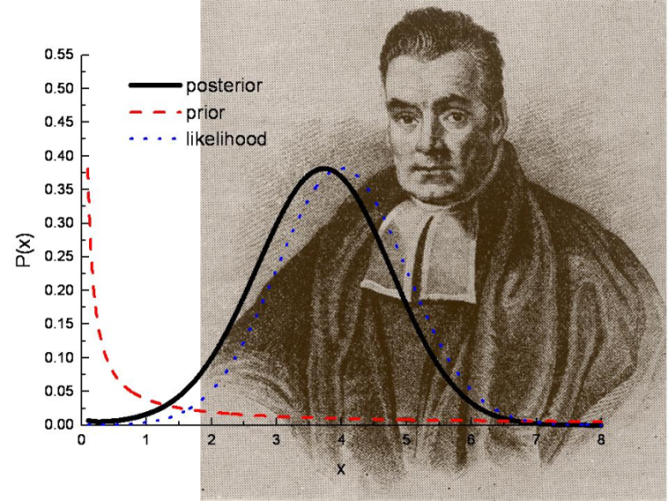
General Methodological Direction
Model C fluxes with the following elements:
  Soil moisture and biogeochemical sub-modules
  Hydrologic model for lateral water flow (i.e. TOPMODEL)
  Use Bayesian/MCMC to optimize model parameters

Slide 22
General Methodological Direction
Leaning towards:
  CASA DVGM (Potter et al, 1999) to be coupled with TOPMODEL
Other possibilities:
  LANDIS II
  MC1
  CLM3.0
  RHESSys

