Slide 1
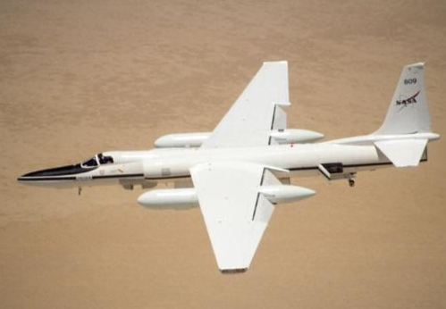
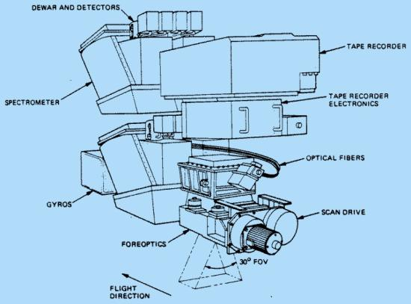
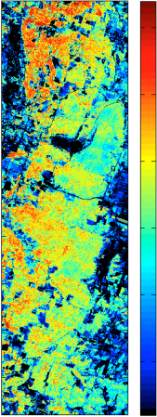
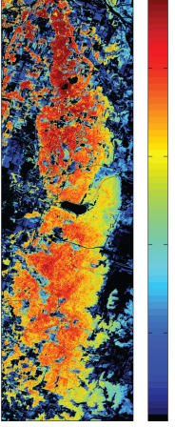
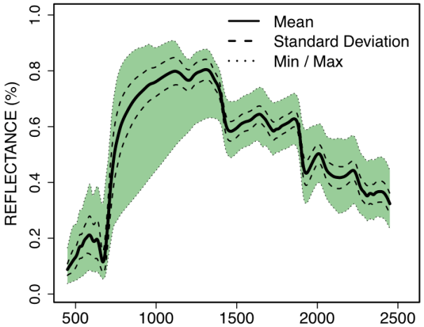
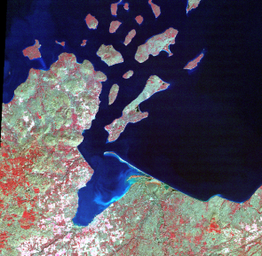
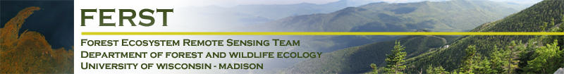

AVIRIS Studies in the ChEAS ecosystem region
…or: Remote Sensing of Ecosystem Function in the Townsend Lab, UW-Madison
Phil Townsend
Shawn Serbin
Aditya Singh
Brenden McNeil
Eric Kruger
John Couture

Slide 2
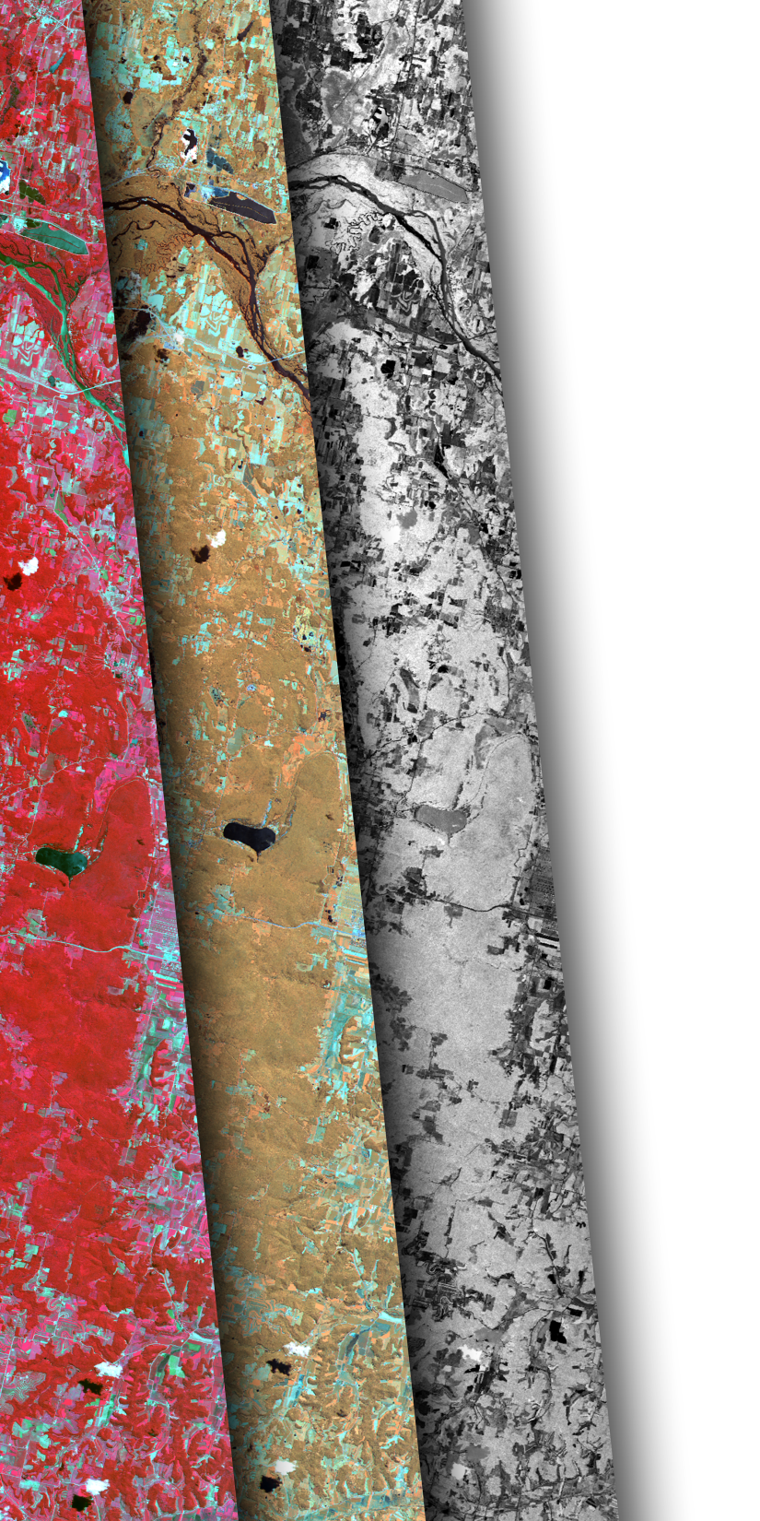
The overarching questions:
How do plant/forest functional traits (PFTs) vary across gradients of environmental change and disturbance?
What are the implications of variations in PFTs for ecosystem function, specifically nutrient retention and carbon assimilation?
Effects of insect defoliation/mortality
Effects on water quality (nutrient export)
Cumulative and legacy effects are especially interesting
Can we map ecosystem attributes and processes?

Slide 3
Remote sensing and methods development:
Measurement of functional traits using spectroscopy
Calibrated and validated using lab/chemical methods
…include chemical/structural traits related to photosynthesis and decomposition, but also:
Defensive compounds,
Differences related to genetics (especially in aspen.)
Spatial scaling using imaging spectroscopy (AVIRIS) ad thermal IR imagery (MASTER)
Mapping functional properties of forests,
We seek ‘global’ calibrations covering large areas (not ad hoc local maps.)
Notes:
imaging spectroscopy?

Slide 4
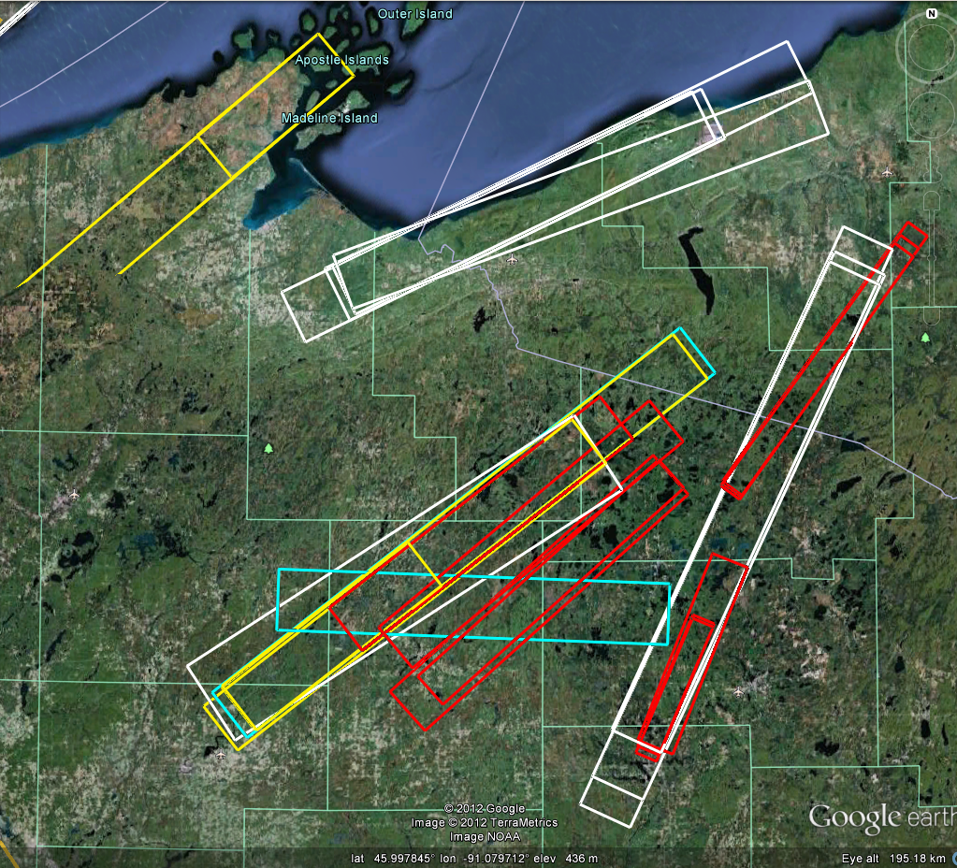
AVIRIS Inventory over the ChEAS ecosystem study region
Of a total of 145 scenes, 26 in ChEAS:
2008: 3 Flambeau
2009: 9 Flambeau, Ottawa, Porkies
2010: 2 Flambeau, Willow creek
2011: 12 Ottawa, Willow Creek
All midsummer (July/August) images
7.0m - 16.8m resolution

Slide 5
Plant Functional Traits: chemistry, structure, metabolism
Leaf nitrogen – measurement of plant nutrient status and photosynthetic potential.
LMA – Describes the fundamental tradeoff in leaf construction costs versus light-interception.
Fiber/Lignin/Cellulose – Predictors of foliar recalcitrance, litter decomposability and ecosystem nutrient cycling.
Leaf δ15N – N cycling and mycorrhizal associations.
Vcmax and Jmax – Photosynthetic capacity of the vegetation.

Slide 6
Plant Functional Traits: chemistry, structure, metabolism
N%, LMA, Fib./Lig./Cellulose, δ¹⁵N, Vcmax, Jmax
These variables (plus a few others from Lidar, Radar and thermal IR) can almost fully characterize plant photosynthetic capacity and carbon storage in terrestrial vegetation.
Also disturbance:
Mapping forest disturbance, defoliation and its ecosystem-level impacts
Characterizing impacts in terms of proportional damage, and
More importantly in measures of C and N flux.

Slide 7
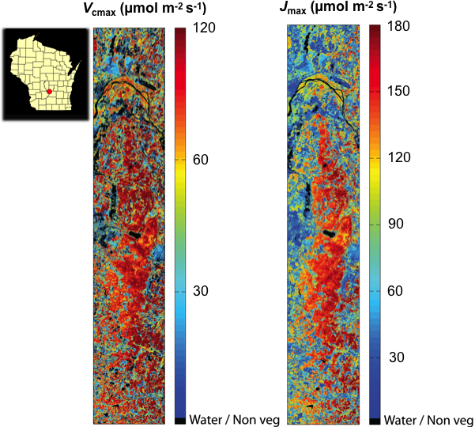
Still a work in progress
Developing scaling approaches for leaf level estimates to the canopy
Validation of retrievals of metabolic parameters (such as Vcmax and Jmax) is a challenge
Need methods to link to flux tower data (= only ‘canopy’ level analog)
ChEAS ecosystem central to our efforts

Slide 8
Thank you! Comments/Suggestions/Questions?

Slide 9
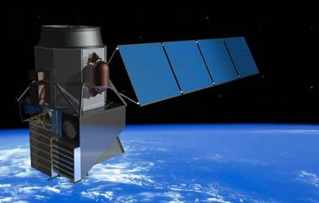
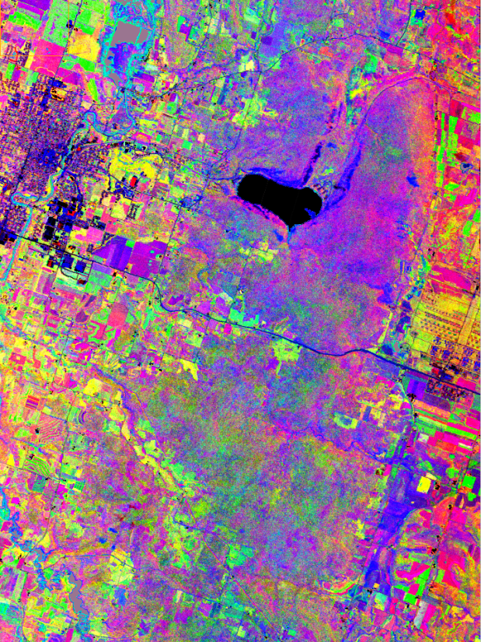
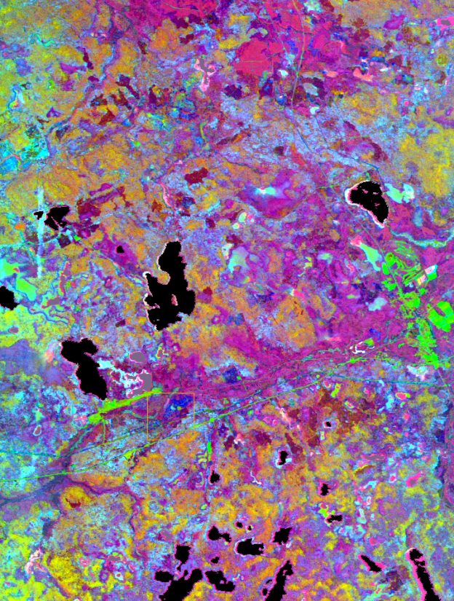
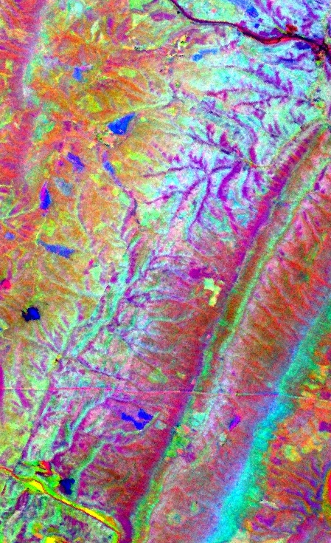
HyspIRI – an imaging spectrometer + thermal IR imager NASA hopes to launch later in the decade.
At present, we use airborne data from the AVIRIS instrument.
Soon to be a new AVIRIS (AVIRIS-NG, hopefully with flights over Willow Creek this summer) as well as identical instruments used by NEON.

Slide 10
Functional traits: one view FFT = C_{s} – (S + [R or M]), where:
Initial view: FFT = C_{s} – (S + [R or M]) where:
Functional Trait | Physiological Trait | Field Measurement
Cell Structure (C_{s}) | V_{c}/V_{w} = Ratio of leaf volume contained within cell membrane to that within cell wall | W_{m} = ratio of leaf water mass to leaf dry mass
Shade Tolerance (S) | Proportional amount of foliar N allocated to light harvesting | Ratio of Chl to W_{m}
Recalcitrance* (R) | Amount of lignin invested to retard decomposition | Foliar lignin
Mycorrhizal* Symbiosis (M) | Type of mycorrhizae that are feeding nutrients to tree in exchange for photosynthate | Foliar δ¹⁵N

Slide 11
Foliar property | # Samples | Broadleaf median | Broadleaf range | Conifer median | Conifer range
Leaf mass per area (M_{area}, g m⁻²) | 1088 | 52.81 | 17.43 – 101.82 | 142.89 | 49.88 – 302.79
N_{mass} (%) | 682 | 2.92 | 1.47 – 4.40 | 1.38 | 0.70 – 1.63
C_{mass} (%) | 682 | 48.65 | 43.70 – 52.36 | 50.63 | 47.37 – 53.65
δ¹⁵N (‰) | 139 | -3.13 | -6.15 – 0.77 | -4.71 | -9.35 – -0.49
Fiber, ADF (%) | 492 | 32.52 | 18.96 – 45.90 | 41.88 | 17.53 – 57.87
Lignin, ADL (%) | 492 | 16.26 | 7.81 – 30.54 | 23.69 | 8.71 – 34.23
Cellulose (%) | 492 | 15.34 | 10.23 – 22.26 | 18.45 | 13.00 – 27.69
Chlorophyll a+b (μg cm⁻²) |  | 38.73 | 18.64 – 55.01
V_{cmax} (μmol m⁻² s⁻¹) | 201 |  | 20.6 – 164.8
J_{max} (μmol m⁻² s⁻¹) | 97 |  | 125.9 – 249.9
Leaf temperature (°C)
Notes:
These are the traits that we are looking to map. Note that there is a combination of structural variables, chemical variables, and also metabolic variables.
Delta N15 lets us know that our plots span a range of soil types, N cycling rates and with understories with and without N fixers ( based on the values that are close to 0 indicating strong uptake of atmospheric N in those plants.

Slide 12
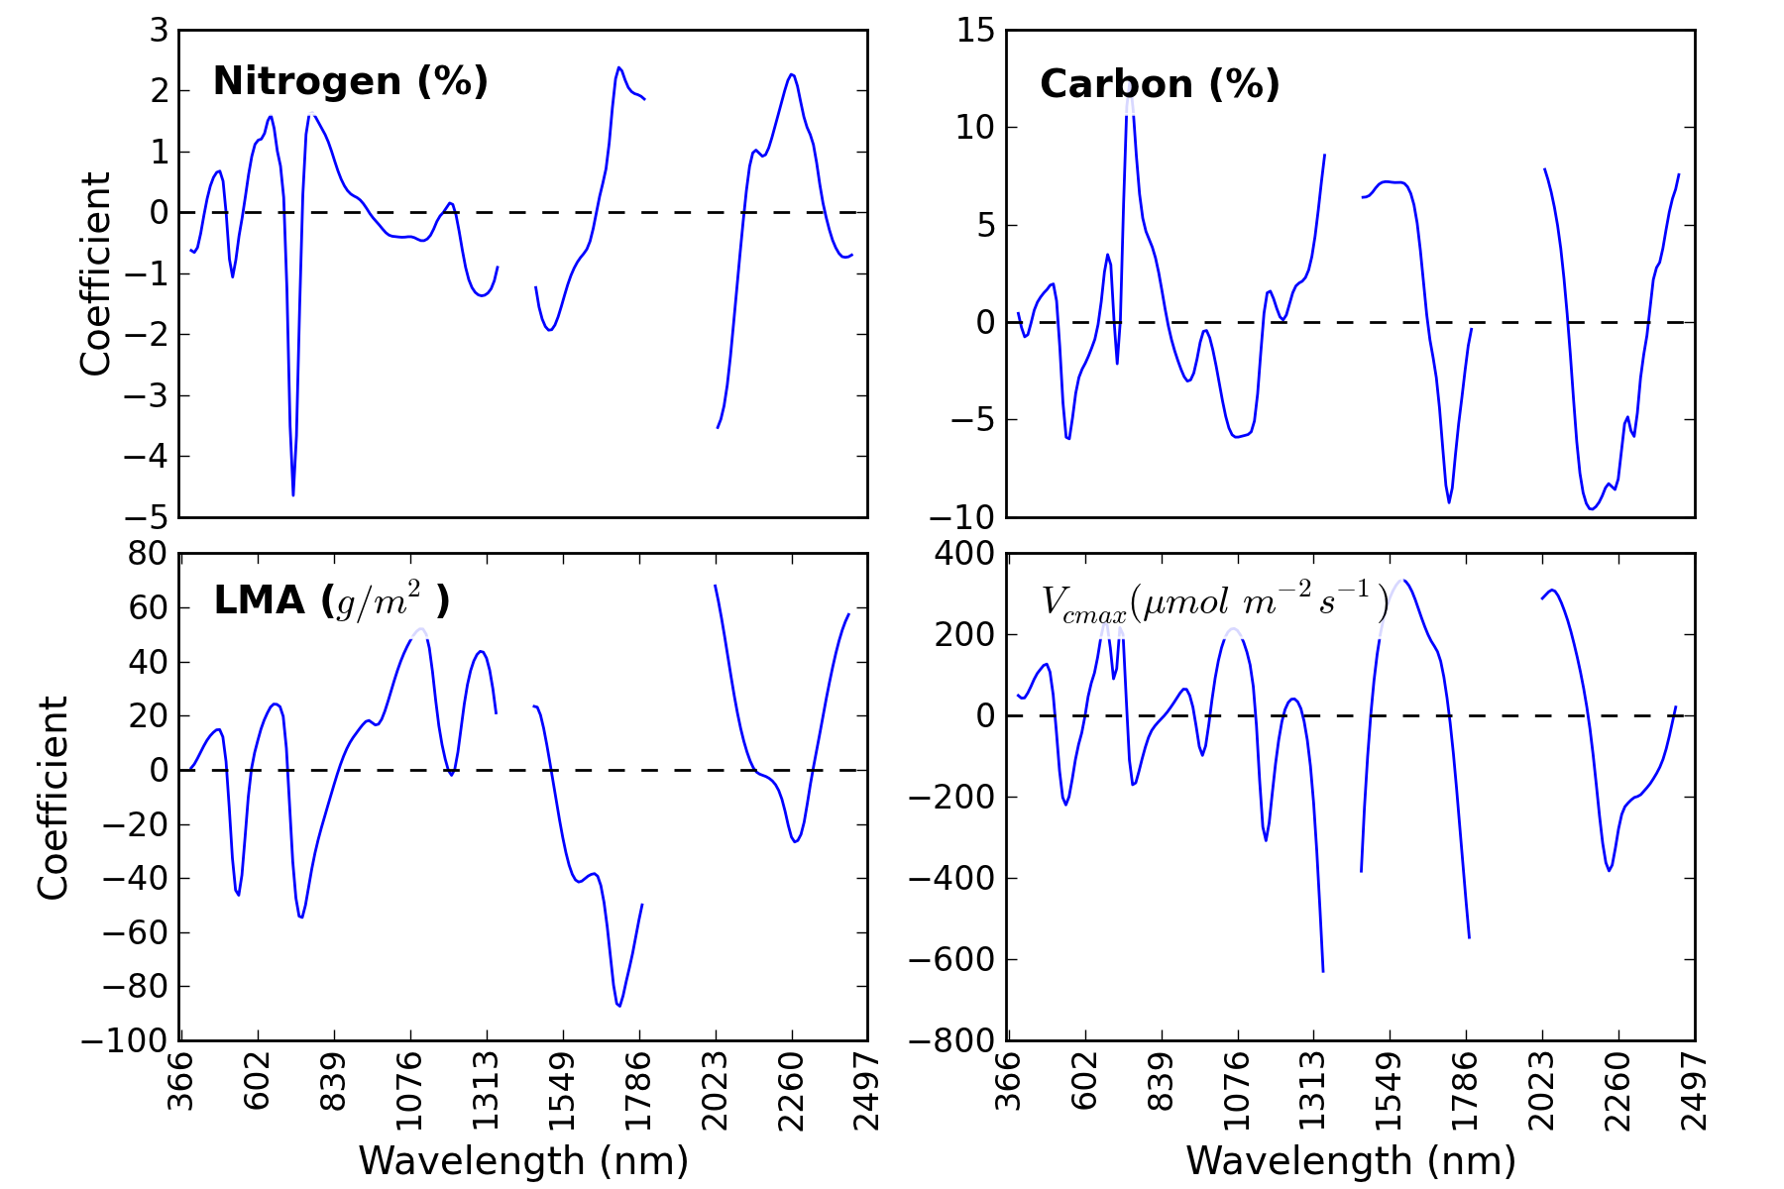
PLS coefficients: we want these to be stable across measurements
Notes:
We develop calibration coefficients with hyperspectral imagery which allows us to make maps of plant functional traits.

Slide 13
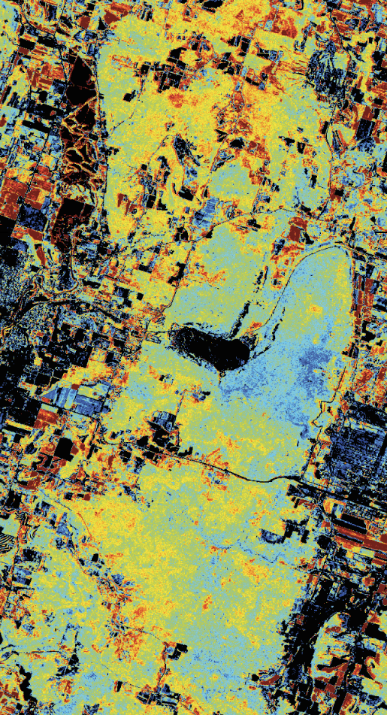
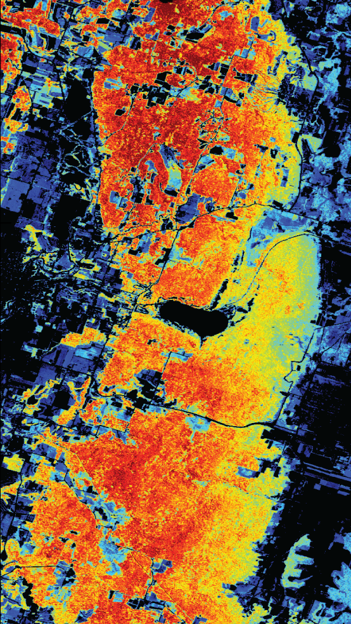
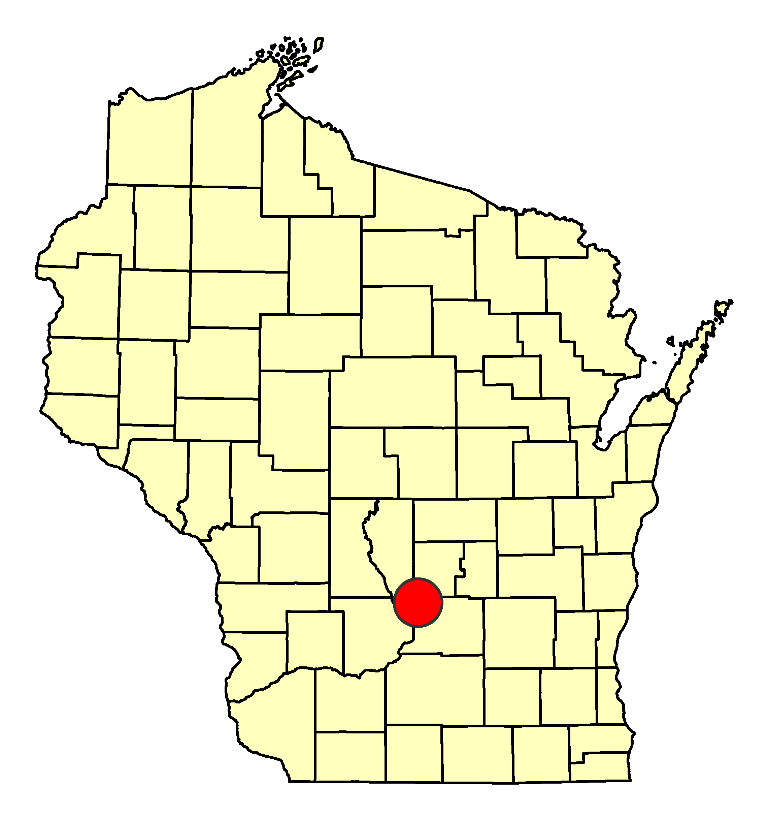
Mapping Foliar structure
3%
100 g/m²
LMA (gm⁻²)
Foliar N (%)
0%
0 g/m²
Notes:
Leaf mass per area (or LMA) is a critical leaf morphological trait that is a measure of leaf thickness and therefore photosynthetic capacity, i.e. ability to assimilate carbon into carbohydrates. LMA is neither good nor bad, but it is an important factor that drives plan growth strategies under different light/temperature (++) and nutrient/water stress (+) conditions. LMA also varies by position in the canopy of vegetation.
LMA = investment (leaf mass) associated with a given rate of return per unit area (Leaf area used for light capture) – Wright et al. 2002
So, lower LMA == potentially faster rate of growth like crops, but less investment in, e.g., longevity of the leaf → more area available for light-capture area (per unit mass) for production, tend to have higher N concentration, shorter diffusion pathlength from stomates to chloroplasts etc etc
Higher LMA (evergreens) == hedge toward long-term performance, i.e. with thicker walled cells == nutrient conservation, water conservation

Slide 14
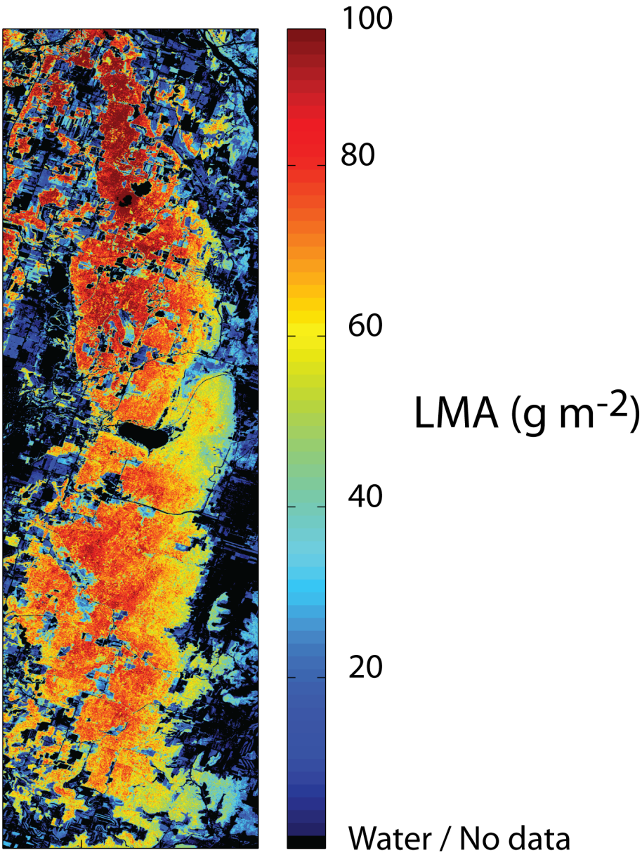
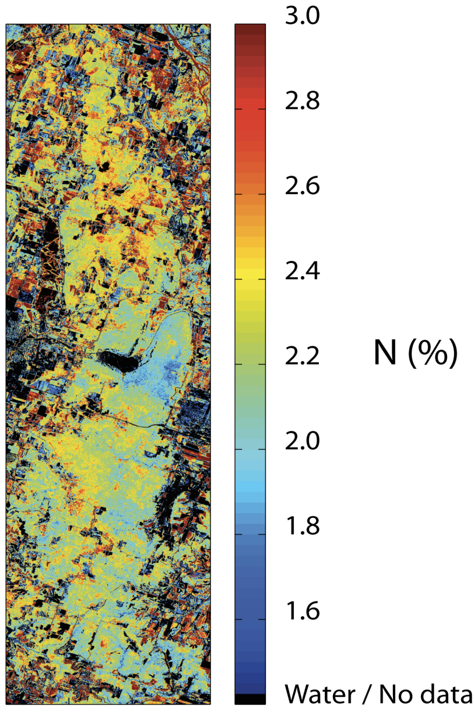
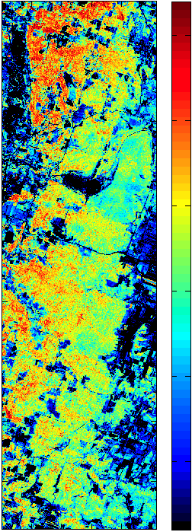
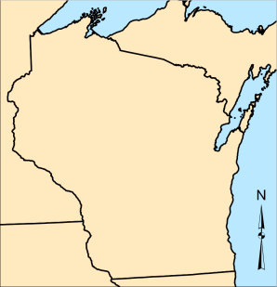
Mapping Light Use Efficiency
LUE ( gC MJ⁻¹)
3.0
2.5
2.0
1.5
1.0
0.5
M_{area} (g m⁻²)
N (%)
Green et al., (2003). AFM
Courtesy Shawn Serbin

Slide 15
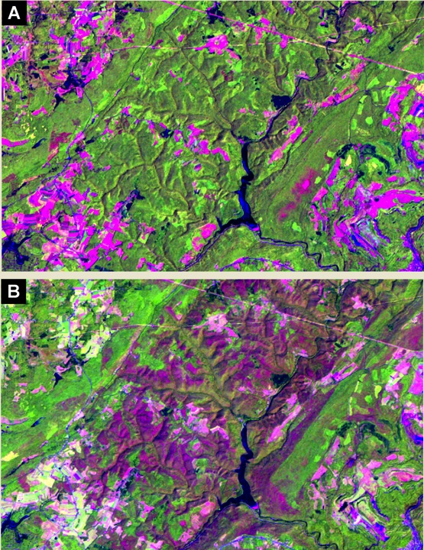
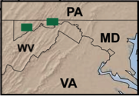
Disturbance mapping
Phil Townsend

Slide 16
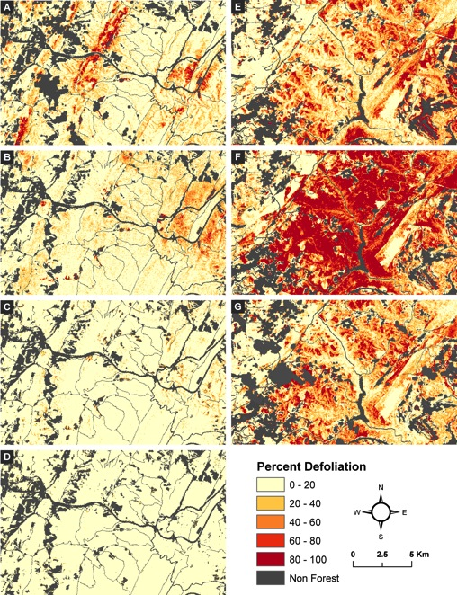
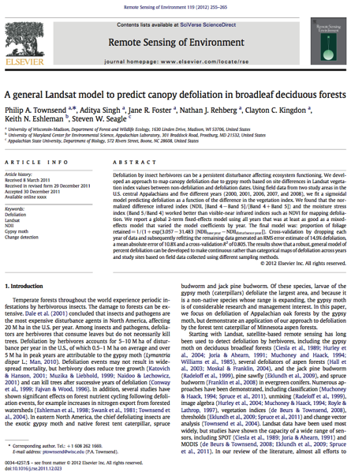
Disturbance mapping

