Slide 1
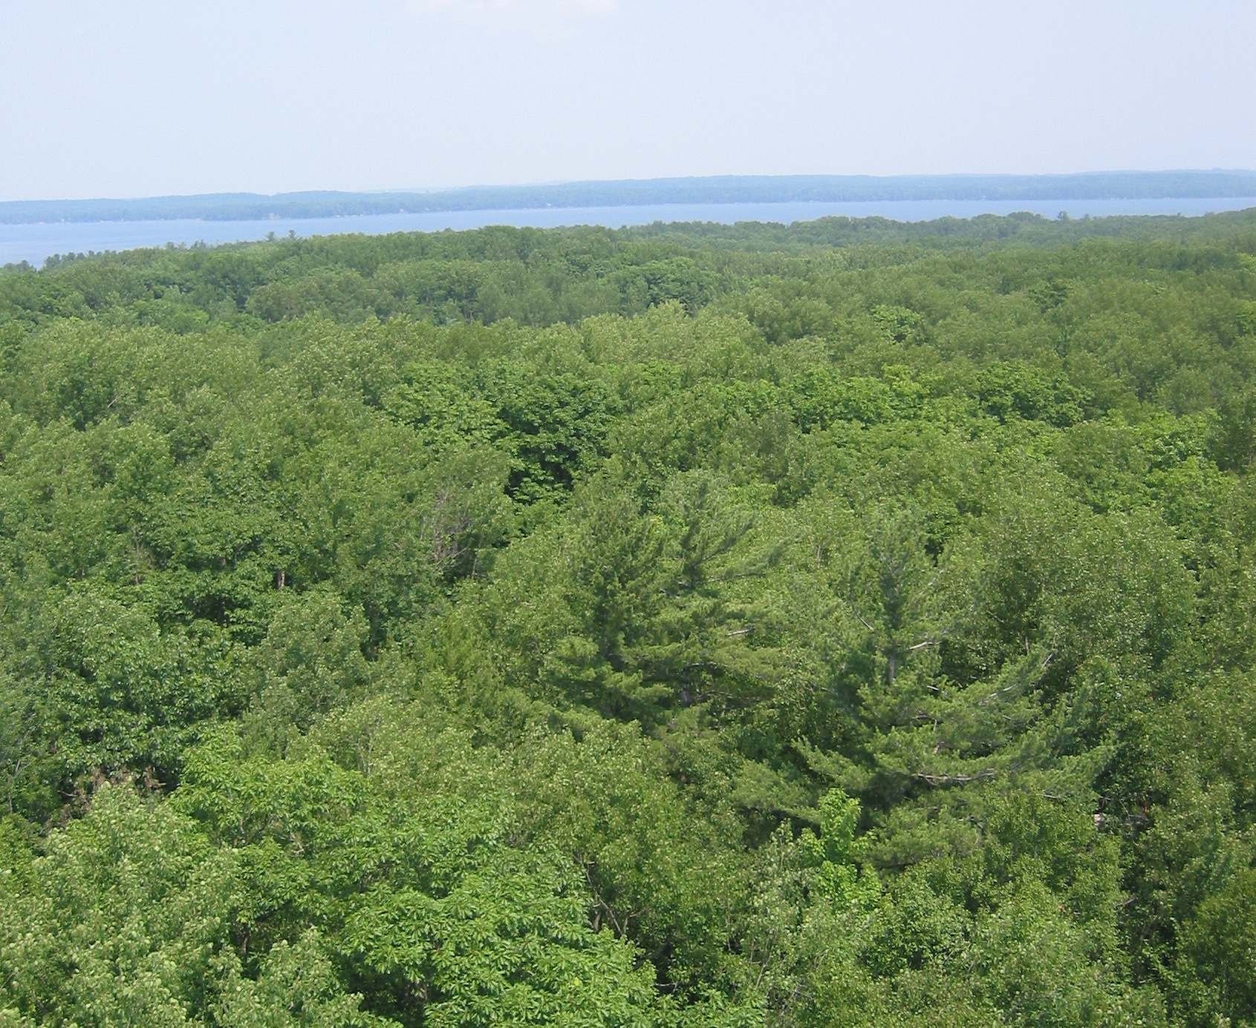
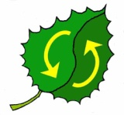
150 Is The New 80: Continuing Carbon Storage In Aging Great Lakes Forests
Is It True?
At What Scale?
What Is The Mechanism?
Can It Be Managed?
UMBS Forest
Carbon Cycle
Research Program

Slide 2

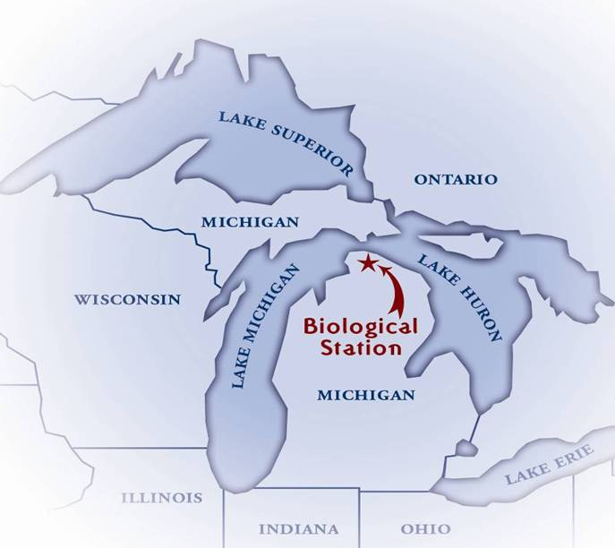
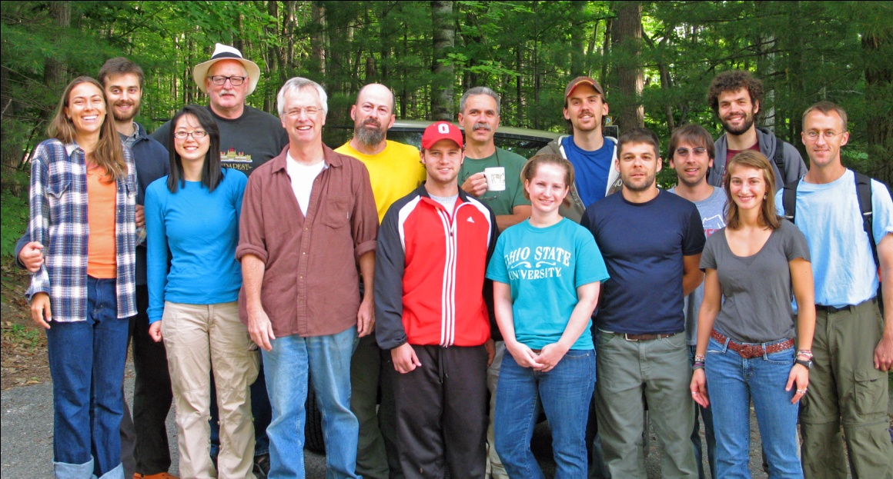
Quantifying ecosystem services of aging northern forests
The UMBS Forest Carbon Cycle Research Program
Peter Curtis, Ohio State Univ.
Gil Bohrer, Ohio State Univ.
Chris Gough, Virginia Commonwealth Univ.
Knute Nadelhoffer, Univ. Michigan
This research is supported by the Office of Science, U.S. Department of Energy, through the Midwestern Regional Center of the National Institute for Global Environmental Change, and the National Institute for Climate Change Research.

Slide 3
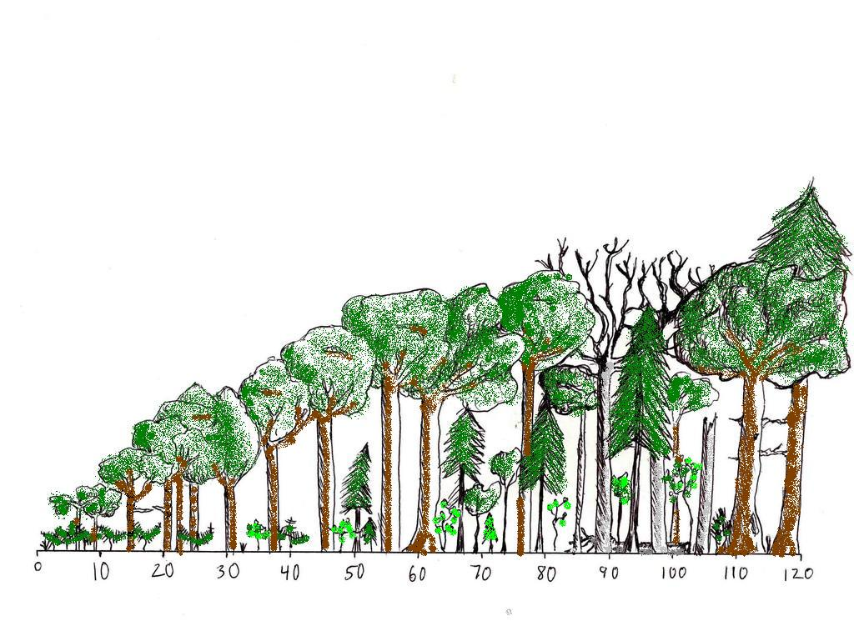
Many Forests Are Now at an Ecological Transition, Between Young and Potentially Old Community Types
UNEVEN-AGED
(maple, oak, pine)
Succession
ASPEN MORTALITY
natural senescence, pathogens, insects
EVEN-AGED
(mostly aspen)
Forest age (years)
WE ARE HERE

Slide 4
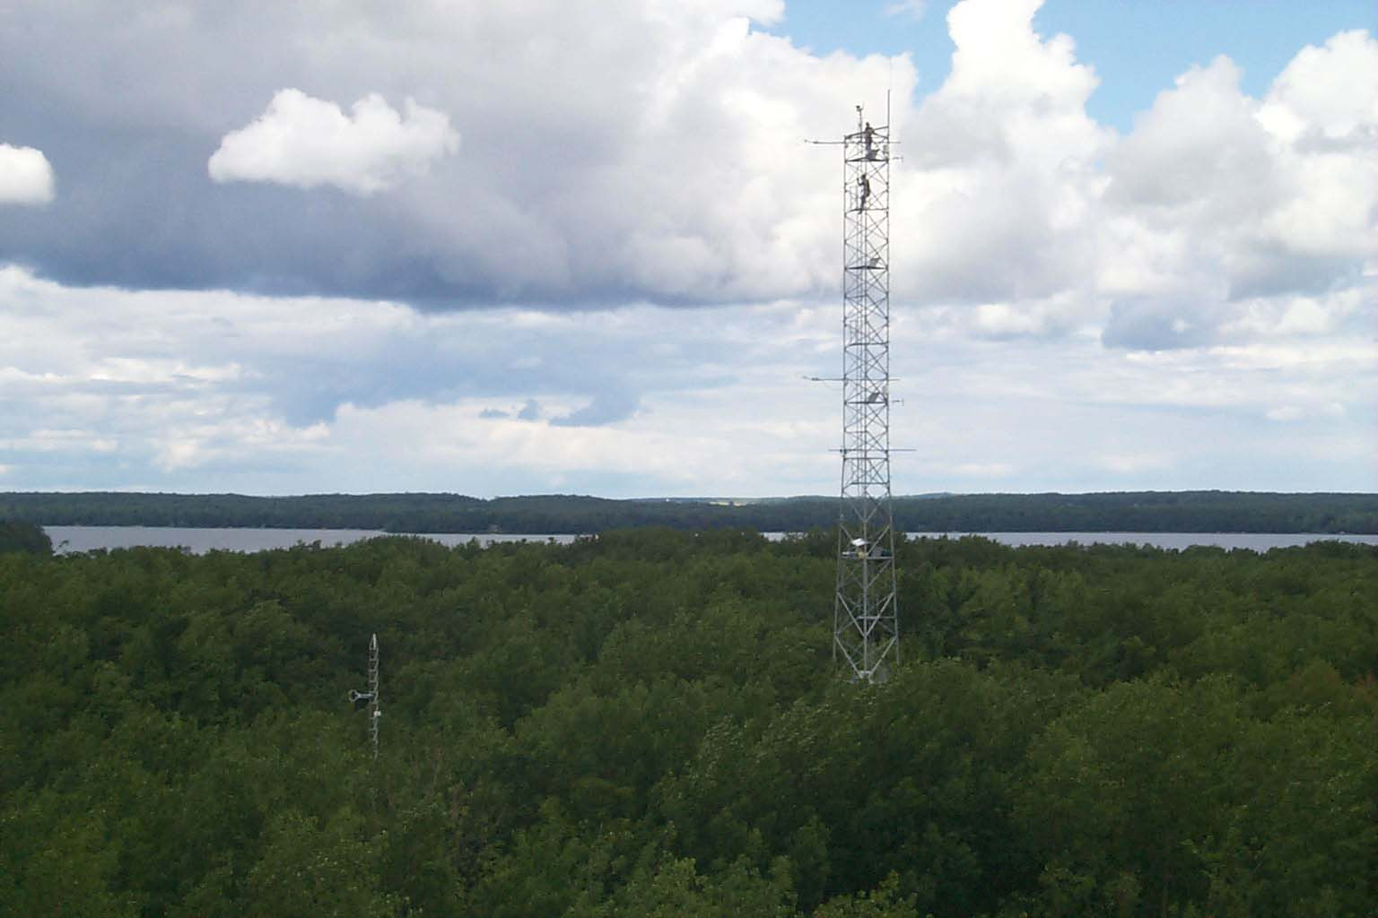
Meteorological Studies of Forest Carbon Storage

Slide 5
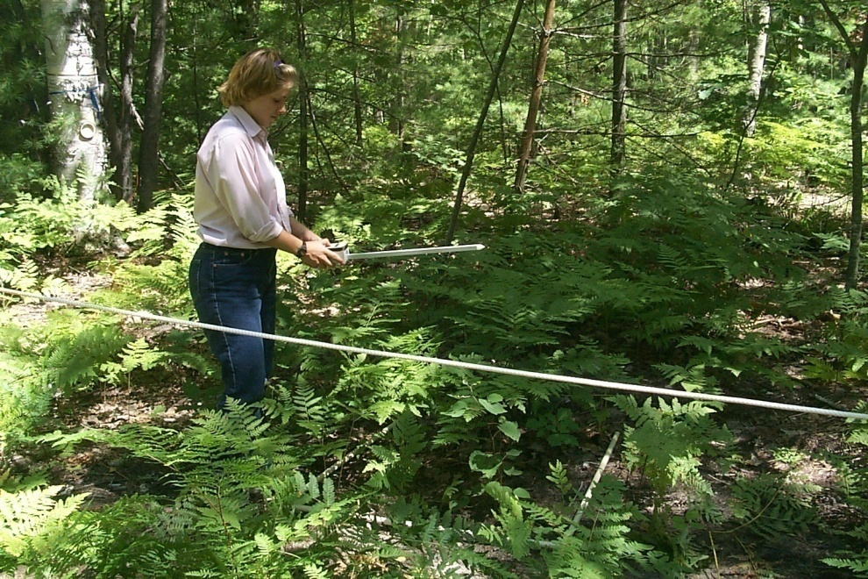
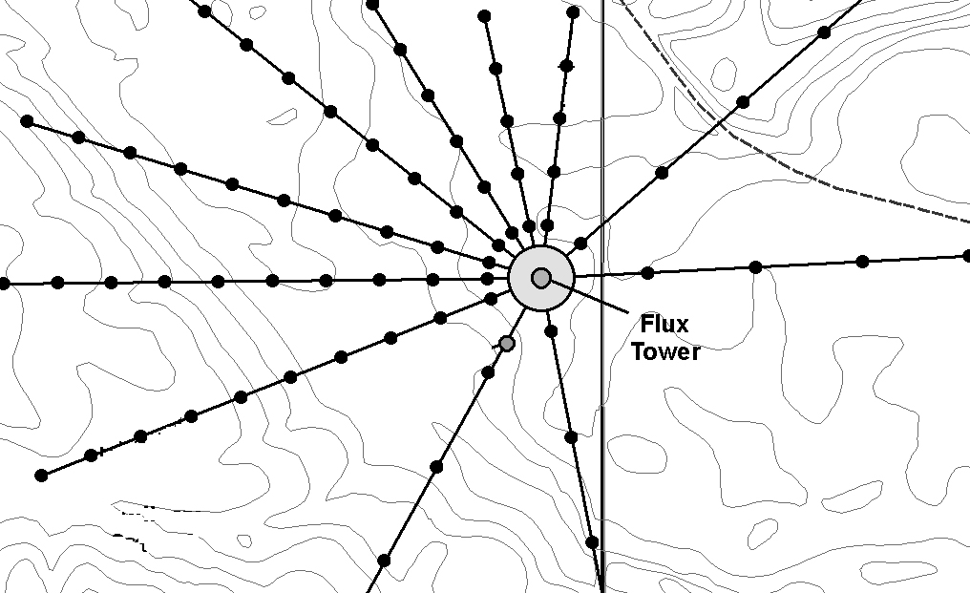
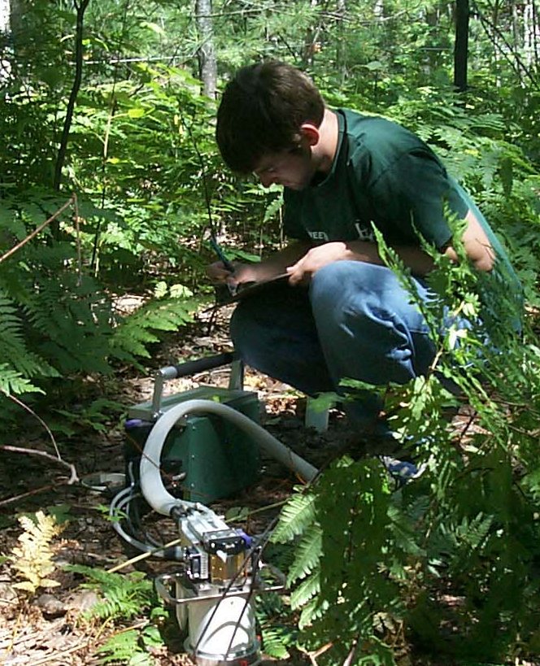
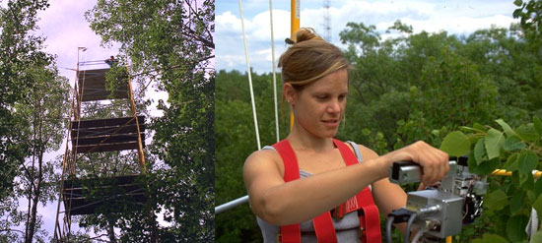
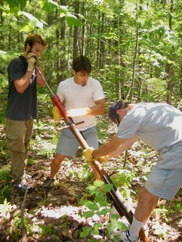
Ecological Studies of Forest Carbon Storage
Permanent Study Plots at UMBS

Slide 6
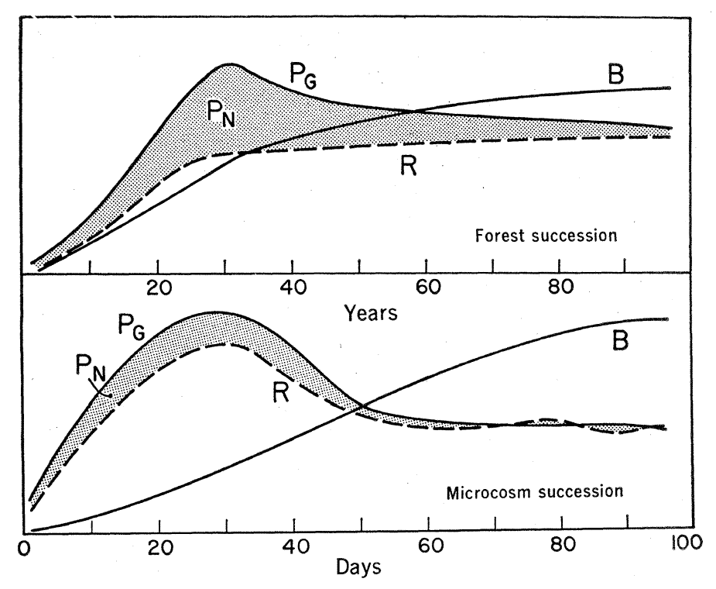
Conventional Theory of Carbon Storage as Forests Age
Wood production (slope of line B) and carbon storage (area of shaded P_{N}) are maximized in young forests.
In forests > 100 yrs, both slow to near zero.
P_{G} = Gross Production (photosynthesis), R = Respiration, B = Biomass, P_{N} = Net Production (Carbon Storage)
E.P. Odum. 1969. The Strategy of Ecosystem Development. Science 164.

Slide 7
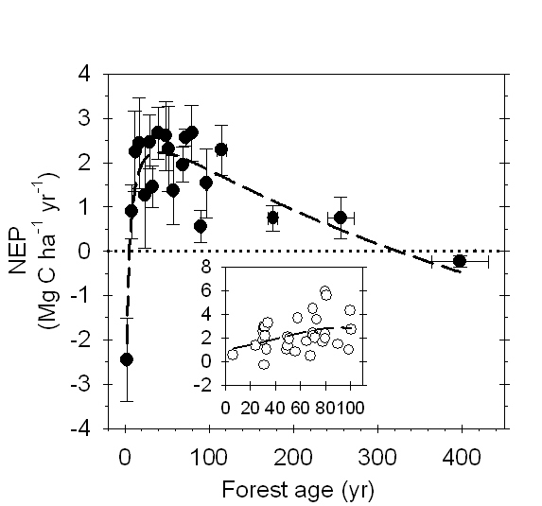
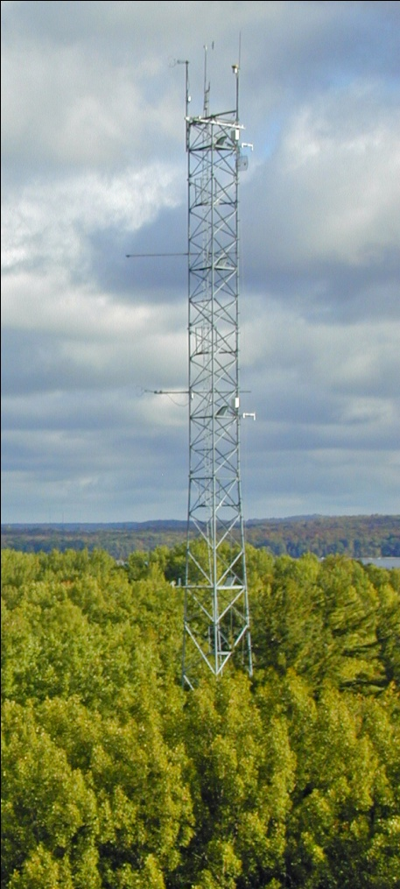
However, Meteorological Data From Around the World Shows Substantial Carbon Storage in Forests > 200 Years Old
Old stands mostly western conifers
Hardwood data stops at 100 yrs
UMBS Forest
Carbon Cycle
Research Program
Gough et al. (2008, Bioscience)

Slide 8
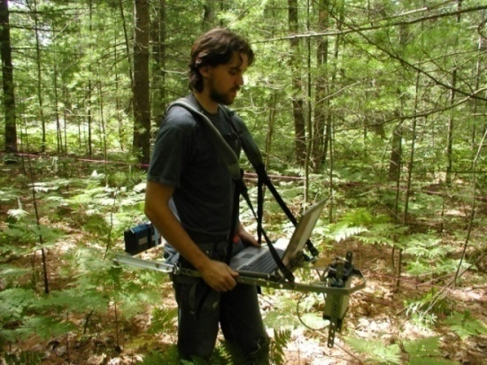
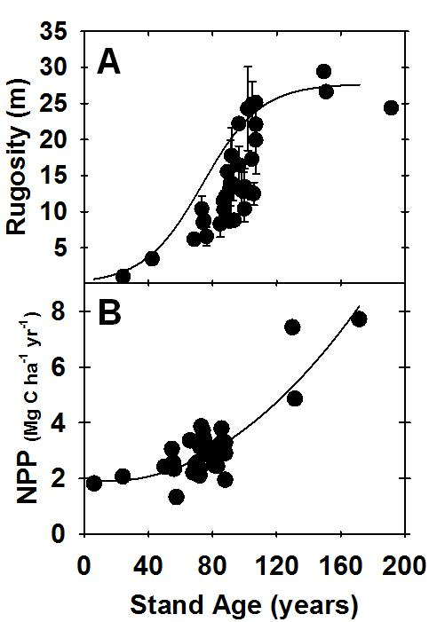
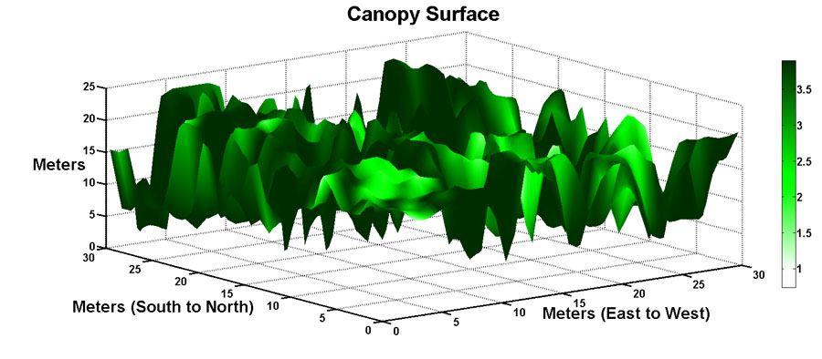
Older Forest Plots At UMBS That Are More Structurally Complex Have Higher Wood Production
We measure canopy complexity (rugosity) with a laser rangefinder.
Both canopy complexity (A) and productivity (B) increase with stand age
Hardiman et al. (2011, Ecology)
UMBS Forest
Carbon Cycle
Research Program

Slide 9
Measuring canopy structure
32m

Slide 10
Quantifying canopy structure
Gap Fraction
Vertical distribution of surface area
LiDAR returns from canopy surface area:
Density
Distribution & Variability
Presence/absence

Slide 11
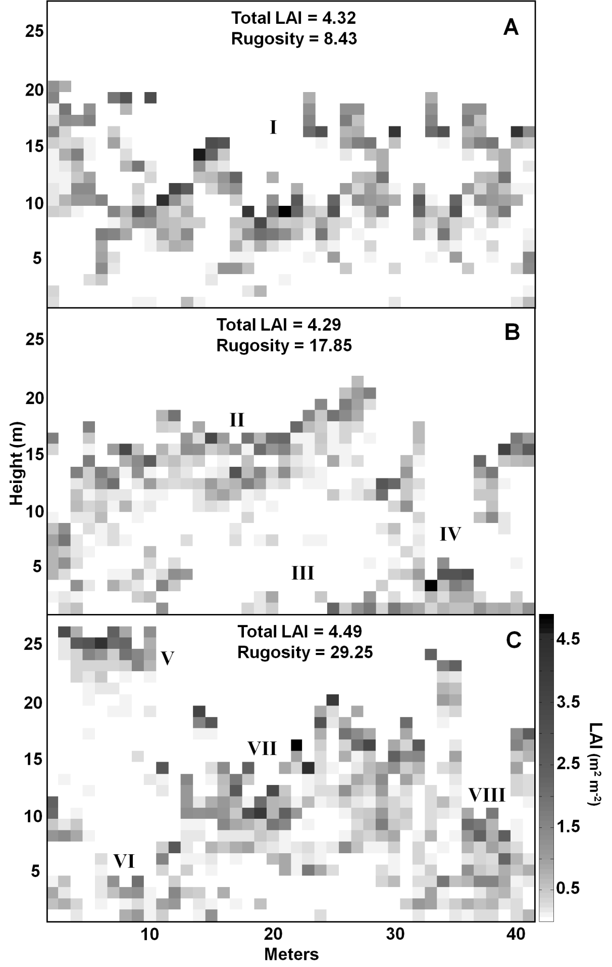
Bias-corrected Distributions of Vegetation Density in Plots of Low (A), Intermediate (B), and High (C) Rugosity but of Similar Total Leaf Area Index (LAI)
UMBS Forest
Carbon Cycle
Research Program

Slide 12
Relationships between Light Use Efficiency (LUE), Nitrogen Use Efficiency (NUE) and canopy rugosity. R²=0.60 and 0.32 for LUE and NUE, respectively. Shaded areas are 95% confidence intervals.
UMBS Forest
Carbon Cycle
Research Program
Hardiman et al. (in prep)

Slide 13
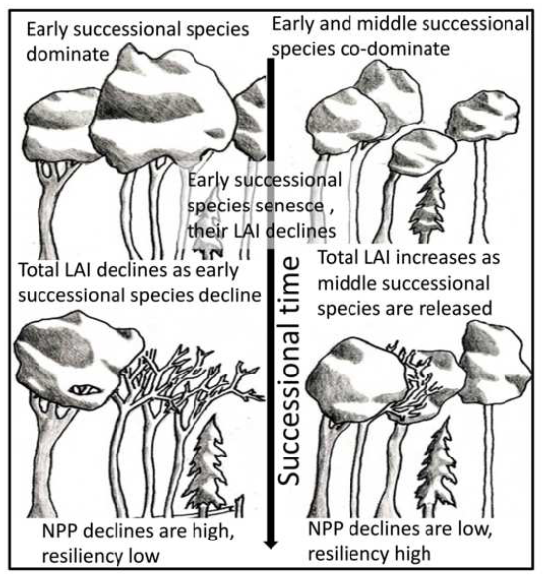
Older Plots That Are More Biodiverse Are More Resilient to Production Declines With Age
Gough et al. (2010, FEM)
Higher biodiversity = greater ecological resilience
UMBS Forest
Carbon Cycle
Research Program

Slide 14
Counter-theory: Carbon Storage will Increase With Forest Age Due to Increasing Ecosystem Complexity
We now are testing this theory with the Forest Accelerated Succession Experiment
UMBS Forest
Carbon Cycle
Research Program

Slide 15
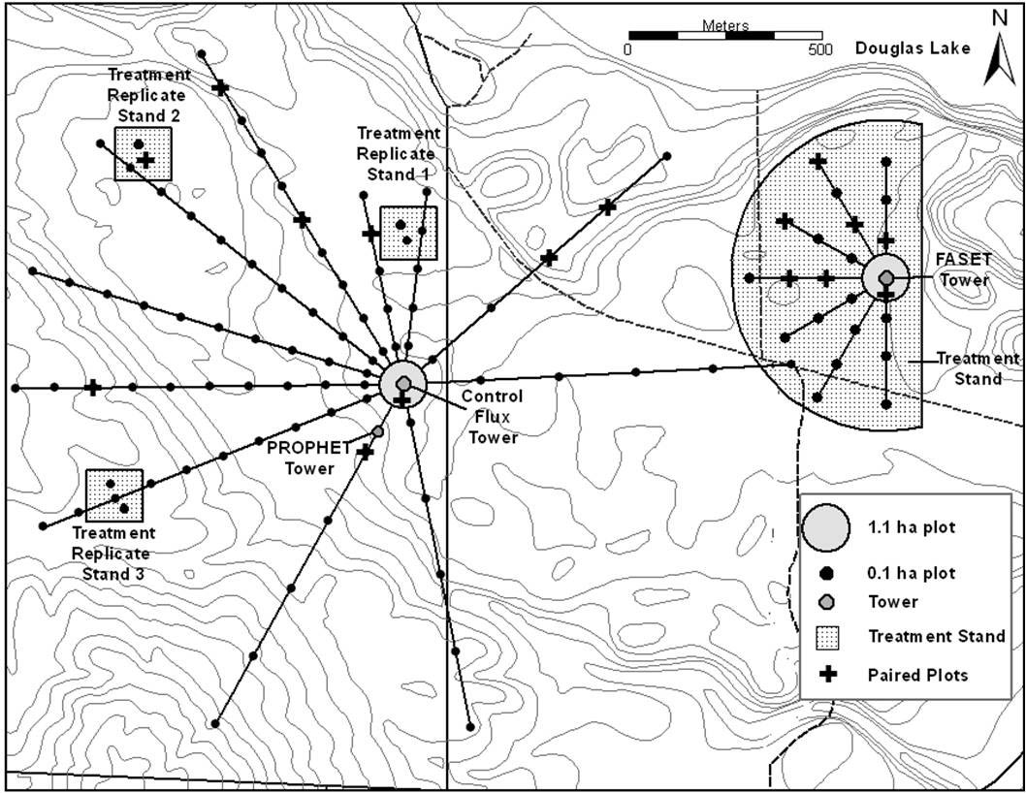
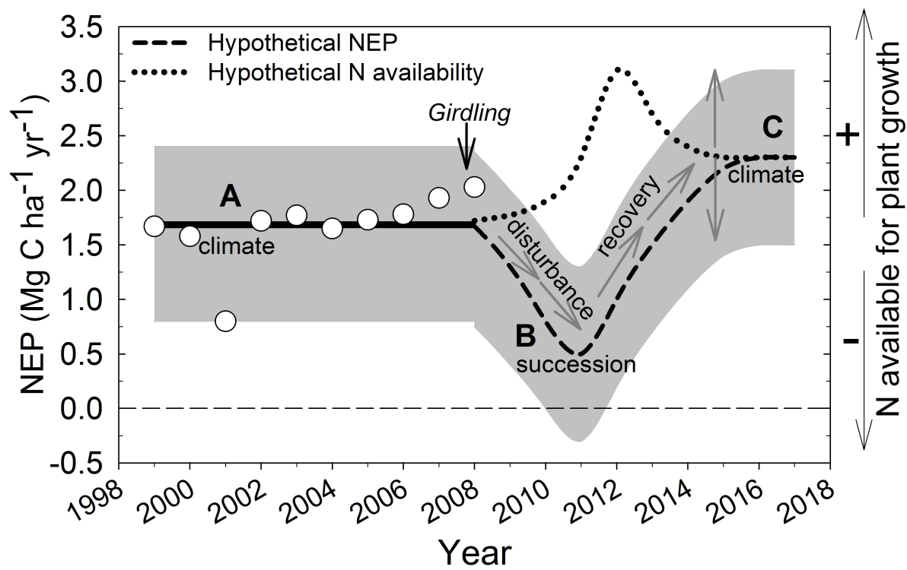
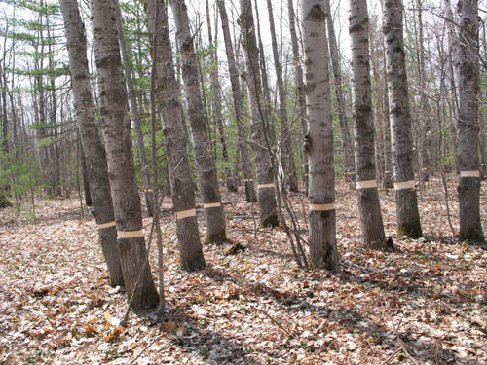
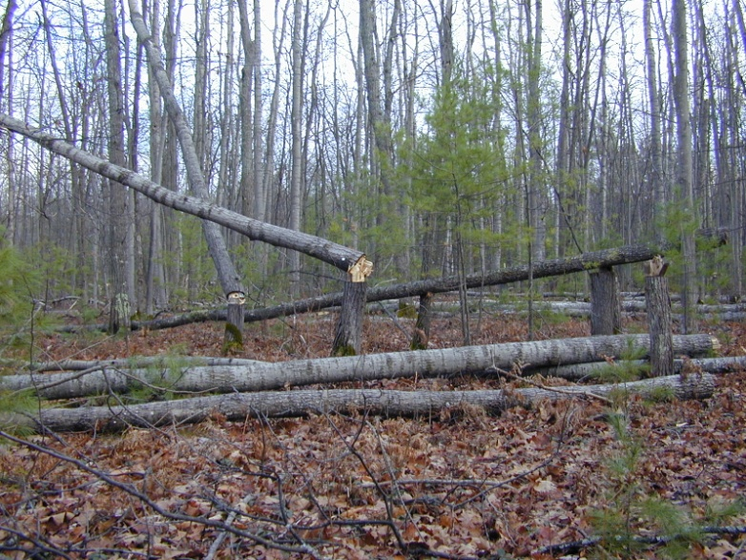
The Forest Accelerated Succession Experiment
Conceptual model of ecosystem carbon storage (NEP) before, during, and after aspen and birch mortality.
2008
2010
UMBS Forest
Carbon Cycle
Research Program
Nave et al. (2011, JGR Biogeosciences)

Slide 16
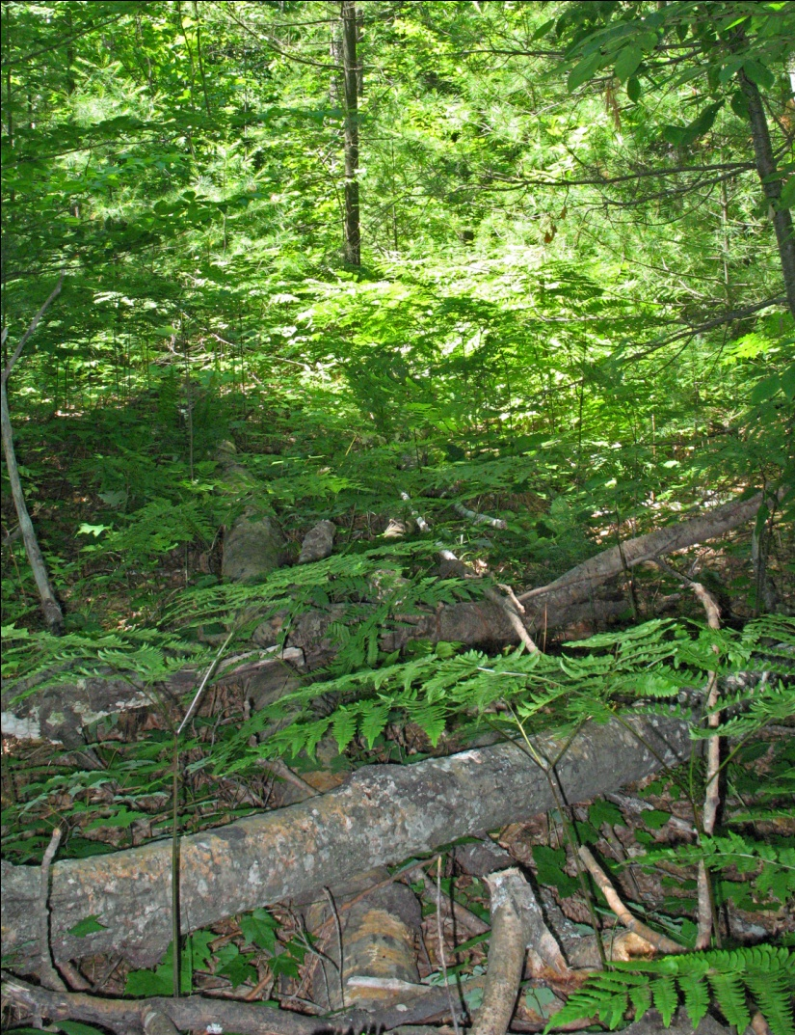
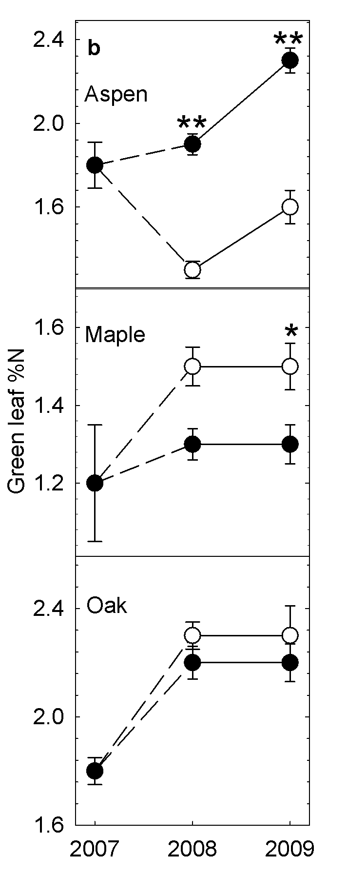

Nitrogen Is Not Lost From The Ecosystem Following Aspen Mortality
Leaf nitrogen decreased in aspen but increased in neighboring maple.
Oak showed little change.
2011
UMBS Forest
Carbon Cycle
Research Program

Slide 17
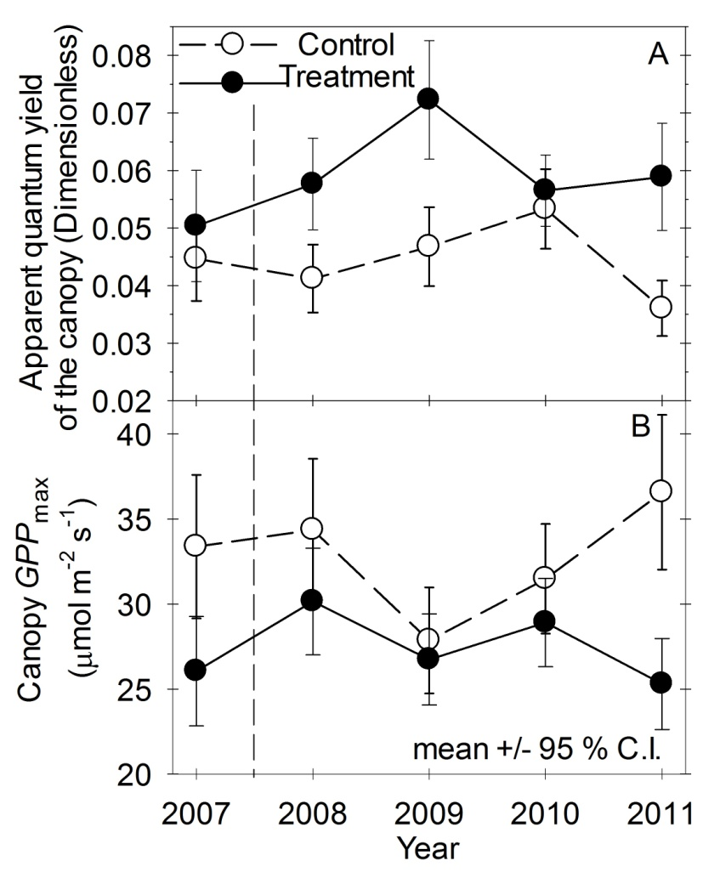
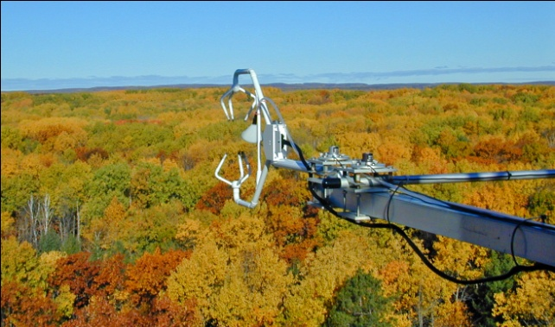
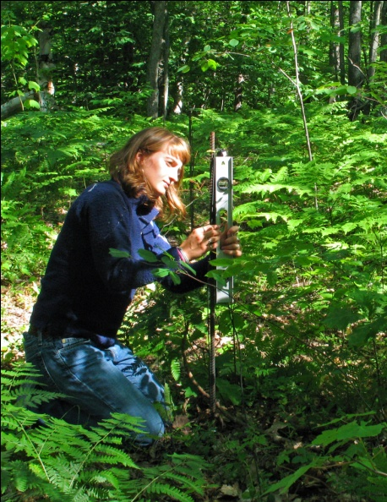
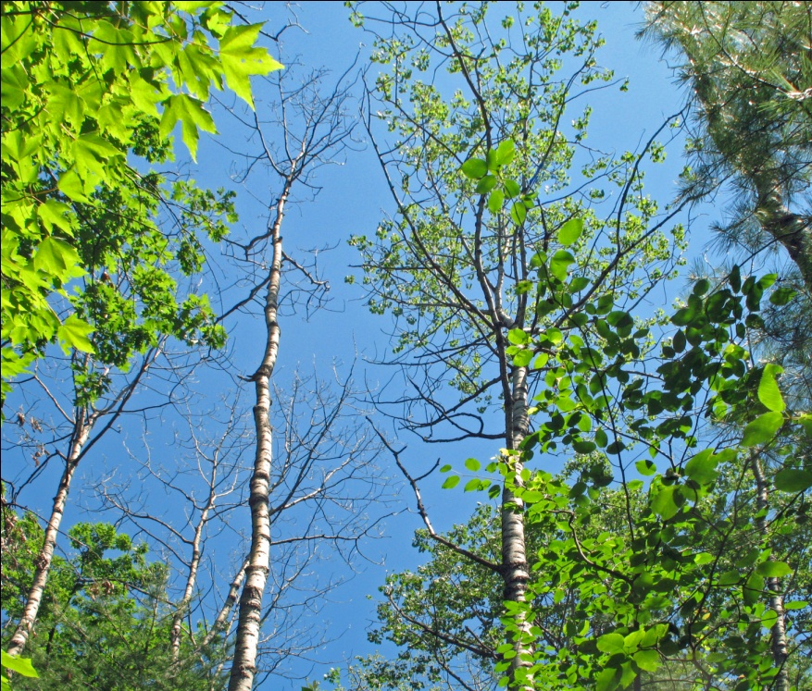
Ecosystem Light Use Efficiency Is Higher Following Aspen Mortality
Quantum yield increased significantly in treatment stands although GPP_{max} declined
Gough et al. (in prep)

Slide 18
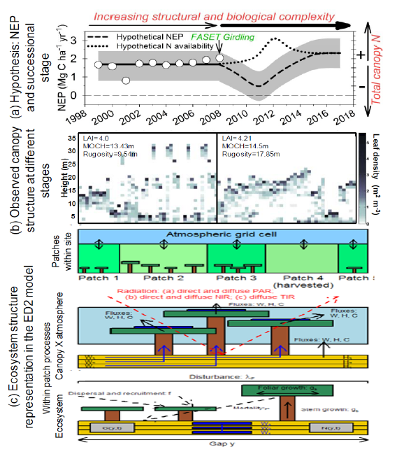
Integration of newly identified mechanisms as components within ED2.
This will allow ED2 to resolve the short-term (flux exchange rates) and long-term (C storage and ecosystem dynamics) effects of canopy biotic and structural change.
UMBS Forest
Carbon Cycle
Research Program

Slide 19
UMBS Forest
Carbon Cycle
Research Program

Slide 20
Current Questions and Future Directions
Generality of sustained C storage in older Great Lakes forests.
Re-instrumentation of Sylvania tower, possible use of other old-growth U.P. sites (Dukes EF, Huron Mt. Club)
Mechanisms of canopy-level response to changing structural and biotic complexity.
Forest ecosystem resistance/resilience to gradients of disturbance.
Integration of new mechanisms into ecosystem models (ED2, BIOME-BGC)

