Slide 1
Building a framework for climate change Mitigation and adaptation models, assessments and applications
Linda Parker Chequamegon-Nicolet Forest Ecologist National Forest
lrparker@fs.fed.us
Notes:
Today I’d like to tell you about a collaborative project to develop a framework for climate change adaption in the forests of northern Wisconsin.
I’ll be focusing on models, assessments, and application

Slide 2



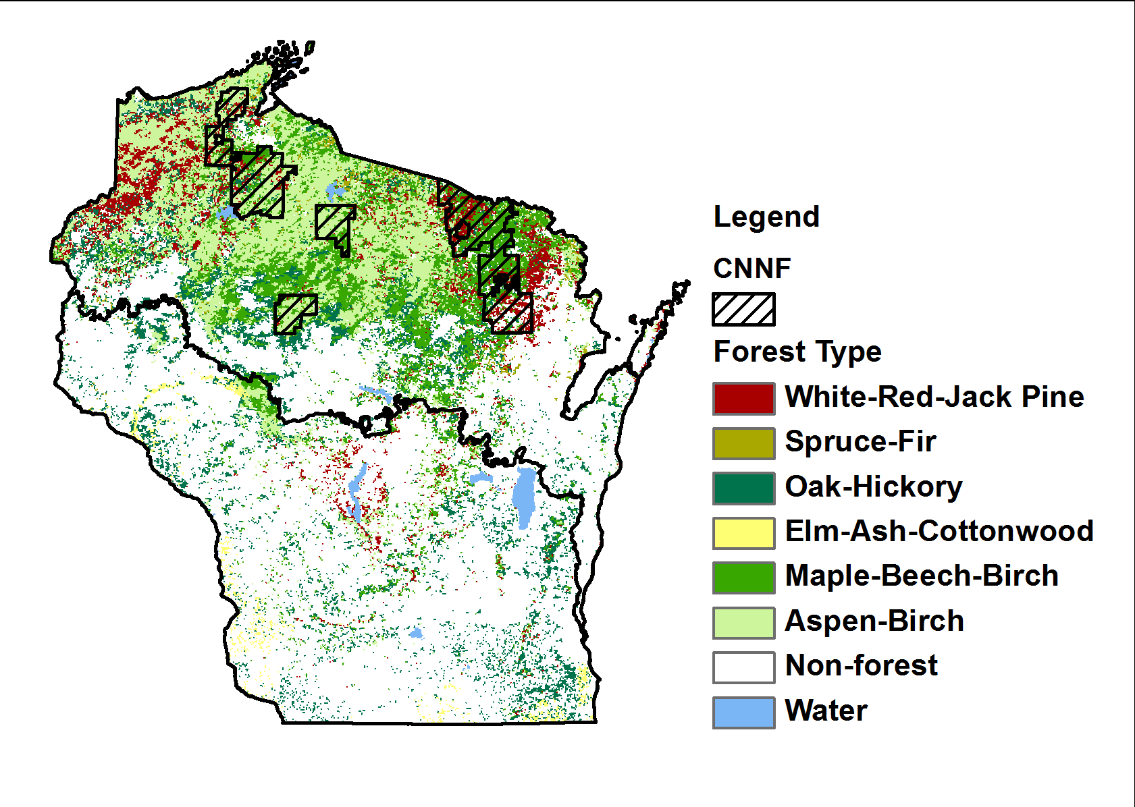



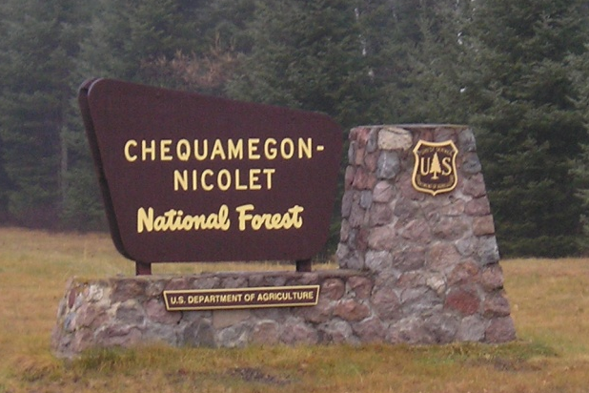
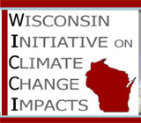
Climate Change Response Framework
Focused on Northern Wisconsin
Notes:
This effort began on the Chequamegon-Nicolet National Forest, but quickly expanded to include all of Northern Wisconsin down to the Province 212 boundary.
Brought together partners from a number of different organizations
Large cast of characters. Each brought their skills and interests.

Slide 3
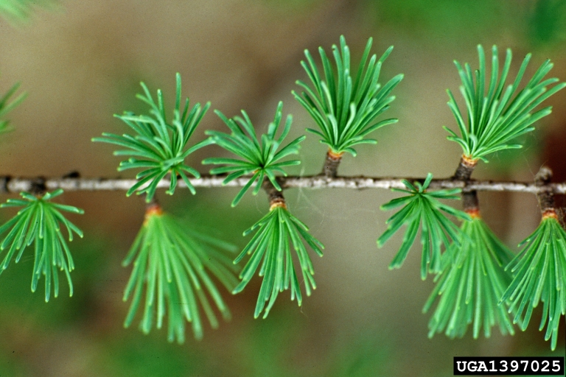
Climate Change Response Framework in Northern Wisconsin
Key Components:
Vulnerability Assessment
Mitigation Assessment
Adaptation Tools
Partnerships
Applications
Notes:
The work I’ll describe today is part of a larger Climate Change Response Framework in Northern Wisconsin
Key Components of the Framework include:
Vulnerability Assessment
Partnerships
Science Applications and Needs
Adaptation Resources

Slide 4
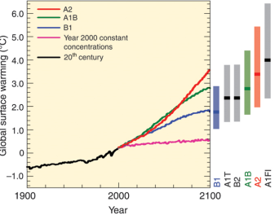
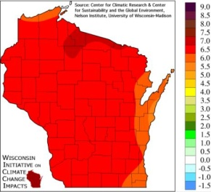
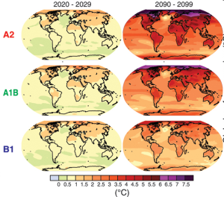
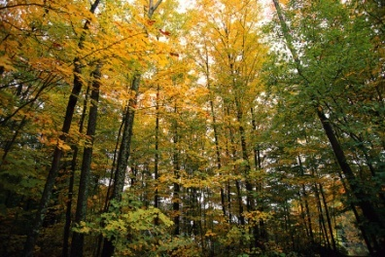
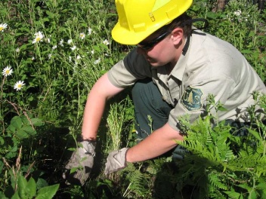

Climate Change Response Framework
Notes:
To move from theoretical discussions and documents to actual on the ground management, numerous demonstration projects are now underway

Slide 5
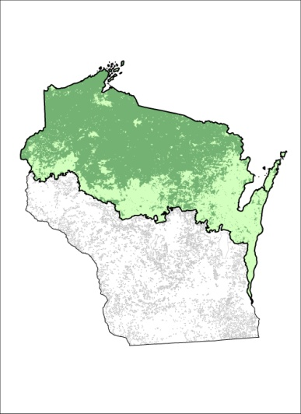
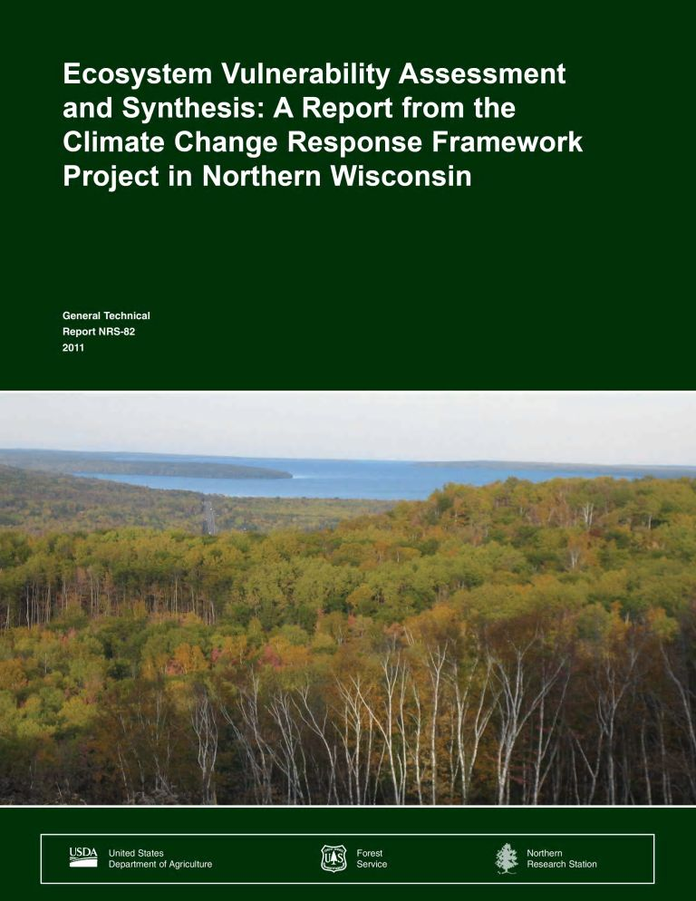
Vulnerability
Ecosystem Vulnerability Assessment and Synthesis (EVAS):
Evaluate key ecosystem vulnerabilities
Primary focus on forest ecosystems.
Hot off the presses!
www.nrs.fs.fed.us/pubs/38255
Notes:
Our first task what to determine what is most at risk from climate change…what is most vulnerable?
To address this questions, our team prepared this document:
Ecosystem Vulnerability Assessment and Synthesis OR “EVAS”:
Our objective was:
To Evaluate key ecosystem vulnerabilities under a range of future climate uncertainty using existing models and information.
With a Primary focus on forest ecosystems.
And Hot off the presses! The EVAS has now been published as a GTR available at this website
www.nrs.fs.fed.us/pubs/38255

Slide 6
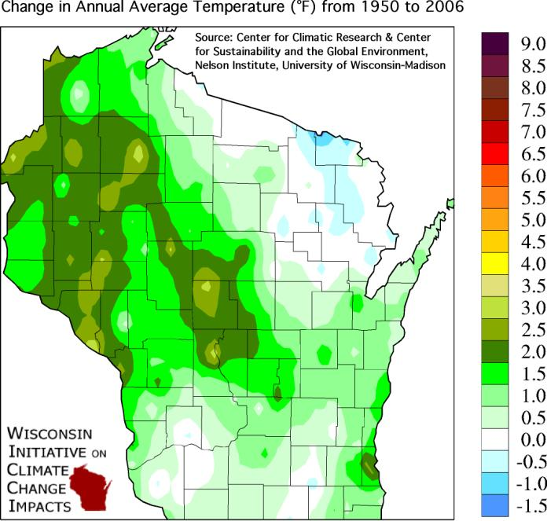
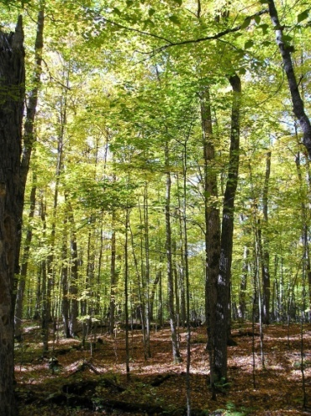
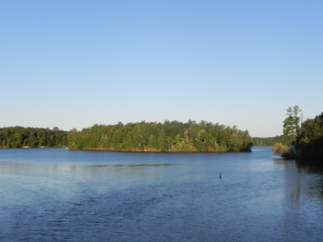
Ecosystem Vulnerability Assessment and Synthesis (EVAS):
Contents
The Contemporary Landscape
Climate Change Science and Modeling
Climate Change in Northern Wisconsin
Climate Change Effects on Forests
Implications for Forest Ecosystems
Notes:
The EVAS covers these major headings:
The Contemporary Landscape
Climate Change Science and Modeling
Climate Change in Northern Wisconsin
Climate Change Effects on Forests
Implications for Forest Ecosystems

Slide 7
Climate Change Effects on Forests
Climate Change Tree Atlas
Species distribution model
Potential changes in suitable habitat
Climate Change Atlas Lab (L. Iverson, USDA Forest Service)
LANDIS II
Process model
Incorporates interactions, disturbance, management to simulate changes in biomass and distribution
Forest Landscape Ecology Lab (D. Mladenoff, UW–Madison)
Notes:
To project the effects of climate change on Forests, we used two different models
The Climate Change Tree Atlas which is a species distribution model: it examines the features that contribute to a tree species’ current habitat and then projects where similar habitat conditions are likely to occur in the future.
LANDIS II, a process model that incorporates interactions, disturbance, and management
This work is done by David Mladenoff and his colleagues

Slide 8
Climate Change Tree Atlas Results
Black Spruce
Balsam Fir
White Cedar
Yellow Birch
Paper Birch
Quaking Aspen
Jack Pine
Red Maple
White Pine
Butternut
Small Decline
Large Decline
No Change
Red Pine
N. Pin Oak
Basswood
Red Oak
Pin & Choke Cherry
White Spruce
Eastern Hemlock
Sugar Maple
Black Ash
Tamarack
Big Tooth Aspen
Notes:
Most of the dominant tree species on the Chequamegon Nicolet are projected to decline

Slide 9
Forest Carbon
Sequestration
and
Mitigation
(Preliminary Mitigation Assessment)
Contributing authors: Rich Birdsey, YudePan, Linda Parker, Susan Stewart, Sarah Hines, Maria Janowiak, Chris Swanston, David Mladenoff, Jeremy Lichstein, Craig Wayson, Kevin McCullough

Slide 10
Suggested Mitigation Options
•Afforestation and restoration
•Conserve existing forests
•Forest soil management
•Managing the industrial forest carbon cycle
–Carbon storage in wood products
–Substituting wood products for other materials
–More efficient use of raw material
•Bioenergy options
Continued….

Slide 11
More mitigation options This is where you come in…
Forest management
–Changing rotation ages
–Changing harvest strategies
–Changing forest density
–Changing harvest intensity
•Minimizing impacts of natural disturbances

Slide 12
Clearcut/Regeneration
Notes:
What contributions can forest management really make?

Slide 13
Possible Approach to Analysis of Mitigation Options –Phase 2
•Scenario analysis (historical climate and disturbance) FIA and FVS (original method)
•Add Scenario analysis (historical climate and disturbance)
–Biome-BGC
–LANDIS-II
–PneT-CN
–Land model (LM3V) from GFDL Earth System model
•Compare life cycle analysis approach

Slide 14

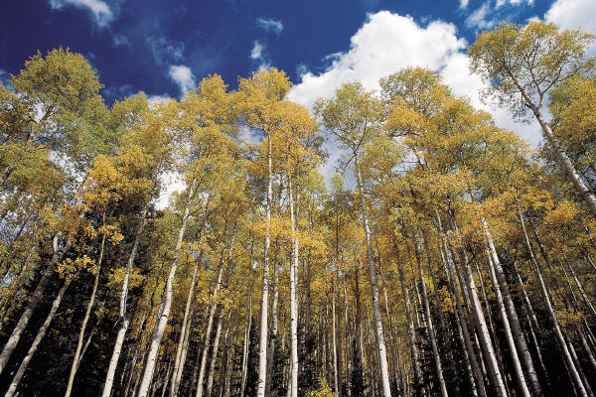
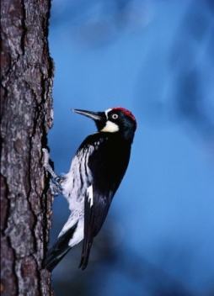
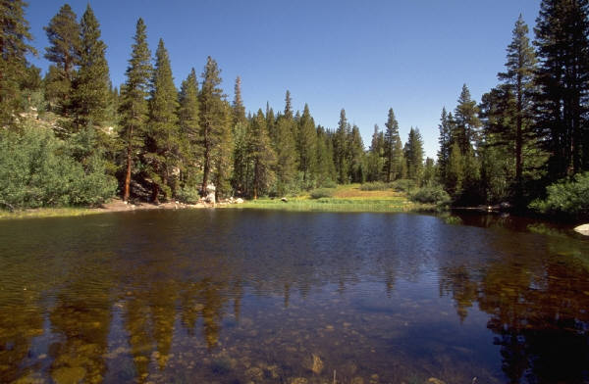
What Can Managers Do? Adapt.
Adaptation is the adjustment of human or natural systems in response to climate change.
Notes:
Once the Vulnerability Assessment was completed, we turned out attention to helping managers make use of this new information.
What can managers do? Adapt

Slide 15
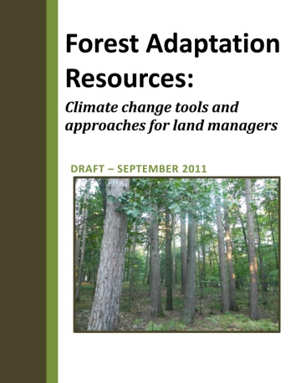
Adaptation Tools
tinyurl.com/FAR-draft
Notes:
To help forest managers incorporate adaptation into management planning and actions we developed the
Forest Adaptation Resources: Climate Change tools and Approaches for Land Managers
While I don’t have very much time to spend on this I did just want to at least mention it briefly.

Slide 16
Forest Adaptation Resources: (FAR)
Climate change tools and approaches for land managers
Notes:
The FAR document, as we refer to it, contains has three major elements:
1) Strategies and Approaches for adaptation created and reviewed by experts (>50 experts) and based on vulnerability assessment.
2) Workbook that will step managers and practitioners through the process of applying the Approaches,
3) Illustrations will provide concrete examples of the entire process using small groups of National Forest managers and practitioners as testers.

Slide 17
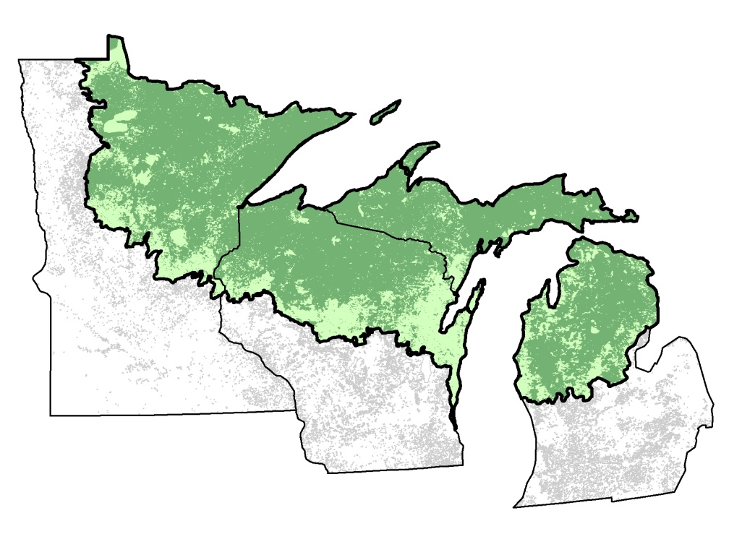
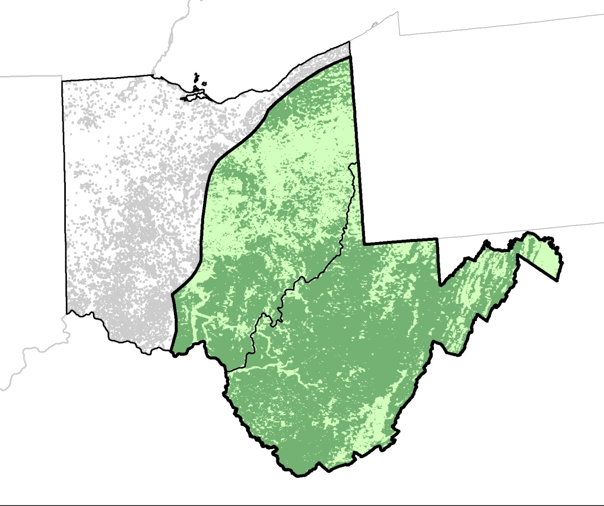
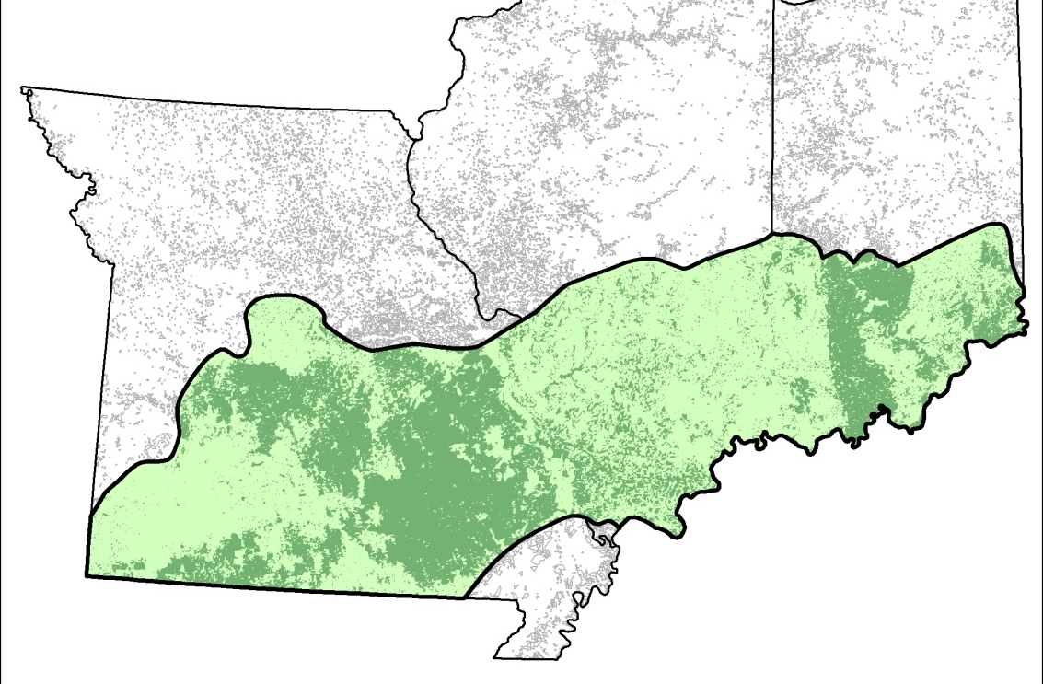
Climate Change Response Framework: Projects now underway
6 National Forests
MN, WI, MI
2 National Forests
OH, WV
3 National Forests
MO, IL, IN
Notes:
Although the Climate Change Response Framework initially focused on Northern Wisconsin, it has been so well received that it is now being duplicated elsewhere in the Eastern Region

Slide 18
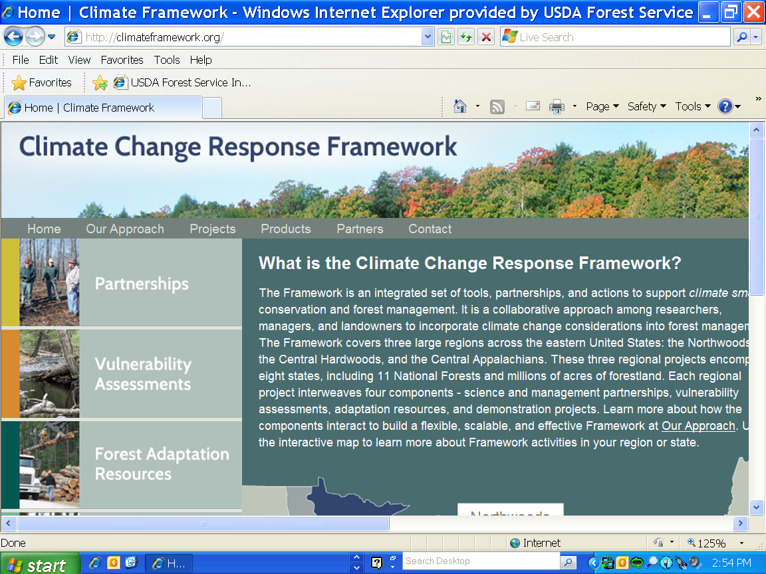
Climateframework.org
Notes:
And finally, if you would like more information on this project you can find it at
Climateframework.org

Slide 19
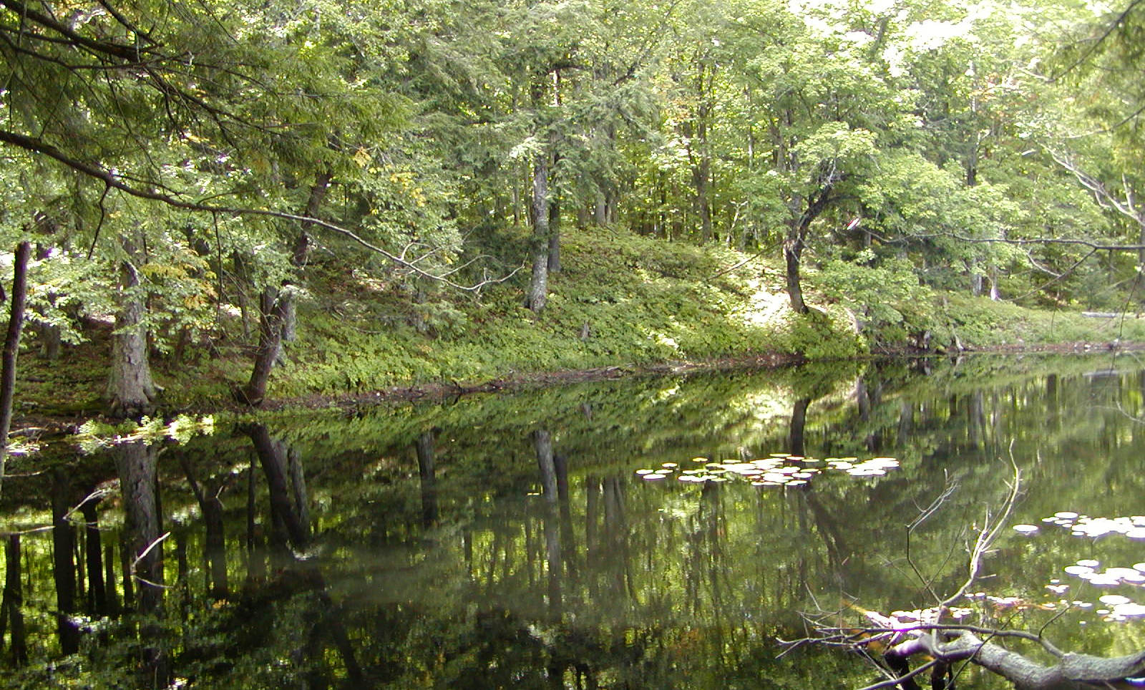
Thank you…
Notes:
Thank you

Slide 20
Notes:
Age l

Slide 21
Carbon Budget of Northern Wisconsin Forests and Wood products, 2000-2009
Energy use and substitution effects not included
Forest Ecosystem 1.0
Transfer to Harvested 0.5
Wood Products
Total 1.5
TgCyr-1
FIA periodic and recent annual inventories (1983, 1996, 2004, annual 2006-2009)
•Calculations done with the FS “Carbon Calculation Tool”

