Slide 1
The role of the Chequamegon Ecosystem-Atmosphere Study in the U.S. Carbon Cycle Science Plan
Ken Davis
The Pennsylvania State University
The 13th ChEAS meeting, 27-29 June, 2012, Kemp Natural Resources Station

Slide 2
Fundamental science questions from a new US Carbon Cycle Science Plan, 2011
Question 1. How do natural processes and human actions affect the carbon cycle on land, in the atmosphere, and in the oceans? (process understanding)
Question 2. How do policy and management decisions affect the levels of the primary carbon-containing gases, carbon dioxide and methane, in the atmosphere? (carbon management)
Question 3. How are ecosystems, species, and natural resources impacted by increasing greenhouse gas concentrations, the associated changes in climate, and by carbon management decisions? (impacts)

Slide 3
Two Core Scientific Goals in Carbon* Cycle Science
Diagnose past/current terrestrial carbon fluxes (primarily a spatial problem).
Predict future terrestrial carbon fluxes (temporal and spatial problem).
(* We could readily add apply the same discussion to water.)

Slide 4
Prediction
Requires observations over long time scales to test/develop prognostic skill. For ecosystems, this means time scales of decades or more.
  Flux towers are tough to run for decades to evaluate how ecosystems respond to climate change and forest management
  You can trade space for time (e.g. measure young and old forest stands), or perform clever experiments to get around this
  ChEAS can help in this area, and is perhaps more unique in its ability to inform the responses of forests to management (many different flux sites) than response of forests to climate change

Slide 5
Diagnosis
ChEAS is one of the best places on the planet to test our ability to diagnose fluxes via flux tower upscaling.
  Globe: 10⁸ km² of land area, ~500 flux towers sampling ~ 1 km² of land each. Each tower must represent 2x10⁵ km² of the earth’s land surface.
  ChEAS: 200x200 km² of land area, ~20 flux towers (17 have run at one time or another) each sampling ~1 km² each (WLEF more like 100 km²?). Each tower must represent about 2x10³ km². 100x denser sampling than available at global scale!
  In addition to lots of flux towers, we have lots of ancillary biological data (e.g. FIA) and innovative remote sensing products available in the region.
  (worries: QC on the flux measurements. Database management.)

Slide 6
A path for ChEAS research
Many efforts underway, both flux tower upscaling (Fluxnet) or ecosystem models (MsTMIP). Global to continental scales.

Slide 7
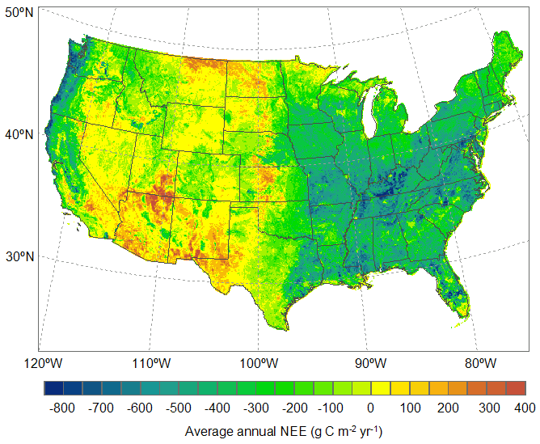
Flux tower upscaling example: Xiao et al., 2008
Xiao et al, 2008, Agr. and F. Met.
EC-MOD

Slide 8
Monthly NEE model-data comparison
Raczka et al., submitted

Slide 9
A path for ChEAS research
Many efforts underway, both flux tower upscaling (Fluxnet) or ecosystem models (MsTMIP). Global to continental scales.
Relatively simple uncertainty estimates
Relatively few comparisons to date, and none at high resolution (e.g. ChEAS)
Few evaluations of the benefits of advanced remote sensing / relative value of innovative remote sensing
These are areas where ChEAS research efforts can help to “write the book” for the global carbon cycle science community.

Slide 10
Northern Forests ecoregion
17 eddy flux towers
Different plant function types (PFTs)
Stand age and disturbance history
Xiao et al., 2011, in prep
Notes:
10

Slide 11
Cross model comparison: Limited convergence to date
This study
MODIS GPP
(Running et al. 2004)
EC-MOD
(Xiao et al., RSE, 2011)
GPP
NEE
Xiao et al., 2011, JGR-B
(g C m⁻² yr⁻¹)

Slide 12
Parametric uncertainty
(gC m⁻² yr⁻¹)

Slide 13
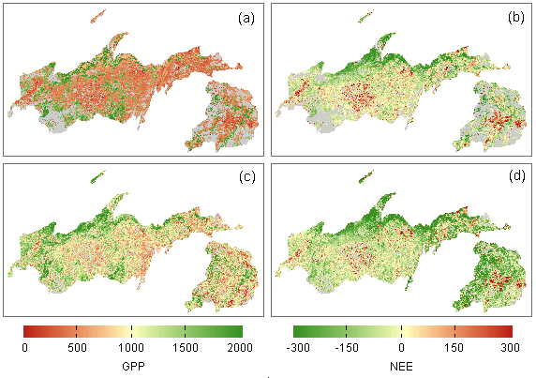
Input data uncertainty
(gC m⁻² yr⁻¹)
GPP (MODIS)
NEE (MODIS)
GPP (NLCD)
NEE (NLCD)

Slide 15
(Goals of a new US CCSP)
Goal 1. Provide clear and timely explanation of past and current variations observed in atmospheric CO2 and CH4 – and the uncertainties surrounding them. (Q1, Q2)
Goal 2. Understand and quantify the socioeconomic drivers of carbon emissions, and develop transparent methods to monitor and verify those emissions. (Q1, Q2)
Goal 3. Determine and evaluate the vulnerability of carbon stocks and flows to future climate change and human activities, emphasizing potential positive feedbacks to sources or sinks that make climate stabilization more critical or more difficult. (Q1, Q2, Q3)
Goal 4. Predict how ecosystems, biodiversity, and natural resources will change under different CO2 and climate change scenarios. (Q3)
Goal 5. Determine the likelihood of success and the potential for side effects of carbon management pathways that might be undertaken to achieve a low-carbon future. (Q1, Q2, Q3)
Goal 6. Address decision maker needs for current and future carbon cycle information and provide data and projections that are relevant, credible, and legitimate for their decisions. (Q1, Q2, Q3)

Slide 16
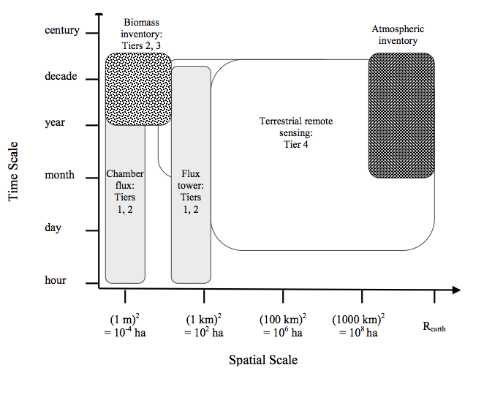
Carbon cycle observations: Methods “see” different spatial and temporal scales
Terrestrial carbon stocks
Atmospheric carbon
Surface radiances
Carbon fluxes
Davis, 2008

