Slide 1
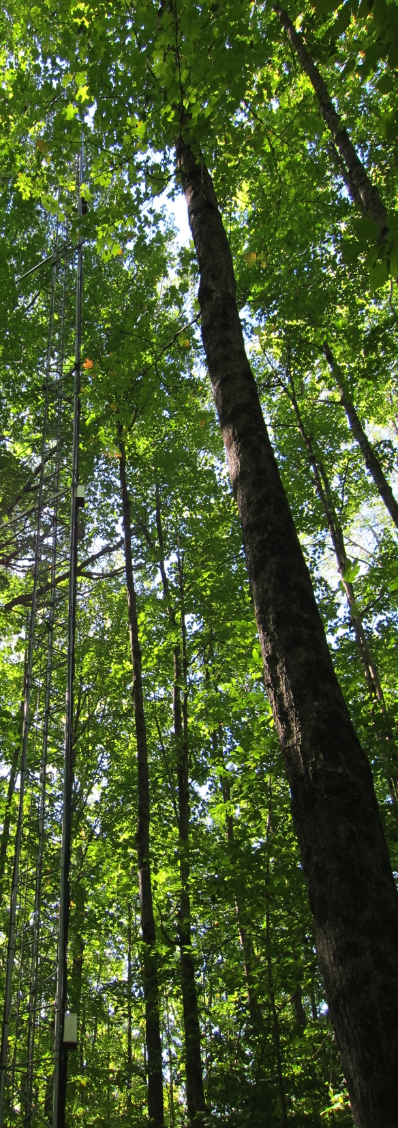
Assessing forest thinning impacts on soil carbon emissions with radiocarbon
Karis Mc Farlane, Claire Phillips—LLNL-DOE
Ankur Desai, Erika Marin-Spiota—UW-Madison
Hypothesized impacts of canopy removal on soil carbon
Increased decomposition (more light, heat, moisture)
Decreased decomposition (reduced carbon inputs)
No change or mixed effects
What is the balance of physical and biological drivers?

Slide 2
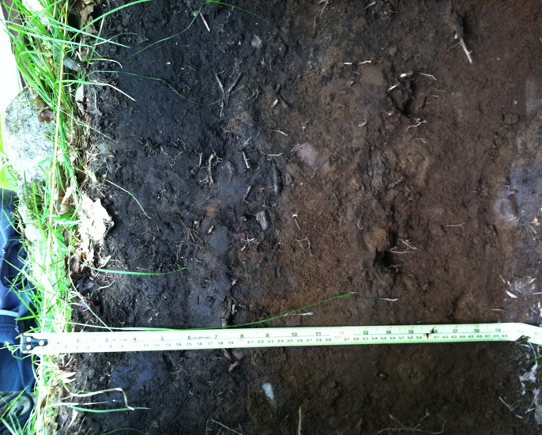
Understanding physical and biological drivers of soil C decomposition
¹⁴C Age
Take advantage of ¹⁴C profile gradients
Will thinning impact:
Shallow, young carbon?
Deep, old carbon?
Both?
0
5
10
20
30
50
70
1
<60
<60
755
1245
1390
2600

Slide 3
Radiocarbon basics
Radiocarbon basics:
¹⁴CO₂ produced in upper atmosphere
Plant tissue ¹⁴C = atmosphere ¹⁴C
¹⁴C decays with half-life ~5730 years
¹⁴C Age
Δ¹⁴C (‰)
0
5
10
20
30
50
70
1
<60
<60
755
1245
1390
2600
40
75.5
43.1
-96.7
-165.1
-237.6
-315.8
“Bomb” spike from nuclear weapons testing, 1963 test ban treaty

Slide 4
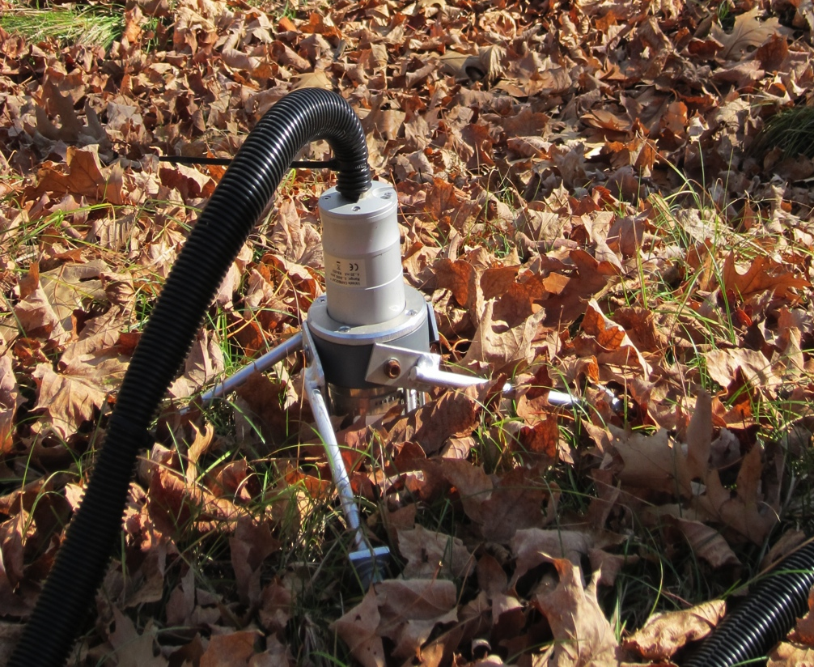
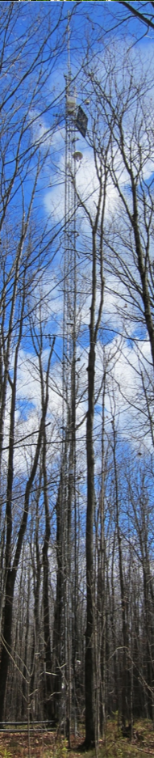
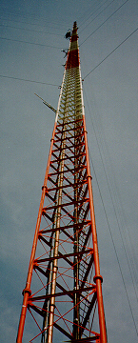
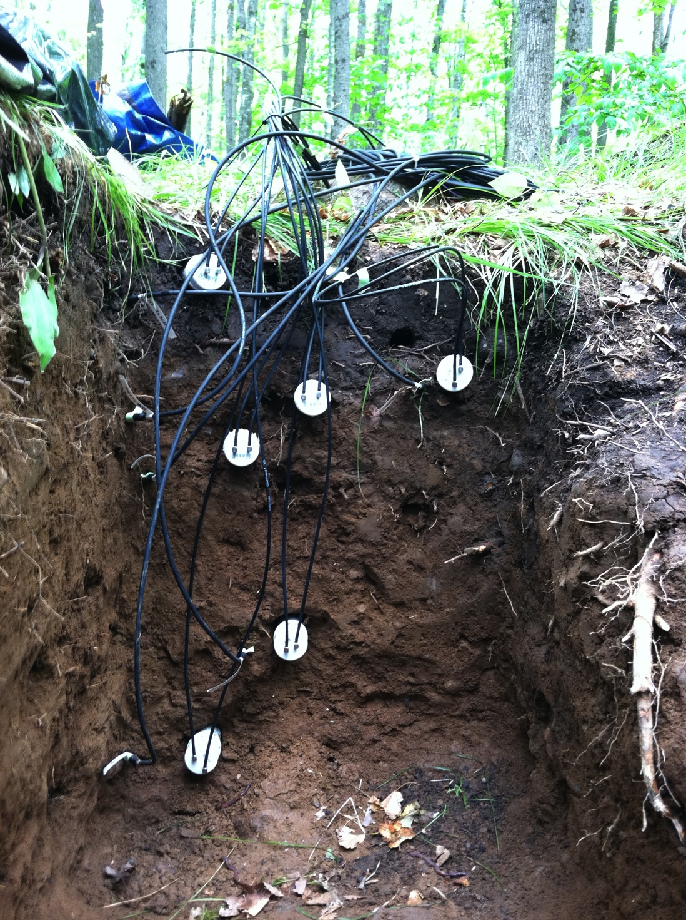
Approach: Use ¹⁴C as a tracer of soil CO₂ sources
¹⁴C as a tracer of soil CO₂ in the atmosphere
Can we detect “bomb” C above the canopy?
(30 m)
Can we detect “bomb” C from large-scale thinning at a regional scale?
¹⁴CO₂ at soil surface
Park Falls (450 m)
¹⁴CO₂ in soil profile

Slide 5
Preliminary results: pre-thinning measurements
¹⁴C of soil air
¹⁴C of putative respiration sources (roots and SOM decomposition)
N = 4
Soil CO₂ is modern throughout the profile…
…even during winter dormancy!
Thus far, little decomposition of deep, old soil C, even at depth.
CO₂ comes from modern sources (roots and SOM) and permeates the profile.

Slide 6
Will we be able to detect soil “bomb carbon” in the atmosphere?
Soil respiration was large relative to whole forest respiration last year

Slide 7
However, respired ¹⁴CO₂ was too similar to atmosphere ¹⁴CO₂ to distinguish
Monitored nocturnal CO₂ build-up at tower through fall 2011
¹⁴C did not increase over night
30m and 450m tower data suggest ¹⁴CO₂ impacted by regional fossil fuel emissions and biological exchange.

Slide 8
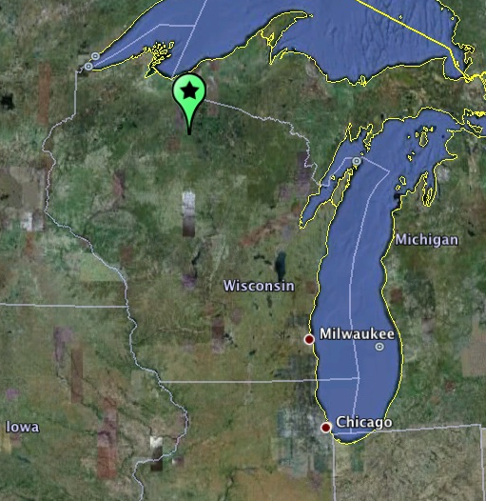
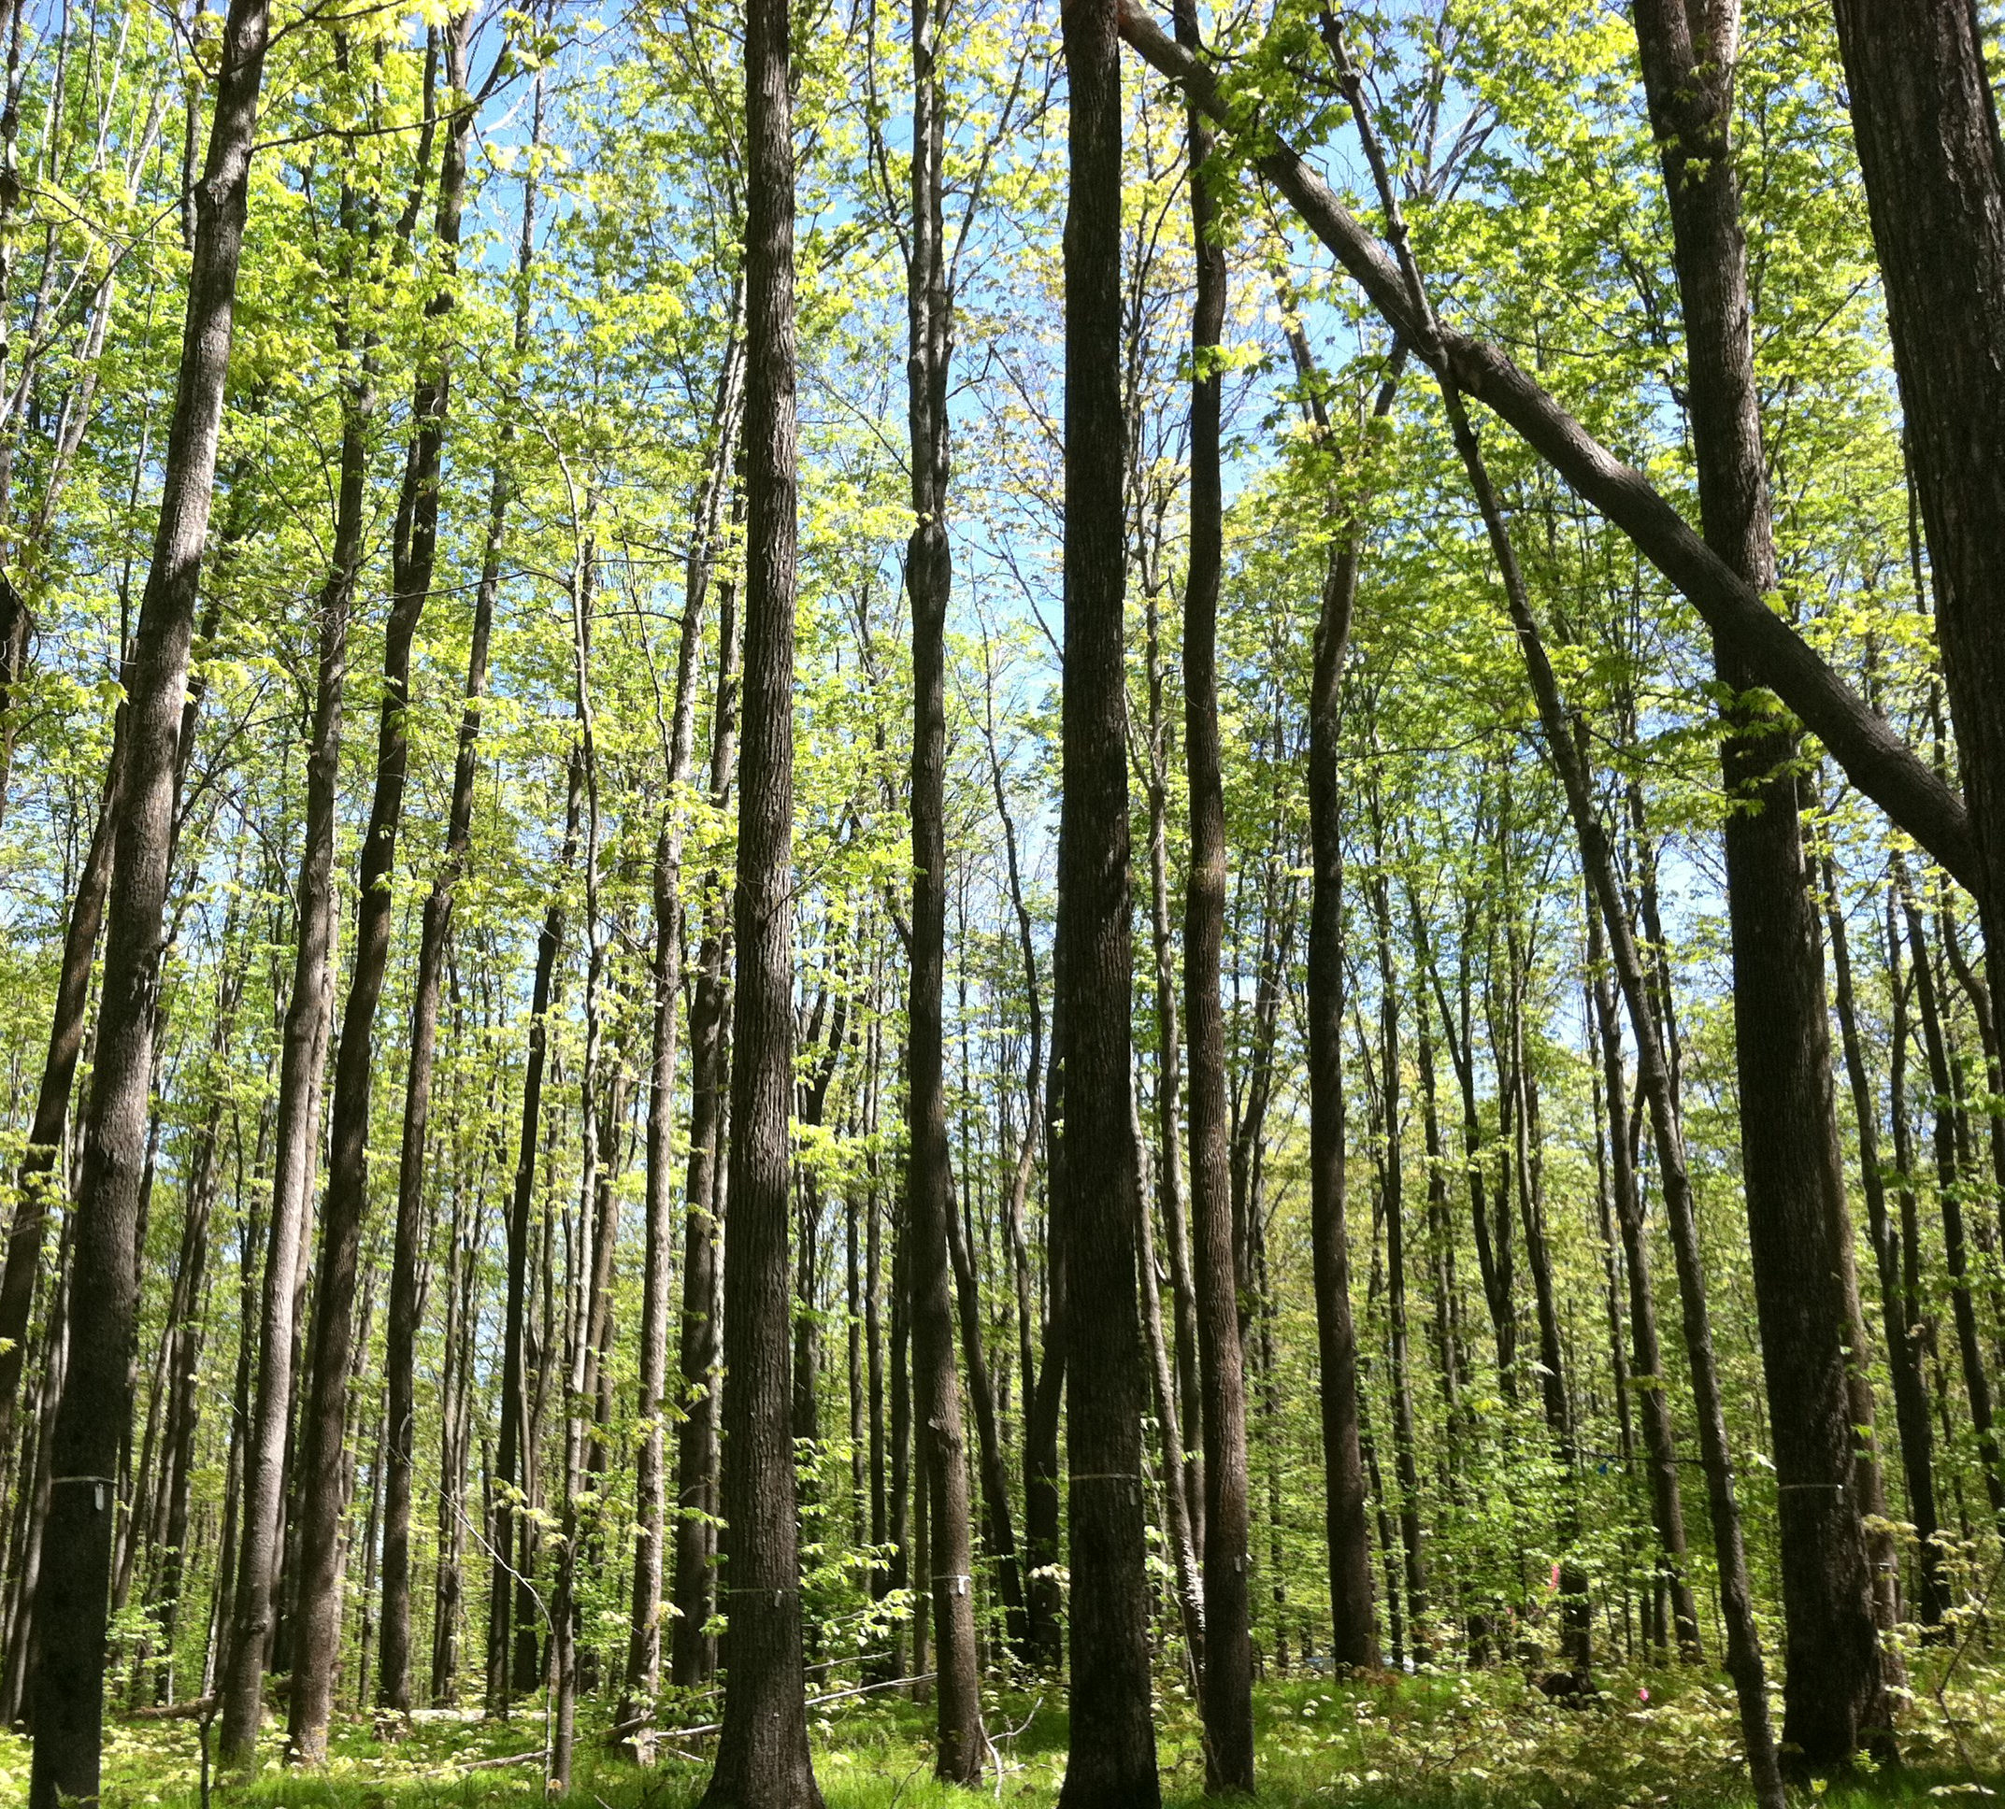
Forest management history
U.S. Forest Service Chequamegon-Nicolet National Forest
Large-scale clearing in late 1800s
Little active management in recent decades
Expansive, even-aged, mid-rotation forests
Proposed 16,000 ha selective harvest and thinning, Winter 2012-13
Management goals:
Increasing diversity of forest age structure
Reduce density in overstocked stands
Reduce ash to slow spread of emerald ash borer

