Slide 1
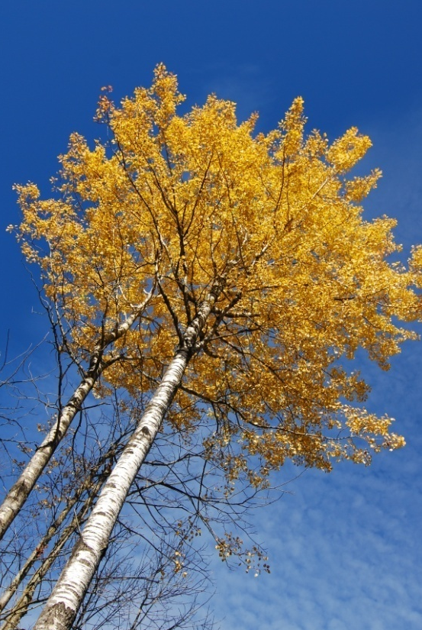
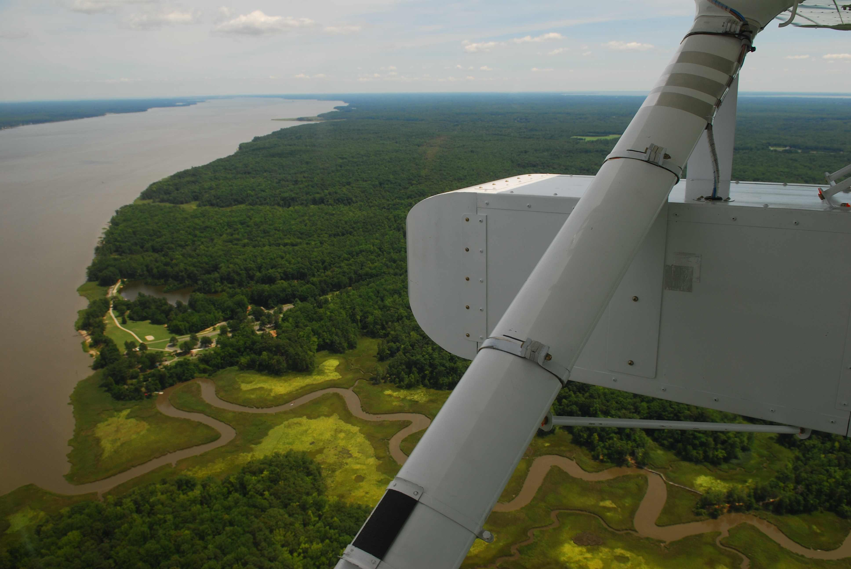
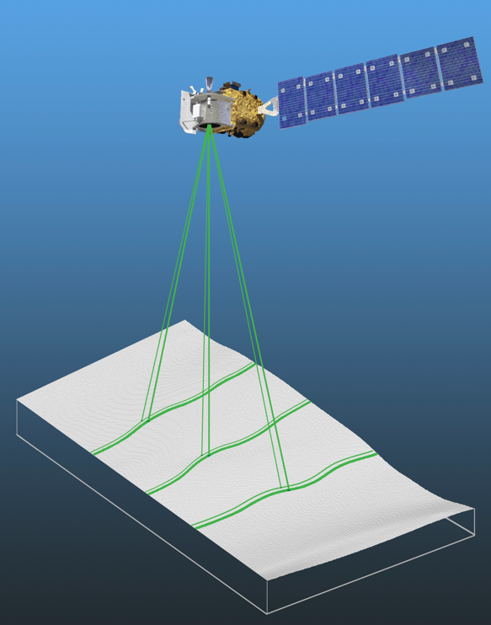
Creating a Disturbance in Northern WI Since 1998: Landsat Products and LiDAR Datasets
Bruce D. Cook
NASA Goddard Space Flight Center
Biospheric Sciences Laboratory
Notes:
Focus on instrumentation specifications vs. eye candy

Slide 2
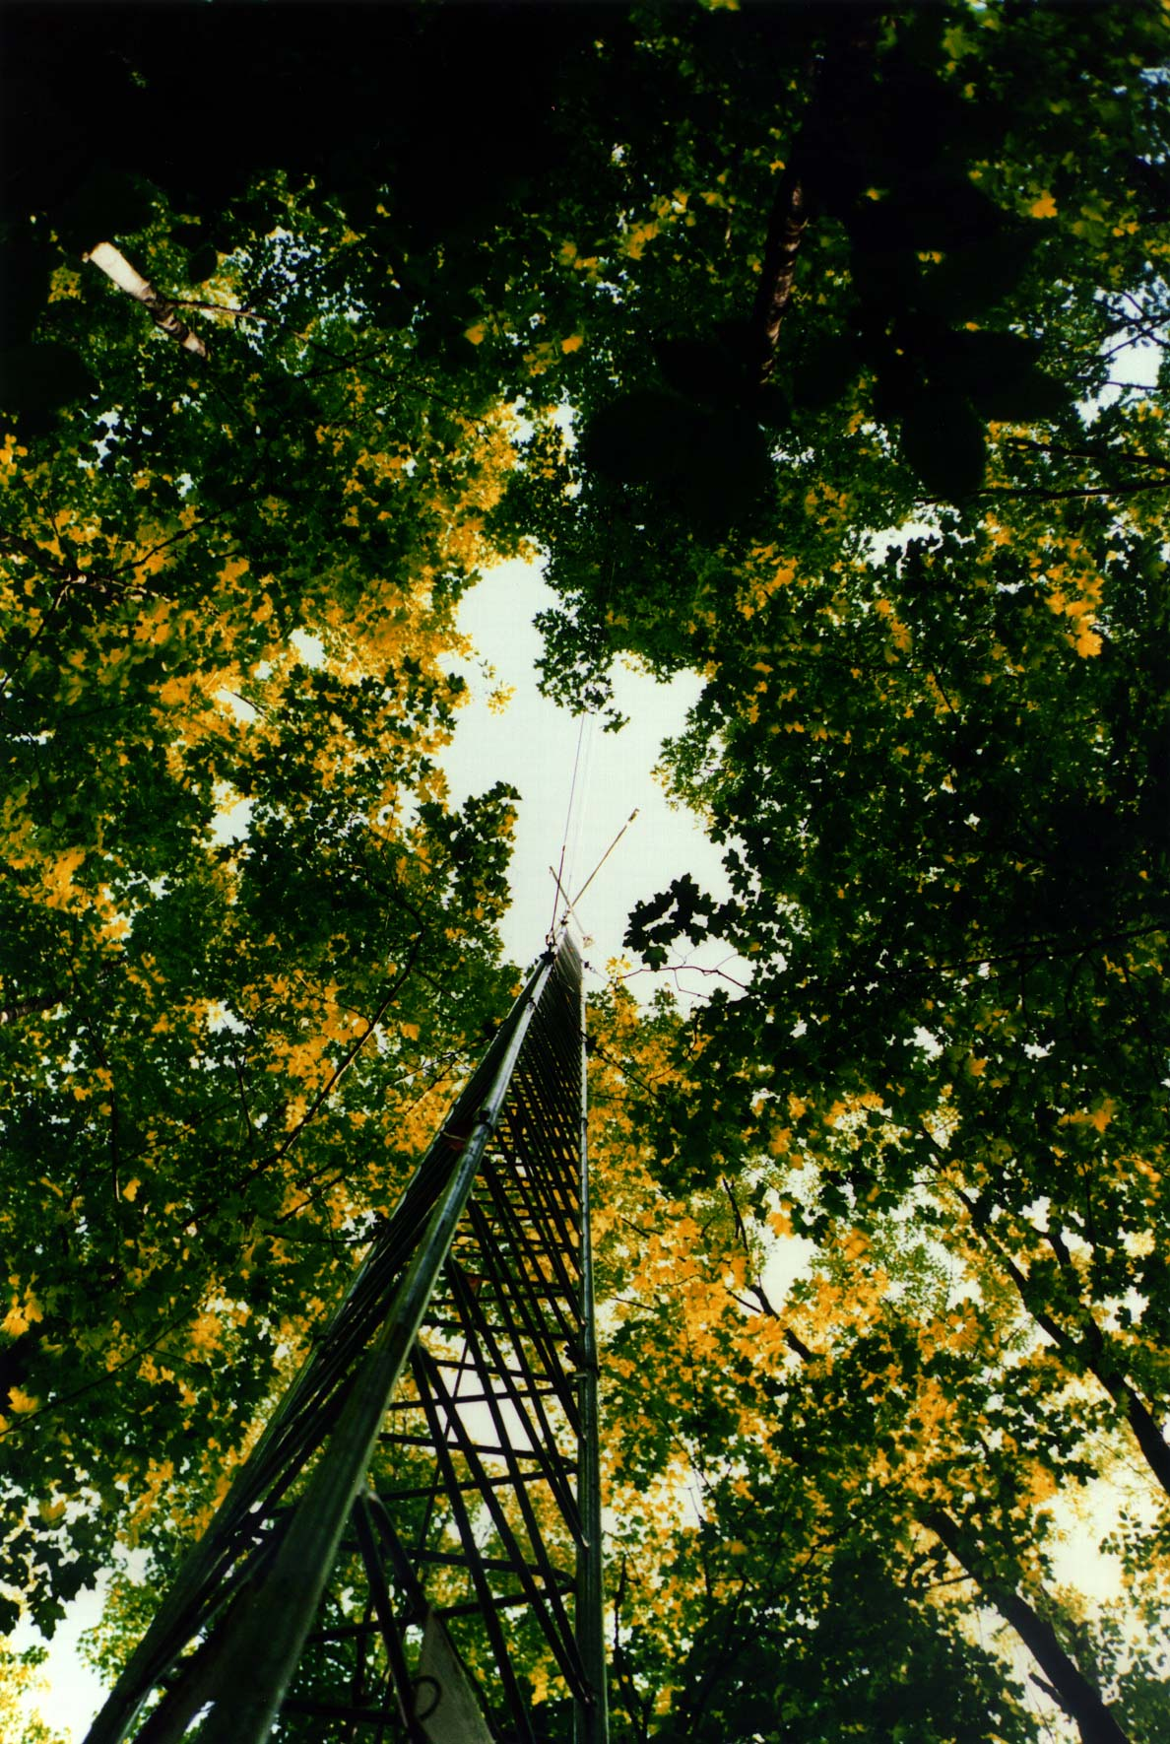
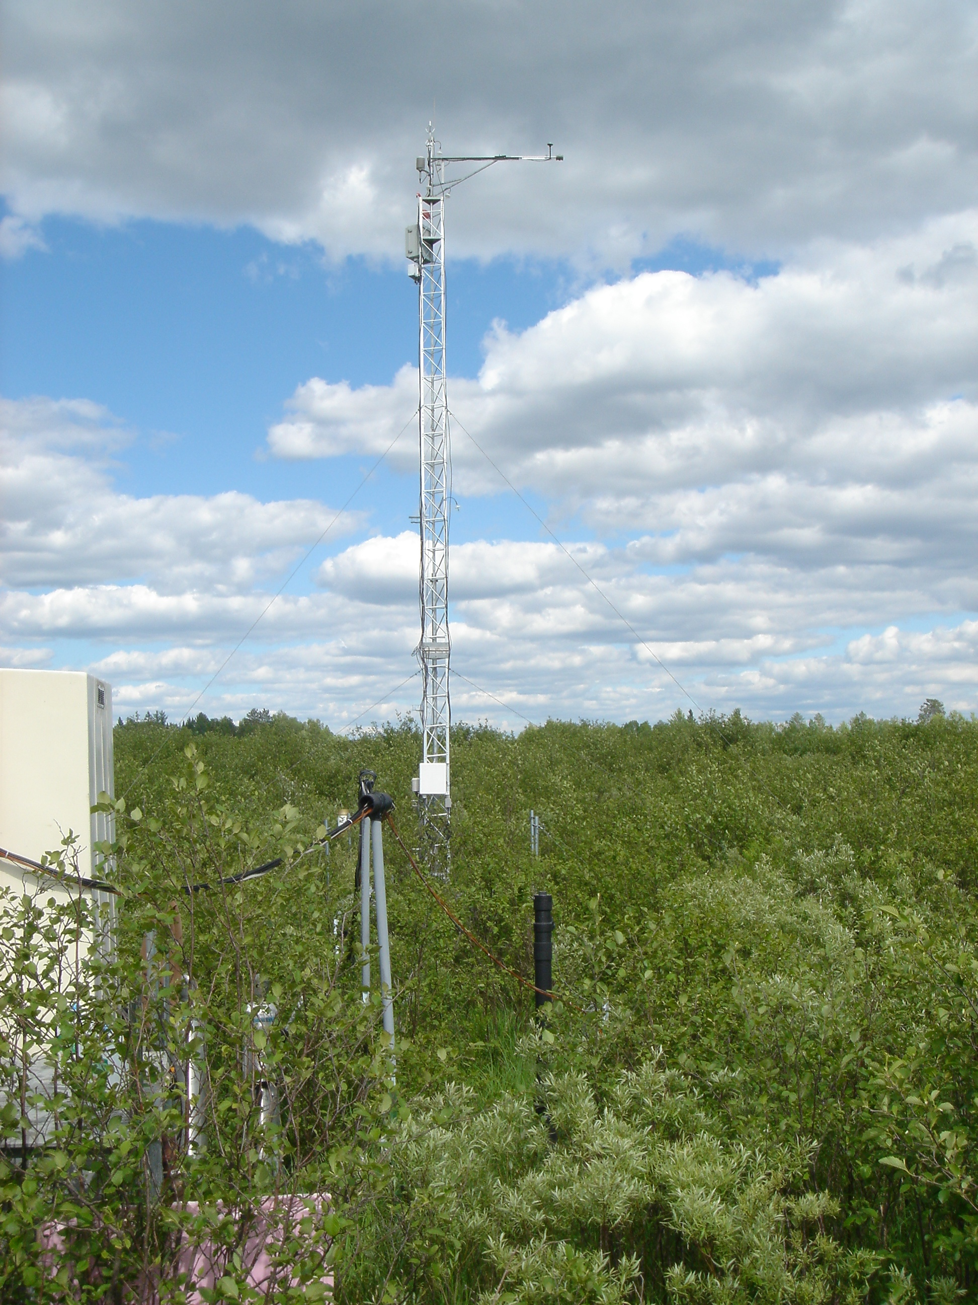
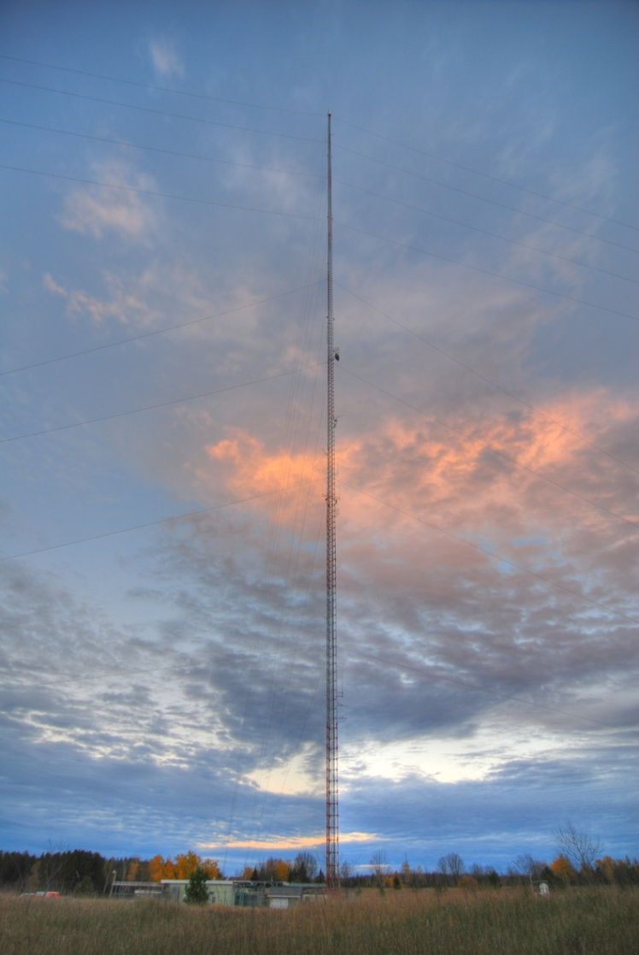
Scaling ChEAS Flux Tower Observations
from Stand- to Landscape-level
+
+
=
Willow Creek
1998
Lost Creek
2000
WLEF
2006

Slide 3
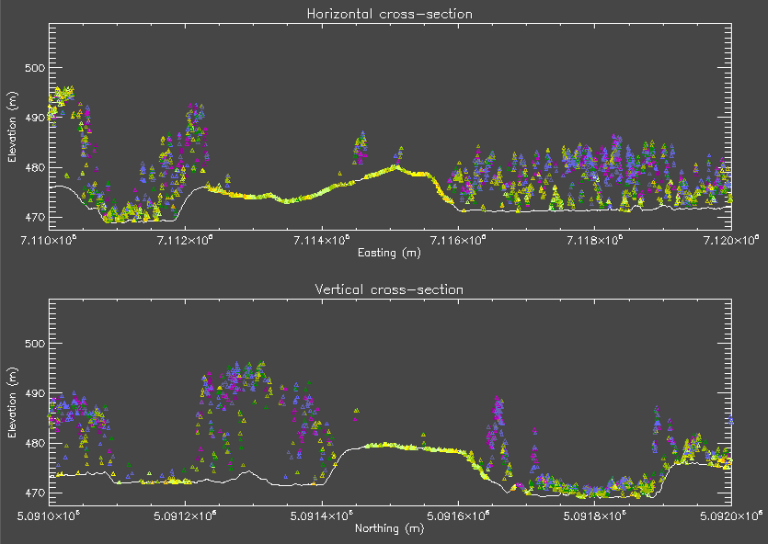
LiDAR Data Acquisition (2005/06)
East-West cross-section
Deciduous
Upland
Upland-Wetland
Catena
Coniferous Wetland
North-South cross-section
Mixed Forest
Hwy 182
Clearcut
Grass
Shrub
Wetland
Notes:
First returns for 1 m slice at WLEF (1 km length)
Note differences in height (e.g., shrub vs forest) and fractional cover (e.g., coniferous wetland vs mixed forest) of plant communities

Slide 4
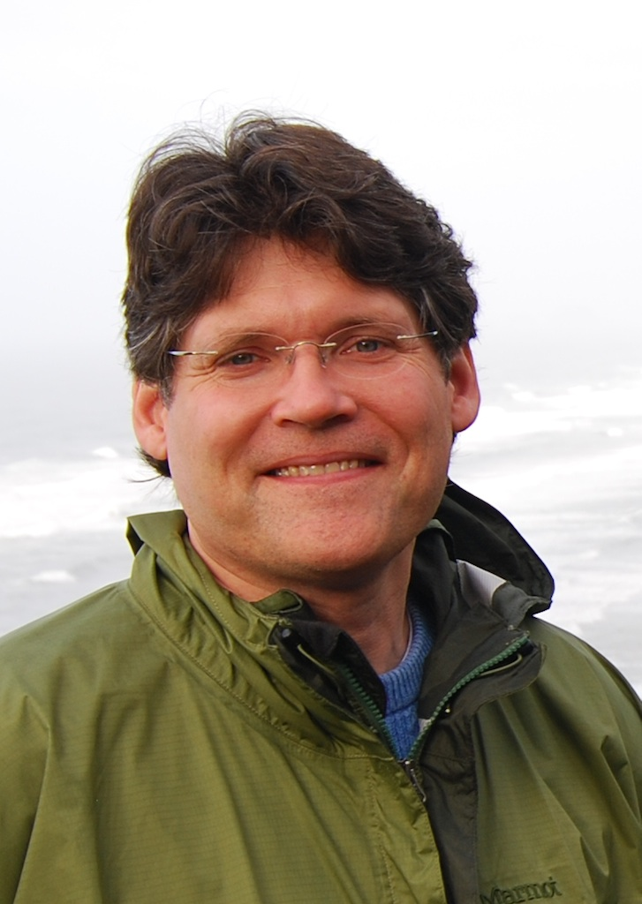
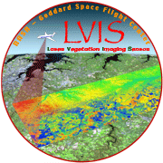
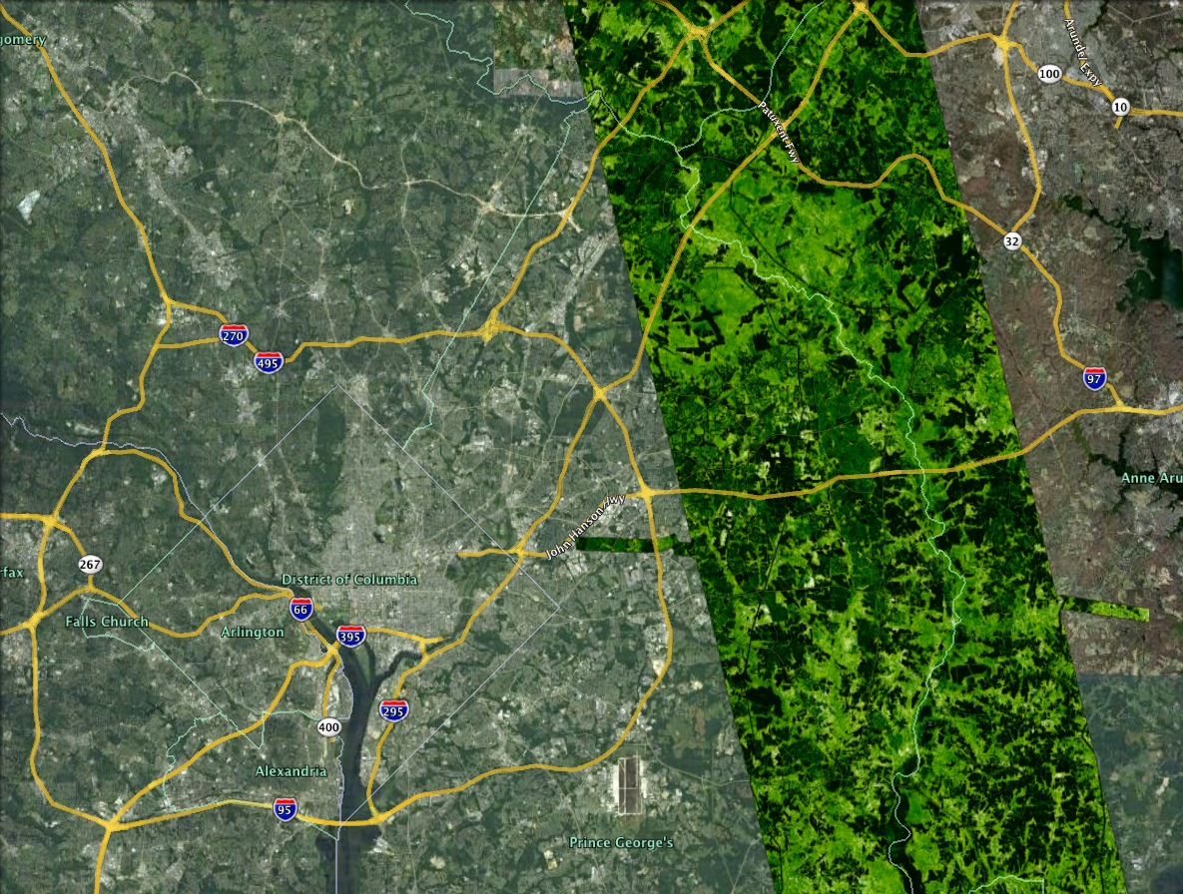
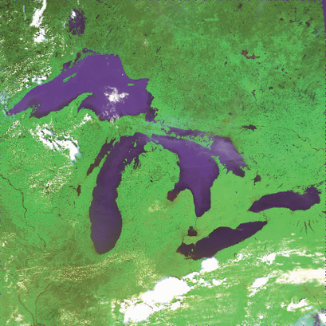
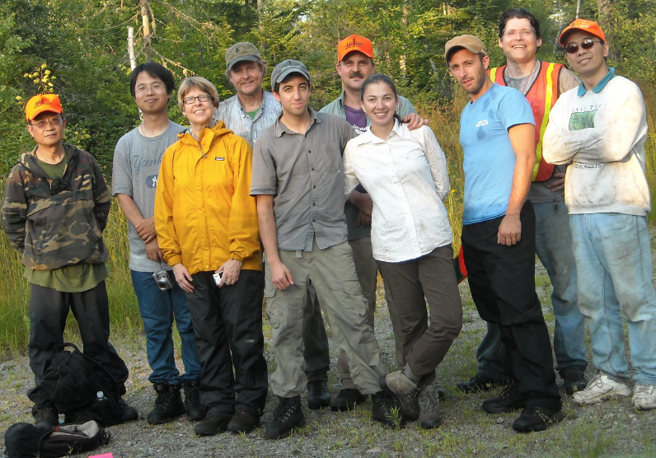
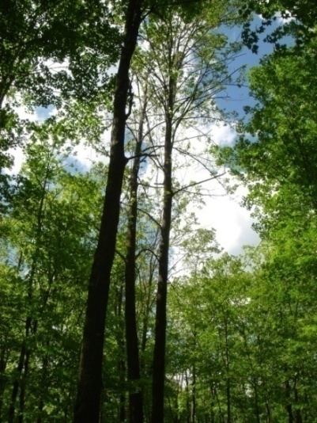
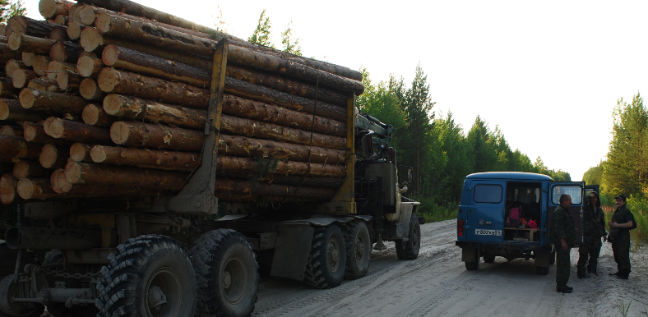
Bruce Cook Biospheric Sciences Laboratory/Code 618
Background
Biology, Soil Science/Meteorology, Forestry/Remote Sensing
Biospheric Science/618 (May 2009--present)
Missions
LDCM Deputy Project Scientist
Carbon Monitoring System
Project Manager pilot project (forest biomass/change mapping)
Research Interests
Instrument fusion (G-LiHT)
LiDAR radiative transfer modeling
Up-scaling of biological processes and CO₂/CH₄ exchange
Field Cal/Val
LiDAR-derived feature heights, MD
Region
Siberia 2010
Maine 2009
Landscape
http://earthobservatory.nasa.gov/blogs/fromthefield/
Stand

Slide 5
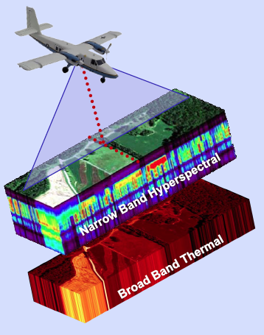
G-LiHT: Goddard’s LiDAR, Hyperspectral and Thermal Airborne Imaging System
Scanning/Profiling
LiDAR
Bruce D. Cook, PI
Larry Corp, Ross Nelson, Betsy Middleton, Jon Ranson, Jeff Masek, Doug Morton
NASA Goddard Space Flight Center, Biospheric Sciences Laboratory
Notes:
Focus on instrumentation specifications vs. eye candy

Slide 6
What Makes G-LiHT Unique?
Off-the-shelf instrumentation (lower costs, higher TRL)
Surface temperature observations
Downwelling irradiance measurements
Profiling and scanning LiDAR instruments
Eye-safe lasers at two wavelengths (905, 1550 nm)
Portability (small, lightweight, non-ITAR)
Versatility (adaptable to many platforms, low power)
Low operating costs (~$1/ha for acquisition and processing)

Slide 7
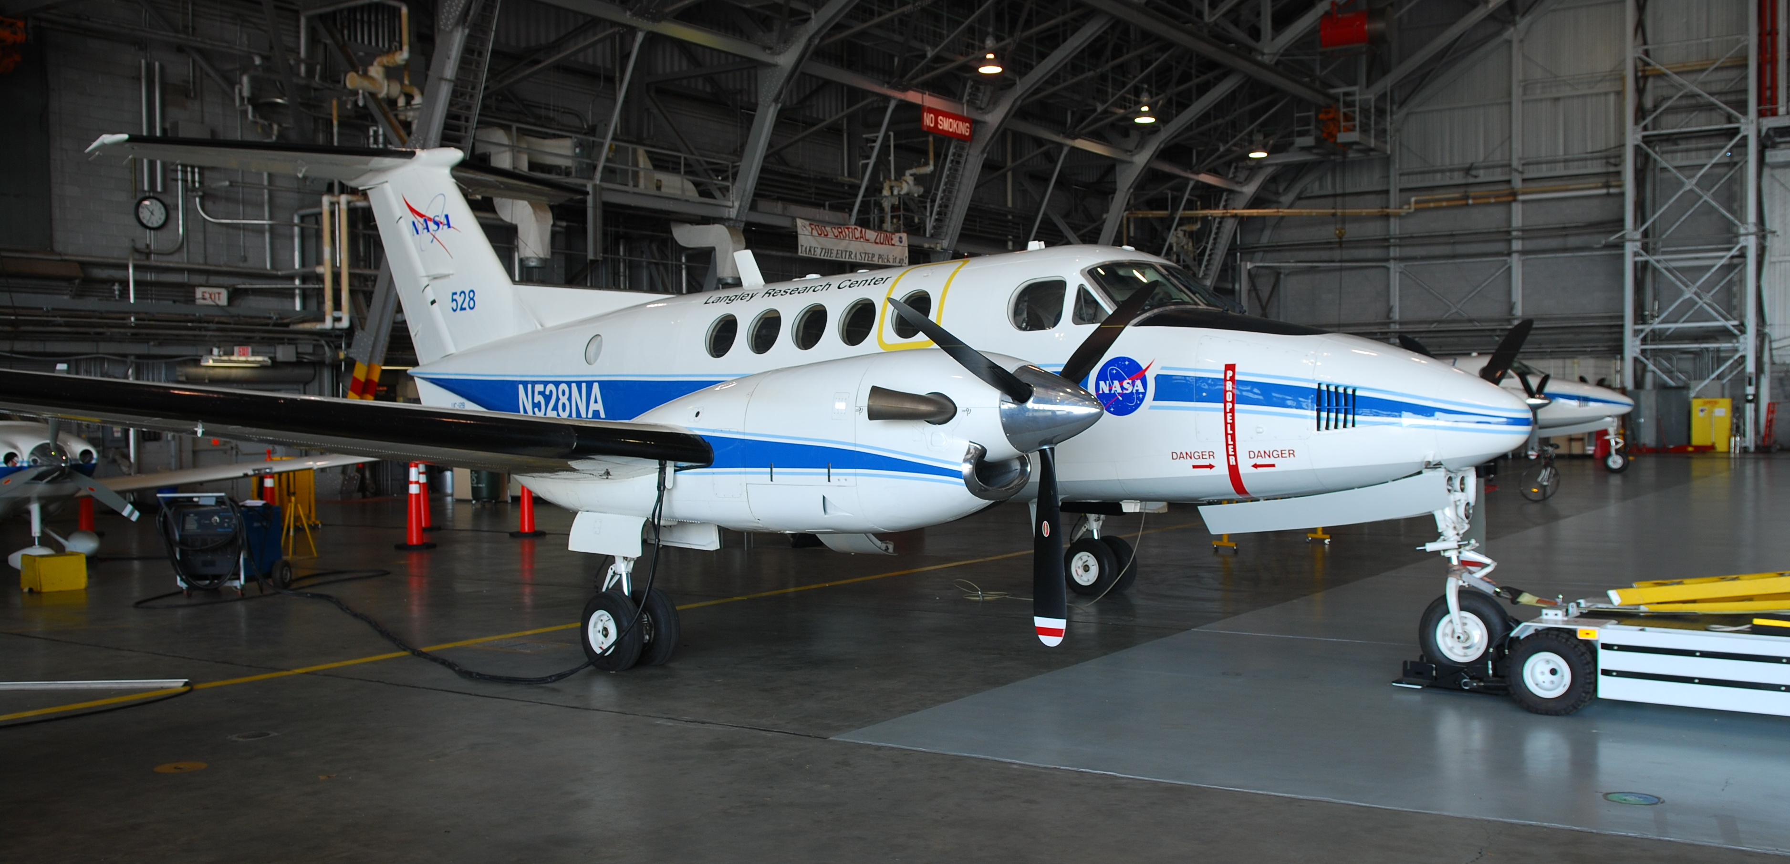
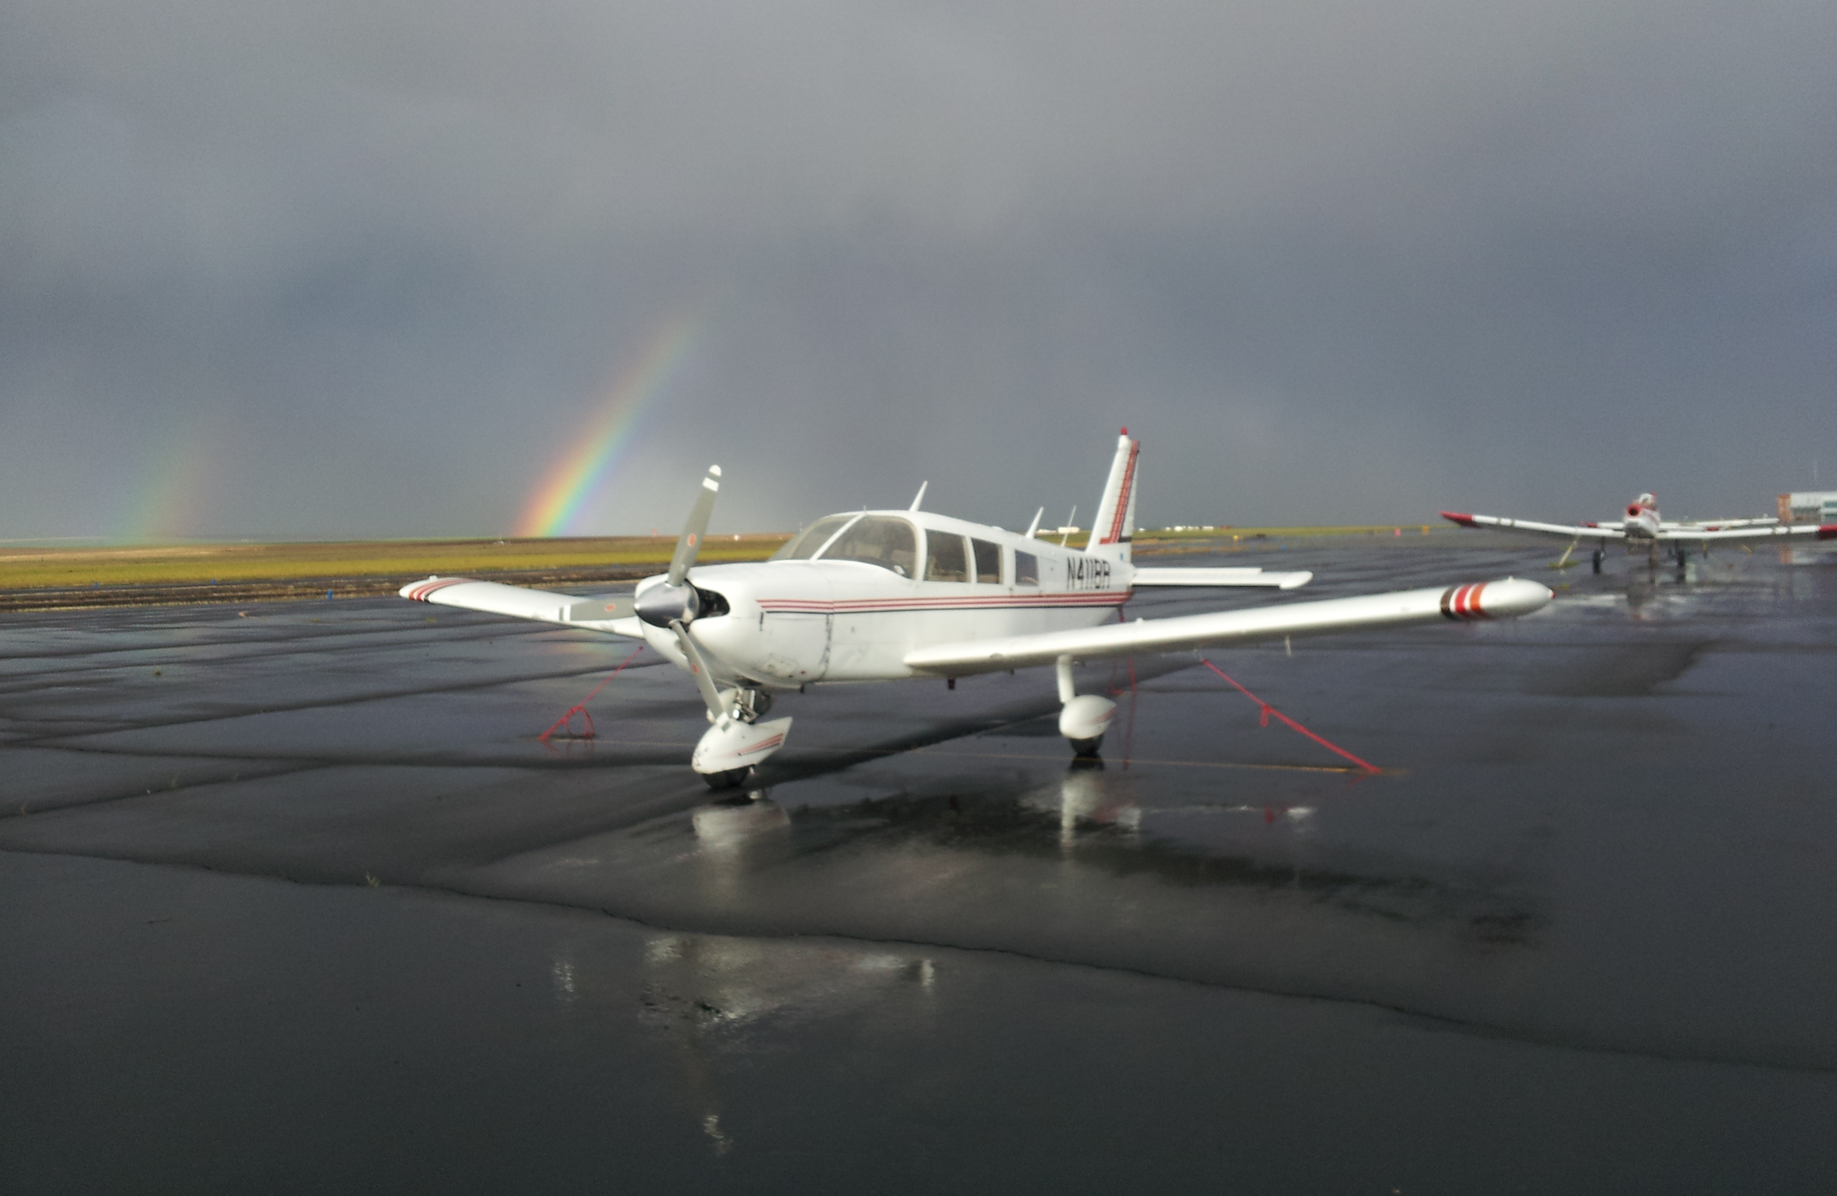
I&T
Fabricated a wing-mounted pod with LaRC that is compatible with all Cessna 206
I&T on other platforms (internal view port)
Pod
(bottom view)
In-flight near York River, VA
Instrument package
Cessna 206H platform (LaRC)
Boresight error ~15 cm in pod
NASA UC-12B (King Air)
Piper Cherokee

Slide 8
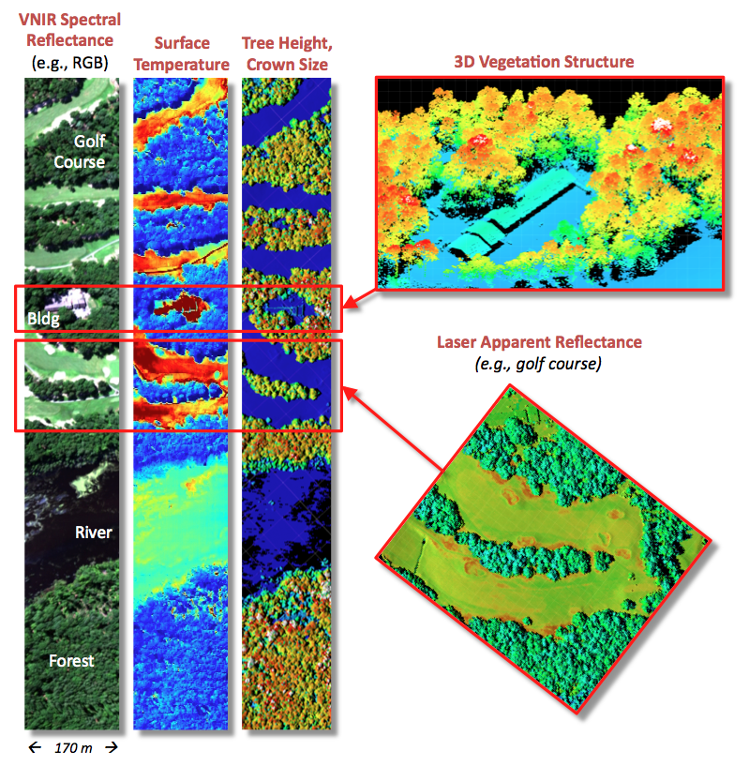
Passive Optical-LiDAR-Thermal Synergy

Slide 9
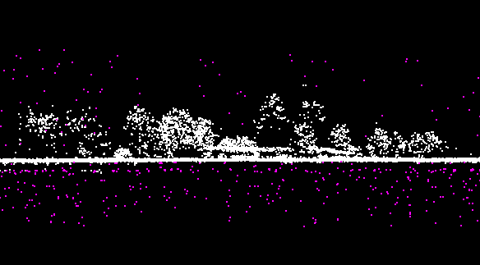
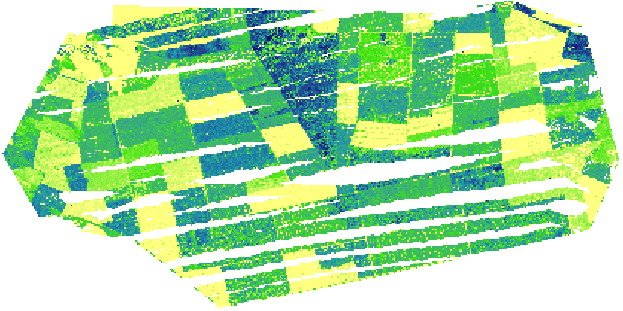
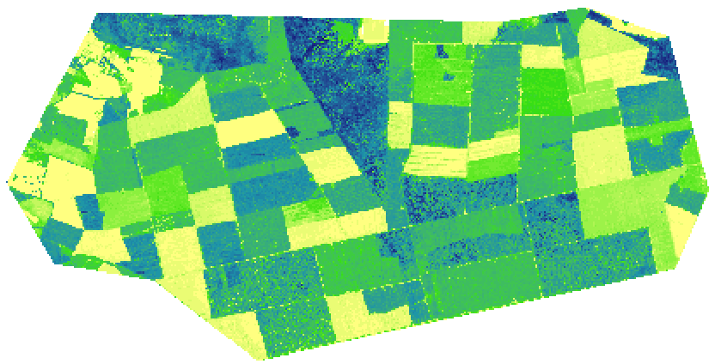
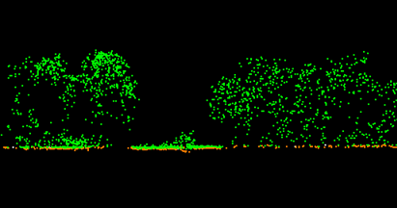
Case Study: Biomass Estimation
Photon Counting
Weyerhaeuser Loblolly Pine Plantation, NC
R² = 0.72
SE = 53 Mg/ha
Discrete ALS
R² = 0.78
SE = 47 Mg/ha
Rosette et al., Silvilaser 2011

Slide 10
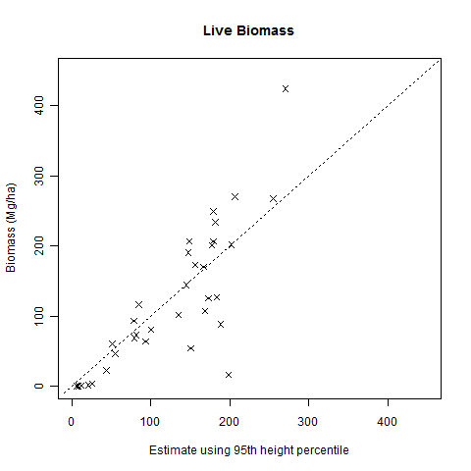
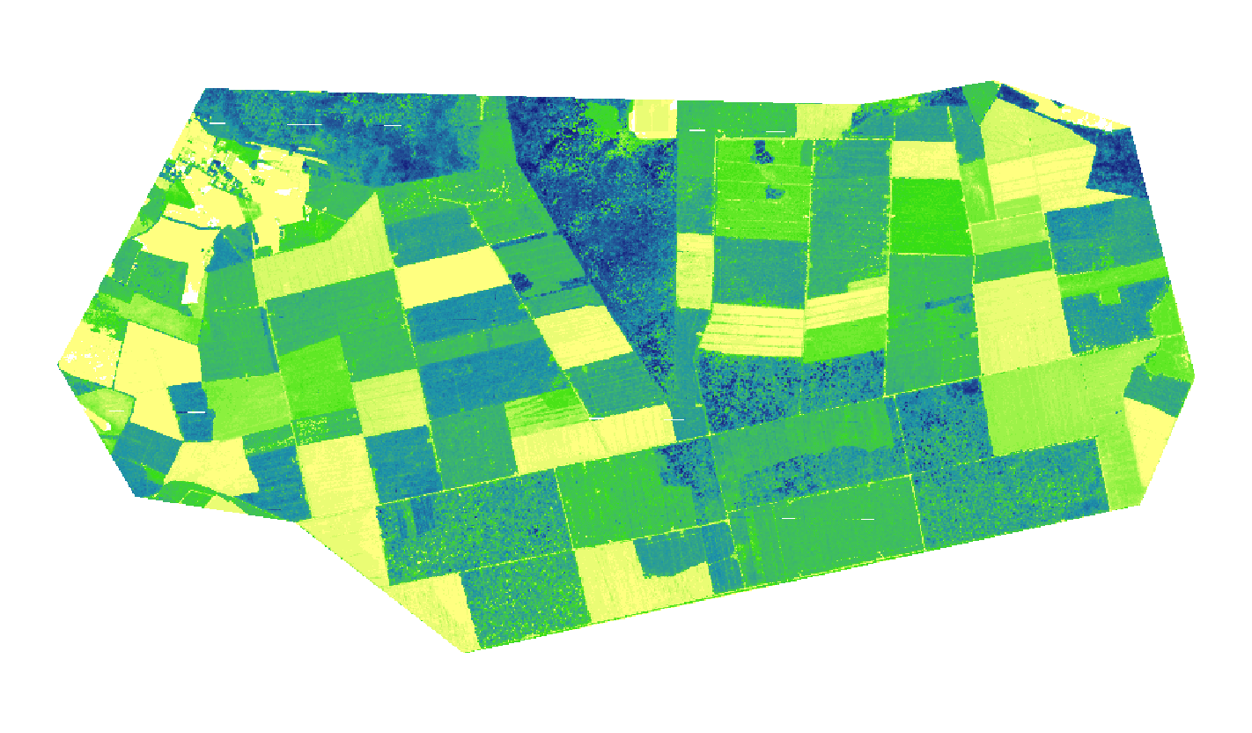
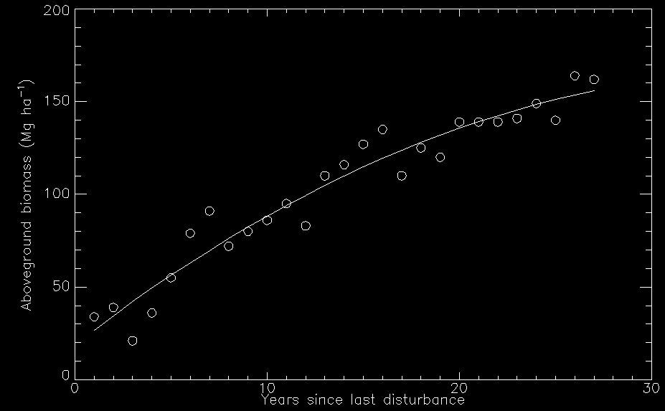
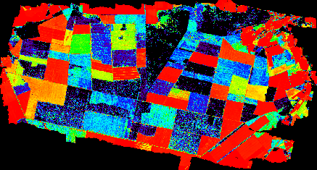
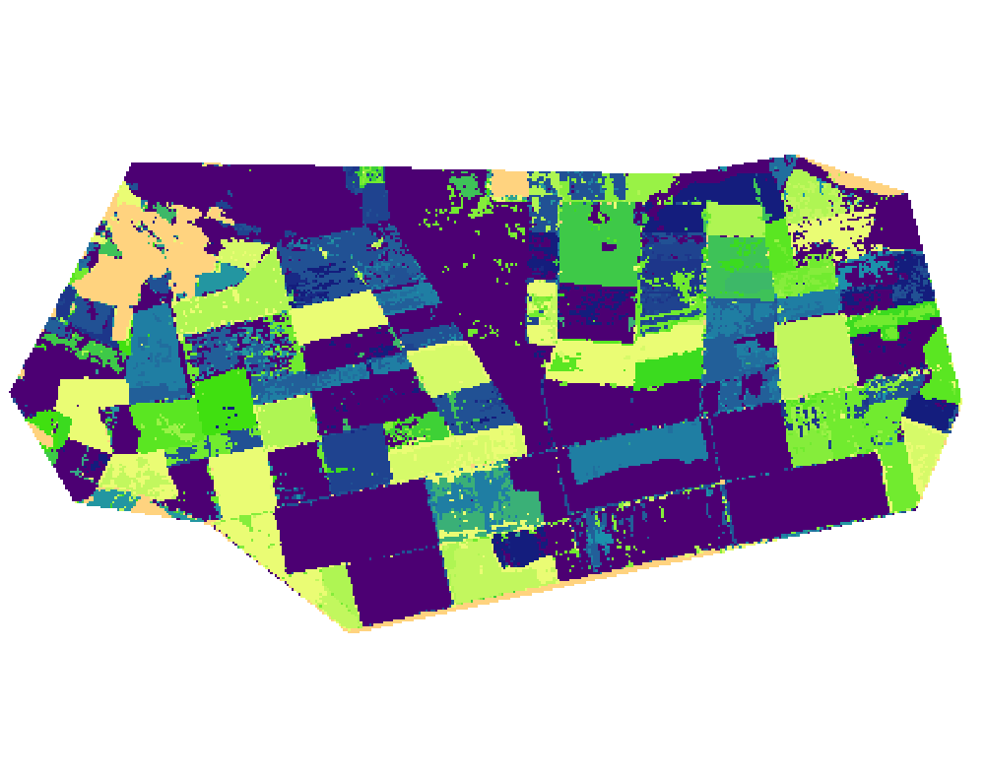
CMS Pilot: Biomass Change
Annual ANPP
(space for time substitution)
Biomass
Aboveground biomass
(Mg ha⁻¹)
Biomass = f(LiDAR metrics)
Stand age
Annual ANPP
Parker Track site means:
Age 13 years
Biomass 104 Mg ha⁻¹
ANPP 4.4 Mg ha⁻¹ y⁻¹
Stand age
(years since disturbance)

Slide 11
June 2012 G-LiHT Acquisition
WLEF landscape (growth, disturbance)
Willow Creek landscape (pre-harvest)

Slide 12
Canopy Height

Slide 13
Calibrated Reflectance (1550 nm)

Slide 14
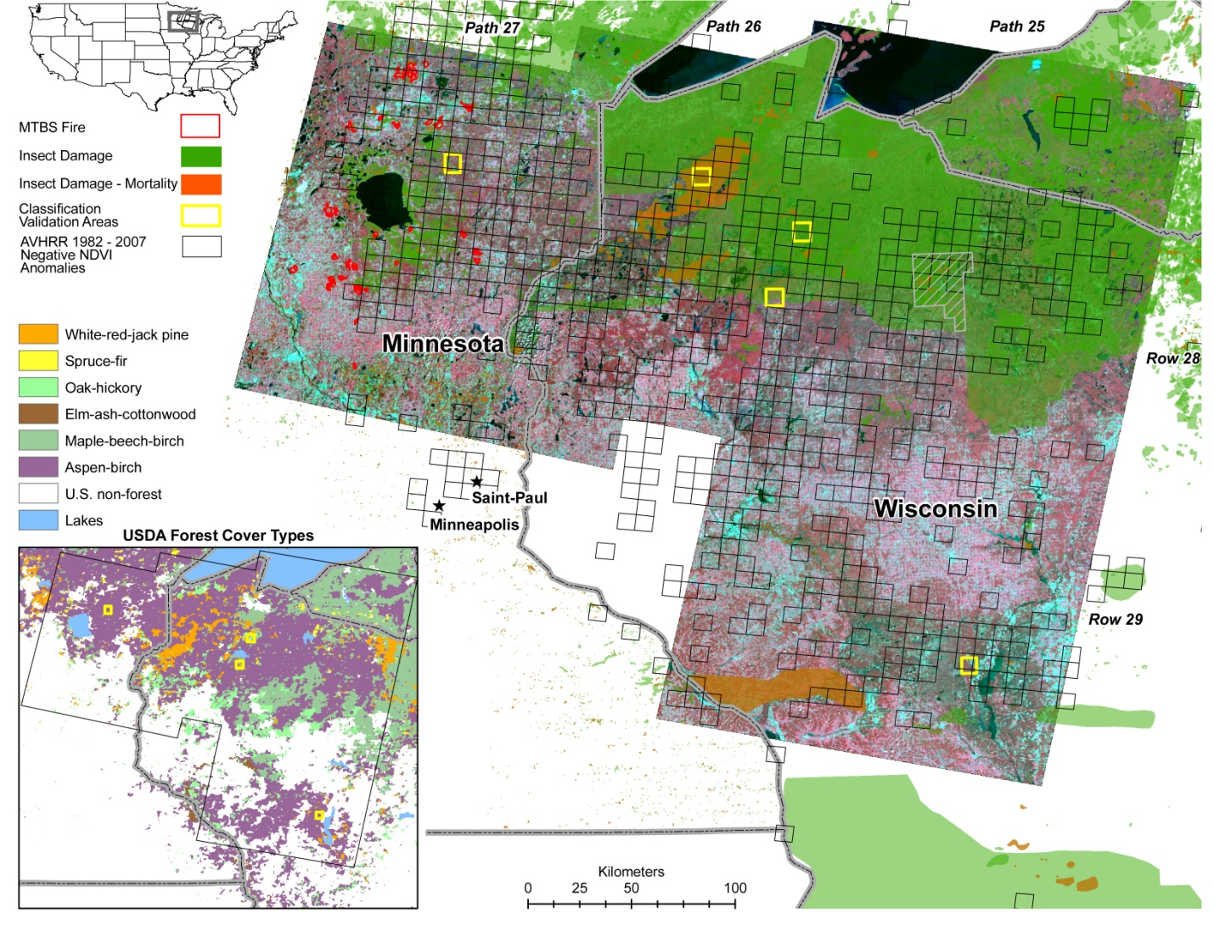
A multi-decade vegetation productivity decline in northern Wisconsin and Minnesota forests forced by increased rates of disturbance (submitted to Landscape Ecology, Neigh et al. 2012)
GIMMS AVHRR NDVI anomalies with a negative trend < -0.05, p < 0.02 from 1982 through 2007 (8 x 8 km black quadrangles) overlaid upon Landsat false-color composite images for the same time period. Grey cross hatched polygon indicates the bounds of the Chequamegon-Nicolet National forest. Lower inset shows the geographic extent of forest cover types throughout the region. Note, the forest cover is primarily Aspen-birch that has had insect damage (transparent green) and Spruce-fir stands that have had mortality (transparent orange).
Next Slide
Extent

Slide 15
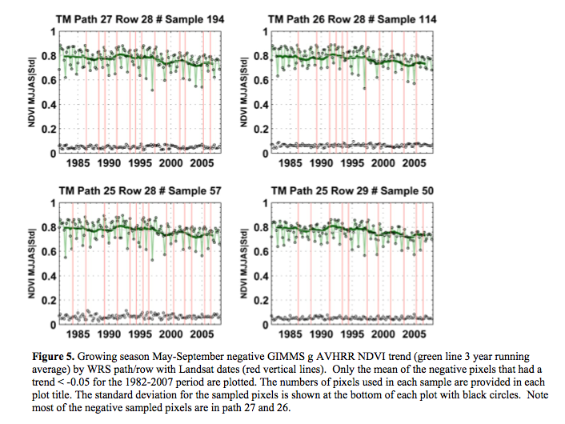
Decreasing Regional NDVI Trends

