Slide 1
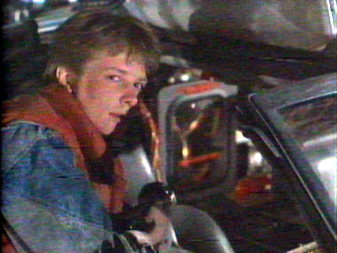
It's been ten years, where's my flux capacitor? Past and future for the flux tower mesonet
Ankur Desai
Associate Professor
Atmospheric and Oceanic Sciences
UW-Madison
ChEAS 2012, 27 June 2012

Slide 2
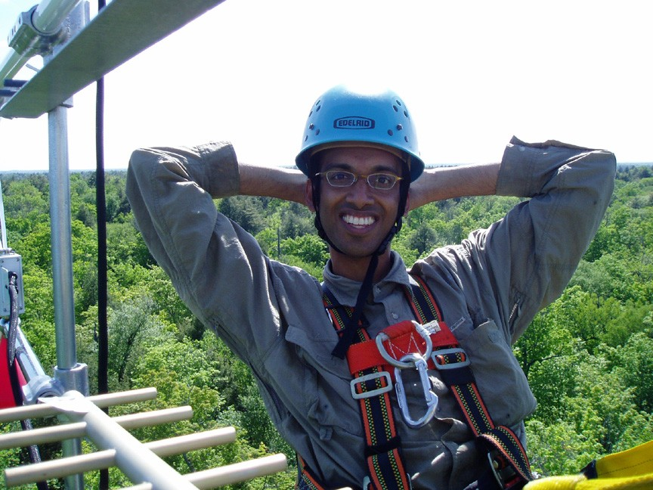
What keeps me up at night?

Slide 3
What keeps me up at night?
>250 million raw data points a day (flux towers, met sensors, auto soil chambers, remote sensors)
Funding it
Processing and harmonizing it
Assimilating it into ecosystem models
Making useful inferences about regional carbon cycle dynamics and biological, anthropogenic, and climatic controls on it
Publishing it

Slide 4
What keeps me up at night?

Slide 5
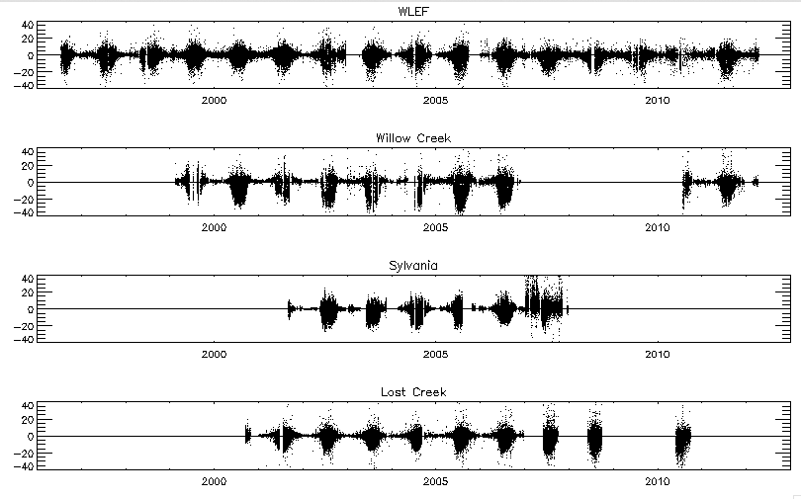
Data Legacy

Slide 6
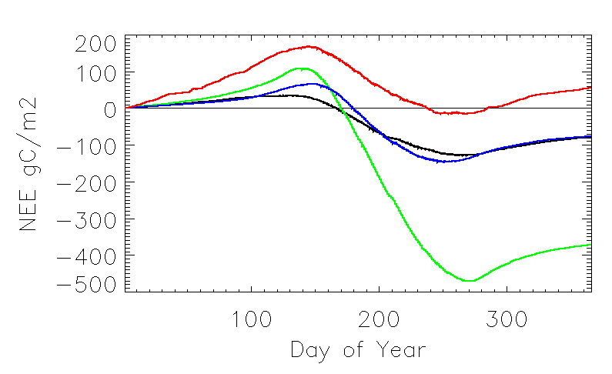
Beat goes on…
Black = WLEF, Green = Willow Creek, Red = Sylvania, Blue = Lost Creek

Slide 7
What keeps me up at night?
>250 million raw data points a day (flux towers, met sensors, auto soil chambers, remote sensors)
Funding it
Processing and harmonizing it
Assimilating it into ecosystem models
Making useful inferences about regional carbon cycle dynamics and biological, anthropogenic, and climatic controls on it
Publishing it

Slide 8
What keeps me up at night?
>250 million raw data points a day (flux towers, met sensors, auto soil chambers, remote sensors)
Funding it
Processing and harmonizing it
Assimilating it into ecosystem models
Making useful inferences about regional carbon cycle dynamics and biological, anthropogenic, and climatic controls on it
Publishing it
+ 3 young children

Slide 9
What keeps me up at night?

Slide 10
What am I doing about it?
Automated data ingest/processing
Data harmonization
Data assimilation
New projects: CH₄, PEcAn, Phenocam, Radiocarbon, Lakeflux
This and other meetings!

Slide 11
What am I doing about it?
Automated data ingest/processing
Data harmonization
Data assimilation
New projects: CH₄, PEcAn, Phenocam, Radiocarbon, Lakeflux
This and other meetings!

Slide 12
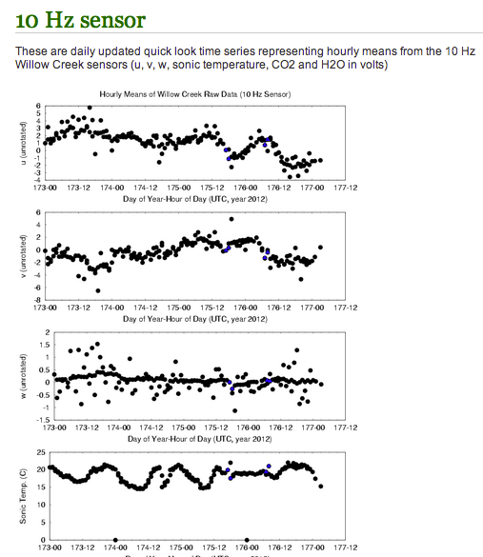
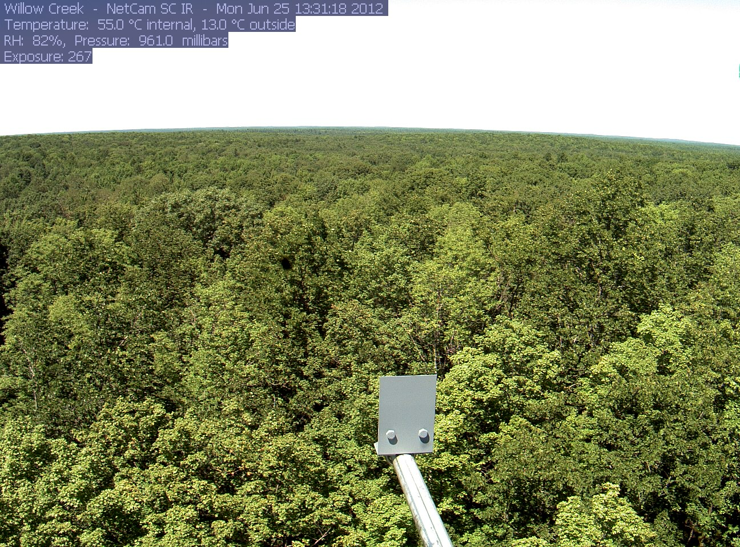
Data Ingest and Processing
http://klima.sr.unh.edu/data/latest/willowcreek
http://flux.aos.wisc.edu/~bjorn/willow_creek/
J Thom, BJ Brooks, AD Richardson

Slide 13
What am I doing about it?
Automated data ingest/processing
Data harmonization
Data assimilation
New projects: CH₄, PEcAn, Phenocam, Radiocarbon, Lakeflux
This and other meetings!

Slide 14
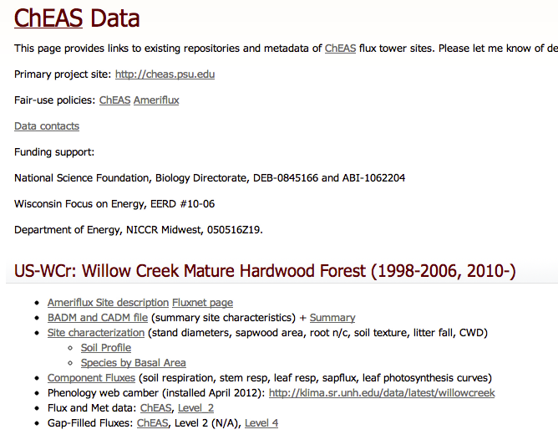
Data Harmonization
http://flux.aos.wisc.edu/twiki/bin/view/Main/ChEASData
D. Hua, A. Desai, S. Serbin

Slide 15
What am I doing about it?
Automated data ingest/processing
Data harmonization
Data assimilation
New projects: CH₄, PEcAn, Phenocam, Radiocarbon, Lakeflux
This and other meetings!

Slide 16
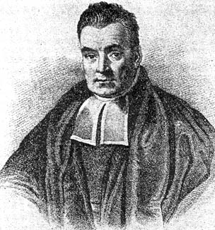
Data Assimilation
Zobitz et al., 2011,
Oecologia

Slide 17
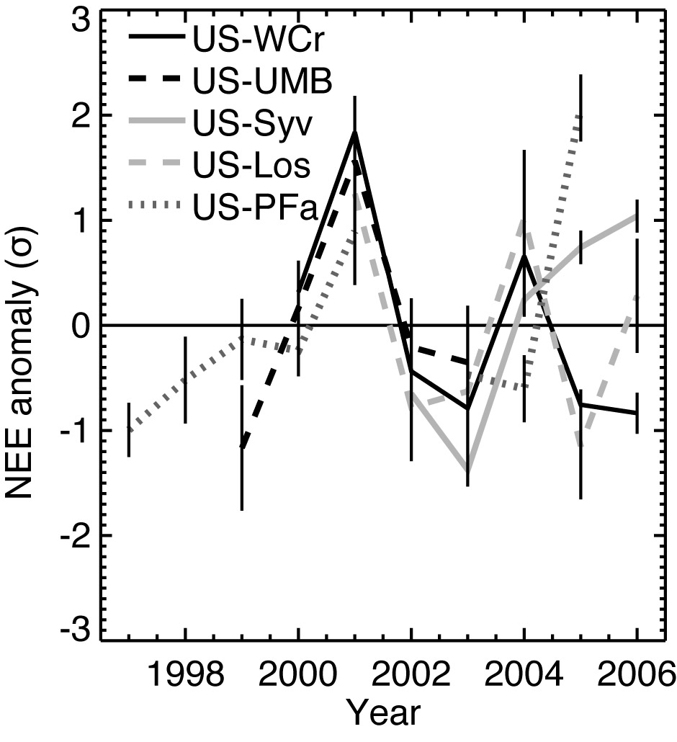
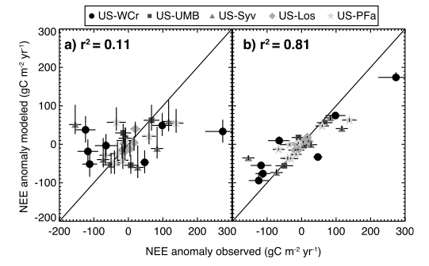
Data Assimilation
Desai, 2010, JGR

Slide 18
What am I doing about it?
Automated data ingest/processing
Data harmonization
Data assimilation
New projects: CH₄, PEcAn, Phenocam, Radiocarbon, Lakeflux
This and other meetings!

Slide 19
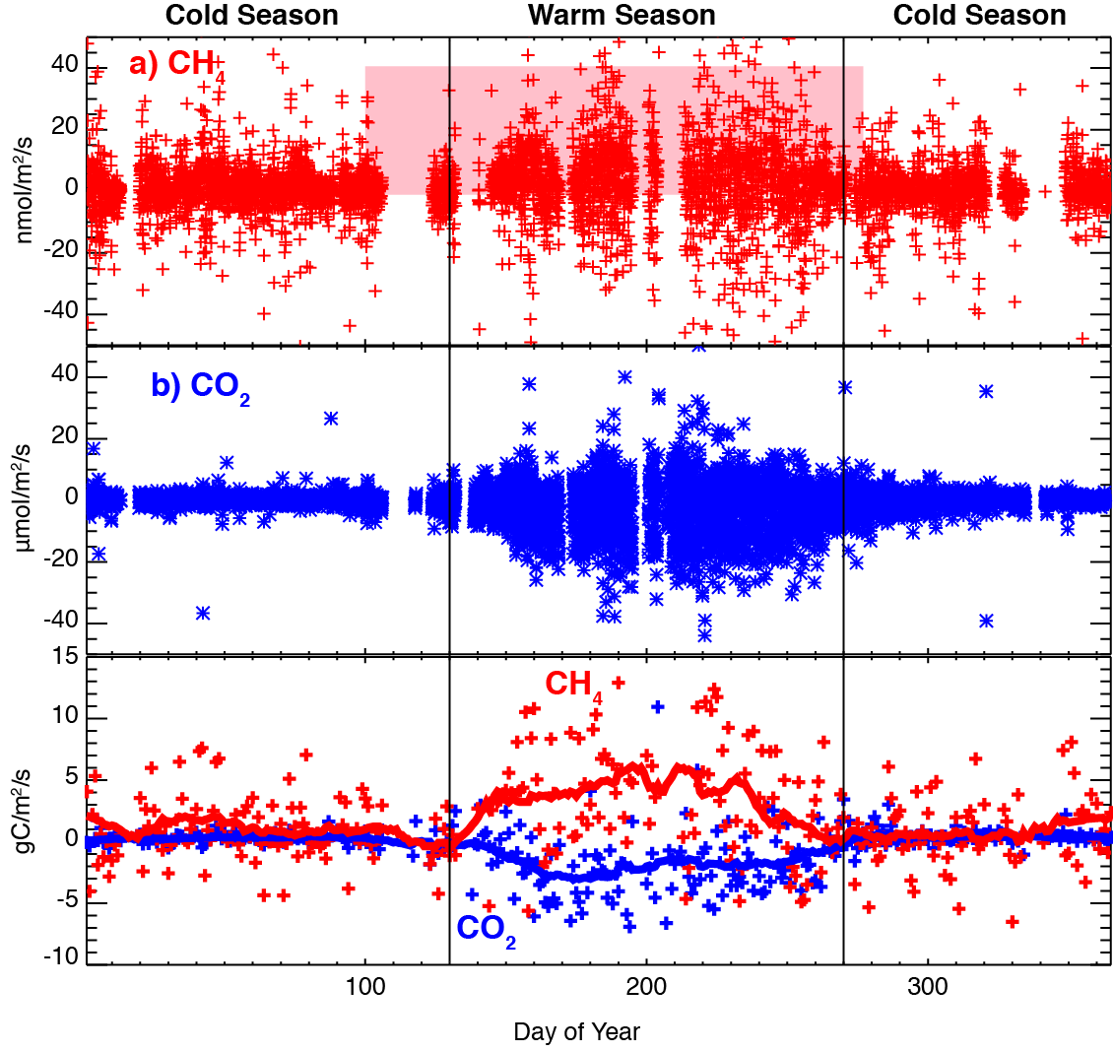
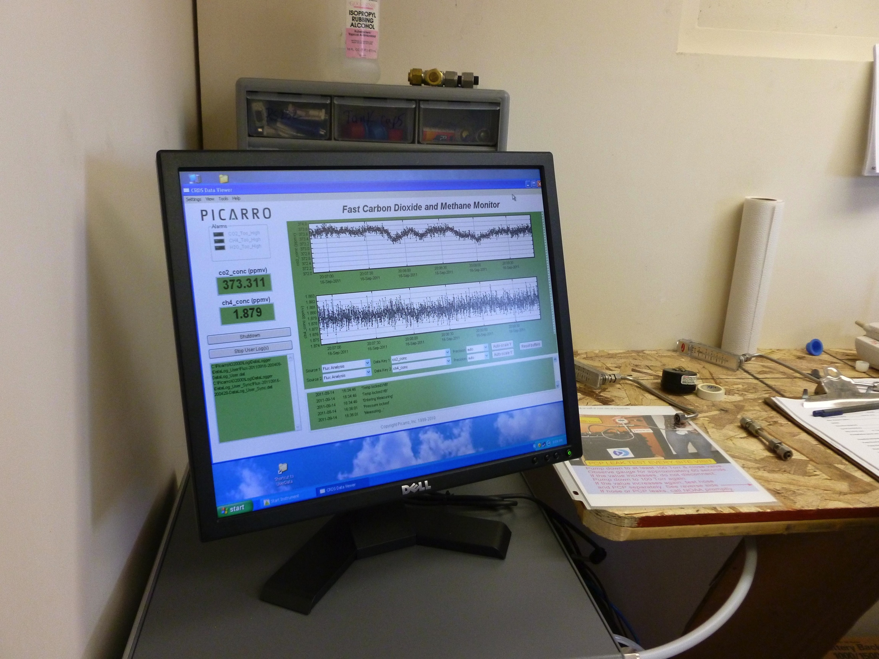
New projects: CH₄
NSF CAREER

Slide 20
New projects: PEcAn
http://pecanproject.org/
M. Dietze, S. Serbin, R. Kooper, A. Desai, D. LeBauer
NSF ABI

Slide 21
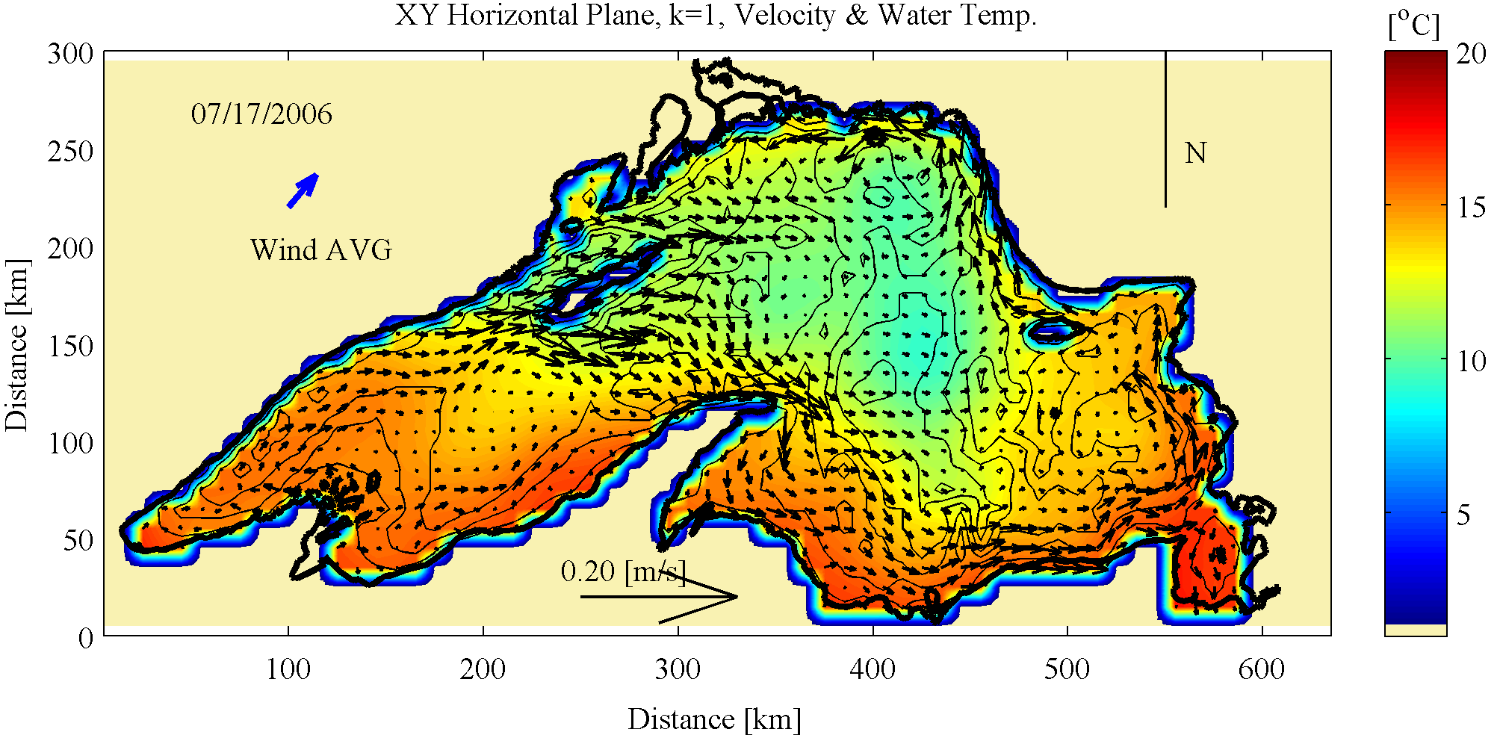
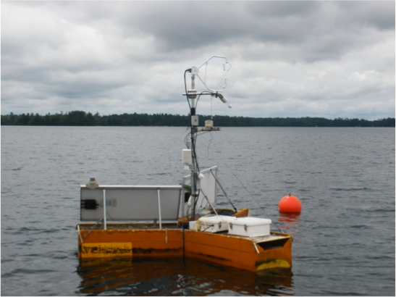
New projects: Lakeflux
M. Golub, G. McKinley, I. Buffam, M. Balliet

Slide 22
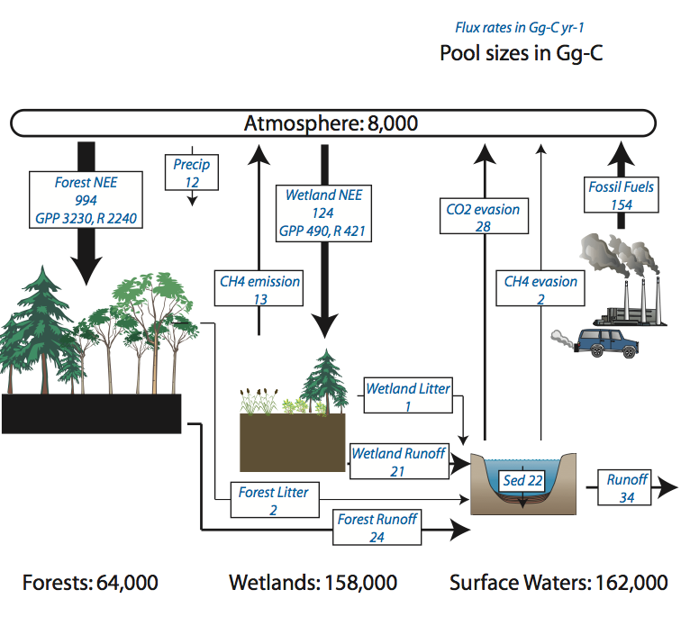
New projects: Lakeflux
Buffam et al., 2011, GCB

Slide 23
New projects: Forest Management and Carbon
Use USFS planned forest thinning to investigate uneven and even aged canopy carbon components around W Creek
Radiocarbon tracers and soil auto chambers (K. Macfarlane, C. Phillips, E. Marin-Spiotta) to look at respiration partitioning
Restart old-growth site to complement UMBS/FASET (P. Curtis, C. Gough, G. Bohrer, A. Fotis)
Ecosystem/carbon cycle modeling of land management in heterogeneous regions for climate adaptation/mitigation assessment (R. Scheller, T. Gower, M. Dietze, D. Moore, D. Hua)

Slide 24
What am I doing about it?
Automated data ingest/processing
Data harmonization
Data assimilation
New projects: CH₄, PEcAn, Phenocam, Radiocarbon, Lakeflux
This and other meetings!
FUNDING!

Slide 25
Meetings!
http://flux.aos.wisc.edu/twiki/bin/view/Main/ForCLIMATE

Slide 26
Thanks!
http://flux.aos.wisc.edu

