Slide 1
Biogeoscience observing system deluge: Are we ready for the flood?
Ankur Desai, University of Wisconsin-Madison
B41B-02
AGU Fall 2019, Monday 1610-1620, MW 2003
Image: https://insider.pureflix.com/

Slide 2
Acknowledge
PEcAn project (NSF DBI-1457897)
Mike Dietze, Istem Fer, Bailey Murphy, Katie Zarada
CHEESEHEAD (NSF AGS-1822420)
Stefan Metzger, Sreenath Paleri, Dave Durden, Ke Xu
Cyverse: Tyler Swetnam
DOE Ameriflux
Kim Novick, George Burba
Ben Bond-Lamberty, Jack Williams, many conversations from many of you, especially students...

Slide 3
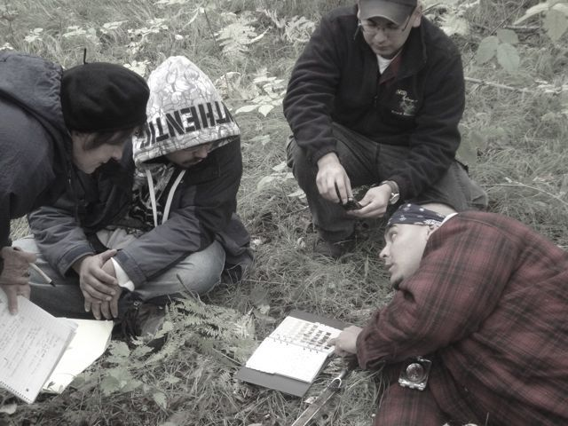
Photo: A Desai

Slide 4
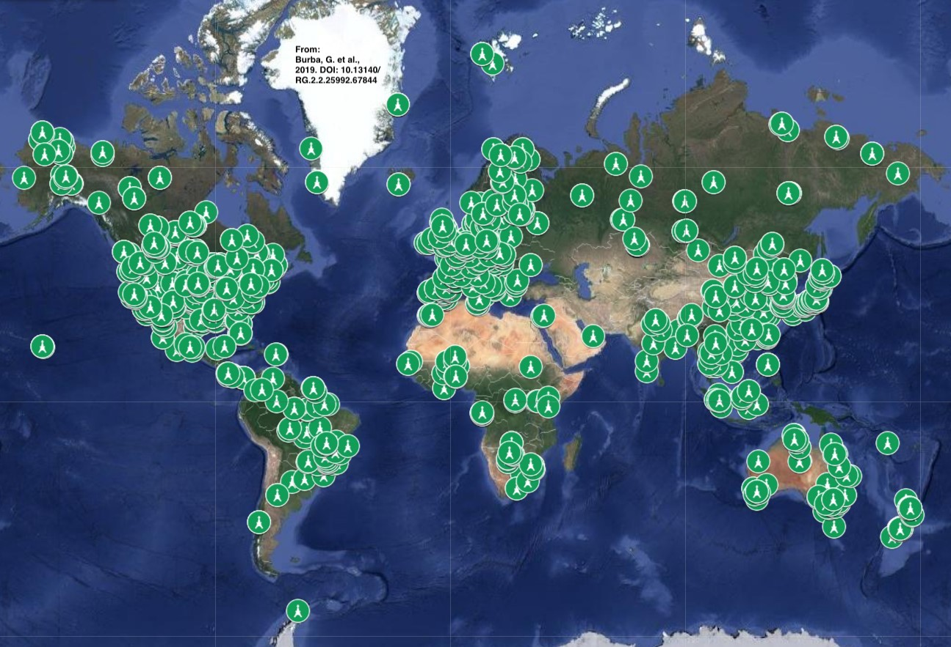
Huge Ecology?

Slide 5
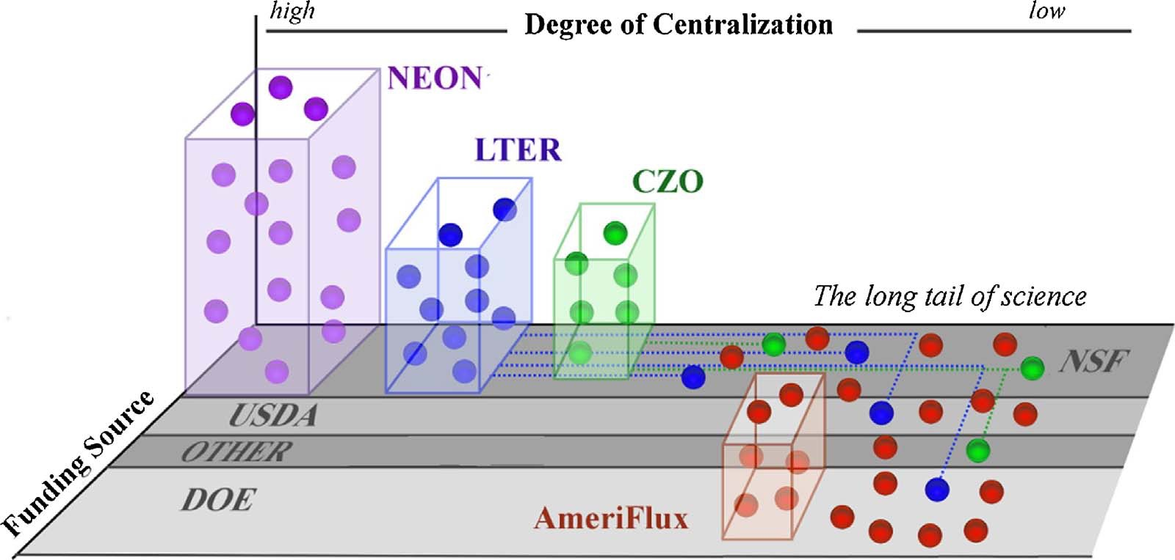
Novick et al., 2018, Agricultural and Forest Meteorology

Slide 6
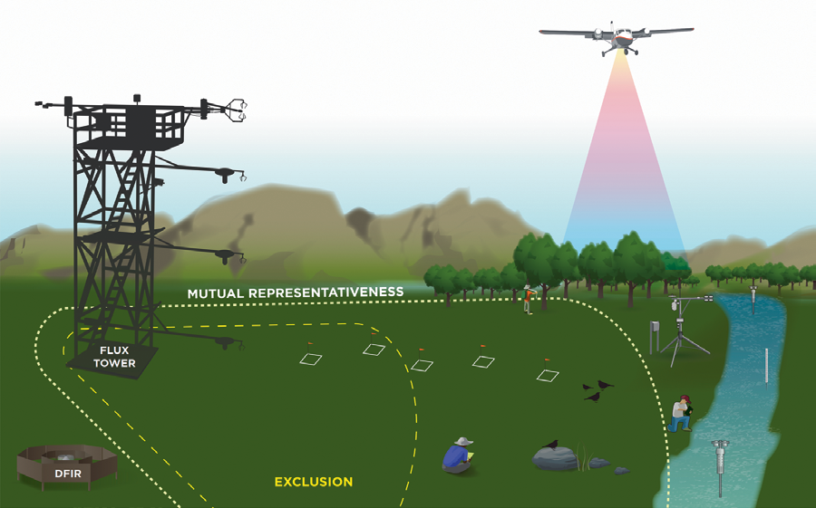
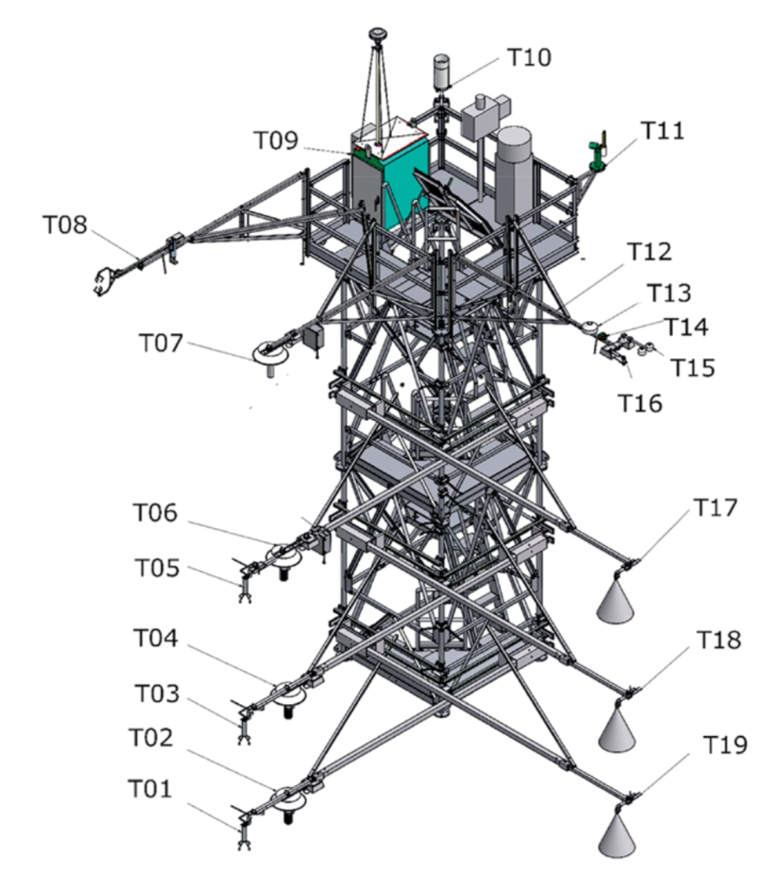
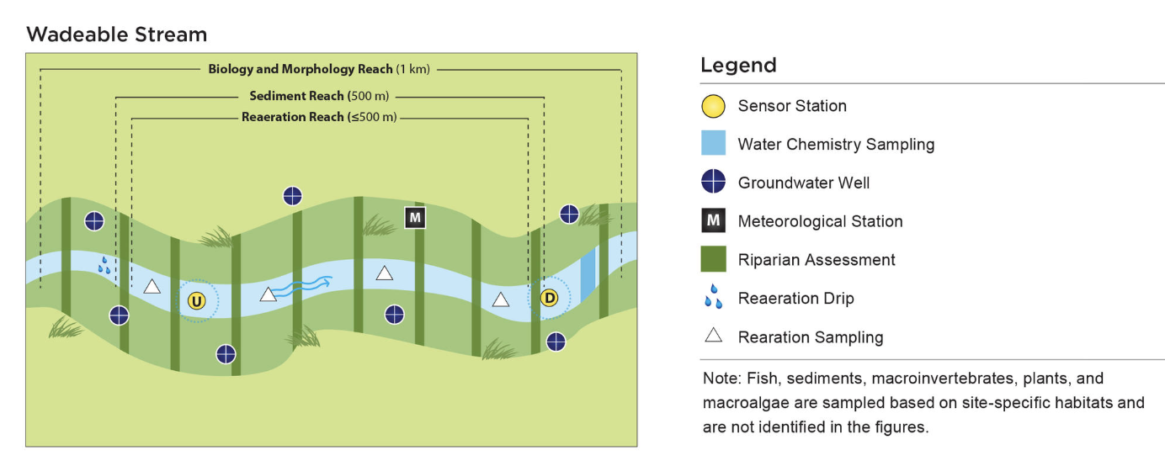
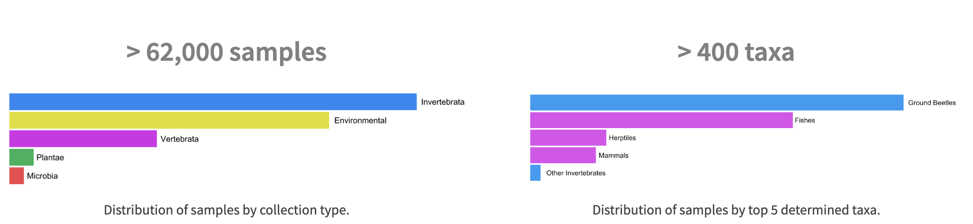
Metzger et al., 2019, Bulletin AMS; Hinckley et al., 2016, Ecosphere; neonscience.org

Slide 7
Huge Ecology!
The past 100 years of ecology went from its birth as a discipline, with theory tested primarily from small experiments in one’s “backyard”, to a modern science that sits at the center of key biogeoscience challenges on land, freshwater, and ocean management, global climate change, biodiversity and habitat loss, restoration, …
Its complexity and data volume will only accelerate in next 100…

Slide 8
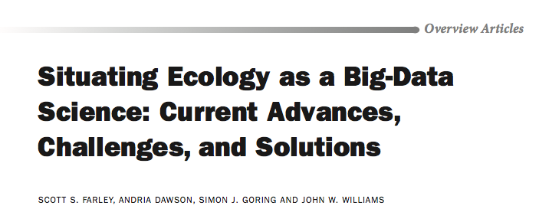
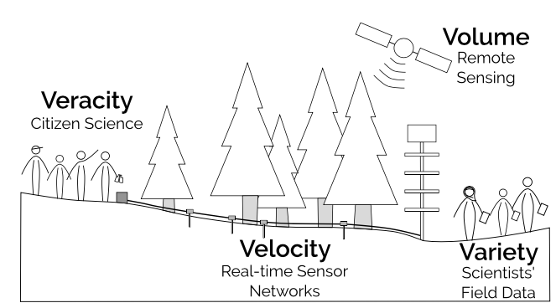
Bioscience, 2018

Slide 9
Huge Ecology!
What elements of Biogeosciences must be nurtured to make sure we are capable?
I will talk about 3 (in 5 minutes!):
Promoting an open science culture
Enabling scalable and reproducible analysis
Removing the wall between models and observations

Slide 10
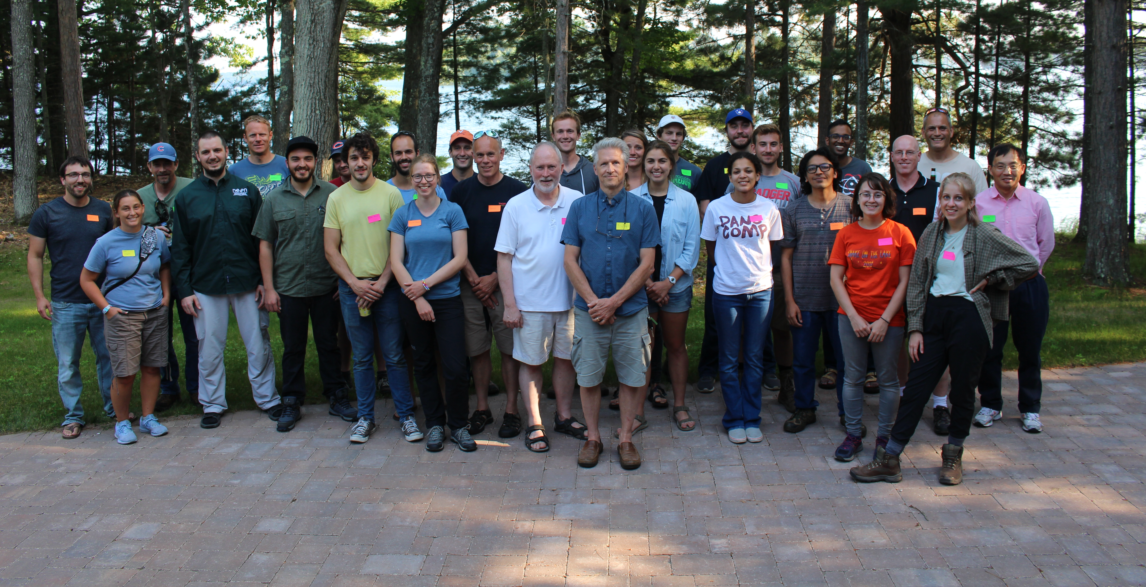
Promoting an Open Science Culture
CHEESEHEAD photos: https://groups.google.com/forum/#!forum/cheesehead

Slide 11
What is open science?
Open, FAIR data (and models!)
Citable code
Transparency in methods (“pre-registration”)

Slide 12
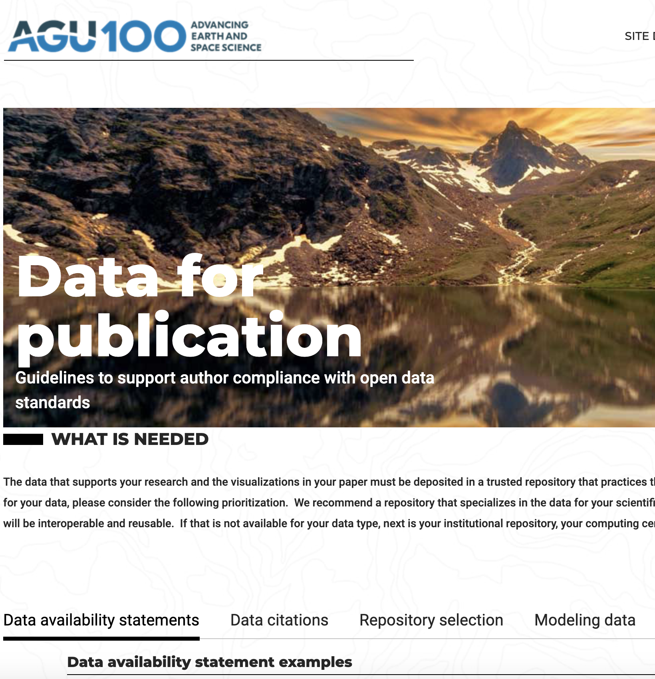
https://www.agu.org/Publish-with-AGU/Publish/Author-Resources/Data-for-Authors

Slide 13
Citable code
https://guides.github.com/activities/citable-code/
Code licenses matter!
https://choosealicense.com/licenses/

Slide 14
#COSORE (Bond-Lamberty)
https://github.com/bpbond/cosore
Open Science: Lamberty et al., 2016

Slide 15
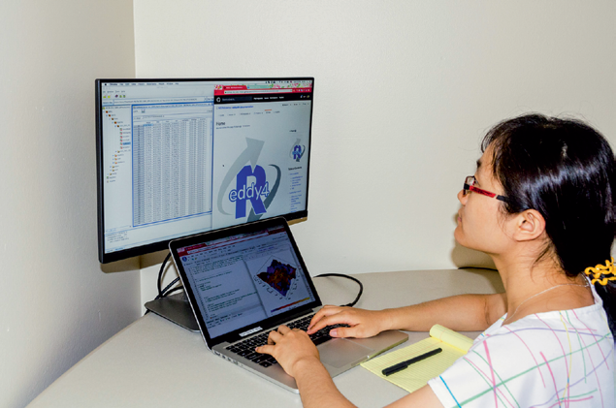
Enabling scalable and reproducible analysis
Metzer et al., 2019, BAMS

Slide 16
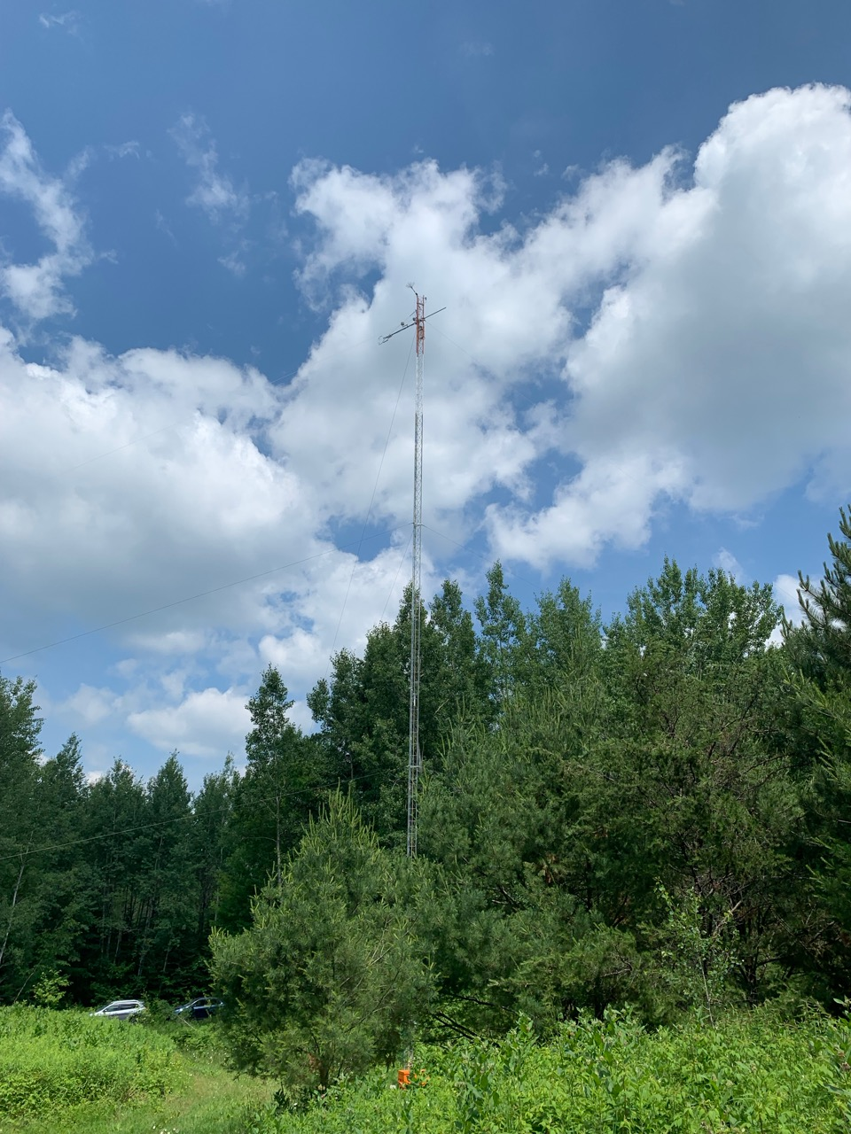
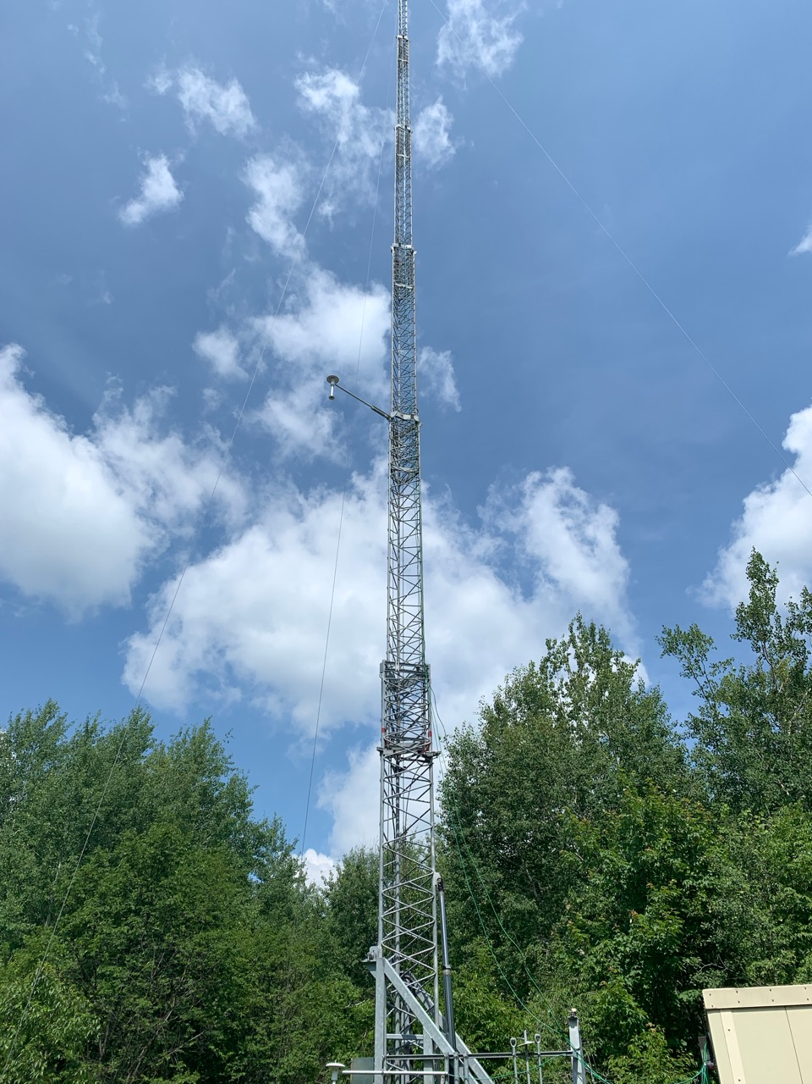
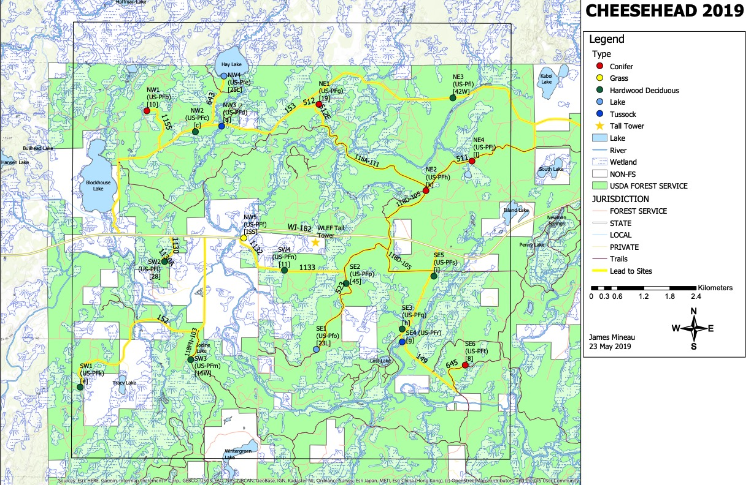
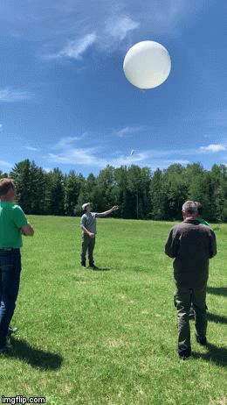
“Small” field projects…
+ -41 NPP/veg plots
-Monthly hyperspectral flights
-Drone canopy LiDAR
-Daily radiosondes
-Car and boat micromet
-Water vapor, wind, temperature profiles by LiDAR, RaDaR and SODAR
-and much more
https://www.eol.ucar.edu/field_projects/cheesehead

Slide 17
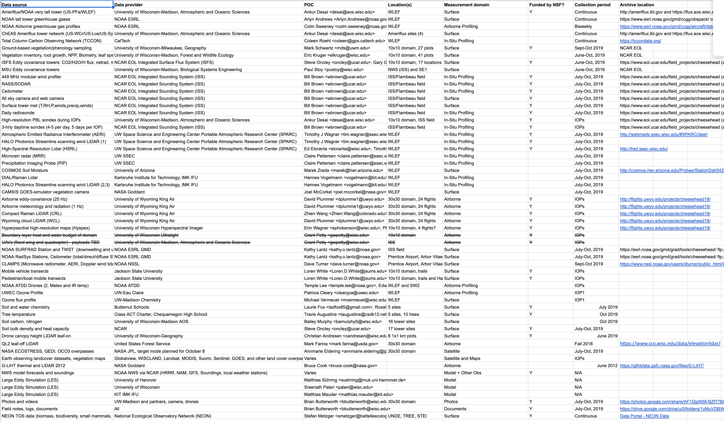
Your eyes should now glaze over..

Slide 18
Analysis and coding are now central to ecology
When data volume is in terabytes, data types number in the dozens, and collaborator lists are in the tens to hundreds, traditional “cottage-industry” style analysis is impractical and inefficient
Bringing code to the data is the new mantra
Example: Cyverse

Slide 19
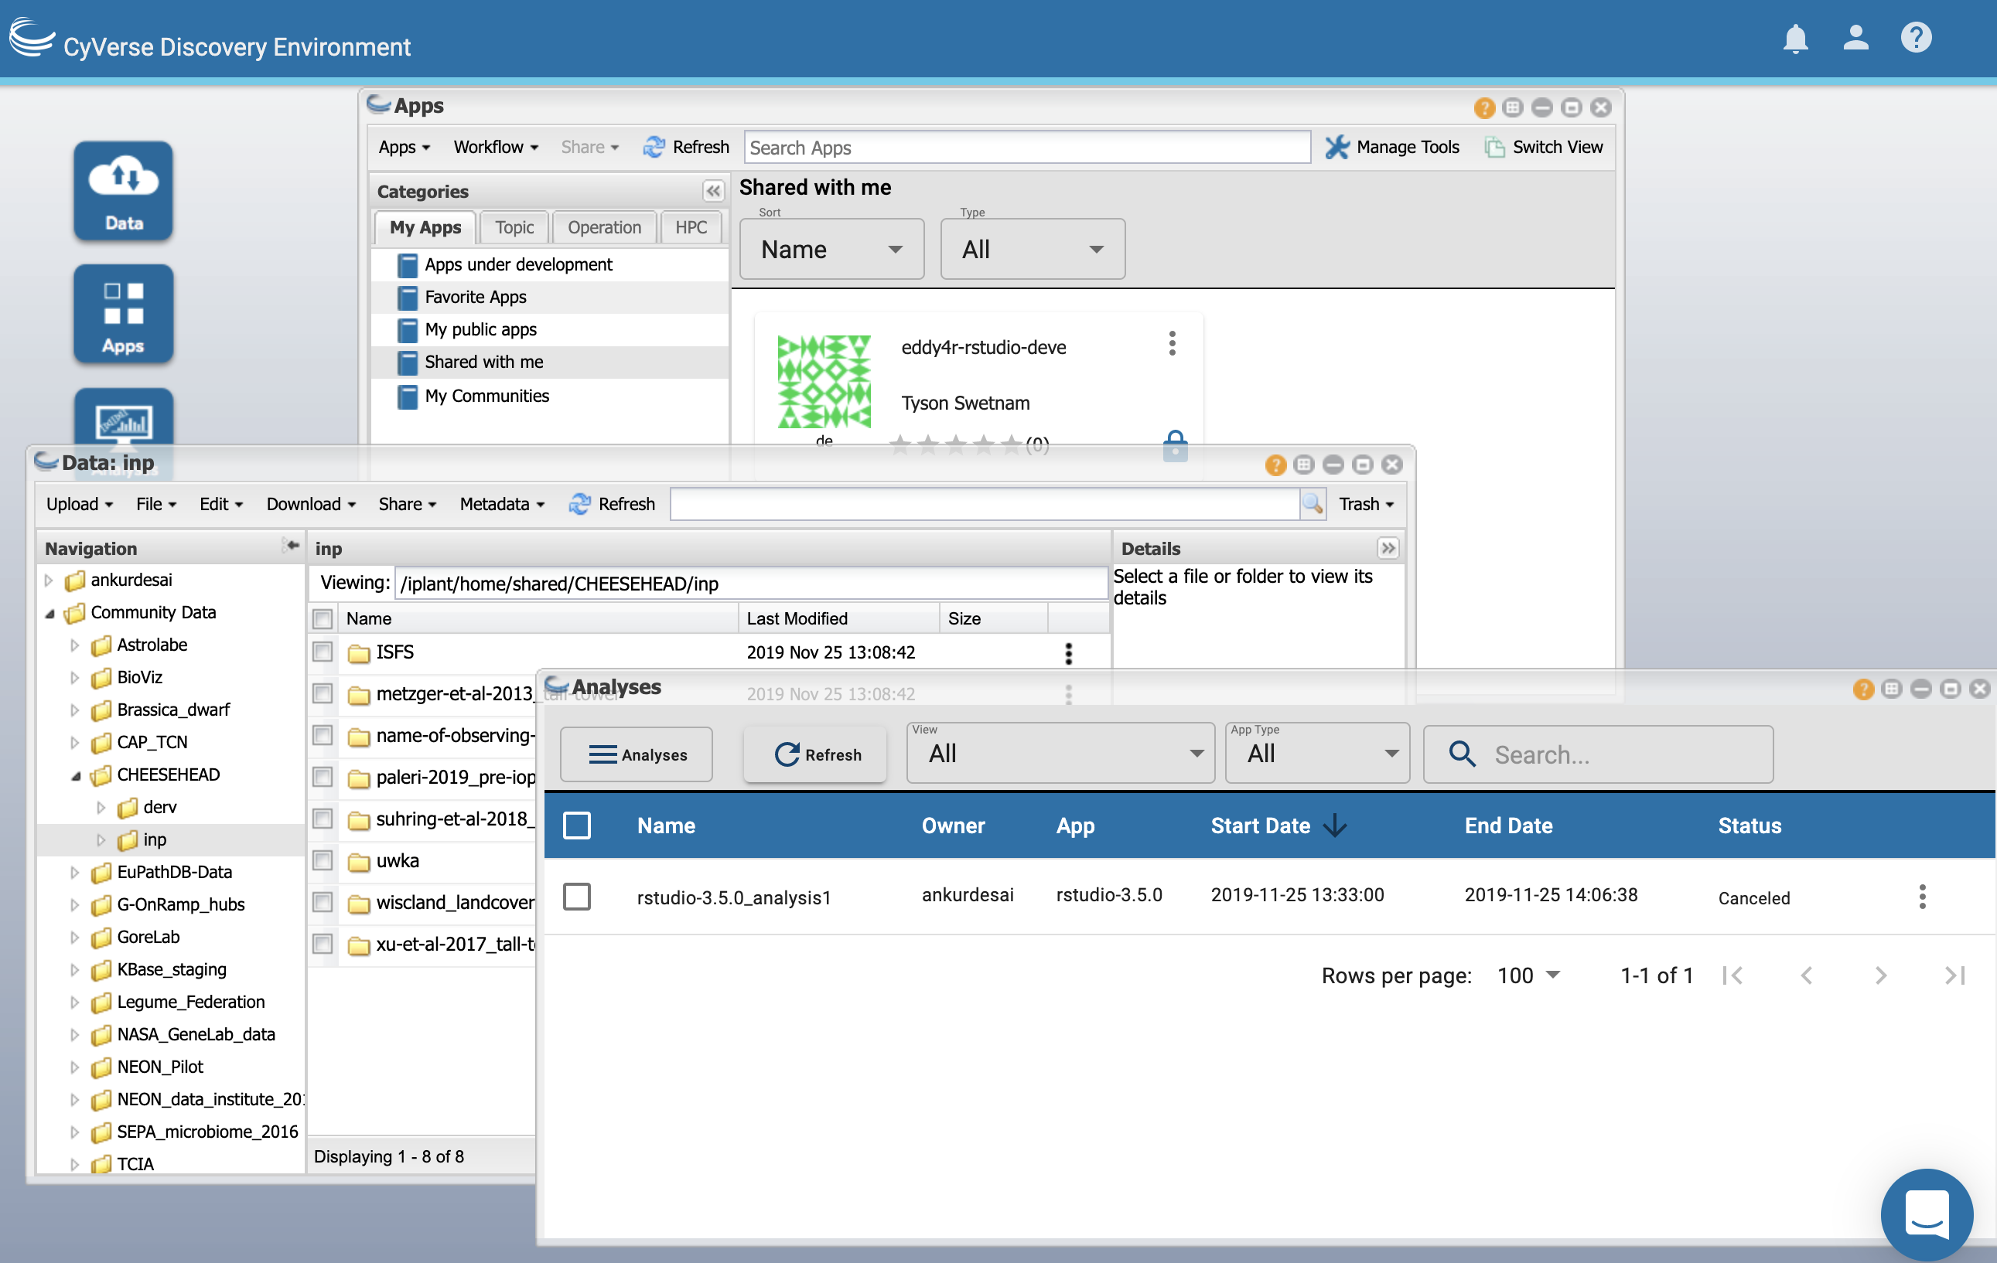
CyVerse
(NSF, U Arizona)
https://www.cyverse.org/atmosphere https://de.cyverse.org/de/

Slide 20
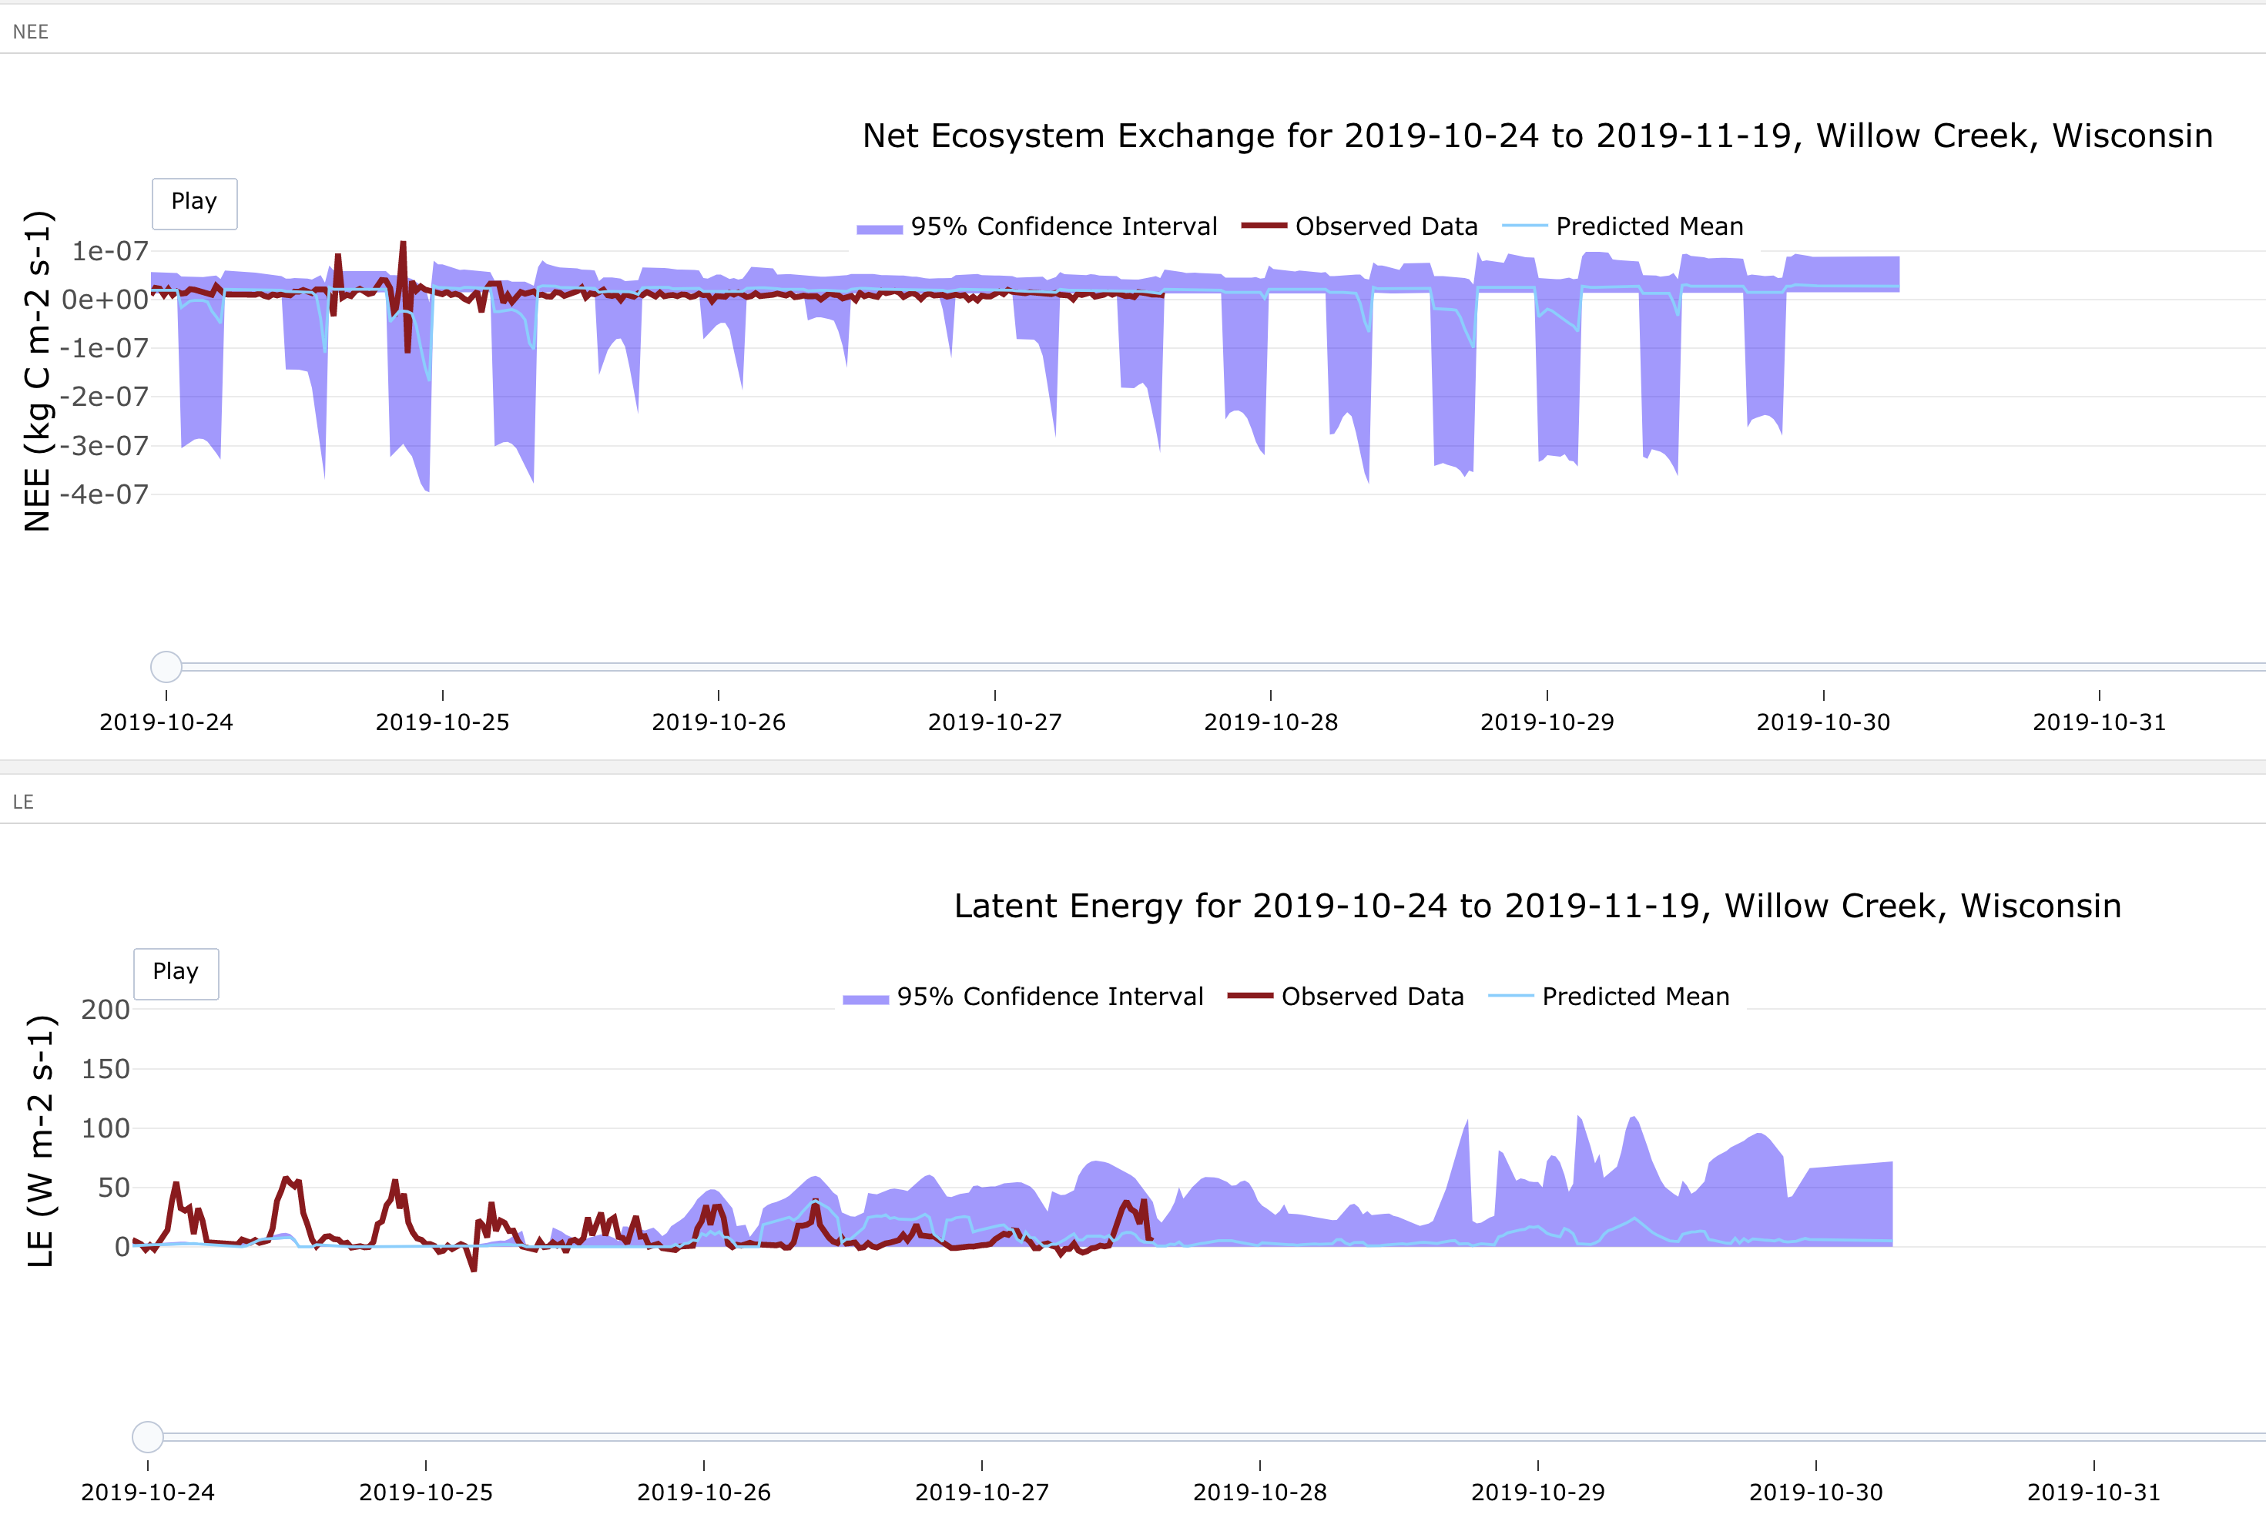
Removing the wall between models and observations
Katie Zarada, Mike Dietze, PEcAn project

Slide 21
No one should be called a “modeler” or an “experimentalist”
Models are how we represent complex non-linear interactions among our theories
No single type of observation is sufficient to evaluate the hypotheses embedded in models
Model intercomparison and benchmarking projects can be made more routine

Slide 22
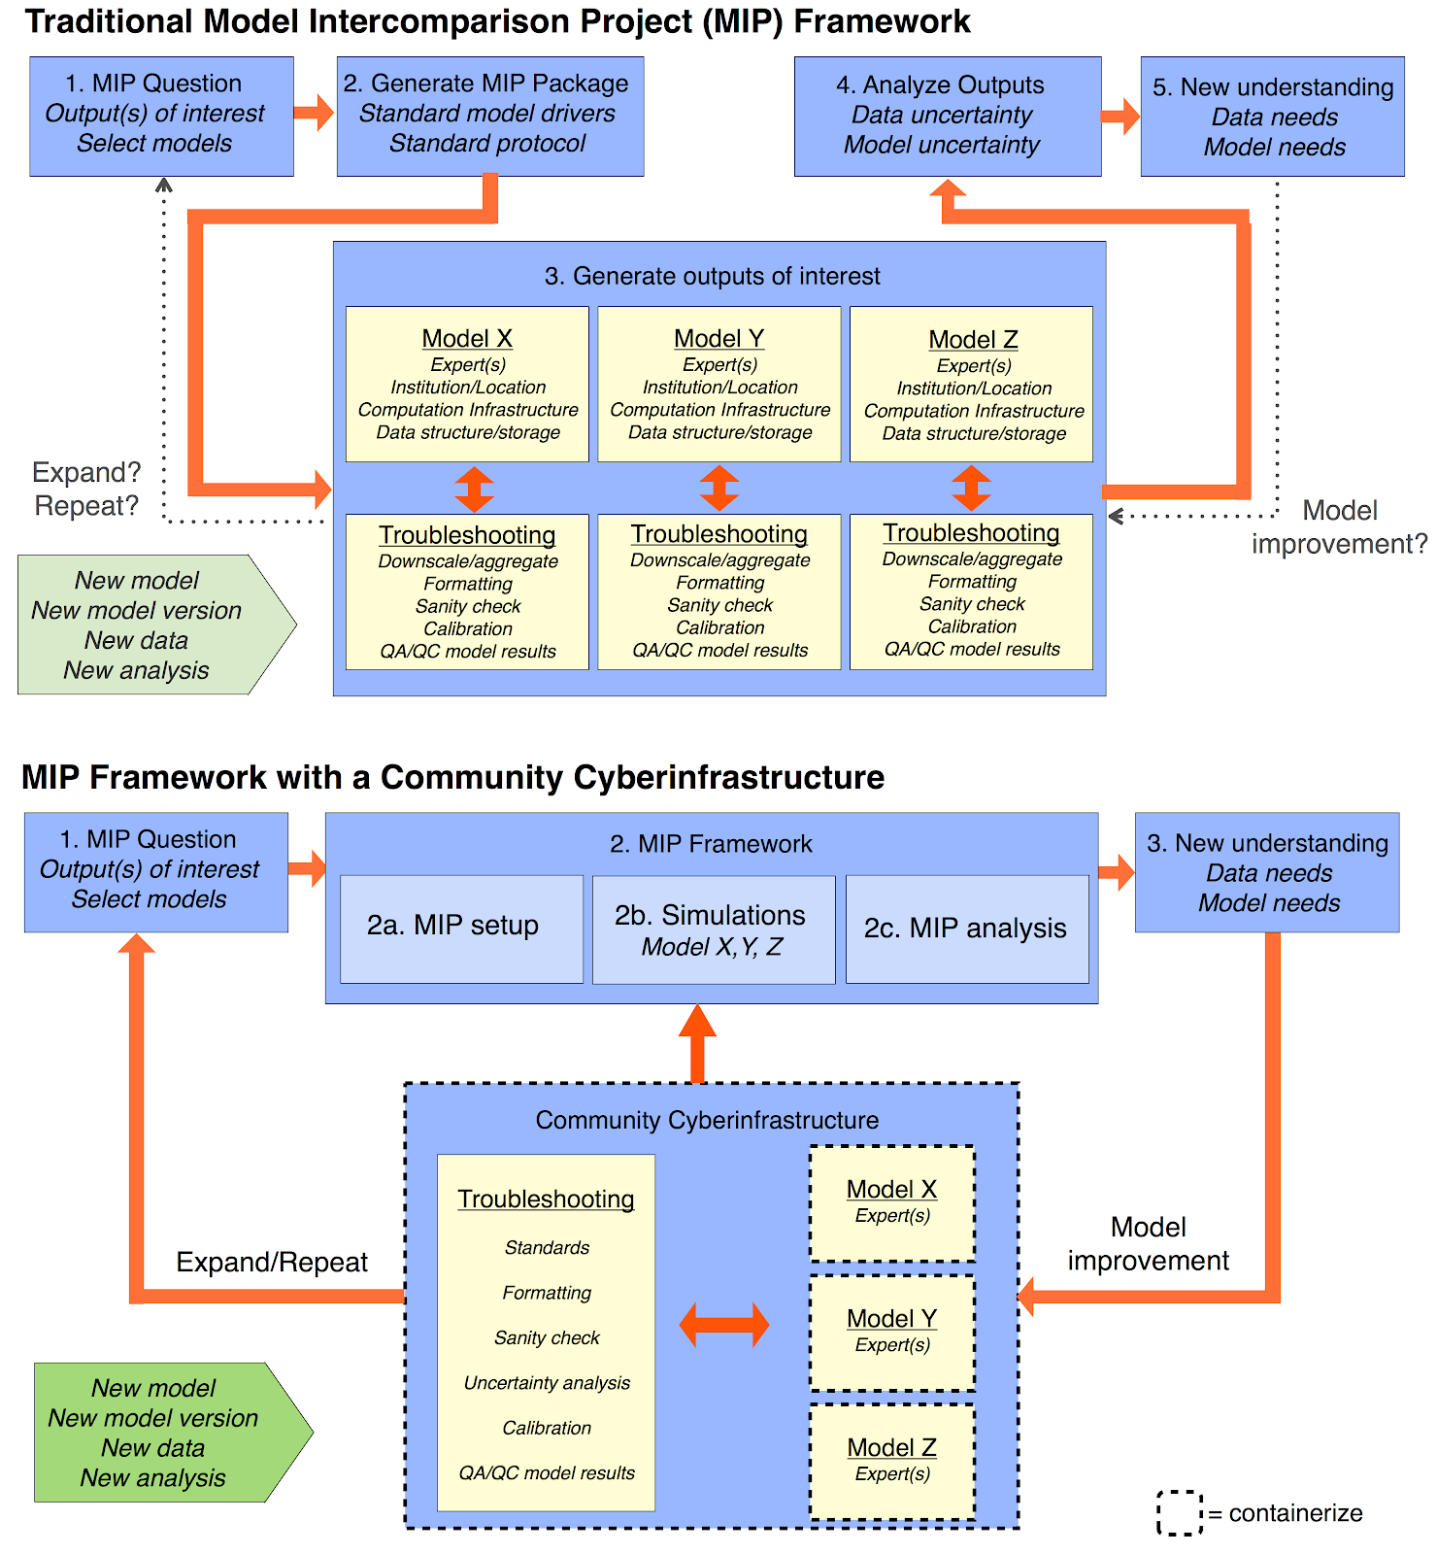
Gardella et al., in prep

Slide 23
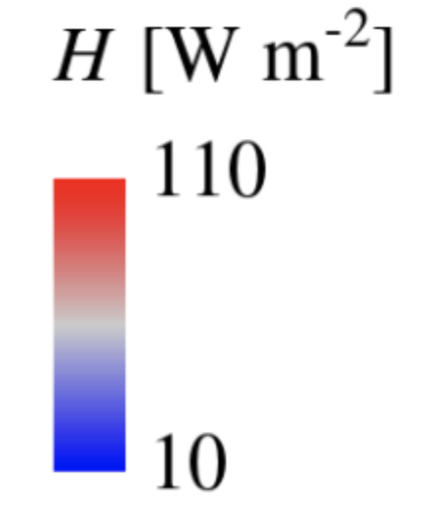
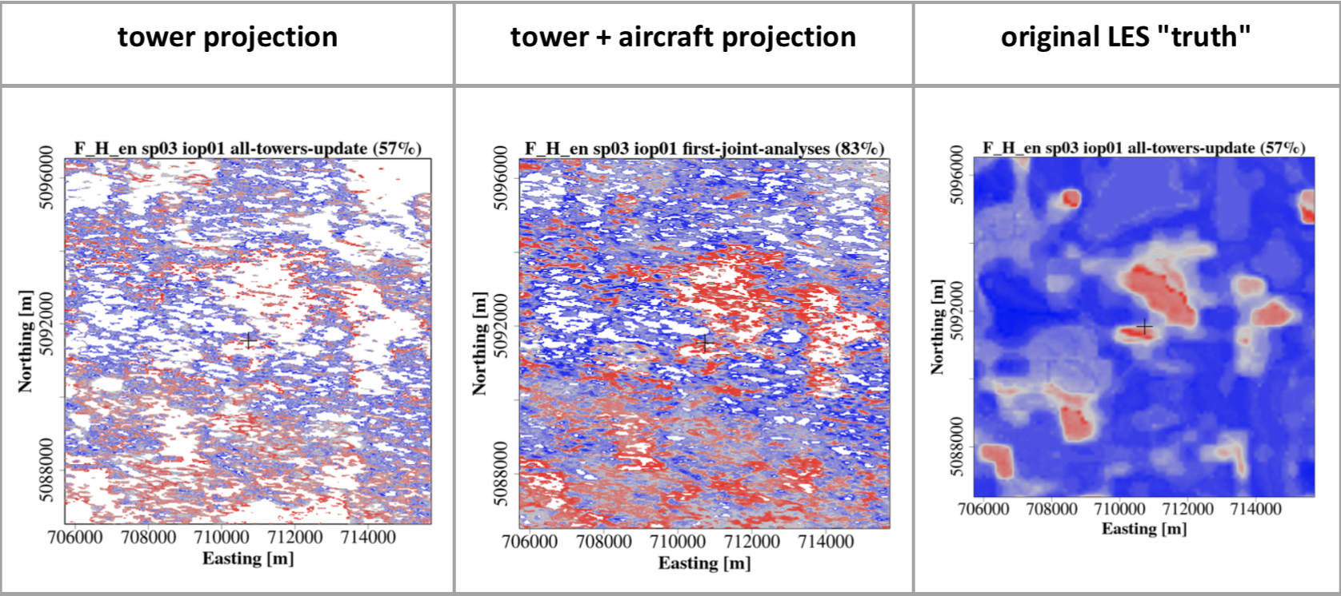
Observing System Simulation Experiments (OSSEs) flip the script on how models are used in experiments
Learn more at B22D-01 Metzger TU 1020 MW3007 and B21C-06 Paleri TU 915-930 MW3007
Metzger et al., 2013; Xu et al., 2017, 2018;
S. Metzger, S. Paleri, K. Xu

Slide 24
Huge Ecology is possible
A diverse community makes global change ecology possible
Diverse solutions are needed to confront the increasing volume in data and complexity in theory and models
There are challenges that need to be solved mostly by students and early career scientists
But supported by community, funders, mentors
The next few decades will be consequential for our discipline for a number of reasons

Slide 25
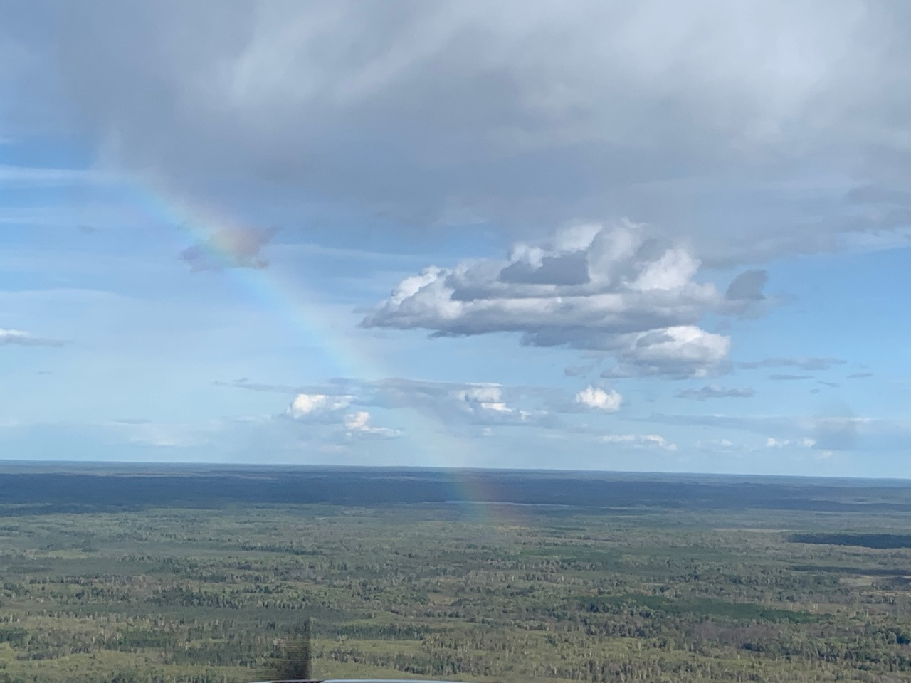
Thank you!
Ankur Desai
desai@aos.wisc.edu
https://flux.aos.wisc.edu
@profdesai
Photo: A. Desai

