Slide 1
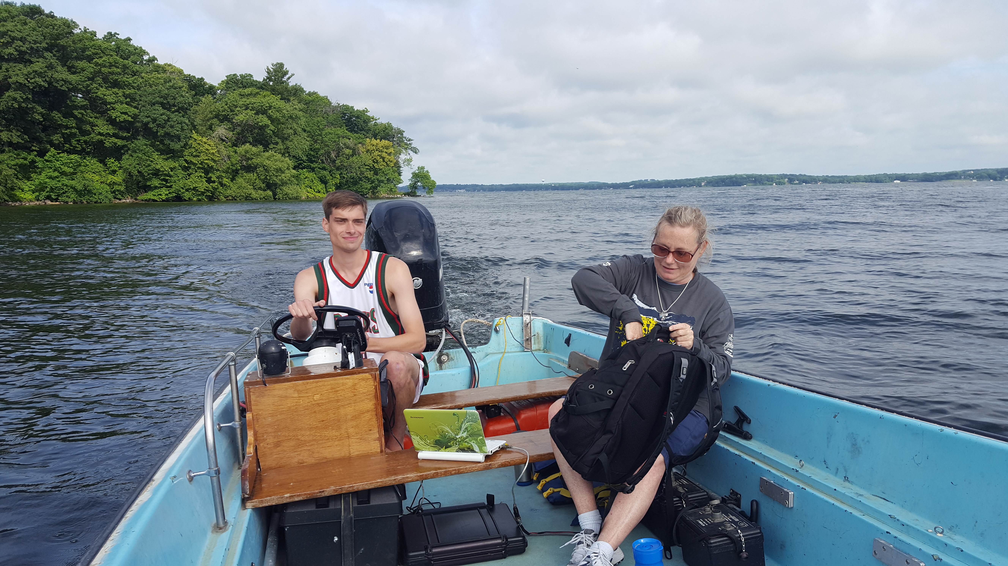
Inland water bodies as surface energy hotspots
Ankur Desai, University of Wisconsin-Madison
B32B-02
AGU Fall 2019, Wednesday 1030-1050, MW 3007
Zack Taebel->
<-Angela Baldocchi

Slide 2
Acknowledge
David Reed (MSU)
Zack Taebel (NCSU)
Jonathan Thom (UW)
Paul Stoy (UW)
Brian Butterworth (UW)
Angela Baldocchi (UW)
Steve Oncley (NCAR)
Gosia Golub (Uppsala)
Loren White (Jackson State)
NSF LTER North Temperate Lakes (DEB-1440297)
NSF CHEESEHEAD (AGS-1822420)
NSF AGS Postdoctoral Fellowship Program

Slide 3
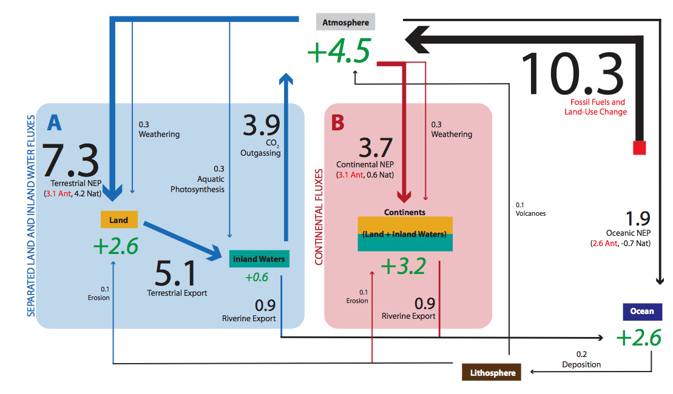
Lakes are thought to be a global carbon cycle hotspot
Drake et al. ,2017

Slide 4
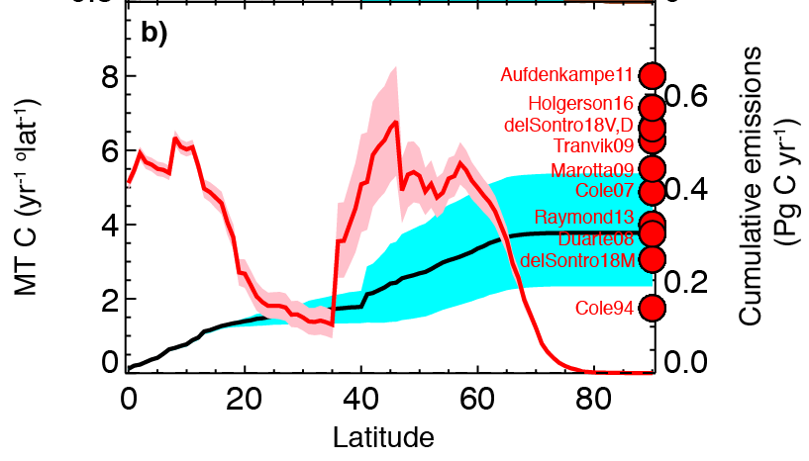
Though with some uncertainty…
Golub et al., submitted

Slide 5
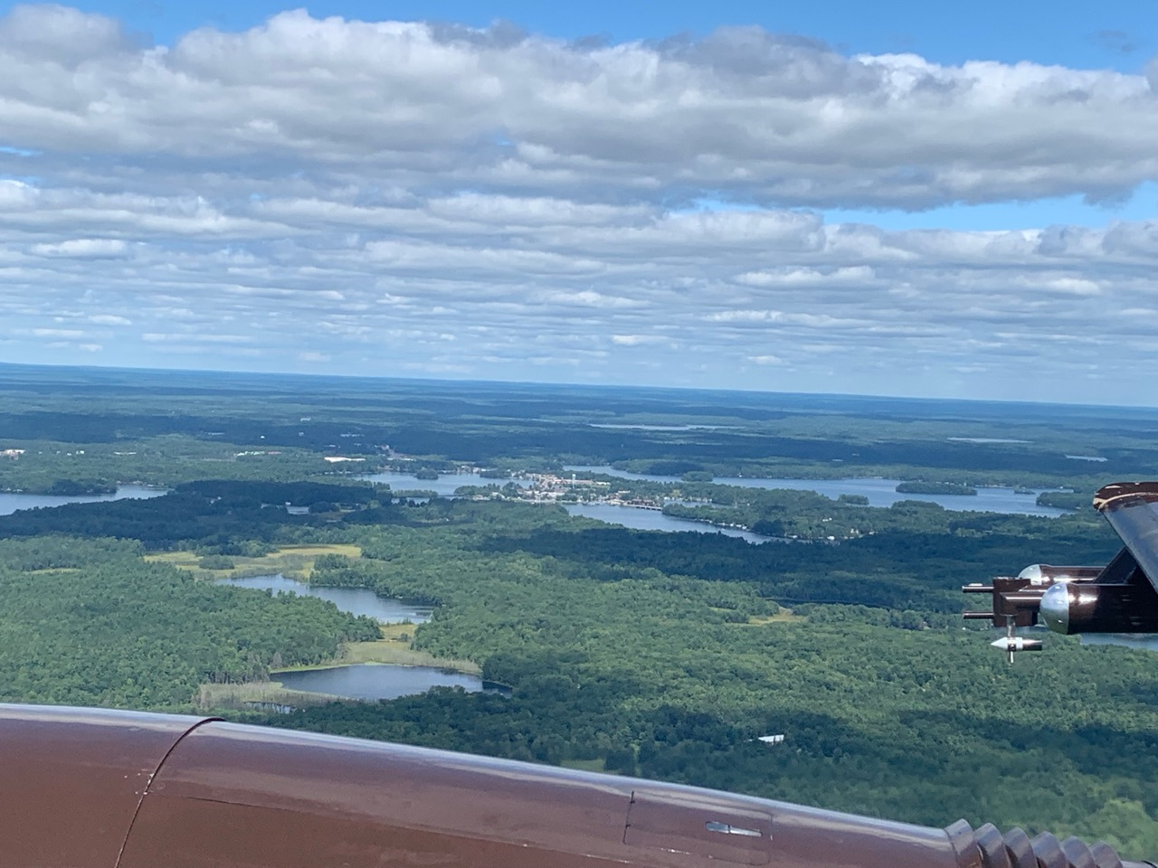
But are they also hotspots in the surface energy balance?
Photo: A. Desai

Slide 6
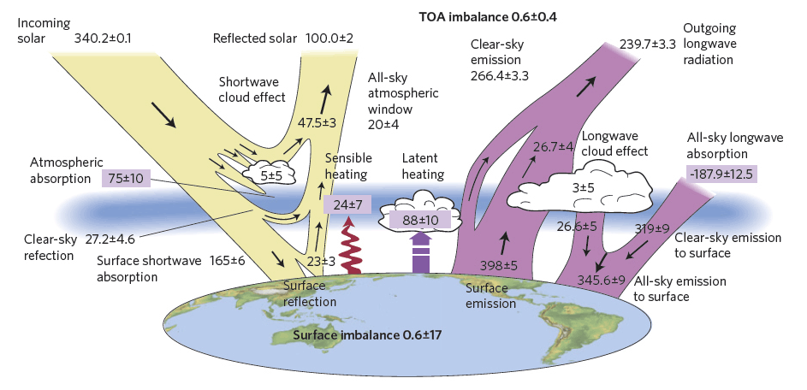
Turbulent fluxes = thermals and evapotranspiration = H + L_{E}
Net Radiation=R_{net}=
SW_in-SW_out + LW_in-LW_out
Heat storage = G
Stephens et al., 2012, Nature Geosci

Slide 7
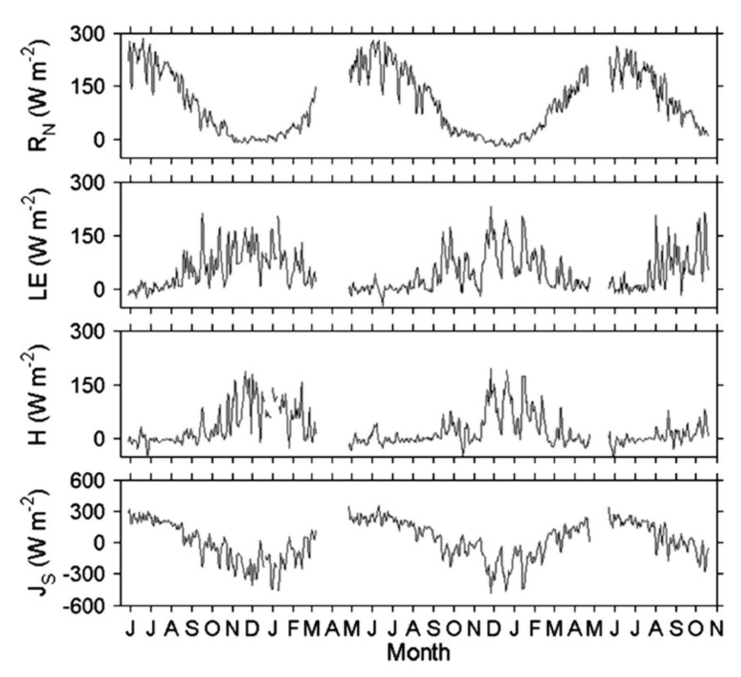
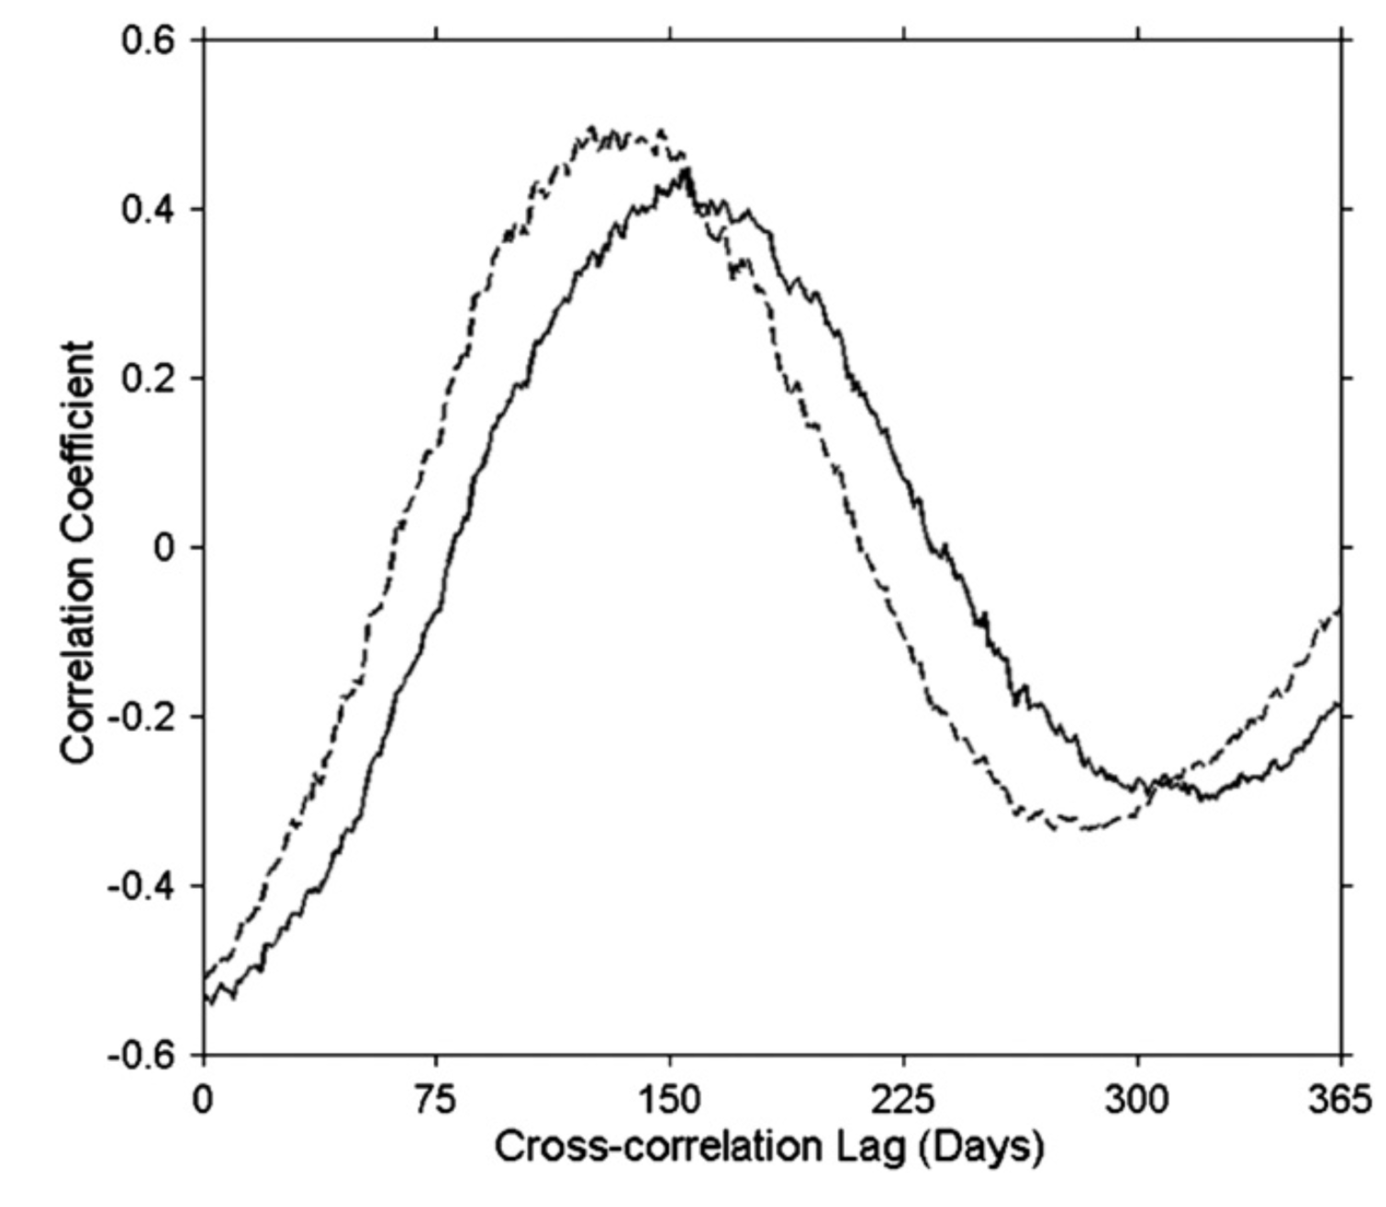
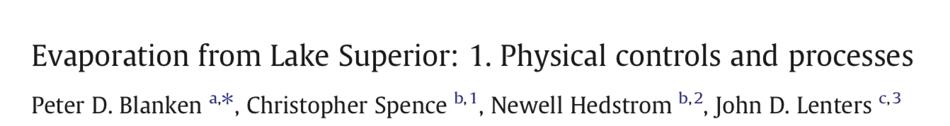
Early work supported the idea that lake energy balance is unique
Blanken et al., JGLR, 2011

Slide 8
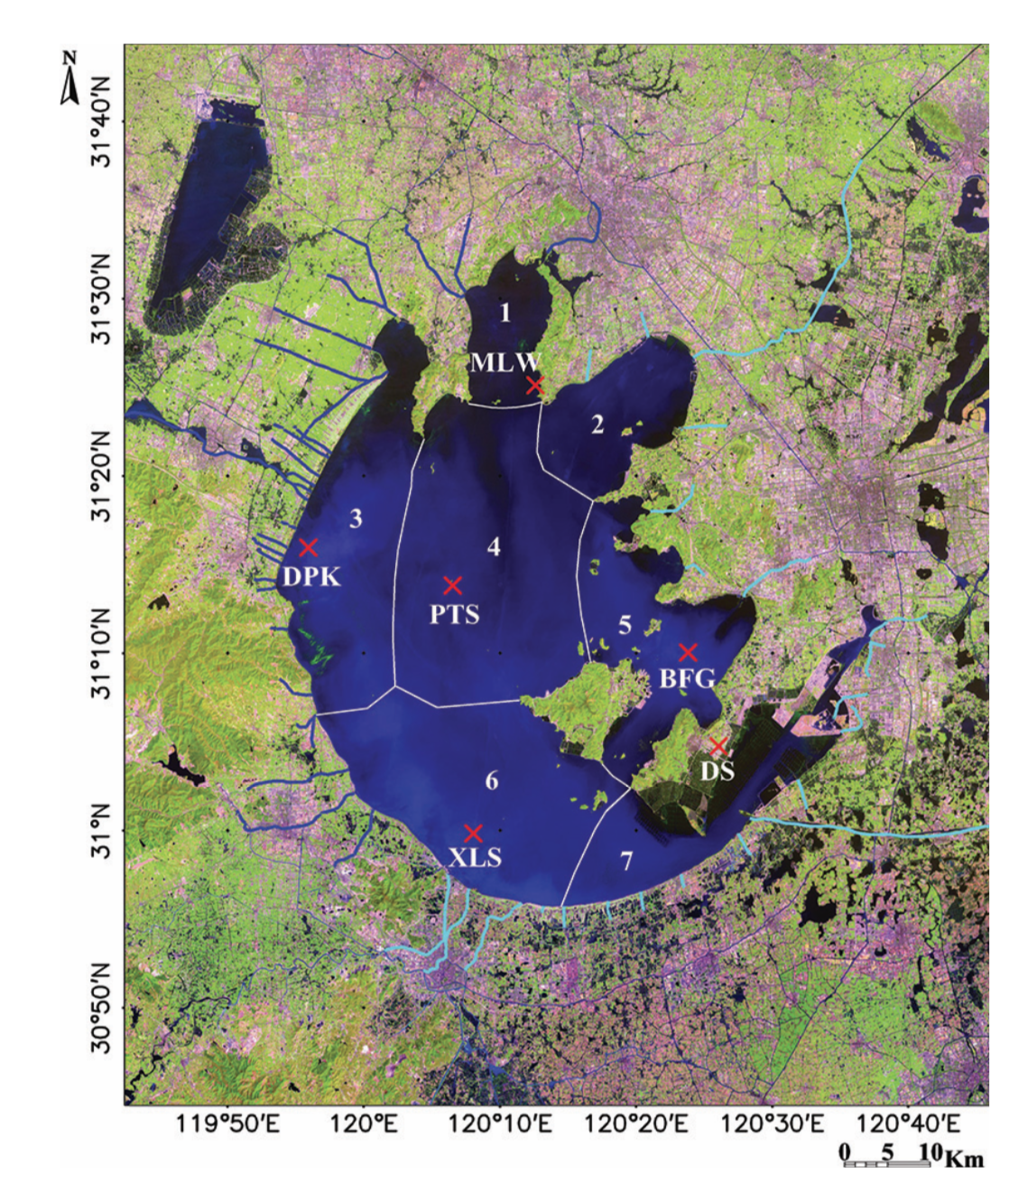
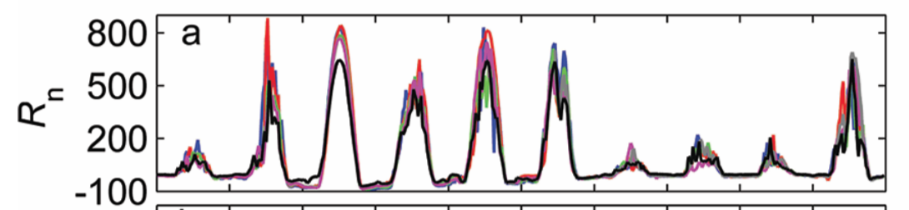
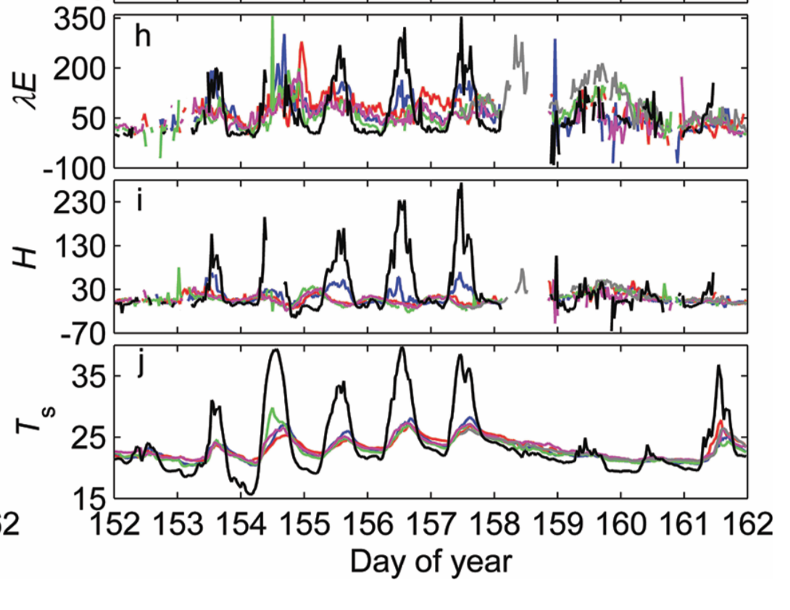

Large within lake spatial variability exists, too!
Lee et al., BAMS, 2014

Slide 9
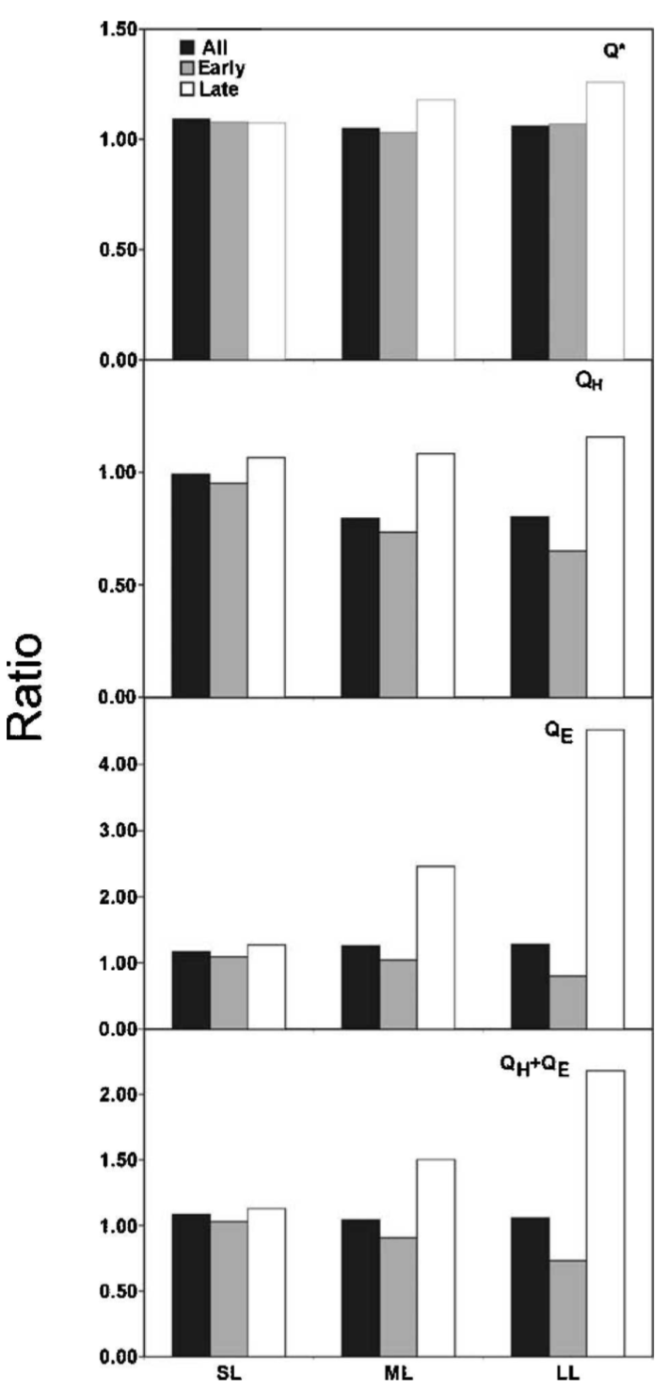
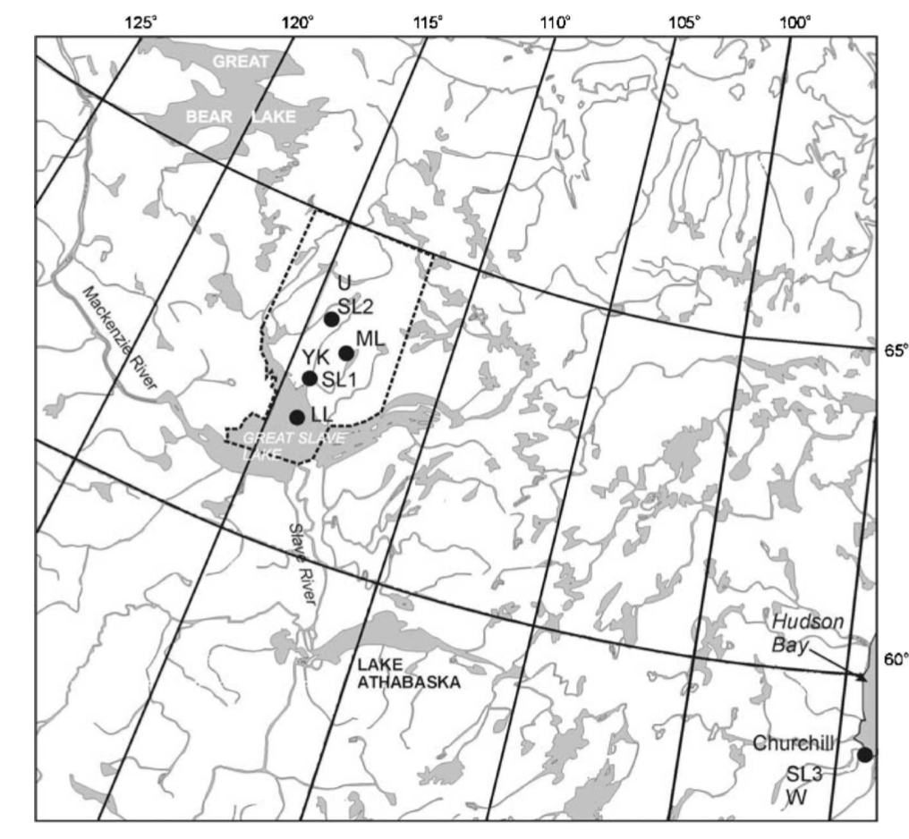
Empirical upscaling models suggest this matters for landscapes
Rouse et al., JHM, 2005

Slide 10
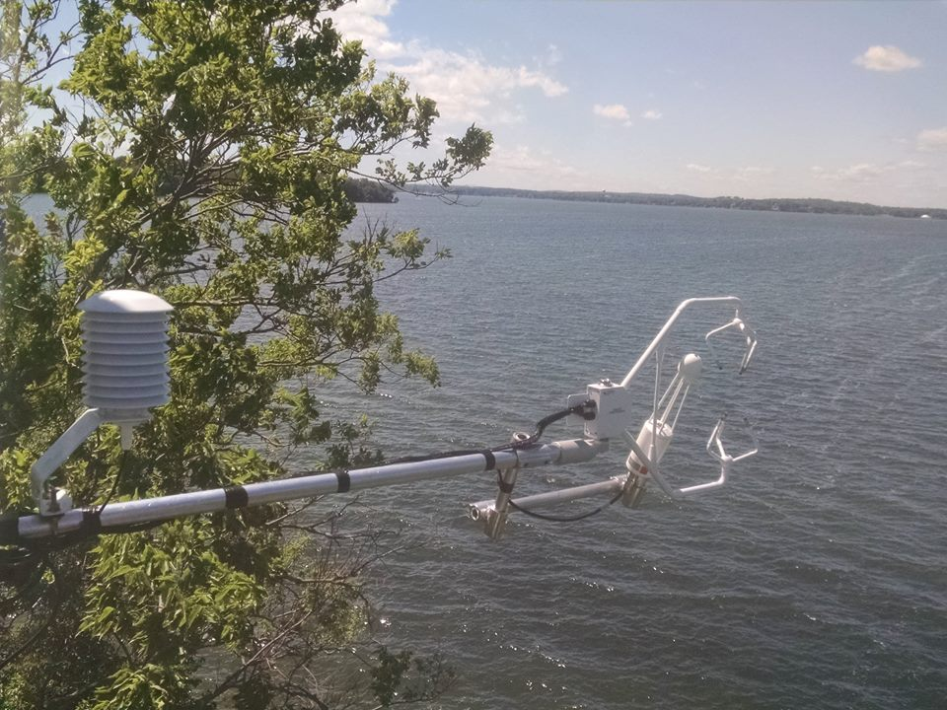
Are models picking up on lake energy balance characteristics?

Slide 11
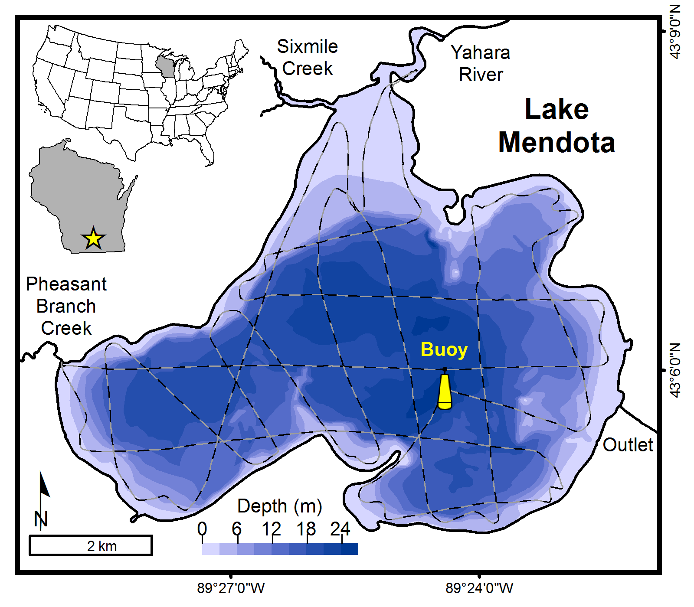
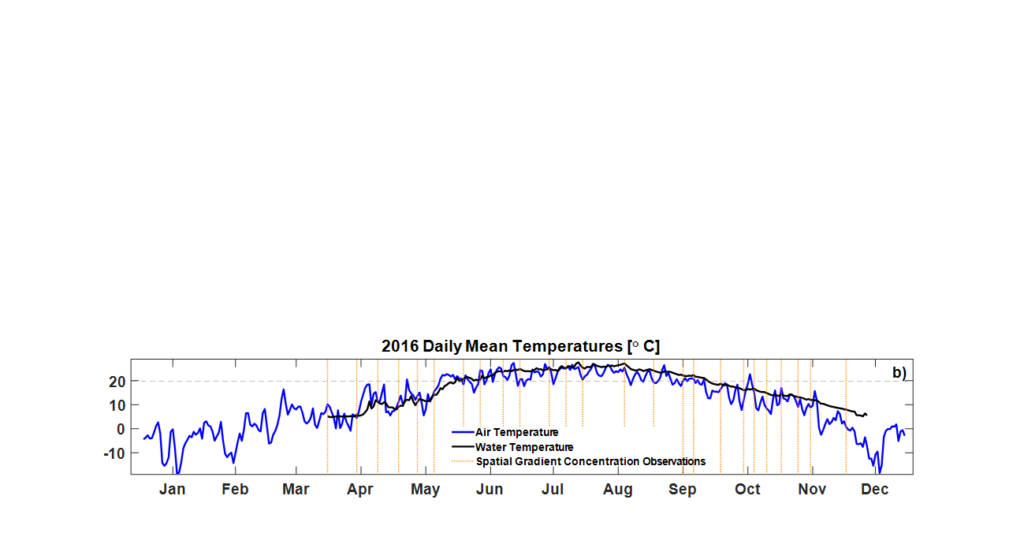
Our test bed: Lake Mendota
Madison, WI USA
Picnic
Point
Tower
CFL Eddy Flux Tower
Taebel et al., JGR-D, submitted; Baldocchi et al., in prep; Loken et al., JGR-G, 2019

Slide 12
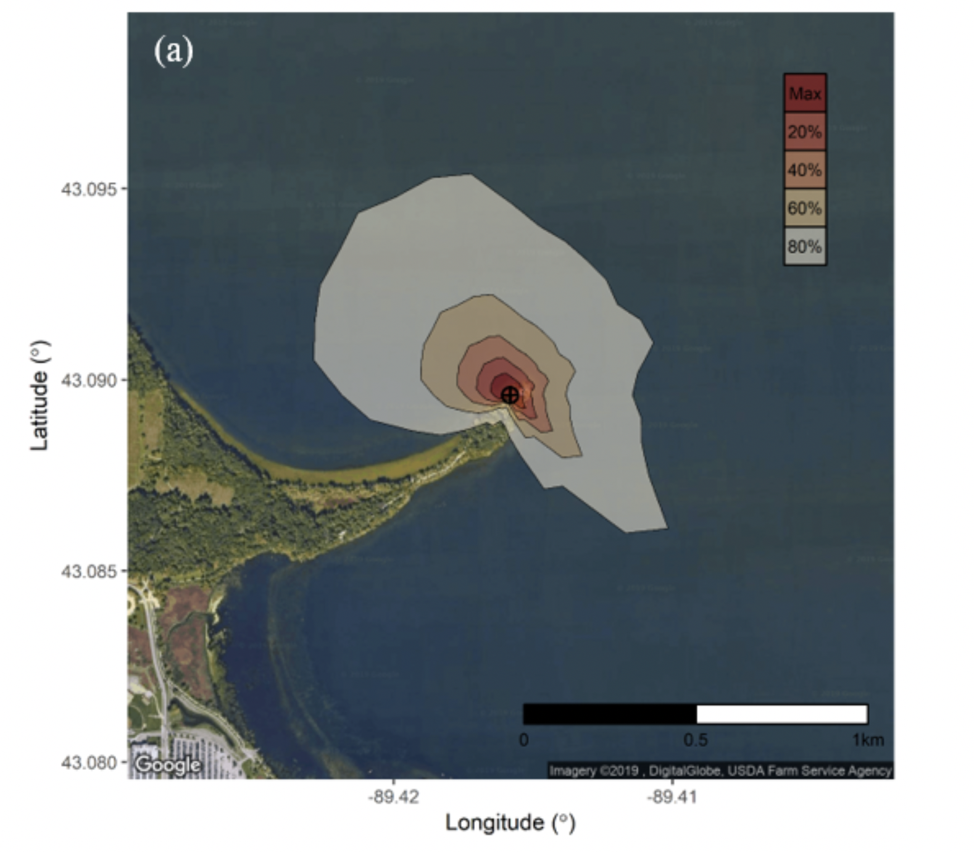
US-PnP
http://dx.doi.org/10.17190/AMF/1433376
Baldocchi et al., in prep

Slide 13
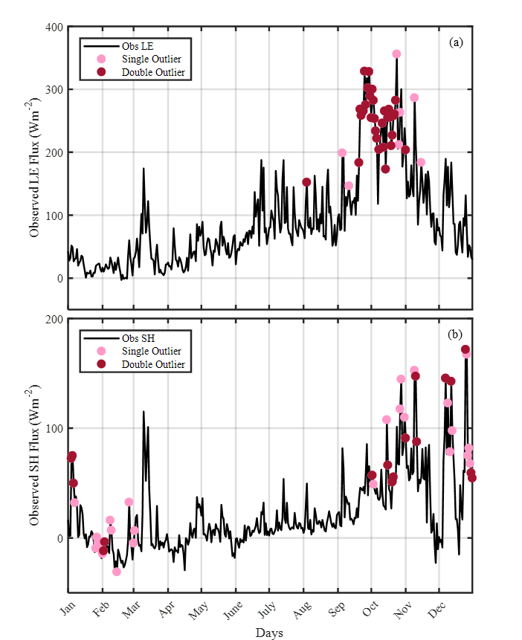
Latent heat flux
Sensible heat flux
Taebel et al., submitted

Slide 14
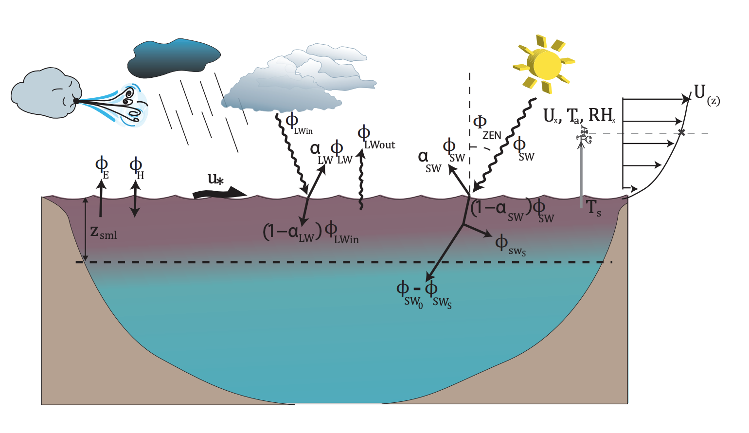
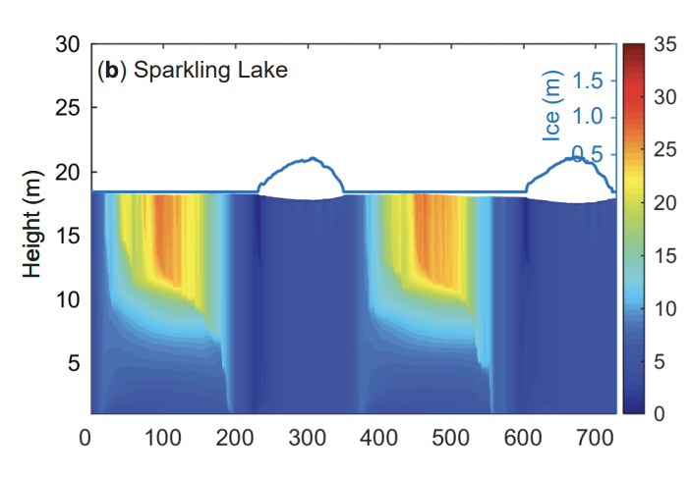
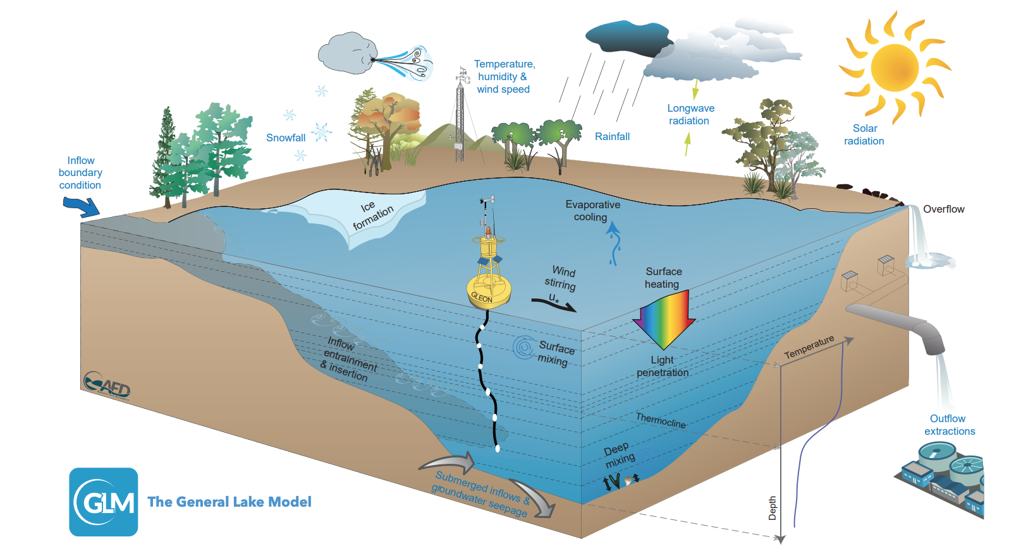
Two 1-D lake models
FLake model: Mironov, 2008
General Lake Model (GLM): Hipsey et al., 2019

Slide 15
Models do well for sensible heat flux, less so for latent heat, especially in autumn
Latent heat flux
Observed
FLake and GLM
Sensible heat flux
Taebel et al., submitted

Slide 16
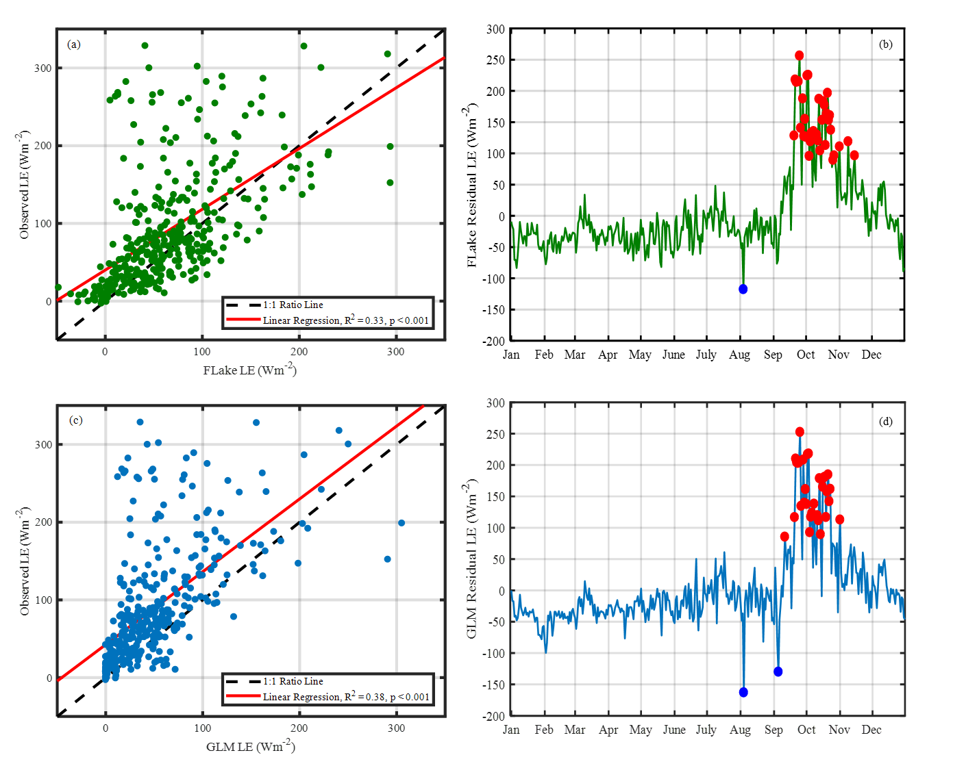
Observed minus FLake
FLake
Observed minus GLM
GLM
Taebel et al., submitted

Slide 17
Only clear source of uncertainty appears to be in autumn modeled lake surface temperatures
GLM
Observed
FLake
Taebel et al., submitted

Slide 18
One caveat: Lake eddy covariance doesn’t always make sense
Diffusive
Eddy
Baldocchi et al., in prep

Slide 19
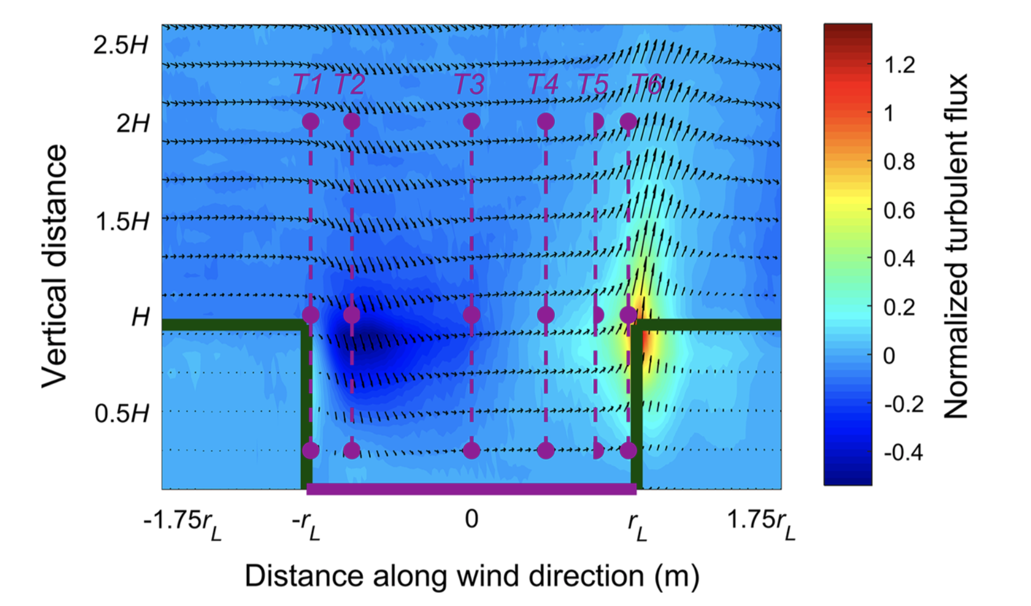
Possible reason: Flux bias at lake-land edges, at least in large eddy simulations of flux towers
Kenny et al., 2017, BLM

Slide 20
What about the landscape?
Let’s move up north to the
  Chequamegon Heterogenous Ecosystem Enery-balance Study Enabled by a High-Density Extensive Array of Detectors
  AKA CHEESEHEAD19
  NSF land-atmosphere field project run in summer 2019
  20 flux towers + flux aircraft, and atmospheric profilers
  https://www.eol.ucar.edu/field_projects/cheesehead

Slide 21
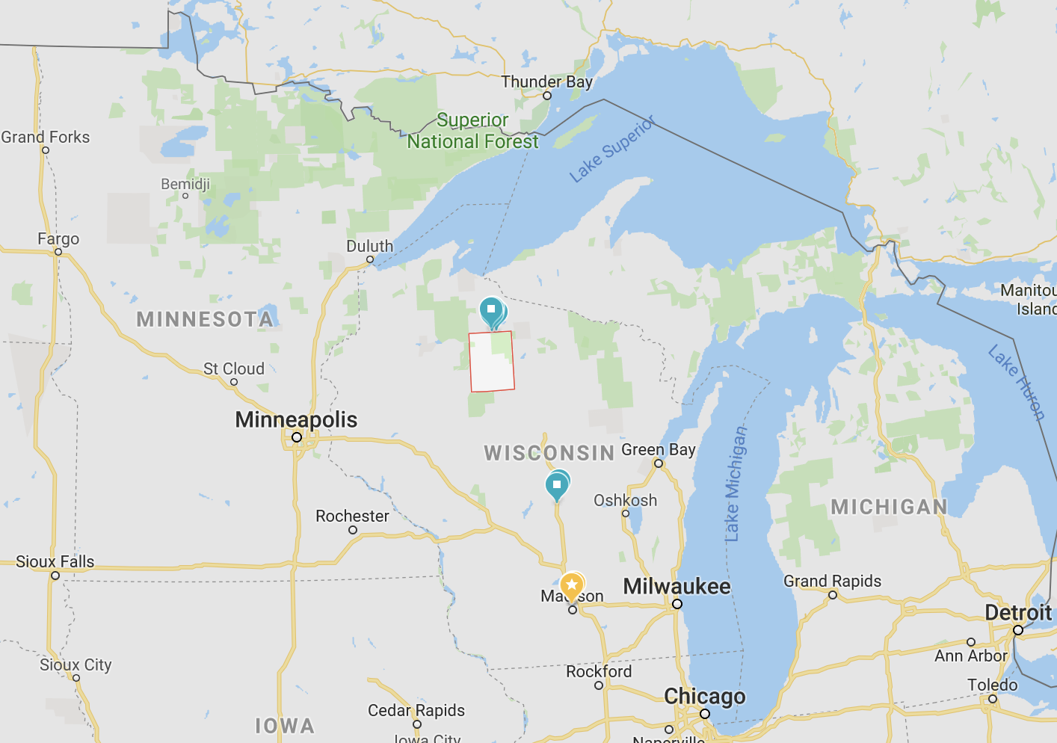
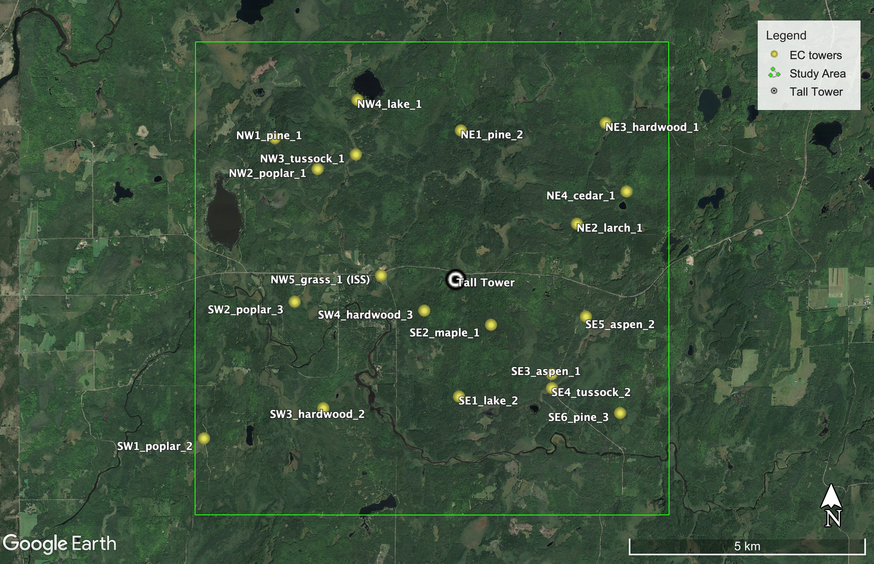
Park
Falls
182

Slide 22
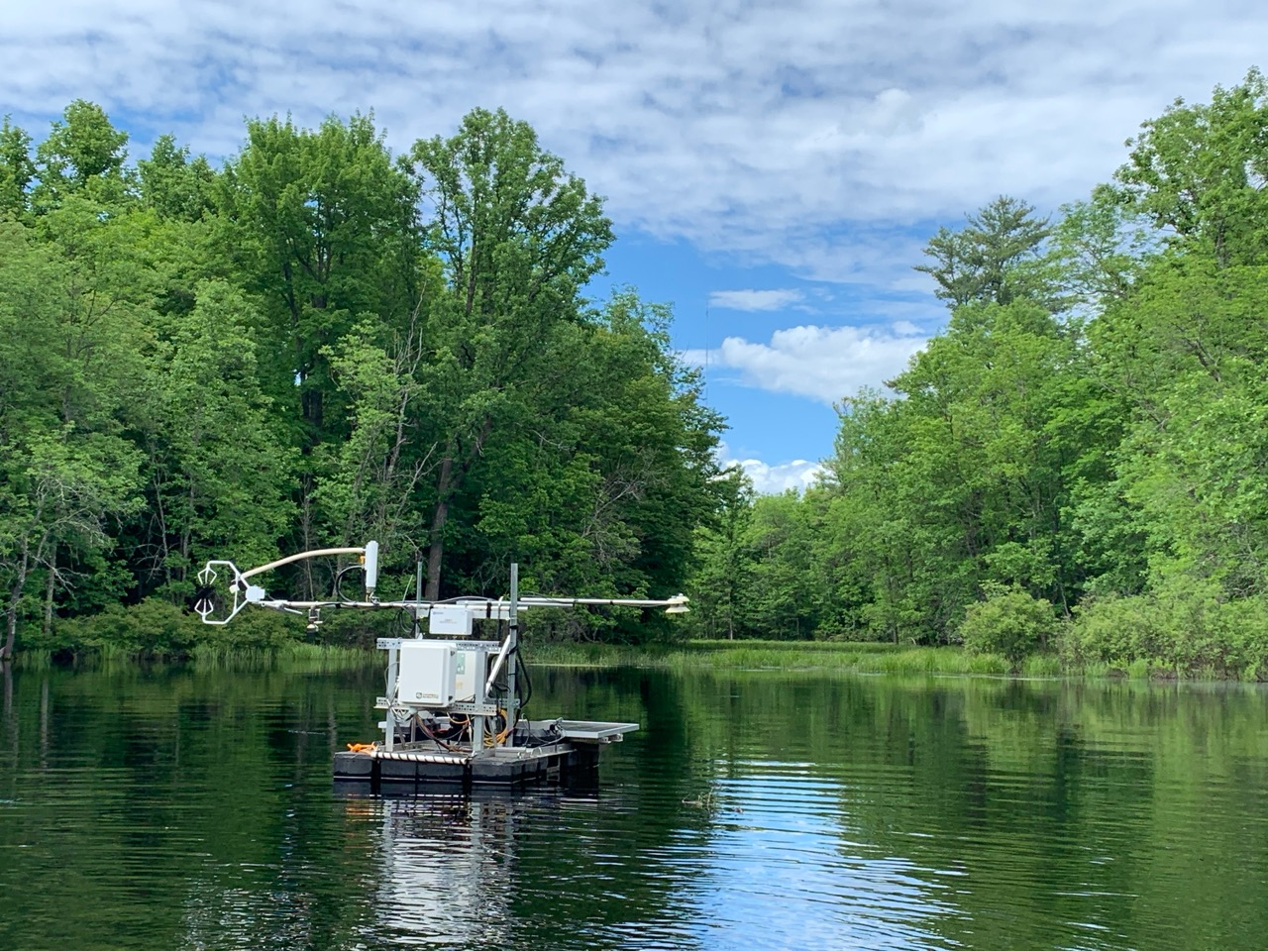
US-PFa
US-PFo (SE1)
Tower: P. Stoy, B. Butterworth, J. Thom, N. Lottig, P. Schramm
Photo: A. Desai

Slide 23
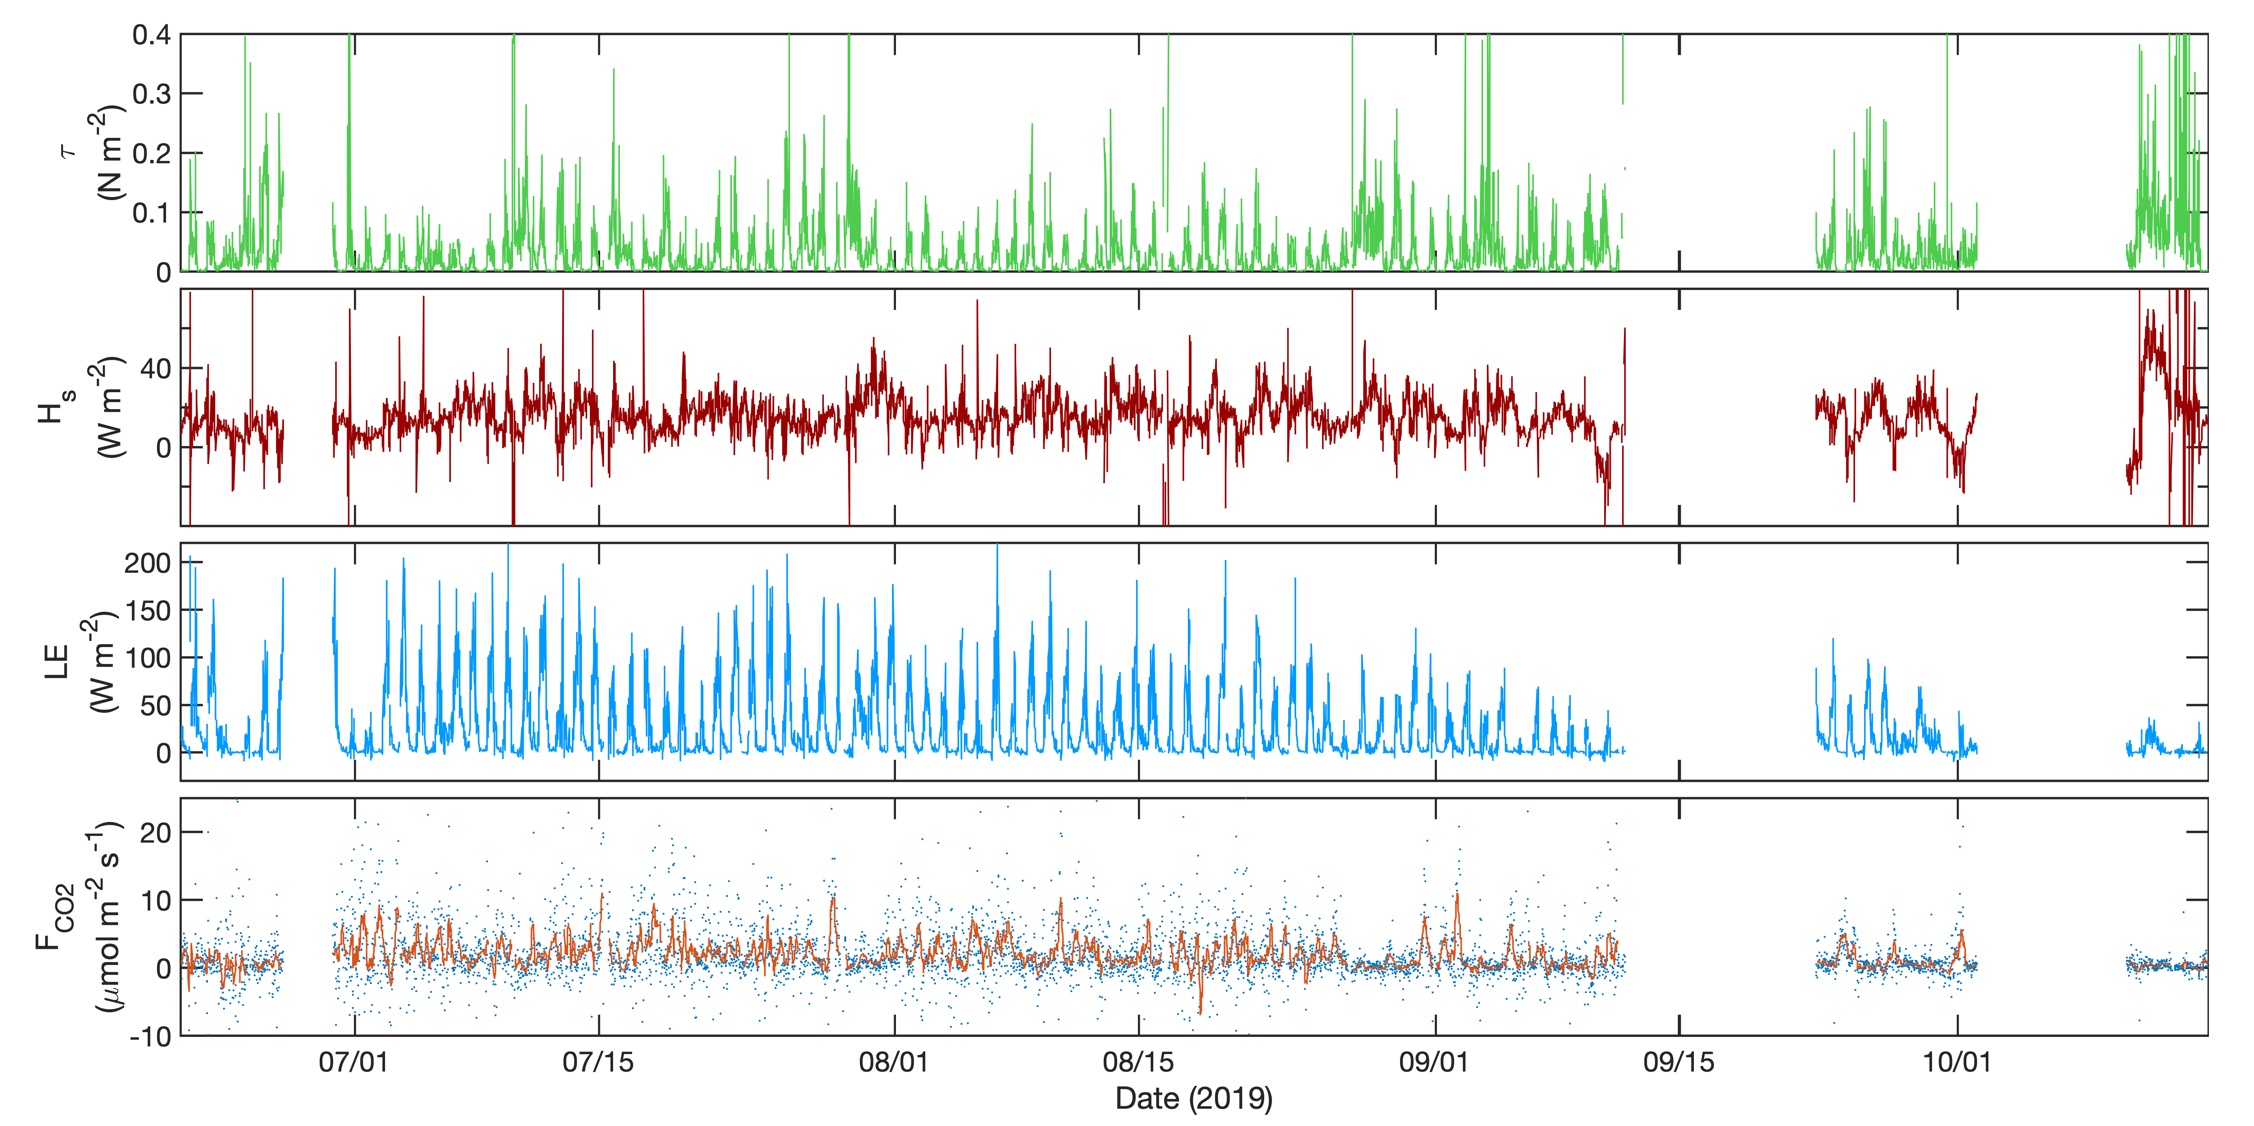
B. Butterworth, P. Stoy, J. Mineau

Slide 25
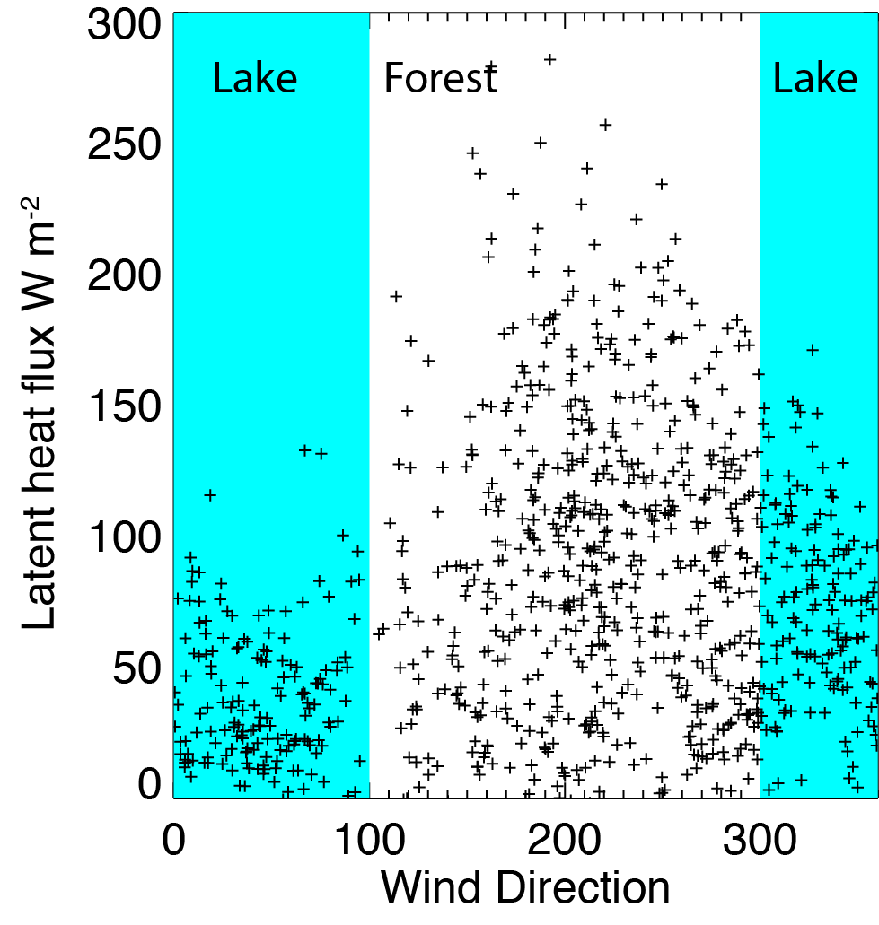

Slide 26
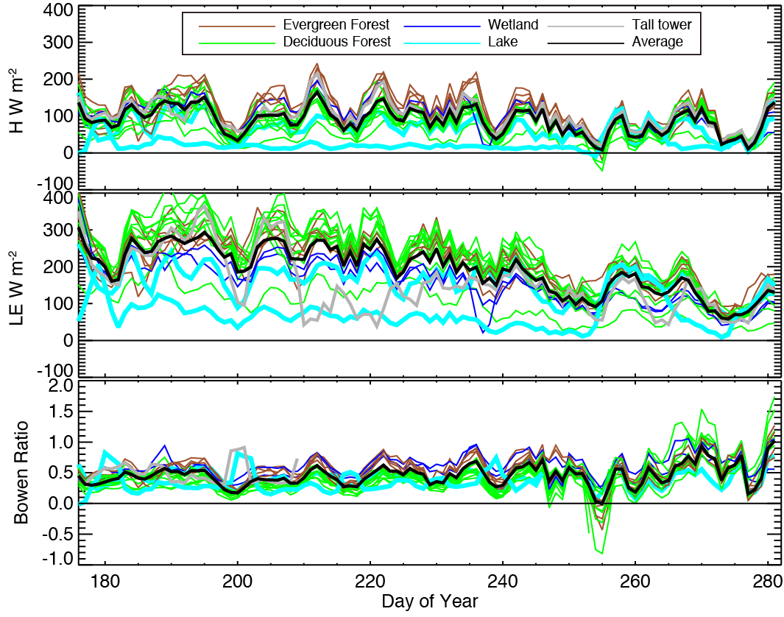
Cold spots?

Slide 27
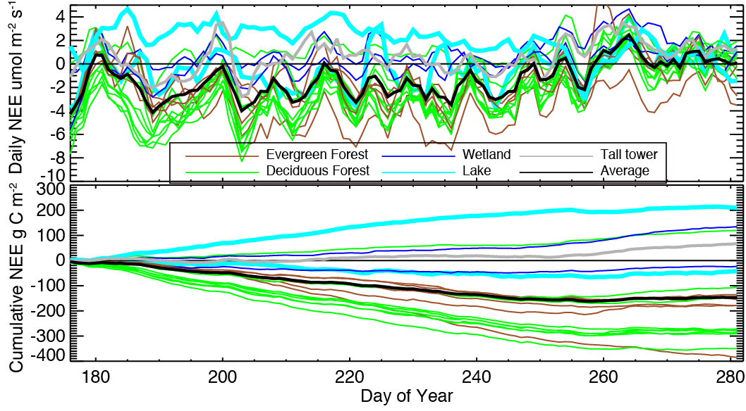
However, lakes do appear to be carbon source hotspots in landscape

Slide 28
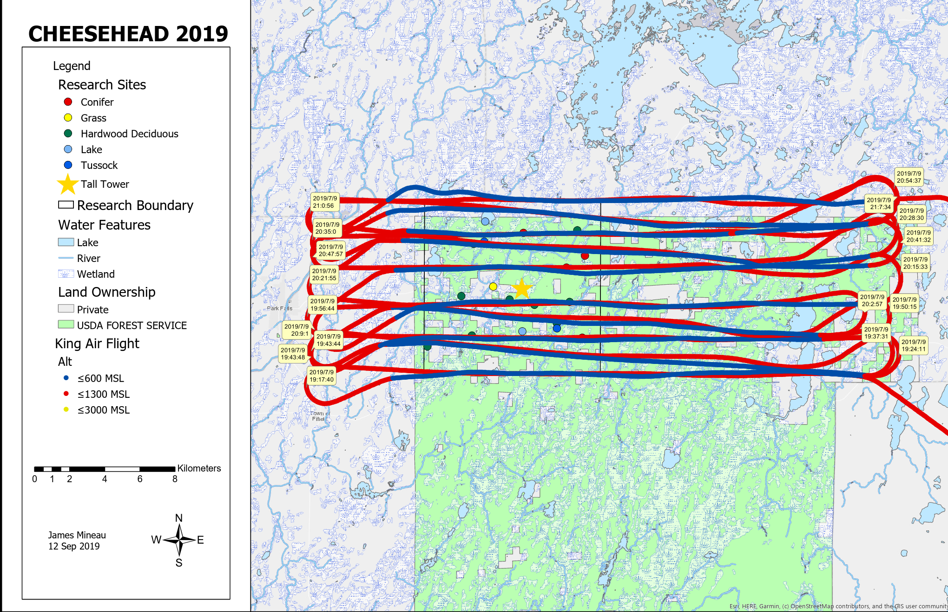
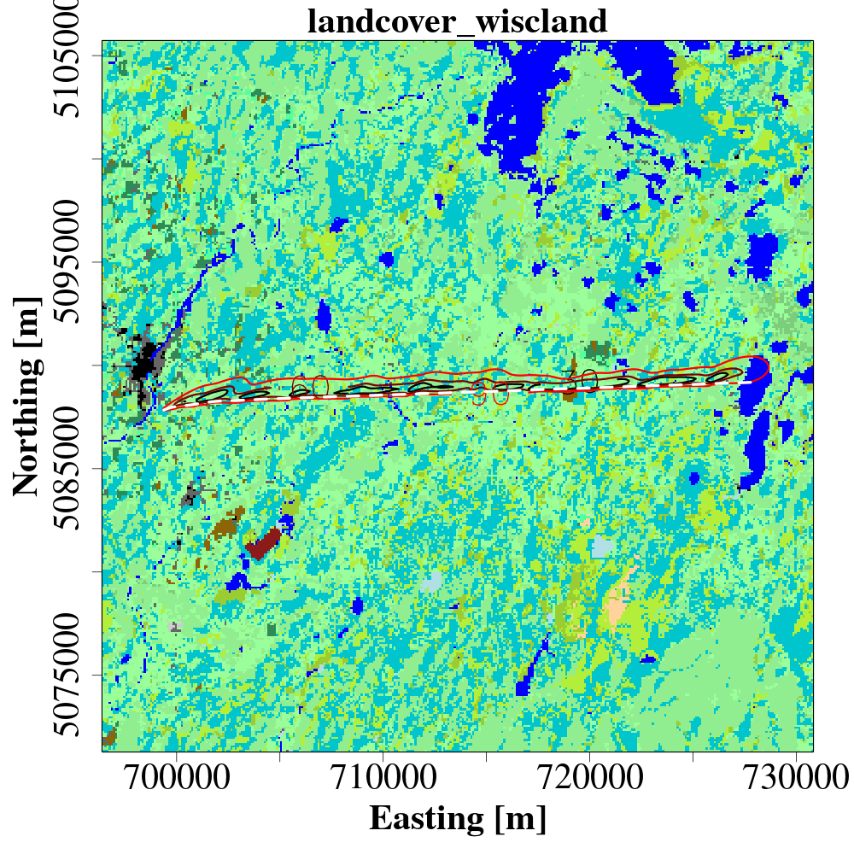
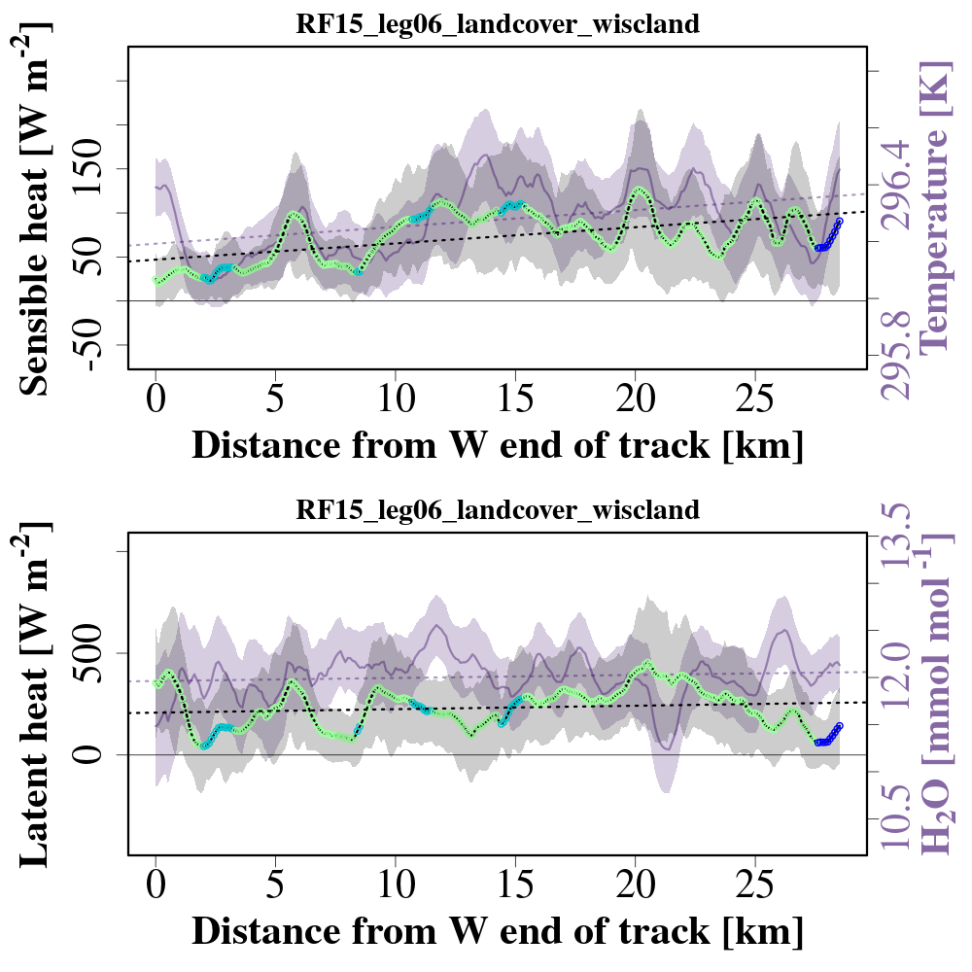
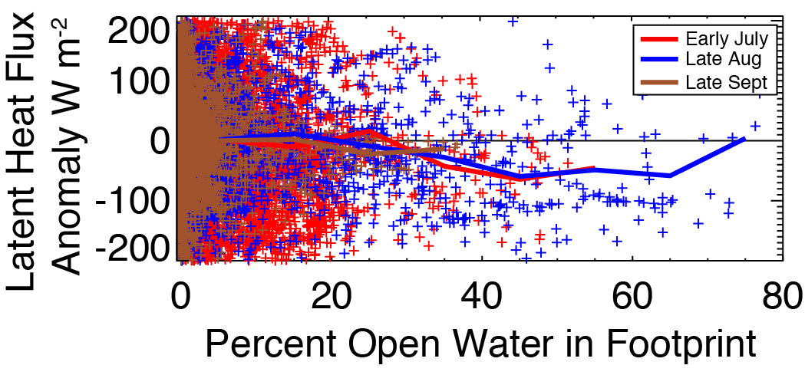
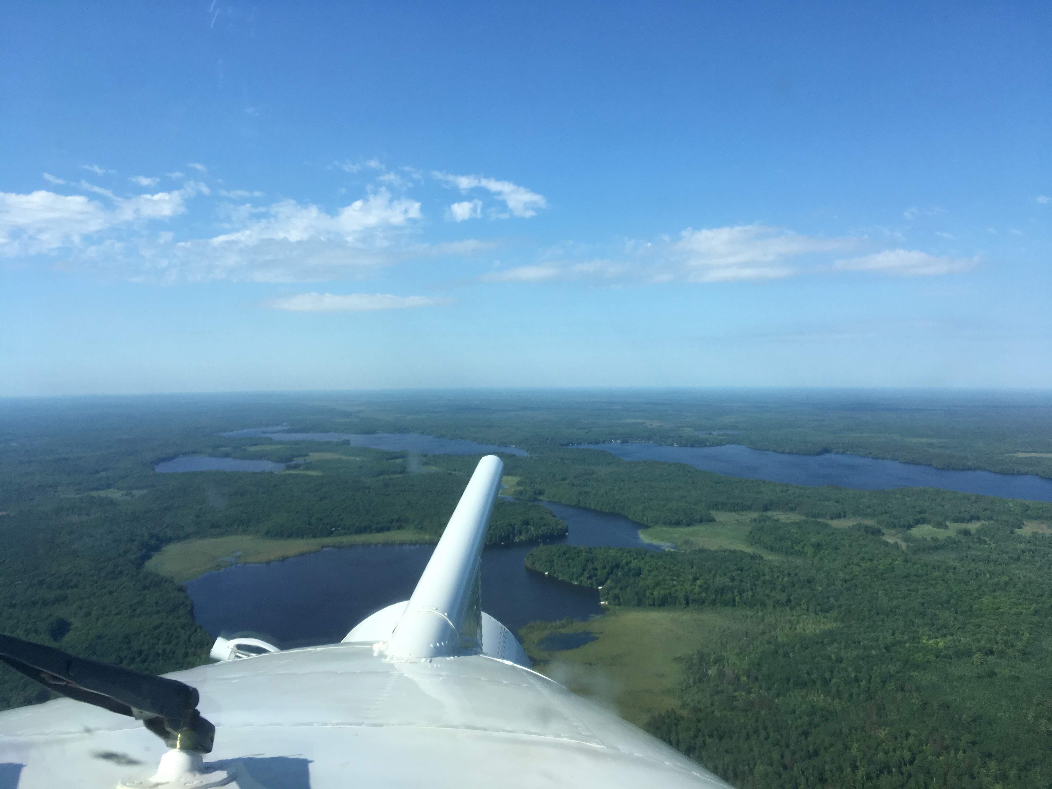
Low-altitude (100m) airborne fluxes also allow us to look at lakes and the landscape
Sensible Heat flux
Latent Heat flux
Map: J. Mineau
Photo: B. Butterworth
Figure: D. Durden, S. Paleri, Z. Wang
Photo: B. Butterworth

Slide 29
Conclusions
Are inland water bodies hotspots of surface energy balance?
  Maybe
  In some lakes, high autumn latent heat fluxes driven by heating lags that are not always captured by 1-D lake models
  In stratified season, some lakes appear to have lower latent heat fluxes than surrounding landscape
  Improving observations and models of inland water energy balance should improve fidelity of regional land-atmosphere feedbacks on clouds, temperature, humidity

Slide 30
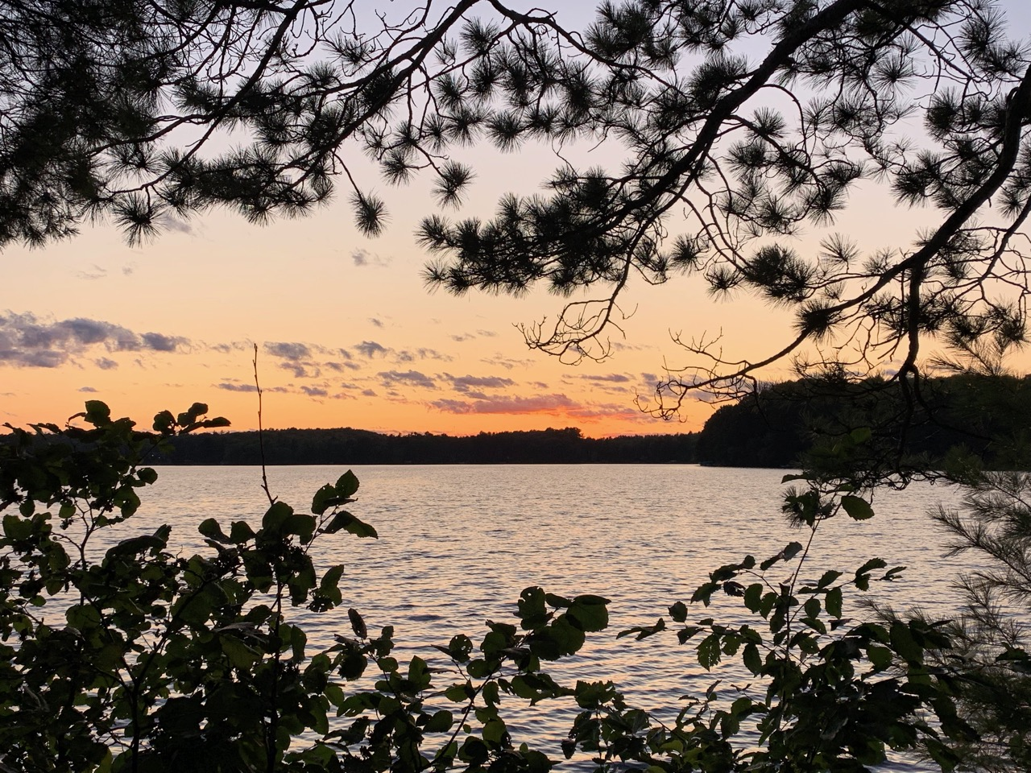
Thank you!
Ankur Desai
desai@aos.wisc.edu
https://flux.aos.wisc.edu
@profdesai
Support: DOE Ameriflux Network Management Project contract to ChEAS core site cluster, NSF AGS 1822420 (CHEESEHEAD), NSF DEB 1440297 (NTL LTER)
Photo: A. Desai

