Slide 1
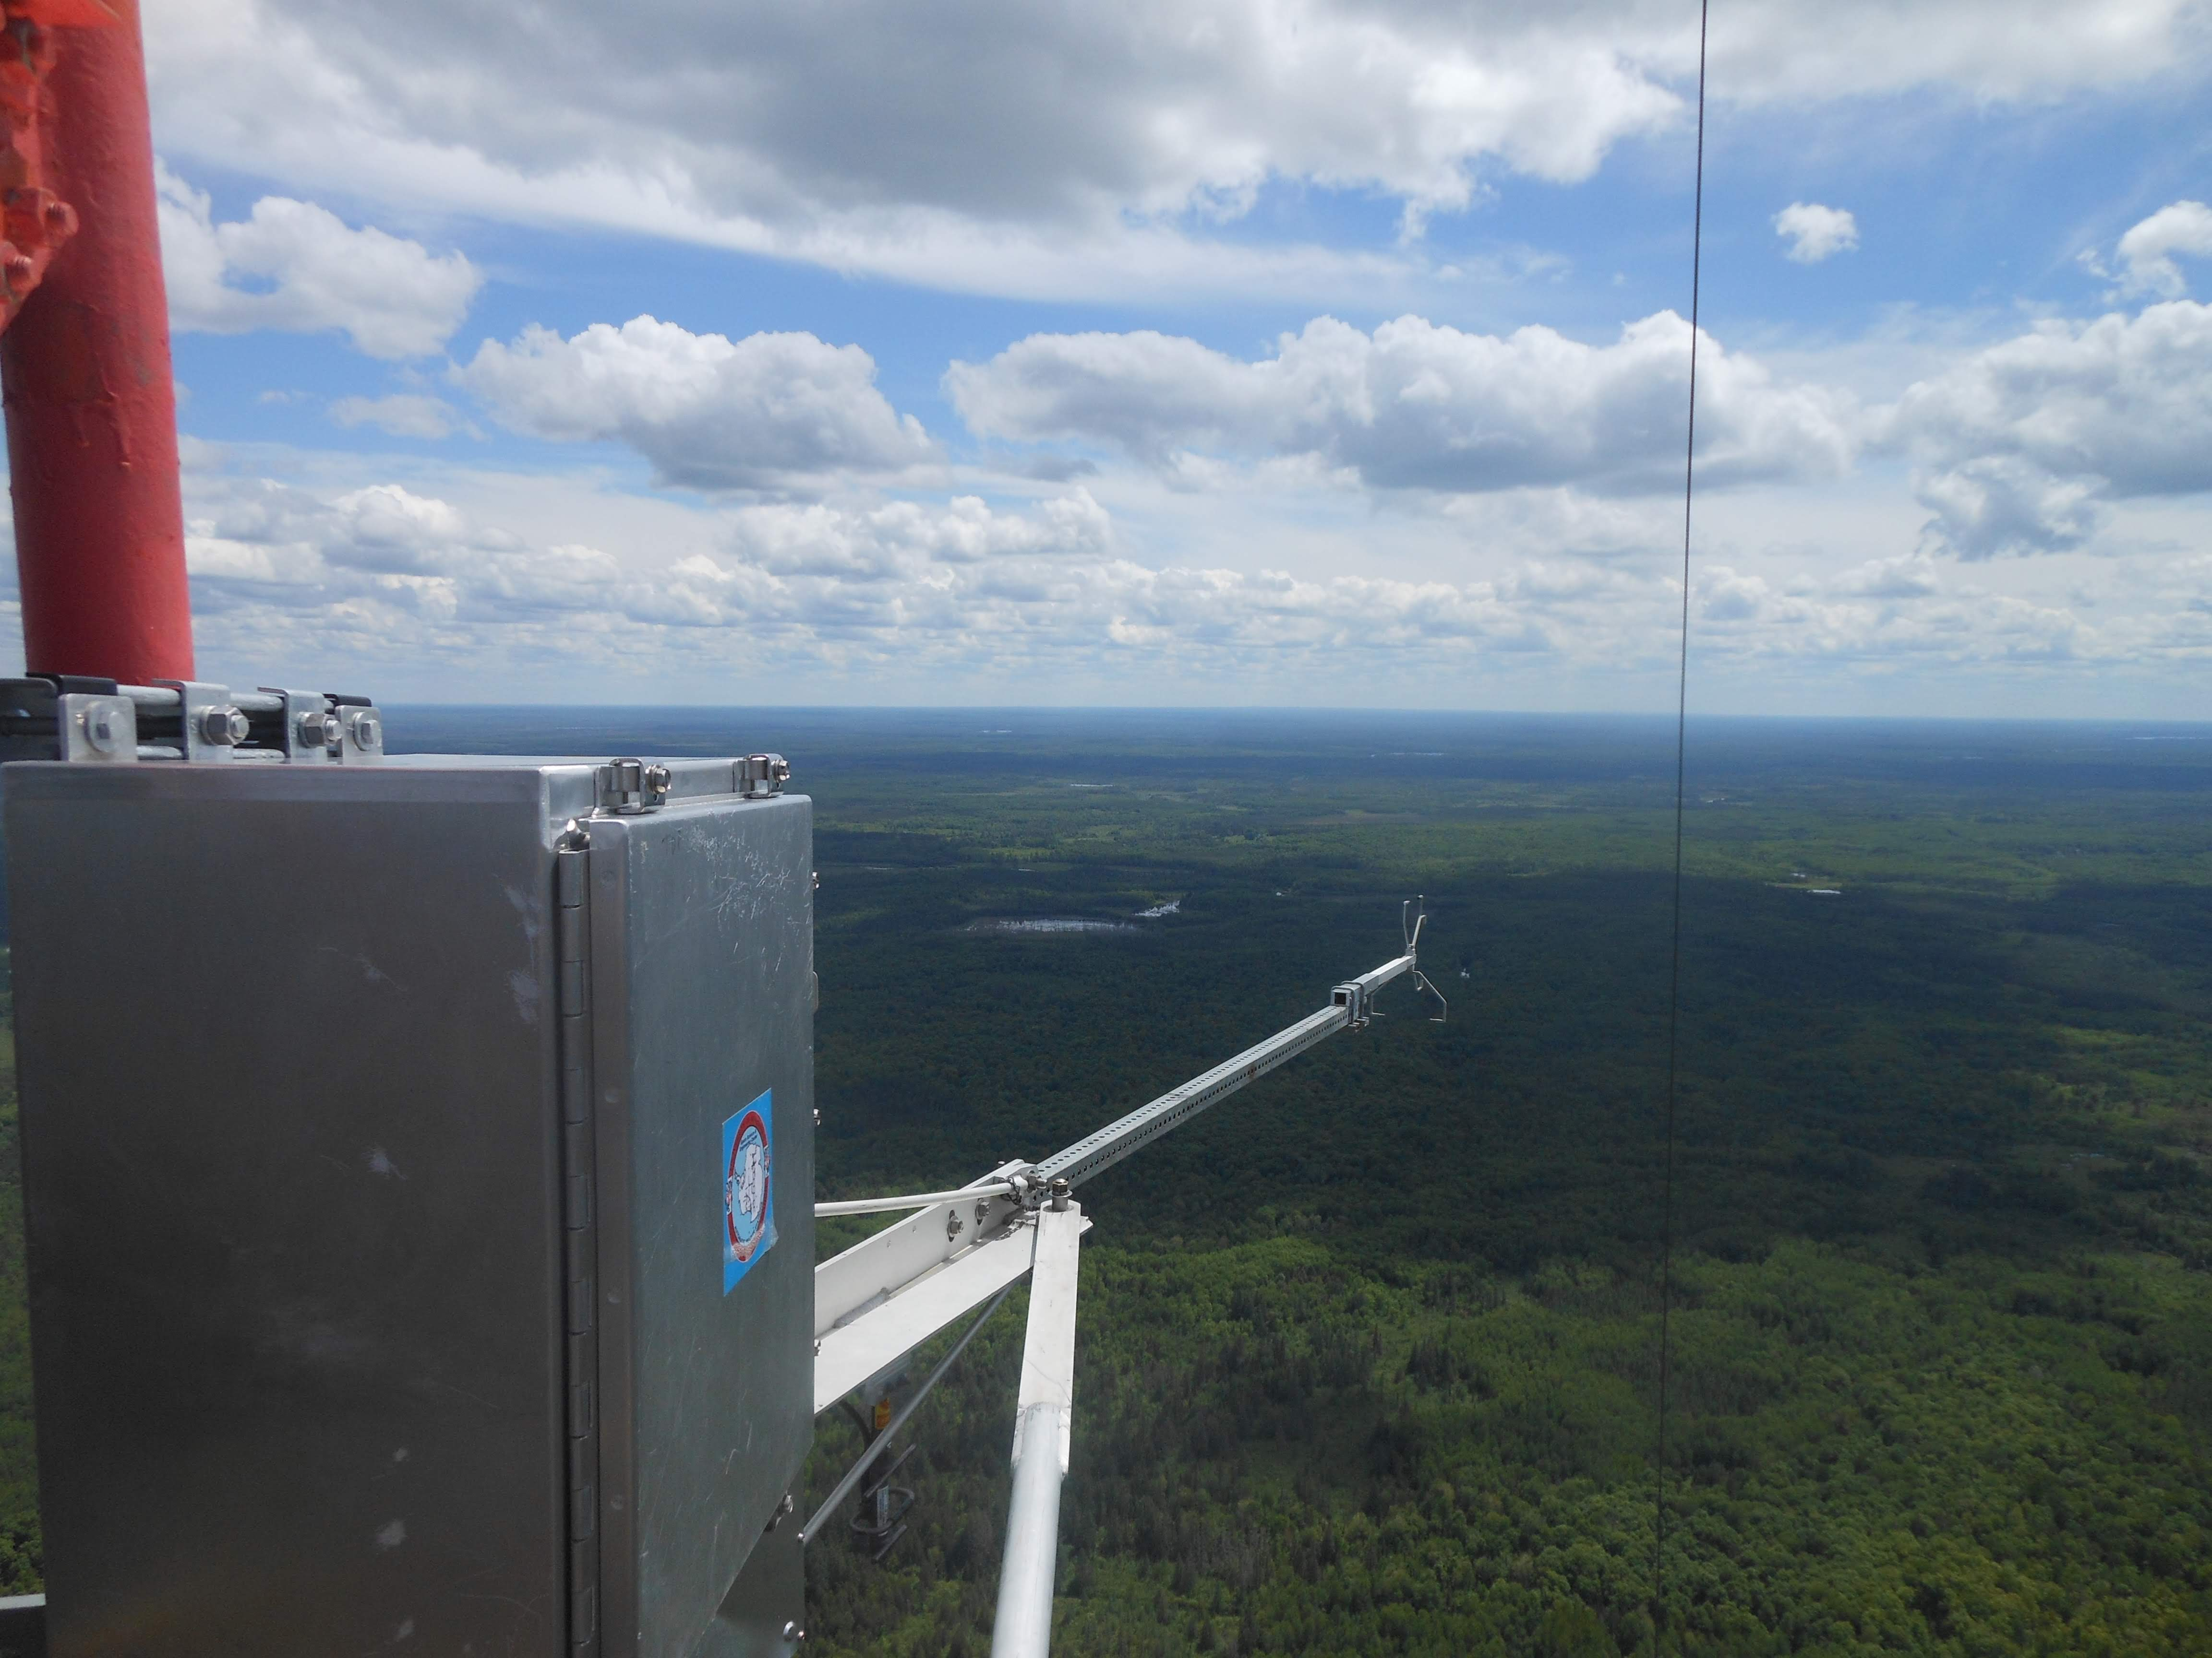
Can satellite greenhouse gas remote sensing capture regional spatial variability in fluxes, drivers, and atmospheric response?
Ankur Desai, University of Wisconsin-Madison
A51E-03
AGU Fall 2019, Friday 830-845, MW 3002

Slide 2
Acknowledge
Bill Brown, Steve Oncley (NCAR)
Brian Butterworth, Ryan Clare, James Mineau (UW)
Erik Olson, Tim Wagner (UW SSEC)
Phil Townsend, Ting Zheng, Erin Wagner (UW Forest Ecology)
Aronne Merrelli (UW SSEC)
Peter Somkuti (CSU/CIRA)
Hannes Vogelmann (KIT IMK-IFU)
Annmarie Eldering, Ryan Pavlick, Josh Fisher (NASA JPL)
Coleen Roehl, Paul Wennberg (Cal Tech)
David Reed, Jeralyn Poe (MSU)
Zhien Wang (CU-Boulder) and UWKA team (U Wyoming)
Arlyn Andrews, Colm Sweeney, Kathryn McKain (NOAA)
NSF CHEESEHEAD AGS-1822420
DOE Ameriflux Network Management Project
DFG (Germany), NOAA, NASA

Slide 3
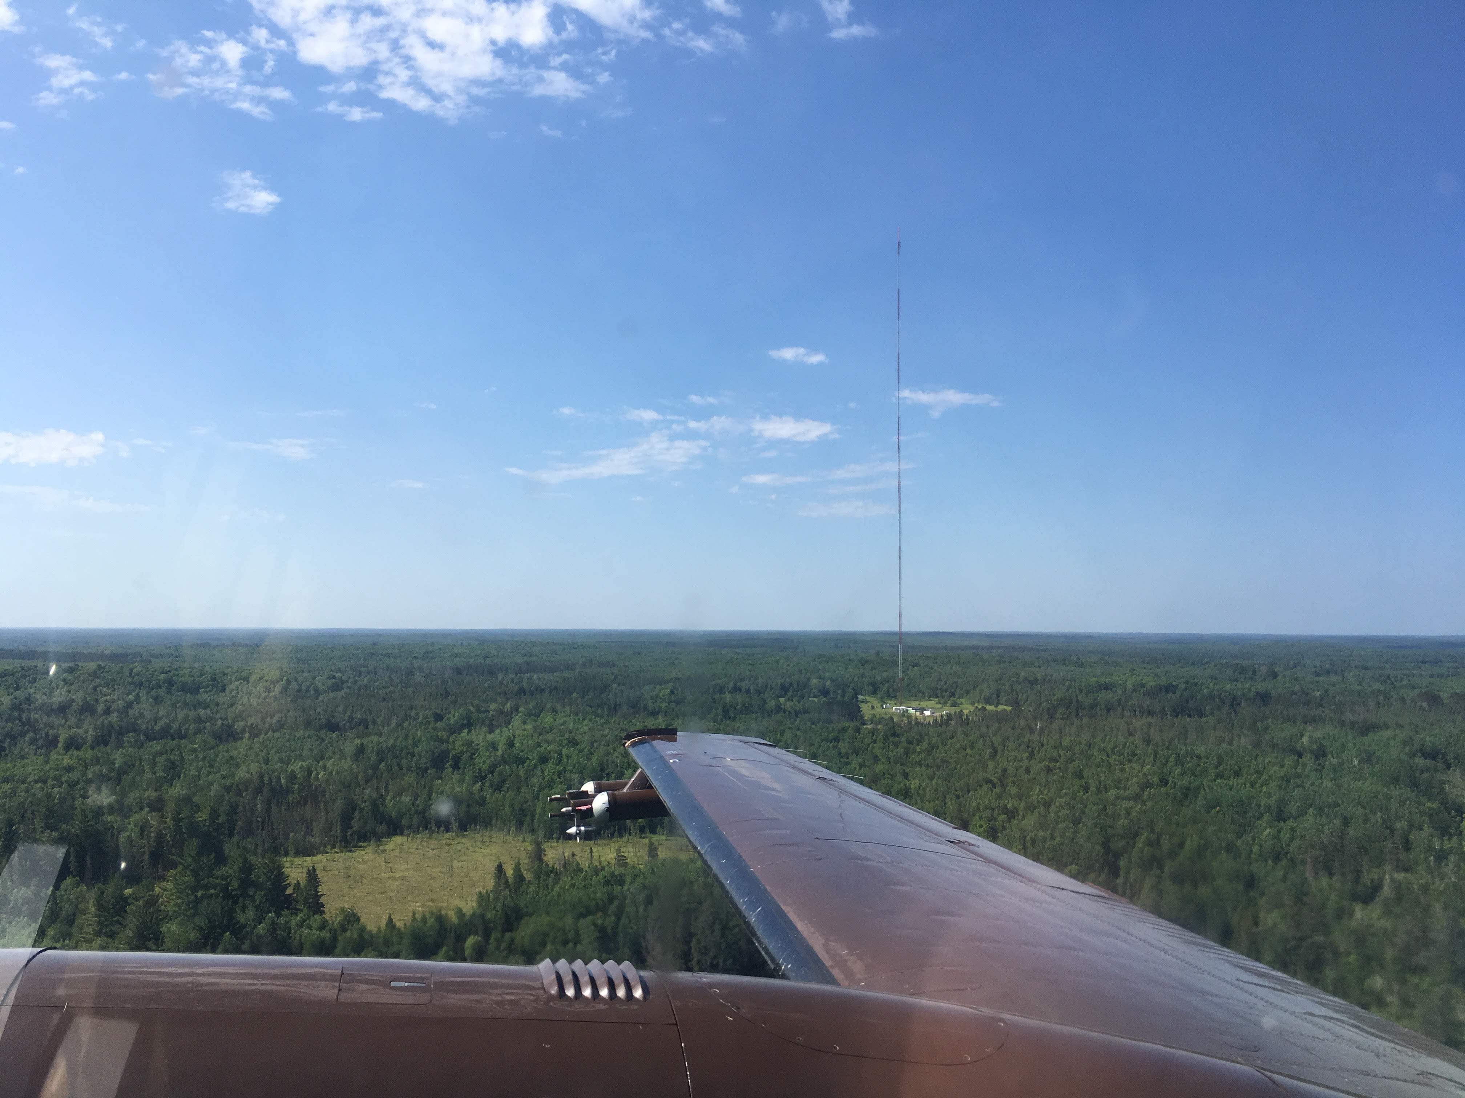
Is regional spatial variation in fluxes captured in satellite remote sensing?
US-PFa
WLEF
Photo: B. Butterworth

Slide 4
US-PFa
US-Los
US-Syv
US-WCr
US-Alq
US-CS1
US-CS2
US-CS3
US-DFC
US-DFK
US-PnP
US-Men
US-PFb
to
Us-PFt
Forests
Wetlands
Lakes
Farms
Urban
Lakes

Slide 5
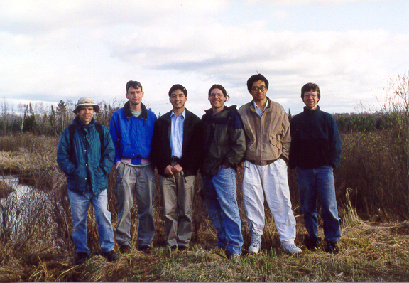
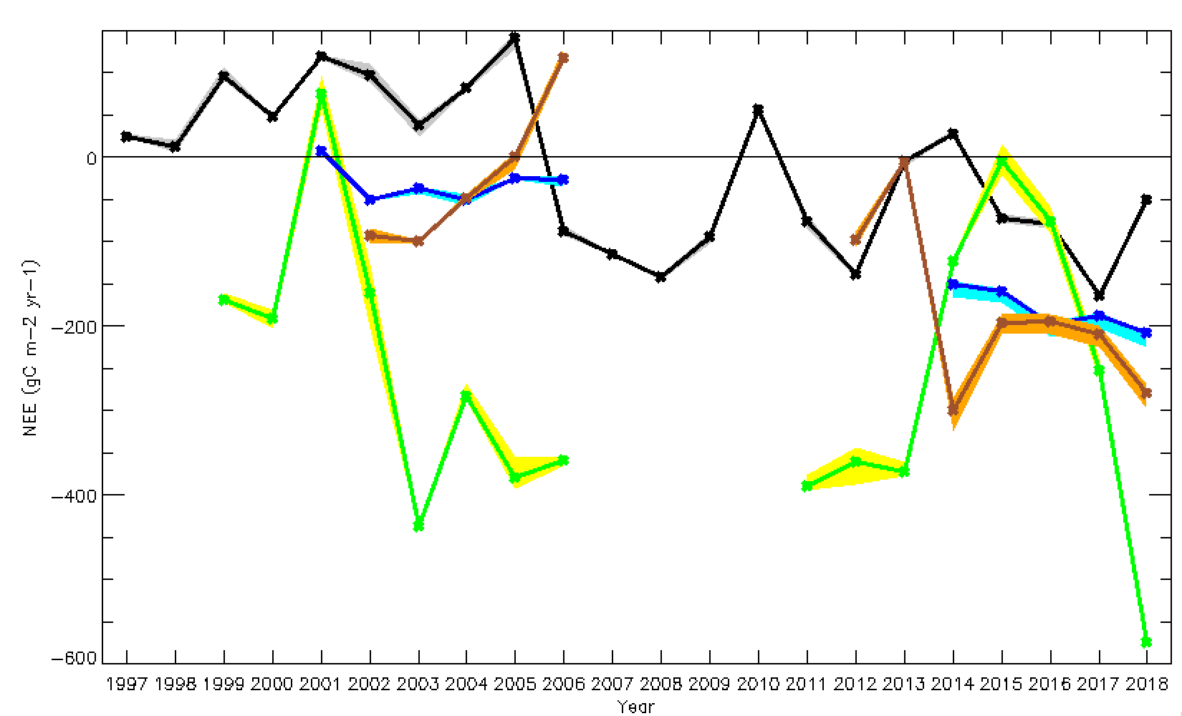
Tent
Caterpillar
US-Syv
US-PFa
Thinning
Drought
Warm/dry
364 ppm
US-Los
Cool/wet
411 ppm
Mortality
US-WCr
https://flux.aos.wisc.edu

Slide 6
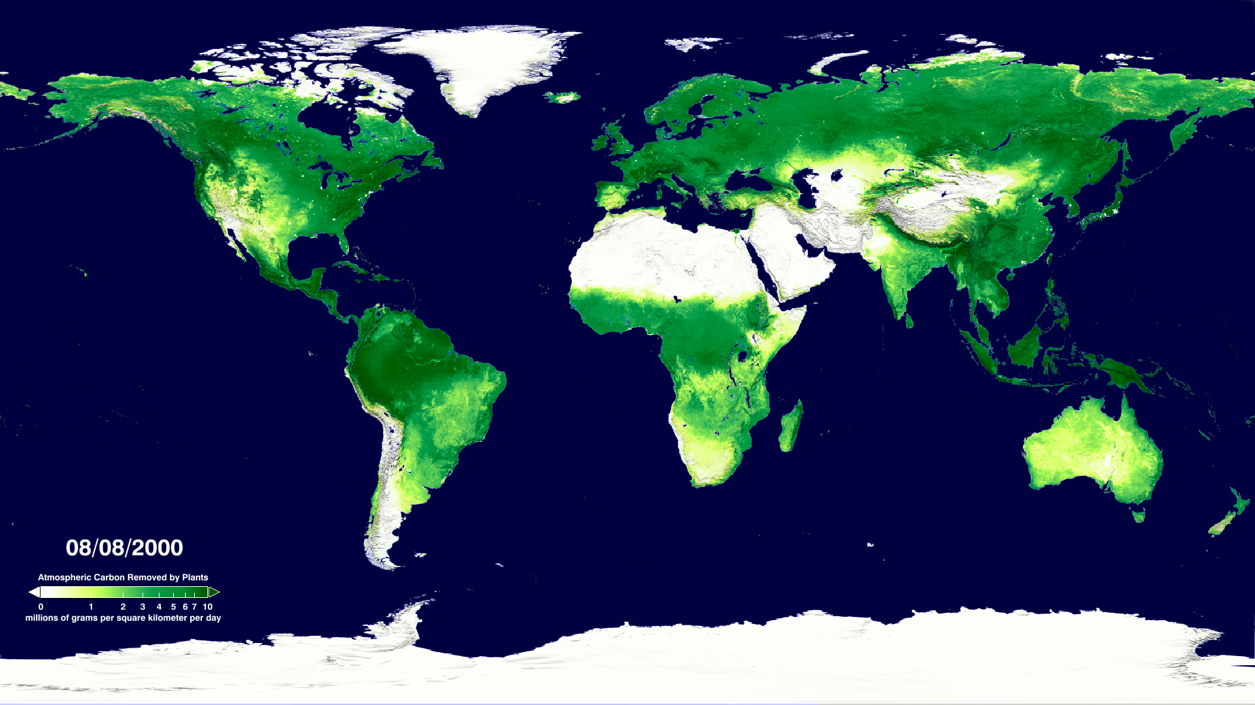
Heinsch et al., 2006

Slide 7
Chequamegon Heterogeneous Ecosystem Energy-balance Study Enabled by a High-density Extensive Array of Detectors (CHEESEHEAD19)
https://www.eol.ucar.edu/field_projects/cheesehead
Ankur R Desai, U. Wisconsin-Madison (PI)
Grant Petty, U. Wisconsin-Madison (co-PI, UW Ultralight)
Phil Townsend, U. Wisconsin-Madison (co-PI, UW SpecEx)
Mark D Schwartz, U. Wisconsin-Milwaukee (co-PI, Phenology)
Stefan Metzger, NEON/Battelle (co-PI, ERF, NEON Assets)
Matthias Mauder, Karlsruhe Institute of Technology (co-I, LiDAR/LES)
Rose Pertzborn, U. Wisconsin-Madison (co-I, K-12 outreach)
Paul Stoy, Montana State University (co-I, towers + being rarely wrong)
+Instrument PIs: Al Rodi (U Wyoming King Air), Steve Oncley (NCAR ISFS), Bill Brown (NCAR ISS), Tim Wagner (SSEC SPARC), Eric Kruger (UW, Biometry), Joel McCorkel (NASA GSFC, CAMSIS)
NSF, Physical and Dynamic Meteorology, #AGS-1822420

Slide 8
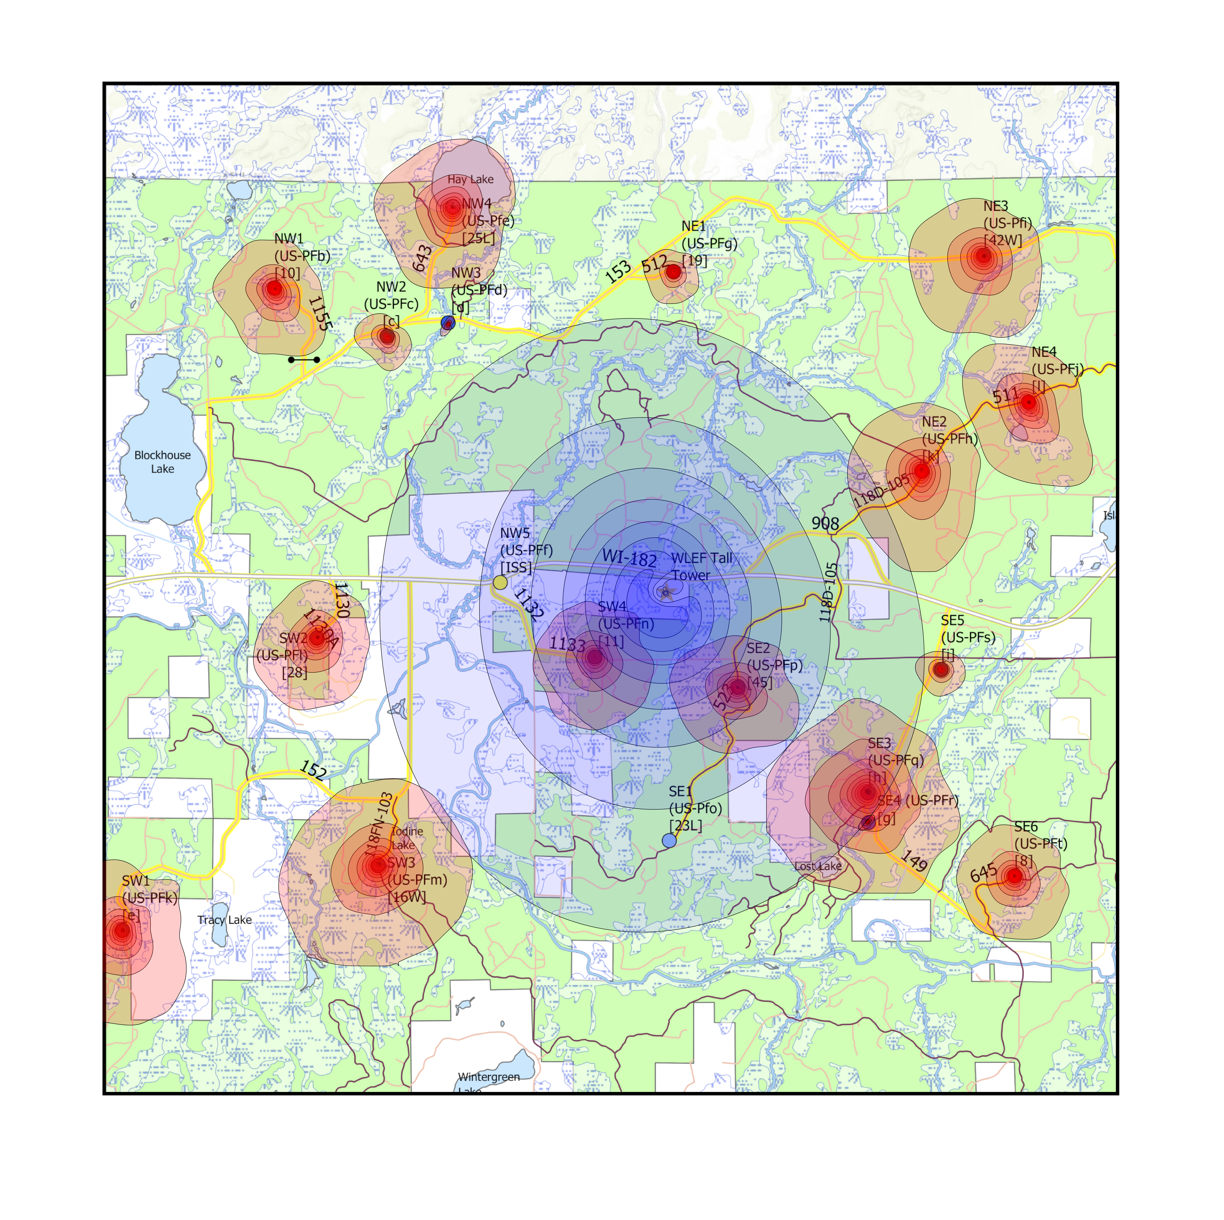
Spatial variability was name of the game in CHEESEHEAD19
20 flux towers in one 10x10 km area
Centered at WLEF / US-Pfa tall flux tower / GHG profile / TCCON site
Brian Butterworth, James Mineau

Slide 9
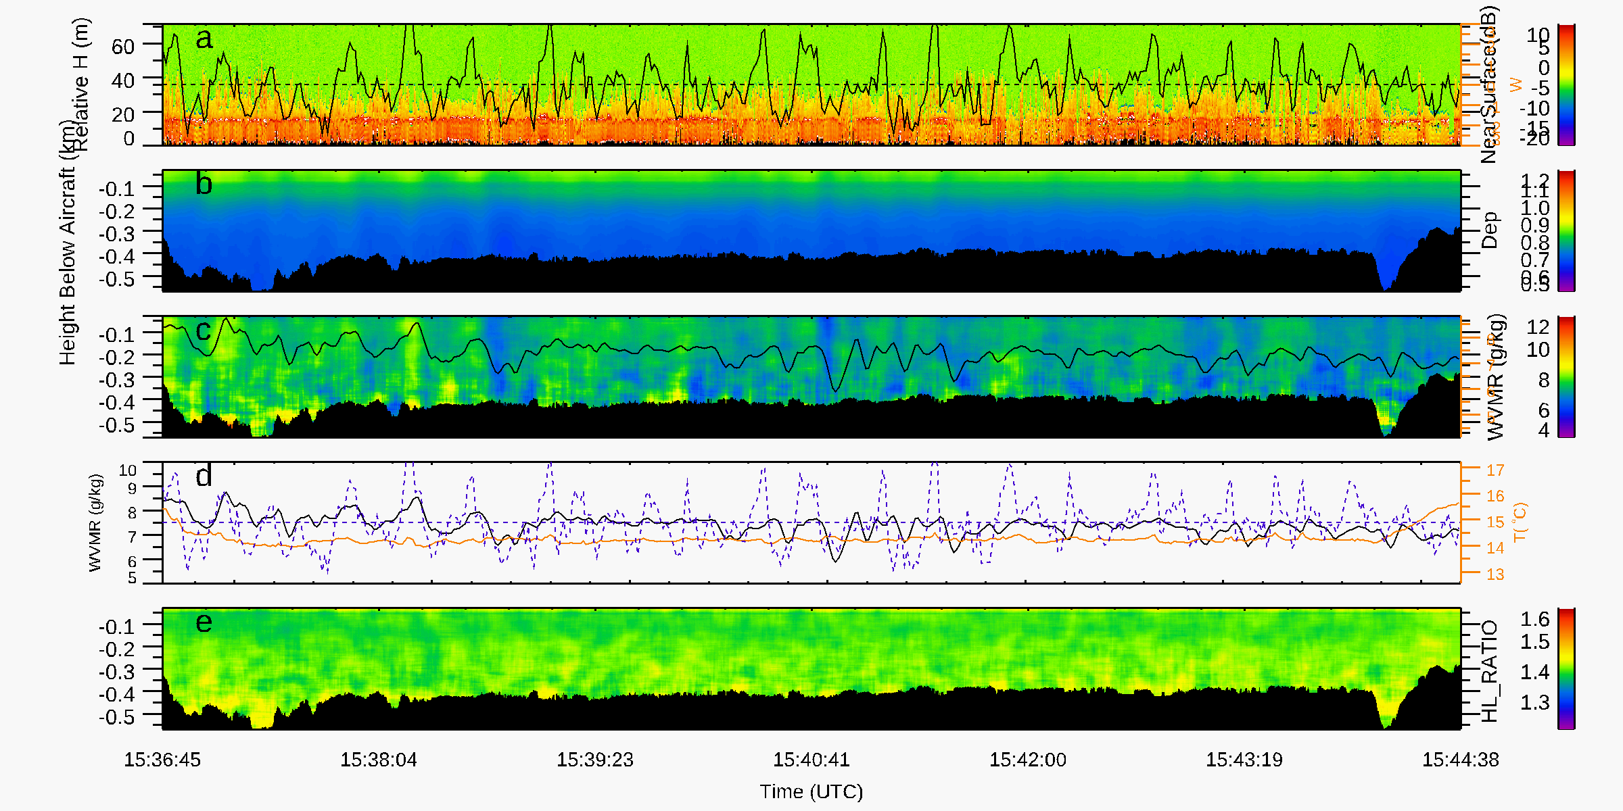
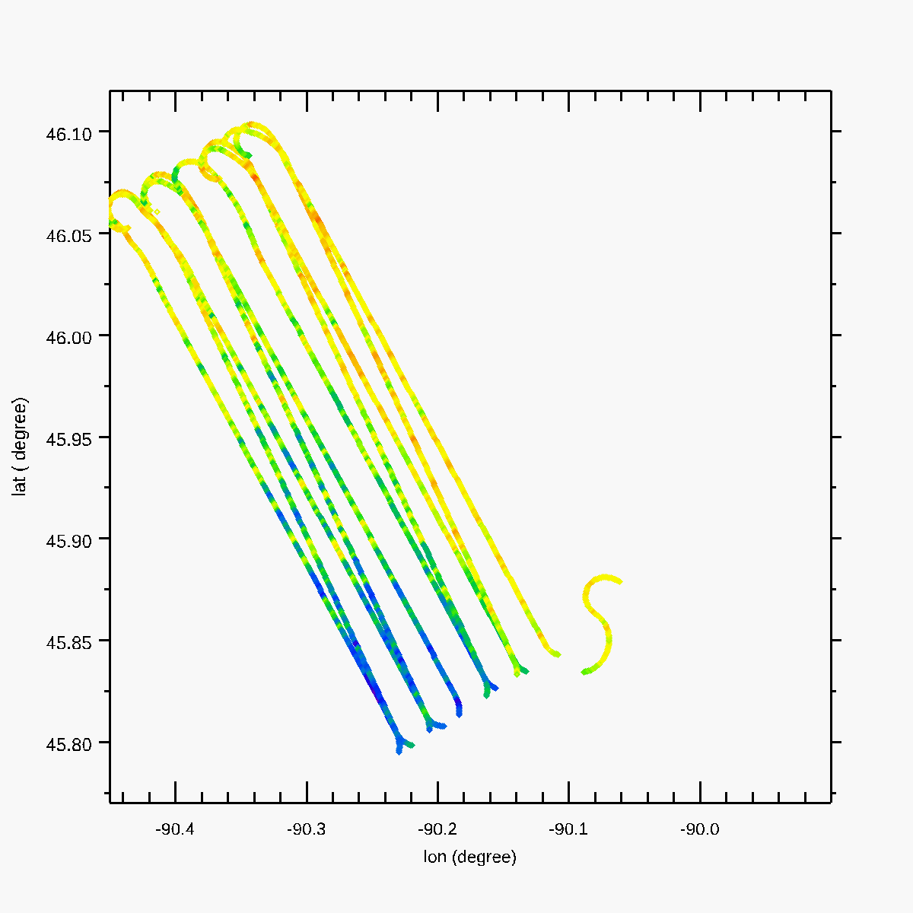
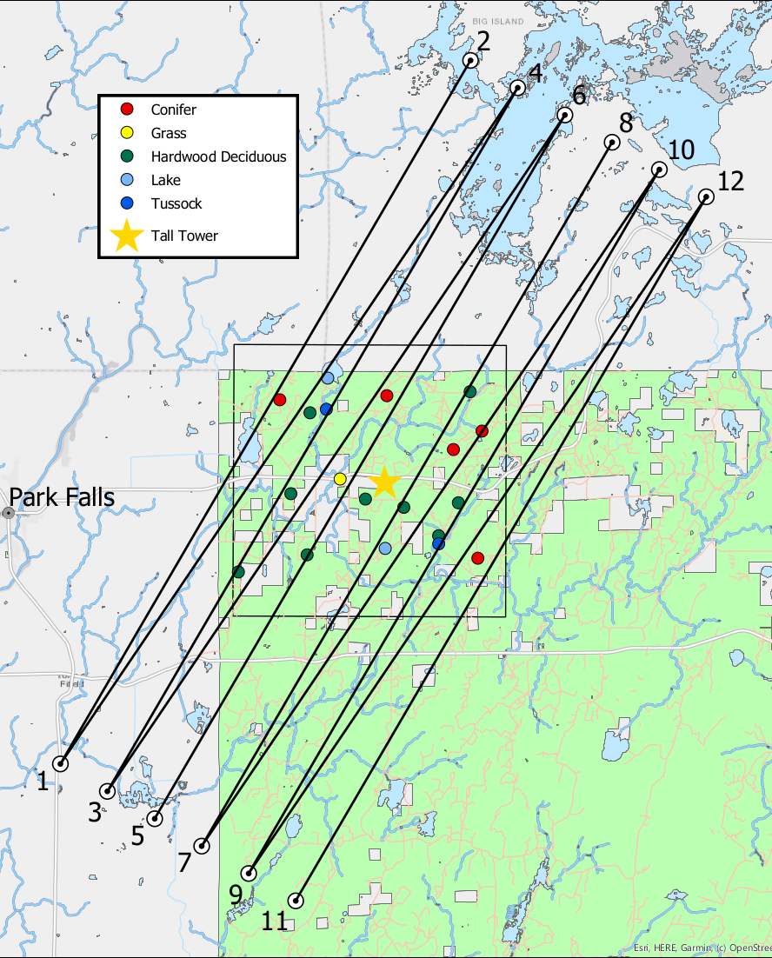
Three intensives with airborne sampling of surface fluxes
84 hours of UWyoming King Air eddy covariance flights at 100 m and 400 m AGL over three time periods (Jul, Aug, Sep)
Compact Raman LiDAR for water vapor and temperature profiles
Z. Wang
UWKA

Slide 10
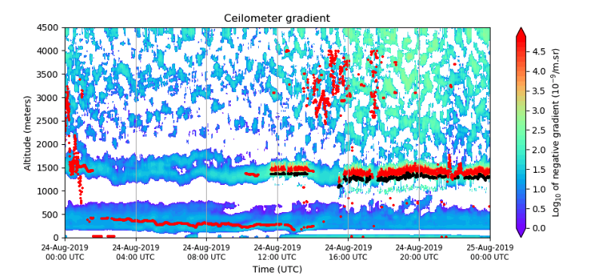
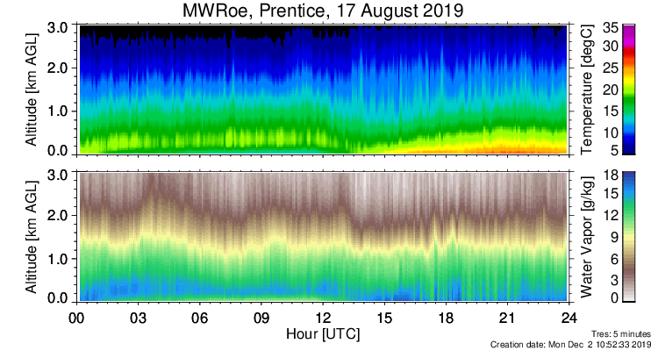
Serious PBL atmospheric profiling by NCAR, NOAA, SSEC, KIT
B. Brown (NCAR)
T. Wagner / E. Olson (UW SSEC)
D. Turner (NOAA ESRL)
Hannes Vogelmann (KIT)

Slide 11
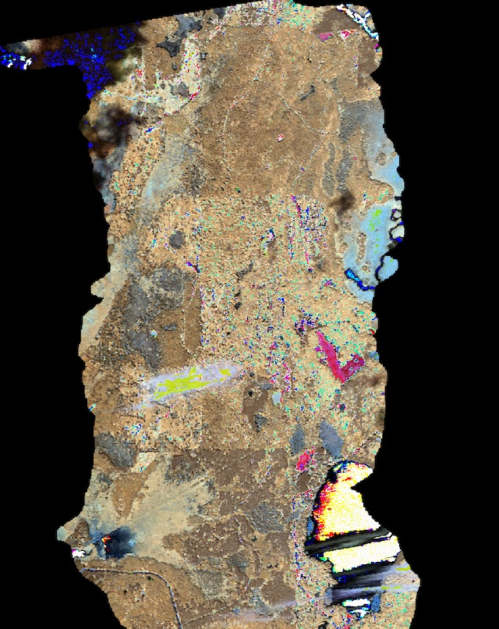
Surface characterization by aircraft and ground (HySpex)
20190626
20190804
20190830
P. Townsend / T. Zheng / E. Wagner (UW)

Slide 12
Drones, too!
C. Andresen (UW)

Slide 13
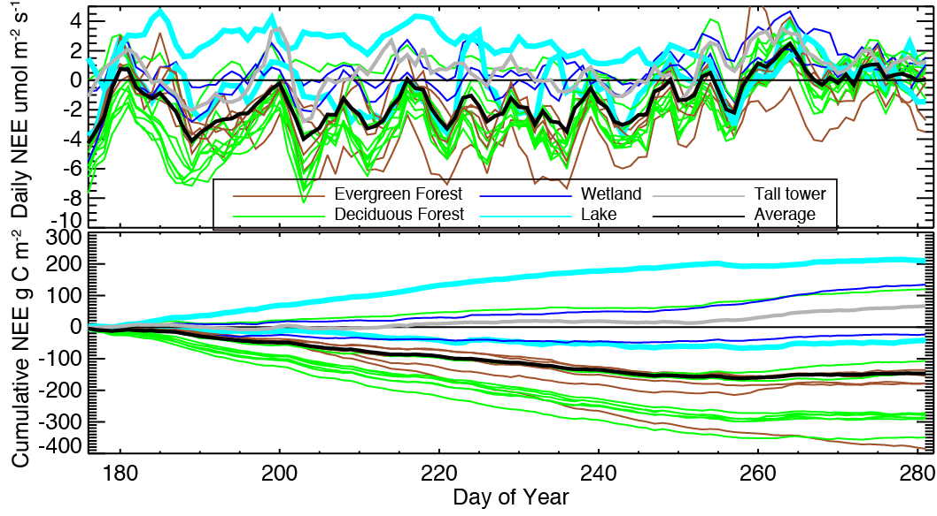
So, what have we learned so far about spatial variability?
Daily NEE
Cumulative NEE

Slide 15
Spatial coherence can now be done with flux tower clusters to improve top-down inversions
Poe, Reed, et al., in prep

Slide 16
Poe, Reed, et al., in prep

Slide 17
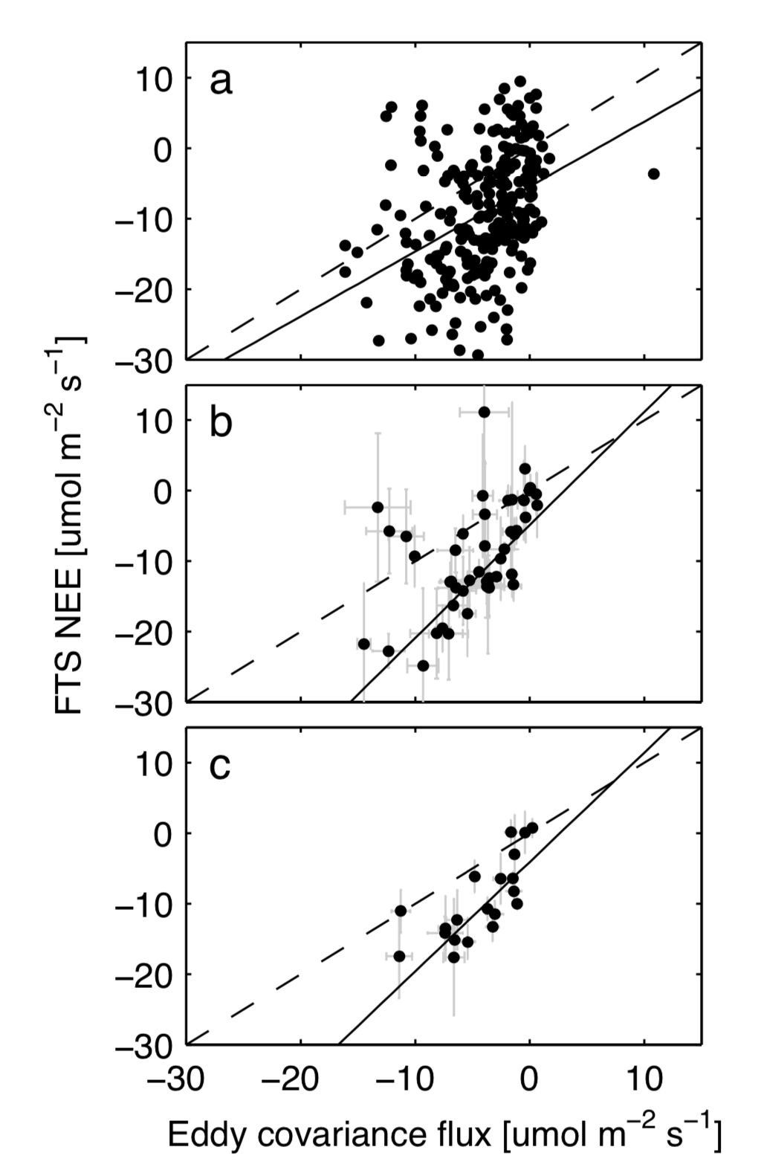
Daily
Weekly
Monthly

Slide 18
Adding PBL depth information to TCCON or XCO2 can help differentiate surface and advected influence on concentrations

Slide 19
A. Desai (UW), C. Roehl, P. Wennberg (CalTech)

Slide 20
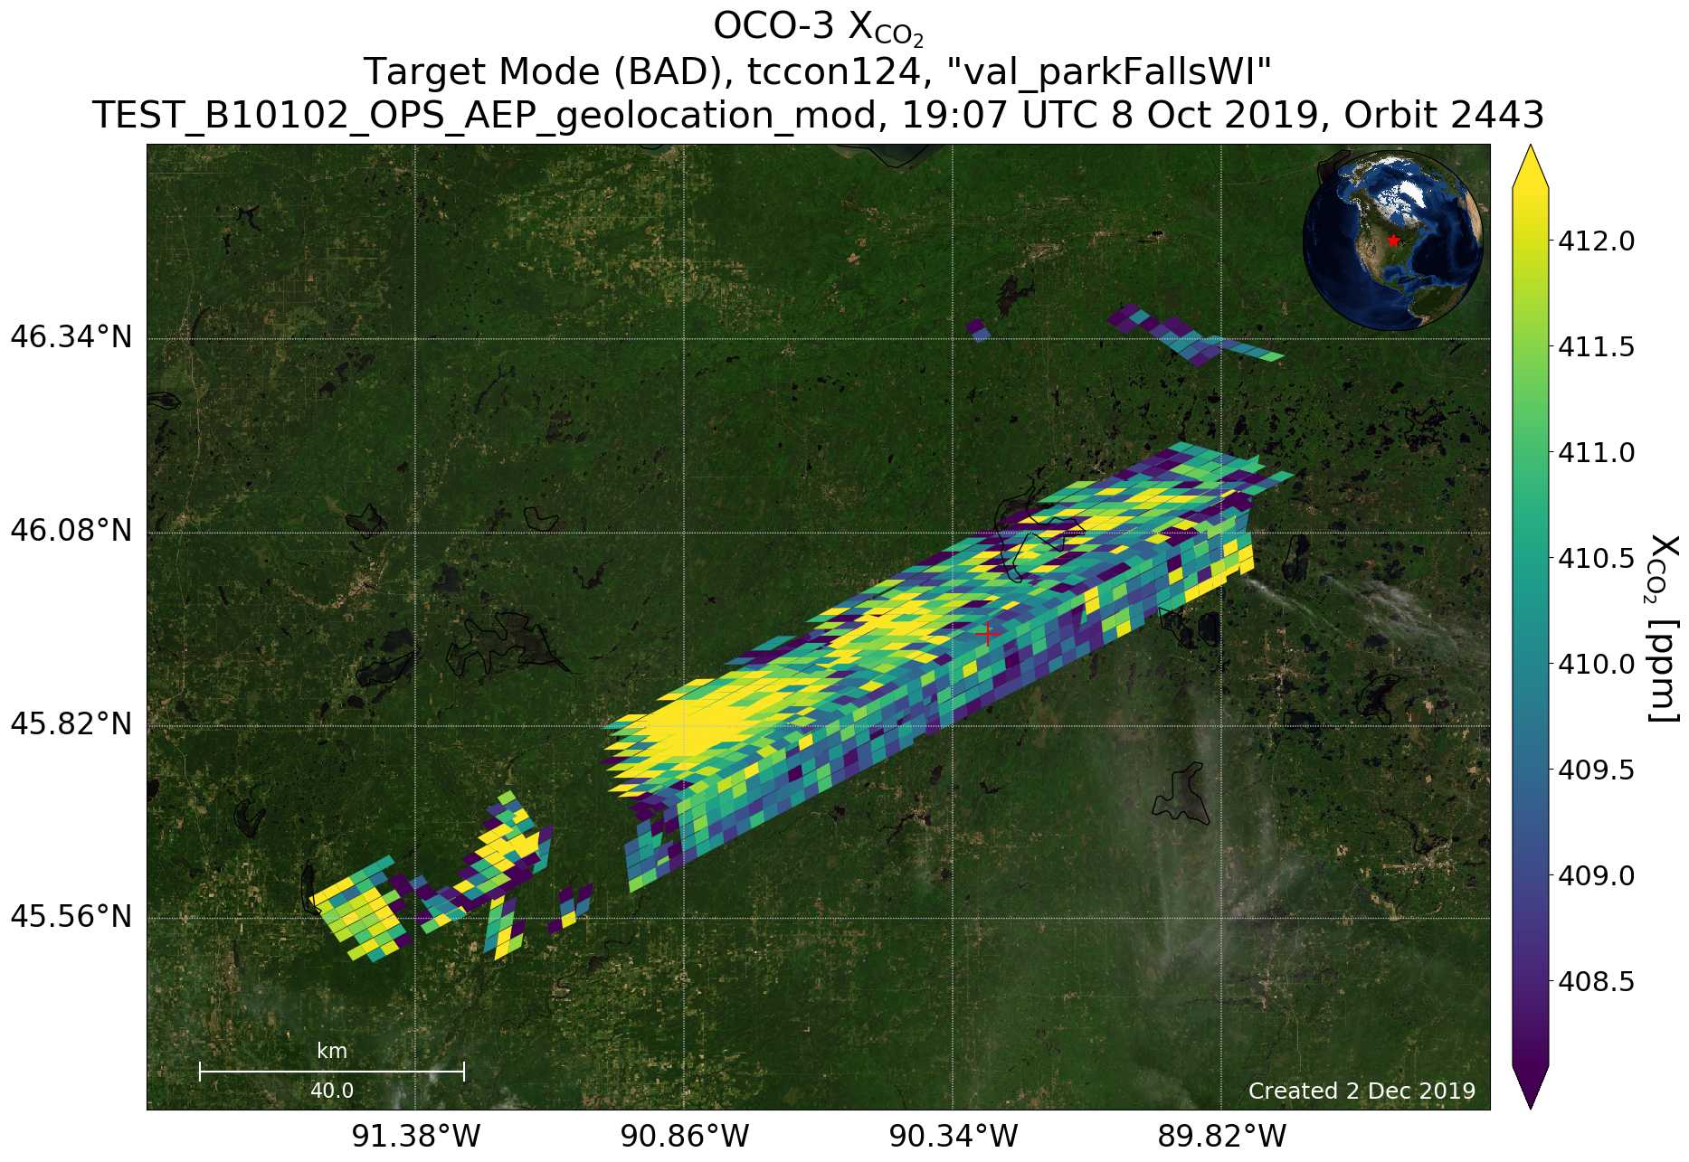
Moving to satellite GHG remote sensing
Aronne Merrelli (UW SSEC) / Annmarie Eldering and Rob Nelson (NASA JPL)

Slide 21
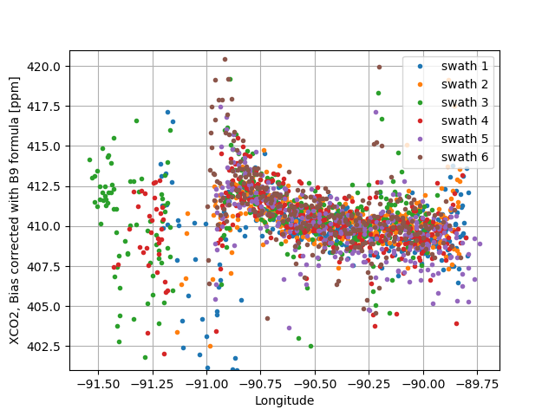
Small-scale spatial gradients link to transport and spatial flux variation
Aronne Merrelli (UW SSEC) / Annmarie Eldering and Rob Nelson (NASA JPL)

Slide 22
SIF is intriguing…
Aronne Merrelli (UW SSEC) / Peter Somkuti (CIRA) /
Annmarie Eldering and Rob Nelson (NASA JPL)

Slide 23
ECOSTRESS, too…
J. Fisher / F. Galvan (JPL)

Slide 24
Next generation surface and atmospheric GHG remote sensing has potential to retrieve fine-scale details
OCO-3 SIF
ECOSTRESS ET

Slide 25
Final thoughts
Satellite remote sensing has revolutionized how we understand global variation and drivers of GHG fluxes and emissions
However, less confidence in how well they capture regional scale GHG sources and sinks, especially in heterogenous regions
CHEESEHEAD19 and similar experiments provide surface and atmosphere benchmarks and critical PBL profile and flux data to improve on this
Next-generate satellites (OCO-3, ECOSTRESS, Hyspiri) provide significant potential to retrieve regional fluxes

Slide 26
Thank you!
Ankur Desai
desai@aos.wisc.edu
https://flux.aos.wisc.edu
@profdesai
https://www.eol.ucar.edu/field_projects/cheesehead
Support: DOE Ameriflux Network Management Project contract to ChEAS core site cluster, NSF AGS 1822420 (CHEESEHEAD)
Image: J. Fisher

