Slide 1
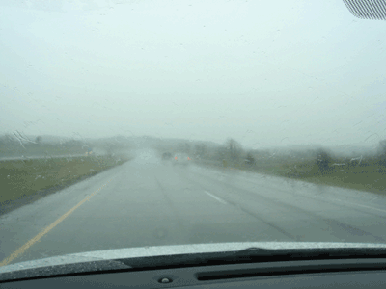
It’s Always Rainy in Wisconsin
Unless You’re a Plant?
Ankur Desai, Atmospheric & Oceanic Sciences, UW-Madison
SAGE Seminar
16 April 2009

Slide 2
Acknowledgments
Ben Sulman, AOS
Steve Loheide, Civil Engineering
Scott Mackay, Geography, SUNY-Buffalo
ChEAS team
DOE NICCR and NASA

Slide 4
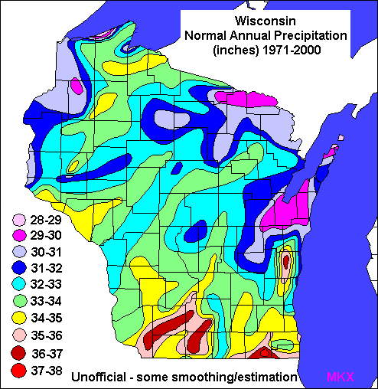
Rainy?
Source : NOAA/NWS (MKX)

Slide 5
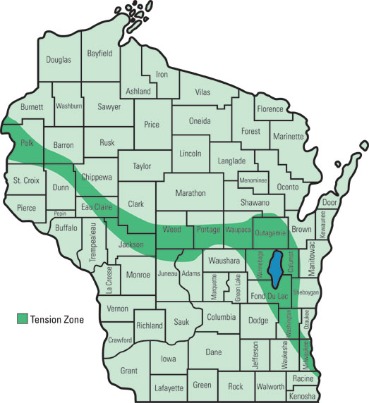
Tension Zone
From Curtis (1959) via WI DNR

Slide 6
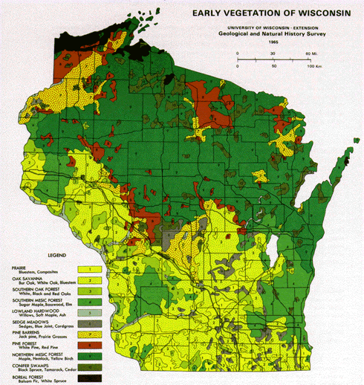
Tension Zone and Vegetation
Left: Curtis (1959) via WI DNR, right: From UWEX, WI Geological Survey

Slide 7
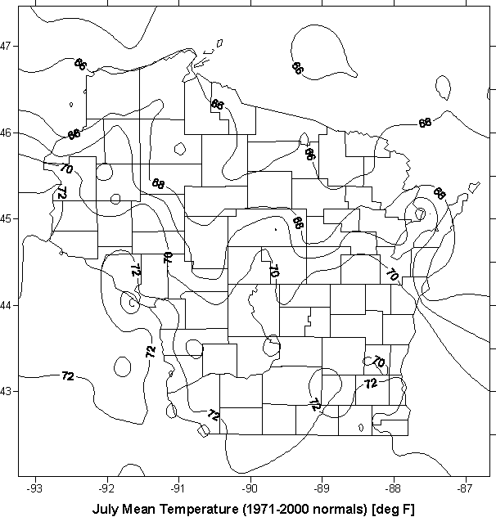
Tension Zone and Climate
P > ET
ET > P
Left: Curtis (1959) via WI DNR, right: From UW, State Climatology Office

Slide 8
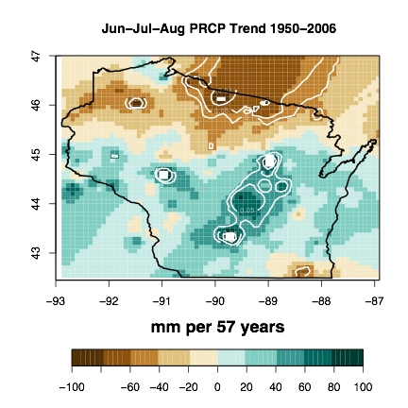
1950-2006 Precipitation Trend
Courtesy of C. Kucharik

Slide 9
Hypothesis
Feedbacks from regional Great Lakes subboreal landscape evapotranspiration (ET) counteract the larger scale upper Midwest secular increase in growing season precipitation
Is ET declining in forests and wetlands?

Slide 10
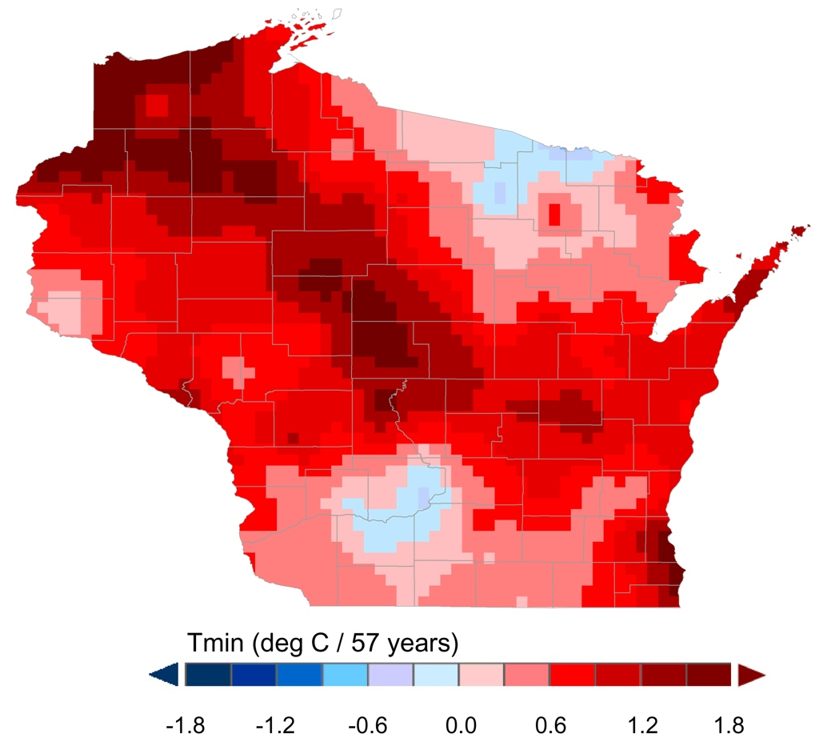
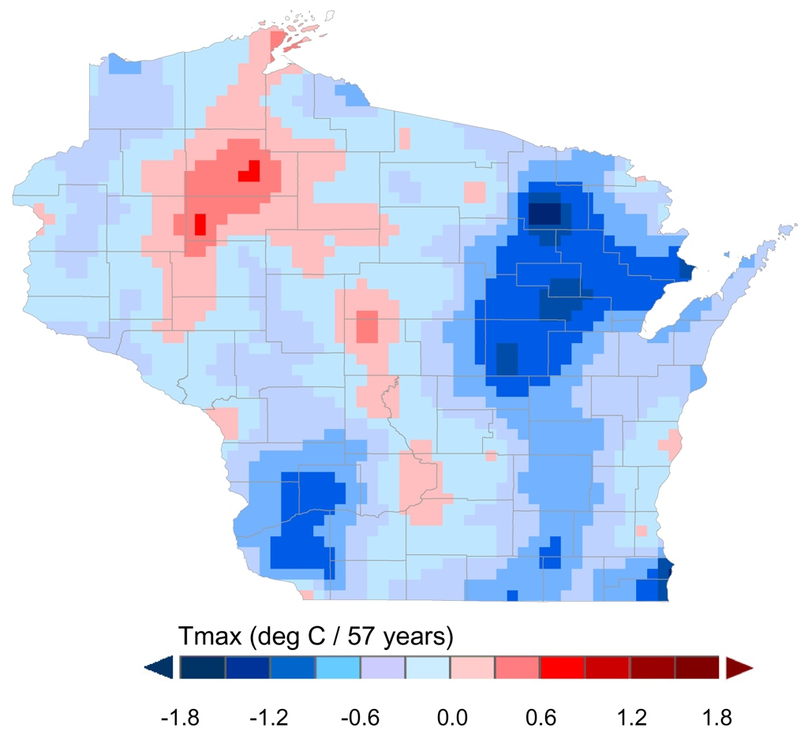
1950-2006 Temperature Trends
Summer Tmin
Summer Tmax
Courtesy of C. Kucharik

Slide 11
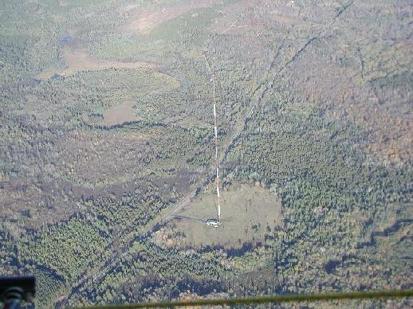
The Landscape

Slide 12
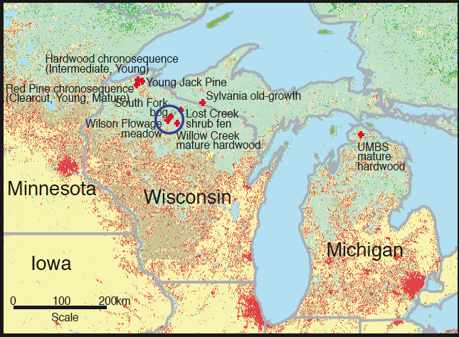
Some Observations from ChEAS!

Slide 13
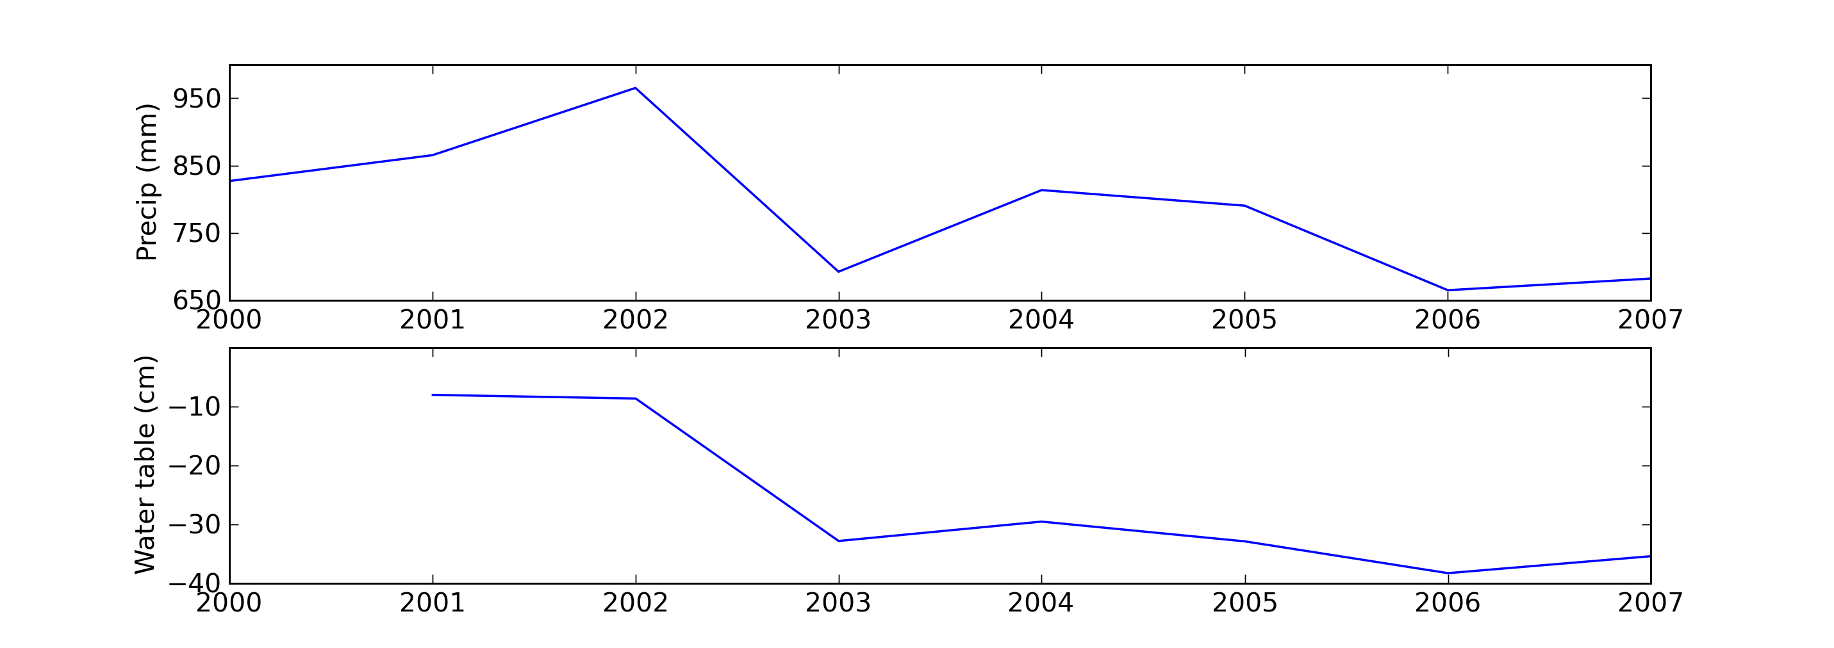
Obs 1: Hydrologic Trend
Sulman et al (2009)

Slide 14
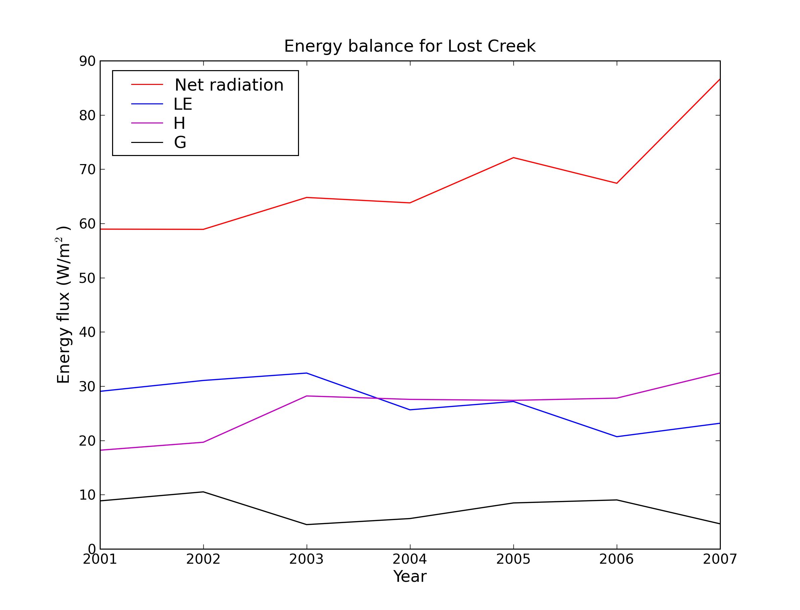
Obs 2: Wetland energy balance

Slide 15
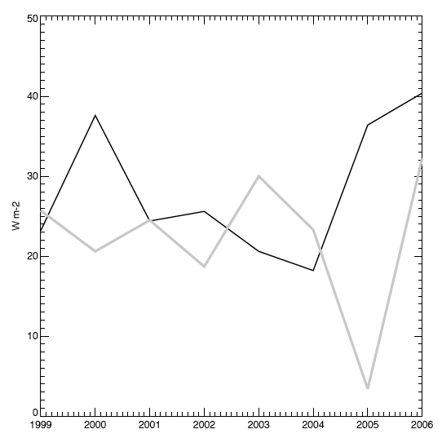
Obs 3: Forest energy balance
ET
H

Slide 16
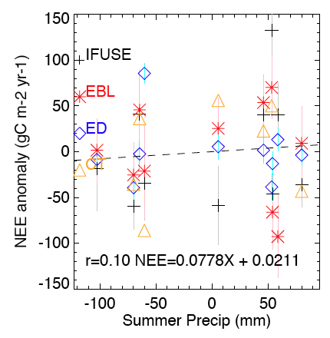
Obs 4: Carbon cycle trends

Slide 17
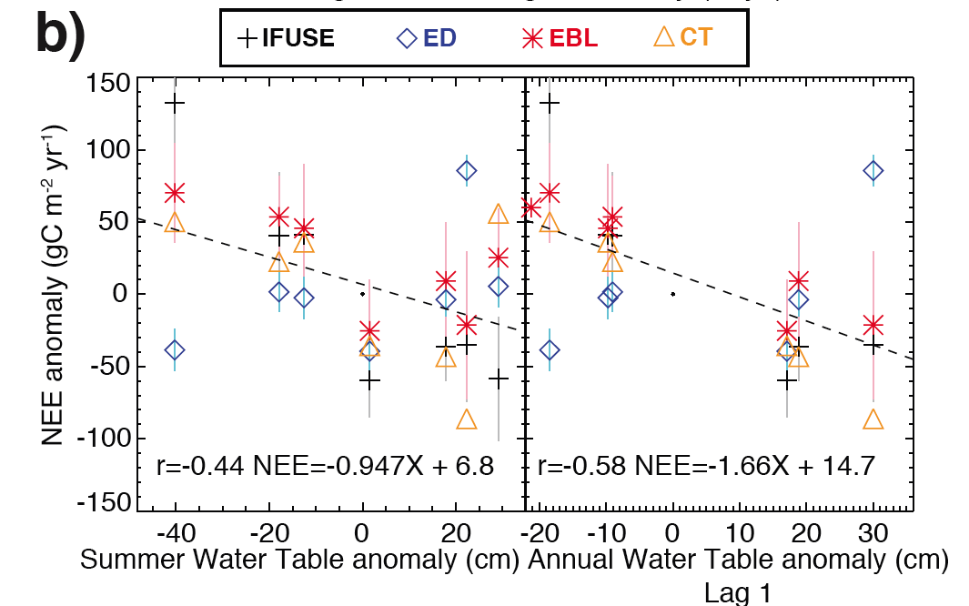
Obs 4: Carbon cycle trends

Slide 18
Alternate Hypothesis
Changes in Lake Superior boundary layer is diminishing lake enhanced precipitation

Slide 19
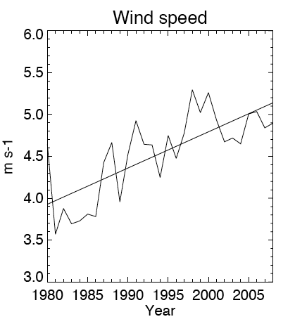
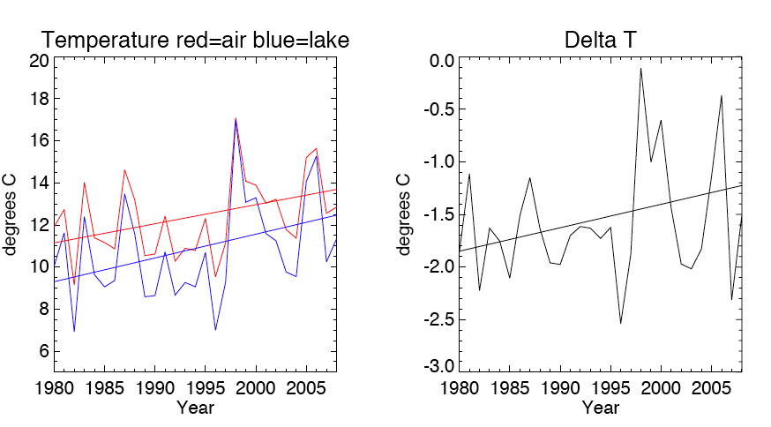
Crazy Big Lake

Slide 20
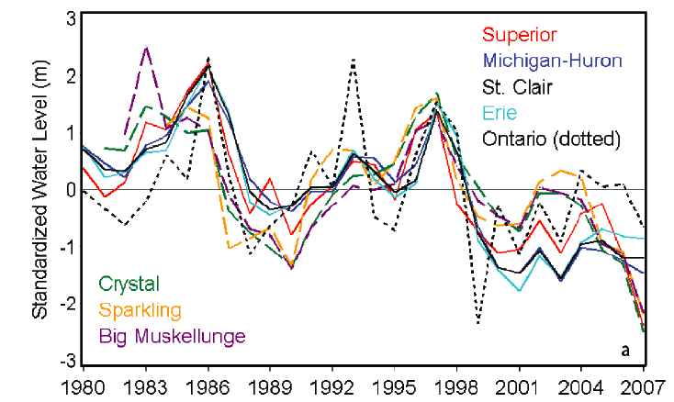
All Lakes Crazy
Increasing ET or decreasing runoff inputs in lakes?
Stow et al (2008)

Slide 21
Parting Thoughts
Most of the upper Midwest is getting warmer and wetter
In contrast, subboreal forest growing seasons are getting drier with warmer nights and cooler days
Bioclimatic feedbacks may be helping drive this by decreasing ET in wetlands and forests
Cooler summer highs => lower ET
Lower water table => lower ET
Decreased productivity => lower ET
BUT: lower ET => more available moisture…
Great Lakes influence on climate probably cannot be ignored

Slide 22
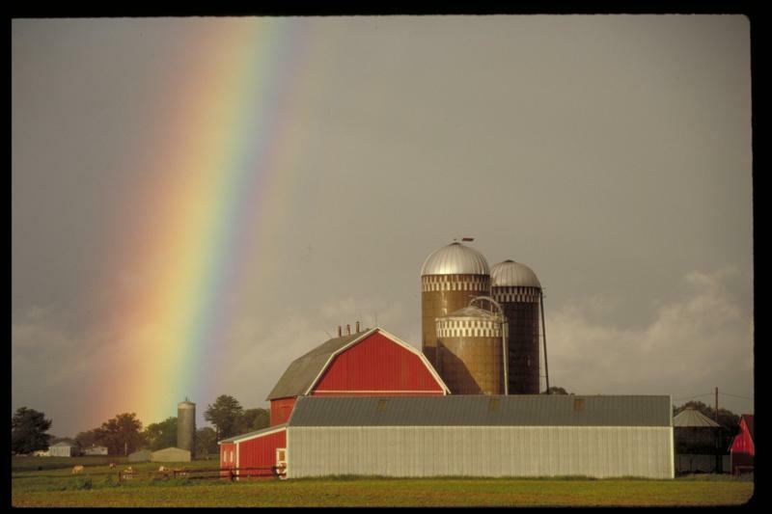
Thanks!

