Slide 1
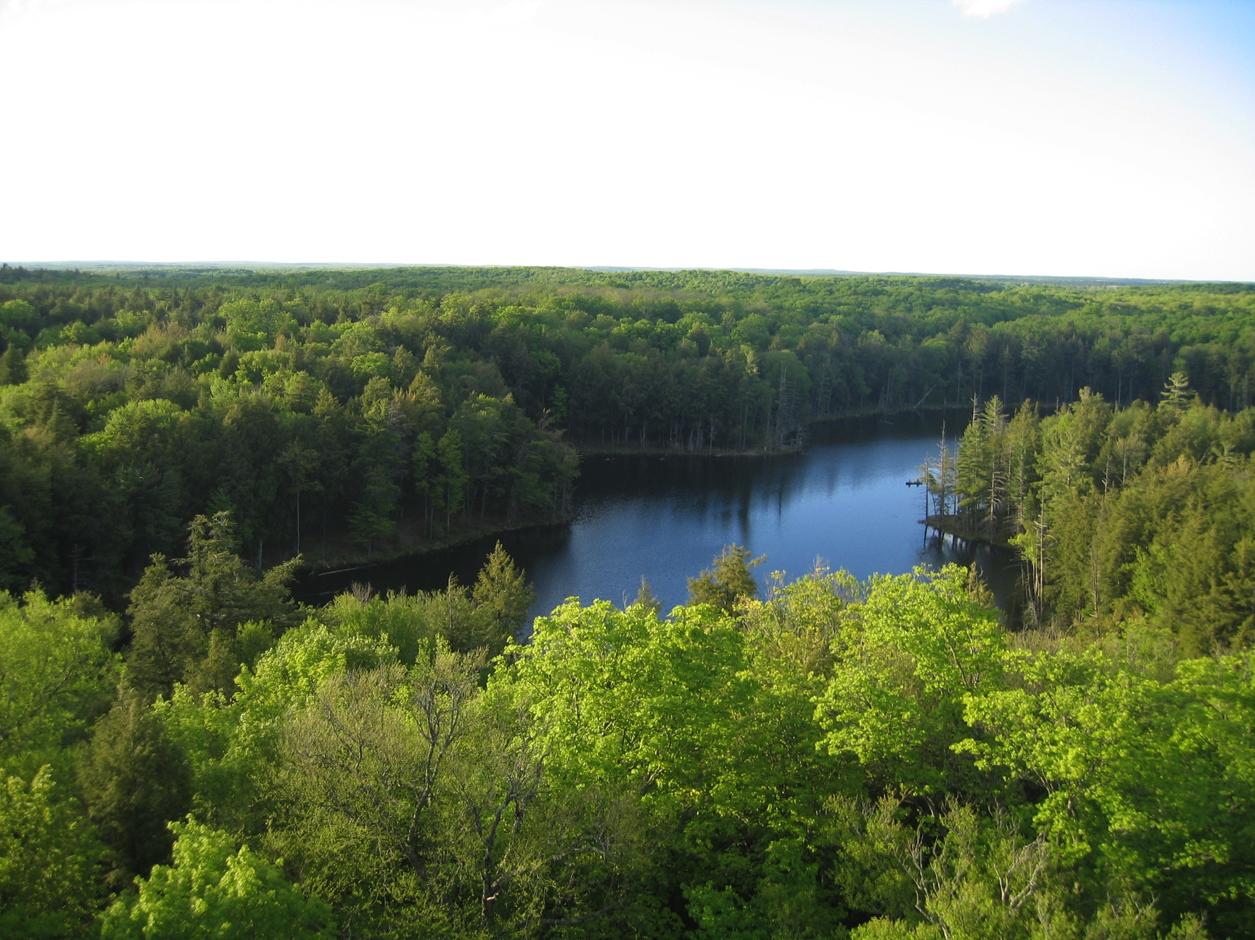
What Can YOU do about
Climate Change?
Ankur Desai
Dept of Atmospheric & Oceanic Sciences
University of Wisconsin-Madison
Milwaukee Public Library

Slide 2
Three things about me

Slide 3
Three things about me
I was born and raised in New Jersey

Slide 4
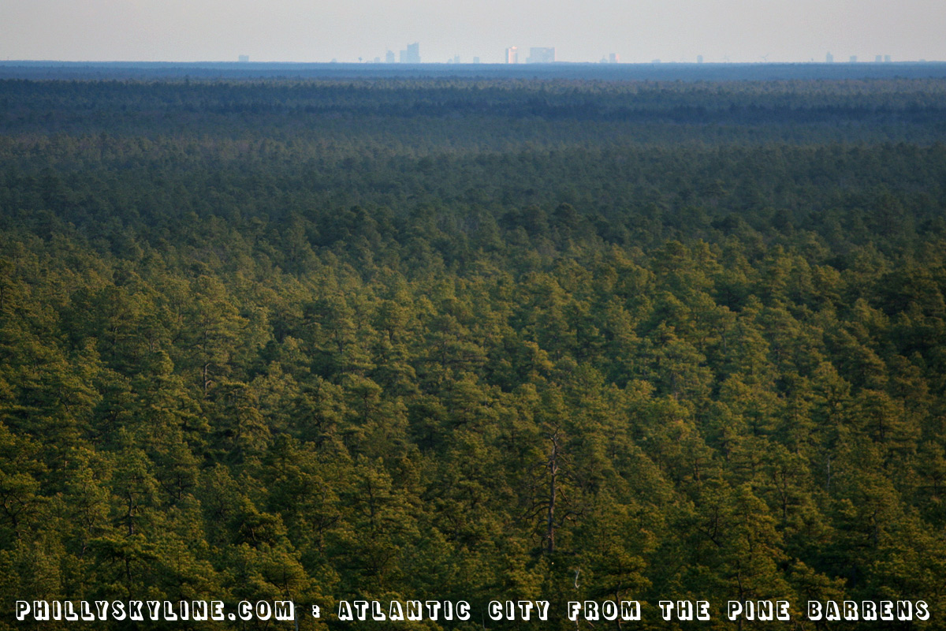
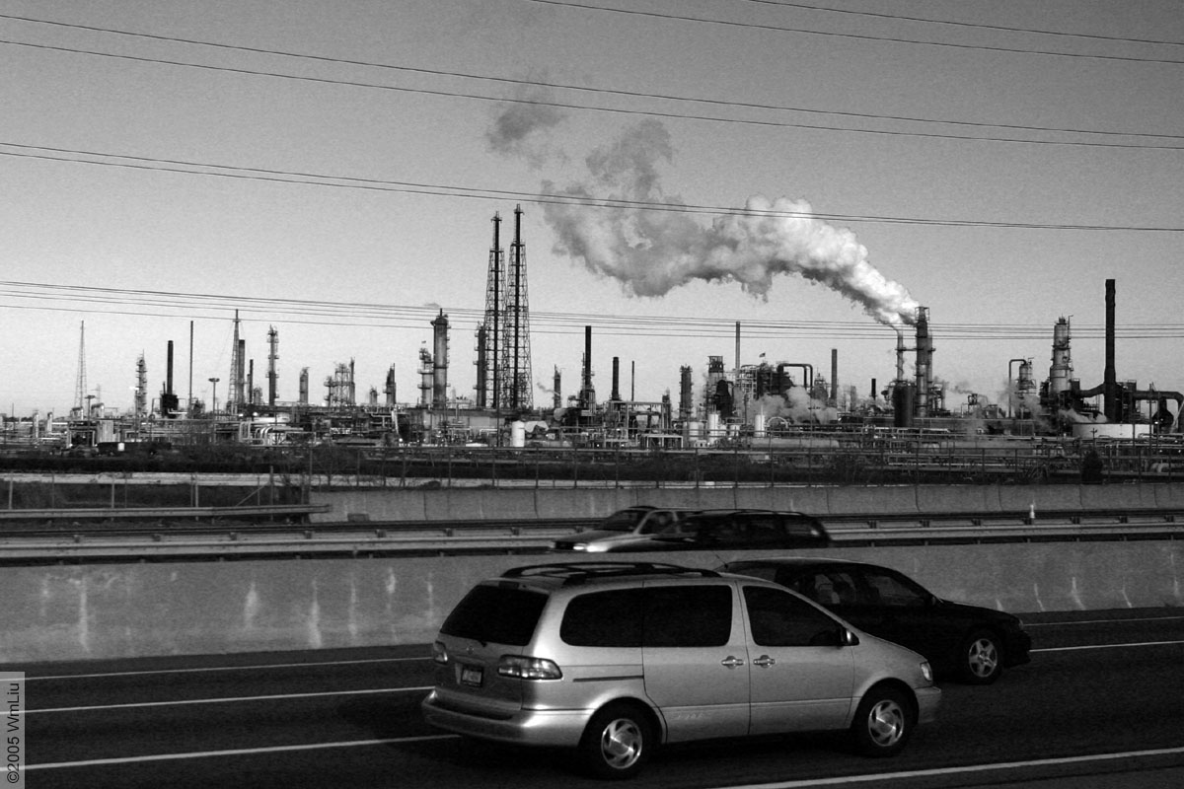
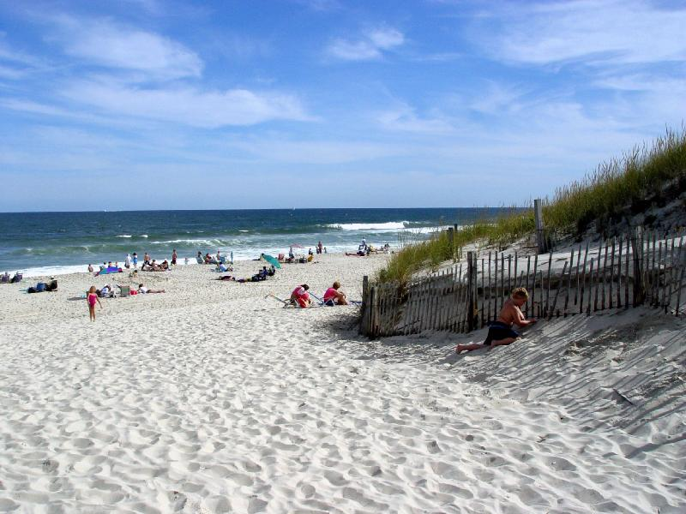

Slide 5
Three things about me
I was born and raised in New Jersey
I live in Madison with my wife and three daughters

Slide 6


Slide 7
Three things about me
I was born and raised in New Jersey
I live in Madison with my wife and three daughters
I am a climate scientist who has spent that past 2 decades studying how plants, climate, and weather all influence each other

Slide 8
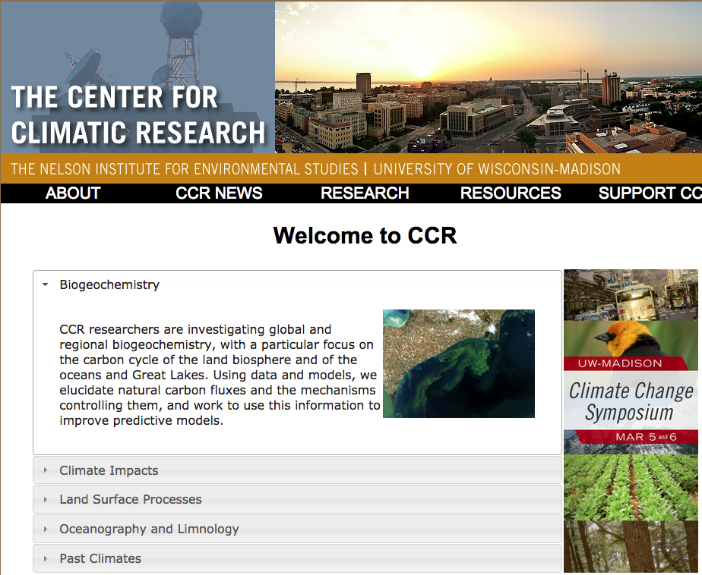
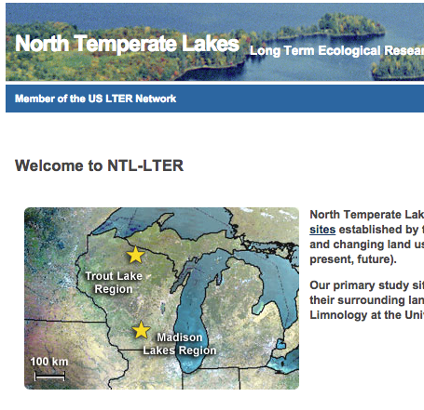
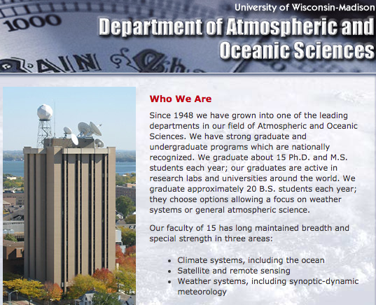

Slide 9
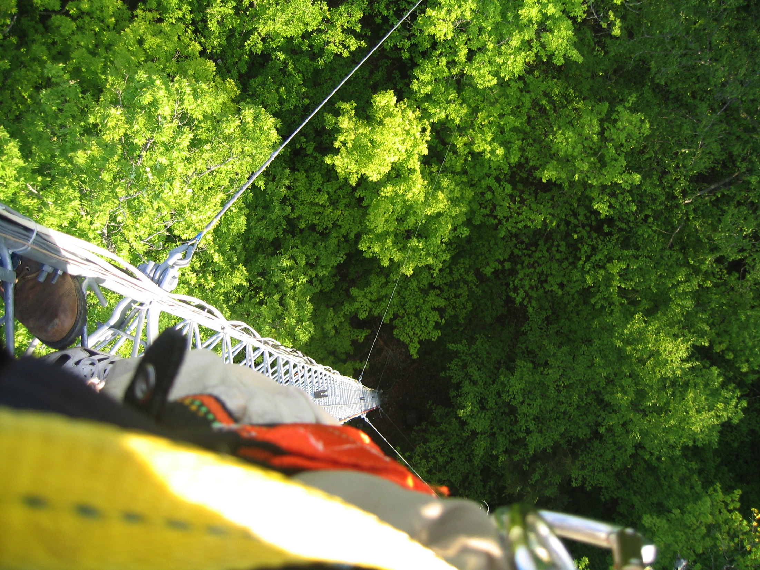

Slide 10
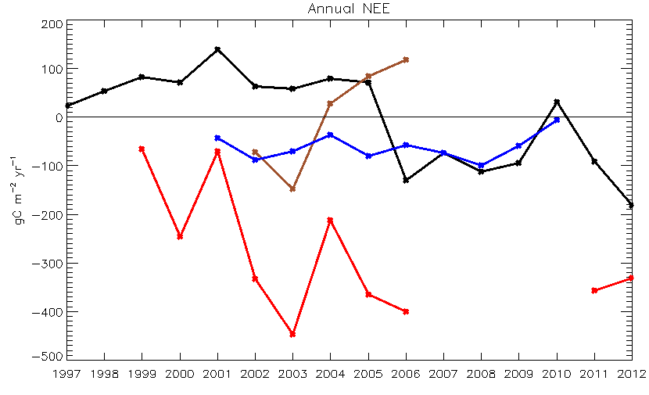
Source to atmosphere
Old-growth
mixed forest
Regional
Tall tower
Shrub
wetland
Mature
hardwood
Sink from atmosphere

Slide 11
Three things about climate

Slide 12
Three things about climate
Climate is the average of weather

Slide 13
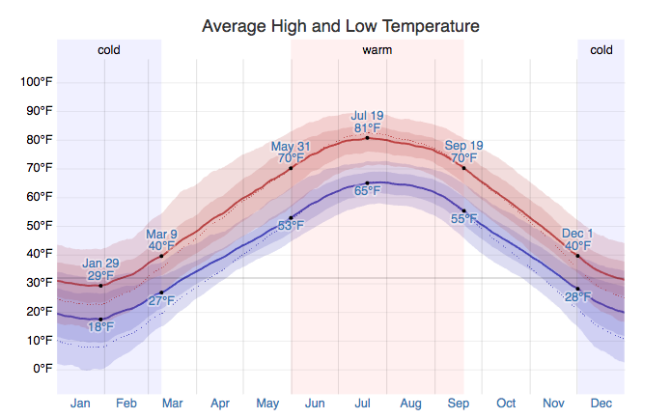
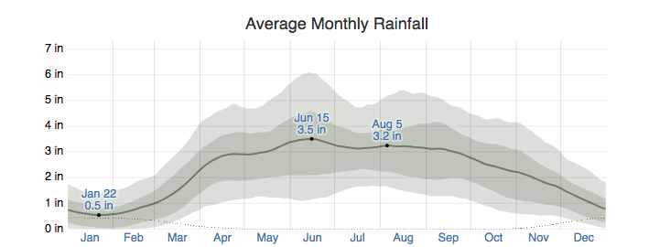

Slide 14
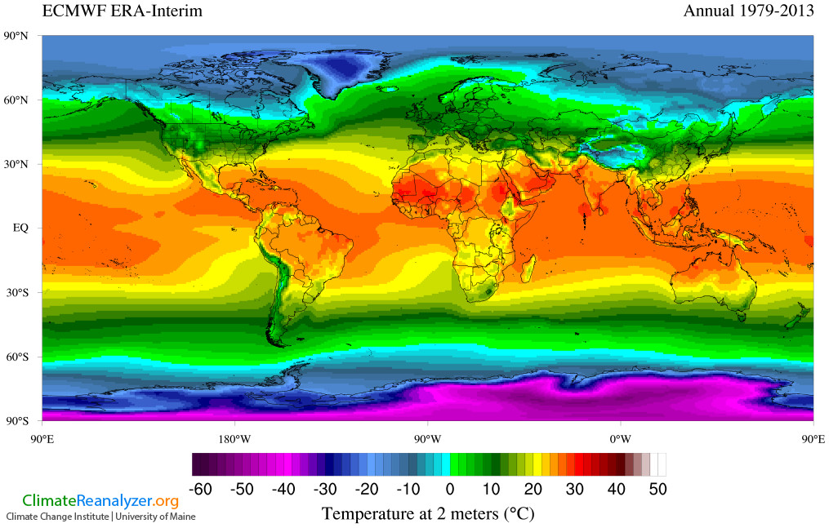
http://cci-reanalyzer.org/

Slide 15
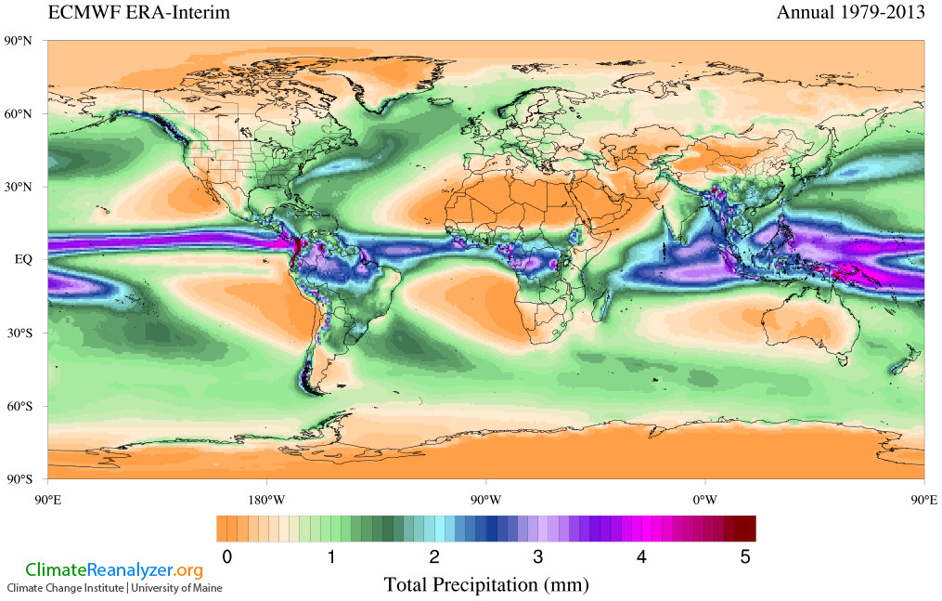
http://cci-reanalyzer.org/

Slide 16
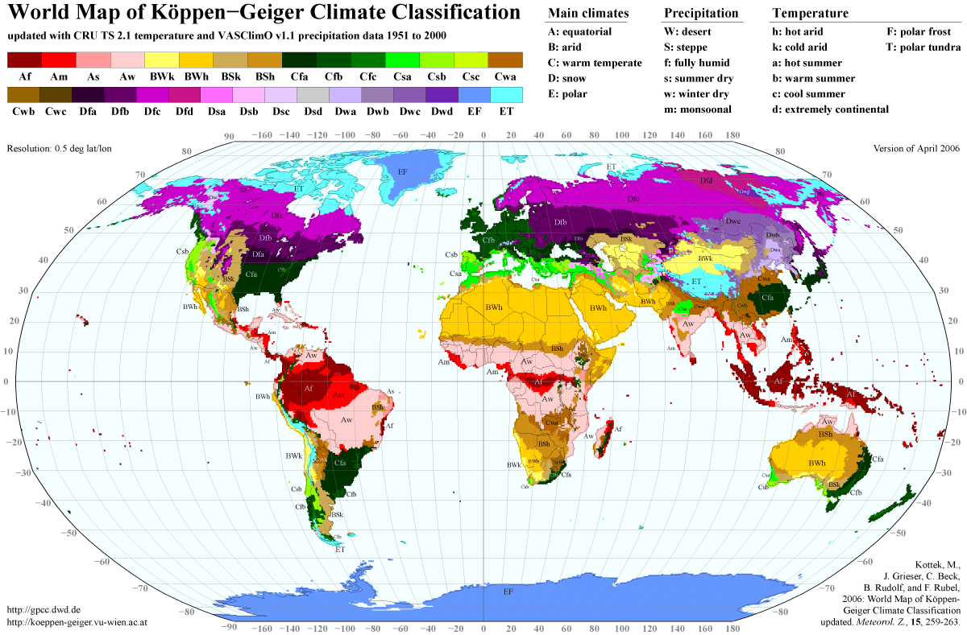

Slide 17
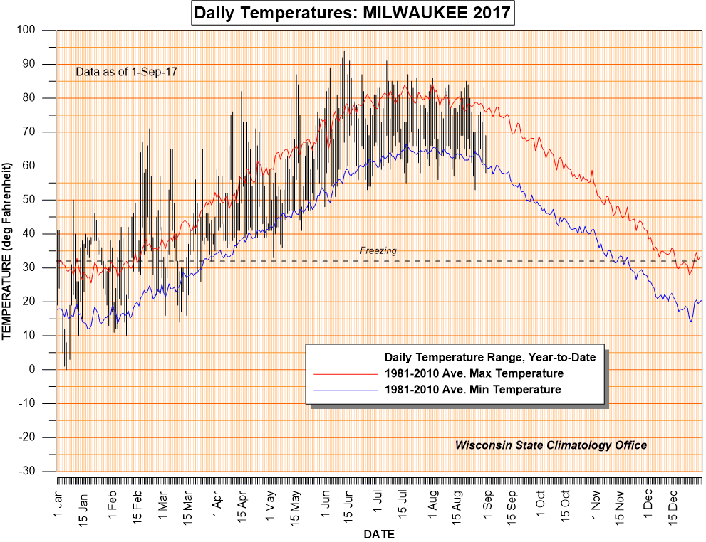

Slide 18
Three things about climate
Climate is the average of weather
Climate changes naturally

Slide 19
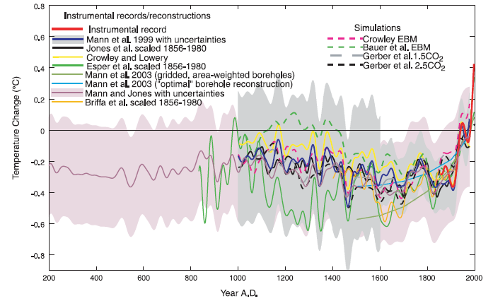
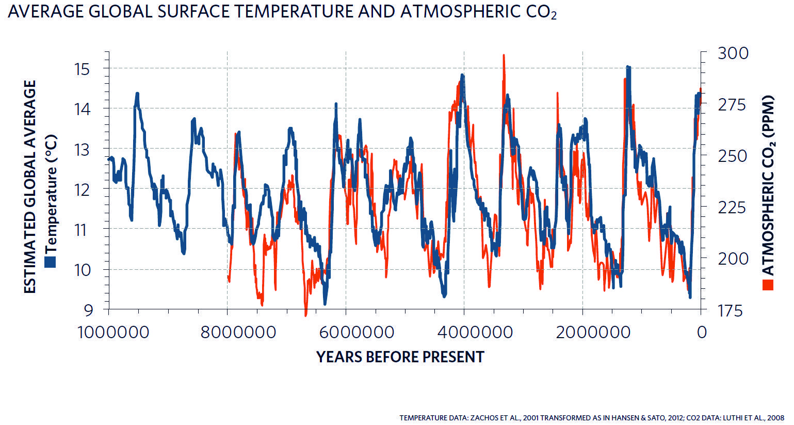
⬥
Mann et al., 2003, EOS

Slide 20
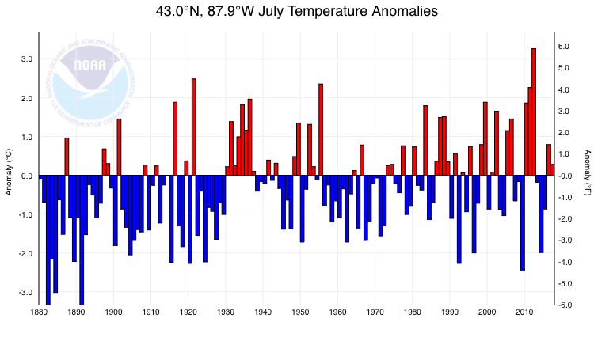
MKE

Slide 21
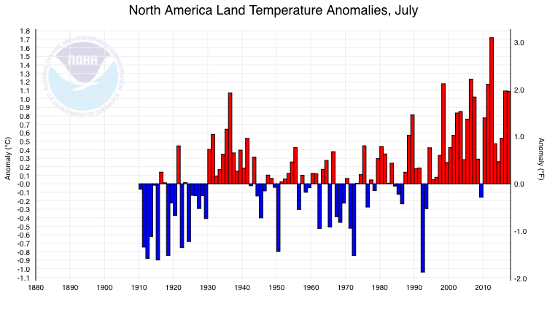
N America

Slide 22
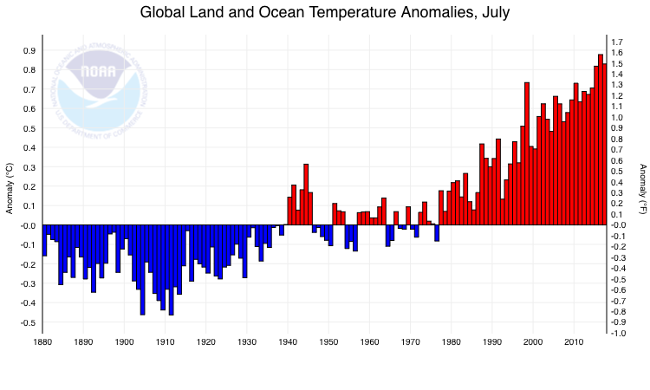
WORLD

Slide 23
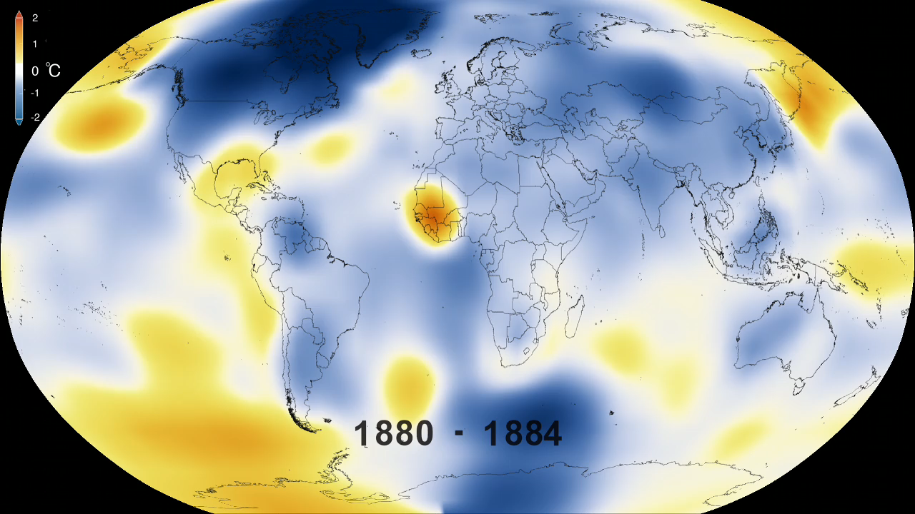
Notes:
Earth’s 2015 surface temperatures were the warmest since modern record keeping began in 1880, according to independent analyses by NASA and the National Oceanic and Atmospheric Administration (NOAA).
Globally-averaged temperatures in 2015 shattered the previous mark set in 2014 by 0.23 degrees Fahrenheit (0.13 Celsius). Only once before, in 1998, has the new record been greater than the old record by this much.
The 2015 temperatures continue a long-term warming trend, according to analyses by scientists at NASA’s Goddard Institute for Space Studies (GISS) in New York (GISTEMP). NOAA scientists agreed with the finding that 2015 was the warmest year on record based on separate, independent analyses of the data. Because weather station locations and measurements change over time, there is some uncertainty in the individual values in the GISTEMP index. Taking this into account, NASA analysis estimates 2015 was the warmest year with 94 percent certainty.
“Climate change is the challenge of our generation, and NASA’s vital work on this important issue affects every person on Earth,” said NASA Administrator Charles Bolden. “Today’s announcement not only underscores how critical NASA’s Earth observation program is, it is a key data point that should make policy makers stand up and take notice - now is the time to act on climate.”
The planet’s average surface temperature has risen about 1.8 degrees Fahrenheit (1.0 degree Celsius) since the late-19th century, a change largely driven by increased carbon dioxide and other human-made emissions into the atmosphere.
Most of the warming occurred in the past 35 years, with 15 of the 16 warmest years on record occurring since 2001. Last year was the first time the global average temperatures were 1 degree Celsius or more above the 1880-1899 average.
Phenomena such as El Niño or La Niña, which warm or cool the tropical Pacific Ocean, can contribute to short-term variations in global average temperature. A warming El Niño was in effect for most of 2015.
“2015 was remarkable even in the context of the ongoing El Niño,” said GISS Director Gavin Schmidt. “Last year’s temperatures had an assist from El Niño, but it is the cumulative effect of the long-term trend that has resulted in the record warming that we are seeing.”
Weather dynamics often affect regional temperatures, so not every region on Earth experienced record average temperatures last year. For example, NASA and NOAA found that the 2015 annual mean temperature for the contiguous 48 United States was the second warmest on record.
The GISTEMP analysis website is located at: http://data.giss.nasa.gov/gistemp/

Slide 24
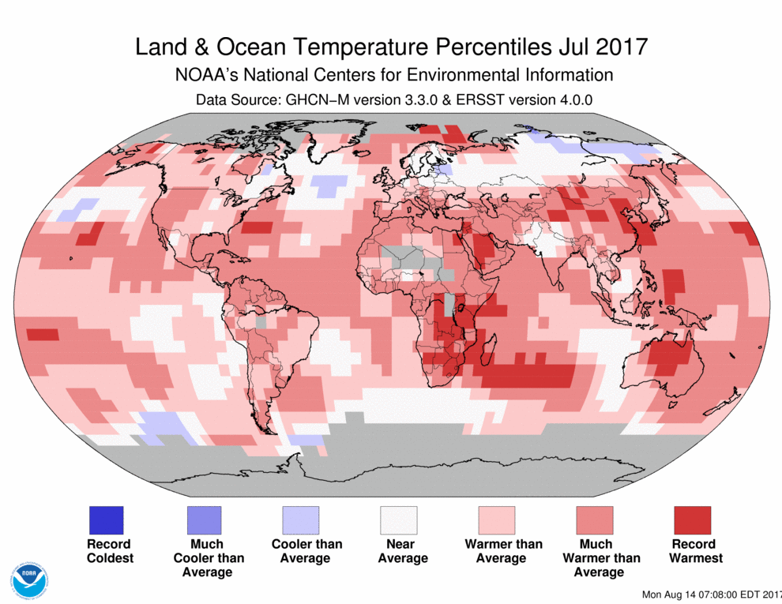

Slide 25
Three things about climate
Climate is the average of weather
Climate changes naturally
The study of climate change is well-established. We know how climate changes and what’s is mostly causing current change

Slide 26
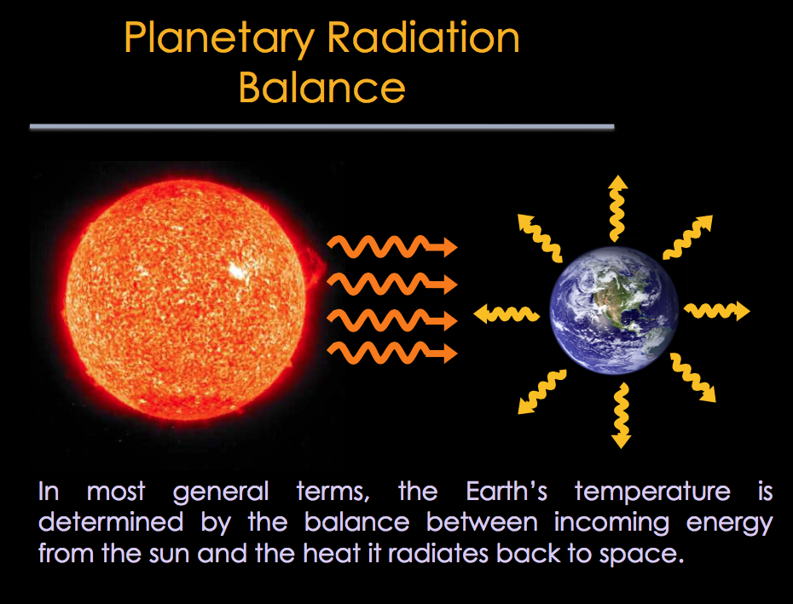

Slide 27
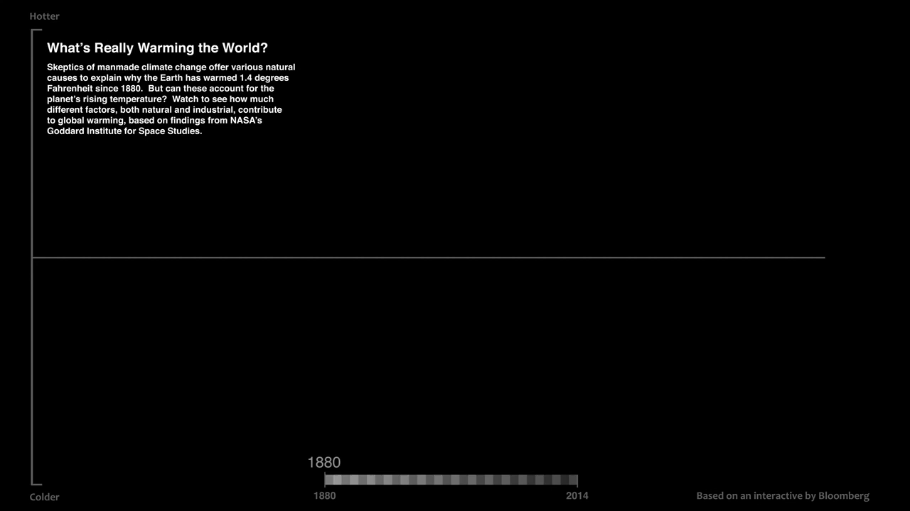
Bloomberg

Slide 28
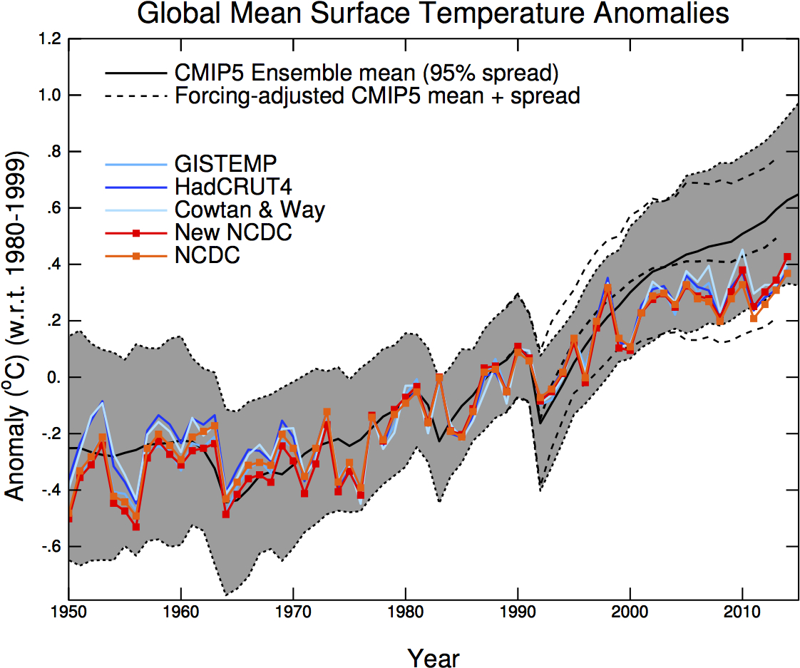

Slide 29
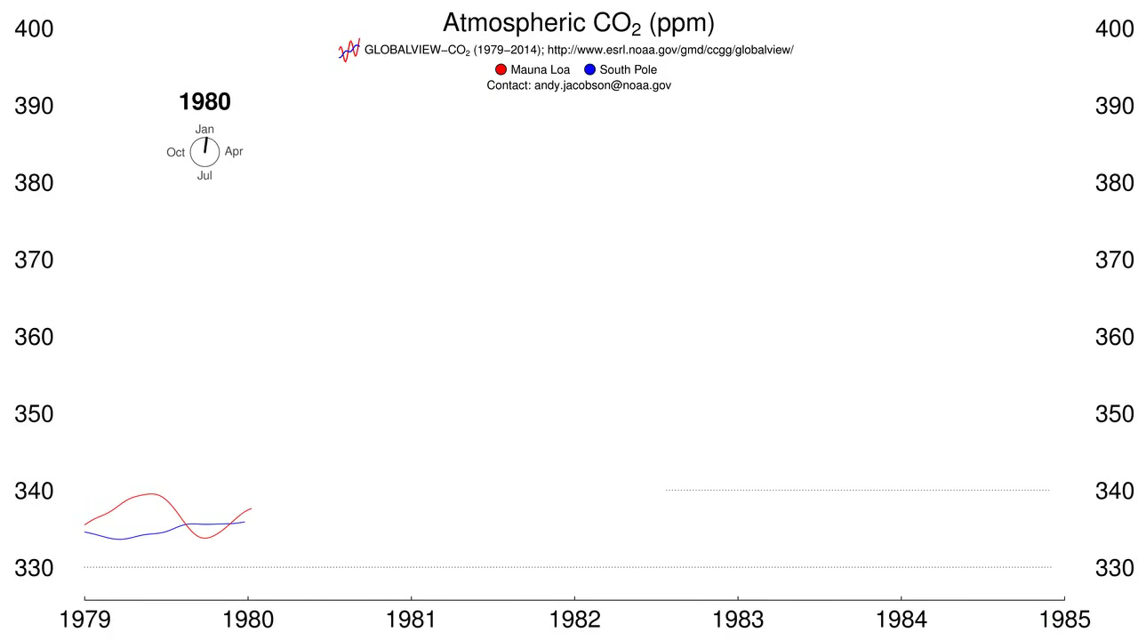
Other evidence: decreasing radiocarbon content of atmosphere, acidification of ocean, increased water use efficiency of plants, concentrations tracks emissions

Slide 30
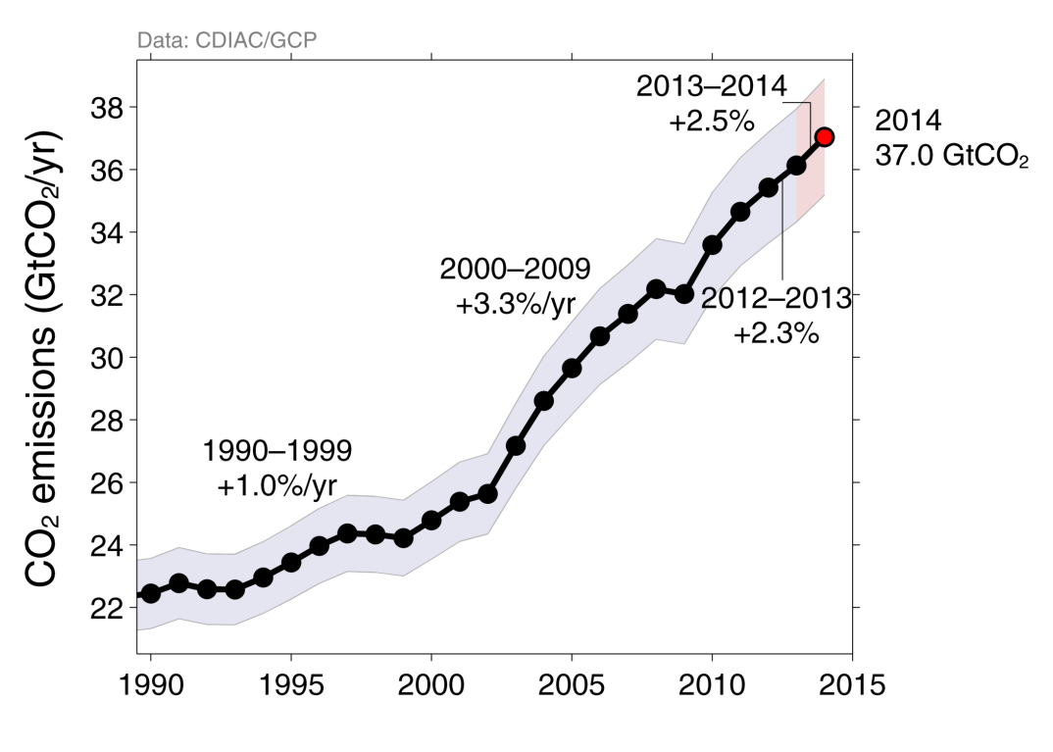
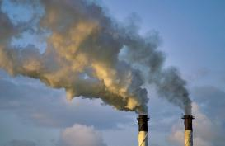
Fossil Fuel and Cement Emissions
Global fossil fuel and cement emissions: 36.1 ± 1.8 GtCO₂ in 2013, 61% over 1990
Projection for 2014 : 37.0 ± 1.9 GtCO₂, 65% over 1990
Uncertainty is ±5% for one standard deviation (IPCC “likely” range)
Estimates for 2011, 2012, and 2013 are preliminary
Source: CDIAC; Le Quéré et al 2014; Global Carbon Budget 2014

Slide 31
So what’s the big deal?

Slide 32
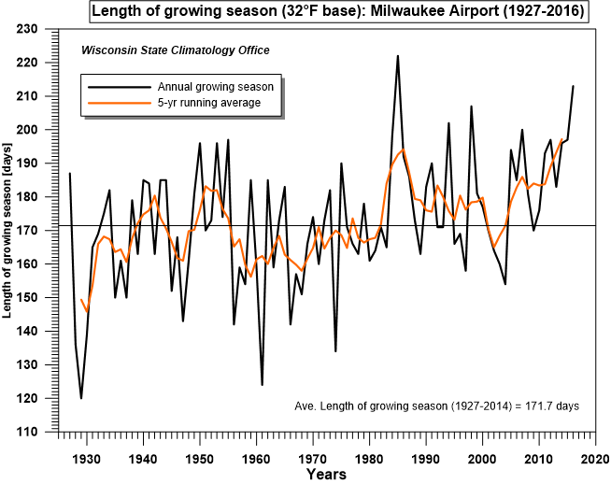

Slide 33
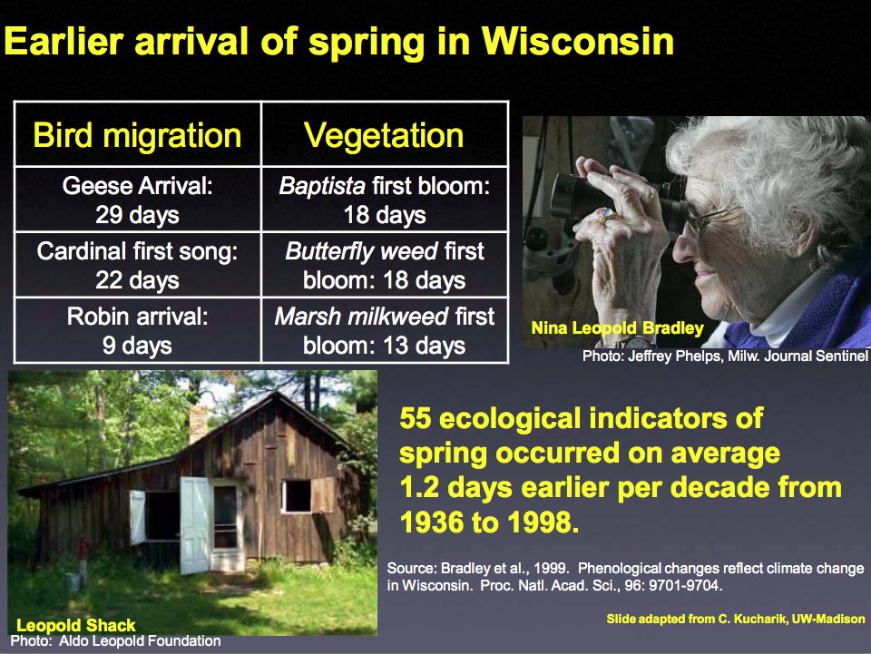

Slide 34
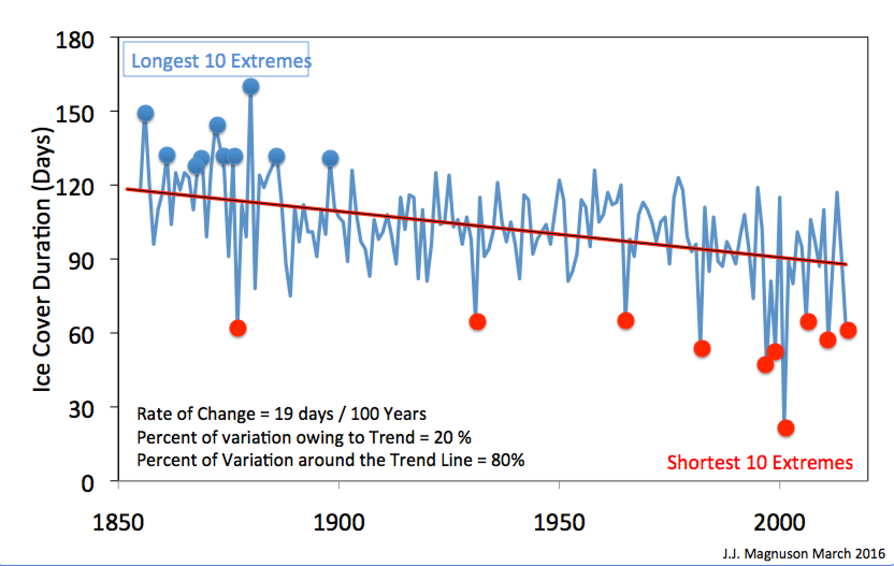
A change in Extreme Winters for Lake Mendota, Wisconsin
Extremes have shifted from cold extremes to warm extremes

Slide 35
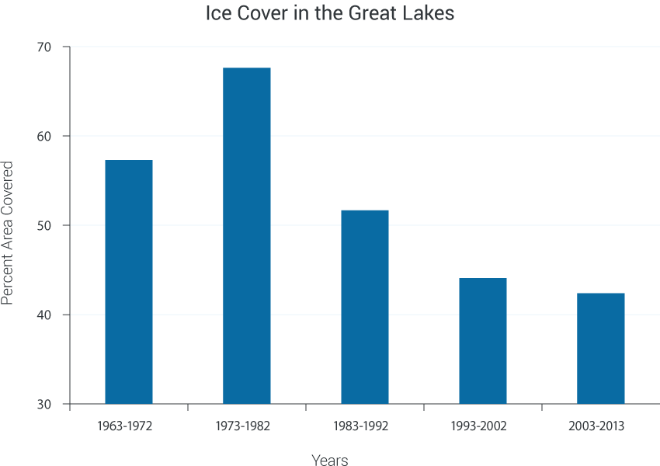

Slide 36
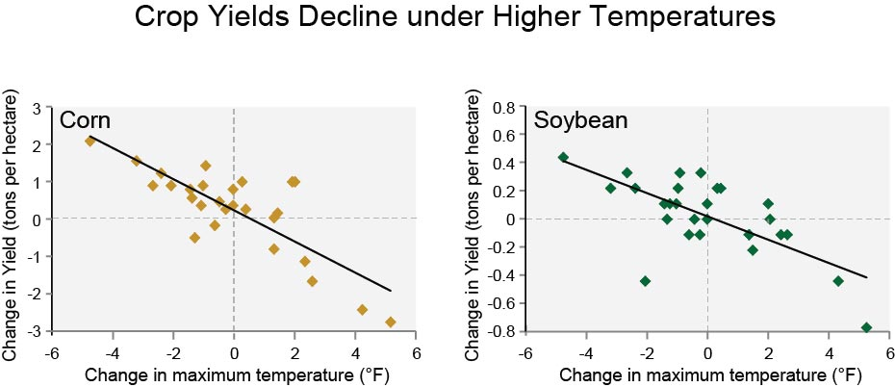

Slide 37
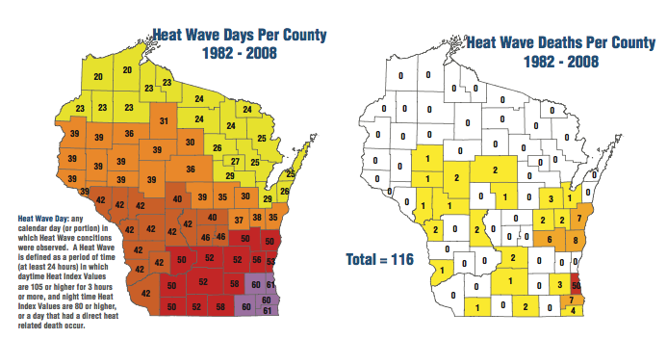

Slide 38
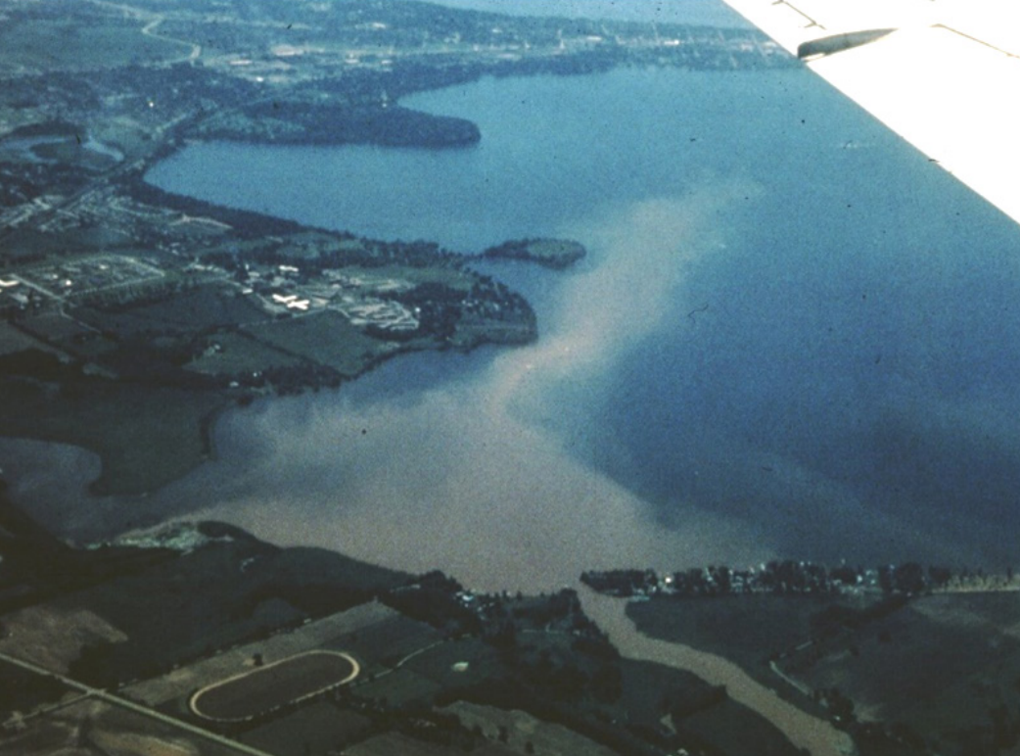
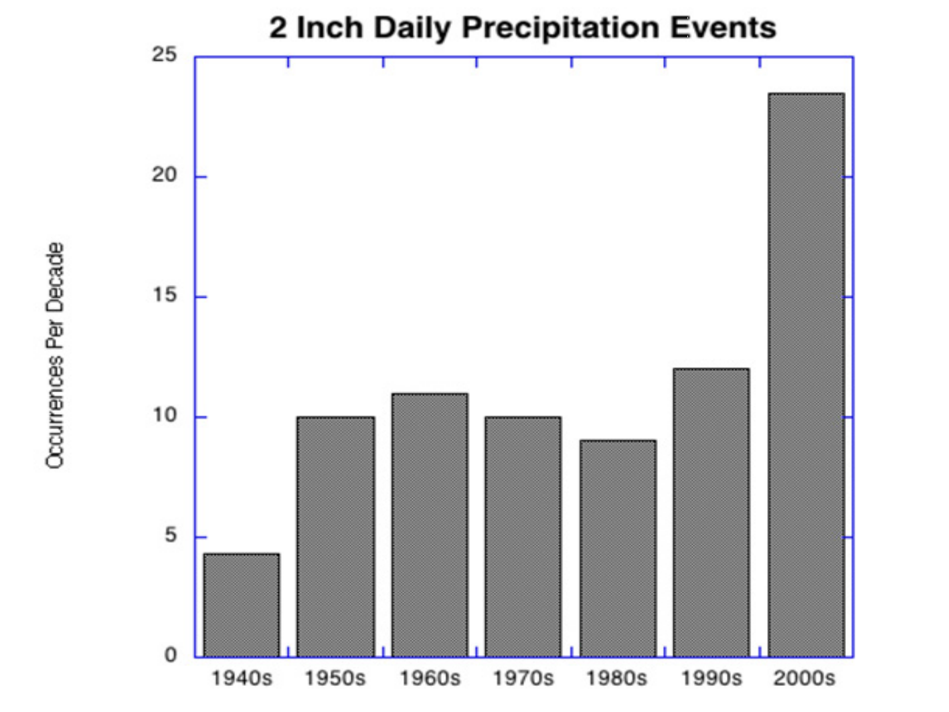
R Lathrop
S. Vavrus

Slide 39
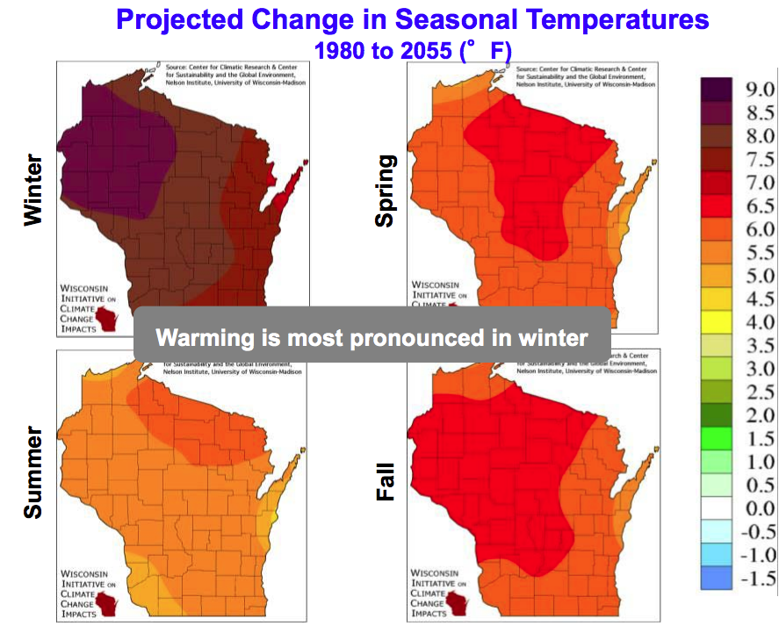

Slide 40
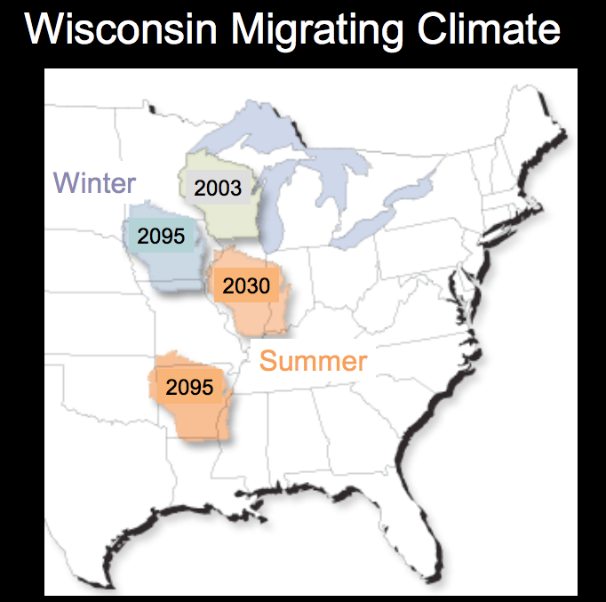

Slide 41
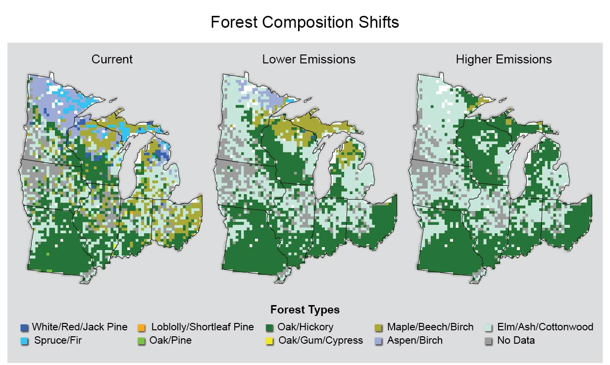

Slide 42
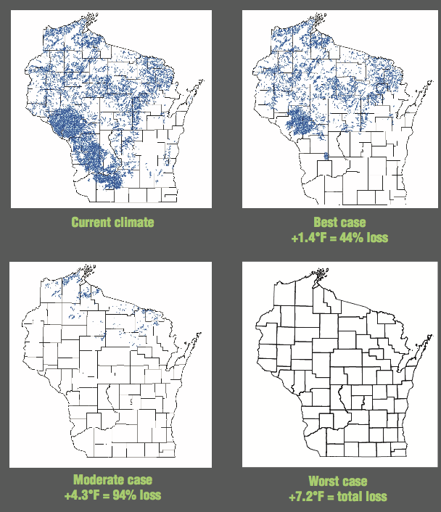
Brook trout streams
Source: WICCI

Slide 43
Why aren’t we doing something about it then?

Slide 44
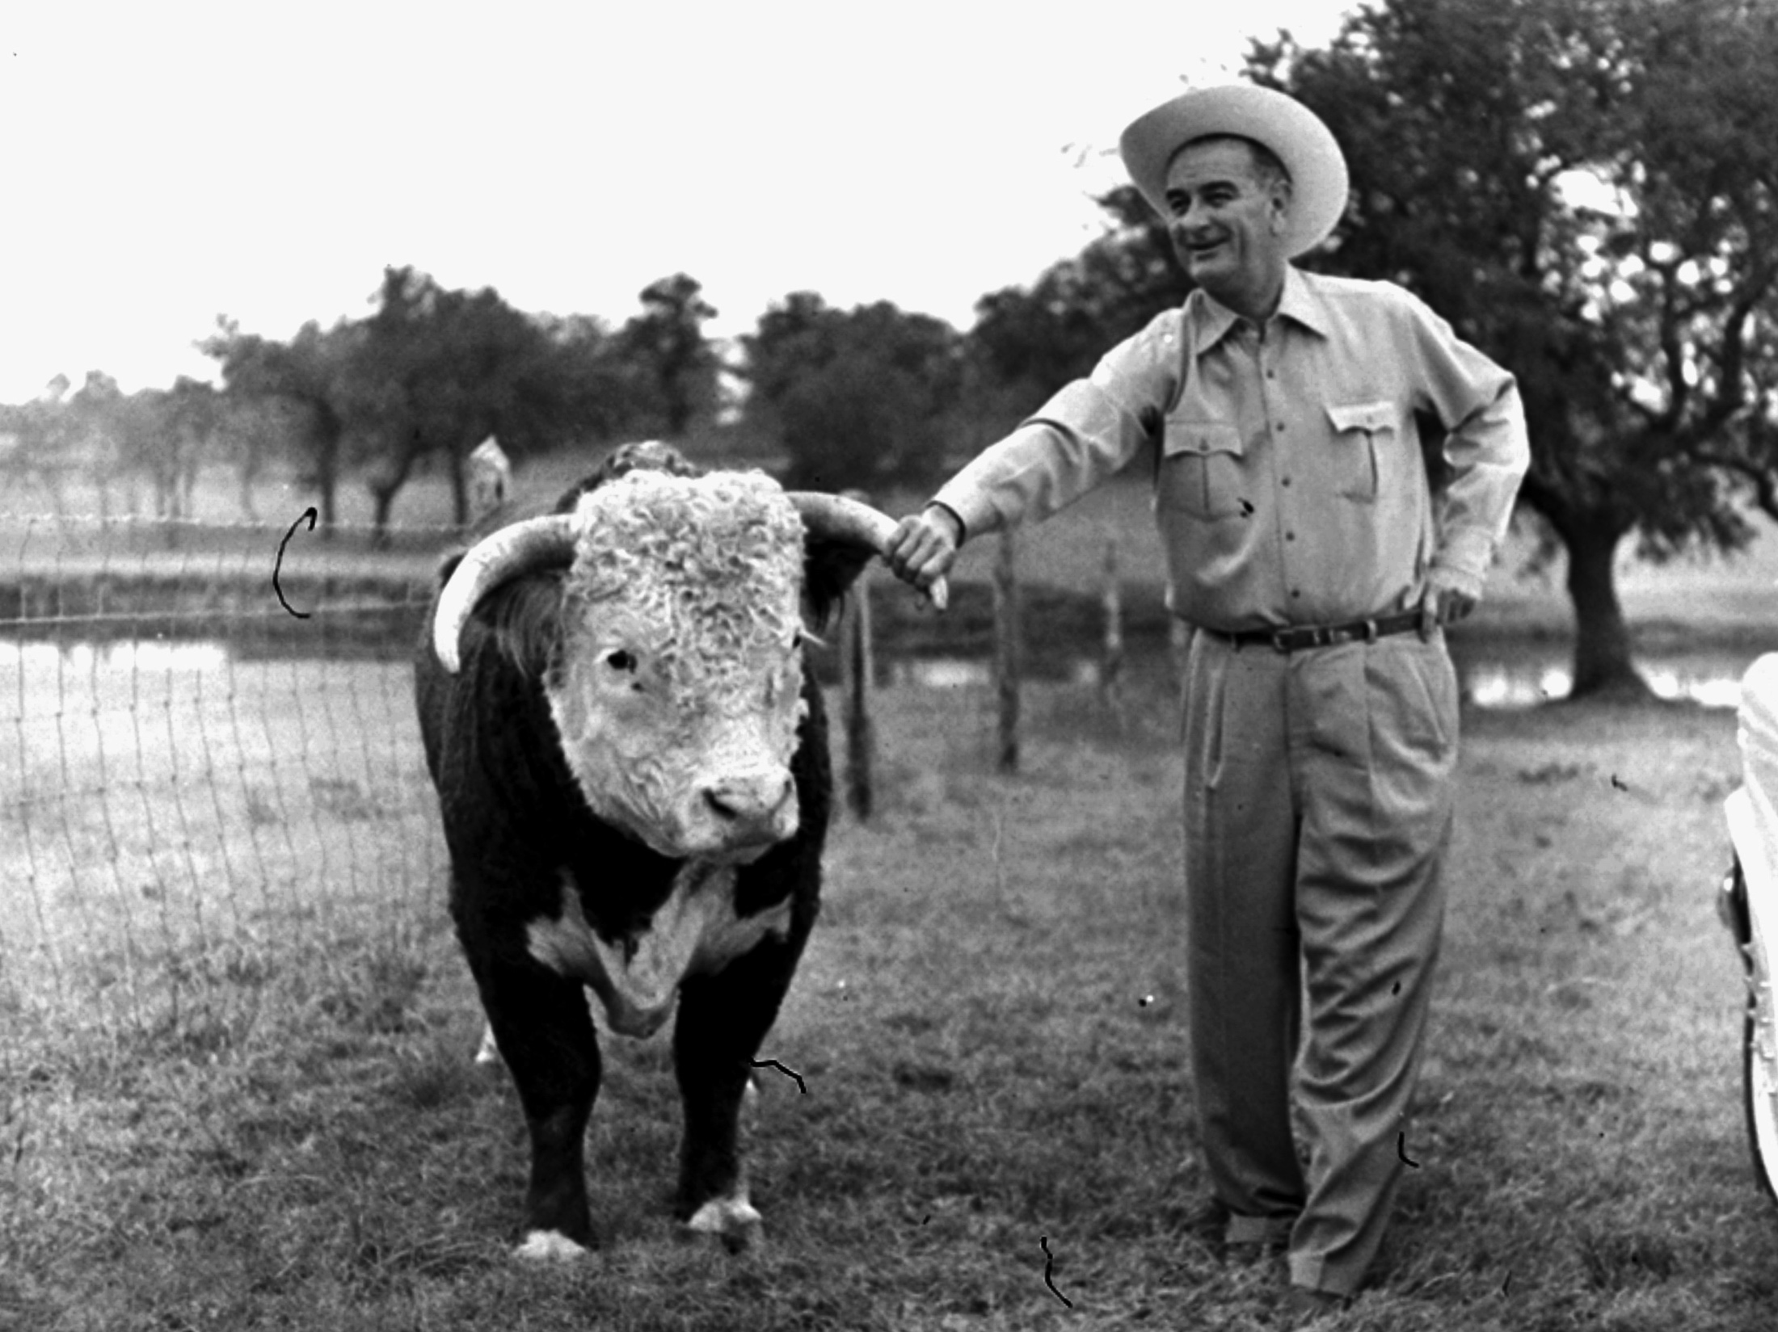
The continued release of CO₂ to the atmosphere from burning fossil fuels would “almost certainly cause significant changes” and “could be deleterious from the point of view of human beings […] and marked changes in climate, not controllable through local or even national efforts.
U.S. President's Science Advisory to President Lyndon B. Johnson 1966

Slide 45
DOOMSDAY Thinking
The imagery of the impossible leads to the art of the no deal

Slide 46
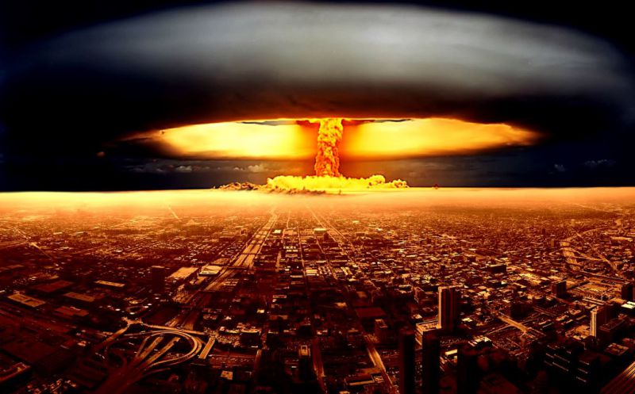
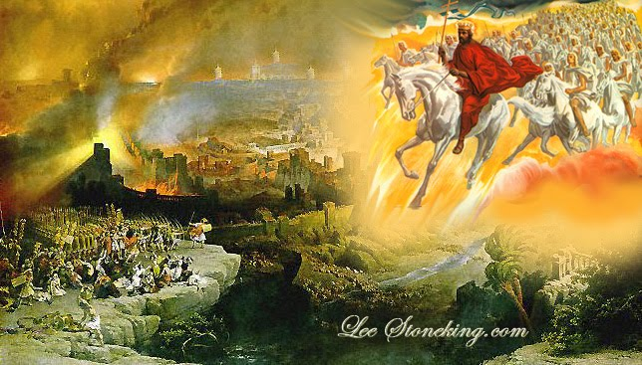
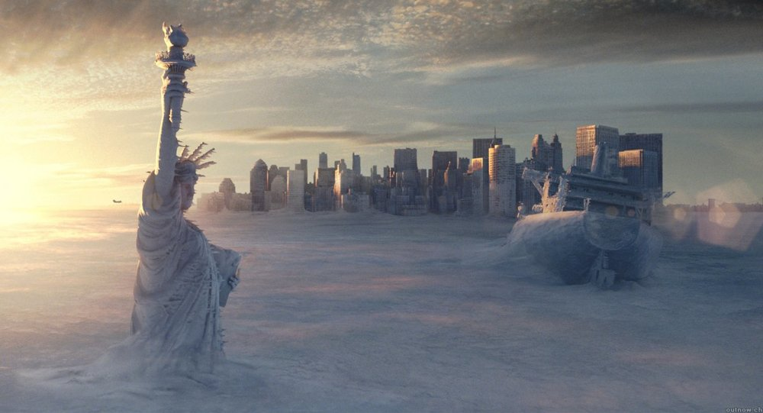
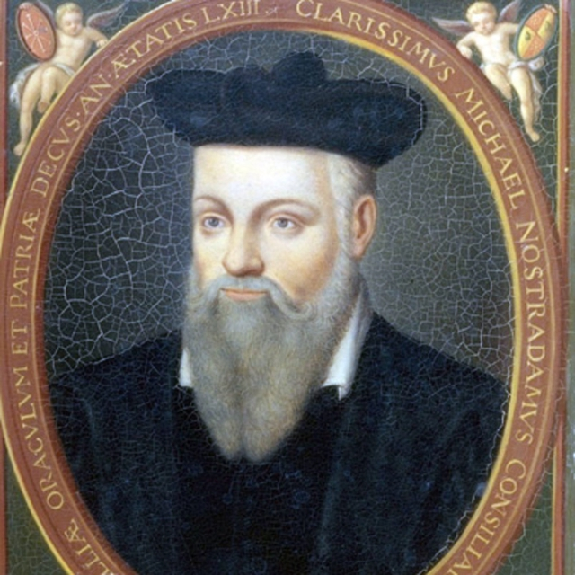



Slide 47
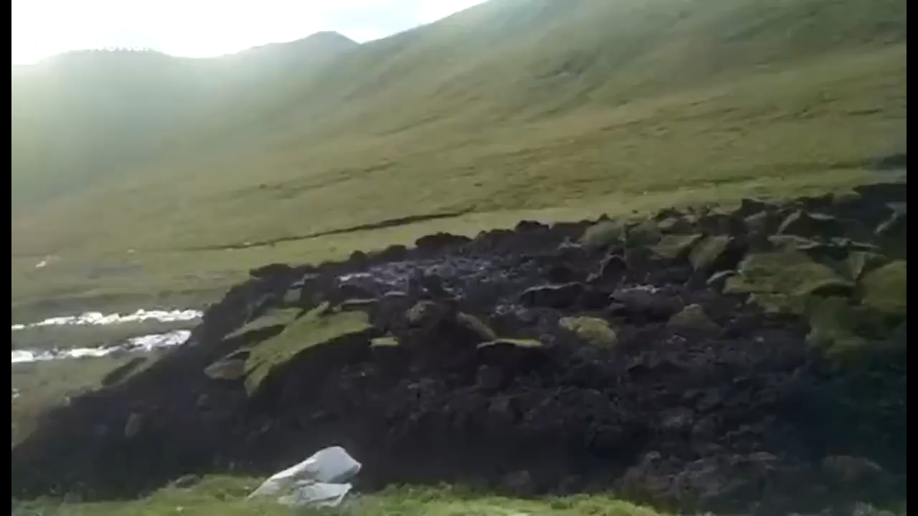

Slide 48
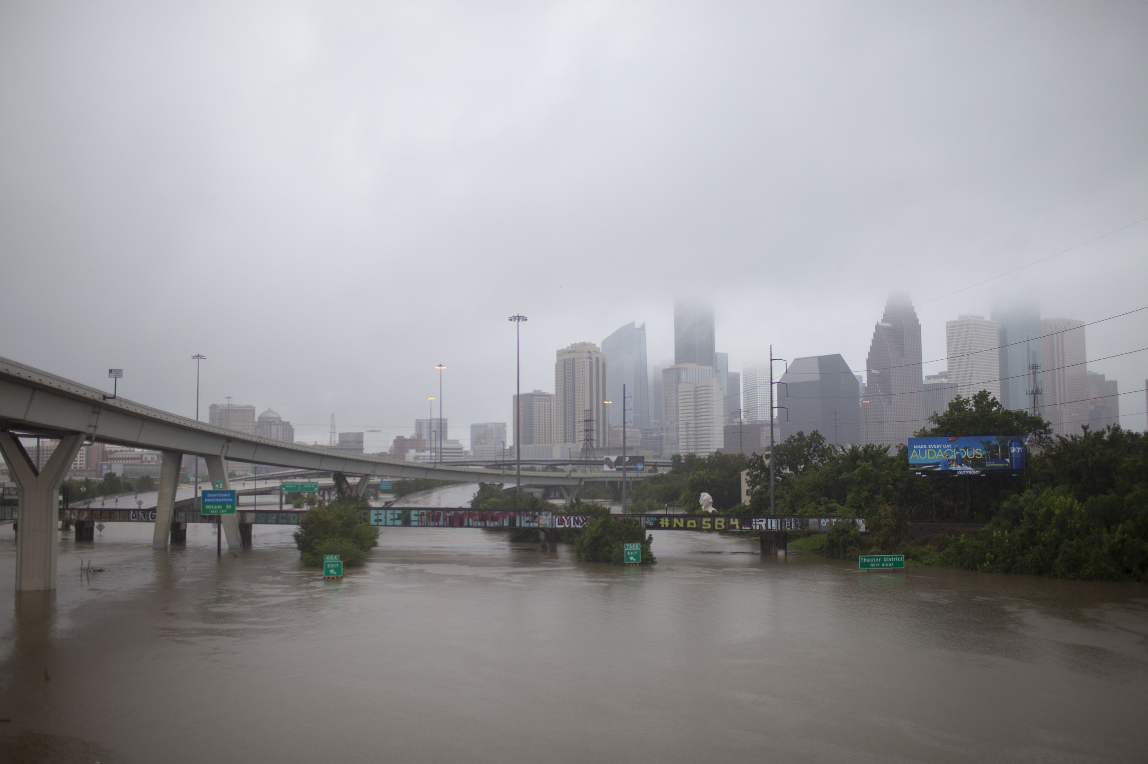
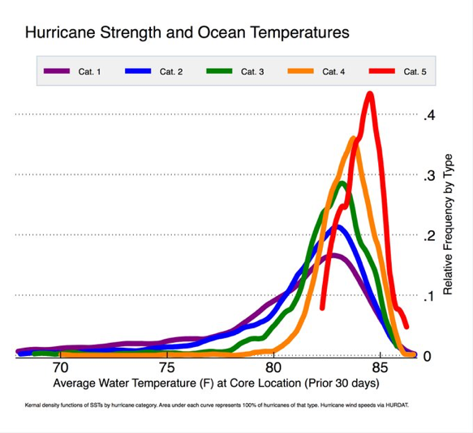

Slide 49
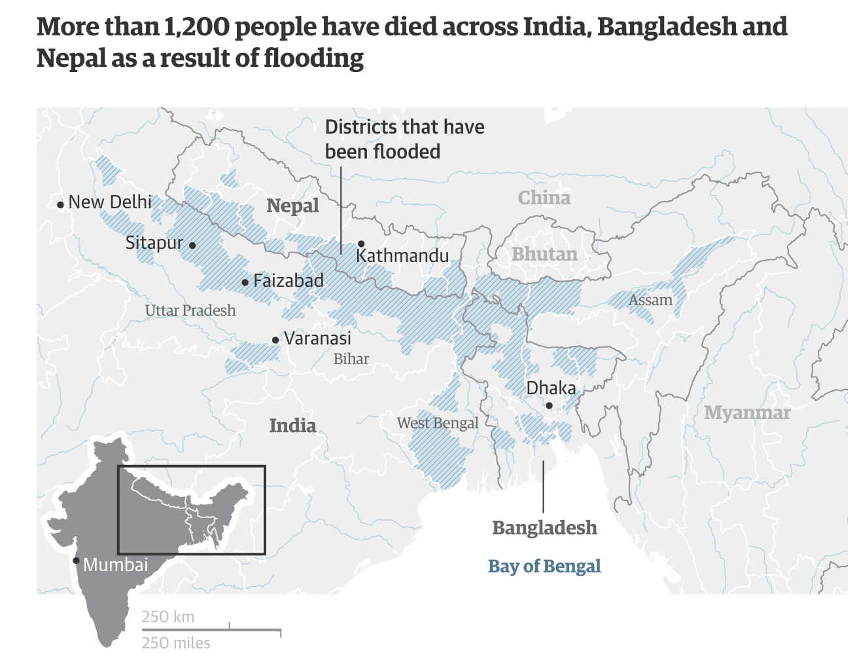
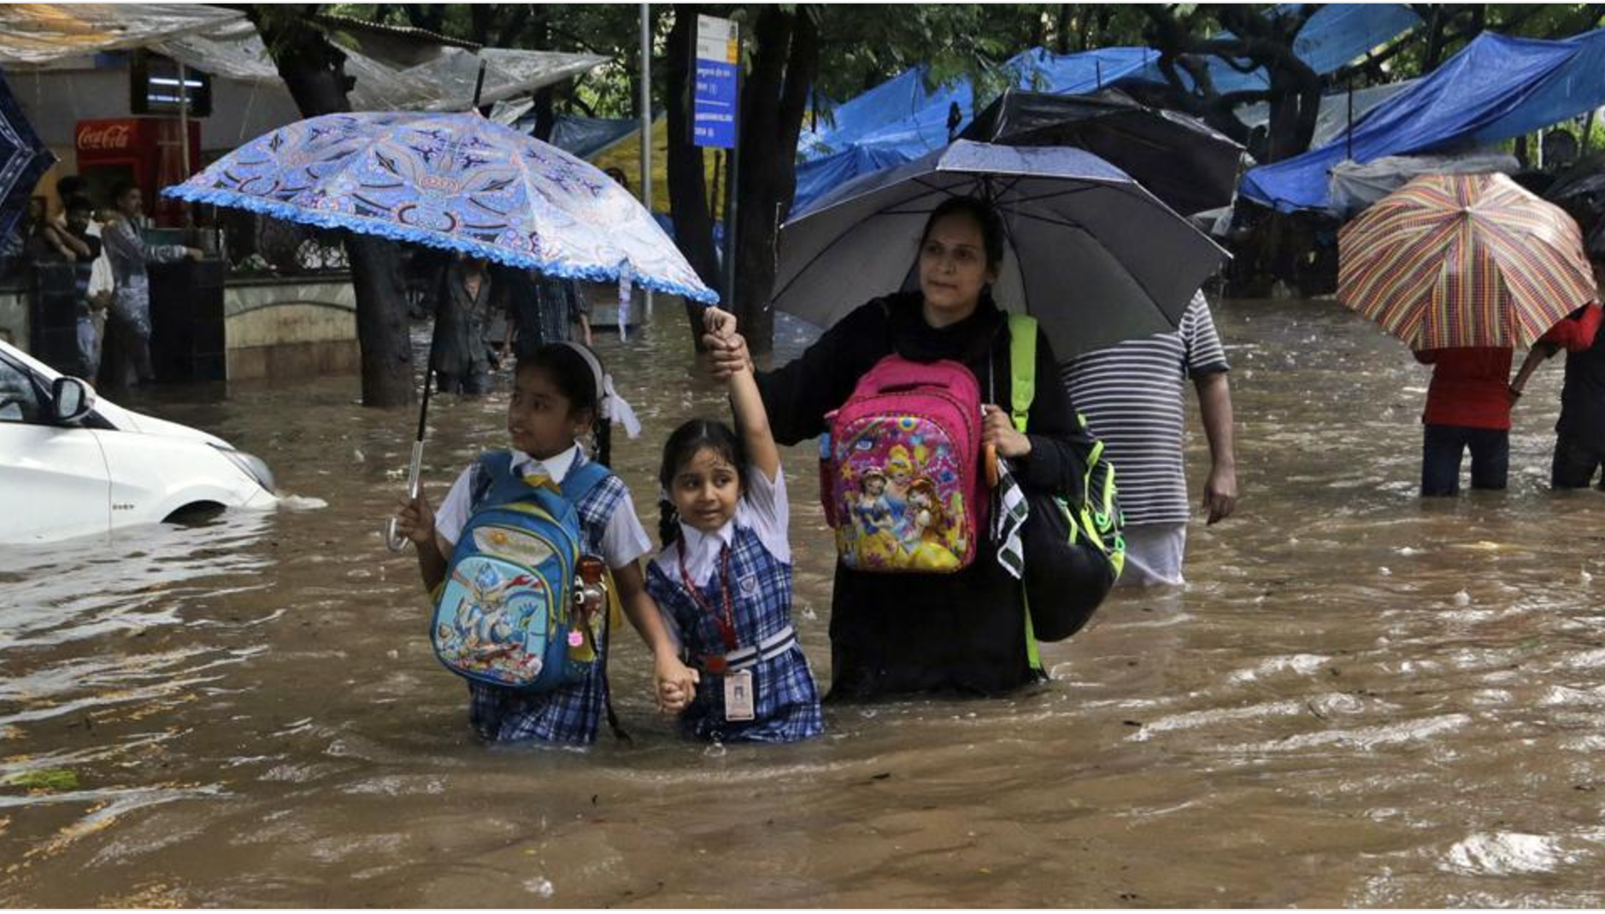

Slide 50




LA Times
NY Times
The Atlantic

Slide 51





Slide 52
So what do you do about climate change?
Denialism is a normal doomsday response
So is alarmism. Trying an “all of the above” solution is paralyzing
But, there are some levers we know work:
  Rethinking agriculture
  Reducing deforestation
  Expanding our energy choices
  Providing incentives to change

Slide 53
We do and believe like our neighbors
Or at least, what we think are neighbors do and believe…

Slide 54


“If you look at global warming alarmists, they don't like to look at the actual facts and the data. […] I read this morning a Newsweek article from the 1970s talking about global cooling. [...] Now, the data proved to be not backing up that theory. So then all the advocates of global cooling suddenly shifted to global warming […] and the solution interestingly enough was the exact same solution -- government control of the energy sector and every aspect of our lives.”
Washington Post, 2 Aug 2015

Slide 55
We do and believe like our neighbors
Or at least, what we think are neighbors do and believe…
BUT

Slide 56
Community standards can change

Slide 57
Community standards can change
Education and generational change
  Recycling

Slide 58


Slide 59
Community standards can change
Education and generational change
  Recycling
Regulation
  Acid rain

Slide 60



Slide 61
Community standards can change
Education and generational change
  Recycling
Regulation
  Acid rain
Innovation
  The Ozone Hole

Slide 62


Chipperfeld et al., 2017

Slide 63

KAYA IDENTITY
http://climatemodels.uchicago.edu/kaya/

Slide 64

“I am not a scientist myself, but my best assessment of the data is that the world is getting warmer, that human activity contributes to that warming, and that policymakers should therefore consider the risk of negative consequences.”
  Sept. 2012
http://www.sciencedebate.org/debate12/

Slide 65

http://globalchange.mit.edu/focus-areas/uncertainty/gamble

Slide 66


Slide 67


Slide 68


Slide 69


Slide 70

“Higher temperatures and less-predictable weather would hurt poor farmers […] It would be a terrible injustice to let climate change undo any of the past half-century’s progress against poverty and disease—and doubly unfair because the people who will be hurt the most are the ones doing the least to cause the problem.”
Linkedin.com

Slide 71
What can you do?
Be mindful of how choices you make today influence the lives for your and other folks’ grandchildren
Denialism and alarmism are both symptoms of doomsday thinking, be wary of either position
Seemingly small changes in habits of transportation, energy use, efficiency, many of which require limited government role, can influence your community, might even save money, & make a big impact
Some level of climate change is inevitable, so local adaptation to flooding, extreme heat, sea level are an essential role for local governments

Slide 72

THANKS!
desai@aos.wisc.edu
Don’t be afraid, be curious

Slide 74


