Slide 1
Lake Superior Eddy Covariance
Stannard Rock Light
PI: Peter Blanken, CU-Boulder
Reported by Ankur Desai
DO NOT DISTRIBUTE

Slide 2
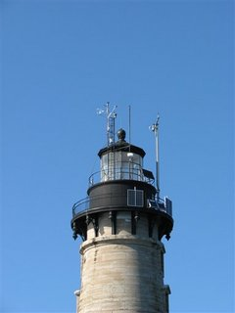
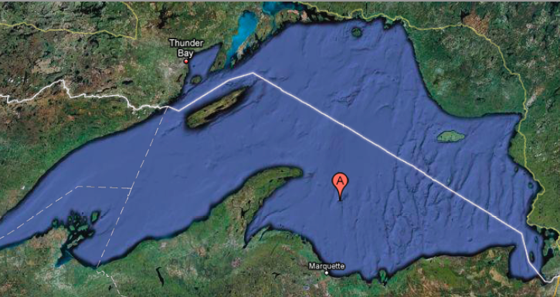
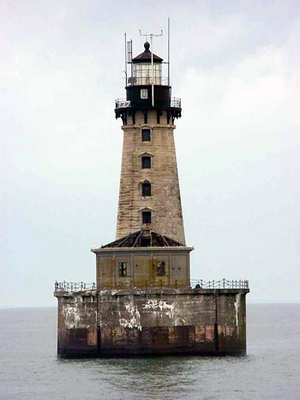

Slide 3
Micrometeorology
Figure 1: General Meteorology. Air (blue lines) temperature and humidity greater than that at water surface (green lines) until roughly DOY 200 (July 18) indicating the lake is in a period of energy storage: gradients for sensible heat (temperature) and latent heat (vapor pressure) directed towards the water surface (water still quite cold). After DOY 200, however, note that the difference between lake and air vapor pressures decreases due to increasing water surface temperatures. Significant cooling and drying DOY 270-275. Total rain = 98.5 mm.

Slide 4
Water surface
Figure 2: 24-hr mean air (blue) and water surface (green) temperature and vapor pressure, and differences. The difference between air and water temperature is decreasing, as is the difference between air/water vapor pressure. The former results in a decrease in the downward sensible heat flux, while the latter results in an increase in the upwards latent heat flux..

Slide 5
Wind Rose
Figure 3. Wind rose/intensity plot for all days, showing prevailing “calm” winds from the northwest, and now stronger, more persistent winds from the southeast

Slide 6
Wind Roses
Figure 3a - LEFT. Wind rose/intensity plot for DOY < 220 (low LE period). RIGHT- Wind rose/intensity plot for DOY >= 220 (LE-active period).

Slide 7
Radiation
Figure 4. Radiation balance (all in W m⁻²). Blue lines are downwards; green are upwards; except for net radiation. Most (nearly all) of the net radiation (which is large) is due to the incident short-wave radiation. Assuming an albedo of 0.07, the net short-wave is huge, and the net long-wave is small, so most of the net radiation is a result of the incident solar. At this time of the year, nearly all of the net radiation is used for lake heat storage (turbulent fluxes are small: see Figure 5). This is the exact same behavior Great Slave showed in June. Around DOY 200 (July 18), notice the decrease in net long-wave due to the steady increase in emitted long-wave (due to higher water surface temperatures: see Figure 2).

Slide 8
Energy Fluxes
Figure 5. 24-hr mean energy balance (all in W m⁻², except evaporative fraction). LE and H were small and often directed towards the surface in June (mean LE and H were -4.13 and -4.68 W m⁻², respectively). Evaporative fraction was typically less than 1, indicating more H that LE. Lake was in a “heat storage mode”, with the large Rn around the summer solstice being used in an attempt to raise the temperature of the massive body of water. Looks like evaporation is beginning to “ramp up”: notice the evaporation event around DOY 200-210, and again around DOY 215, and recently DOY 270-275 (intrusion of cold, dry air). Also notice the evaporative fraction, LE/(LE+H) is beginning to increase post DOY 210.

Slide 9
Wind and drag
Figure 7. Relationship between U and u* (the slope is essentially the drag coefficient), indicating the difficulty of wind to deform the surface.

Slide 10
Evaporation
Figure 9. For June (blue dots), E (total mm per day) was usually negative (condensation), and the water was so cold that the saturation vapor pressure was less that the ambient, making the x-axis values negative. Beginning late July-early August (red dots), as E became positive, you can see the mass transfer coefficient beginning to develop.

Slide 11
CO₂ flux
Figure 10: Carbon dioxide concentration and flux. CO₂ concentration is decreasing as the growing season progresses. There was CO₂ uptake during the DOY 270-275 event, and beyond – need to explore this to make sure it’s real.

Slide 12
E vs P
Figure 11. Cumulative evaporation (92.8 mm). Before September 1 (DOY 245), a total of 14.8 mm. After September 1, 150.6 mm; 91% of the evaporation has occurred after September 1. P = E on October 3 (~80 mm).

