Slide 1

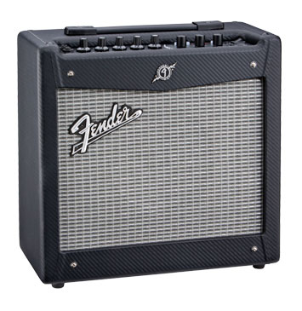
Why do ecosystem carbon cycle feedbacks matter for climate
Ankur R Desai
Ecometeorology Lab
CCR-SAGE Symposium
20 March 2012

Slide 2

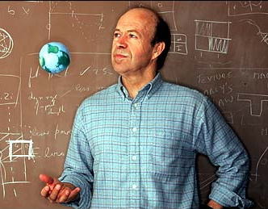

Or… Why Climate Scientists will never hug Ecologists again
Or why CCR and SAGE need each other more than ever…

Slide 3


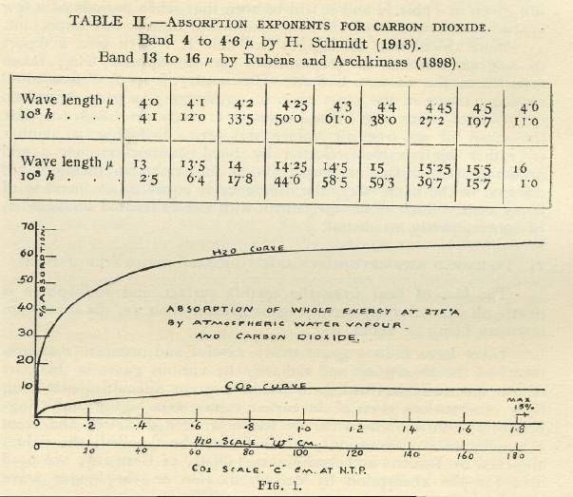
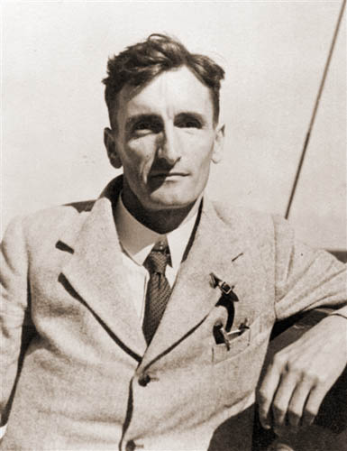
Arrhenius, S., 1896. On the influence of carbonic acid in the air upon the temperature of the ground.
if the quantity of carbonic acid increases in geometric progression, the augmentation of the temperature will increase nearly in arithmetic progression
Double CO2 ->
5-6 C increase
Callendar, G.S., 1938. The artificial production of carbon dioxide and its influence on climate. QJRMS, 64, 233-240.

Slide 4
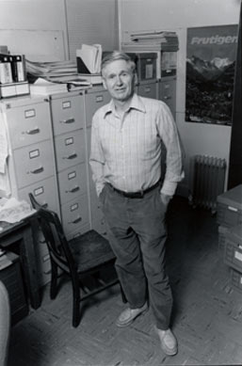
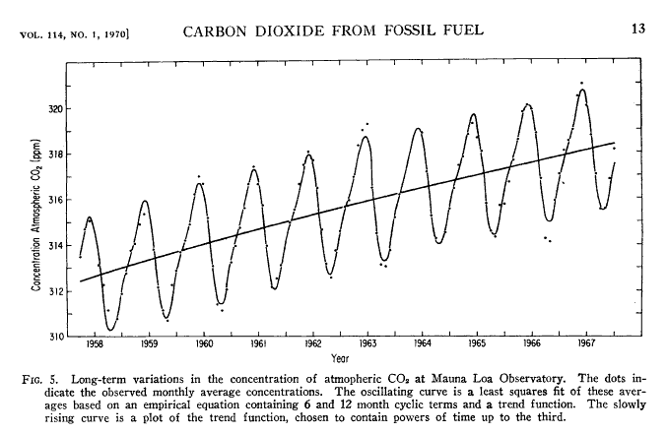
If only were it so simple…

Slide 5
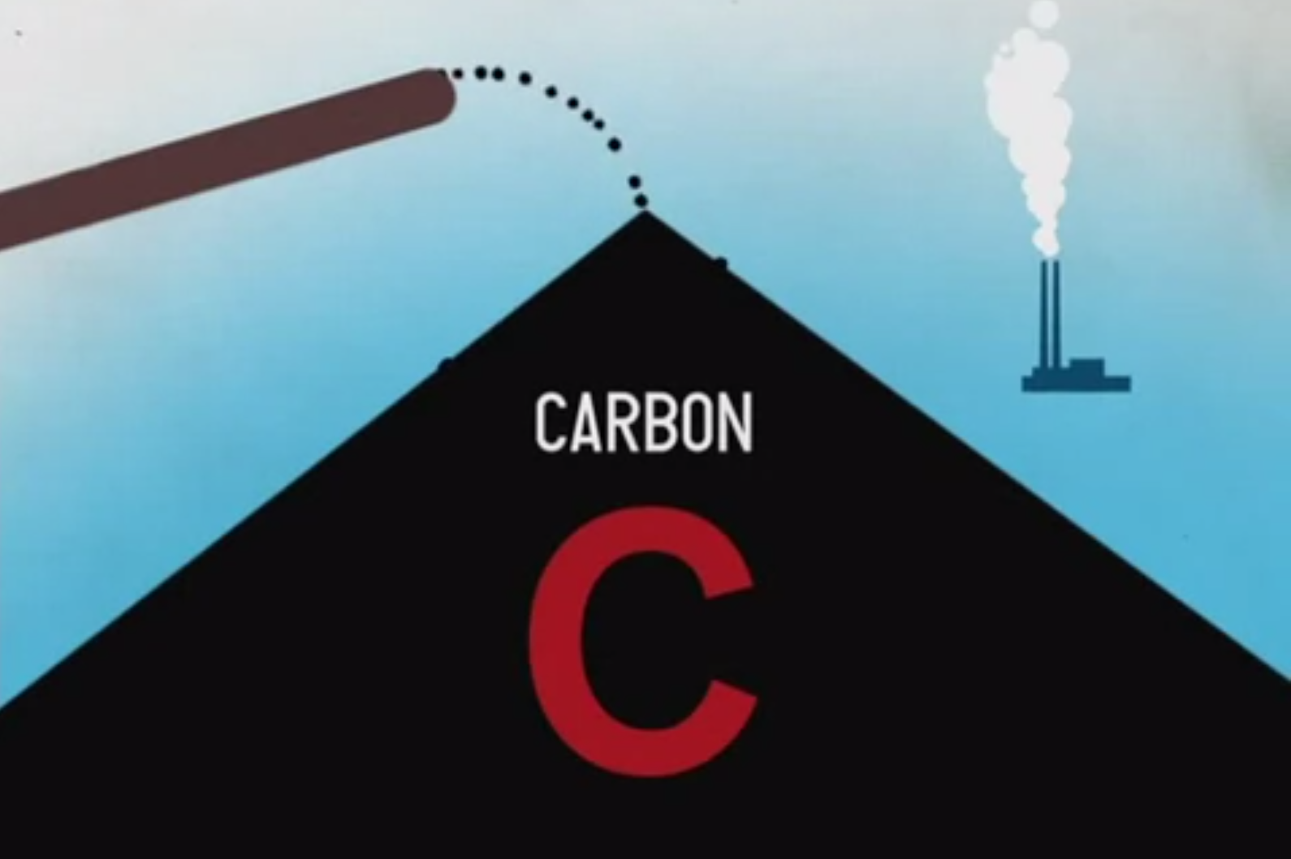
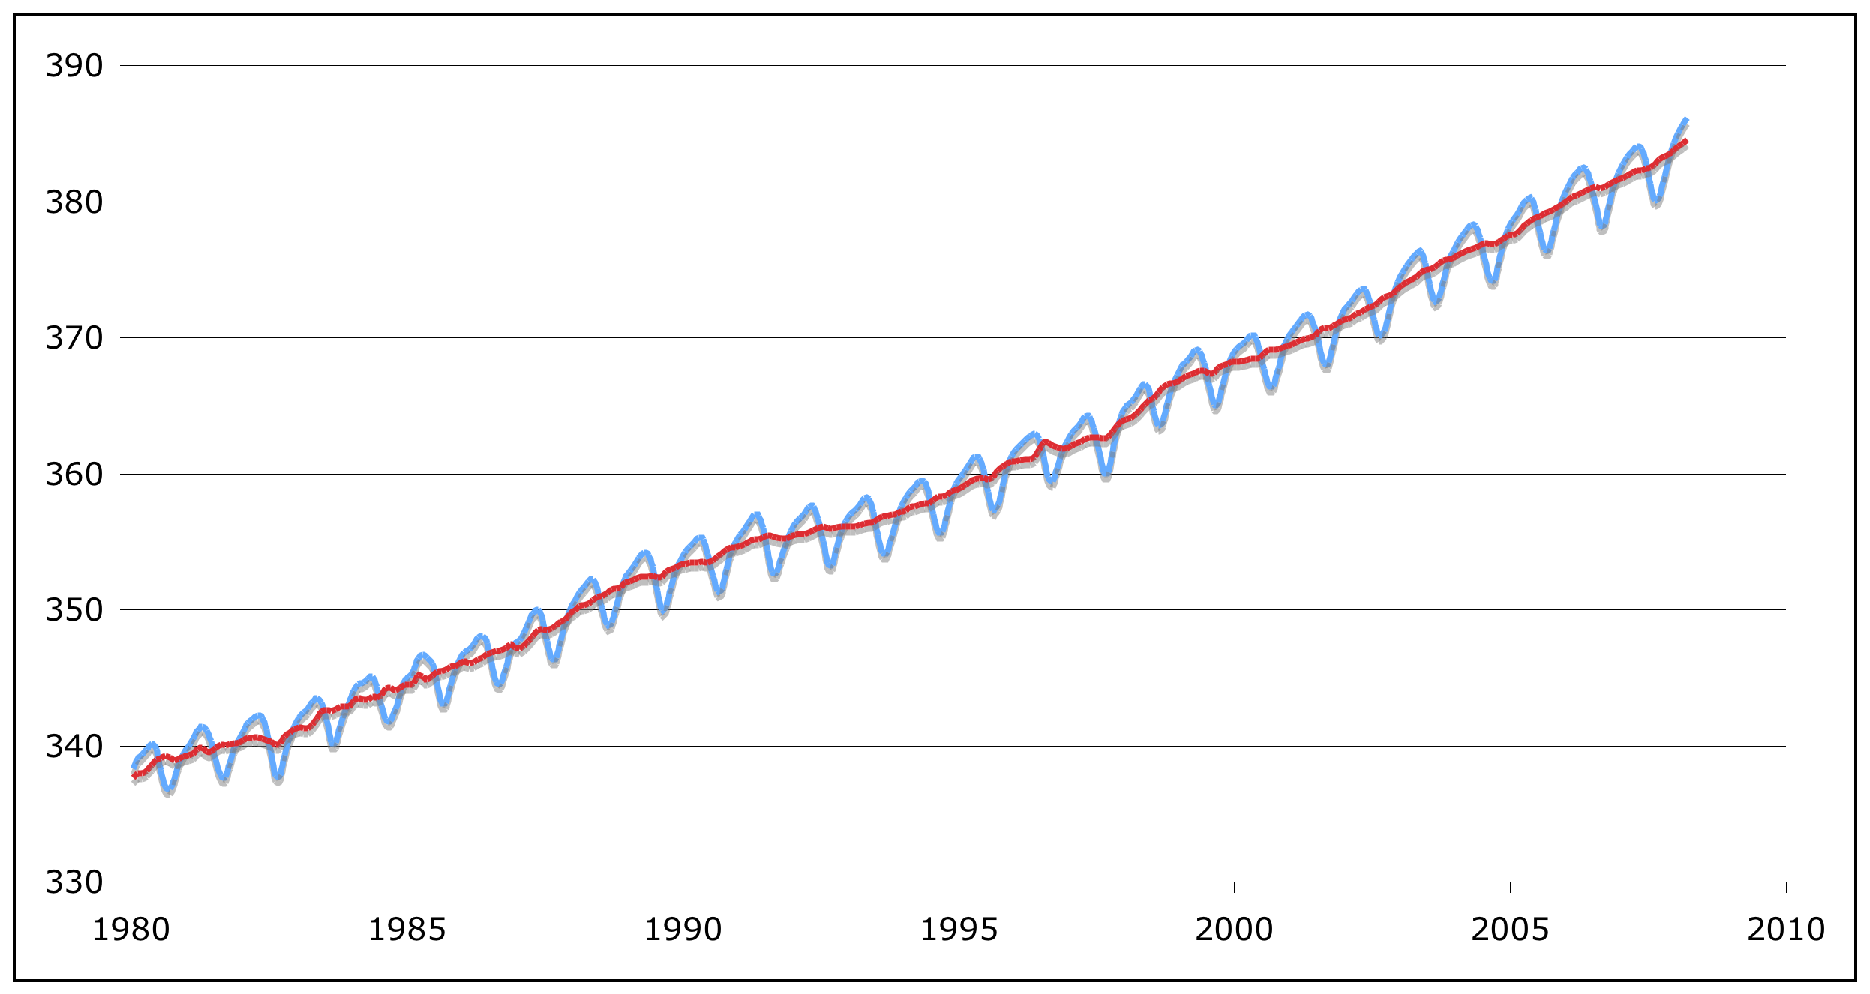
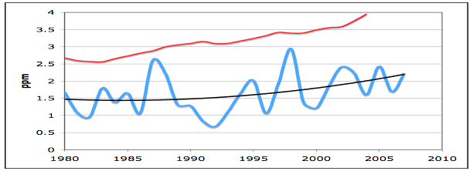
The Beat Goes On…
Data: NOAA/ESRL
Image: They Might Be Giants

Slide 6
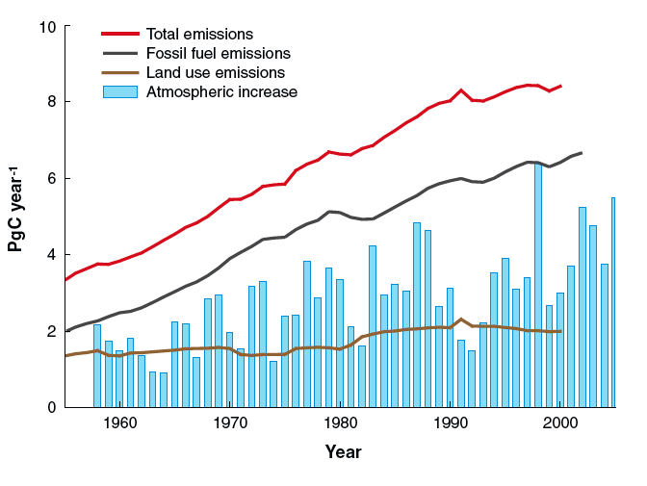
Biology drives Physics
Ecosystem Carbon Sink
Houghton et al. (2007)

Slide 7
And we fail at modeling it…
Feedbacks are ubiquitous and unconstrained
Friedlingstein et al., 2006

Slide 8

Why?
xkcd.com

Slide 9

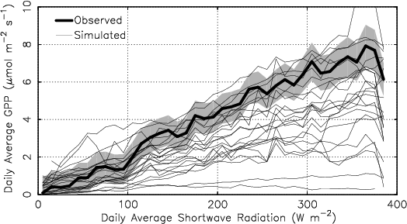
Light
Schaefer et al., submitted

Slide 10

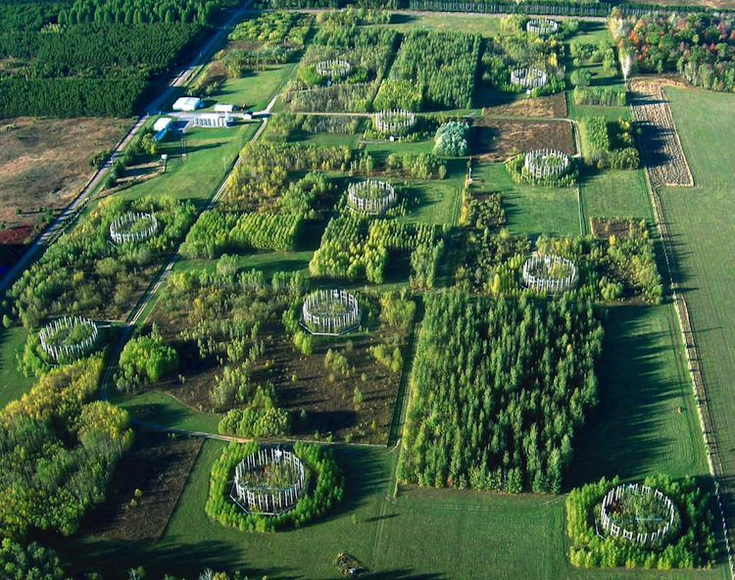
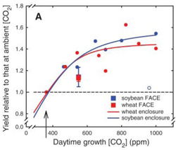
Farquhar vs LUE
Long et al., 2006
C3 vs C4

Slide 11
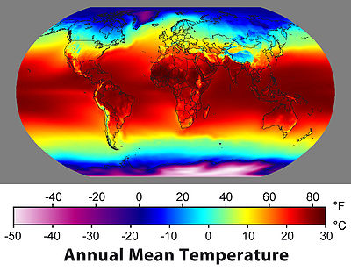
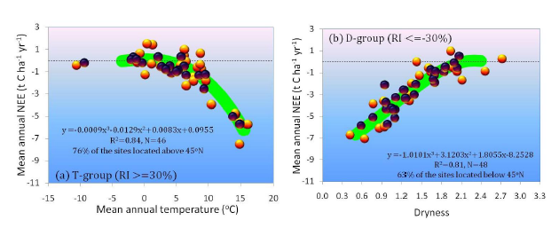
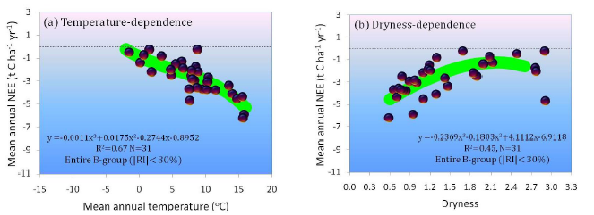
Temperature and Humidity
Yi et al., 2011

Slide 12
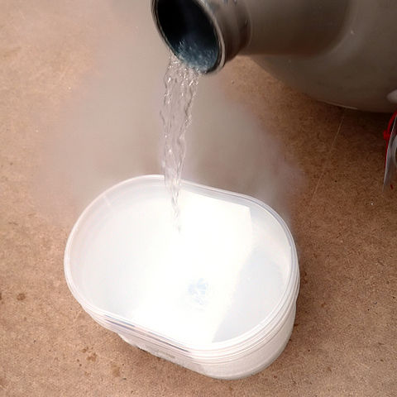
[N]
Janssens et al., 2010

Slide 13

Indirect Climate 1: Phenology
Richardson et al., 2012

Slide 14
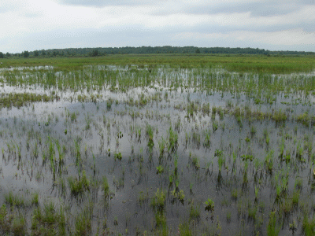
Indirect Climate 2: Water
Sulman et al., 2012

Slide 15
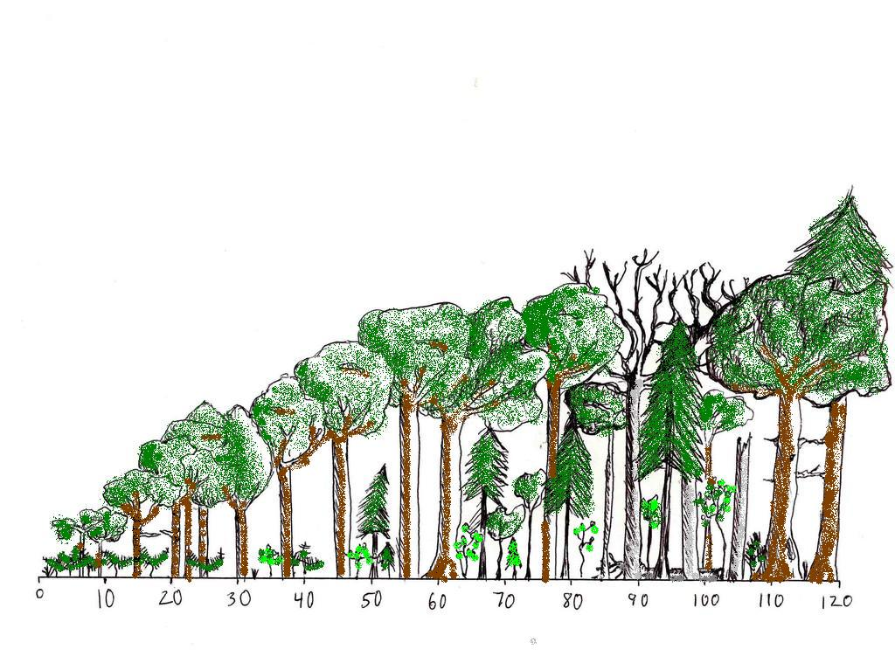
Forest Succession
Image: P. Curtis, Figure: Amiro et al., 2010

Slide 16
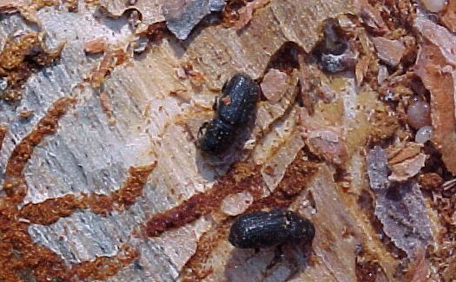
Pests
Amiro et al., 2010

Slide 17
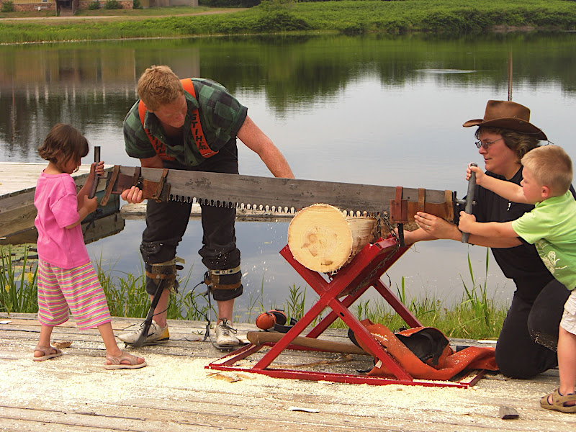
People!
Gower et al., submitted

Slide 18


What else?
Microbes, fungi, earthworms
Herbivores (deer)
Shading, resource competition
Genetic variation
Dispersal, recruitment, adaptation/evolution
Fire, extreme events, feedbacks
Acclimation
Riverine export
Ahhhh!

Slide 19

It Matters…
Friedlingstein et al., 2006

Slide 20
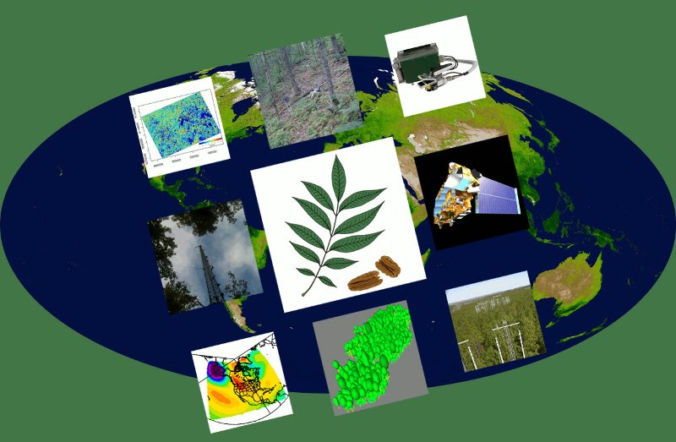

What to do?
4th Paradigm: Confronting science with intensive data
NSF Advances in Biological Informatics
M. Dietze, A. Desai, D. LeBauer, R. Kooper
www.pecanproject.org

