Slide 1
Carbon Cycling in a Warmer, Greener World
The Incredible Unpredictable Plant
Ankur R Desai
University of Wisconsin-Madison
CPEP Spring 2009

Slide 2
Acknowledgments
Brent Helliker, U. Pennsylvania
Joe Berry, Carnegie Institution for Science
Paul Moorcroft, Harvard U.
Arlyn Andrews, NOAA ESRL
Ben Sulman, AOS
ChEAS and Ameriflux investigators, technicians, students
U.S. Forest Service Northern Research Station, Rhinelander, WI
Funders: DOE NICCR, DOE TCP, NASA Carbon Cycle, USDA

Slide 3
Conclusions
Globally
Significant uncertainty in trajectory of future land carbon sink (source?)
Ecosystem models can’t capture observed interannual variability and disagree with inverse models
Regionally
Boreal forests show increased decomposition in response to autumn warming (Piao et al., 2008)
Temperate forests show increased uptake in response to spring warming (Richardson et al., submitted)
Boreal-temperate transition forests appear neutral WRT spring and show increased uptake in warmer autumns, but are also strongly sensitive to regional hydrology (Desai et al., in prep)

Slide 4
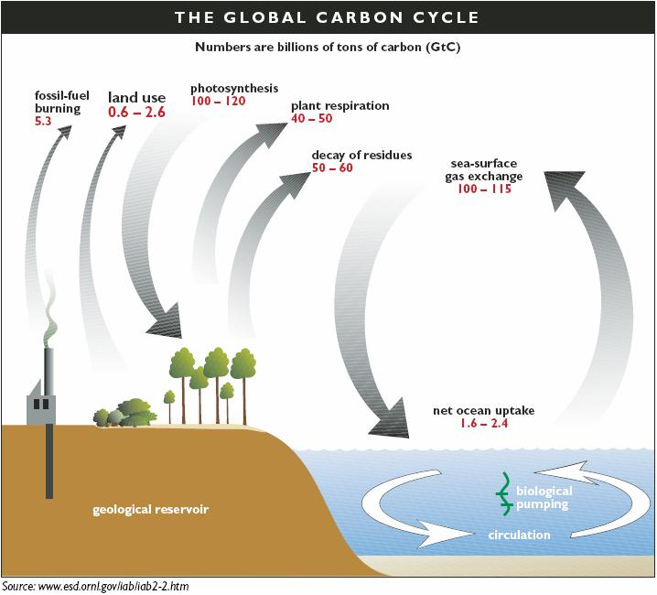
Let’s get on the same page

Slide 5
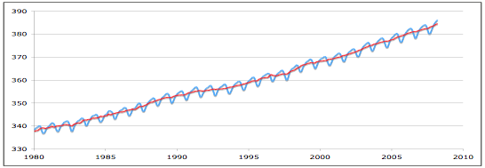
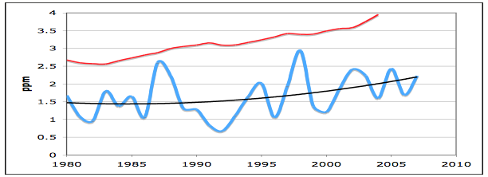
Let’s get on the same page

Slide 6
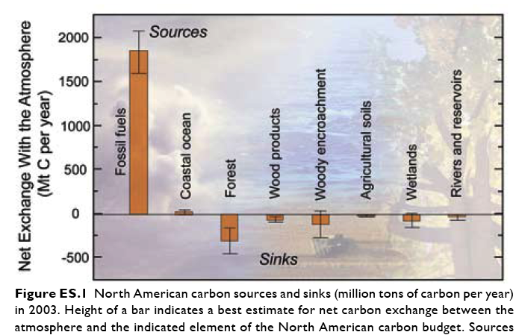
State of the Carbon Cycle
SoCCR report (CCSP SAP 2.2), 2007

Slide 7
Terms
NEE = Net Ecosystem Exchange of CO₂
Positive = source to atmosphere
GPP = Gross photosynthetic production
RE = Respiration of ecosystem
NEE = RE – GPP
IAV = Interannual variability of NEE

Slide 8
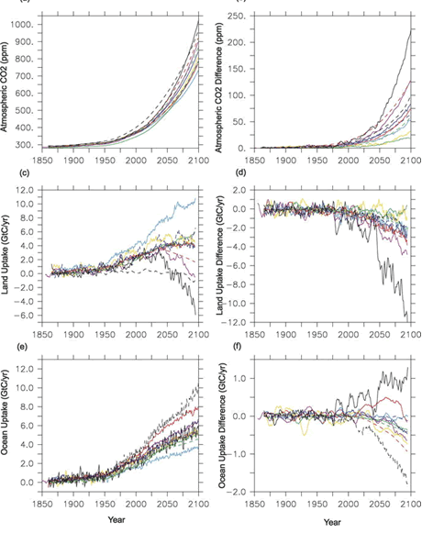
Friedlingstein et al., 2006

Slide 9
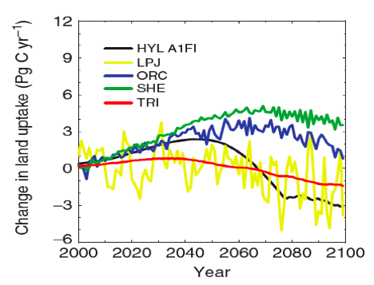
The future is hazy
Sitch et al., 2008

Slide 10
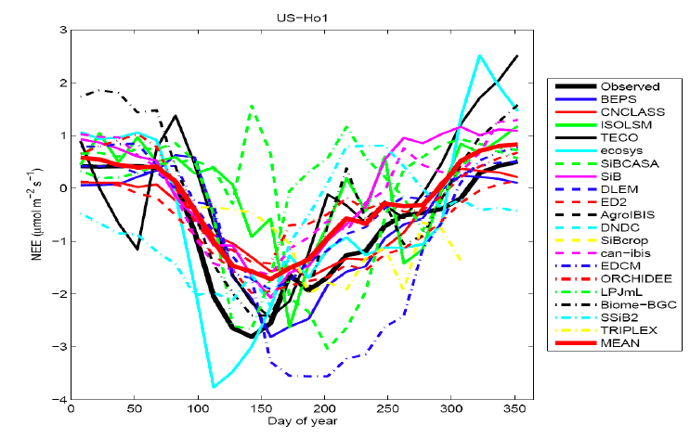
Pick a model, any model…
Thornton et al., in prep

Slide 11
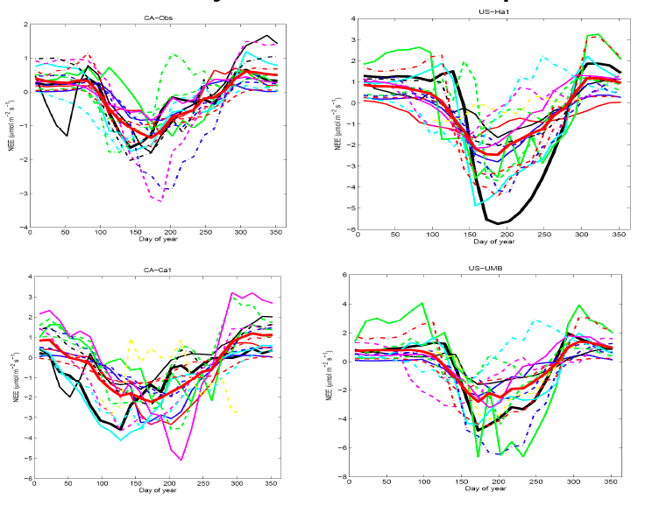
Kinda depressing?

Slide 12
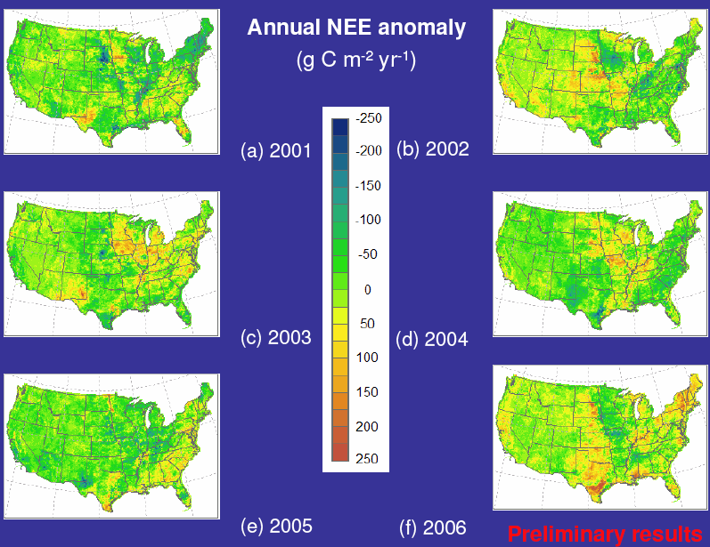
Xiao et al., in press

Slide 13
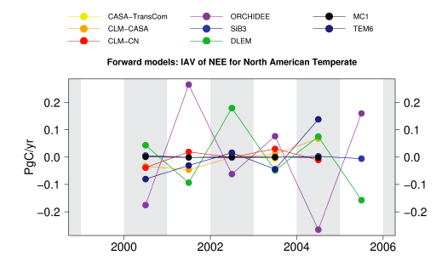
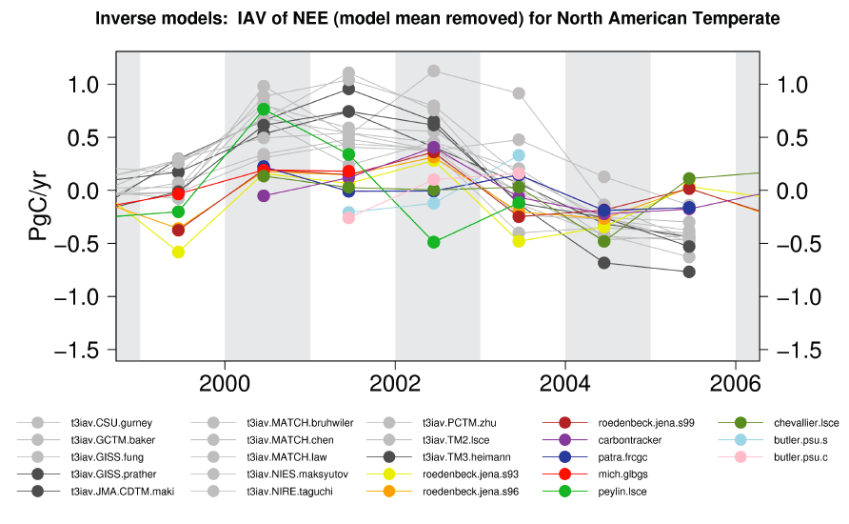
Jacobson et al., in prep

Slide 14
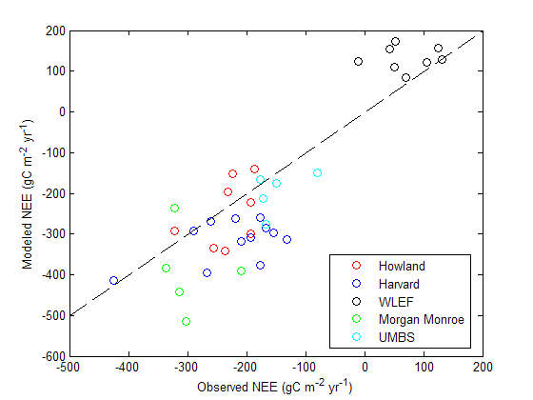
Modeling Interannual variability
Ricciuto et al. (submitted)

Slide 15
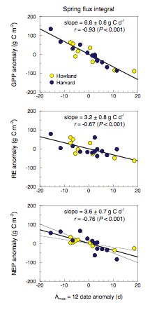
Richardson et al., submitted

Slide 16
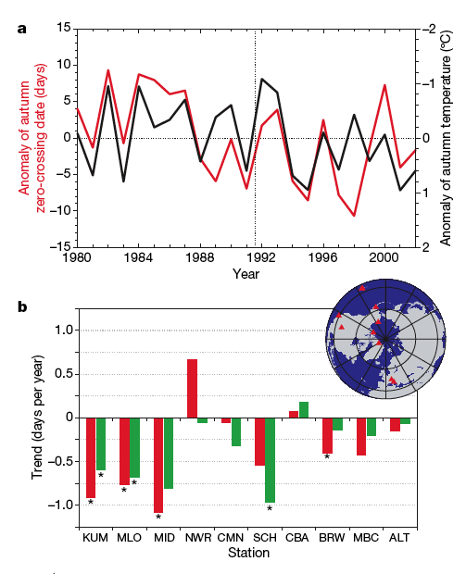
Piao et al., 2008

Slide 17
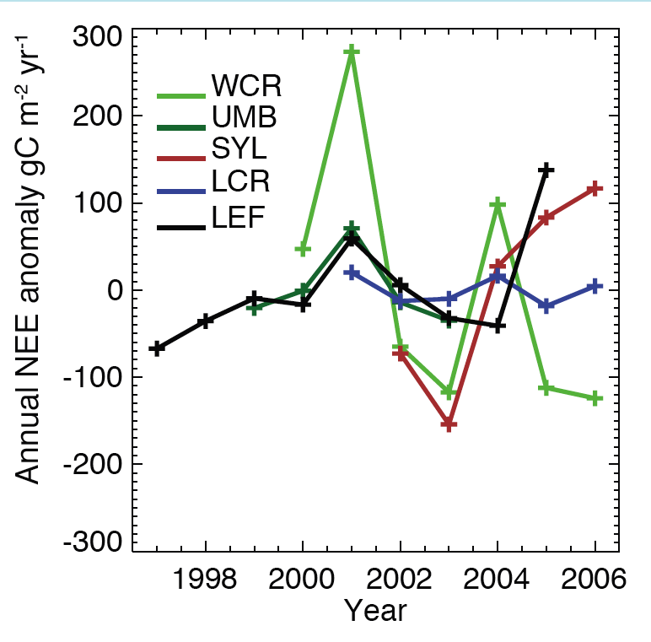
Subboreal IAV

Slide 18
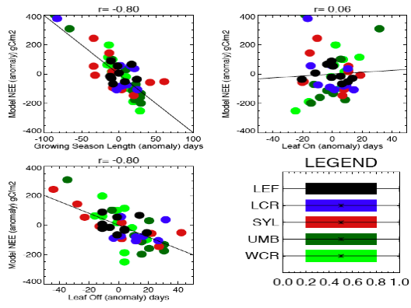
Desai et al., in prep

Slide 19
Motivation
Interannual variation (IAV) in carbon fluxes from land to atmosphere is significant at the ecosystem scale, but we know little as we scale to the region
Regional fluxes are hard to observe and model but we’ve made progress
Still: IAV (years-decade) is currently poorly observed and modeled, while hourly, seasonal, and even successional (century) are better
Key to understanding how climate change affects ecosystems and vice versa comes from succesfully modeling IAV
Subboreal regions likely to be strongly impacted by climate change

Slide 20
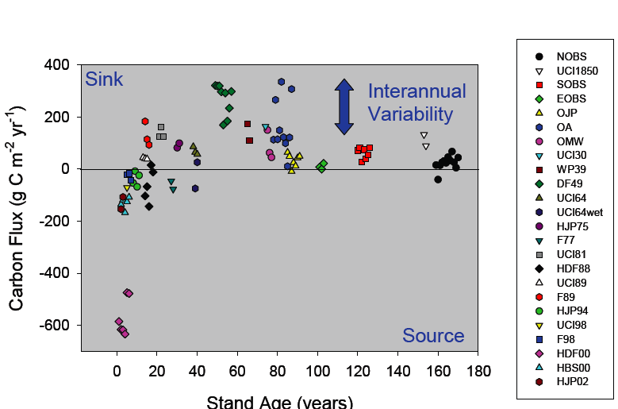
Succesional vs IAV
courtesy of H. Margolis (2009)

Slide 21
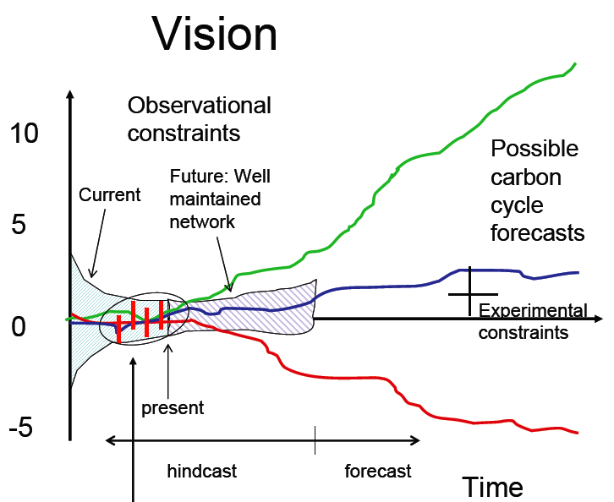
Role of Observations
courtesy of K.J. Davis (2009)

Slide 22
Climate Drivers of Carbon Flux
Temperature
Precipitation
Radiation
[CO₂]

Slide 23
Climate Drivers of IAV
Temperature -> Phenology
Precipitation -> Water table
Radiation -> Light quality
[CO₂] -> Acclimation

Slide 24
Questions
In temperate-boreal transition regions:
What is regional IAV of NEE?
What are the climatic controls on it?
How can these findings be used to improve carbon cycle and climate prediction?

Slide 25
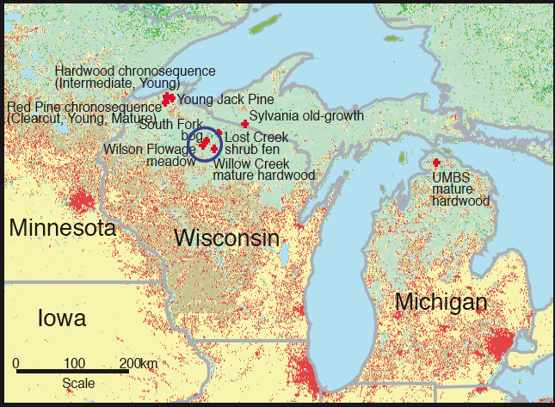
Region

Slide 26
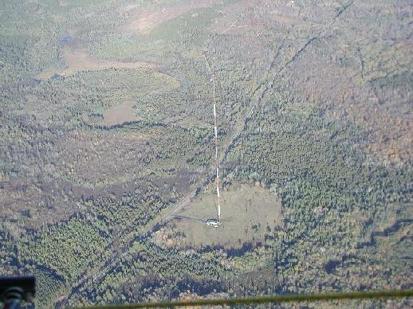
Region

Slide 27
Phenology and water table?
Kucharik and Serbin, in prep show:
Growing season length increasing by 1-4 weeks in past 50 years
Shoulder season warming > mid-summer warming, especially in minimum temperatures
Effect on spring growing degree days < autumn freeze date
Most of Wisconsin has gotten 10-15% more precipitation in past 50 years, except in N. Wisconsin, where summers are getting drier
This drying signal is seen in water table and lake level observations

Slide 28
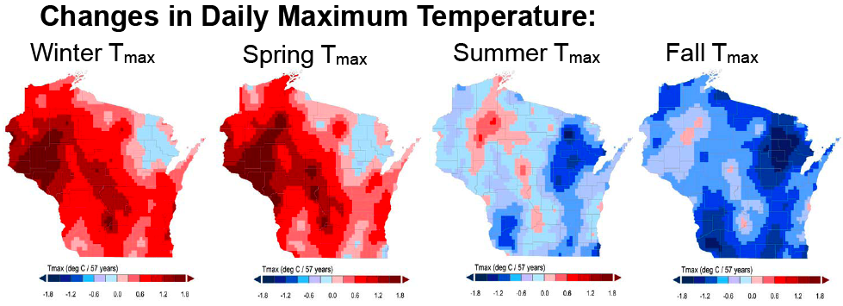
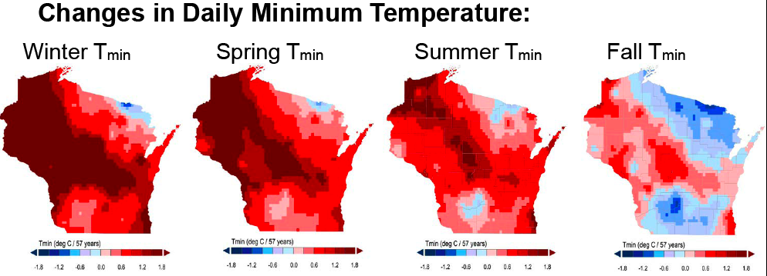
Kucharik and Serbin, in prep

Slide 29
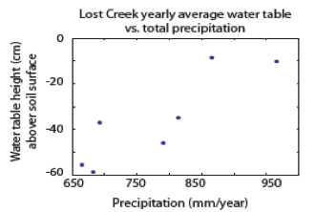
Water Table
Sulman et al. (2009)
Water table declines seen regionally and appear related to precipitation trends

Slide 30
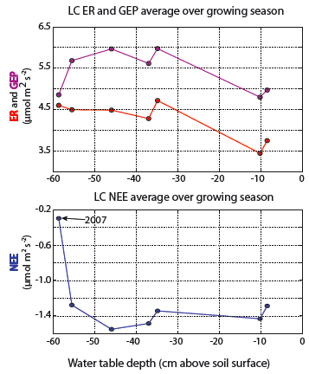
Shrub Wetland Flux Response
Sulman et al (2009)

Slide 31
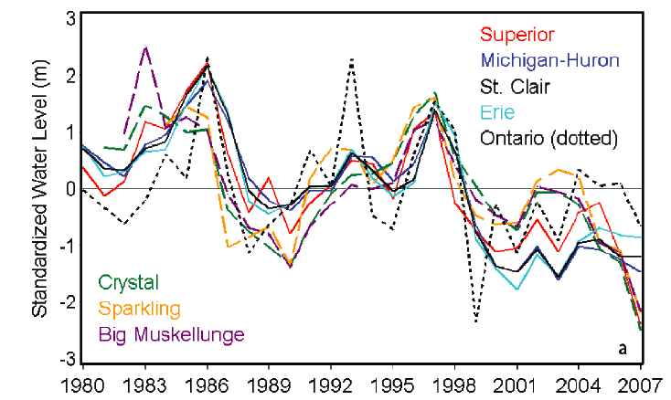
Lake Water Levels
Stow et al., 2008

Slide 32
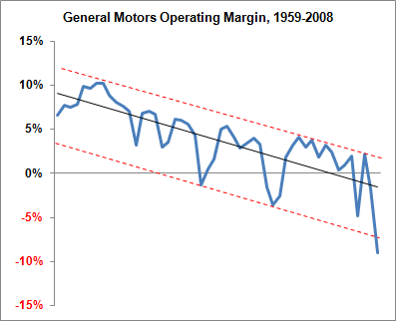
Correlation?

Slide 33
Regional Flux Tools
Forward
IFUSE – Interannual Flux-tower Upscaling Sensitivity Experiment
ED – Ecosystem Demography model
Inverse
EBL – Equilibrium Boundary Layer
CT - CarbonTracker

Slide 34
Forward: IFUSE
Use ~1-km fetch eddy covariance flux towers to sample regional flux
Estimate parameters for a simple ecosystem model that includes phenology
Markov Chain Monte Carlo
Half-daily flux observations
Scale model by land cover and age maps
Desai et al (2008, in prep), Buffam et al (in prep)

Slide 35
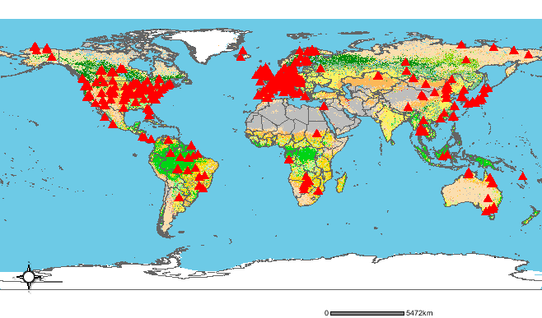
Fluxnet

Slide 36
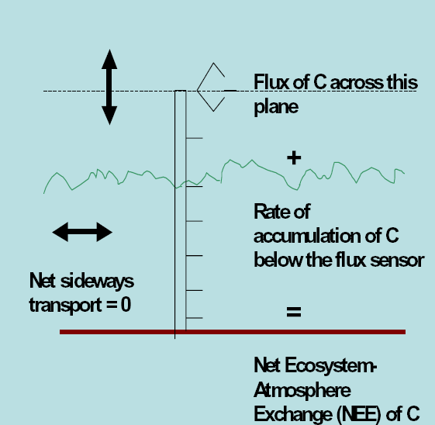
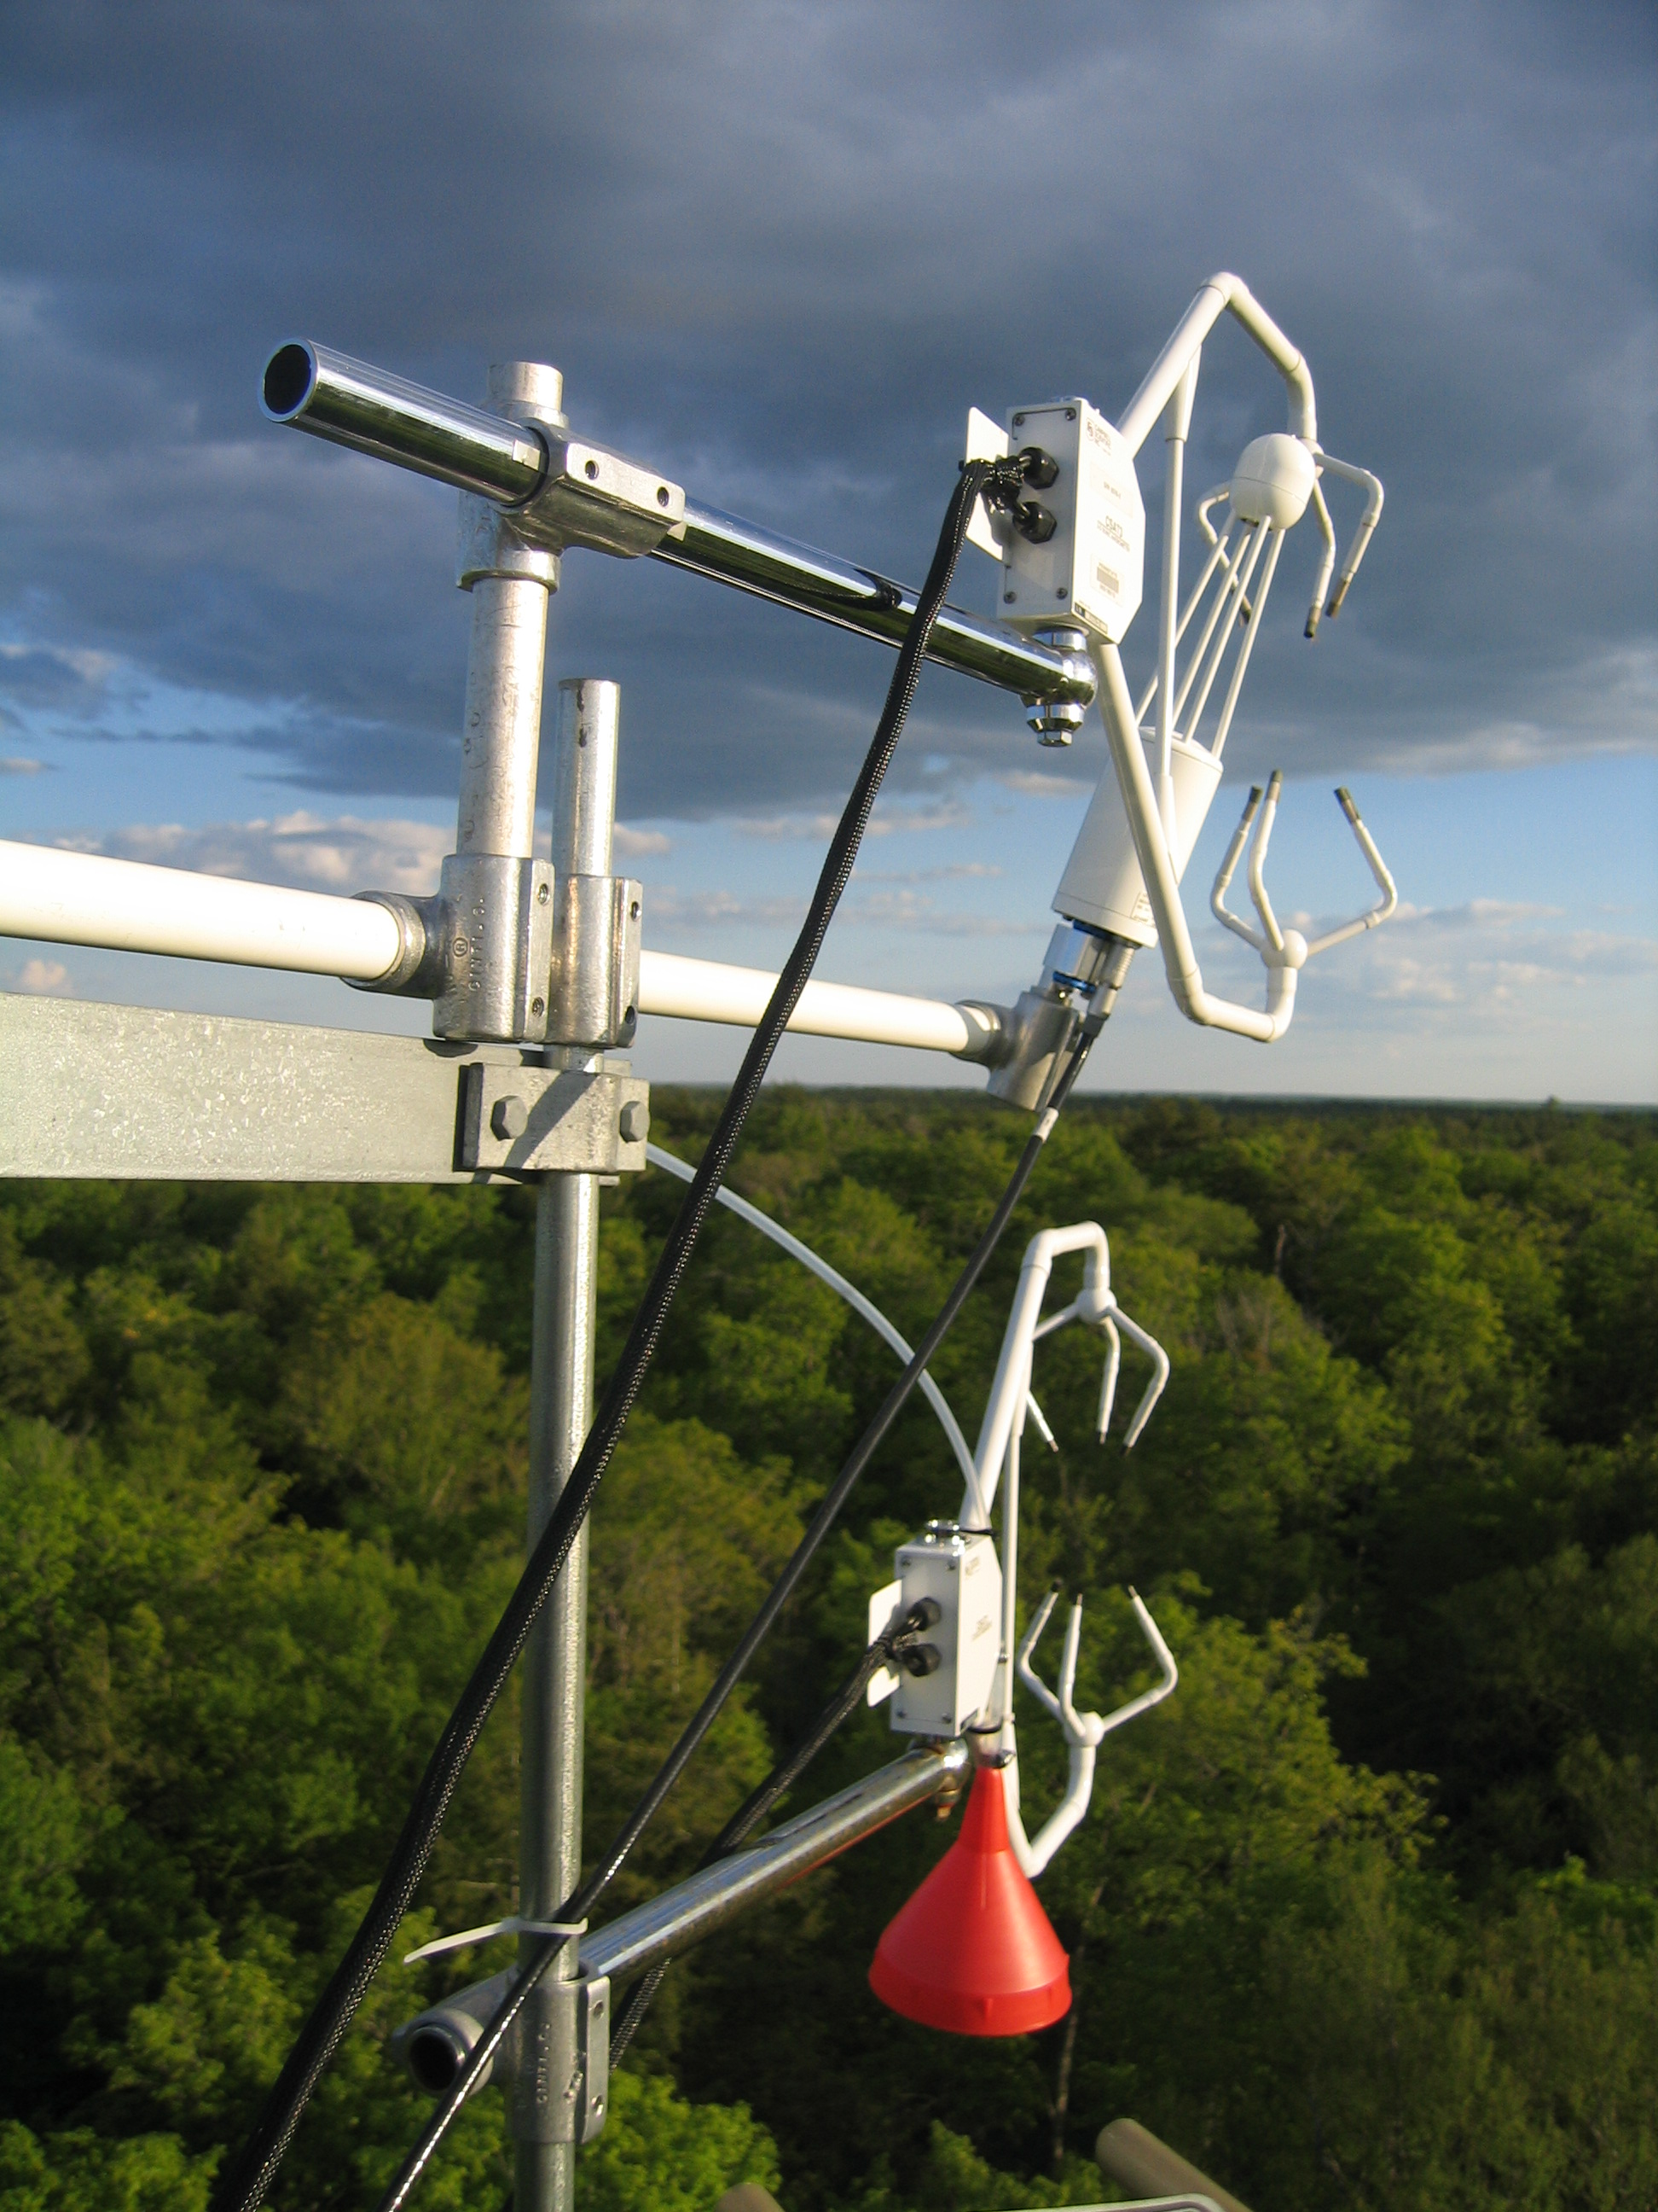
How eddy covariance works

Slide 37
Region

Slide 38
Typical data
Lost Creek shrub wetland, N. WI

Slide 39
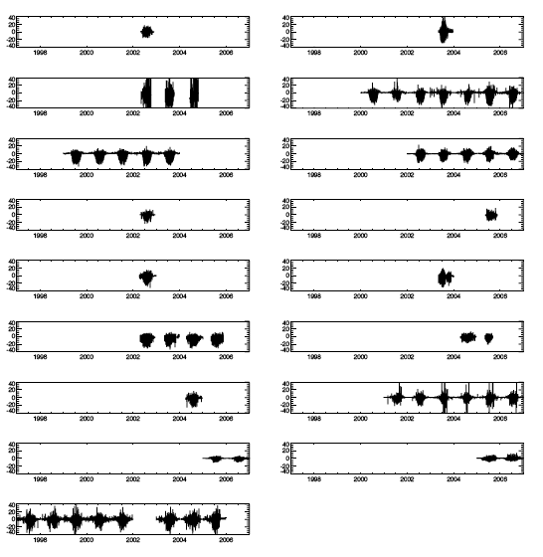
Bunches of data

Slide 40
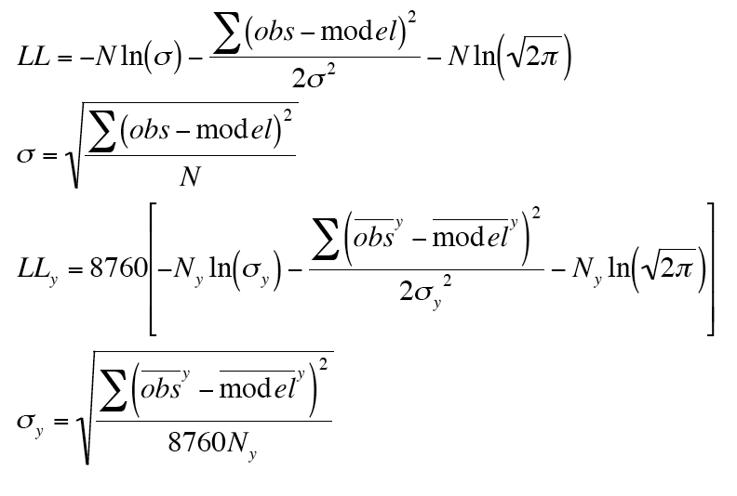
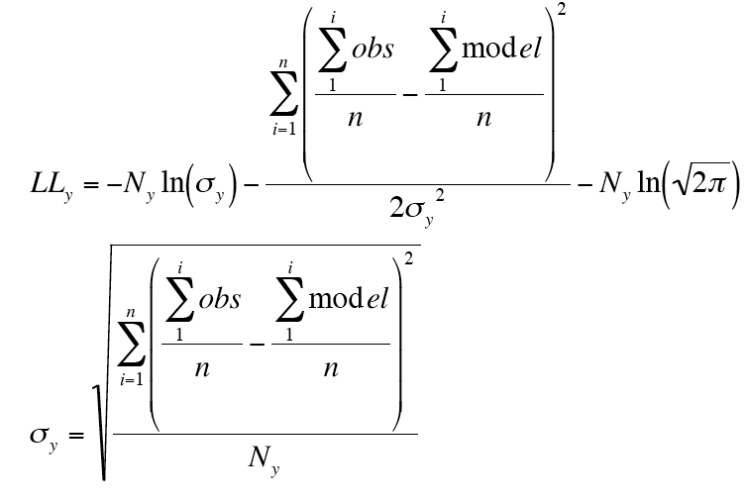
Optimization
HOURLY
IAV

Slide 41
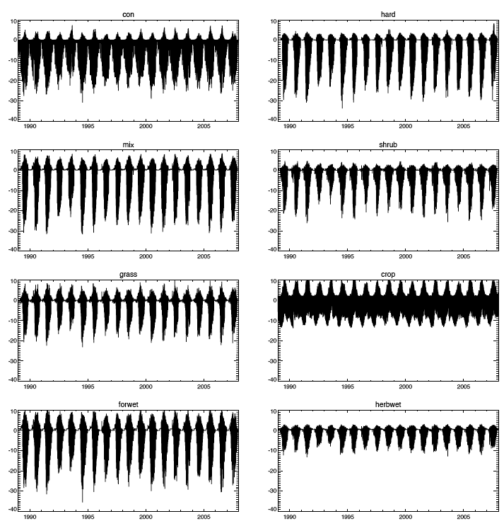
Magic

Slide 42
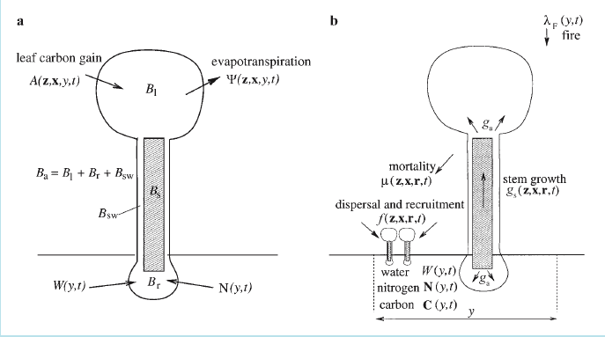
Forward: ED Model
Desai et al (2007), Moorcroft et al (2001), Albani et al (2006)

Slide 43
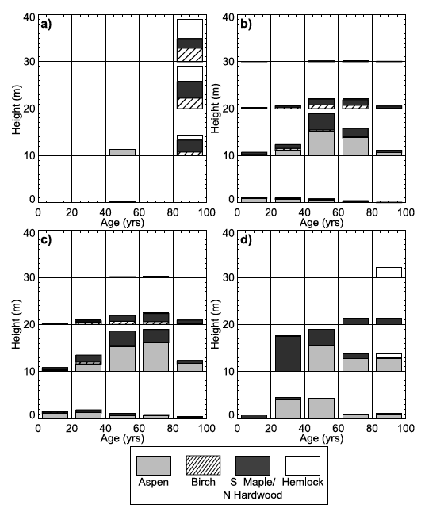
ED Model Parameterization
Parameterized by Forest Inventory Analysis

Slide 44
Inverse: EBL
Helliker et al (2004), Bakwin et al (2004)
Assume boundary layer ventilates with free troposphere on synoptic timescale (days-weeks)
Goal is to estimate ρW for multi-week averages

Slide 45
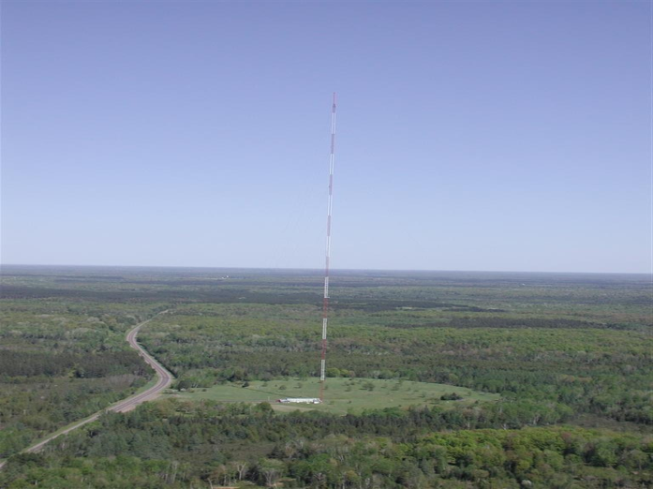
A tall tower

Slide 46
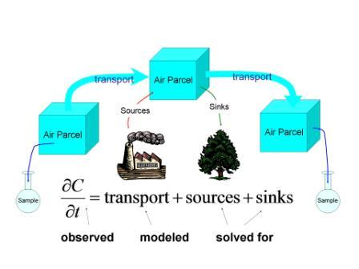
Inverse: CarbonTracker
Estimate fluxes from network of concentration

Slide 47
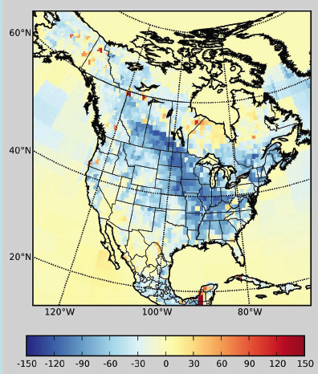
Inverse: CarbonTracker
Peters et al (2007) Nested grid Ensemble Kalman Filter

Slide 48
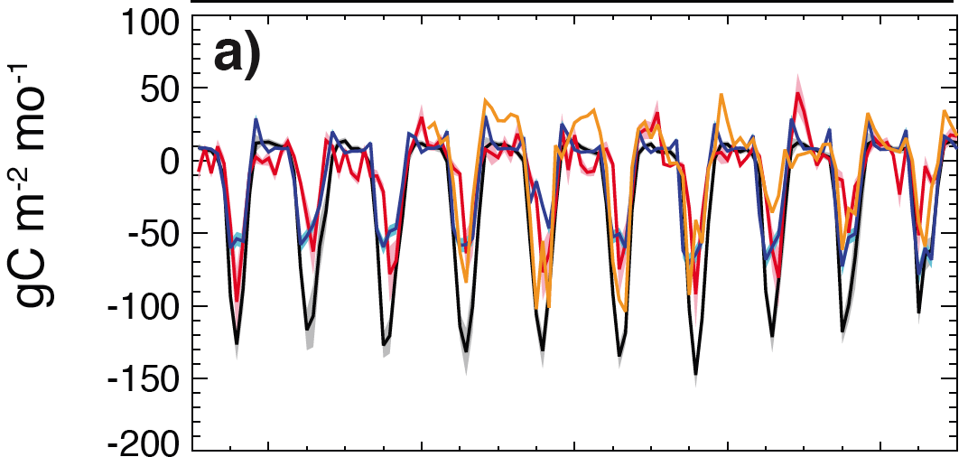
Results: Monthly

Slide 49
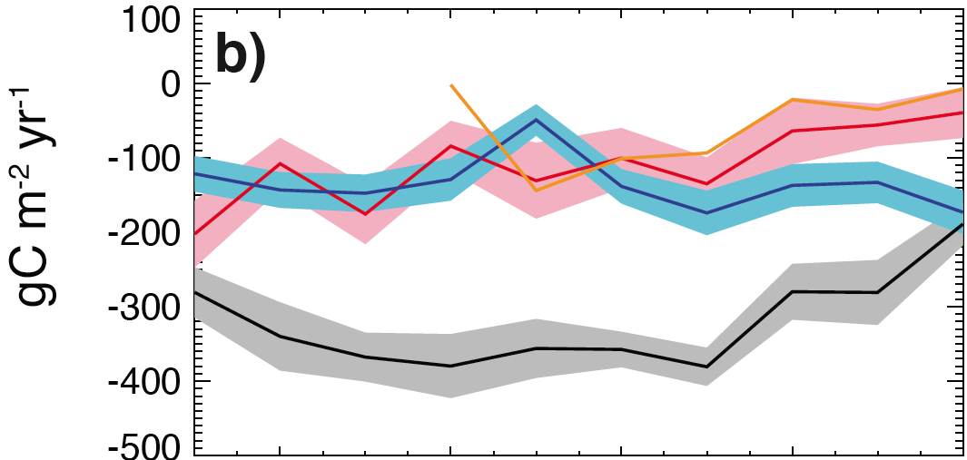
Results: Annual

Slide 50
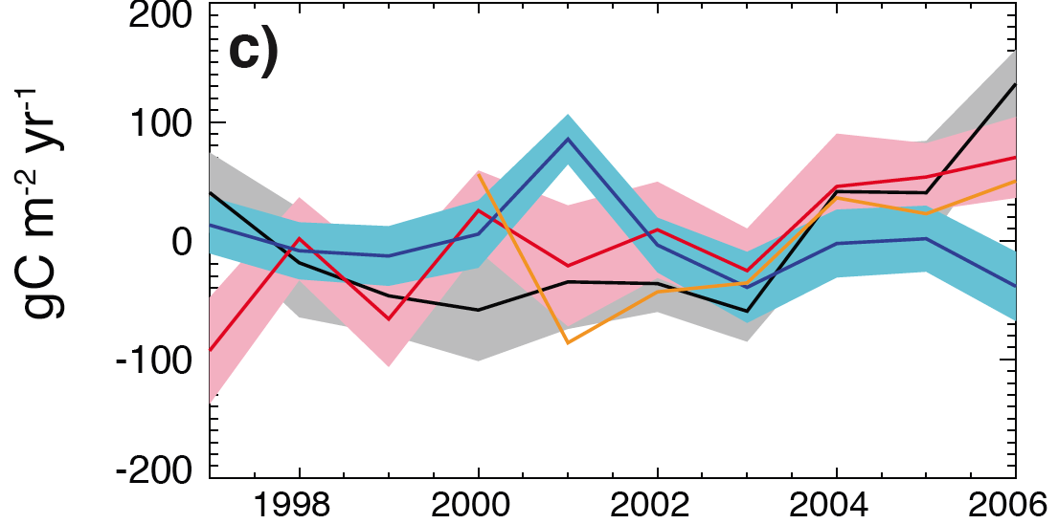
Results: IAV

Slide 51
Results: Controls
Annual | Winter | Spring | Summer | Fall
Leafon
Leafoff
GSL
AirT | AirT | AirT | AirT | AirT
SoilT | SoilT | SoilT | SoilT | SoilT
PAR | PAR | PAR | PAR | PAR
Precip | Precip | Precip | Precip | Precip
VPD | VPD | VPD | VPD | VPD
SoilM | SoilM | SoilM | SoilM | SoilM
WaterTable | WaterTable | WaterTable | WaterTable | WaterTable
CO2
NAO | NAO | NAO | NAO | NAO
NINO3.4 | NINO3.4 | NINO3.4 | NINO3.4 | NINO3.4
PDO | PDO | PDO | PDO | PDO
PNA | PNA | PNA | PNA | PNA
SOI | SOI | SOI | SOI | SOI

Slide 52
Results: 1-year Lag
Annual | Winter | Spring | Summer | Fall
Leafon
Leafoff
GSL
AirT | AirT | AirT | AirT | AirT
SoilT | SoilT | SoilT | SoilT | SoilT
PAR | PAR | PAR | PAR | PAR
Precip | Precip | Precip | Precip | Precip
VPD | VPD | VPD | VPD | VPD
SoilM | SoilM | SoilM | SoilM | SoilM
WaterTable | WaterTable | WaterTable | WaterTable | WaterTable
CO2
NAO | NAO | NAO | NAO | NAO
NINO3.4 | NINO3.4 | NINO3.4 | NINO3.4 | NINO3.4
PDO | PDO | PDO | PDO | PDO
PNA | PNA | PNA | PNA | PNA
SOI | SOI | SOI | SOI | SOI

Slide 53
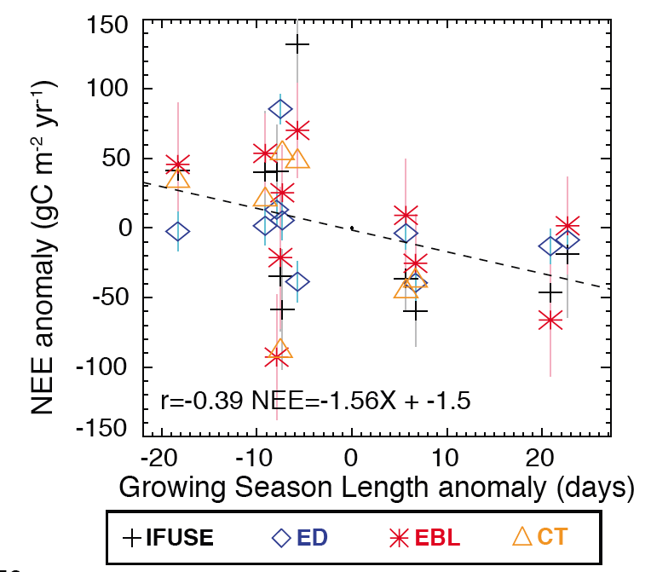
Controls: Phenology

Slide 54
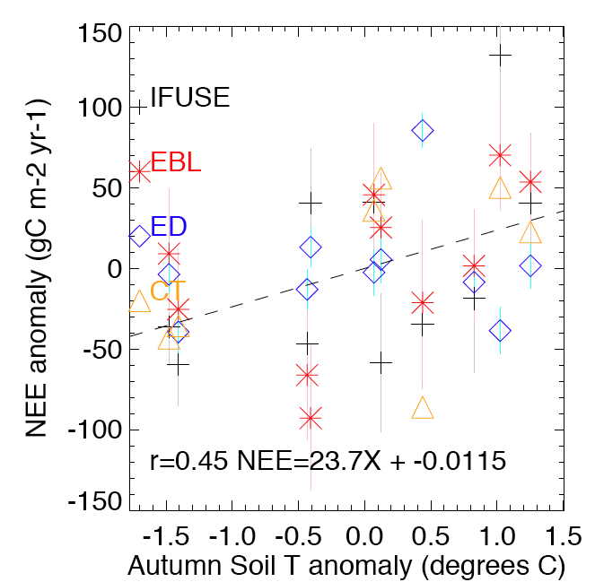
Controls: Phenology

Slide 55
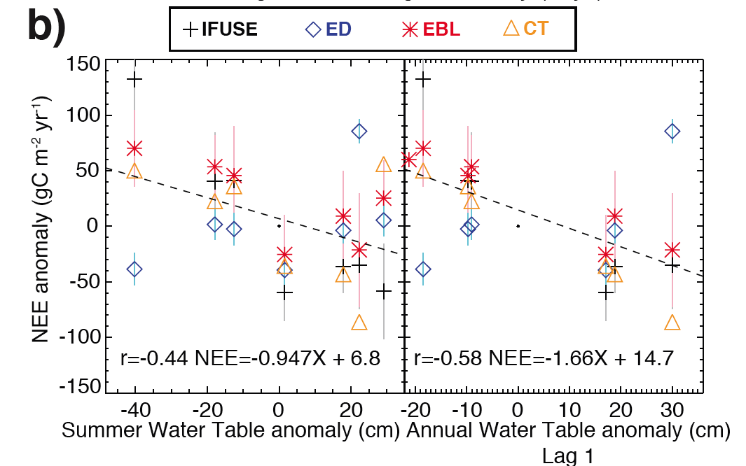
Controls: Hydrology

Slide 56
Answers?
In temperate-boreal transition regions:
What is regional IAV of NEE?
-160 gC m⁻² yr⁻¹ +/- 112 gC m⁻² yr⁻¹
Consistent trends across some years
What are the climatic controls on it?
Growing season (autumn), water table, some climatic teleconnections may exist
How can these findings be used to improve carbon cycle and climate prediction?
Land-atmosphere models should couple hydrology and investigate models of leaf phenology
Wetlands are poorly represented

Slide 57
Thanks
More green monsters…

