Slide 1
Quantification of Regional Carbon Fluxes and Boundary Layer Heights from the Airborne Carbon in the Mountains Experiment 2007
William Ahue
University of Wisconsin – Madison
Dept. of Atmospheric and Oceanic Sciences
Department Seminar
28 April 2010
Advisor: Prof. Ankur Desai

Slide 2
What to Expect
Motivation and Background
Why study carbon dioxide?
Why study boundary layers in mountainous terrain?
What is ACME?
Data and Methods
Boundary Layer Budget Method
Determination of Boundary Layer Heights
Profile Matching
Results
Summary and Future Work

Slide 3
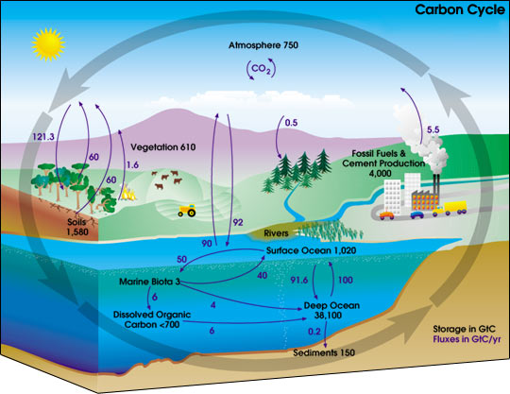
Why study carbon dioxide?
All life begins and ends with carbon
NASA/NASA Earth Science Enterprise

Slide 4
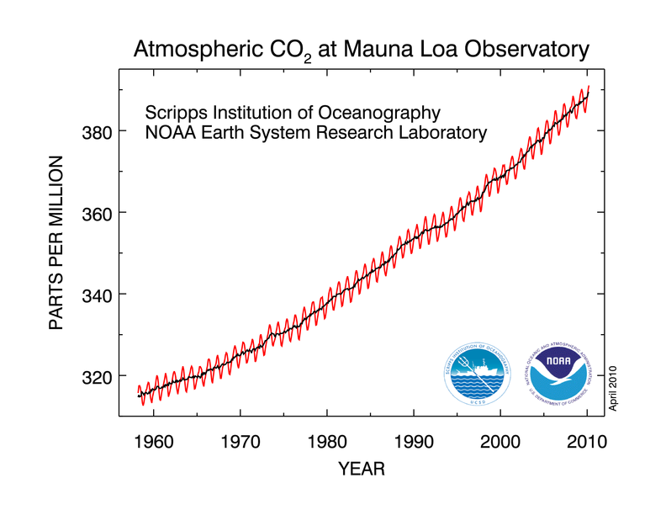
Why study carbon dioxide?
Biosphere
NOAA ESRL, 2010

Slide 5
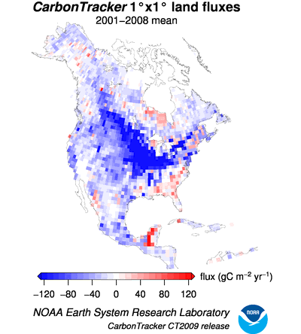
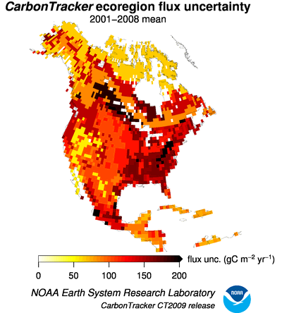
Why study carbon dioxide?

Slide 6
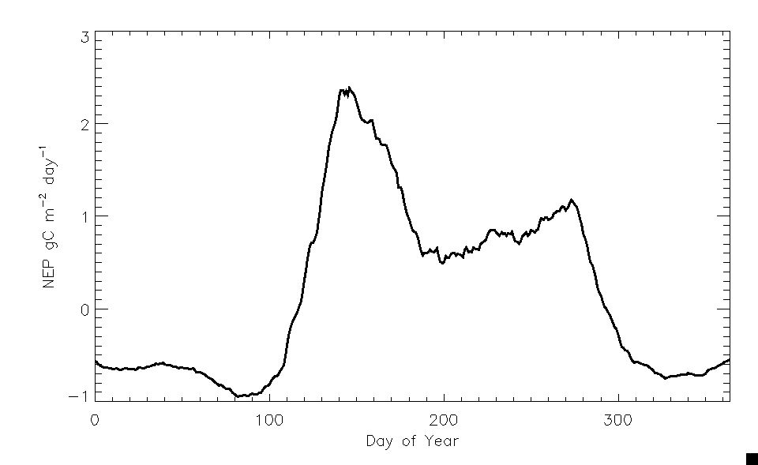
Why study carbon dioxide?
Summer Drought
Onset of Spring
Summer Monsoon
Courtesy of R. Monson, CU-Boulder

Slide 7
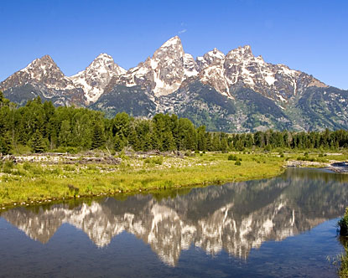
Why study carbon dioxide in the Rocky Mountains?
Forest ecosystem is an important carbon sink (Schmil et al., 2002)
Ongoing stresses add to the uncertainty about future carbon uptake (Raffa et al., 2008)
CO₂ land-atmosphere exchange is poorly constrained in global models (Schmil et al., 2002)
Data rich location
http://www.destination360.com

Slide 8
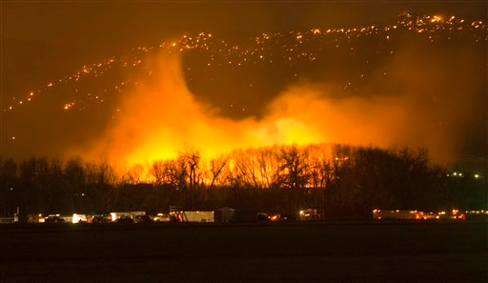
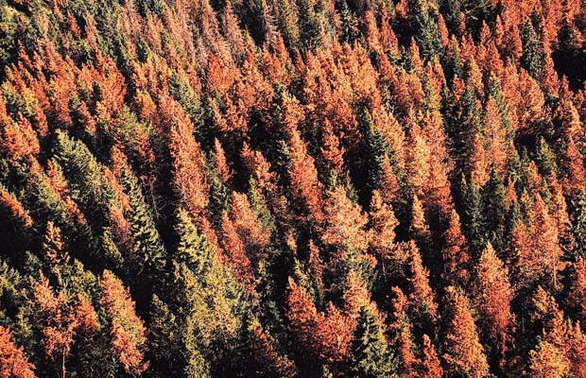
Stressors
AP Photo/Peter M. Fredin
Photo Credit: Shawn Martini

Slide 9
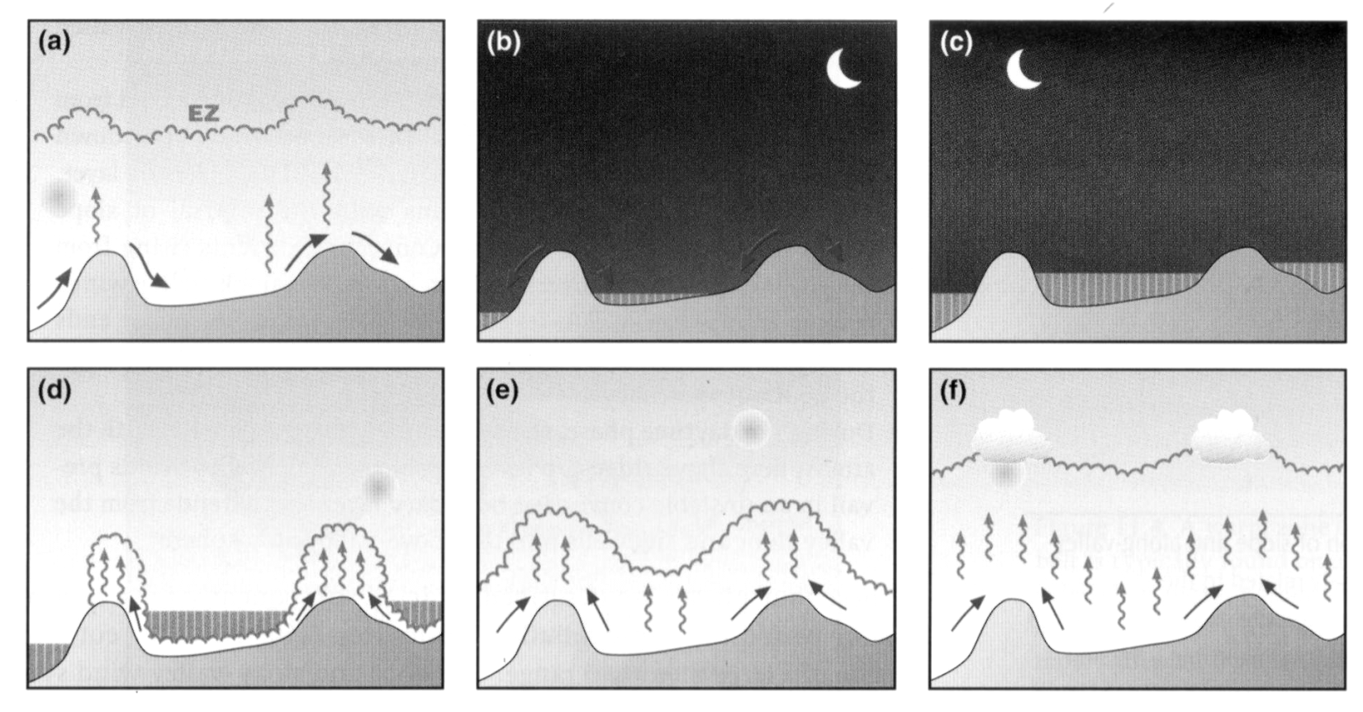
Why study boundary layer processes in Rocky Mountains?
Interactions between terrain and overlying atmosphere lead to complex flows
Determines how carbon dioxide is mixed vertically and its exchange with the free troposphere
Whiteman, 2000

Slide 10
What is ACME?
Field experiment that flew paired morning upwind and afternoon downwind profiles to measure carbon in the Central Rocky Mountains
Collected airborne measurements of CO, CO_{2,} O₂ and H₂O as well as other atmospheric variables
Over 60 hours of flight time from May to August
University of Wyoming’s King Air Aircraft
First conducted in 2004 (Sun et al., 2010)
Methods were improved for 2007

Slide 11
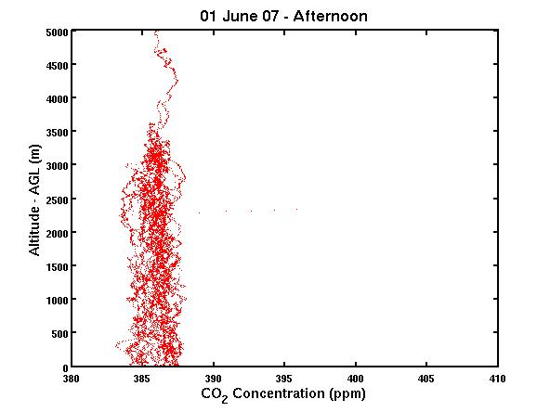
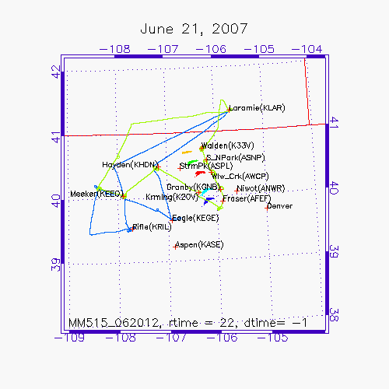
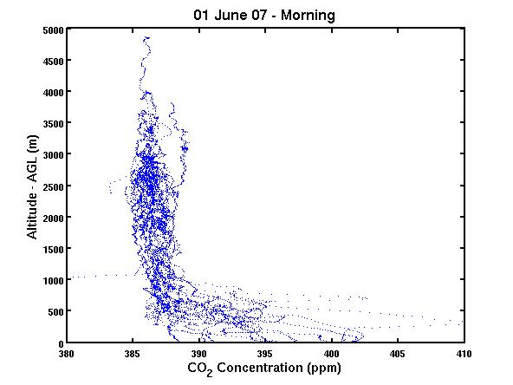
Measurement Approach
UPWIND
DOWNWIND

Slide 12
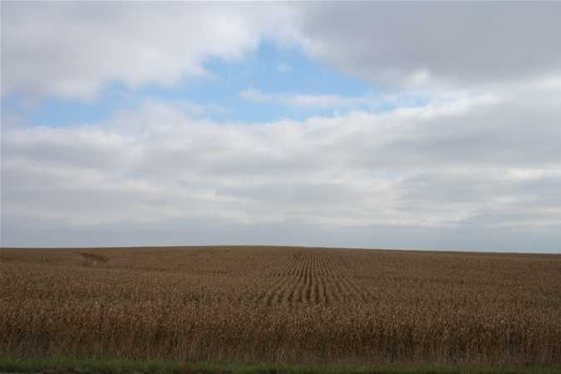
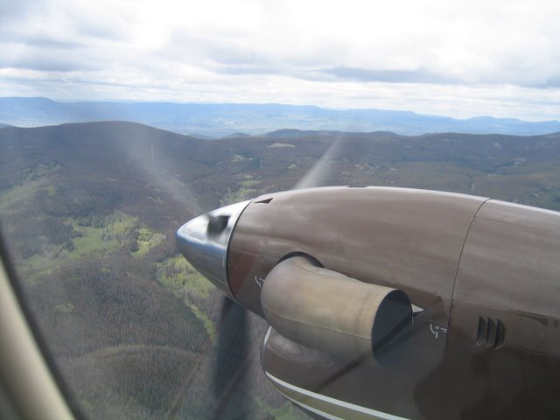
How is ACME Different?
Experiment was conducted in the Central Rocky Mountains
Complex terrain with various mesoscale flows
Used multiple parallel profiles
http://roadtripusa.net

Slide 13
Lessons learned from ACME 2004
Complex terrain imparted flux variations
Multiple parallel profile approach needed
Vertical shear was large
Valley cold pools vented later than expected
Shifted times of flights

Slide 14
Research Questions
What is the magnitude of carbon uptake in the Central Rocky Mountains?
How do flux estimates from the boundary layer budget (BLB) method compare with CarbonTracker and Niwot Ridge?
What is the uncertainty of boundary layer heights in the region?

Slide 15
What to Expect
Motivation and Background
Why study carbon dioxide?
Why study boundary layers in mountainous terrain?
What is ACME?
Data and Methods
Boundary Layer Budget Method
Determination of Boundary Layer Heights
Profile Matching
Results
Summary and Future Work

Slide 16
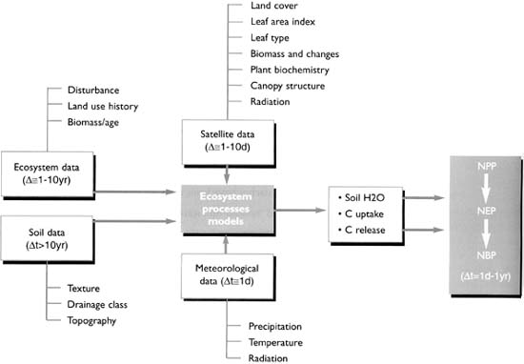
Strategies to study the carbon cycle
Top-Down
Based on inversions of atmospheric concentrations
Particle transport models, running in the back trajectory mode, are used to obtain influence functions
Bottom- up
Local processes are scaled up in time and space from the site level
Limited by the accuracy and spatial footprint of the measurements
UN FAO, 2010
UN FAO, 2010

Slide 17
Issues with Inverse Modeling
Why not use an inverse model??
It is HARD!!!
Global inverse models provide too coarse a resolution
Regional inverse models require good inflow fluxes and accurate assimilation methods
Also have to account for spatial heterogeneity and local processes

Slide 18
Boundary Layer Budget Method (Raupach et al., 1992)
Column averaged variations are not affected by variations in boundary layer height
Issues with Method
Ability to track air masses from one region to another
Requires accurate estimates of boundary layer height

Slide 19
Why use PBL_{max}?
The convective boundary layer is a vertically confined column of air (Stull, 1988; Garrat, 1990)
It incorporates overlaying air into it as it grows
Resolves issues with vertical entrainment
Bulk properties of the column are independent of small scale heterogeneities (Stull, 1988; Garrat, 1990)
Natural integrator of surface fluxes over complex terrain
Simulations with idealized initial conditions using RAMS show PBL_{max} to be a good proxy when compared with observations (DeWekker, in prep)

Slide 20
Determination of Boundary Layer Heights
Three different estimates of boundary layer heights were obtained
North American Regional Reanalysis Model (NARR)
TKE based method
Parcel Method
Visual inspections of vertical profiles of Virtual Potential Temperature and Water Vapor Mixing Ratio
Bulk Richardson Number
Ri_{c} = 0.25 (Pleim and Xiu, 1995)

Slide 21
Profile Matching
Particle dispersion results from 5 receptors and various forecast models were used to determine likely source locations
Using an least squares estimate, distance from the centroid of the released particles to the flight path were determined
This distance was used to determine which receptor the air sampled in the morning belonged to (Source)

Slide 22
Profile Matching
Afternoon flight flew diving spirals around each receptor location (Sink)
Air sampled from the flight profile for each receptor source and sink were used to determine the receptor’s flux

Slide 23
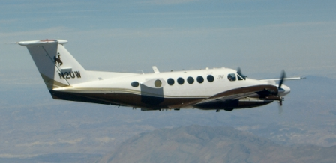
Data
NEE from Niwot Ridge AmeriFlux Tower
NEE from 2008 release of CarbonTracker (NOAA ESRL)
Airborne Observations from seven flight days
NARR Boundary Layer Heights (NOAA NCEP)
Photo Credit: Vanda Grubisic, DRI

Slide 24
Other Data
Regional Atmospheric Modeling System (RAMS) Version 6.0
06 UTC 21 June 07 to 00 UTC 22 June 07
Domain centered at 40N, 106.5W
1.5 km Resolution
Hybrid Particle and Concentration Transport Model (HYPACT)
Lagrangian Particle Dispersion Model
5 source locations from the morning flight profile from 21 June 07
1000 particles were released at 15 UTC 21 June 07
Source located 100 m AGL

Slide 25
What to Expect
Motivation and Background
Why study carbon dioxide?
Why study boundary layers in mountainous terrain?
What is ACME?
Data and Methods
Boundary Layer Budget Method
Determination of Boundary Layer Heights
Profile Matching
Results
Summary and Future Work

Slide 26
Results
Evaluation of RAMS and HYPACT
Does the Experimental Design Work?
Initial Boundary Layer Budget Fluxes using NARR PBL
Estimation and Comparison of Boundary Layer Heights
Boundary Layer Budget Fluxes Revisited
Receptor and Receptor Averaged Fluxes

Slide 27
Observation from NWR and SPL compared to RAMS
Niwot Ridge
Storm Peak Lab
Observations
Model

Slide 28
HYPACT Results – Does Flight Approach Work?

Slide 29
Results
Evaluation of RAMS and HYPACT
Does the Experimental Design Work?
Initial Boundary Layer Budget Fluxes using NARR PBL
Estimation and Comparison of Boundary Layer Heights
Boundary Layer Budget Fluxes Revisited
Receptor and Receptor Averaged Fluxes

Slide 30
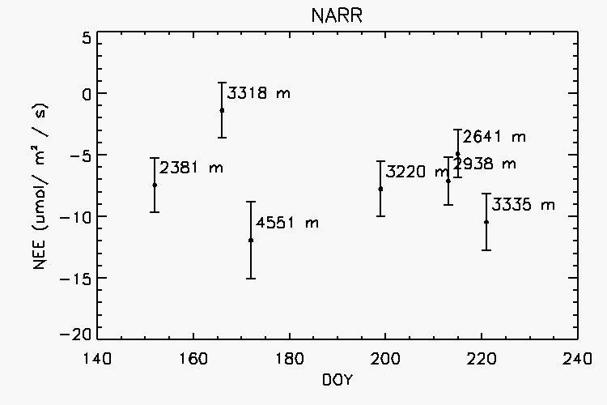
NEE using NARR PBL

Slide 31
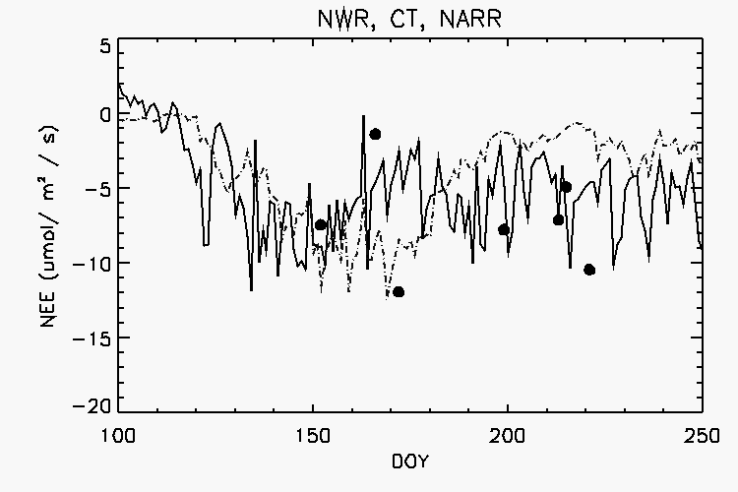
Niwot Ridge vs. CarbonTracker with BLB Flux from NARR PBL
Niwot Ridge
CarbonTracker
BLB

Slide 32
Results
Evaluation of RAMS and HYPACT
Does the Experimental Design Work?
Initial Boundary Layer Budget Fluxes using NARR PBL
Estimation and Comparison of Boundary Layer Heights
Boundary Layer Budget Fluxes Revisited
Receptor and Receptor Averaged Fluxes

Slide 33
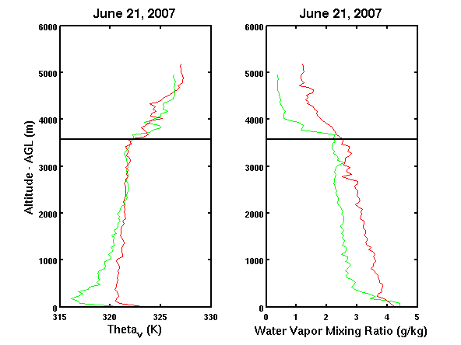
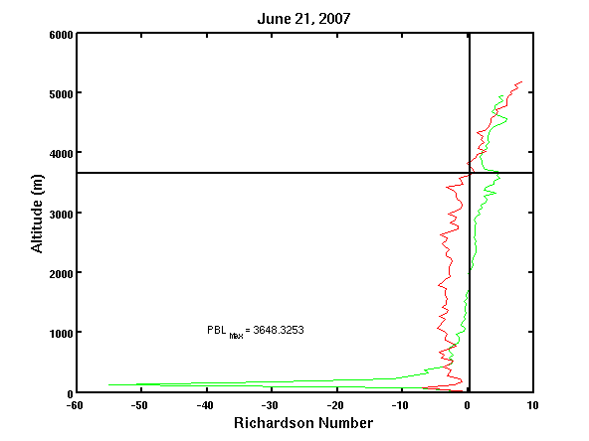
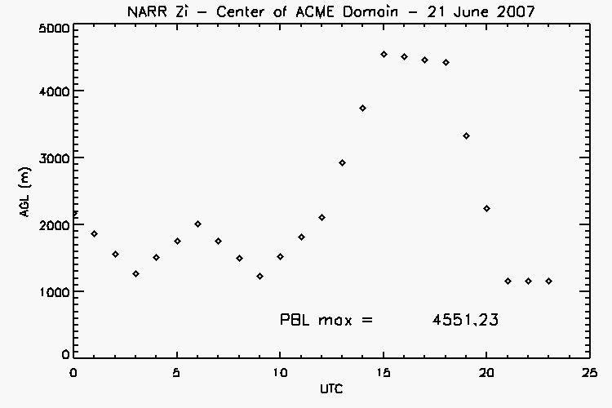
Boundary Layer Height Estimates
Morning
Afternoon
PBL_{Max} = 3648

Slide 34
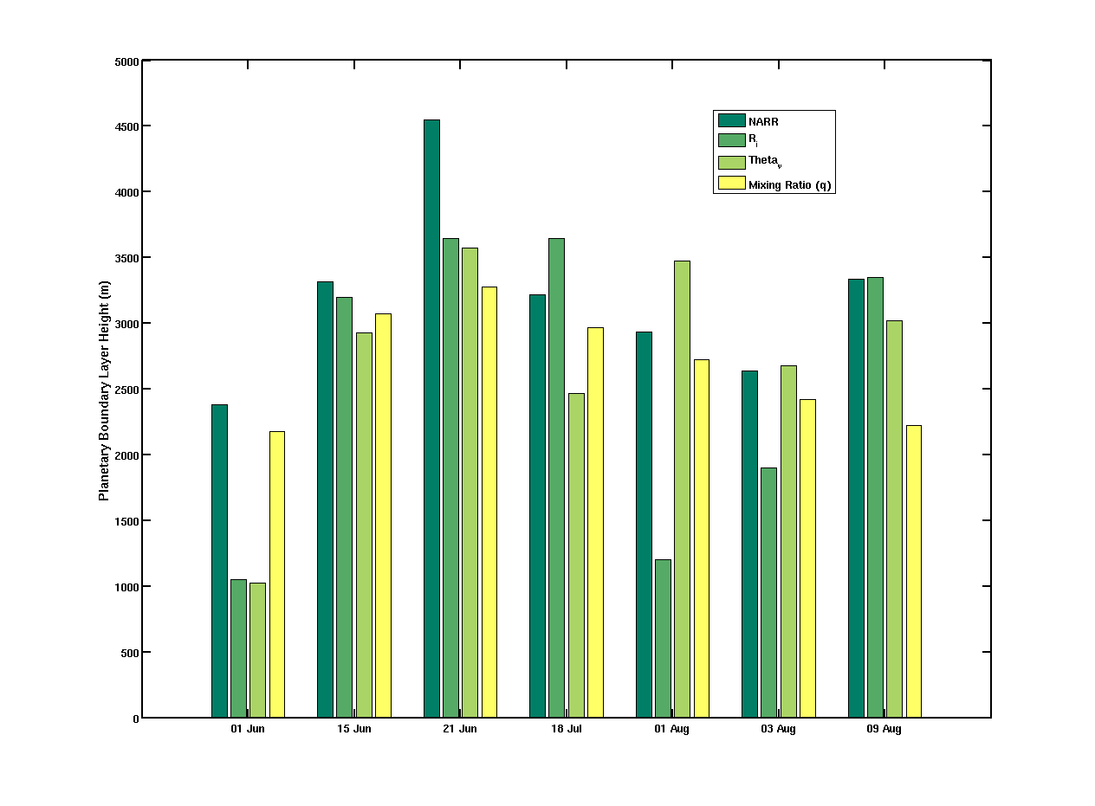
Comparison of Boundary Layer Heights

Slide 35
Results
Evaluation of RAMS and HYPACT
Does the Experimental Design Work?
Initial Boundary Layer Budget Fluxes using NARR PBL
Estimation and Comparison of Boundary Layer Heights
Boundary Layer Budget Fluxes Revisited
Receptor and Receptor Averaged Fluxes

Slide 36
Niwot Ridge vs. CarbonTracker with BLB Flux from Observed PBL
Niwot Ridge
CarbonTracker
BLB

Slide 37
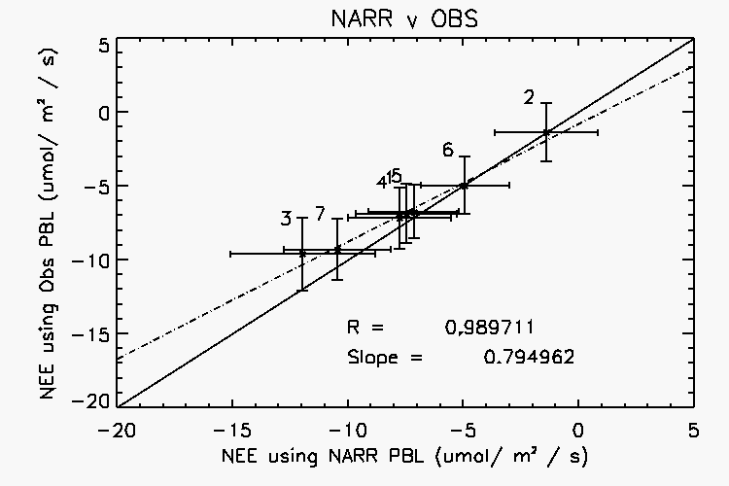
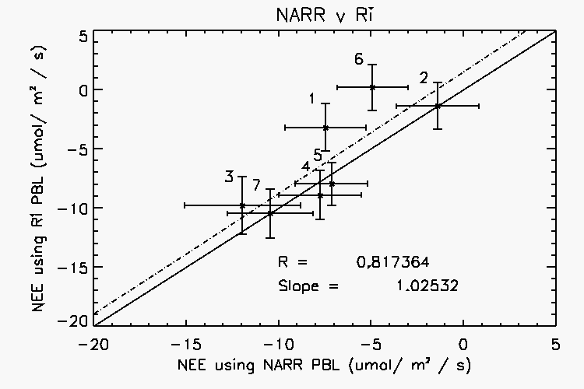
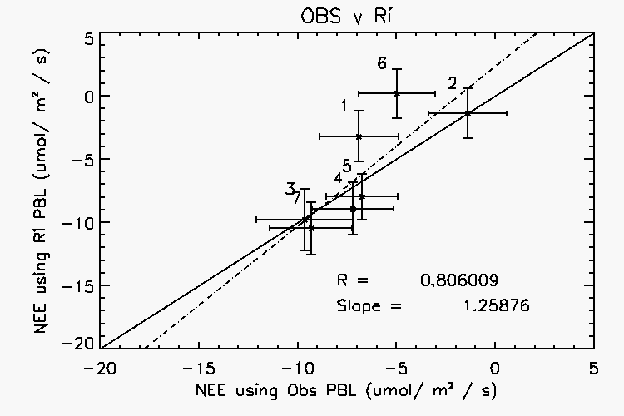
Comparison of NEE from different estimates of PBL
Notes:
Roughly 60% of the variance can be explained by the changes in PBL with an uncertainty of around 20%

Slide 38
Results
Evaluation of RAMS and HYPACT
Does the Experimental Design Work?
Initial Boundary Layer Budget Fluxes using NARR PBL
Estimation and Comparison of Boundary Layer Heights
Boundary Layer Budget Fluxes Revisited
Receptor and Receptor Averaged Fluxes

Slide 39
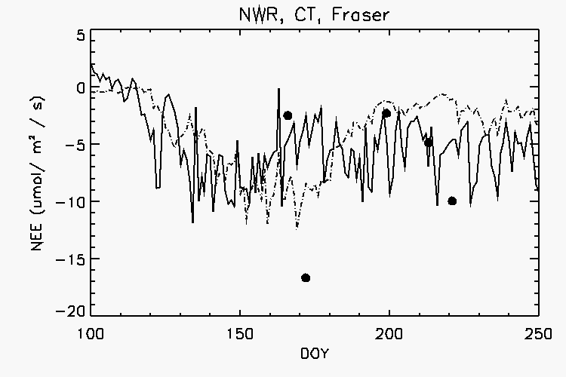
Receptor Fluxes vs. Niwot Ridge and Carbon Tracker – Fraser Experimental Forest
Niwot Ridge
CarbonTracker
BLB

Slide 40
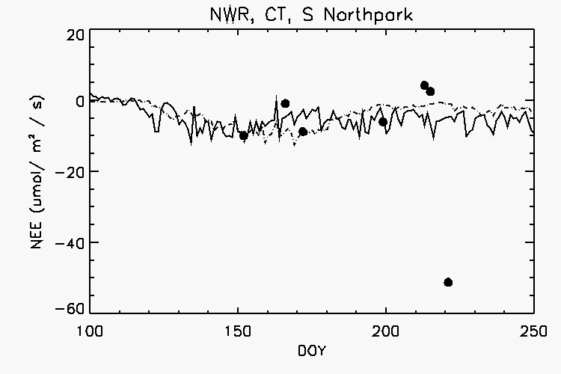
Receptor Fluxes vs. Niwot Ridge and Carbon Tracker – South Northpark
Niwot Ridge
CarbonTracker
BLB

Slide 41
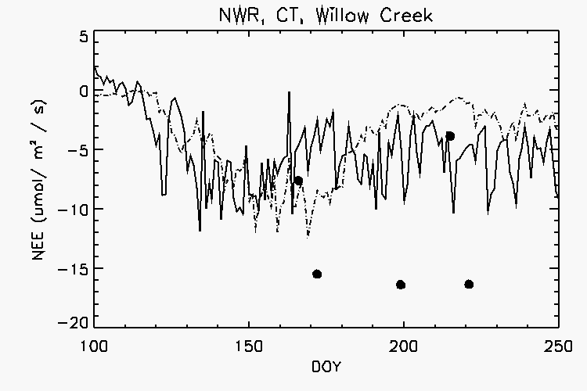
Receptor Fluxes vs. Niwot Ridge and Carbon Tracker – Willow Creek
Niwot Ridge
CarbonTracker
BLB

Slide 42
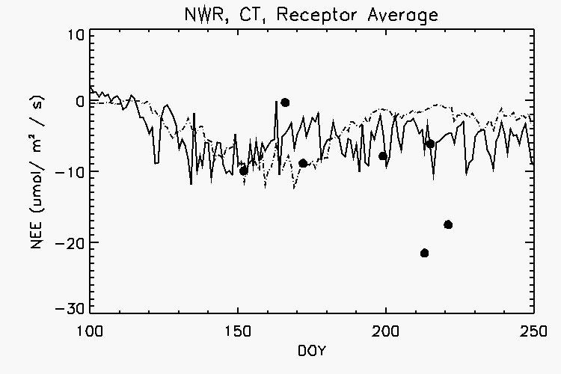
Receptor Fluxes vs. Niwot Ridge and Carbon Tracker – Receptor Average
Niwot Ridge
CarbonTracker
BLB

Slide 43
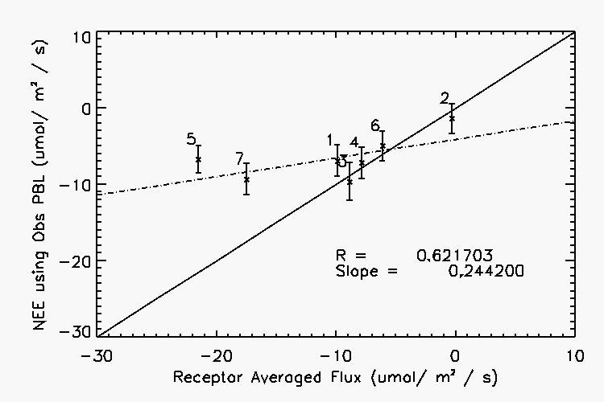
Receptor Averaged Flux vs. NEE from Observed PBL

Slide 44
What to Expect
Motivation and Background
Why study carbon dioxide?
Why study boundary layers in mountainous terrain?
What is ACME?
Data and Methods
Boundary Layer Budget Method
Determination of Boundary Layer Heights
Profile Matching
Results
Summary and Future Work

Slide 45
Summary
Meteorological observations from Niwot Ridge and Storm Peak Lab show general agreement with RAMS
Difference are most likely caused by local processes not capture by the model
HYPACT results validates experimental design
Able to chase air using morning downwind / afternoon up flight profiles

Slide 46
Summary
CarbonTracker shows less uptake in mid-summer when compared to Niwot Ridge and airborne observations
Initial BLB fluxes shows broad agreement among the three methods
Accurate estimates of boundary layer growth required to further narrow the uncertainty of carbon fluxes in complex terrain
General agreement among all estimates of PBL

Slide 47
Summary
Receptor fluxes show broad agreement when compared with Niwot Ridge and CarbonTracker
Some receptor fluxes show larger uptake
How do you compare fluxes that vary in scale, time and method of calculation?
With the exception of two flight day, receptor averaged fluxes compare well with fluxes calculated using the entire flight profile
Spatial and temporal averages of CarbonTracker fluxes over the domain show an inverse relationship when compared with airborne observations

Slide 48
Future Work
Run RAMS simulations for remaining flight days
Using RAMS output, Run HYPACT
Release particles along entire morning upwind flight profile to determine its influence on the afternoon downwind flight profile
Assimilate airborne observations into a regional inverse model
Top-down Approach
Compare BLB flux estimates with an ecosystem model (i.e. SIPNET)
Bottom-up Approach

Slide 49
Acknowledgment
My Advisor: Prof. Ankur Desai
M.S. Thesis Readers:
Prof. Galen McKinley and Prof. Dave Turner
Rest of the ACME Collaborators
Stephan DeWekker (UVa)
Teresa Campos (NCAR)
Fellow Grad Students
AOS Faculty and Staff
Funding Sources:
DoD SMART Scholarship
NSF and NOAA
UW Graduate School

Slide 50
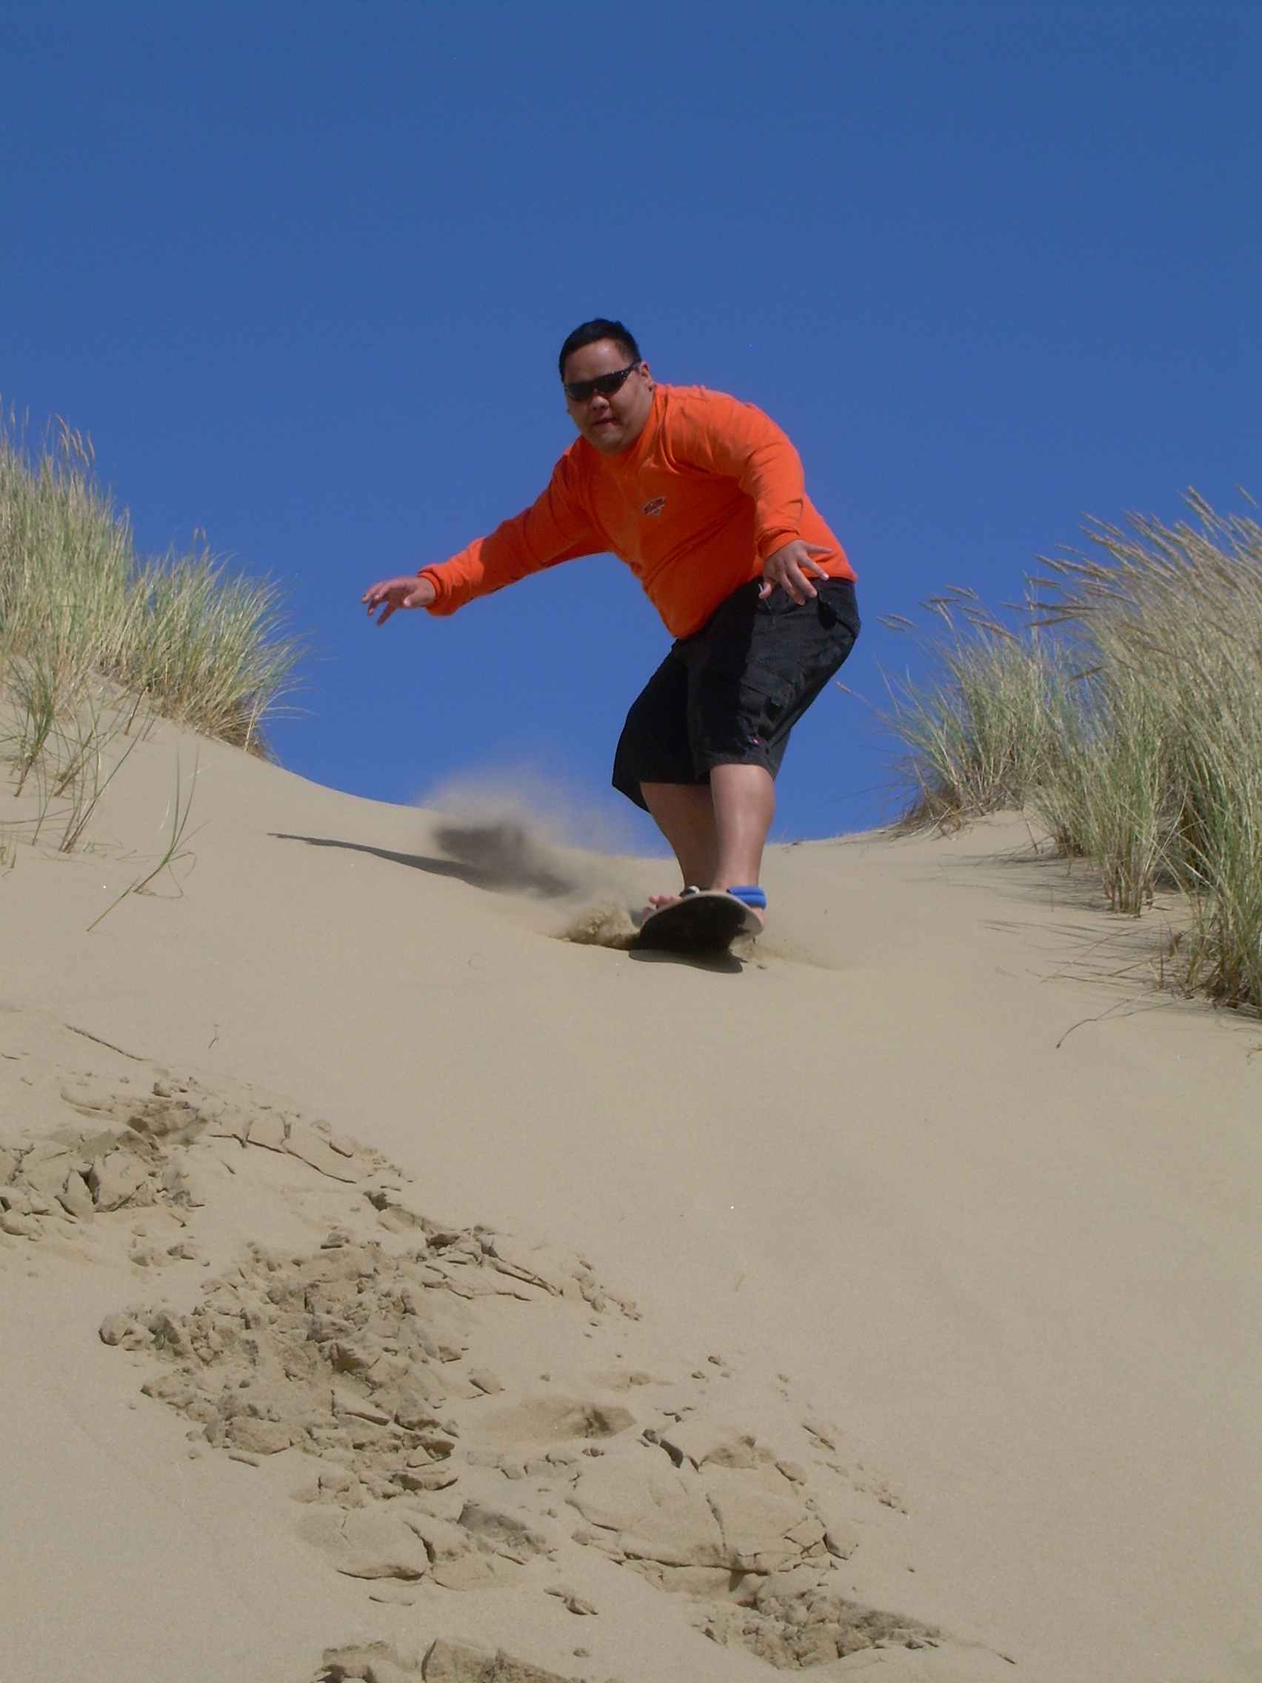
Questions?

