Slide 1
Phenological responses of NEE in the subboreal
Controls on IAV by autumn zero-crossing and soil thermal profile
Dr. Desai

Slide 2
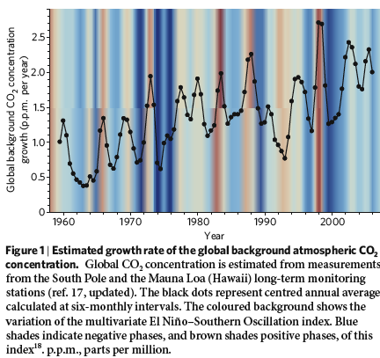
MOTIVATION
Several authors have shown that autumn zero-crossing date has been advancing in concert with climate anomalies, especially in boreal regions. For example, Piao et al (2008) show such a correlation in the NOAA ESRL flask CO2 network and find further with ORCHIDEE that it is related to flux response not transport.
Stochastic tems neglected
Yet, most eddy covariance observations suggest increasing GSL in response to autumn and spring warming
A condundrum appears
Solution to look at flux tower records and model data assimilation
Major results have not been tested by a rigorous Bayesian estimator framework

Slide 3
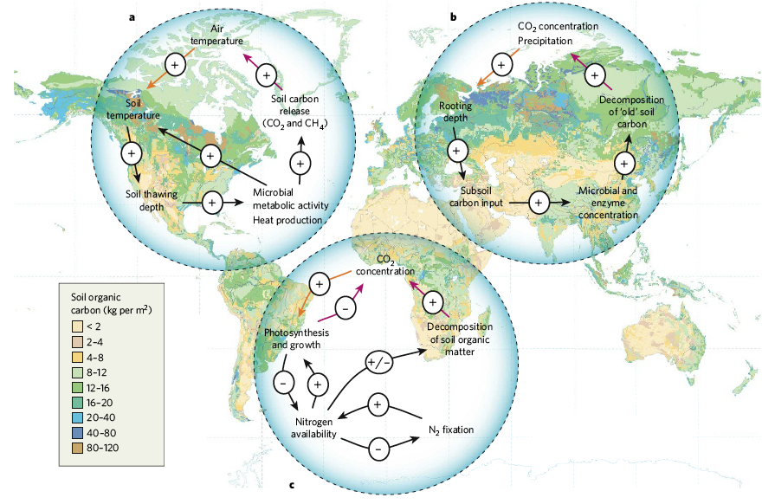
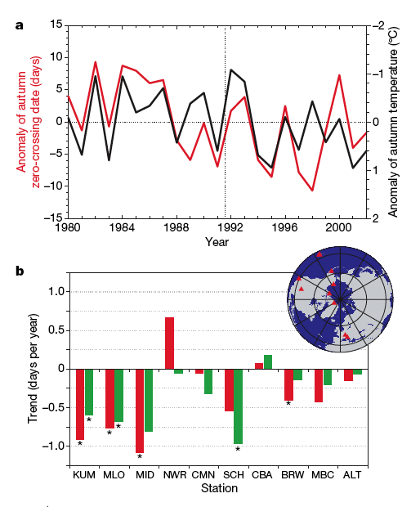
WHY IMPORTANT

Slide 4
Our framework
A Bayesian Markov Chain Monte Carlo assimilation is performed against flux tower data observed in the upper Midwest and used in a twin experiment of the IFUSE ecosysem model. The details of this are in Desai et al (in prep).
The hypothesis suggests that NEP_annual is controlled by GPP for CO2 (possibly not true for CH4), which in turn is controlled by leaf off parameterized by the common Schwartz soil temperature model at 5 cm.

Slide 5
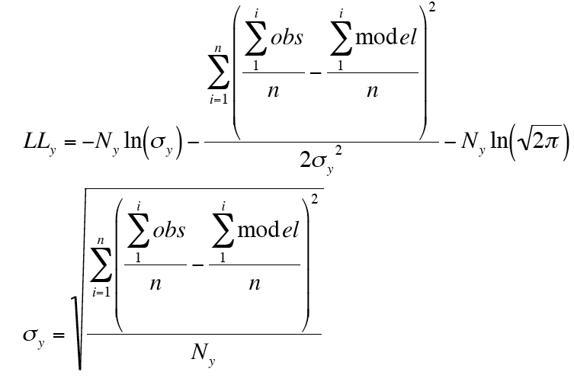
Analysis
Flux observation using stationary turbulence tests and screening:
MCMC cost function using log likelihood modified for annual variation sensitivity

Slide 7
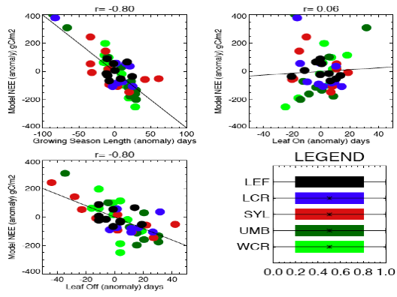
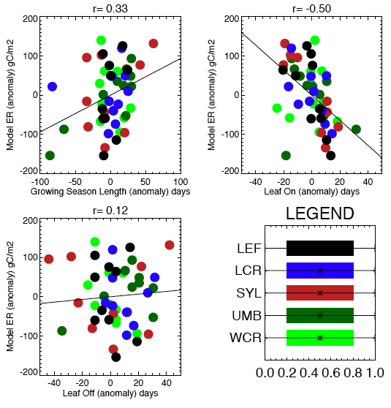
Results

Slide 8
Discussion
Obvious to the viewer, Piao et al does not apply for this region according to the model test conducted.
More work needs to be done to test phenology models with better flux methods and also regional fluxes.
These results are quite intuitive.
Thank you.

Slide 9
FINAL THOUGHTS
FAIL

Slide 10
How to give a terrible talk
What went wrong?
Which of these are the hardest to avoid?
How might they be remedied?

Slide 11
LET’S START OVER

Slide 12
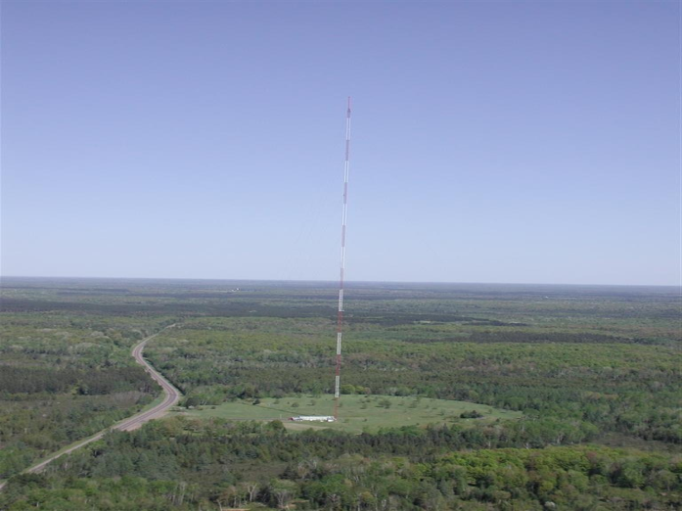
CARBON, WATER, LAND USE & CLIMATE
Understanding Interannual Variability in Surface-Atmosphere Greenhouse Gas Exchange
Ankur R Desai
Asst. Professor
Atmospheric & Oceanic Sciences
University of Wisconsin-Madison

Slide 13
Motivation
Magnitude and variability of past and future climate change driven by variability in atmospheric greenhouse gases
Most important driver is CO₂
Variability in atmospheric CO₂ driven by fossil fuel emissions, land use change, land sinks and ocean sinks
Sinks = net photosynthesis

Slide 14
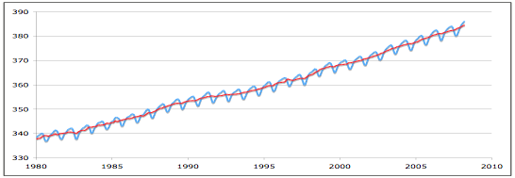
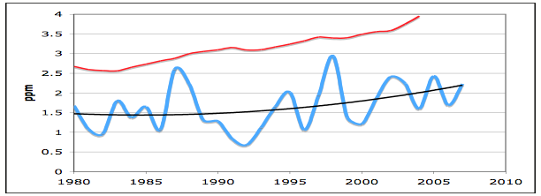
Global Atmospheric CO₂

Slide 15
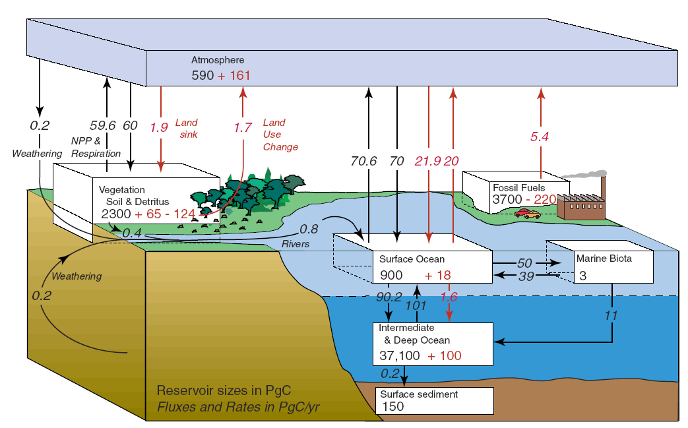
The Carbon Cycle

Slide 16
The Problem
Land carbon cycle controls bulk of interannual variability (IAV) of atmospheric CO₂
BUT: IAV of land carbon cycle is poorly understood and poorly modeled
Function of variations in both Respiration (RE) and Gross Primary Production (GPP). The difference between the two is Net Ecosystem Exchange (NEE)
Major source of climate change uncertainty

Slide 17
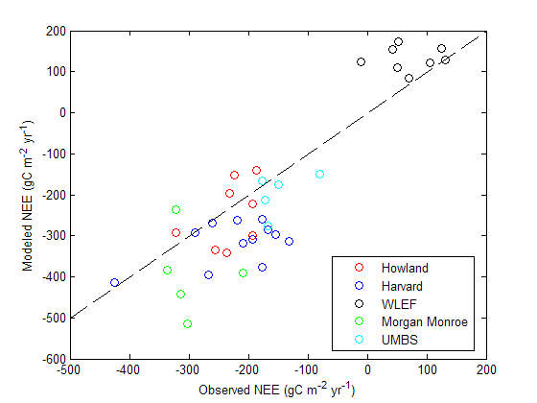
Modeling IAV
Ricciuto et al (2008)

Slide 18
Recent Hypotheses
Piao et al (2008) show that boreal atmospheric CO₂ “zero-crossing” anomalies are positively correlated to autumn temperature anomalies
Later autumn => Less net uptake (more GPP, but much more RE)
Richardson et al (in press) show that Northeastern forest fluxes are correlated to spring onset (leaf-out)
Earlier spring => More net uptake (more GPP, little enhancement in RE)

Slide 19
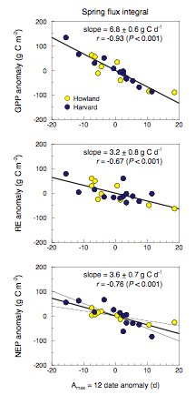

Slide 20
Our Project
What controls IAV for forest CO₂ exchange in upper Great Lakes subboreal forests?
Method: Test leaf phenology models in a simple ecosystem model, parameterized with eddy covariance flux tower data at 5 sites
Use a Bayesian statistical framework for parameter estimation
Two model setups: LEAF and NOLEAF

Slide 21
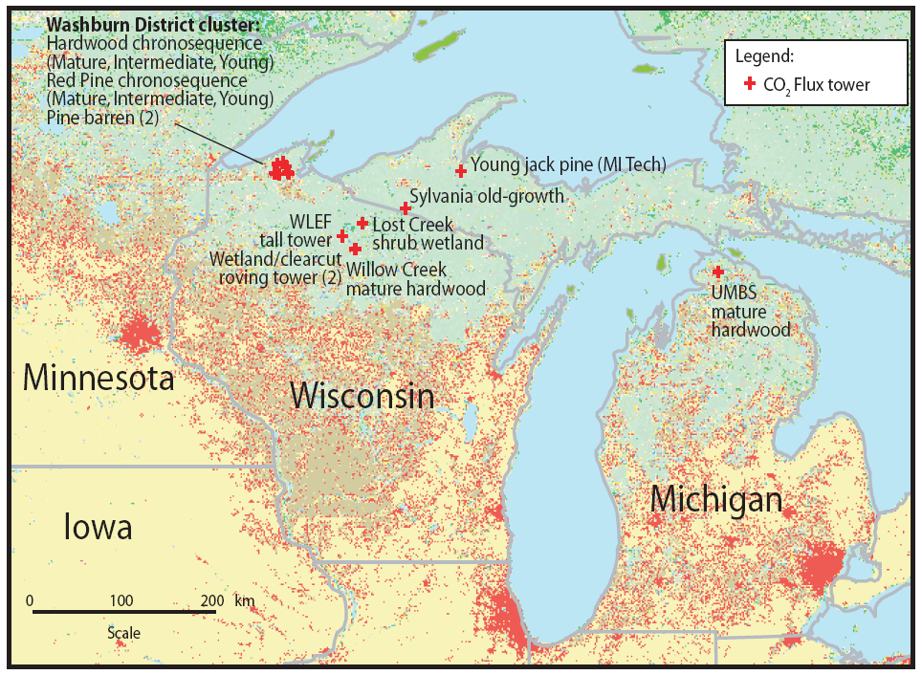
Study Area

Slide 22
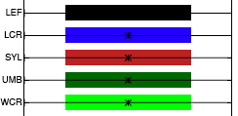
The Sites
Five sites with 5-8 years of data
1 regional (LEF), 1 wetland (LCR), 3 upland forests (SYL, UMB, WCR)
Assimilate 1st 4 years of data to calibrate model

Slide 23
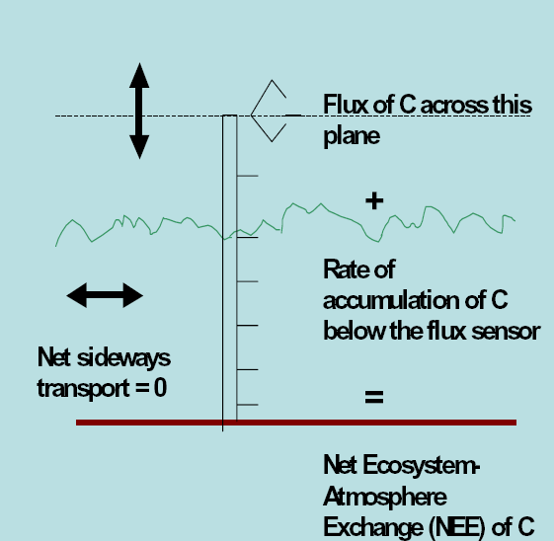
Eddy Covariance Technique
Eddy covariance uses tower-based atmospheric turbulence observations to directly measure net exchange of trace gases, energy, and momentum

Slide 24
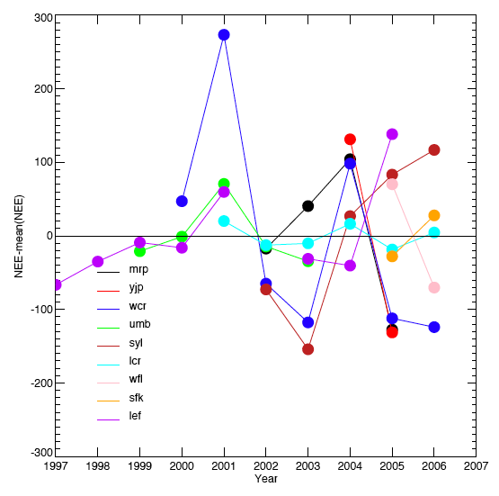
Is There Coherent IAV?

Slide 25
Phenology Models
Both models can capture spatial variability, but leaf phenology model (right) captures more IAV at more sites
IAV NOLEAF
IAV LEAF

Slide 26
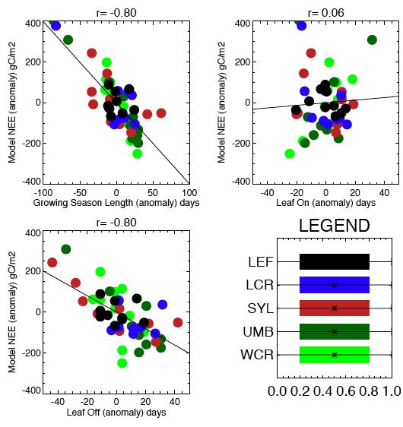
Controls on IAV
Autumn timing (leaf off) is more important than spring onset (leaf on) or growing season length in determining modeled IAV

Slide 27
Controls on IAV
Anomaly in autumn leaf out primarily affects GPP at most sites
Autumn leaf threshold driven by soil and air temperature
These results contrast both Piao (autumn affects RE) and Richardson (spring affects GPP)

Slide 28
Conclusions
There is growing evidence that spring onset and fall senescence are strong controlling factors of land carbon cycle interannual variability
Depending on sign/strength of effect, implies potential for under-recognized climate feedbacks from land system
Ecosystem models and observational diagnoses are getting better, but a consistent picture remains elusive
Upper Great Lakes land CO₂ IAV shows a consistent sensitivity to anomalies in autumn leaf off, in contrast to some recent findings
More work needed on models of leaf phenolgoy and links to climate systems

Slide 29
Thanks
Chequamegon Ecosystem-Atmosphere Study (ChEAS) project team (http://cheas.psu.edu)
U.S. Forest Service Northern Research Station, Rhinelander, WI
DOE National Institute of Climate Change Research (NICCR) and NASA Carbon Cycle Program

Slide 30
Giving Good Talks
It’s all about telling a good story
Why it matters (more than you think!)
Science is driven by communication and peer-review (informal and formal) of ideas and experiments concerning the natural world
Practice, practice, practice
Do not turn down opportunities to do so!

