Slide 1
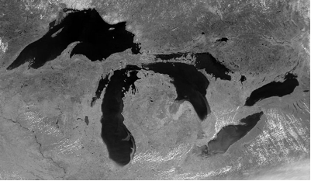
Why Has Wind Speed Increased Over Lake Superior?
Ankur Desai
AOS 405, Spring 2010

Slide 2
What’s Happening in the Great Lakes?

Slide 3
Why Great Lakes Are Interesting
Important freshwater source = 22% of world’s fresh surface water, could cover all of lower 48 with 3m of water
Great Lakes important to regional economy
Large lakes are regional sentinels of climate change
Great Lakes more ocean-like than lake-like in physical and biogeochemical processes
Great Lakes have been globally important long term sinks of carbon in sediments

Slide 4
Why Lake Superior Is Interesting
Largest freshwater lake in world by area
82,400 km²
3rd largest freshwater lake by volume
Average depth 147m, max 406m
Relatively undeveloped shoreline
But important shipping route
Large enough to create regional microclimate
180 year residence time of water = buffer effect
Midwestern location = strongly affected by cyclones and climate warming

Slide 5
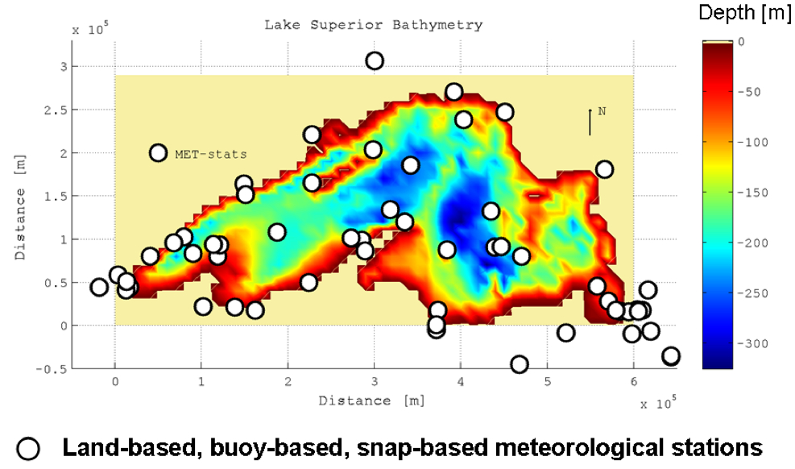
Complex System
But data are sparse!

Slide 6
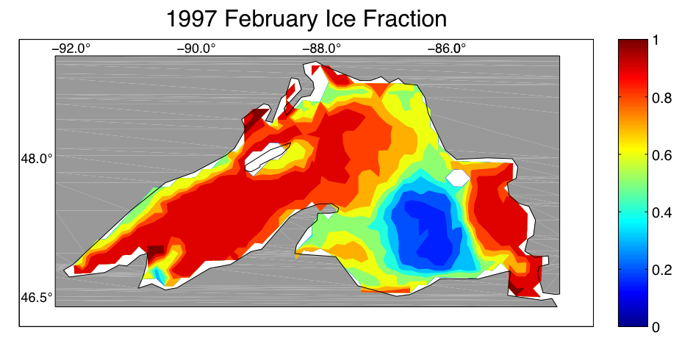
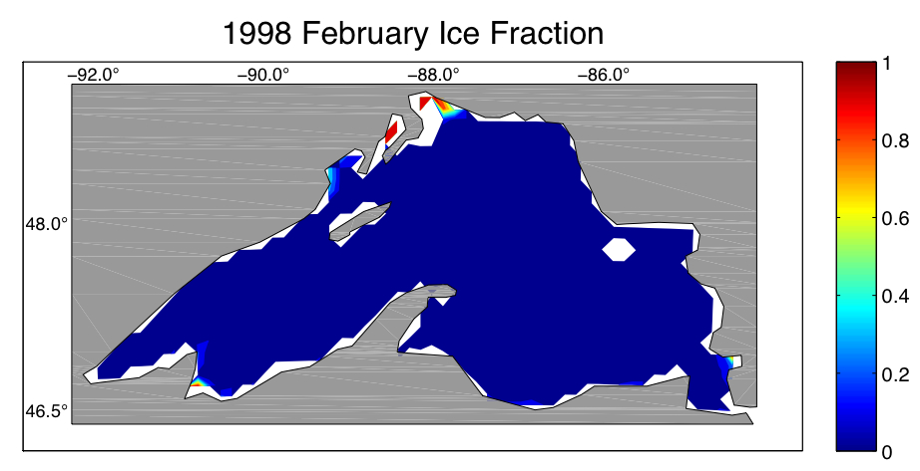
(Surprising) Large Variability

Slide 7
What Is My Lab Doing Getting Wet?
My lab studies surface-atmosphere interaction, boundary-layer meteorology, and terrestrial biogeochemistry/carbon cycle
Regional climate changes interact with boundary layer, surface-atmosphere exchange, and biogeochemistry
We use experiments, observation diagnoses, and model-data syntheses to answer questions about these systems
We are funded to work on Lake Superior biogeochemistry with Galen McKinley

Slide 8
Overview
Climate Trends
Wind Speed
Physical Models of Lake Superior

Slide 9
Climate Trends

Slide 10
Temperature Cycle

Slide 11
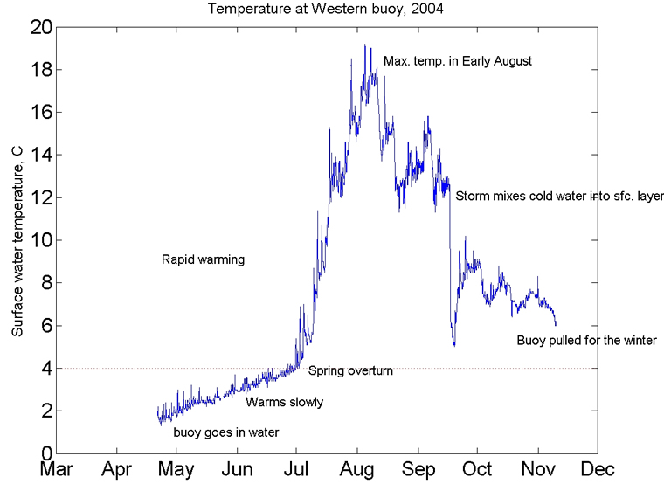
Temperature Profiles

Slide 12
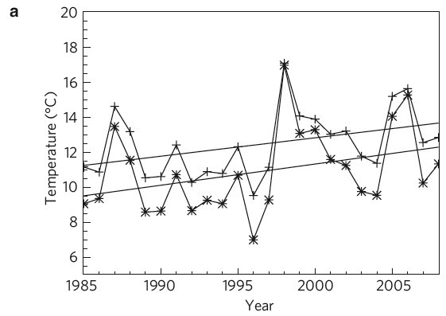
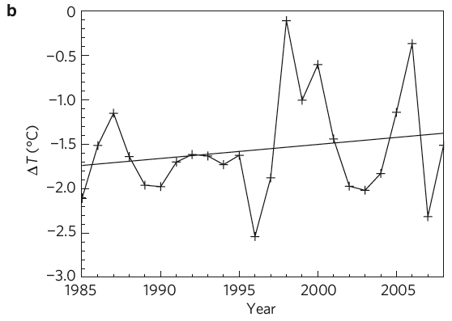
Temperature Trends
Air: 1.05 C decade⁻¹ vs Lake: 1.21 C decade⁻¹

Slide 13
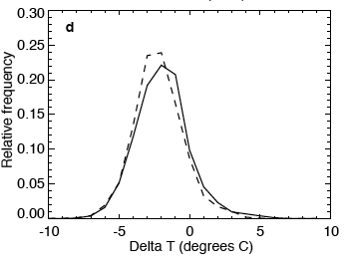
Histogram of Shifts
Dotted = 1985-1994, solid = 1999-2008

Slide 14
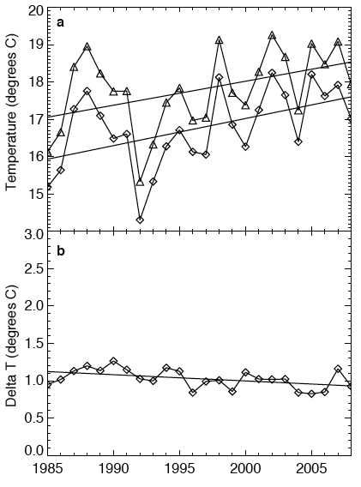
Land Surface Effect?
0.7 C decade⁻¹ in 2m temps over land
-0.08 C decade⁻¹ land surface-air diff.

Slide 15
Ice Trends
Declining trends in mean ice cover

Slide 16
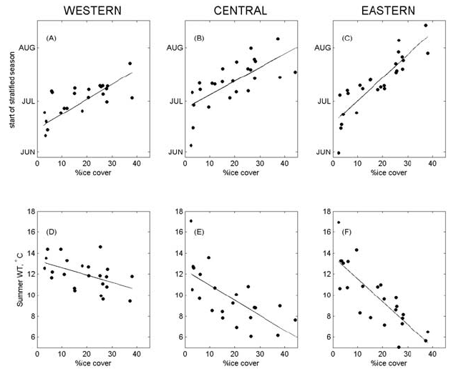
Ice Influences Summer Temp
Austin and Colman (2007)

Slide 17
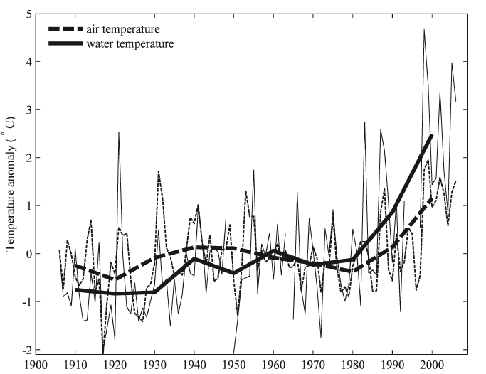
The Long View
Austin and Colman (2008)

Slide 18
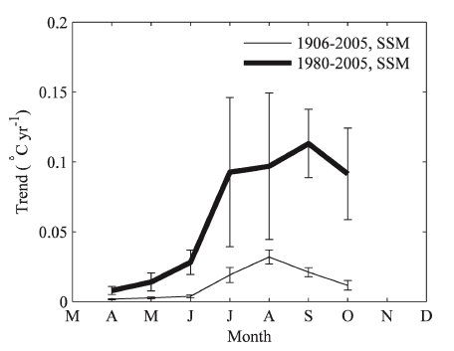
Warming Trends

Slide 19
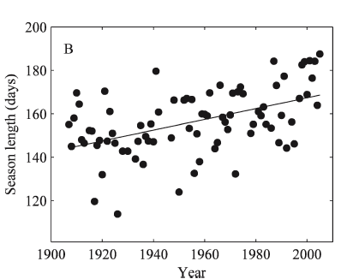
Season Length

Slide 20
Putting It All Together

Slide 21
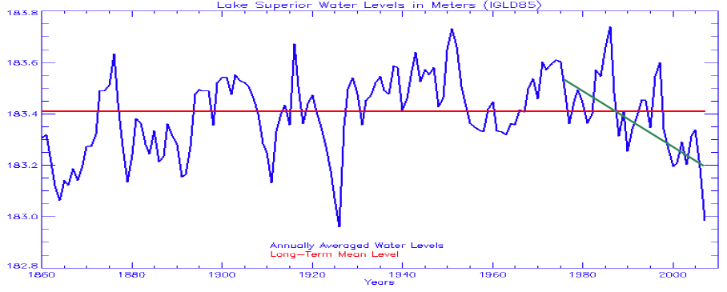
Lake Level Effect?
Evaporation increases, runoff decreases?

Slide 22
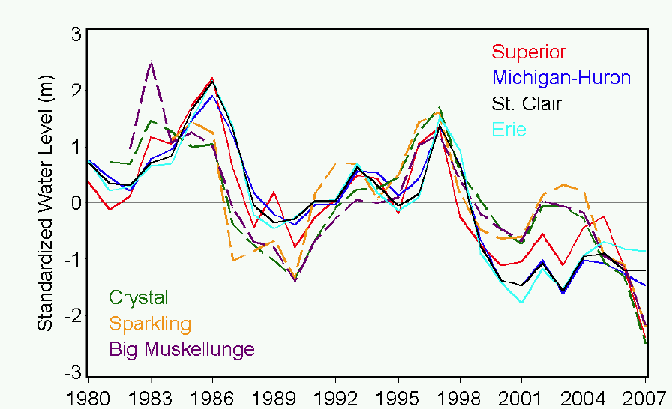
Regional Water Levels

Slide 23
Wind Speed Trend

Slide 24
Sparse Observations

Slide 25
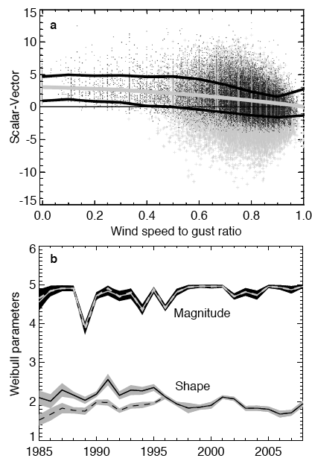
Messy Observations
Buoy observations corrected for a vector-averaging low bias
Satellite scatterometery used to evaluate wind speeds in latter part of record

Slide 26
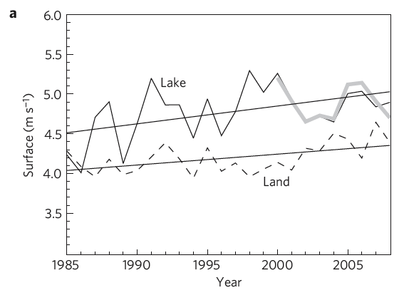
Observed Trend Over Lake
0.22 m s⁻¹ dec⁻¹ vs 0.15 m s⁻¹ dec⁻¹

Slide 27
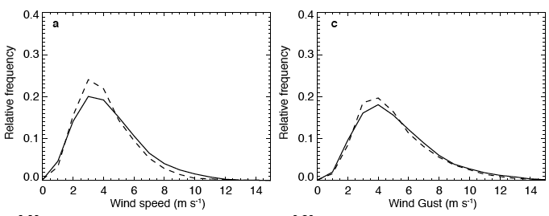
Wind Speed Distribution
Shifts are due to central tendency not gusts
Dotted = 1985-1994, solid = 1999-2008

Slide 28
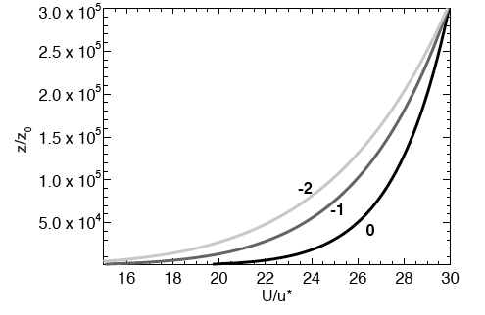
Stability Effect on Wind
DT = Lake temp – Air temp

Slide 29
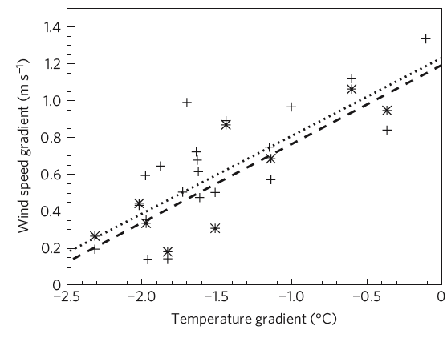
Basin Average Relationship
X: Water-air temp gradient
Y: Land-above lake wind speed difference

Slide 30
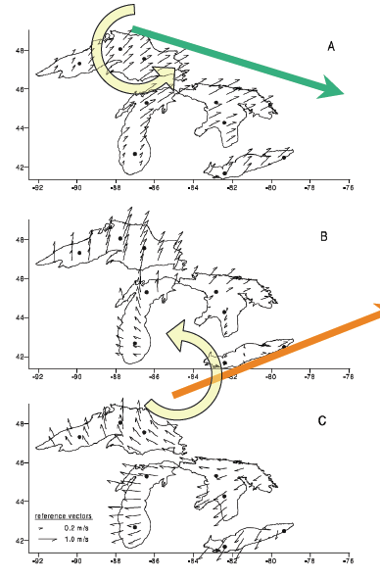
An Alternate Hypothesis
Klump et al (2002)
Shift in storm track?

Slide 31
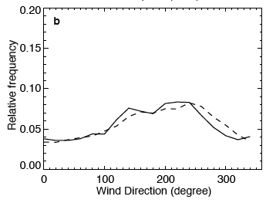
An Alternate Hypothesis
Doesn’t seem to be the case here
Dotted = 1985-1994, solid = 1999-2008

Slide 32
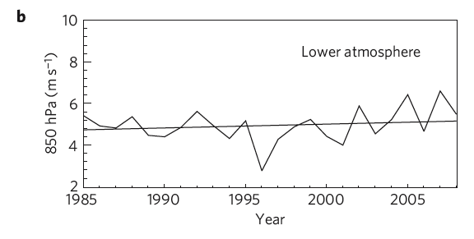
Large Scale Circulation
Reanalysis does suggest an increase from 1980s-2000s in regional wind speeds at 850 mb of 0.15 m s⁻¹ dec⁻¹, but not significant

Slide 33
Physical Models of Lake Superior

Slide 34
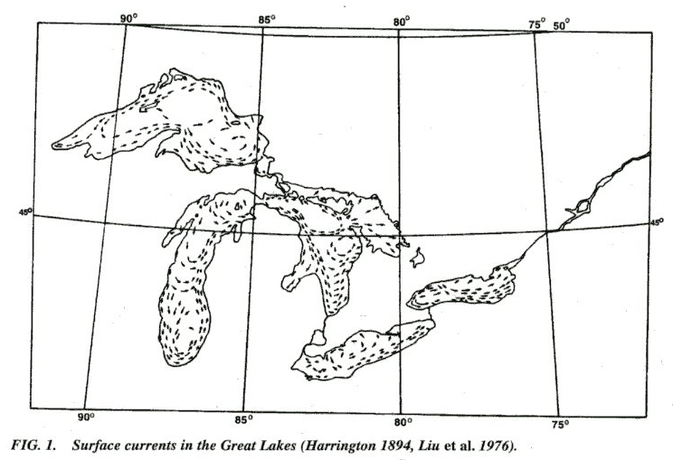
What We Know

Slide 35
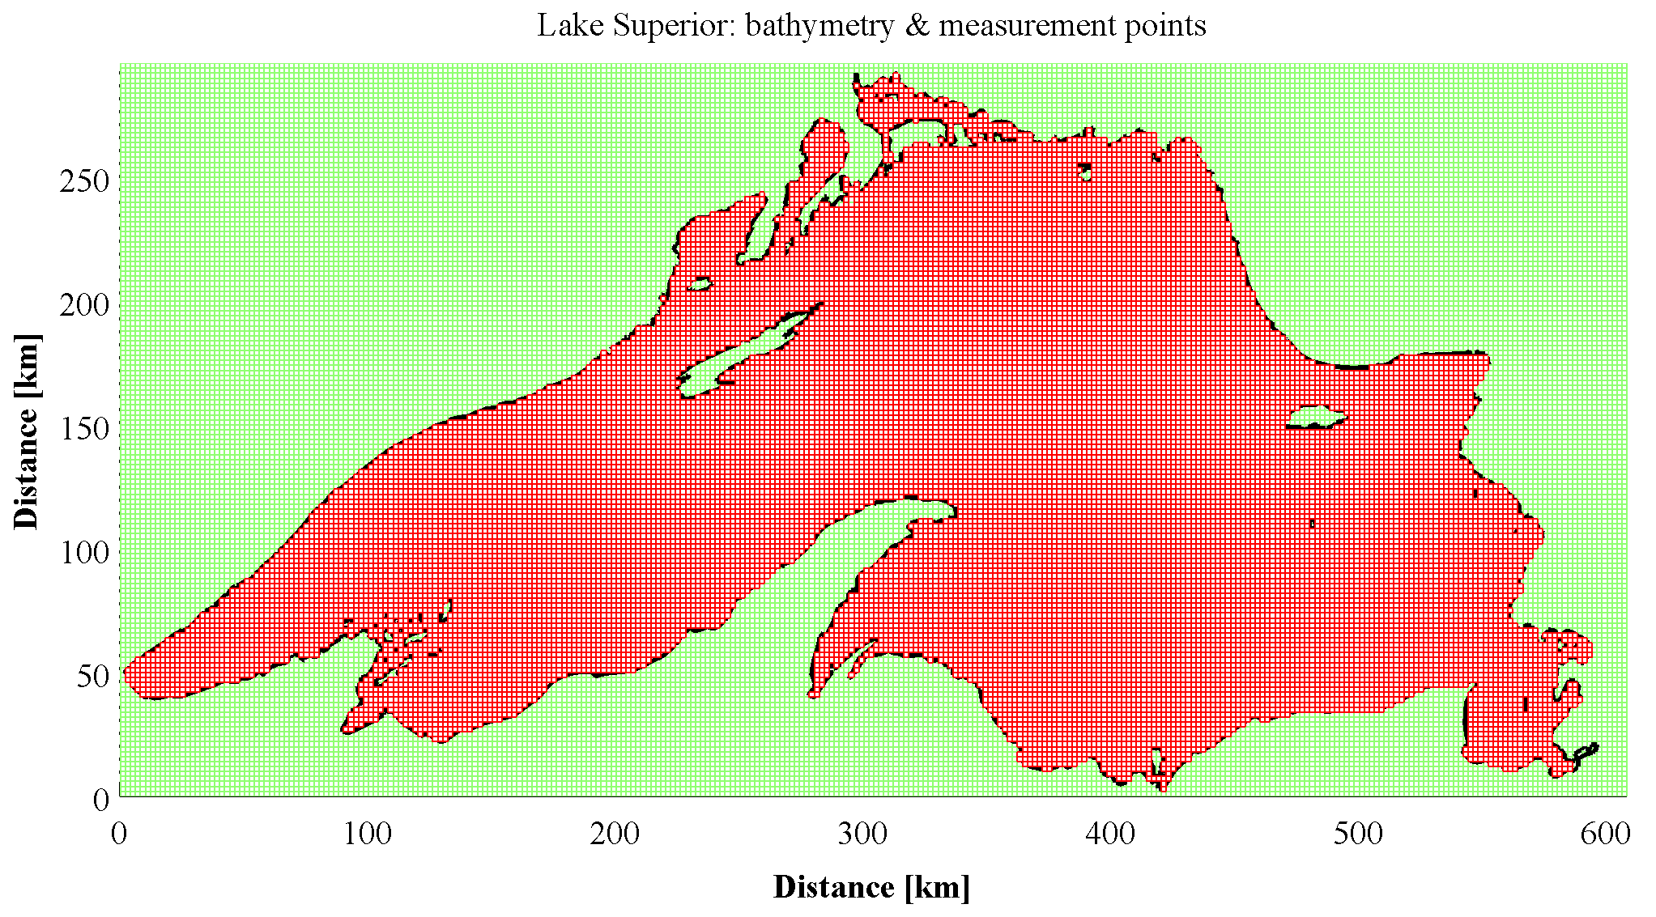
Computation domain: 2km
MIT-GCM ocean model applied to a lake

Slide 36
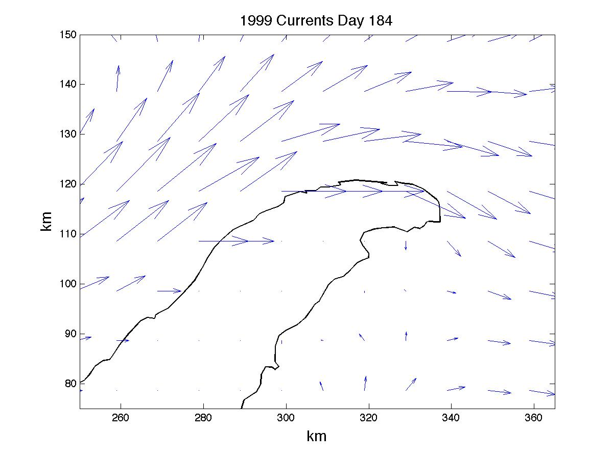
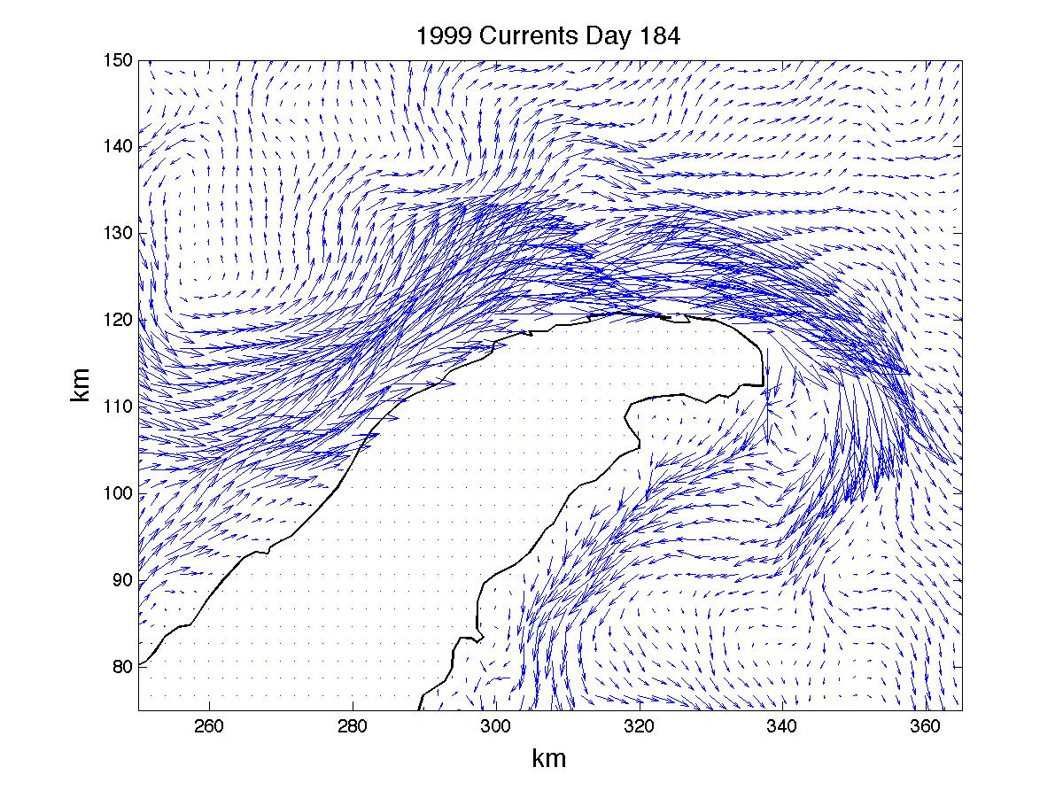
Why 2km?

Slide 37
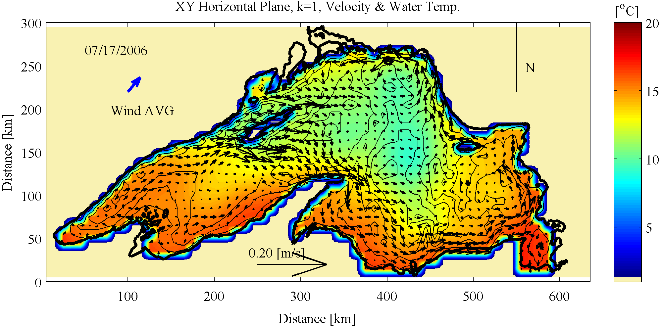
Model Progress
Forced with NARR 32km surface meteorology

Slide 38
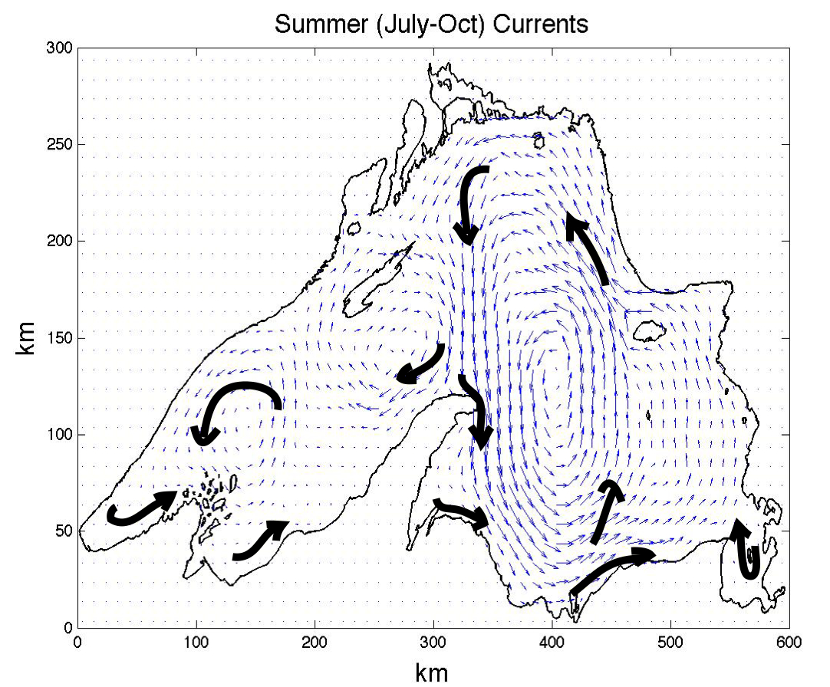
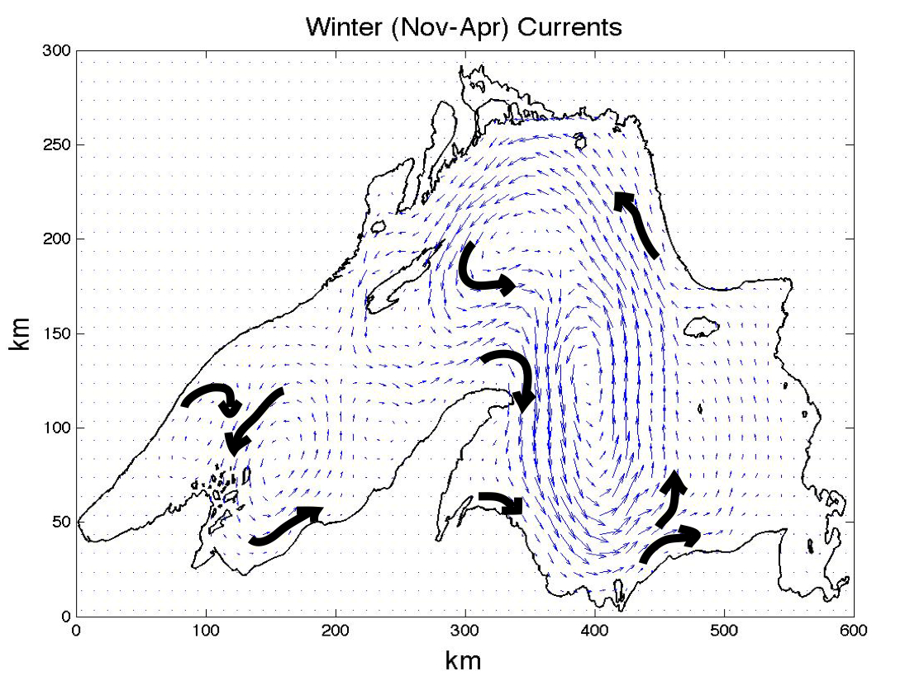
Model Progress

Slide 39
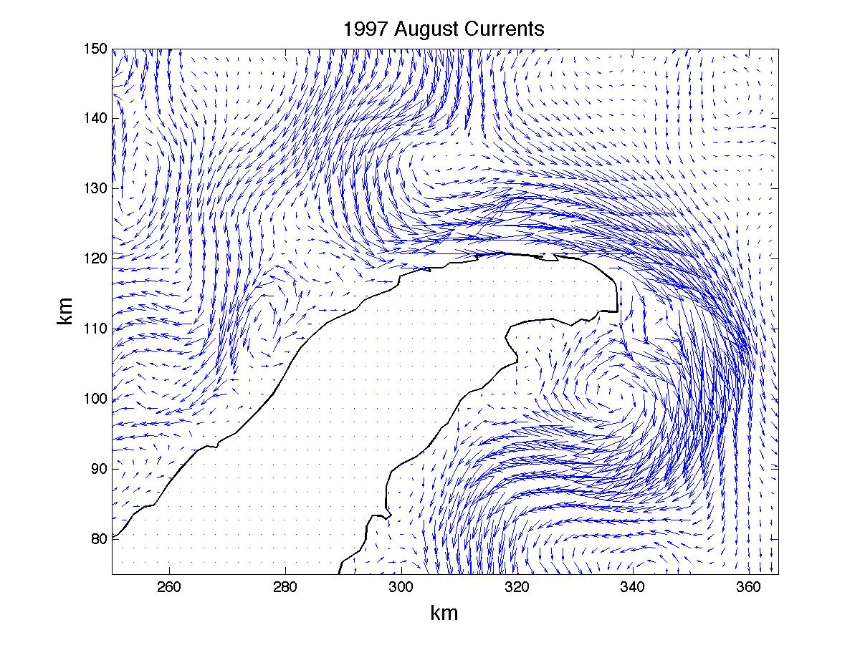
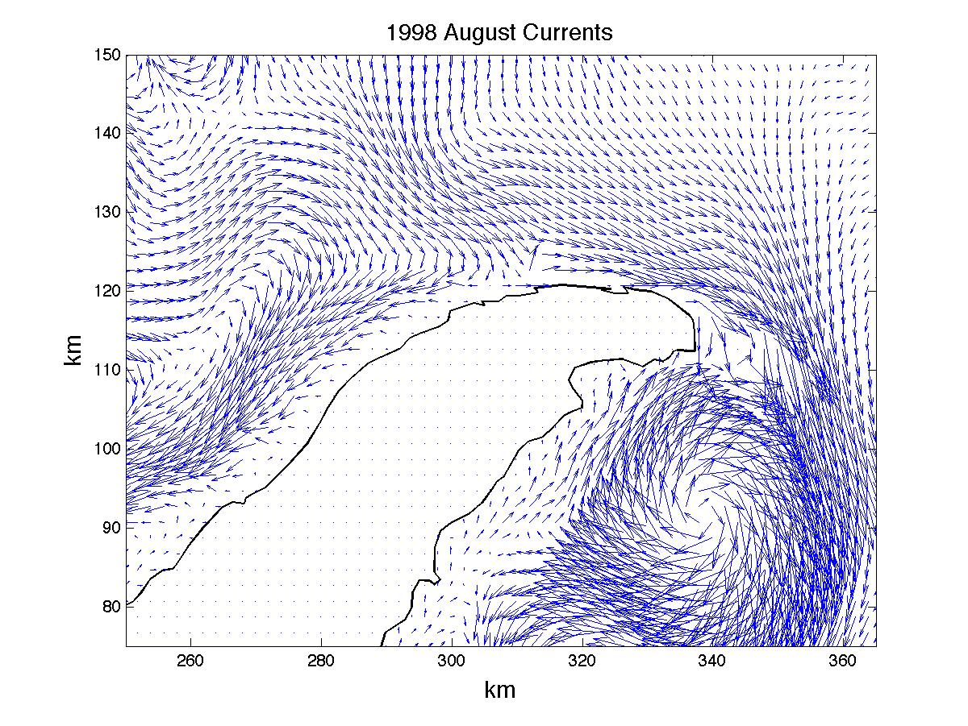
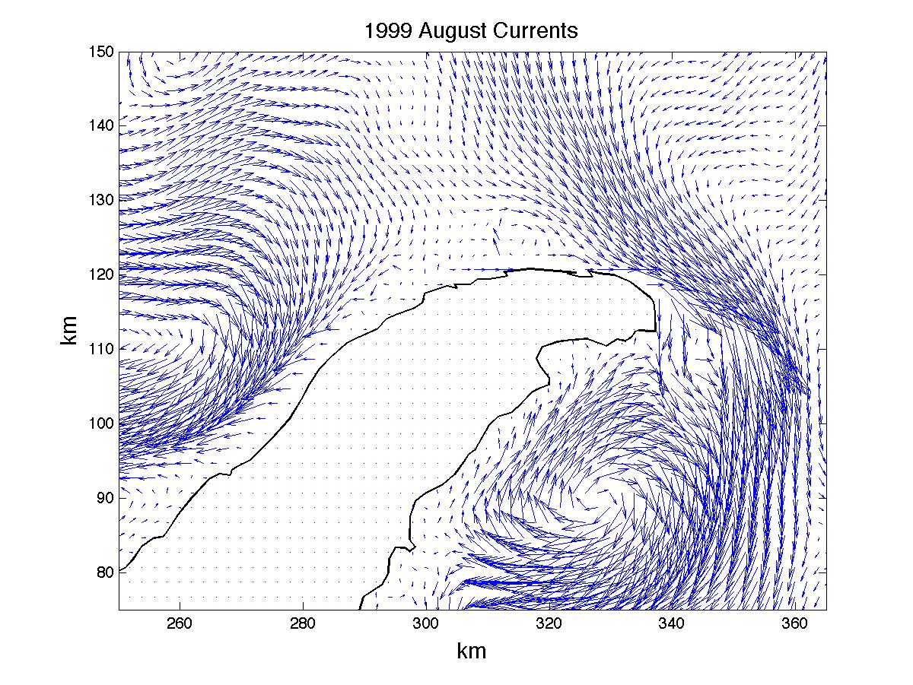
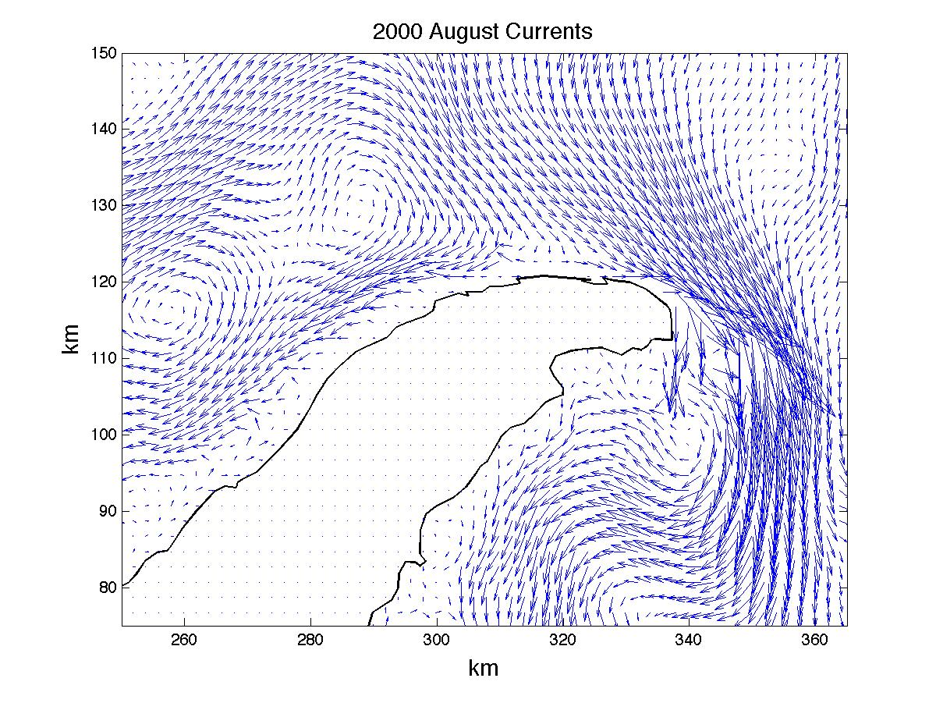
Model Progress

Slide 40
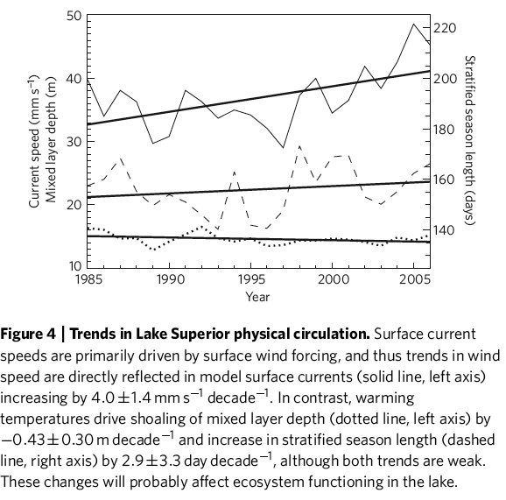
Wind Speed Impacts

Slide 41
Conclusions
Regional warming is reducing ice cover
Reduced ice cover is increasing summer stratified season length and temperatures faster than air temperatures
One consequence is higher wind speeds
However, alternate hypotheses related to large-scale circulation needs more examination
Progress is being made on modeling the effect of these wind speed and temperature trends on lake currents and biogeochemistry

Slide 42
Thanks
Thanks to J. Austin (U MN Duluth / LLO), V. Bennington (UW-Madison), G. McKinley (UW-Madison)
Funding from NSF/OCN Carbon and Water
Desai, A.R., Austin, J.A., Bennington, V., and McKinley, G.A., 2009. Stronger winds over a large lake in response to a weakening air to lake temperature gradient. Nature-Geoscience, 855-858, doi:10.1038/NGEO693.

