Slide 1
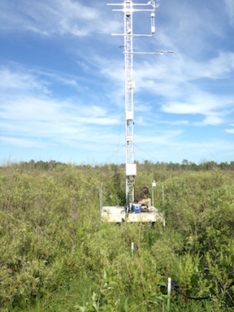
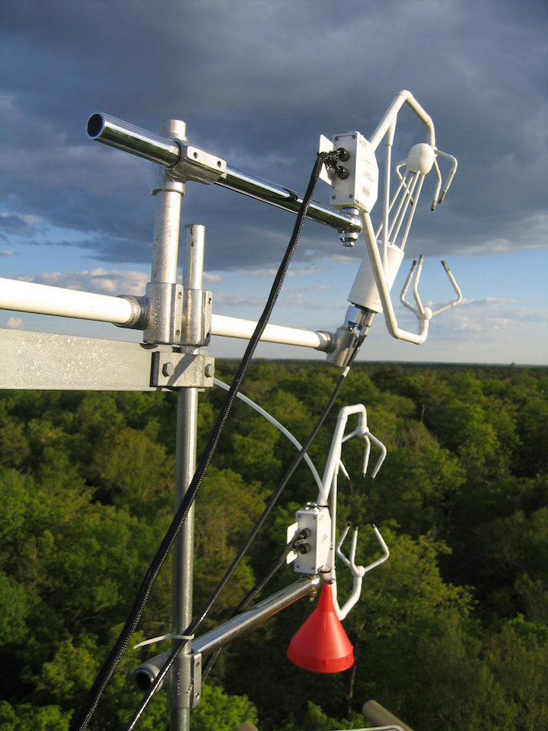
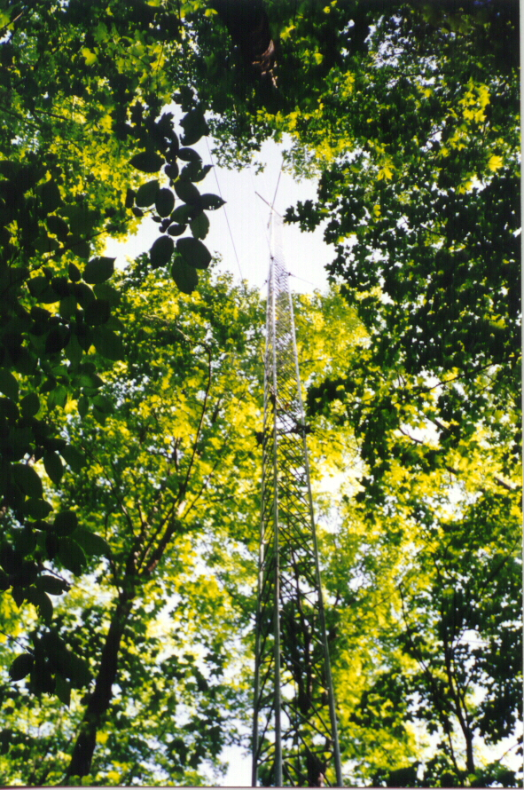
The infinite flux tower project
Contribution of land surface energy-balance heterogeneity to mesoscale circulations and flux tower biases
NSF #AGS-1822420, DFG (Germany), DOE Ameriflux
Ankur R Desai, UW-Madison, @profdesai, http://flux.aos.wisc.edu
AGU Fall 2018
B21D-02
TUE Dec 11 8:15 am

Slide 2
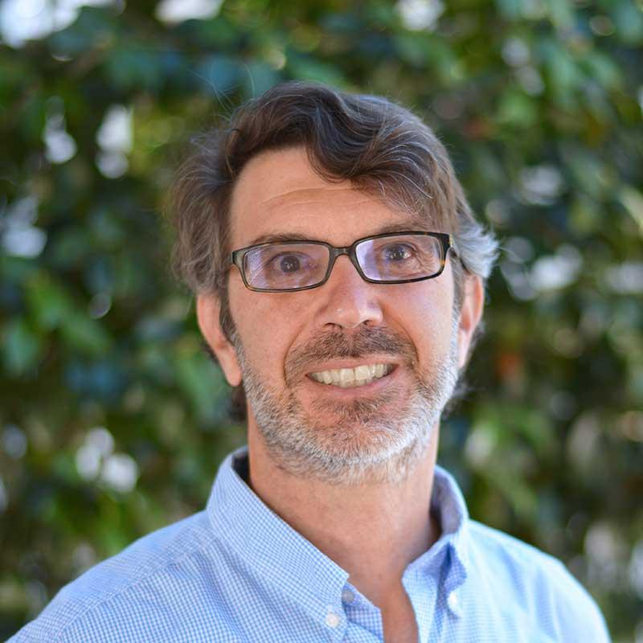
In the beginning…
Wanted to measure fluxes “everywhere and all of the time” [Chu et al., 2018]
But we can’t just keep building more flux towers, could we?

Slide 3
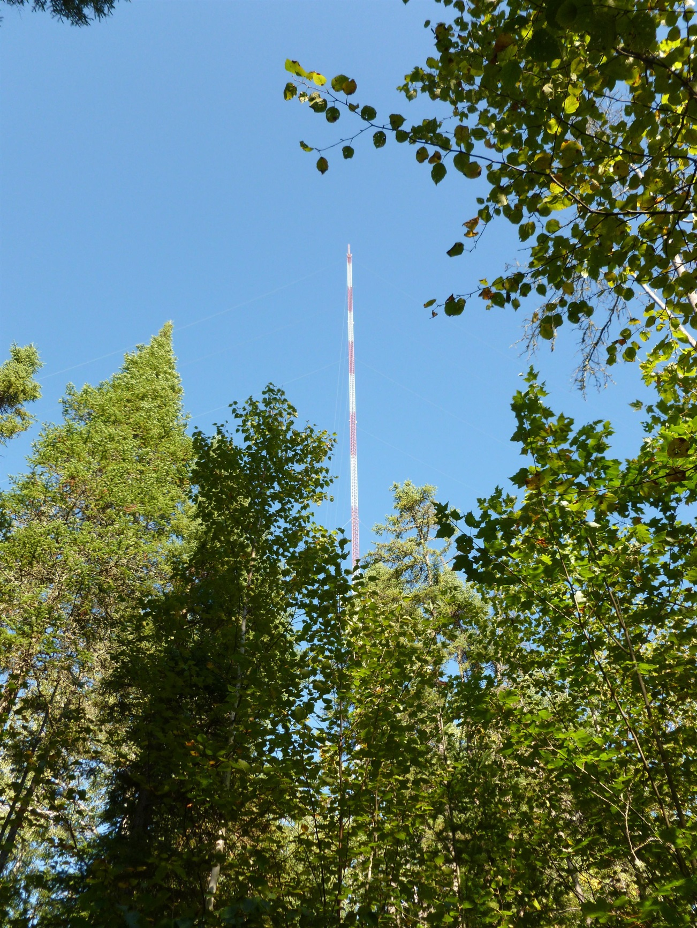
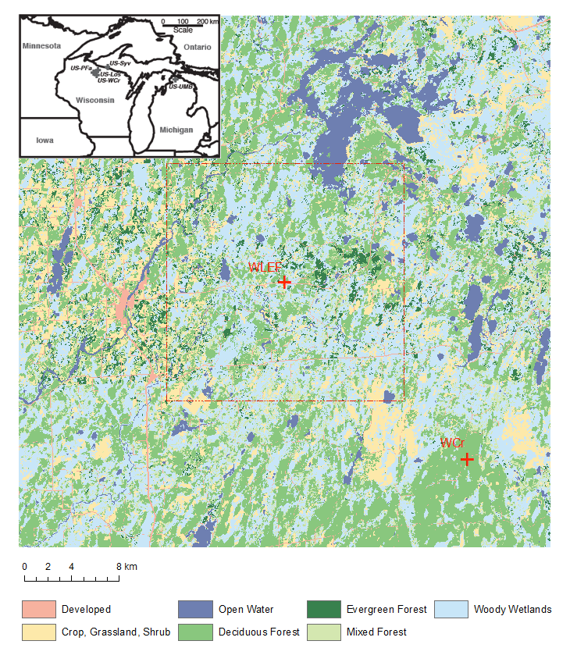
Park Falls/Chequamegon-Nicolet National Forest region, Wisconsin
Park Falls WLEF tower (US-PFa) EC fluxes at 30, 122, 396 m
NOAA tall tower greenhouse gas site
COSMOS soil moisture
TCCON column GHG
Credit: Matt Rydzik (U Wisconsin)
Desai et al., 2015, AFM
Notes:
update the picture to show “tall” tower
North Wisconsin blow out, no WCr, no red box

Slide 4
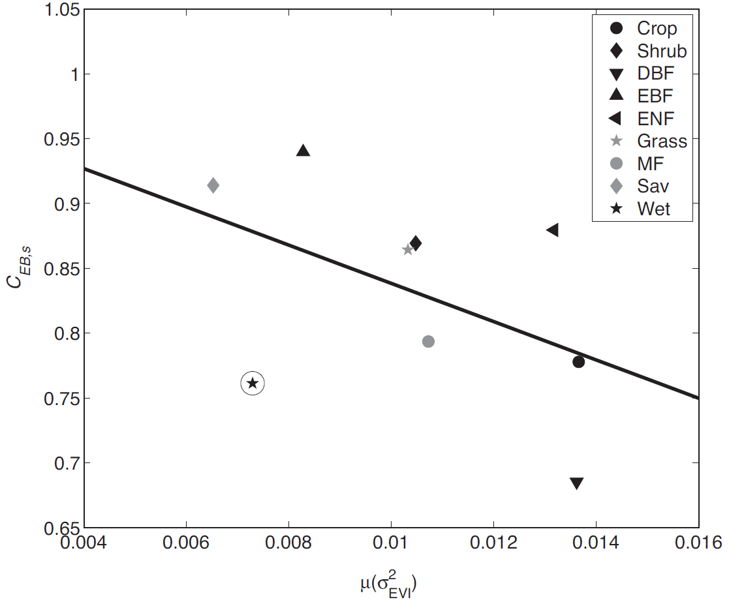
Energy imbalance worsen with increased regional spatial heterogeneity
EBC=
H+Le
-------
Rnet-G
Greenness spatial variance
Stoy et al., 2013, AFM

Slide 5
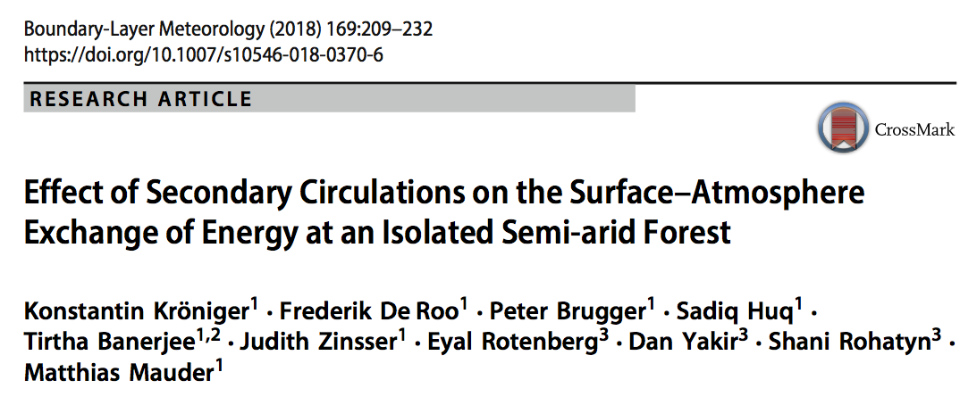
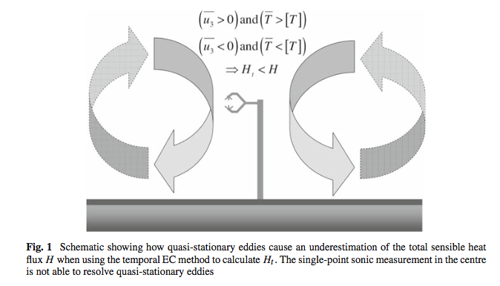
Landscape variance potentially drives stationary eddies
Mauder et al., 2008, BLM

Slide 6
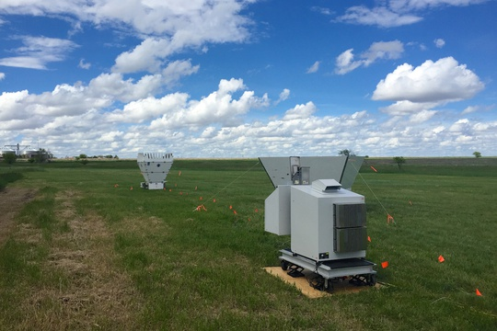
Atmospheric Emitted Radiance Inferometer (AERI) at tall tower in fall demonstrates existence of large roll eddies > flux averaging time even near surface

Slide 7
QUESTIONS?????
How homogenous is homogenous enough?
  How well does a single eddy flux tower represent a typical earth system model domain (10x10 km) mean surface energy fluxes and how does mean flux and energy balance closure vary with surface flux heterogeneity?
How many flux towers are towers enough?
  If you had multiple towers, how many would you need before sufficiently sampling domain mean flux? Are there smarter ways to compute the mean flux when you have multiple towers?
When and where does local surface heterogeneity drive local atmosphere circulations?
  How does the presence or absence of these circulations influence the reliability and representativeness and energy balance closure of single-point eddy covariance flux tower measurements?

Slide 8

Chequamegon Heterogeneous Ecosystem Energy-balance Study Enabled by a
High-density Extensive Array of Detectors (CHEESEHEAD19)
http://flux.aos.wisc.edu/twiki/bin/view/Main/CHEESEHEAD19
Ankur R Desai, U. Wisconsin-Madison (PI)
Grant Petty, U. Wisconsin-Madison (co-PI, UW Ultralight)
Phil Townsend, U. Wisconsin-Madison (co-PI, UW SpecEx)
Mark D Schwartz, U. Wisconsin-Milwaukee (co-PI, Phenology)
Stefan Metzger, NEON/Battelle (co-PI, ERF, NEON Assets)
Matthias Mauder, Karlsruhe Institute of Technology (co-I, LiDAR/LES)
Rose Pertzborn, U. Wisconsin-Madison (co-I, K-12 outreach)
Paul Stoy, Montana State University (co-I, towers + being rarely wrong)
+Instrument PIs: Al Rodi (U Wyoming King Air), Steve Oncley (NCAR ISFS), Bill Brown (NCAR ISS), Tim Wagner (SSEC SPARC), Eric Kruger (UW, Biometry), Ryan Pavlick (NASA JPL, CFIS), Randy Kawa (NASA GSFC, CARAFE), Joel McCorkel (NASA GSFC, CAMSIS)
NSF, Physical and Dynamic Meteorology, #AGS-1822420

Slide 9
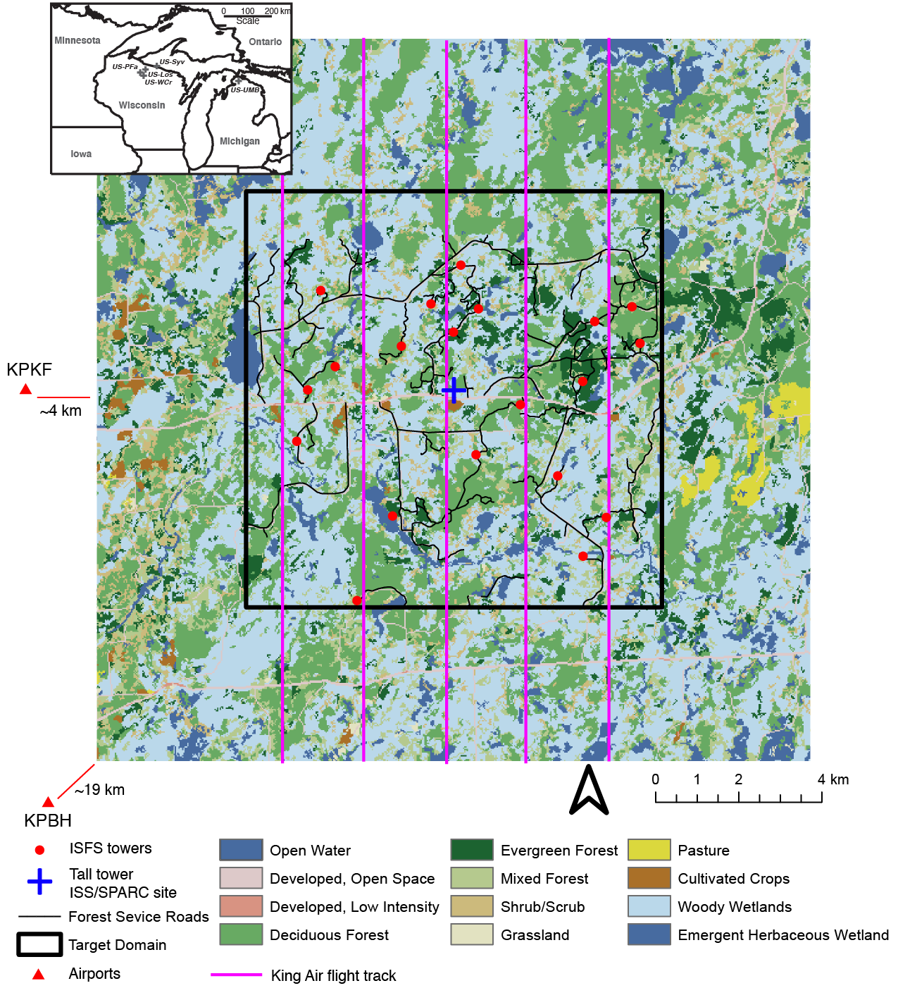
Experimental Design (Not BOREAS-II)
Distribute 10 rapid-deployment eddy covariance flux towers (red dots) within 10x10 km box (black box, right) around US-PFa WLEF tall tower (blue cross).
Run July-Oct 2019
Ecophys, NPP, and phenology bi-weekly sampling
Place in-situ and remote profiling instruments in 100 m clearing.
3 IOPs in late Jul, late Aug, late Sep with airborne legs in 2 km spacing at 500 and 1000 ft AGL (purple lines).
  Upward pointing LiDAR to map PBL dept. Raman LiDAR for profiles of temperature and water vapor, if possible
  Hyperspectral visible-IR and canopy LiDAR mapping mission from UW SpecEx
LES simulations for each IOP and select cases across study period

Slide 10
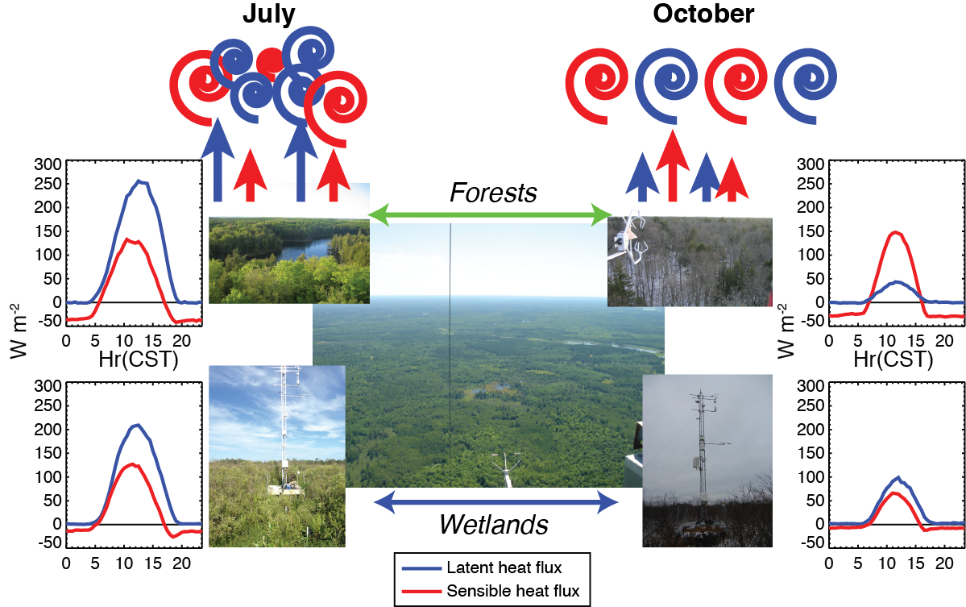
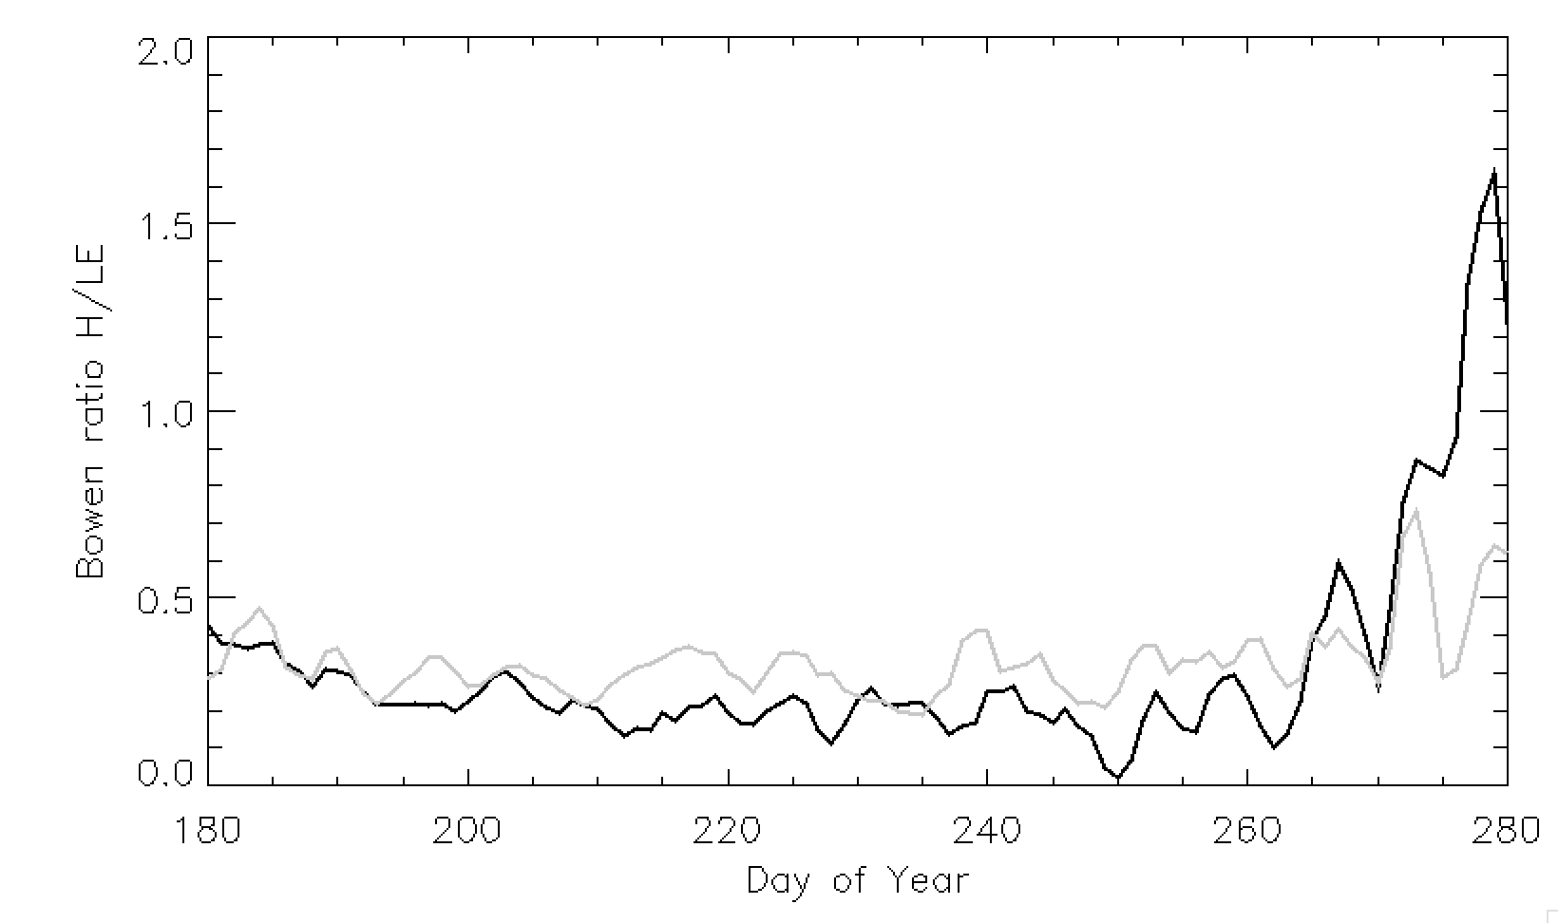
July-October allows us to sample landscape as it evolves from homogenous LE (transpiration) driven, to patchier H and LE patterns depending on ecosystem
Bowen ratio = H/LE
Wetland
Forest

Slide 11
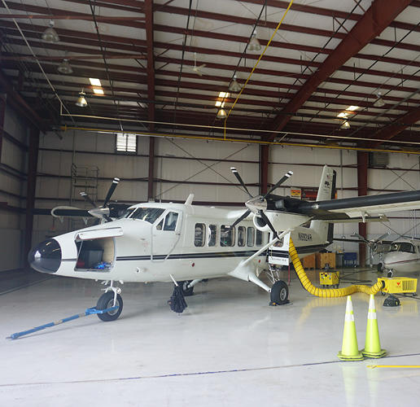
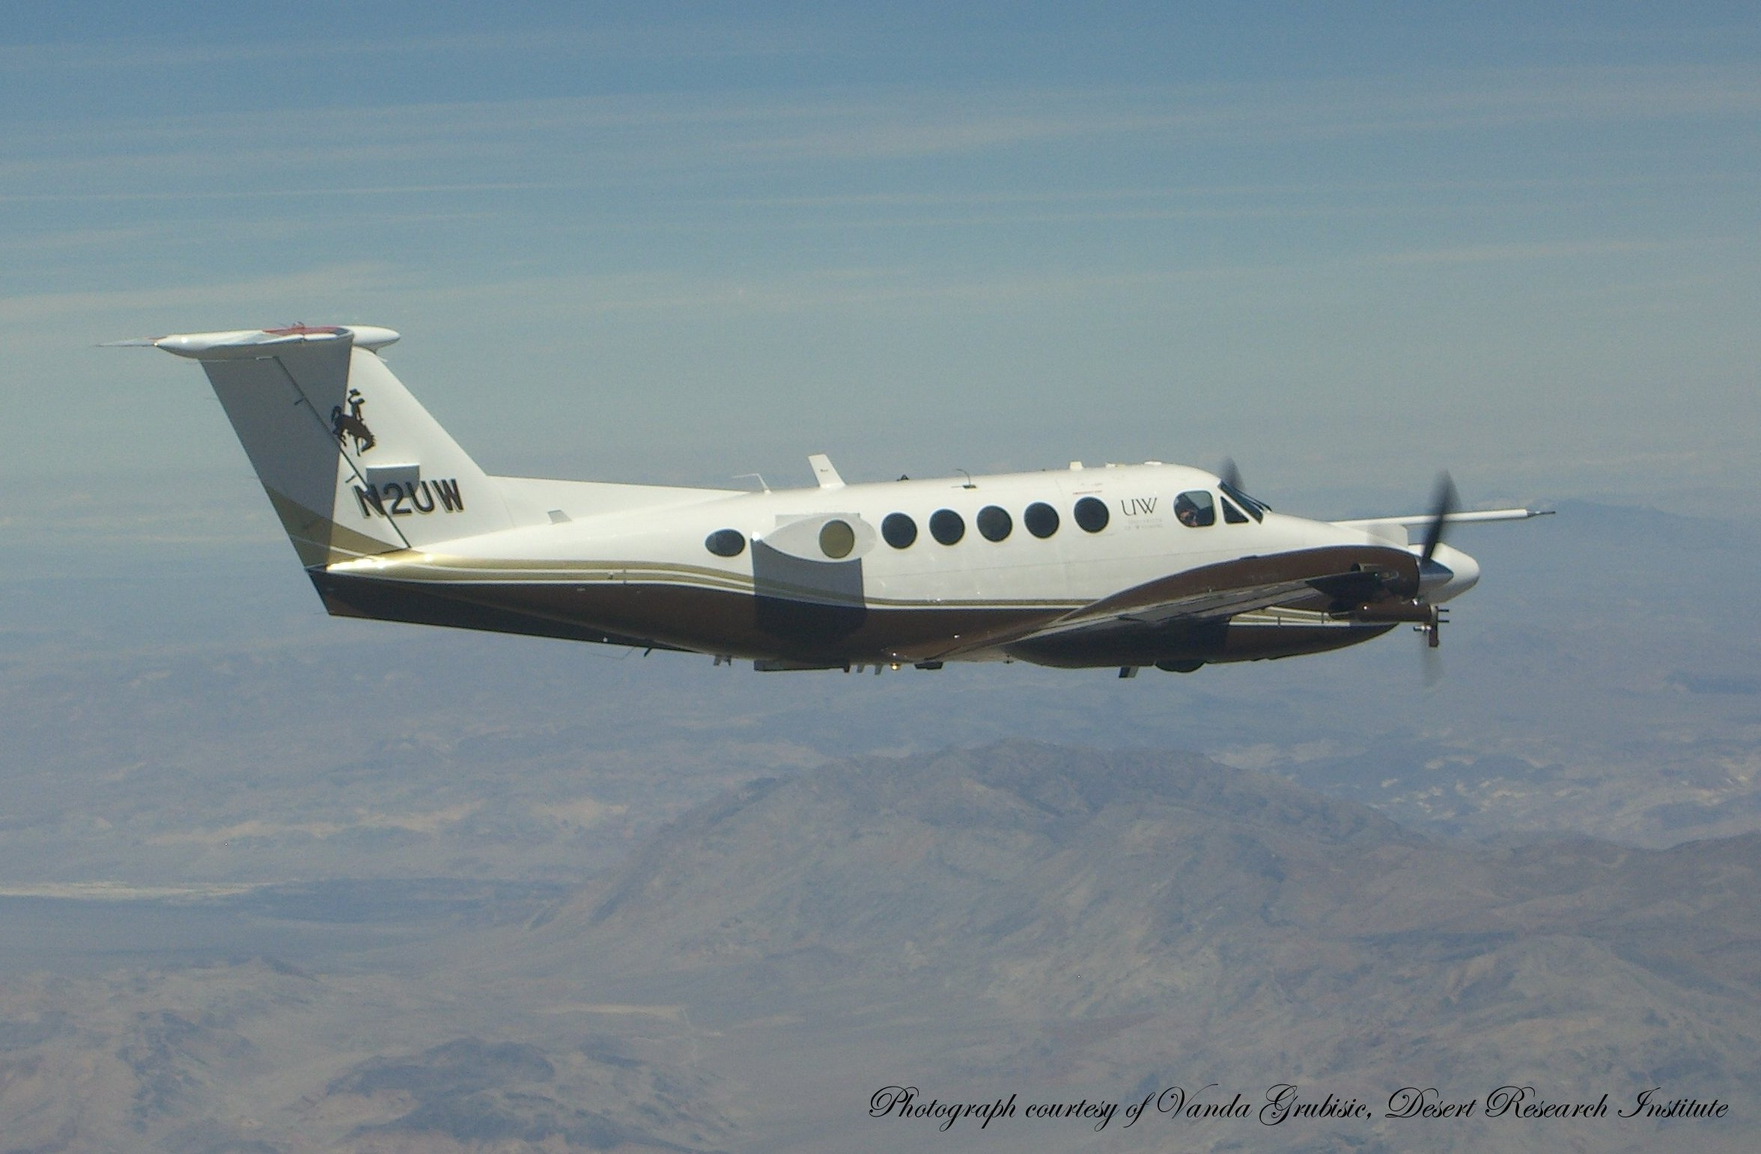
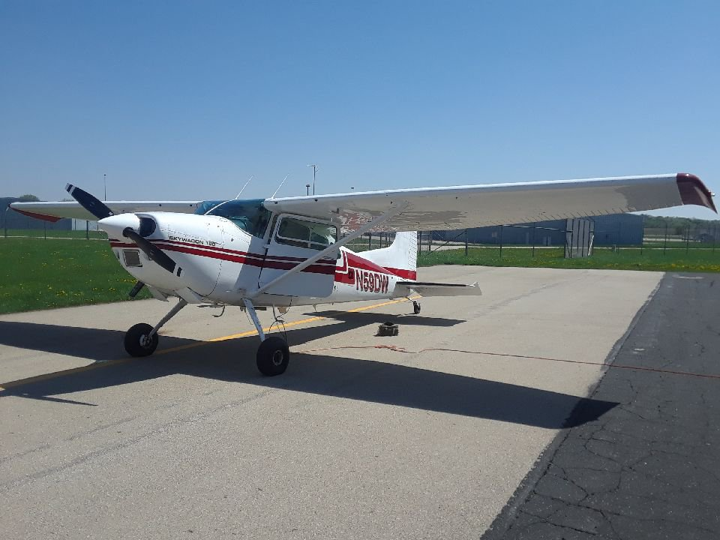
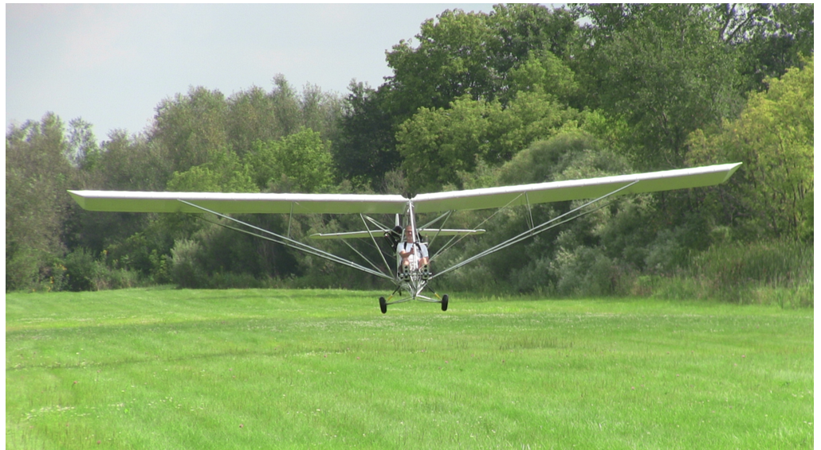

Slide 12
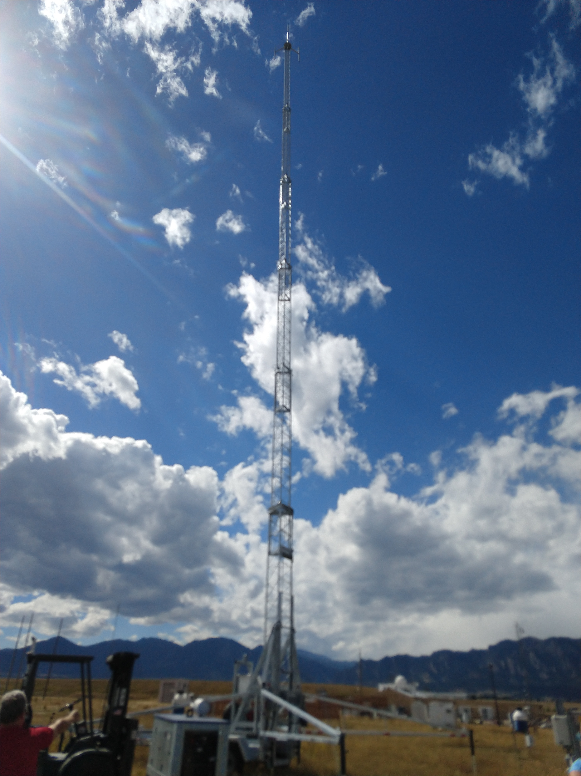
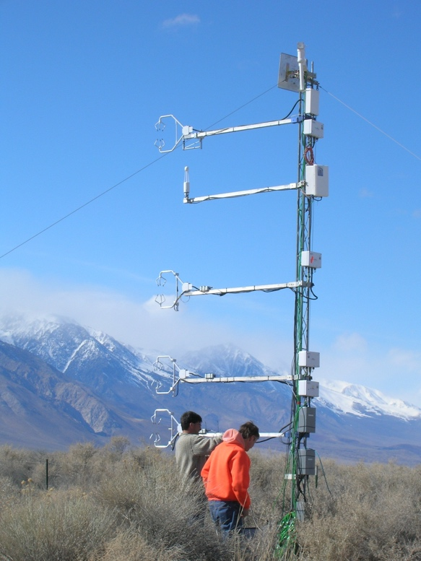

Slide 13
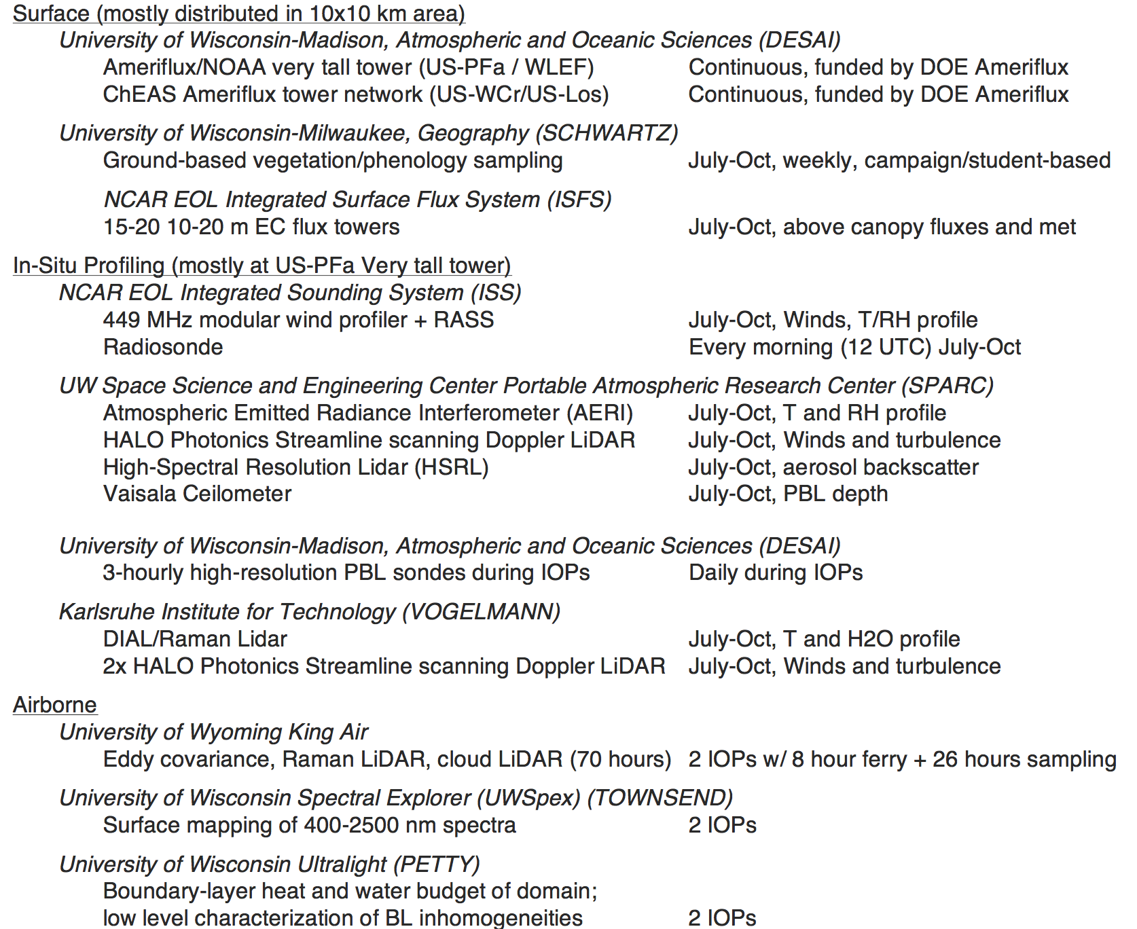
But will it work?

Slide 14
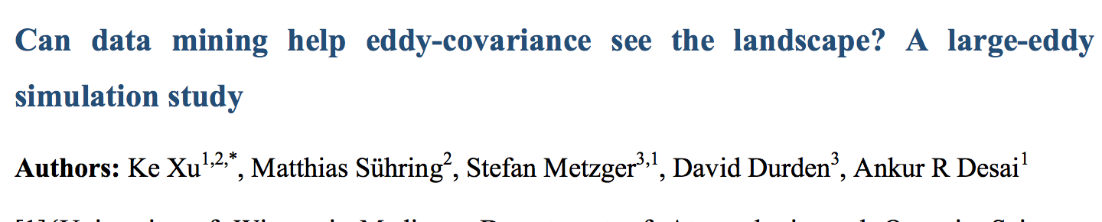
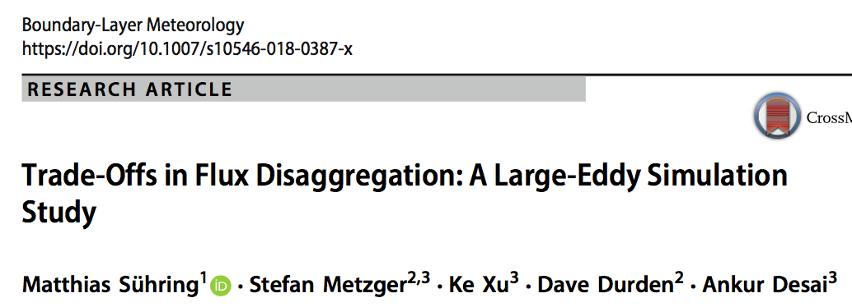
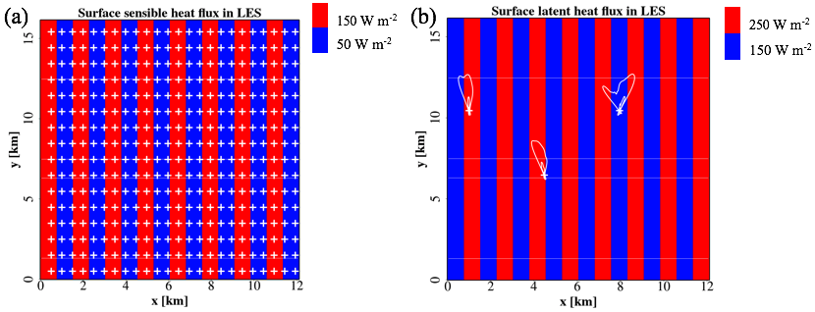
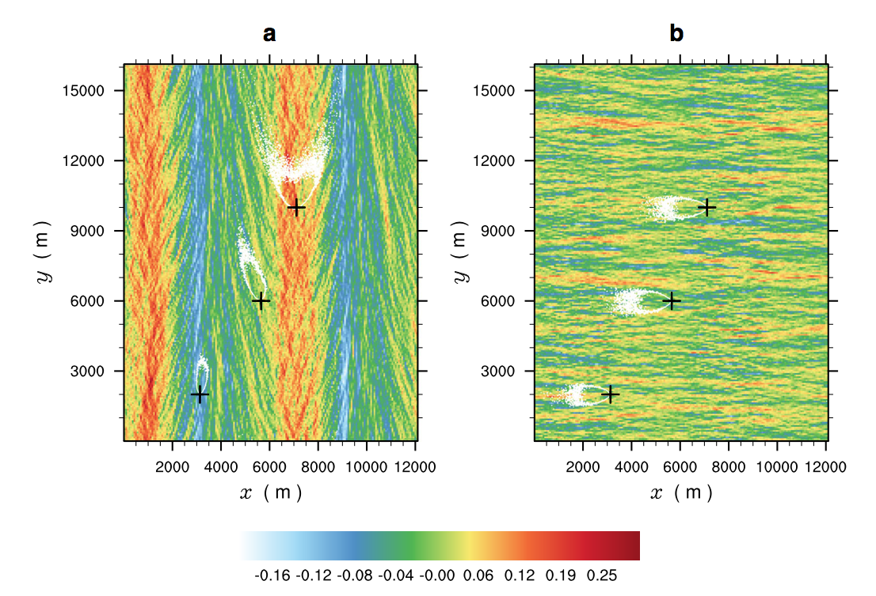

Slide 15
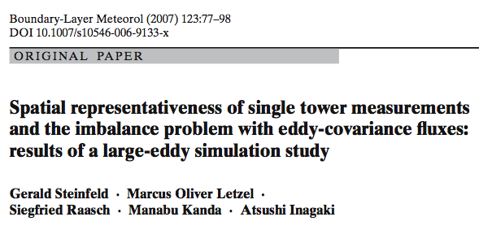
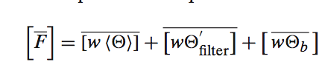
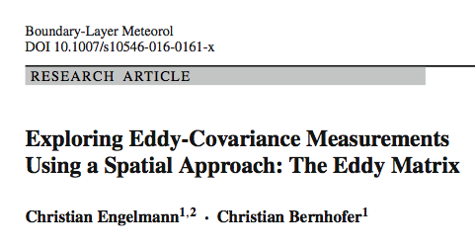
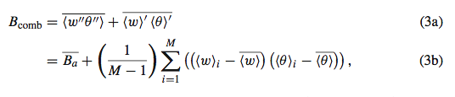
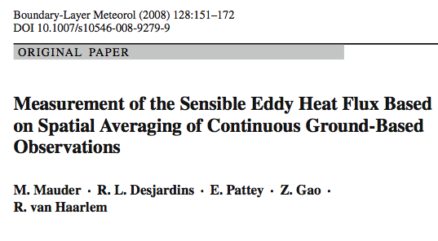
We can test 3 spatial eddy covariance methods that account for meso-scale eddies

Slide 16
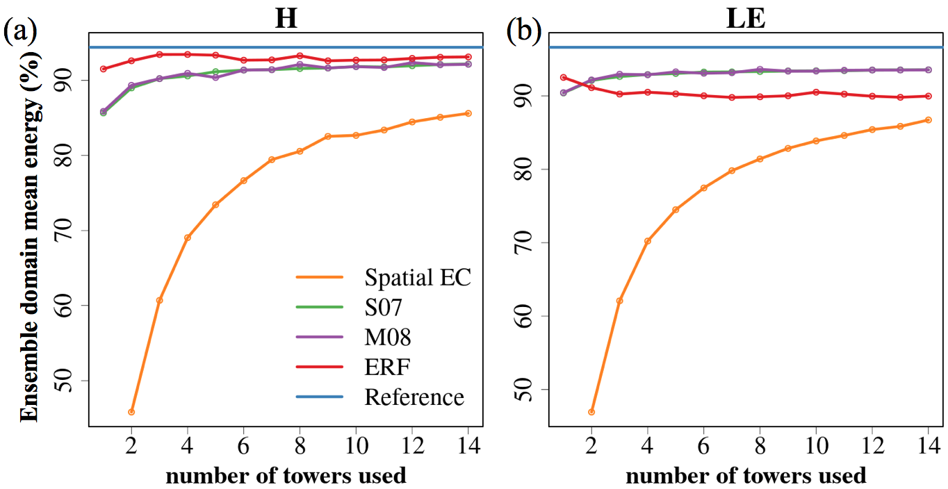
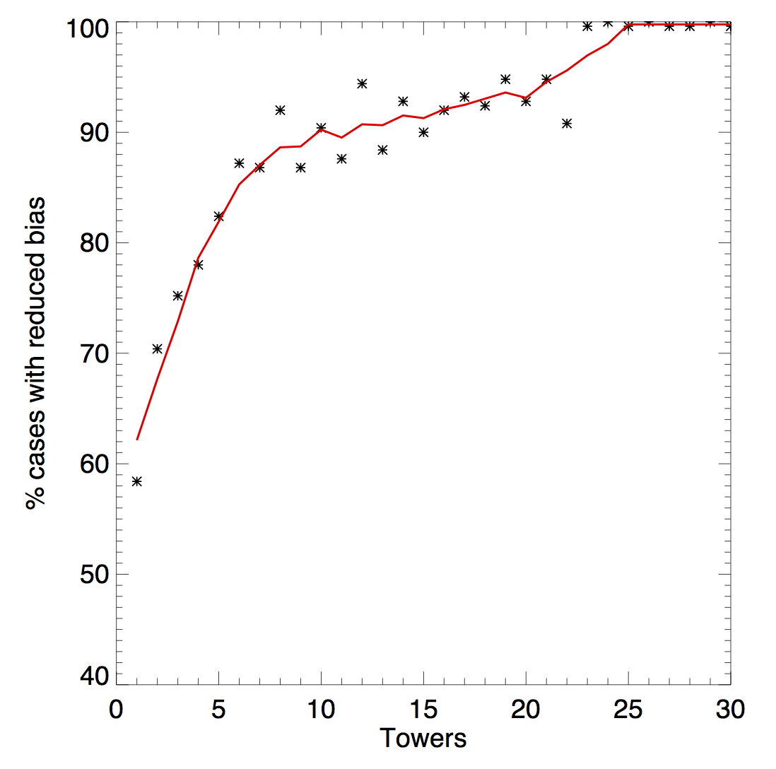
Spatial eddy covariance improves energy balance and more rapidly converges to domain mean flux than naïve upscaling
Spatial EC
Naïve upscaling
So we only need 70 million towers?
Xu et al, in review, BLM
What’s the ERF one?

Slide 17
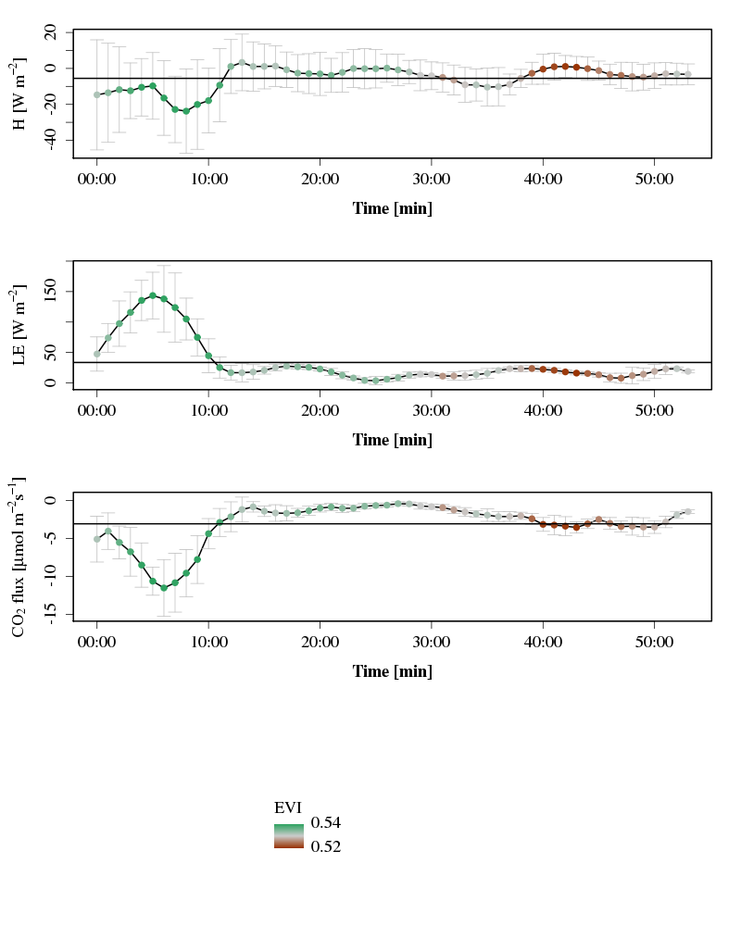
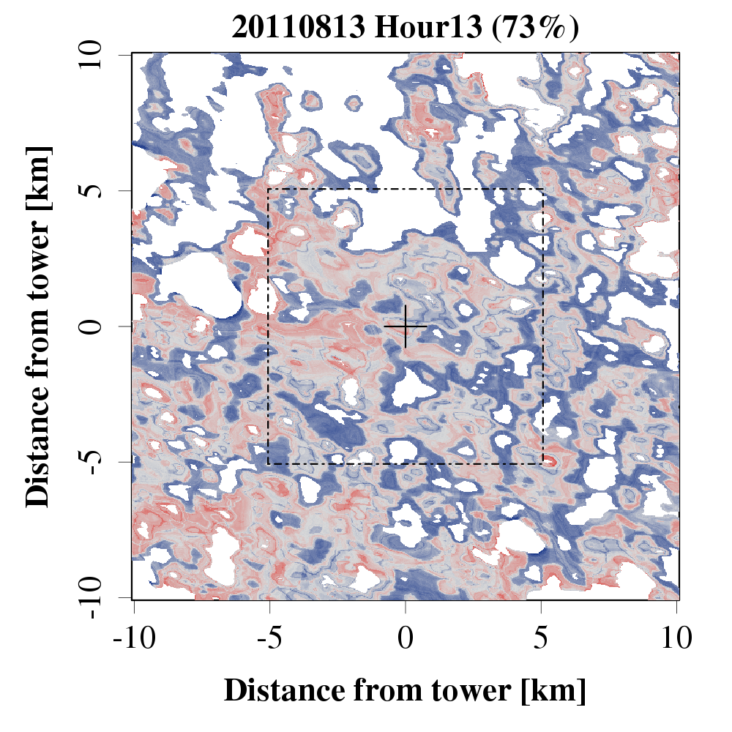
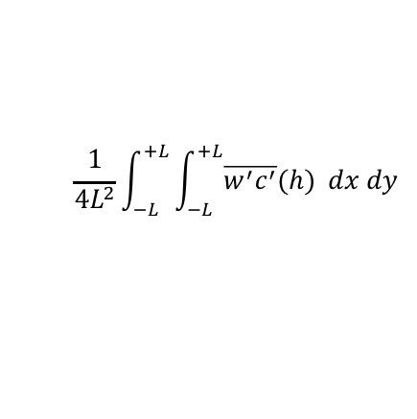


Environmental Response Function (ERF) scaling method
Metzger et al., 2013, Biogeosci , Xu et al., 2017, AFM, Metzger, 2018, AFM, Xu et al., 2018, AFM
High frequency time series of flux response and drivers
$$\overline{w^{′}c^{′}}(h)$$
$$\frac{1}{4L^{2}}\int_{−L}^{+L}{\int_{−L}^{+L}{\overline{w^{′}c^{′}}(h) }}dx dy$$
Domain-projected turbulent
flux at measurement level
Extracted relationships
B33I-2806: Inke Forbrich WED afternoon
$\int{\left[\frac{1}{4L^{2}}\int_{−L}^{+L}{\int_{−L}^{+L}{\frac{∂\overline{w^{′}c^{′}}}{∂z}}}dx dy\right]}$

Slide 18
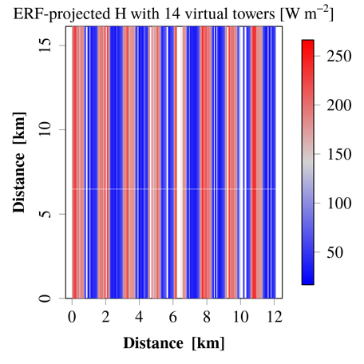
With 14 towers, we can recover highly heterogeneous fluxes in LES with ERF
Original
Xu et al, in review, BLM
Retrieved

Slide 19
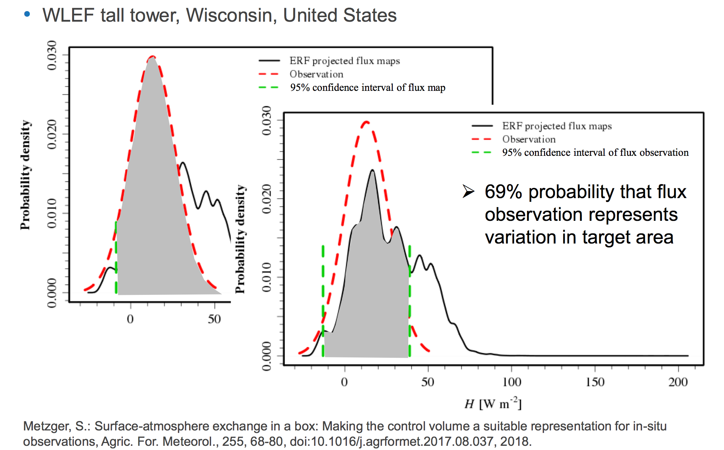
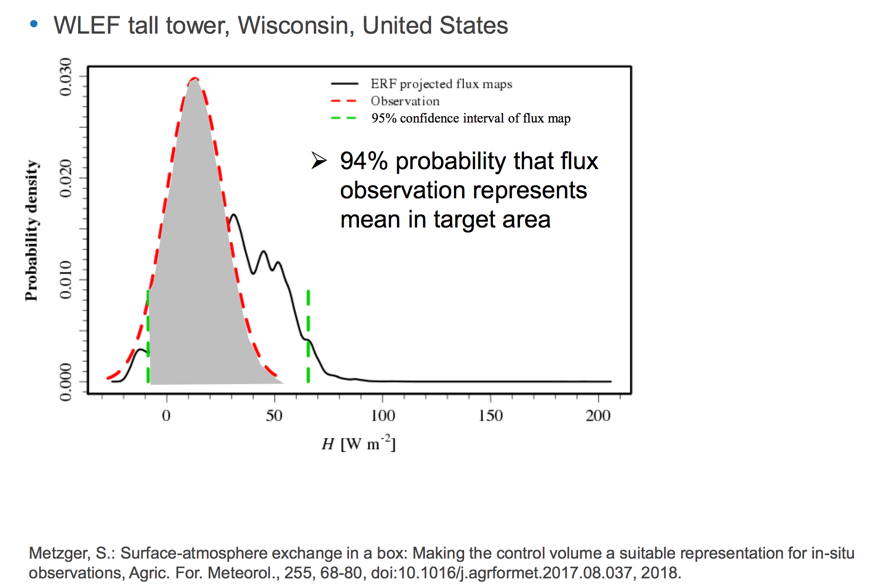
So how regional is our very tall tower?

Slide 20
We are looking for infinite collaborators!
Working on permitting now for tall tower clearing, USFS tower sites, FAA waivers
Towers to operate mid June 2019 to mid October 2019
All data (including raw turbulence) open-access, online < 6 months, NCAR hosted repository
Contact: Ankur Desai, desai@aos.wisc.edu 608-218-4208, Twitter: @profdesai
http://flux.aos.wisc.edu

