Slide 1
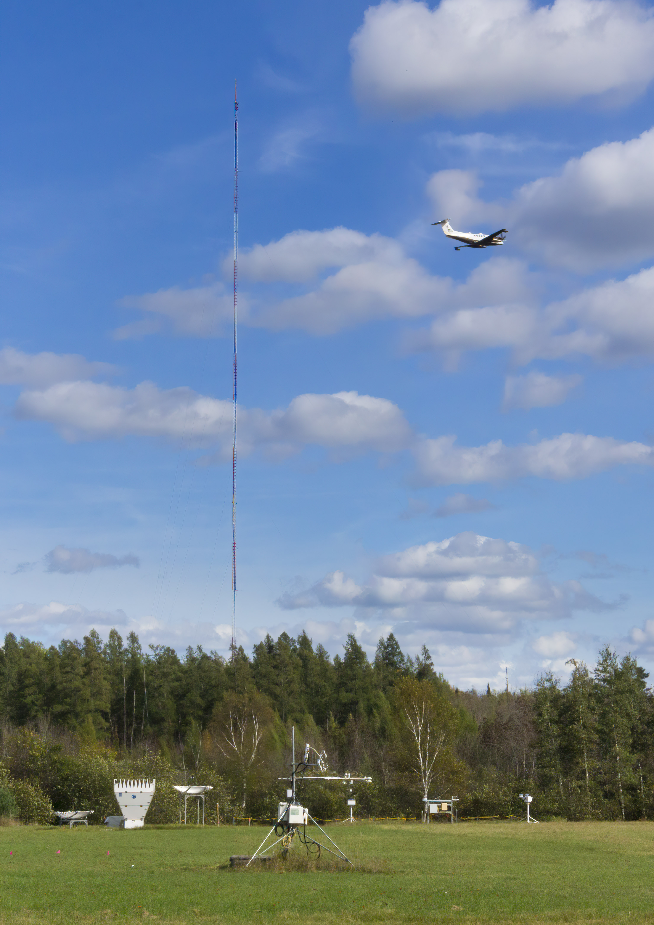
A Comparison of Temporal and Spatial Eddy Covariance for Investigating Energy Balance Closure over a Heterogeneous Ecosystem
Brian J. Butterworth, Ankur R. Desai, Sreenath Paleri, Stefan Metzger, David Durden, Christopher Florian, Matthias Mauder, Luise Wanner
Agricultural and Forest Meteorology Meeting
June 23, 2021

Slide 2
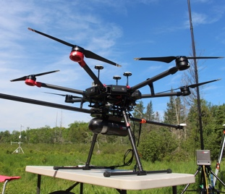
CHEESEHEAD19 project
Chequamegon Heterogeneous Ecosystem Energy-balance Study Enabled by a High-density Extensive Array of Detectors 2019
Objectives
Determine how spatial heterogeneity of the land surface impacts the Earth’s energy balance
Evaluate the hypothesis that mesoscale features are an important cause of energy balance non-closure
Measurements
10×10 km - heterogeneous forest in Wisconsin
1 very tall (447-m) tower
19 eddy covariance towers
Lidar, sodar, and radar for profiles of U, H₂O, T
Airborne eddy covariance

Slide 3
NCAR EOL Integrated Surface Flux System
Tower Network
19 EC towers
Measured HS, HL, RN, and ground flux
Installed over a variety of surface types:
evergreen forest
deciduous forest
wetlands
lakes

Slide 4
Energy balance map
$$\frac{H_{S}+H_{L}}{R_{N}−G}$$

Slide 5
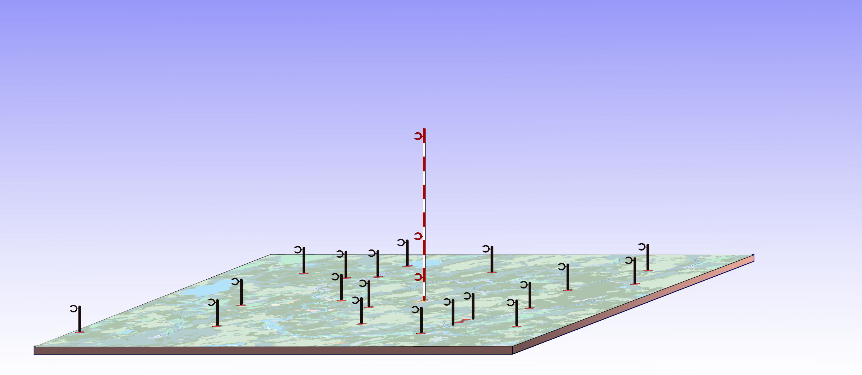
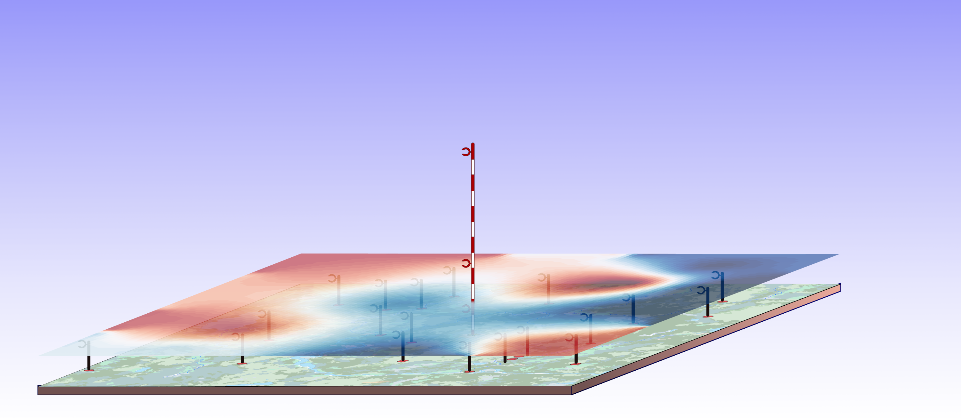
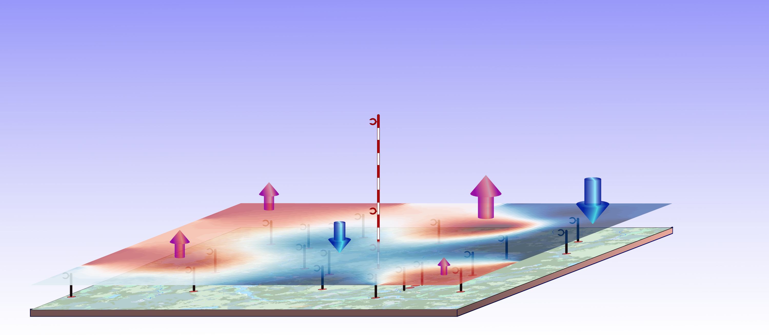
Are these patterns due to mesoscale eddies?
If so, how can we account for them?

Slide 6
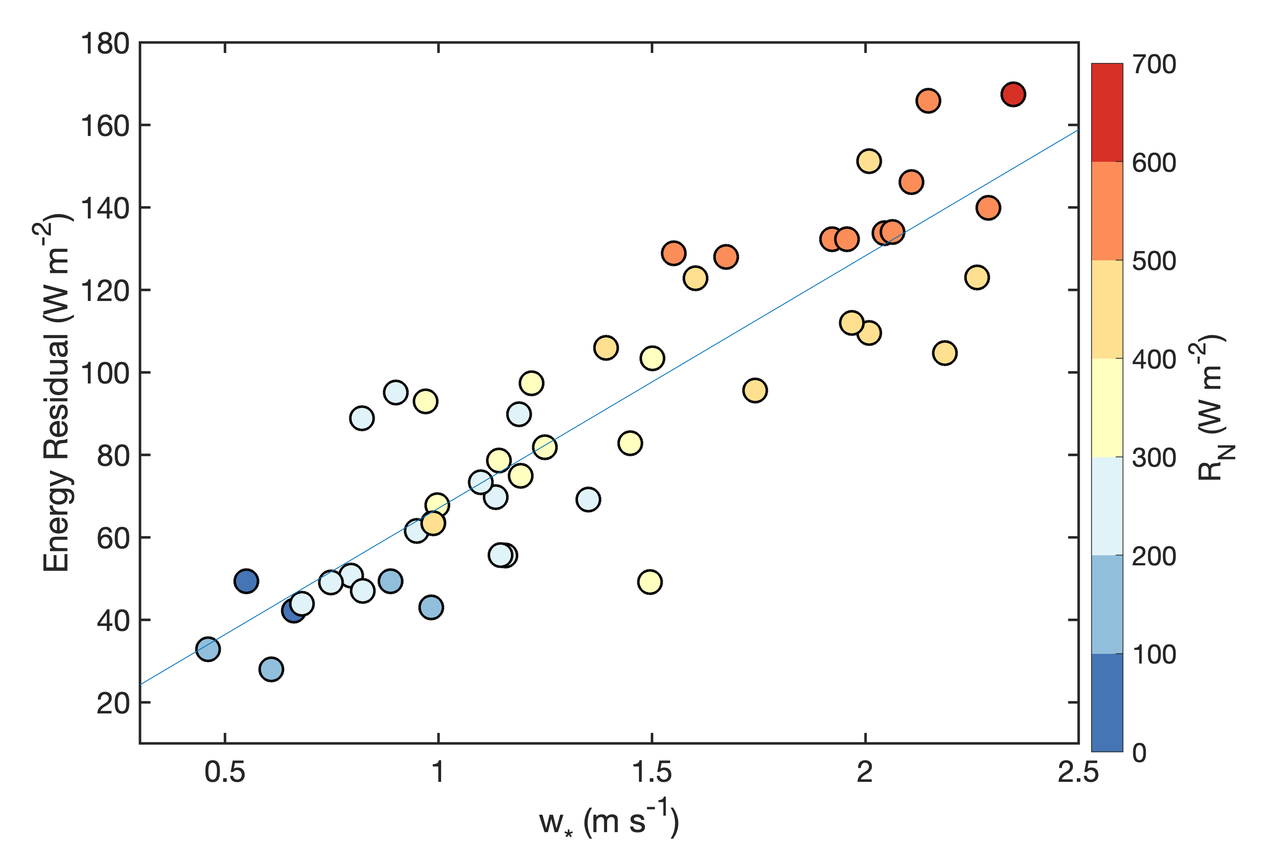
Mesoscale eddies influence energy balance
larger scale eddies are at least partially responsible for energy balance non-closure

Slide 7
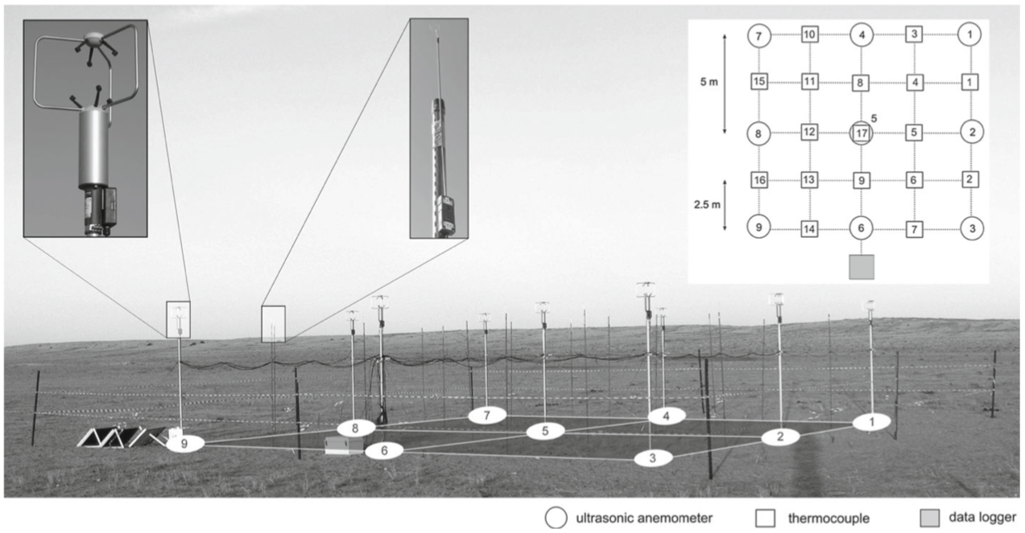
Can Spatial EC improve energy balance closure?
Unlike traditional EC, in which spatial information of eddies is inferred by assuming turbulence is “frozen” (Taylor 1938) as it advects past a single EC tower…
Spatial EC samples eddies simultaneously across multiple sites
Previous Studies:
Eddy Matrix: 10 m x 10 m - Engelmann and Bernhofer (2016)
IPAQS: 1 km x 1 km - Morrison et al. (2021)
Ottawa Experiment: 3.5 × 3.5 km - Mauder et al. (2008)
LES studies: - Steinfeld et al. (2007), Xu et al. (2020)

Slide 8
Can Spatial EC improve energy balance closure?
Recent LES results (Xu et al. 2020) showed:
Spatial EC captured 89% of prescribed energy fluxes
Spatio-temporal captured 95% of prescribed energy fluxes with even fewer towers (reducing energy balance non-closure)
Our goal: to test these findings with field data

Slide 9
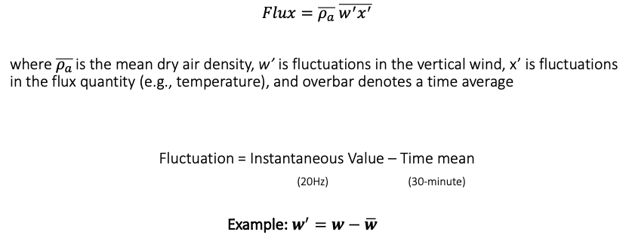
Temporal Eddy Covariance
Example: w′=w−⟨w⟩

Slide 10
Spatial Eddy Covariance
For the spatial eddy covariance:
Fluctuation = Instantaneous Value – Spatial mean
(where the spatial mean represents the mean value across many sites)
Example:
For the spatio-temporal eddy covariance:
Fluctuation = Instantaneous Value – Space-time mean
(where the space-time mean represents the mean value across many sites over a given period of time)
Example:
$$w′=w−⟨w⟩$$
$$w′=w−\overline{⟨w⟩}$$
Example: w′=w−⟨w⟩
Notes:
For this analysis:
Temporal EC data were calculated for each tower individually and then averaged to get domain-wide fluxes
Spatial and spatio-temporal EC were calculated across all flux towers as if the entire set of towers was one super site. Note, this is different from spatial EC as originally conceived, whereby a flux time series is produced for each tower separately. Here we’ve built on that approach by processing data from all towers as samples in one flux calculation. Assuming the towers sufficiently sample landscape variation, the final flux time series represents the domain-wide flux.

Slide 11
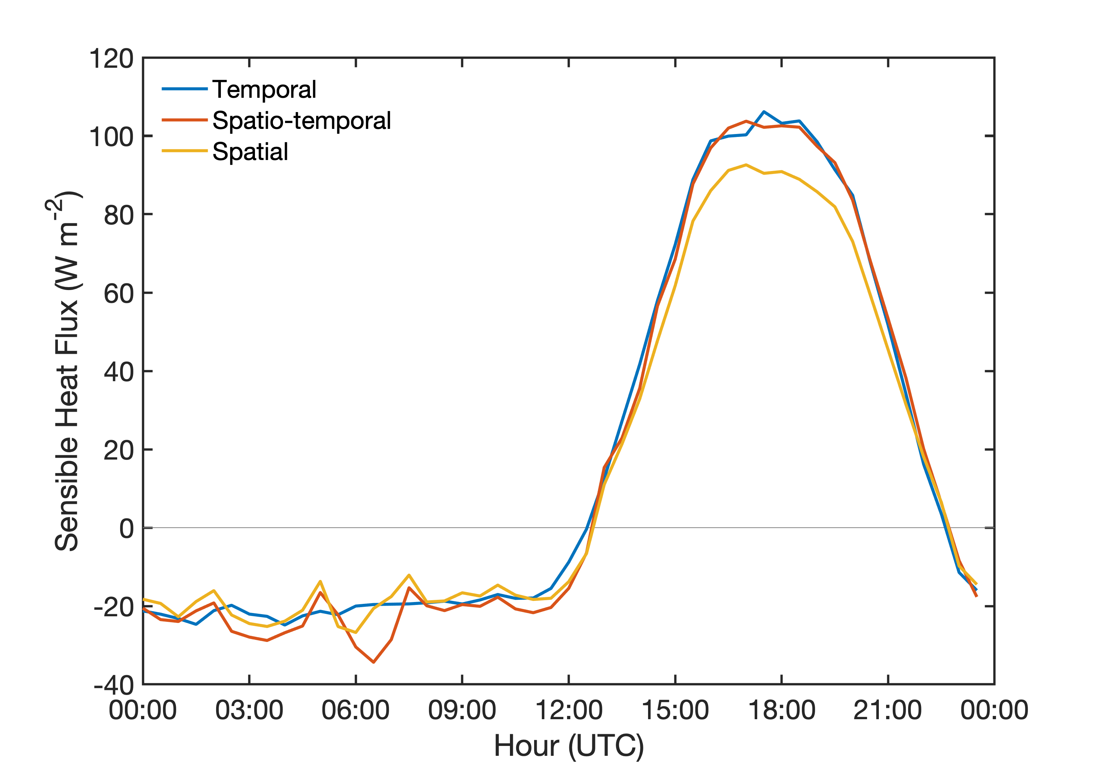
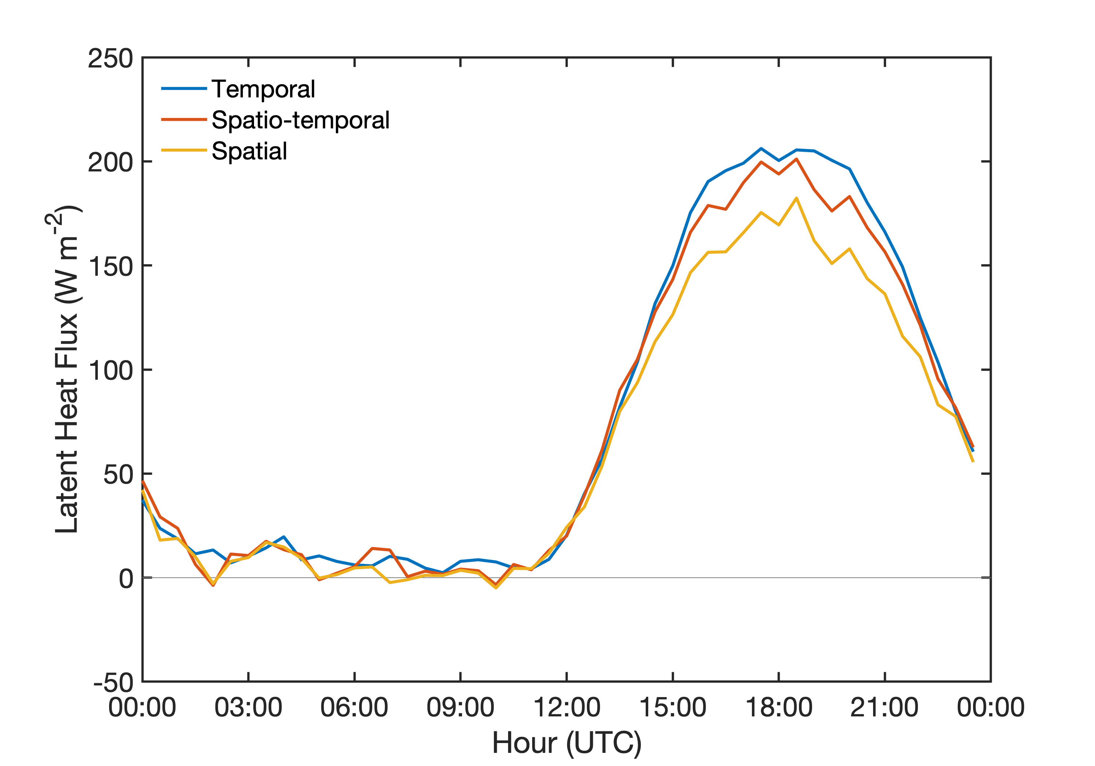
Mean Diurnal Fluxes
(all towers, 4-month study period)
What matters to energy balance is how latent and sensible heat flux change
Calculation notes: all sites rotated plumb to gravity, with no detrending of the signals

Slide 12
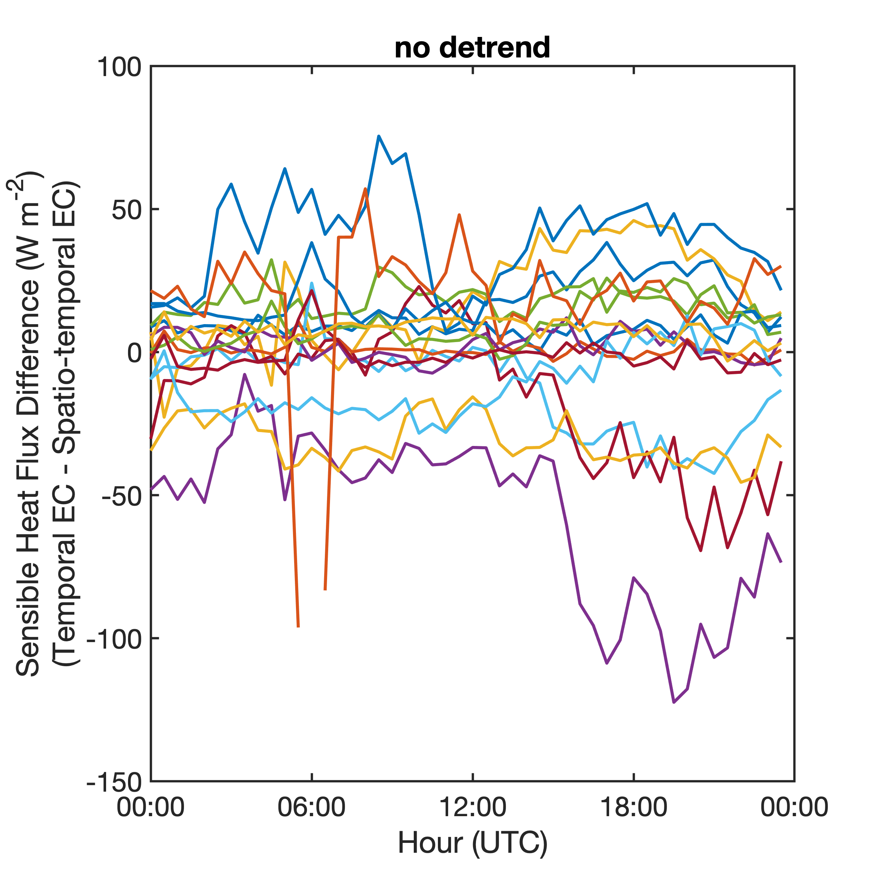
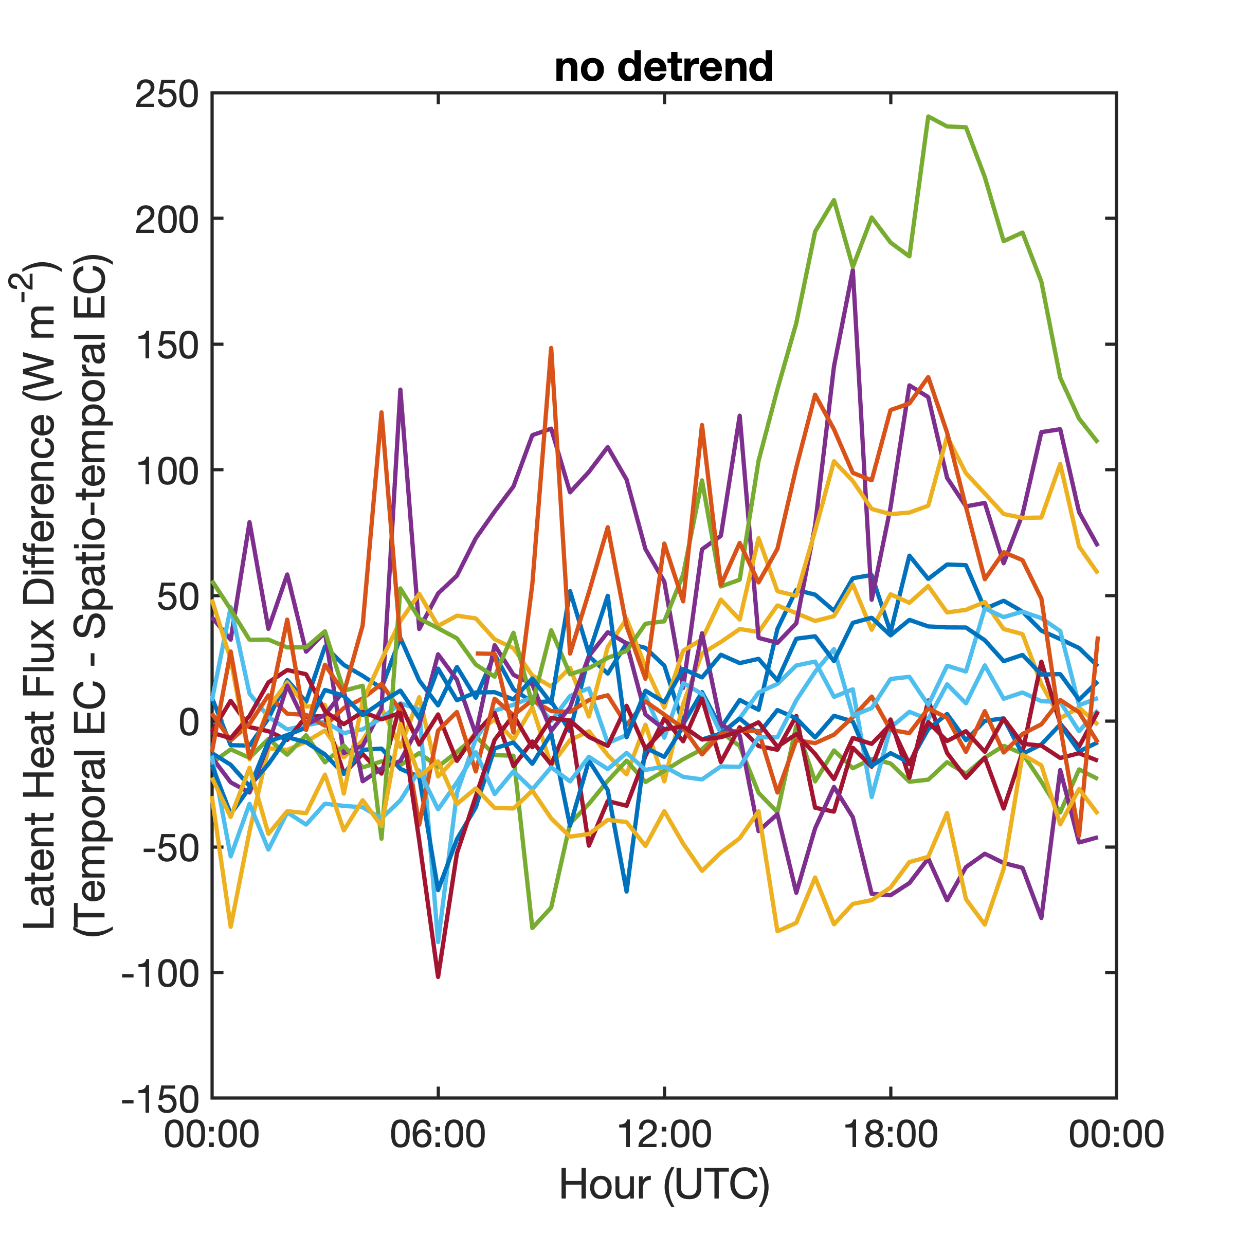
Mean Diurnal Flux Differences
(colors represent different towers)
large differences between temporal and spatio-temporal EC fluxes at individual sites

Slide 13
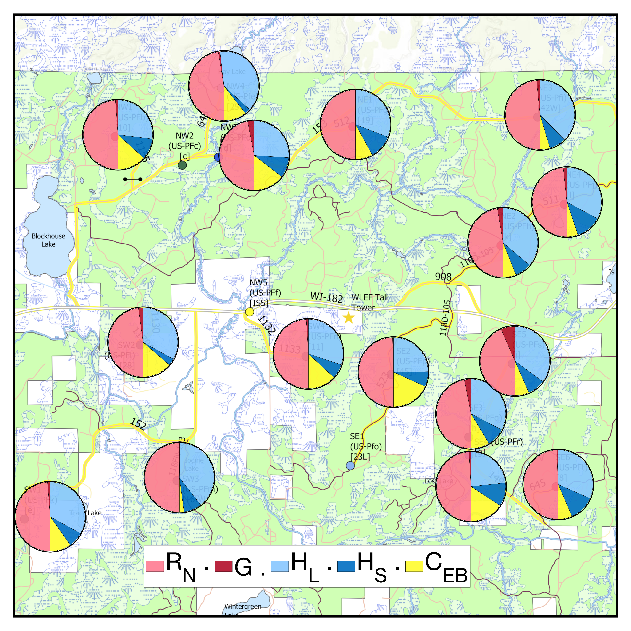
Temporal Spatio-temporal
Project average (4-month) mean diurnal energy balance components
Large differences in energy balance. Some sites C_{EB} goes up, some sites it goes down.

Slide 14
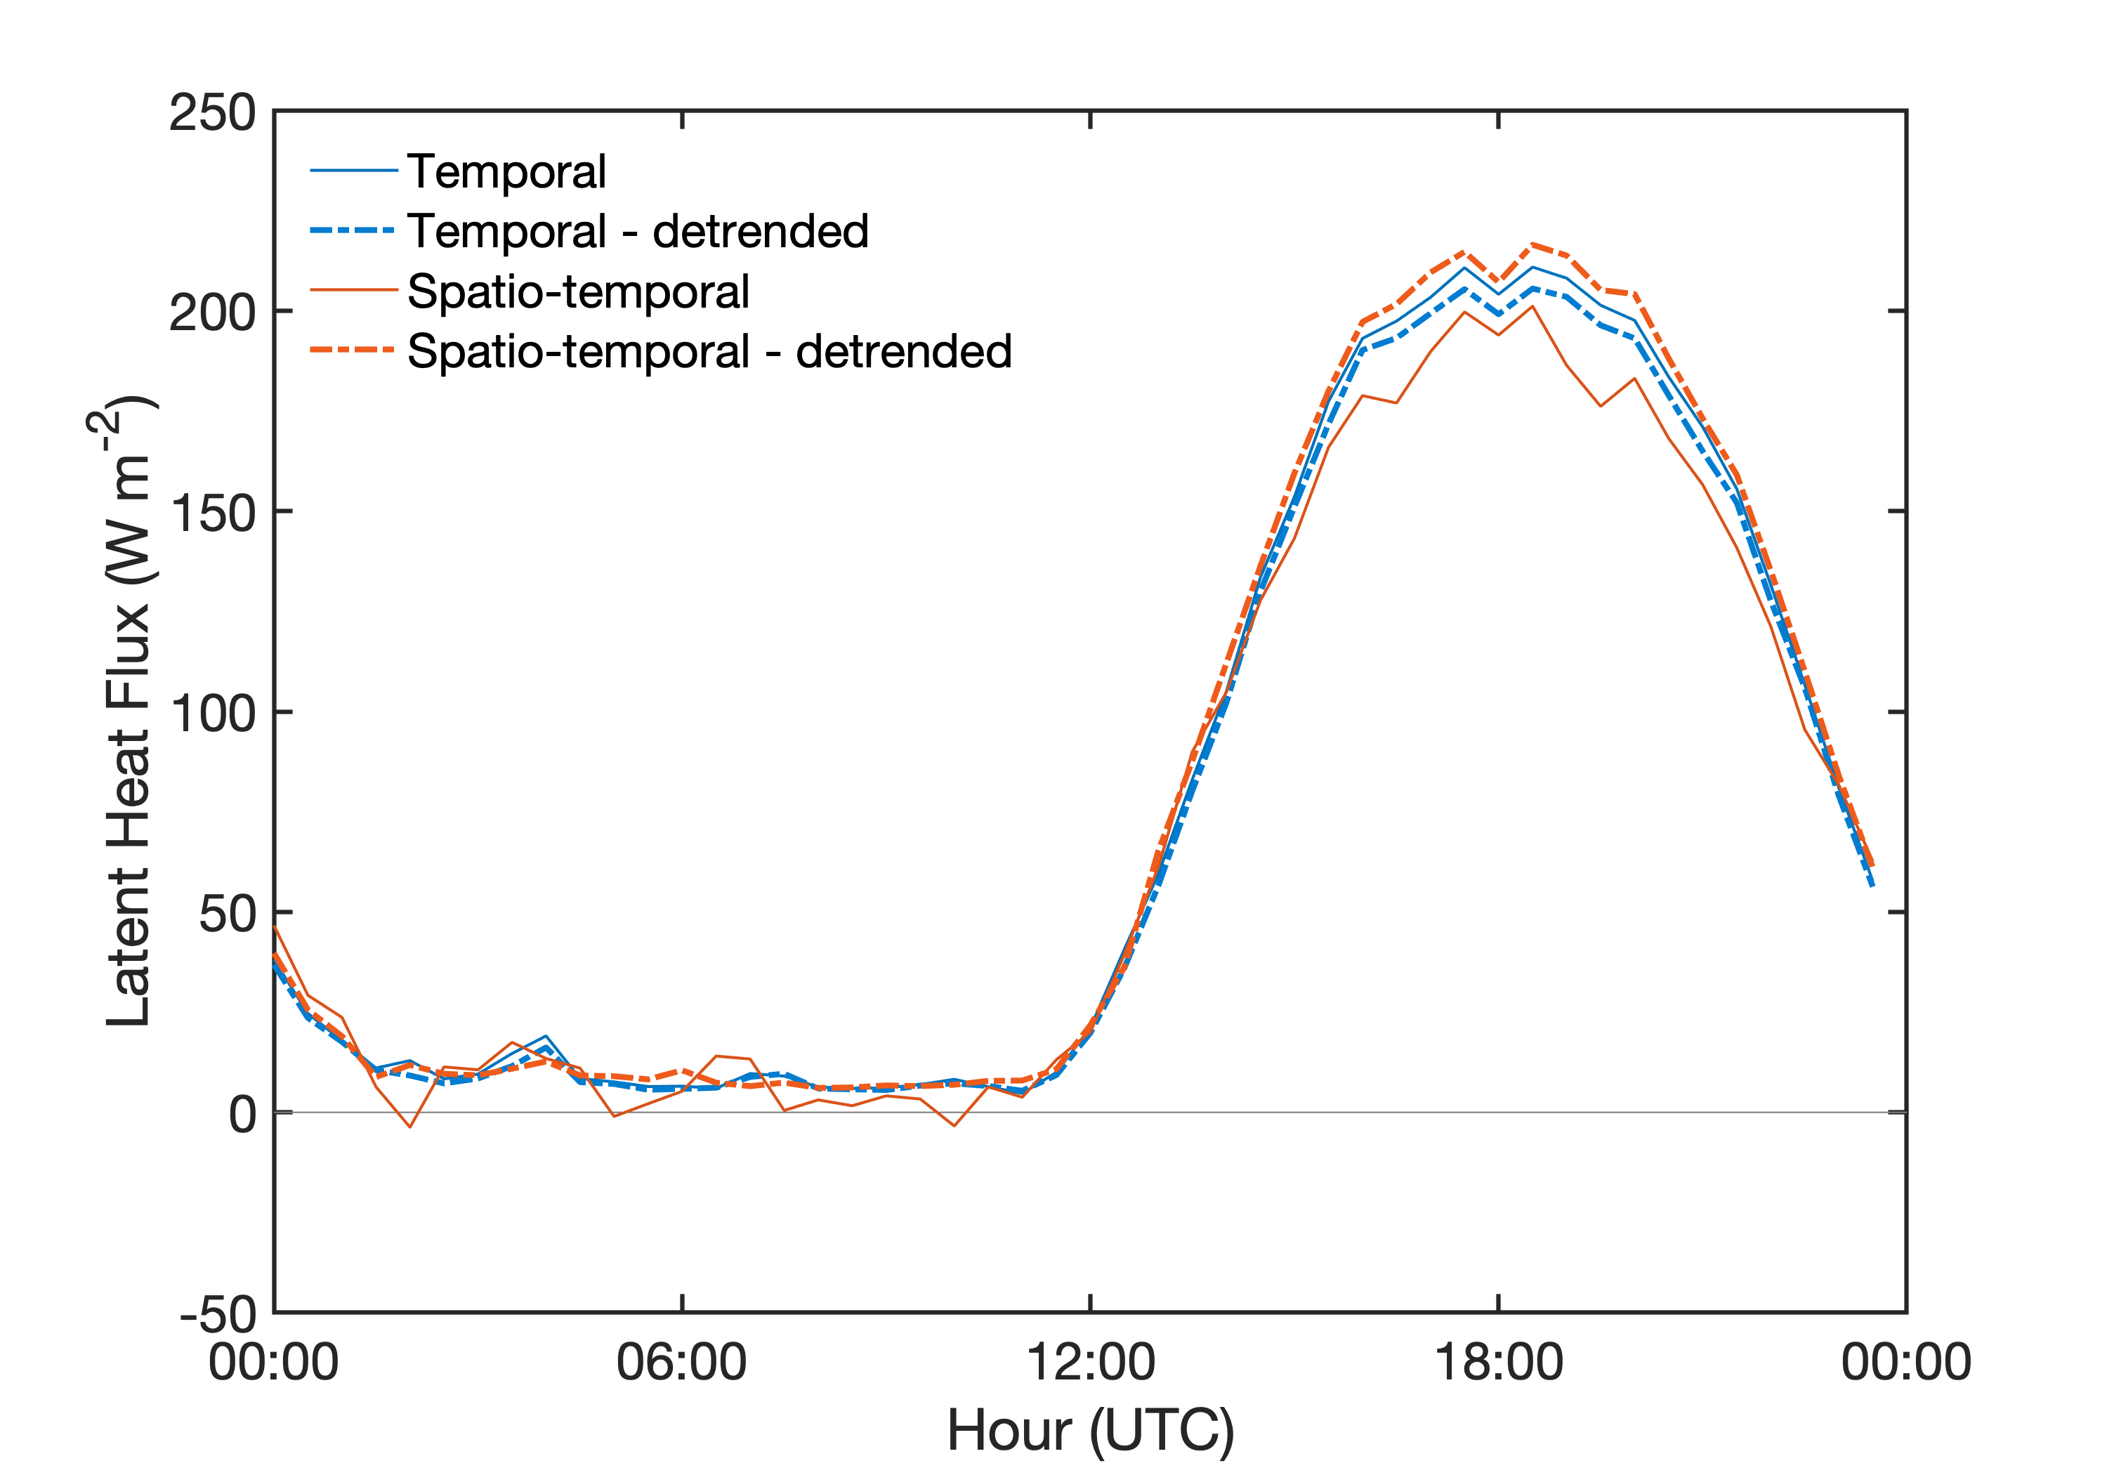
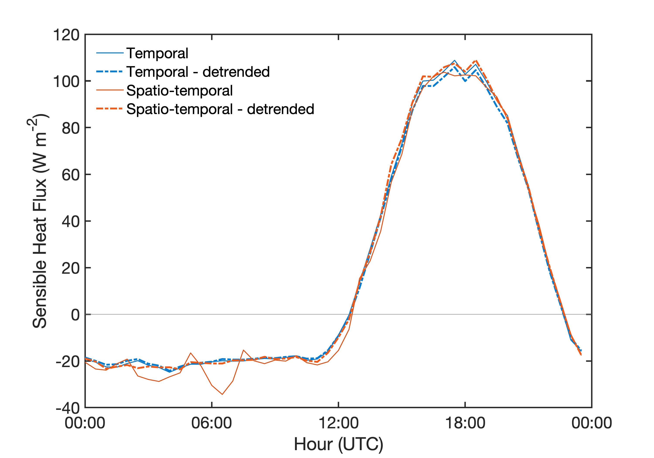
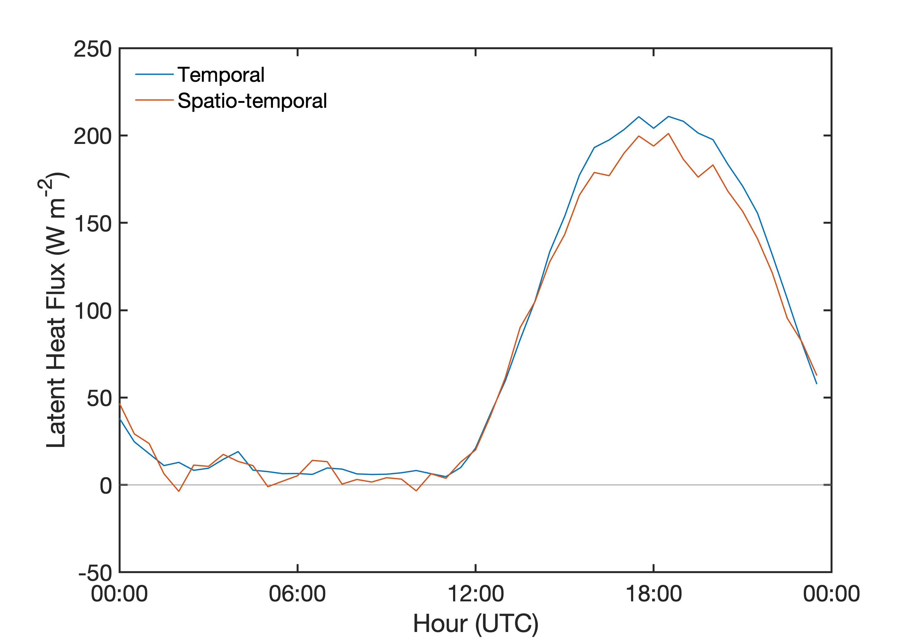
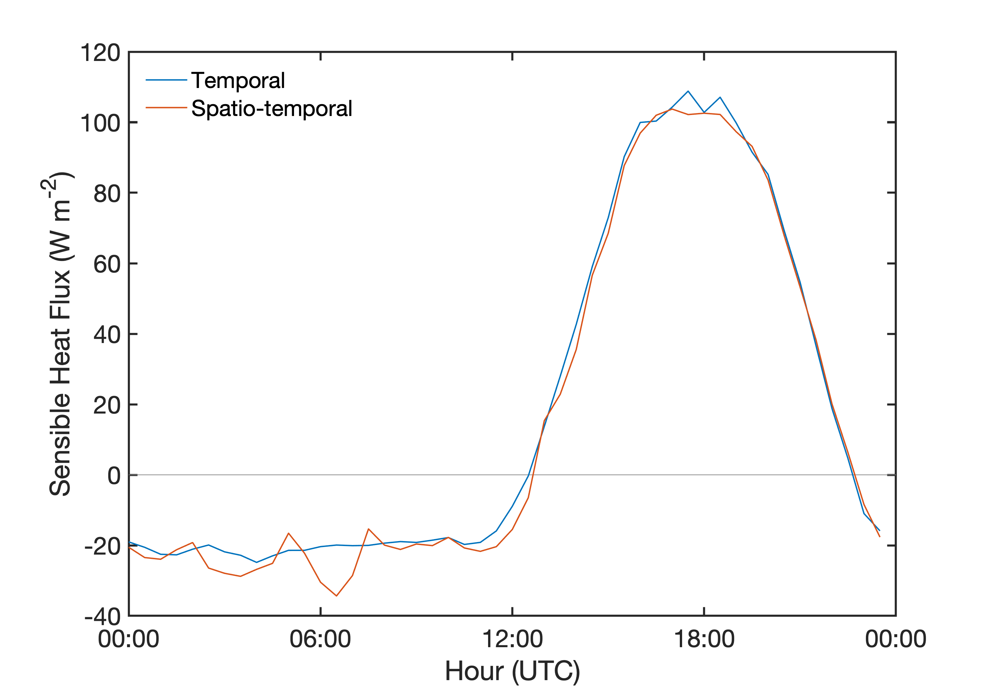
Mean Diurnal Fluxes
(all towers, 4-month study period)

Slide 15
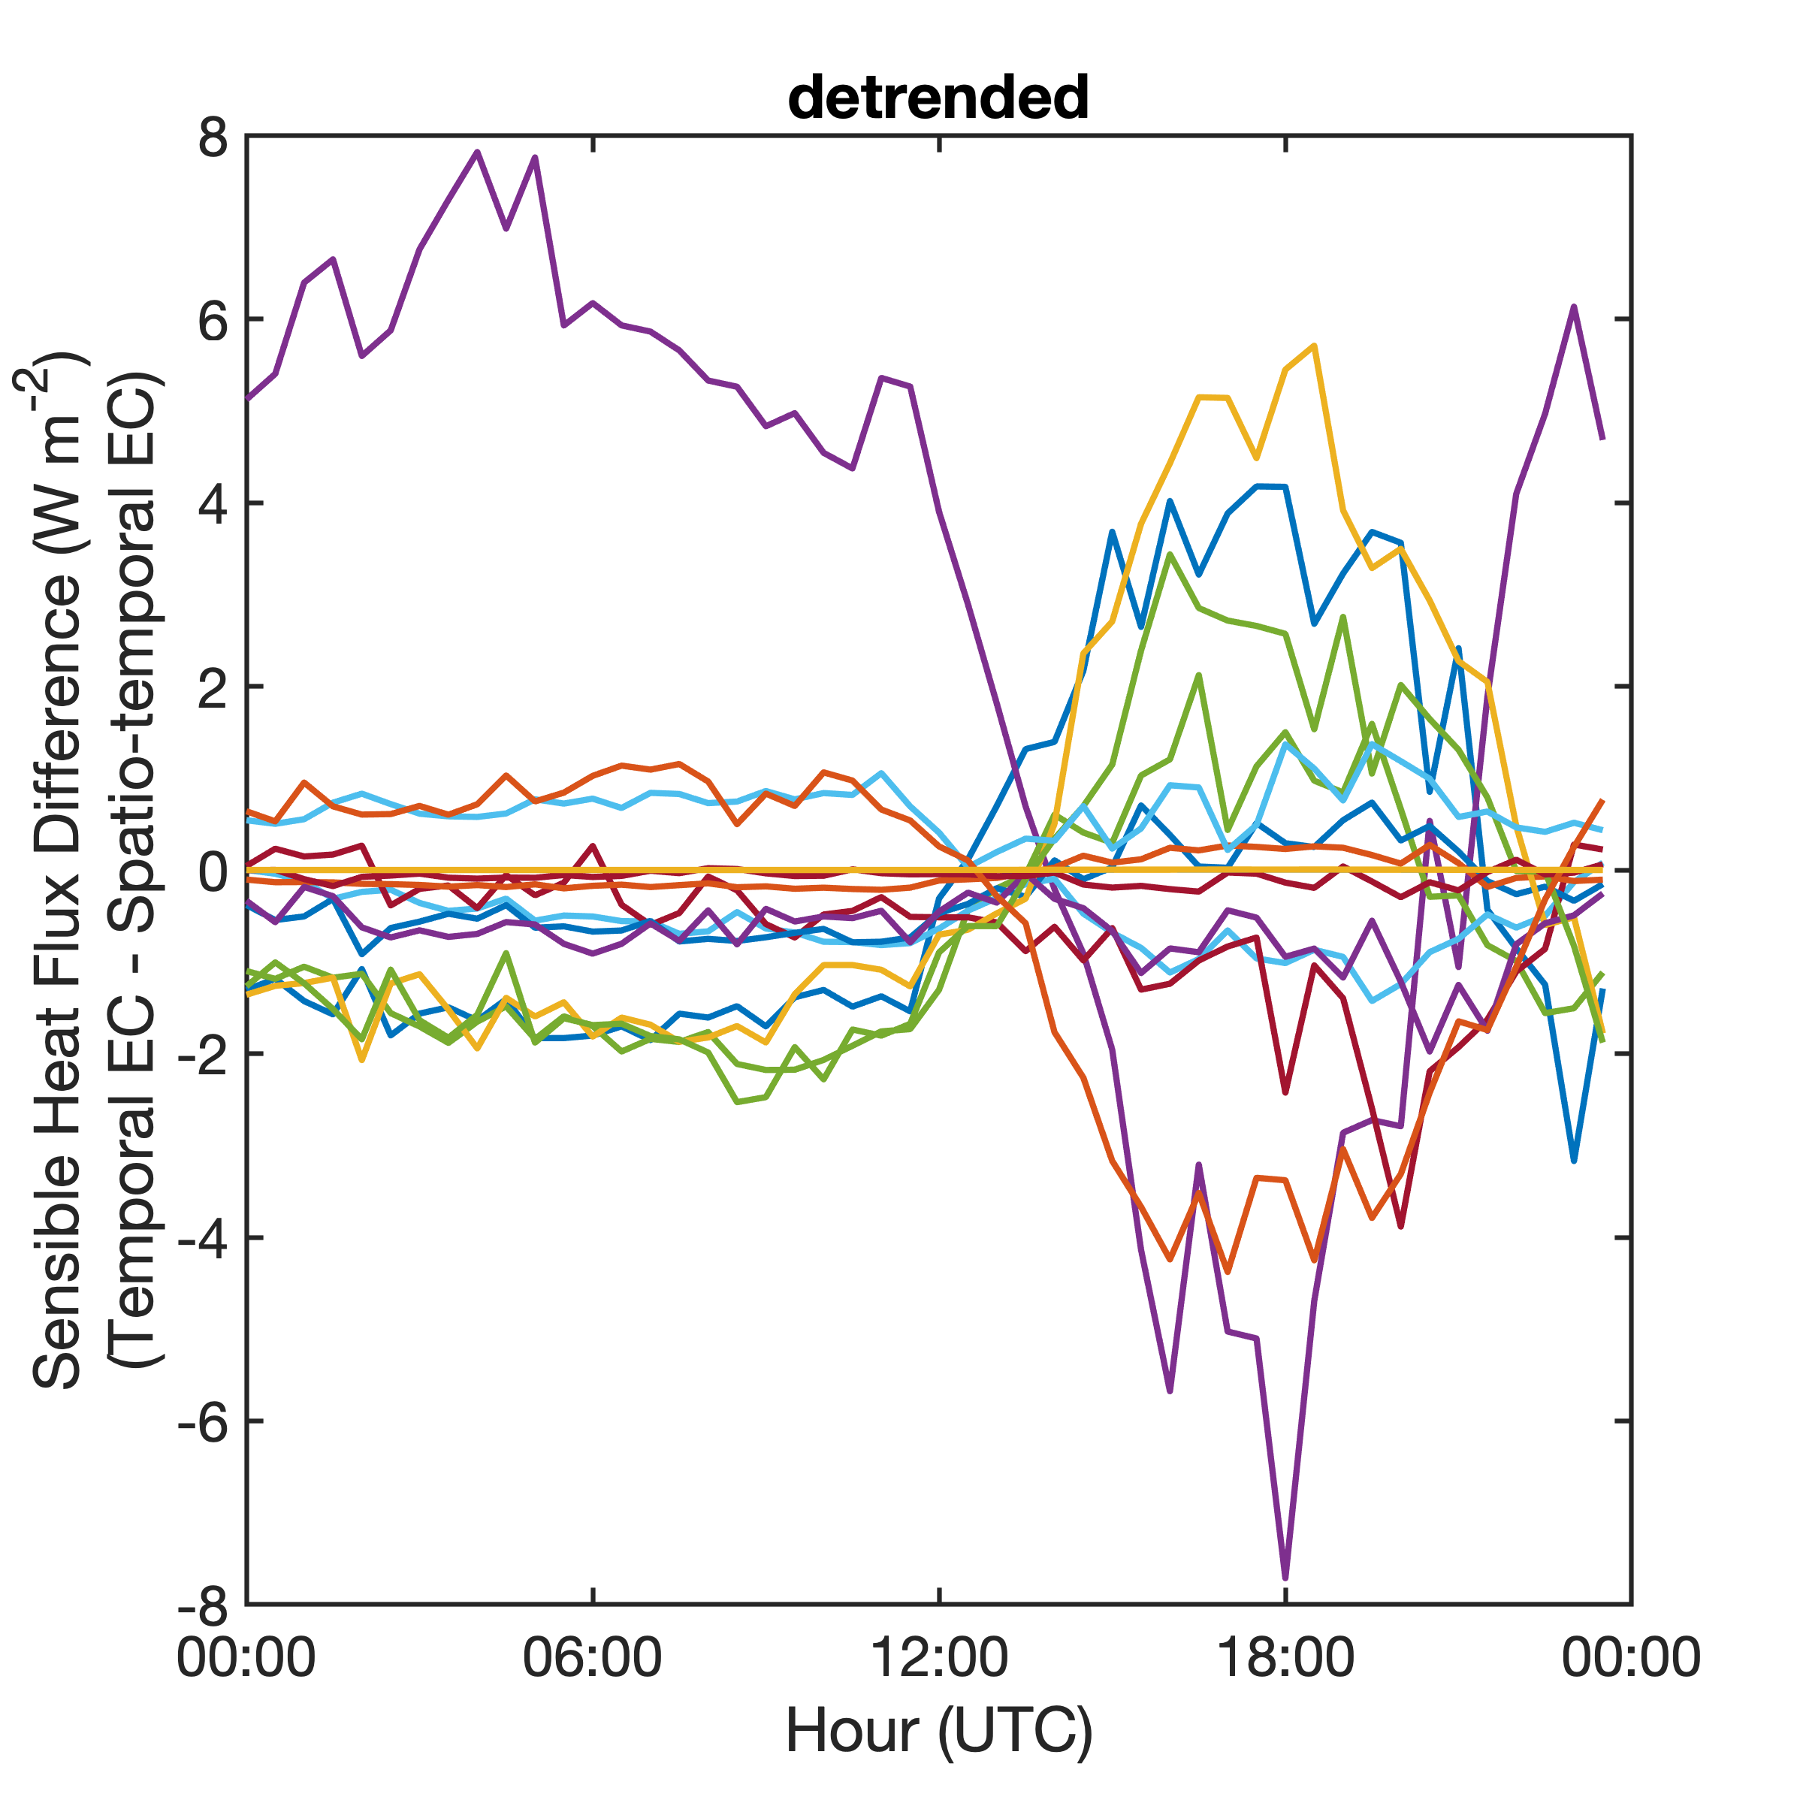
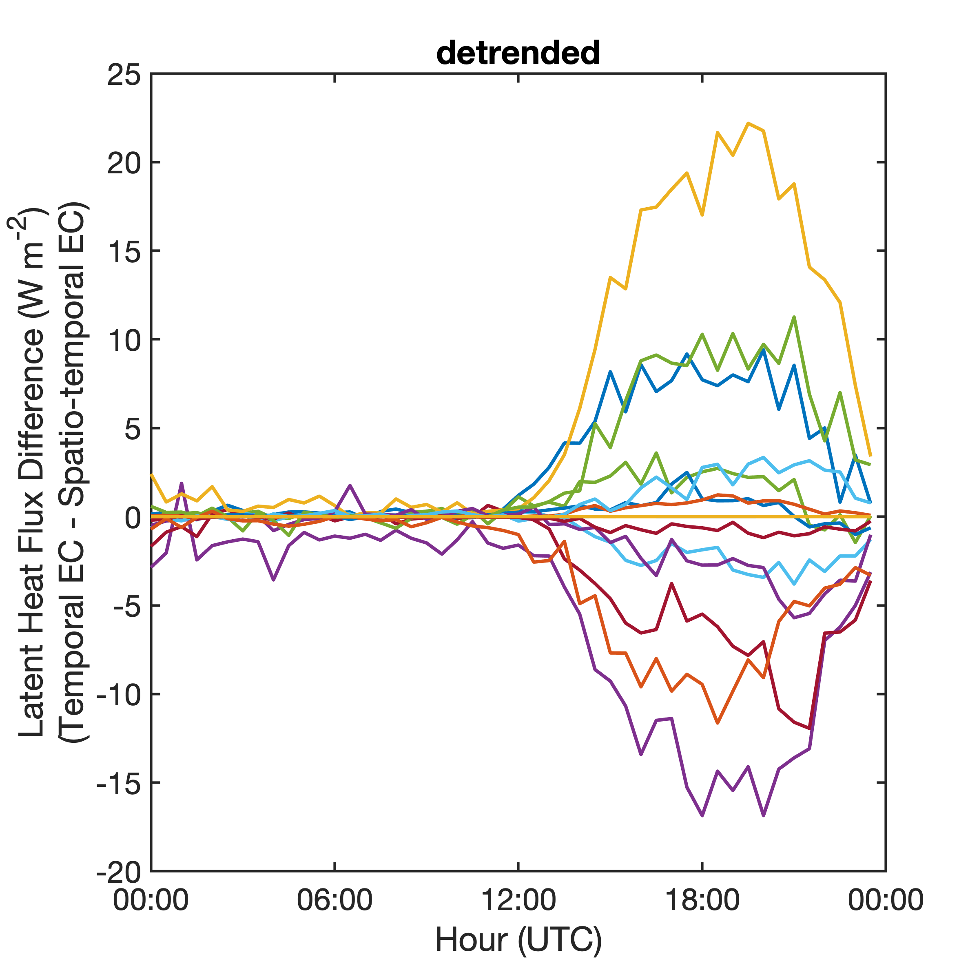
Mean Diurnal Flux Differences
(colors represent different towers)

Slide 16
Project average (4-month) mean diurnal energy balance components
Temporal
Spatio-temporal
Small differences in energy balance. At most sites C_{EB} decreases slightly.

Slide 17
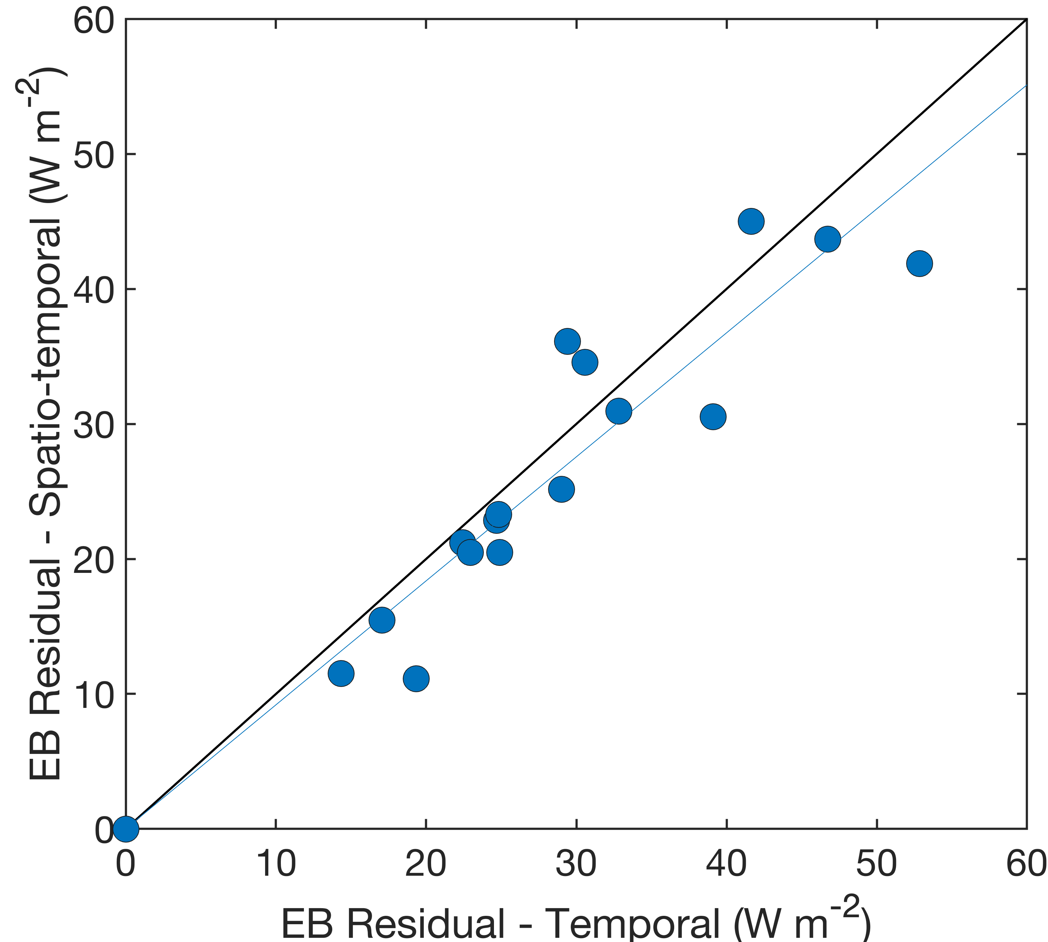
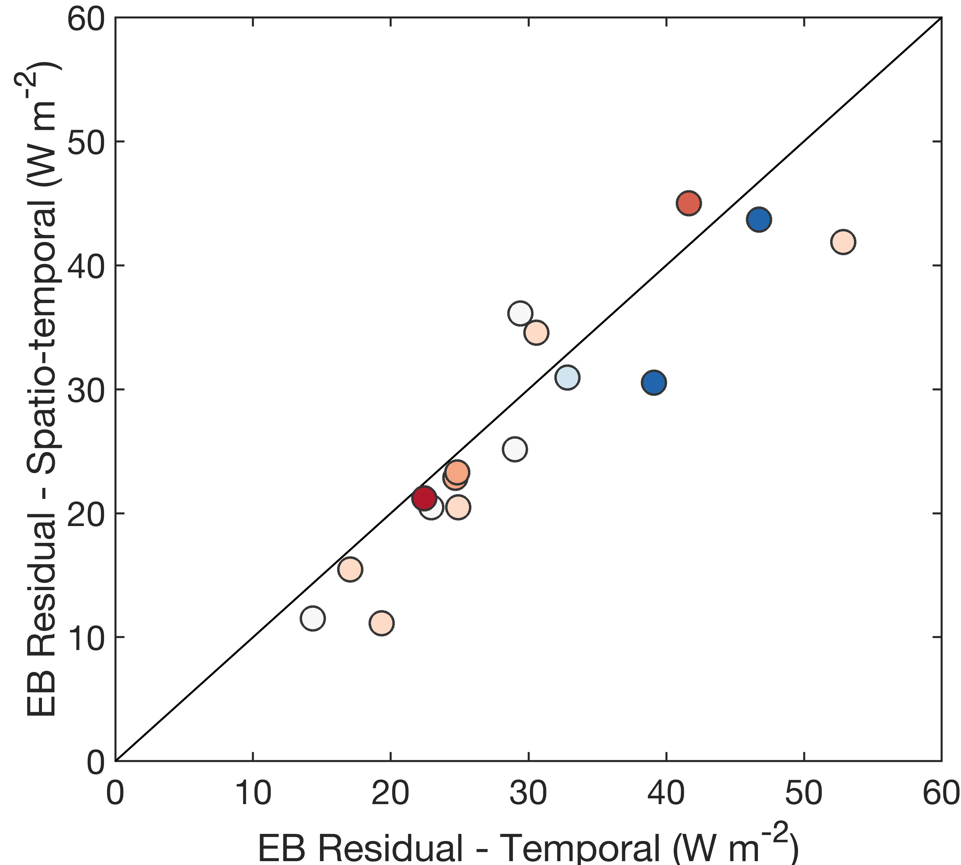
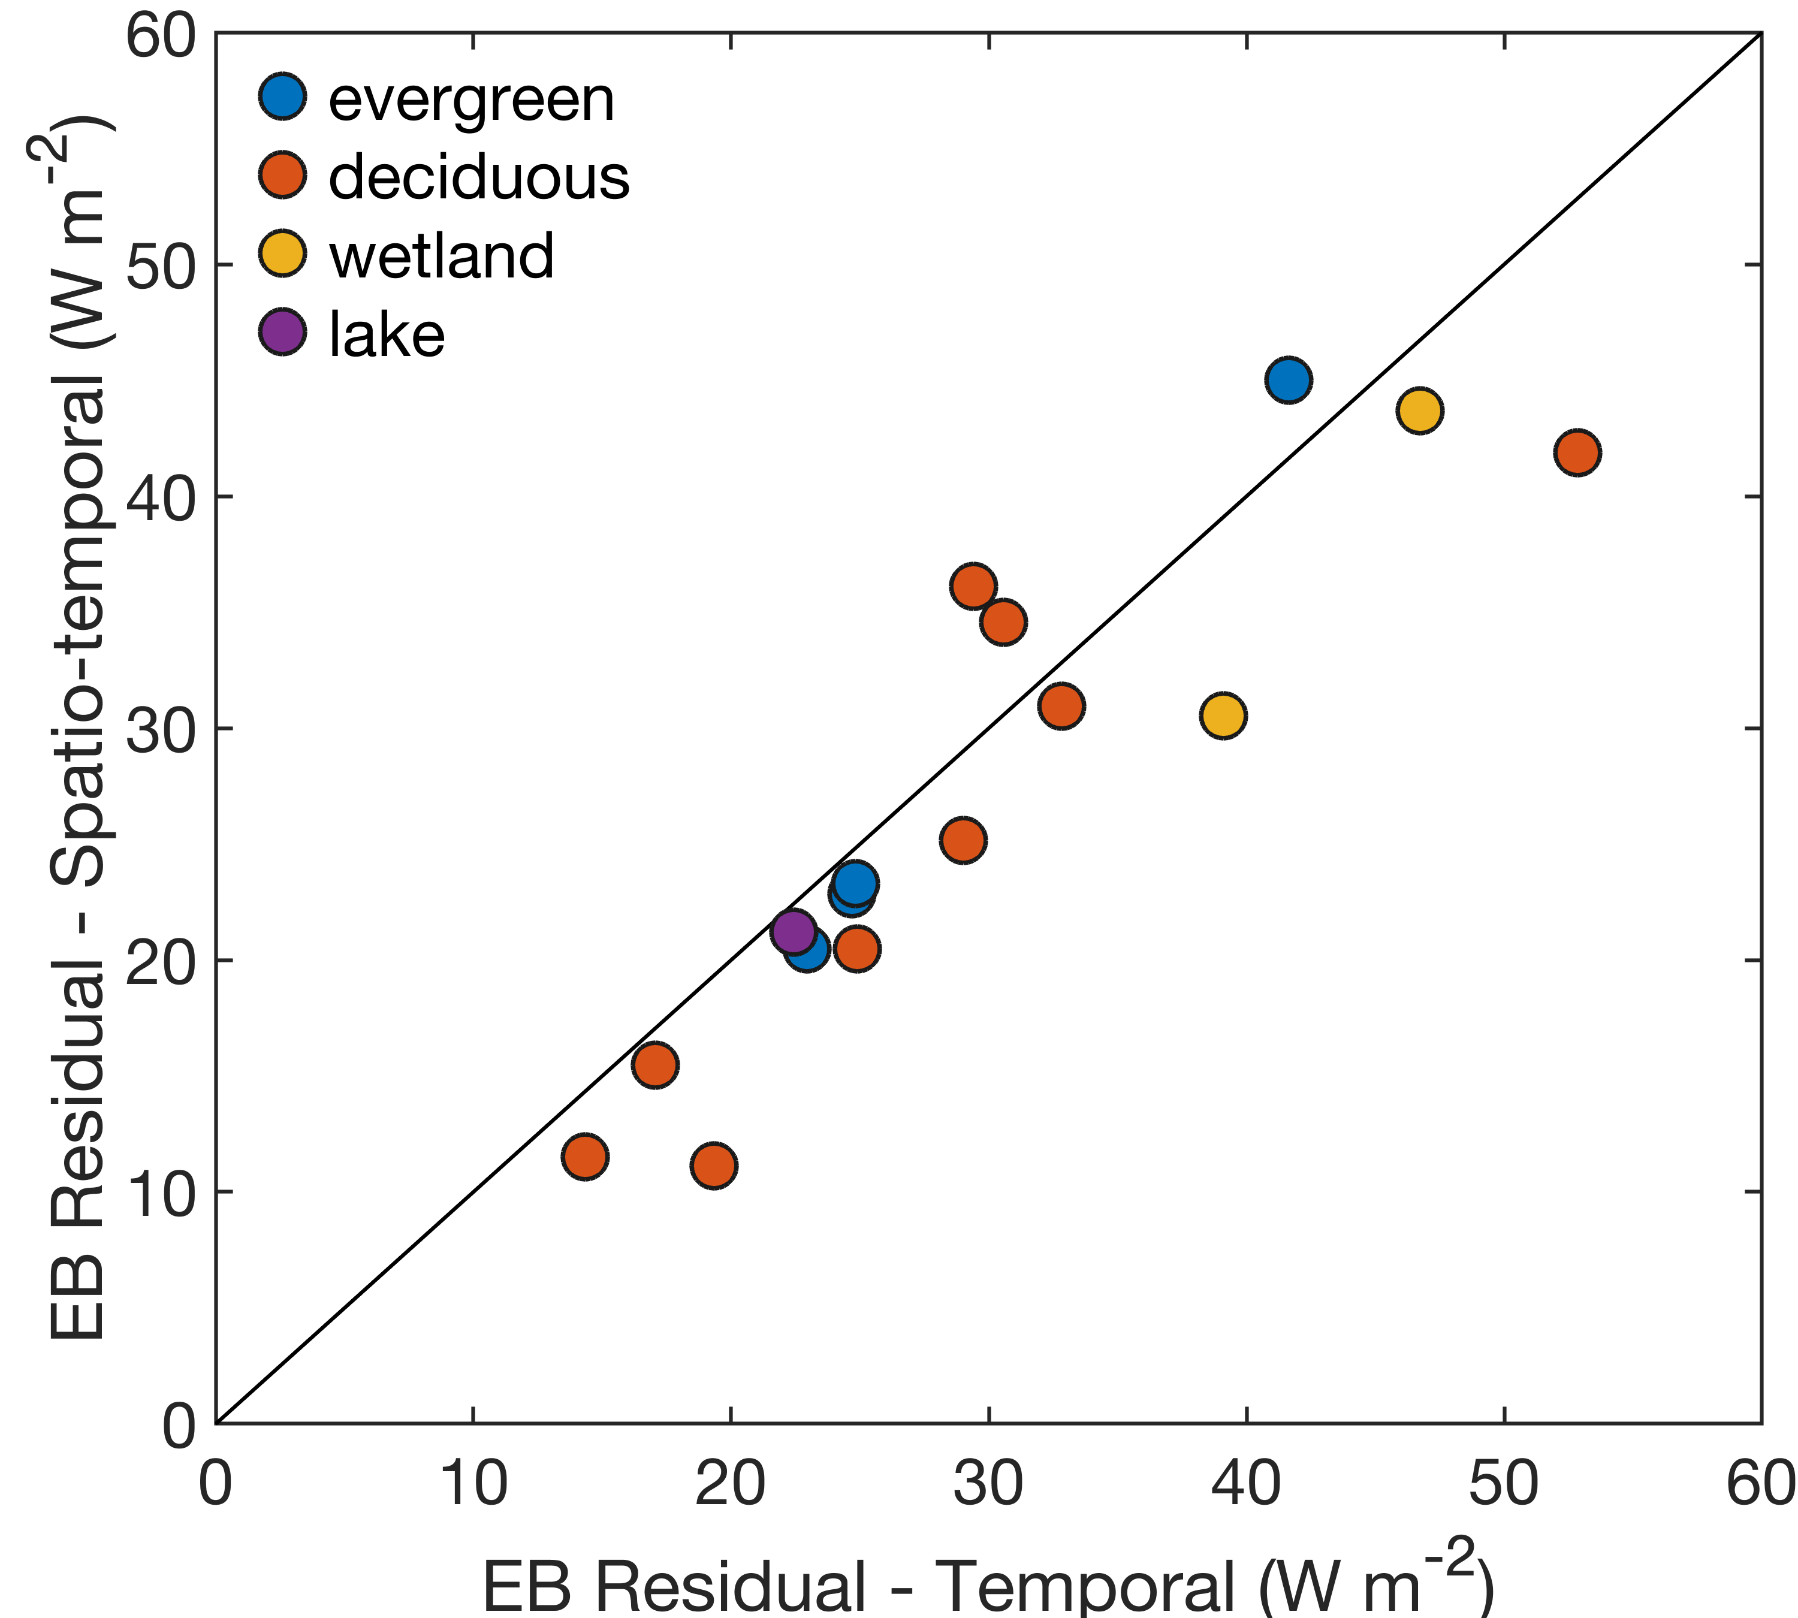
Daily mean energy balance residual
9 m
9% decrease in C_{EB}
What variables are responsible?
Vegetation type
Canopy structure
Topography
Surface temperature
Canopy Stdev
0 m

Slide 18
Combined Spatial Eddy Covariance
Where the total flux is equal to:
Spatial or spatio-temporal eddy covariance Example:
- Plus -
The temporal flux of the spatial means:
Fluctuation = Spatial Mean – Space-time mean
Example:
$$w′=w−\overline{⟨w⟩}$$
w′= ⟨w⟩ $−$ $\overline{⟨w⟩}$
$$w′=w−⟨w⟩$$
Notes:
For this analysis:
Temporal EC data were calculated for each tower individually and then averaged to get domain-wide fluxes
Spatial and spatio-temporal EC were calculated across all flux towers as if the entire set of towers was one super site. Note, this is different from spatial EC as originally conceived, whereby a flux time series is produced for each tower separately. Here we’ve built on that approach by processing data from all towers as samples in one flux calculation. Assuming the towers sufficiently sample landscape variation, the final flux time series represents the domain-wide flux.

Slide 19
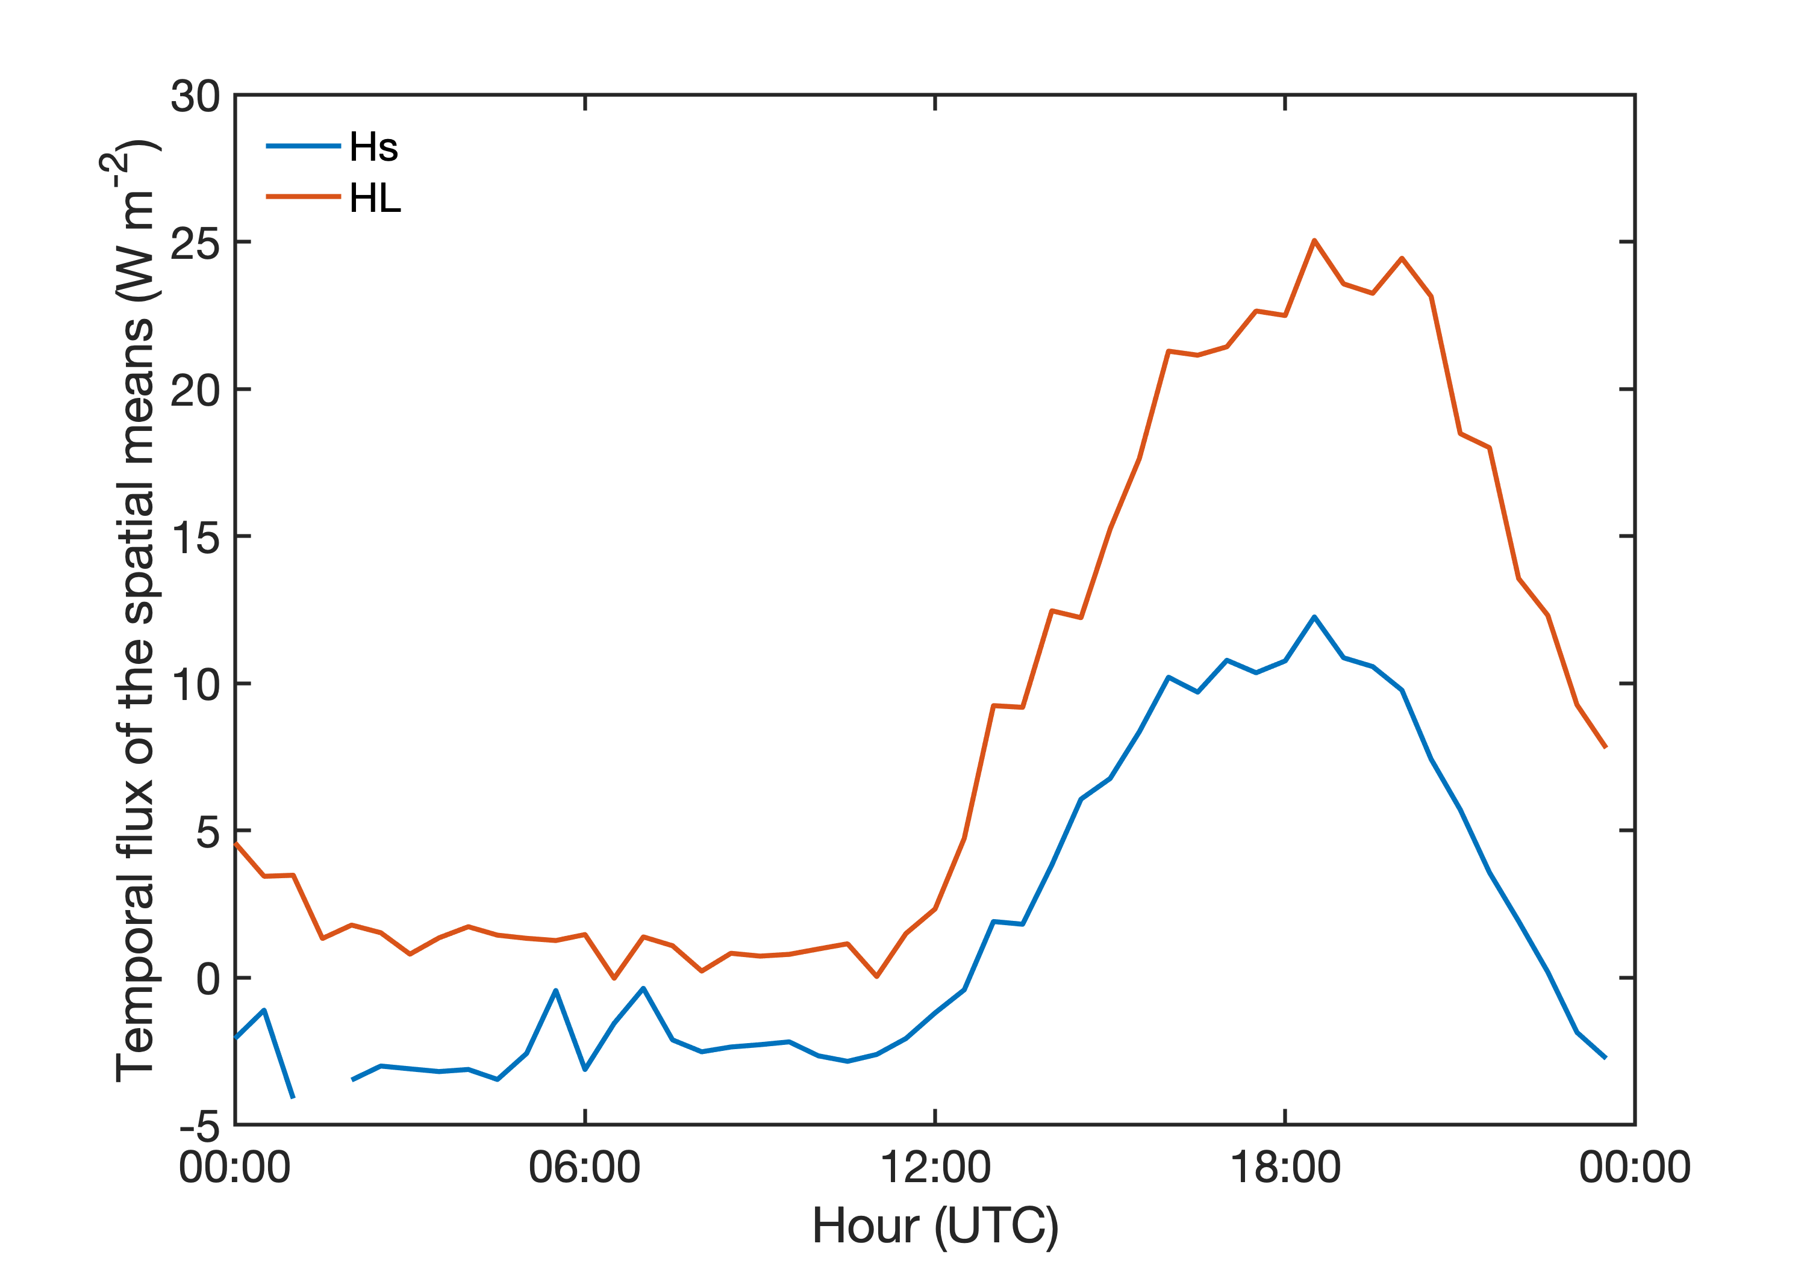
Temporal flux of the spatial means

Slide 20
Future Work
Compare the relationships between flux and surface characteristics at different sites and compare them to corresponding relationships at individual sites under different flux footprints.
More…

Slide 21
Conclusions
Spatial EC is sensitive to how input data is processed
Spatio-temporal EC performs better than spatial EC at closing energy budget
More…

Slide 22
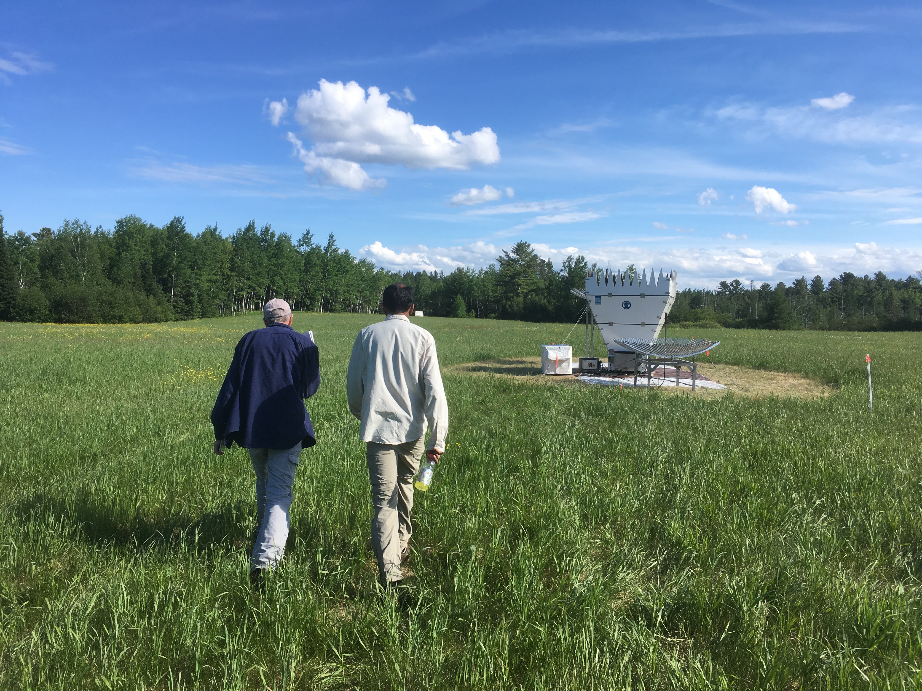
Thank you!
Brian Butterworth
bbutterworth@wisc.edu
www.brianbutterworth.com
Acknowledgements
Thank you to Steve Oncley, Bill Brown, and the rest of the NCAR EOL team for providing this dataset. Funding provided by the National Science Foundation (Award #1822420), DOE AmeriFlux Management Project, NOAA, DFG Award #406980118

